Slide 1
D3.JS Guide 2
Notes:
2021

Slide 2
Outline
Load data (csv and json)
d3-selection
Enter, Merge, Exit
d3-transition
Transition(), duration(),delay()
d3-scale
Resource & Reference

Slide 3
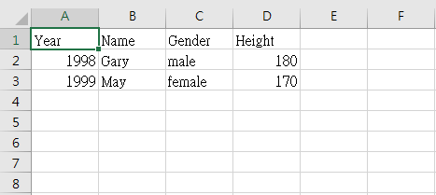
Load data - CSV
CSV 為 Comma Separated Values 的縮寫
以逗點分格資料的檔案格式，使用純文字檔案儲存資料，常用於試算表或資料庫
Excel 開啟
csv

Slide 4
d3-csv
d3.csv is an asynchronous method
first();
d3.csv("path/to/file.csv", function(rows) {
third();
});
second();
expect
first();
third();
second();
But maybe
first();
second();
third();
Notes:
https://stackoverflow.com/questions/9491885/csv-to-array-in-d3-js

Slide 5
d3-fetch
d3-fetch(v5)
以csv為例 使用d3.csv()讀csv檔
d3.csv(“file.csv”, row).then(function(data){
drawText("#csvDemo", data);
}); //fetch
Notes:
https://github.com/d3/d3-fetch

Slide 6
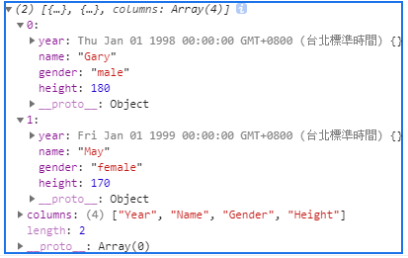
d3-fetch
file.csv
使用d3.csv()讀csv檔
function row(d) {
console.log(d); 1st 2nd
return {
year: new Date(+d.Year, 0, 1), // convert "Year" column to Date
name: d.Name,
gender: d.Gender,
height: +d.Height // convert “Height" column to number
}
};
d3.csv("path/to/file.csv“, row).then(function(data){
console.log(data);
});
1
2
3
Notes:
https://github.com/d3/d3-fetch
csv.html

Slide 7
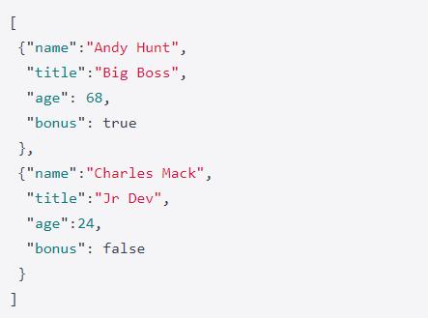
d3-JSON
JSON (JavaScript Object Notation, 物件表示法)
一種以純文字為基礎，來儲存和交換簡單結構的輕量級【資料交換格式】(類似 XML)。
read
Employees.json

Slide 8
d3-selection
selectAll(element tag) : 選取所有 設定的 tag或是 id
select(element tag) : 選取一個 tag或是 id

Slide 9
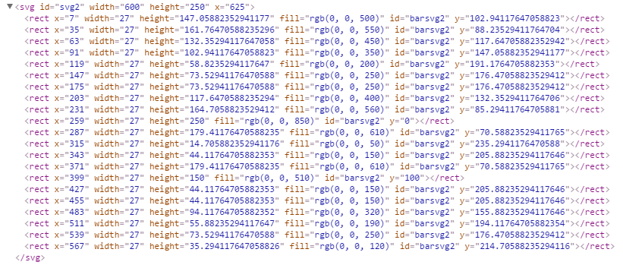
Select
只選擇在svg1裡的所有方形(rect)

Slide 10
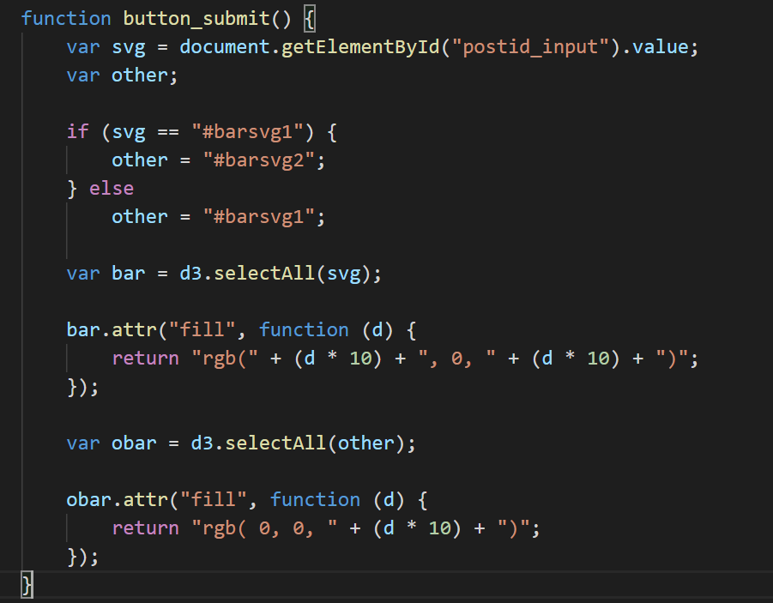
two_svg.html
Notes:
function button_submit() {
var svg = document.getElementById("postid_input").value;
var other;
if (svg == "#barsvg1") {
other = "#barsvg2";
} else
other = "#barsvg1";
var bar = d3.selectAll(svg);
bar.attr("fill", function (d) {
return "rgb(" + (d * 10) + ", 0, " + (d * 10) + ")";
});
var obar = d3.selectAll(other);
obar.attr("fill", function (d) {
return "rgb( 0, 0, " + (d * 10) + ")";
});
}

Slide 11
Select
d3.selectAll(“#barsvg1”)
d3.select(“#svg1”)
.selectAll(“rect”)

Slide 12
Enter, Merge, Exit
.selectAll(‘’).data(data) //新資料update入舊elements
.enter().append() //將沒有bind入舊elements的data創造新elements
.merge() //將舊elements和新創的elements合併處理
.exit() //是列出多餘的舊elements
.remove() //是將多餘的 element移除

Slide 13
Enter, Merge, Exit
.selectAll(“rect”).data(data)
只找到三個方形
可是data有五個
data
element
data
element
data
element
data
?
data

Slide 14
Enter, Merge, Exit
data
element
Merge()會將舊的element和新創的element一起選取以利後續共同處理
enter()會產生相等於沒bind的data數量的element
data
element
data
element
data
New element
data
New element

Slide 15
Enter, Merge, Exit
data
element
data
element
透過remove()移除多餘的elements
exit()會列出多餘的elements
data
element
data
element
data
element
element
element

Slide 16
baradd.html
var dataset = [];
var x = 1;
dataset.push(x);
update(dataset); // The initial display.
setInterval(function () {
if (dataset.length > 10) {
dataset = [];
x = 0;
remove(dataset);
}
x++;
dataset.push(x);
update(dataset);
}, 1500);

Slide 17
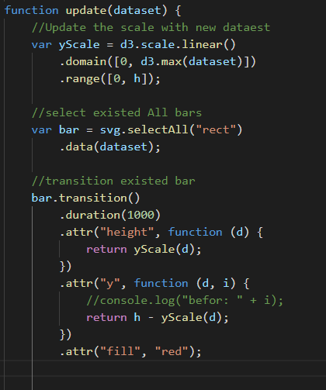
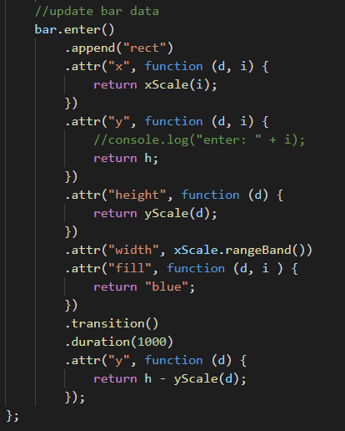

Slide 18
d3-transition
Without transition
With transition
Notes:
With transition
https://codepen.io/sean721721721/pen/PoqVMax?editors=1010

Slide 19
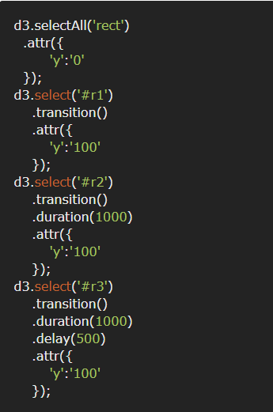
d3-transition
transition() :
Makes it easy to animate transitions when changing the DOM.
duration() : animation time
delay() : delay start time
r1
r2
r3
Notes:
https://jsbin.com/yoxedip/1/edit?html,js,output
https://www.oxxostudio.tw/articles/201501/svg-d3-14-transition-1.html
function d3Transition(){
d3.selectAll('div')
.style({
'top':'30px'
});
d3.select('.box1')
.transition()
.style({
'top':'100px'
});
d3.select('.box2')
.transition()
.duration(1000)
.style({
'top':'100px'
});
d3.select('.box3')
.transition()
.duration(1000)
.delay(500)
.style({
'top':'100px'
});
}

Slide 20
Example
General Update Pattern, III
https://bl.ocks.org/mbostock/3808234

Slide 21
d3-scale
a to b -> x to y 有線性和非線性的映射方式
let ZScale = d3.scaleLinear() .domain([a, b]) .range([x, y])
usage
.attr(“cx”, (d) => ZScale(d[0]))
d3.scaleLog()
d3.scalePow()
常用於映射數值和顏色
let color = d3.scaleLinear() .domain([10, 100]) .range([‘red’, ‘blue’])

Slide 22
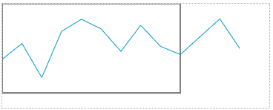
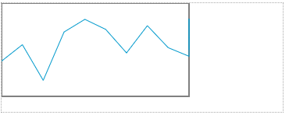
d3-scale clamp
clamp(false) //default
var scaleX = d3.scale.linear()
.range([0, width])
.domain([0, 9]);
clamp(true)
var scaleX = d3.scale.linear()
.range([0, width])
.domain([0, 9])
.clamp(true);
Notes:
如果將 clamp 設為 true，超過的部分一律以最大值呈現

Slide 23
Simple http server: python
安裝python
切換到你要分享的目錄
$cd home/public
啟動http server
$ python -m http.server 8888
Or Python2指令: $ python -m SimpleHTTPServer 8888
進入
http://localhost:8888
要讀local 檔案如csv，需要架個http server

Slide 24
Simple http server: nodejs
安裝nodejs
https://nodejs.org/en/
安裝express套件
$ npm install express
啟動http server
$ node server.js
進入第一個範例
http://localhost:3000
Notes:
const express = require('express')
const app = express()
const port = 3000
app.use(express.static('public'))
app.listen(port, () => console.log(`Example app listening on port ${port}!`))

Slide 25
Resource & Reference
http://devdocs.io/
http://blockbuilder.org/search
https://medium.com/@enjalot/the-hitchhikers-guide-to-d3-js-a8552174733a

Slide 26
END

