Slide 1
Information Visualization
Analysis Framework

Slide 2
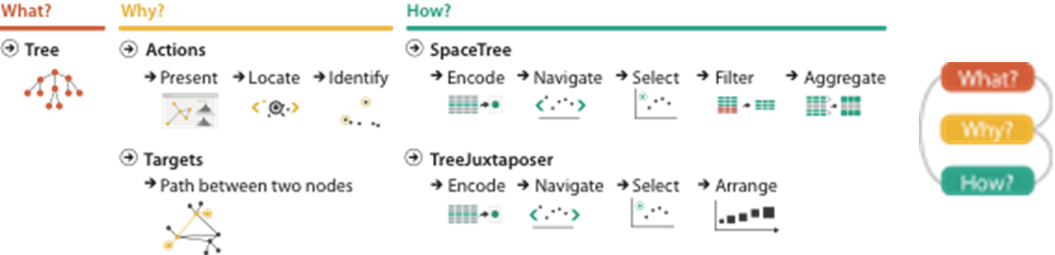
What is shown?
  Data abstraction
Why is the user looking at it?
  Task abstraction
How is it shown?
  Idiom: visual encoding and interaction

Slide 3

Analysis framework: Four levels, three questions
domain
domain situation
  who are the target users?
abstraction
  translate from specifics of domain to vocabulary of vis
  what is shown? data abstraction
    often don’t just draw what you’re given: transform to new form
  why is the user looking at it? task abstraction
idiom
  how is it shown?
    visual encoding idiom: how to draw
    interaction idiom: how to manipulate
algorithm
  efficient computation
abstraction
idiom
algorithm
[A Nested Model of Visualization Design and Validation.
Munzner. IEEE TVCG 15(6):921-928, 2009 (Proc. InfoVis 2009). ]
domain
abstraction
idiom
algorithm
[A Multi-Level Typology of Abstract Visualization Tasks
Brehmer and Munzner. IEEE TVCG 19(12):2376-2385, 2013 (Proc. InfoVis 2013). ]

Slide 4
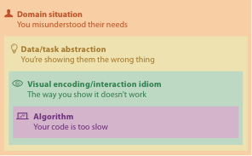
Why is validation difficult?
different ways to get it wrong at each level

Slide 5
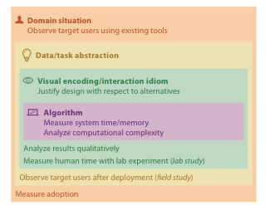


Why is validation difficult?
solution: use methods from different fields at each level
  problem-driven work
  anthropology/
  ethnography
  design
  computer science
  technique-driven work
  cognitive psychology
  anthropology/
  ethnography
[A Nested Model of Visualization Design and Validation. Munzner. IEEE TVCG 15(6):921-928, 2009 (Proc. InfoVis 2009). ]

Slide 6
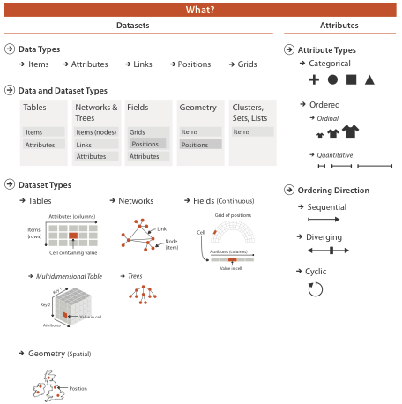
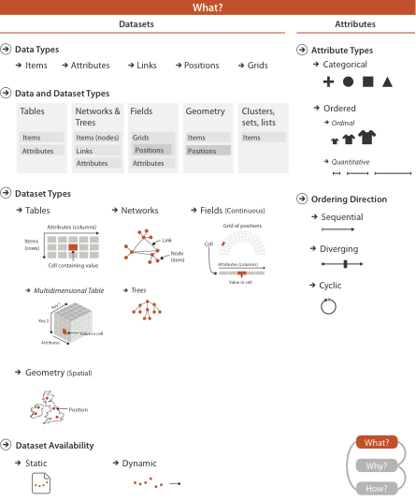

Slide 7
What?

Slide 8
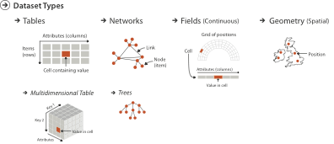
Three major dataset types
Spatial
visualization vs computer graphics
  geometry is design decision

Slide 9
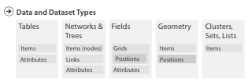

Dataset and data types

Slide 10
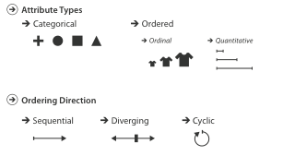
Attribute types

Slide 11
Why?

Slide 12
{action, target} pairs
  discover distribution
  compare trends
  locate outliers
  browse topology

Slide 13
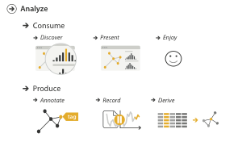
Actions: Analyze
consume
  discover vs present
    classic split
    aka explore vs explain
  enjoy
    newcomer
    aka casual, social
produce
  annotate, record
  derive
    crucial design choice

Slide 14
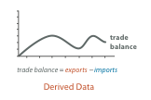

Derive
don’t just draw what you’re given!
  decide what the right thing to show is
  create it with a series of transformations from the original dataset
  draw that
one of the four major strategies for handling complexity

Slide 15
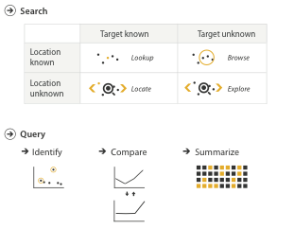
Actions: Search, query
what does user know?
  target, location
how much of the data matters?
  one, some, all
independent choices for each of these three levels
  analyze, search, query
  mix and match

Slide 16
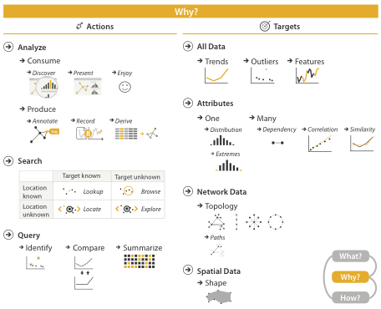
Why: Targets

Slide 17
A preview of How

Slide 18
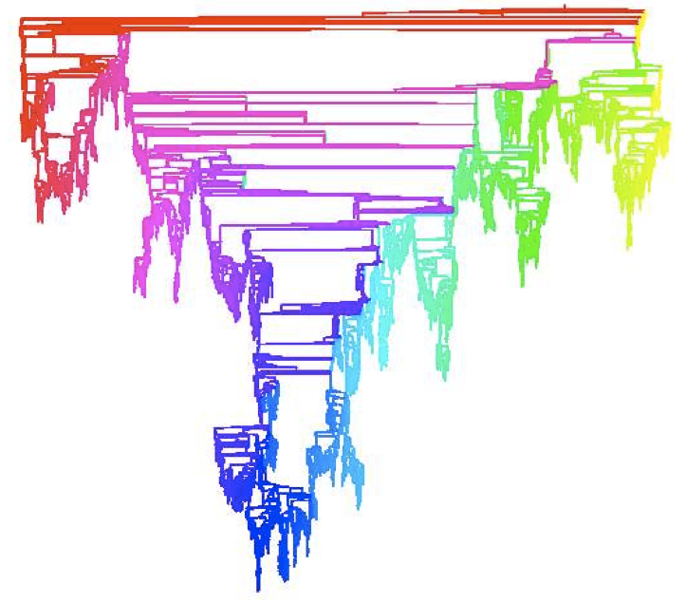
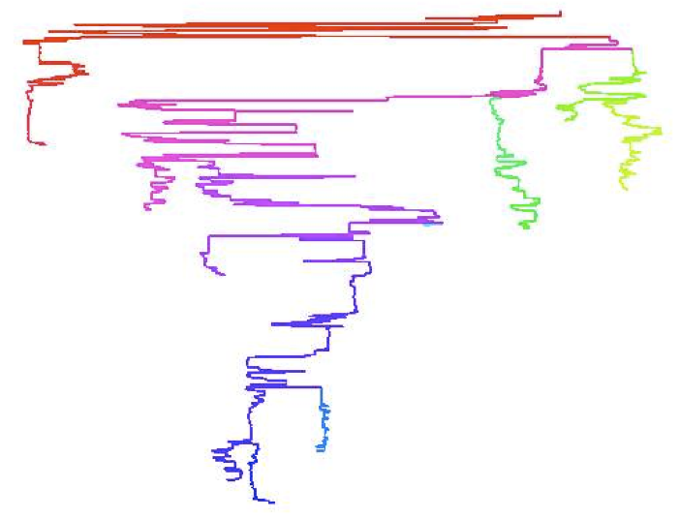
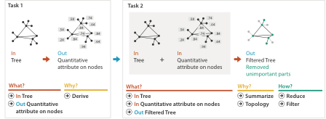
Analysis example: Derive one attribute
Strahler number
  centrality metric for trees/networks
  derived quantitative attribute
  draw top 5K of 500K for good skeleton
[Using Strahler numbers for real time visual exploration of huge graphs. Auber. Proc. Intl. Conf. Computer Vision and Graphics, pp. 56–69, 2002.]

Slide 19
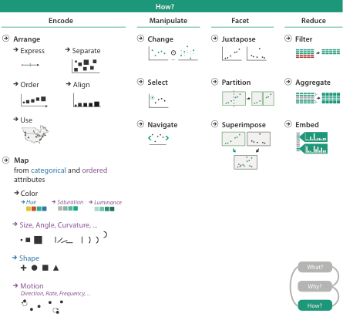
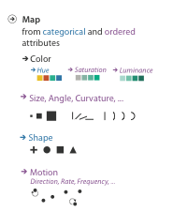


Slide 20
Further reading
Visualization Analysis and Design. Munzner. AK Peters Visualization Series, CRC Press, 2014.
  Chap 2: What: Data Abstraction
  Chap 3: Why: Task Abstraction
A Multi-Level Typology of Abstract Visualization Tasks. Brehmer and Munzner. IEEE Trans. Visualization and Computer Graphics (Proc. InfoVis) 19:12 (2013), 2376–2385.
Low-Level Components of Analytic Activity in Information Visualization. Amar, Eagan, and Stasko. Proc. IEEE InfoVis 2005, p 111–117.
A taxonomy of tools that support the fluent and flexible use of visualizations. Heer and Shneiderman. Communications of the ACM 55:4 (2012), 45–54.
Rethinking Visualization: A High-Level Taxonomy. Tory and Möller. Proc. IEEE InfoVis 2004, p 151–158.
Visualization of Time-Oriented Data. Aigner, Miksch, Schumann, and Tominski. Springer, 2011.

Slide 21
Reading visualization papers
one strategy: multiple passes
  title
  abstract, authors/affiliation
  flip through, glance at figures, notice structure from section titles
  skim intro, results/discussion (maybe conclusion)
  fast read to get big ideas
    if you don’t get something, just keep going
  second pass to work through details
    later parts may cast light on earlier parts for badly structured papers
  third pass to dig deep
    if it’s highly relevant, or you’re presenting it to class
literature search
  decide when to stop reading: is this relevant to my current concerns?

Slide 22
Marks and Channels

Slide 23

Visual encoding
analyze idiom structure
Notes:
How did we decide to use those particular visual channels? How many more visual channels are there? What kinds of information and how much information can each channel encode? Are some channels better than others? Can all of the channels be used independently or do they interfere with each other?

Slide 24

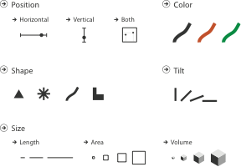
Definitions: Marks and channels
marks
  geometric primitives
channels
  control appearance of marks
  can redundantly code with multiple channels

Slide 25
Visual encoding
analyze idiom structure
  as combination of marks and channels
1:
vertical position
2:
vertical position
horizontal position
3:
vertical position
horizontal position
color hue
4:
vertical position
horizontal position
color hue
size (area)
mark: line
mark: point
mark: point
mark: point

Slide 26
Channels: Expressiveness types and effectiveness rankings

Slide 27
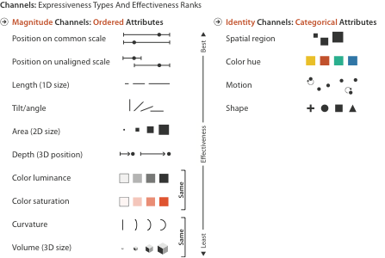
Channels: Matching Types
expressiveness principle
  match channel and data characteristics

Slide 28
Channels: Rankings
expressiveness principle
  match channel and data characteristics
effectiveness principle
  encode most important attributes with highest ranked channels

Slide 29


Channels: Expressiveness types and effectiveness rankings
expressiveness principle
  match channel and data characteristics
effectiveness principle
  encode most important attributes with highest ranked channels
  spatial position ranks high for both

Slide 30
Accuracy: Fundamental Theory

Slide 31
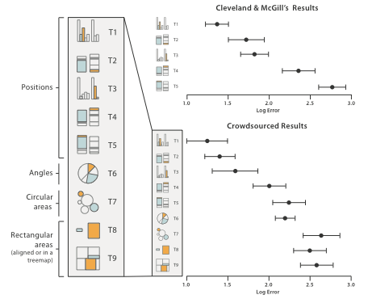
Accuracy: Vis experiments
[Crowdsourcing Graphical Perception: Using Mechanical Turk to Assess Visualization Design. Heer and Bostock. Proc ACM Conf. Human Factors in Computing Systems (CHI) 2010, p. 203–212.]
after Michael McGuffin course slides, http://profs.etsmtl.ca/mmcguffin/

Slide 32
Discriminability: How many usable steps?
must be sufficient for number of attribute levels to show
  linewidth: few bins
[mappa.mundi.net/maps/maps 014/telegeography.html]

Slide 33
Separability vs. Integrality
2 groups each
2 groups each
3 groups total:
integral area
4 groups total:
integral hue

Slide 34






Popout
find the red dot
  how long does it take?
parallel processing on many individual channels
  speed independent of distractor count
  speed depends on channel and amount of difference from distractors
serial search for (almost all) combinations
  speed depends on number of distractors

Slide 35
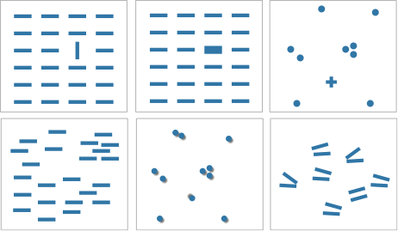

Popout
many channels: tilt, size, shape, proximity, shadow direction, ...
but not all! parallel line pairs do not pop out from tilted pairs
Notes:
Fig 5.12

Slide 36
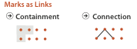
Grouping
containment
connection
proximity
  same spatial region
similarity
  same values as other categorical channels

Slide 37
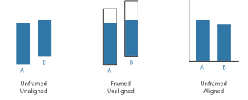
Relative vs. absolute judgements
perceptual system mostly operates with relative judgements, not absolute
  that’s why accuracy increases with common frame/scale and alignment
  Weber’s Law: ratio of increment to background is constant
    filled rectangles differ in length by 1:9, difficult judgement
    white rectangles differ in length by 1:2, easy judgement
length
position along unaligned common scale
position along aligned scale
after [Graphical Perception: Theory, Experimentation, and Application to the Development of Graphical Methods. Cleveland and McGill. Journ. American Statistical Association 79:387 (1984), 531–554.]

Slide 38
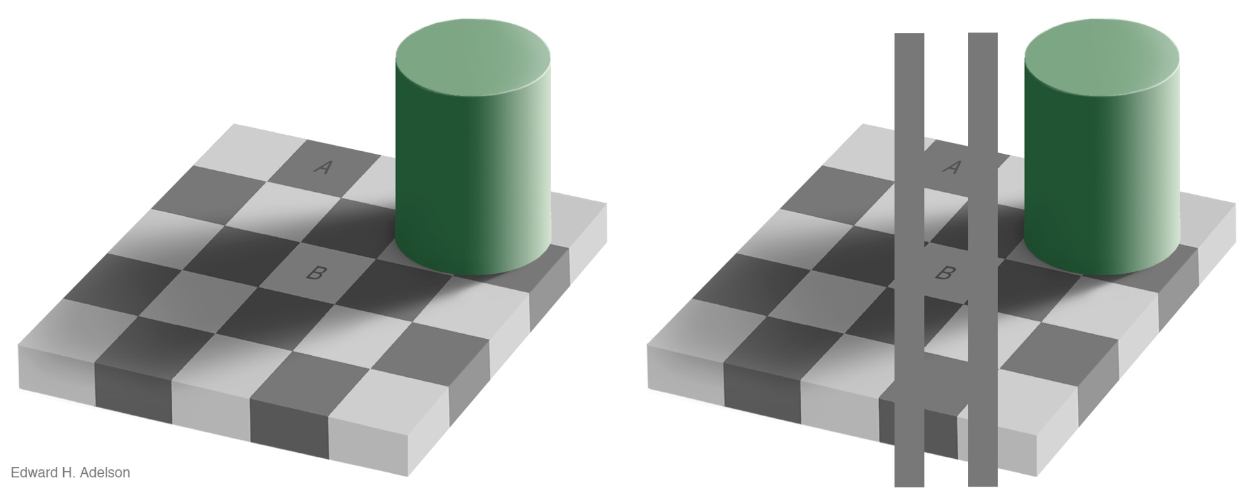
Relative luminance judgements
perception of luminance is contextual based on contrast with surroundings
http://persci.mit.edu/gallery/checkershadow

Slide 39
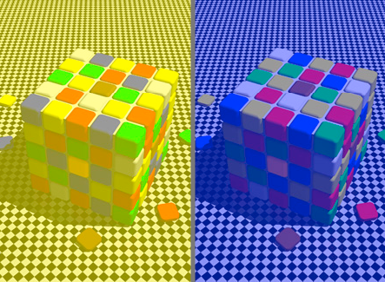
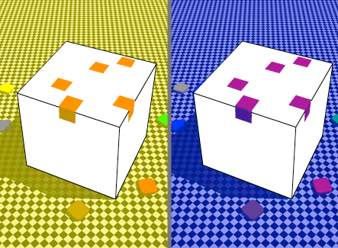
Relative color judgements
color constancy across broad range of illumination conditions
http://www.purveslab.net/seeforyourself/

Slide 40
Further reading
Visualization Analysis and Design. Munzner. AK Peters Visualization Series, CRC Press, 2014.
  Chap 5: Marks and Channels
On the Theory of Scales of Measurement. Stevens. Science 103:2684 (1946), 677–680.
Psychophysics: Introduction to its Perceptual, Neural, and Social Prospects. Stevens. Wiley, 1975.
Graphical Perception: Theory, Experimentation, and Application to the Development of Graphical Methods. Cleveland and McGill. Journ. American Statistical Association 79:387 (1984), 531–554.
Perception in Vision. Healey. http://www.csc.ncsu.edu/faculty/healey/PP
Visual Thinking for Design. Ware. Morgan Kaufmann, 2008.
Information Visualization: Perception for Design, 3rd edition. Ware. Morgan Kaufmann /Academic Press, 2004.

