Slide 1
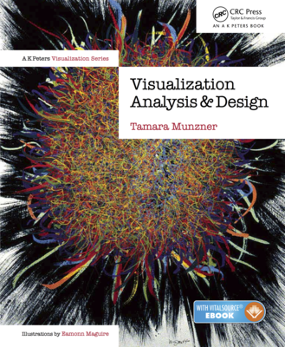
Information Visualization
Rules of Thumb
Slides refer to https://www.cs.ubc.ca/~tmm/

Slide 2
Rules of Thumb
No unjustified 3D
  Power of the plane
  Disparity of depth
  Occlusion hides information
  Perspective distortion dangers
  Tilted text isn’t legible
No unjustified 2D
Eyes beat memory
Resolution over immersion
Overview first, zoom and filter, details on demand
Responsiveness is required
Function first, form next

Slide 3
No unjustified 3D: Power of the plane
high-ranked spatial position channels: planar spatial position
  not depth!

Slide 4
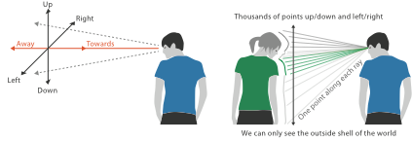
No unjustified 3D: Danger of depth
we don’t really live in 3D: we see in 2.05D
  acquire more info on image plane quickly from eye movements
  acquire more info for depth slower, from head/body motion
Notes:
up/down and sideways: image plane: acquire more info quickly from eye movements
away: depth into scene: only acquire more info from head/body motion

Slide 5
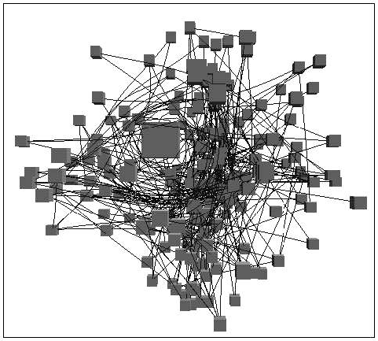
Occlusion hides information
occlusion
interaction complexity
[Distortion Viewing Techniques for 3D Data. Carpendale et al. InfoVis1996.]

Slide 6
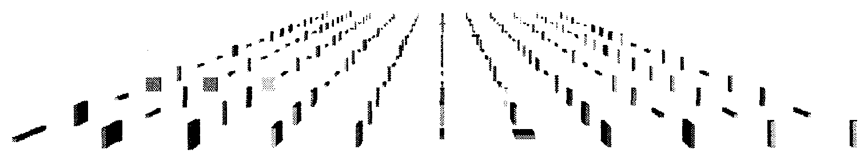
Perspective distortion loses information
perspective distortion
  interferes with all size channel encodings
  power of the plane is lost!
[Visualizing the Results of Multimedia Web Search Engines.
Mukherjea, Hirata, and Hara. InfoVis 96]

Slide 7
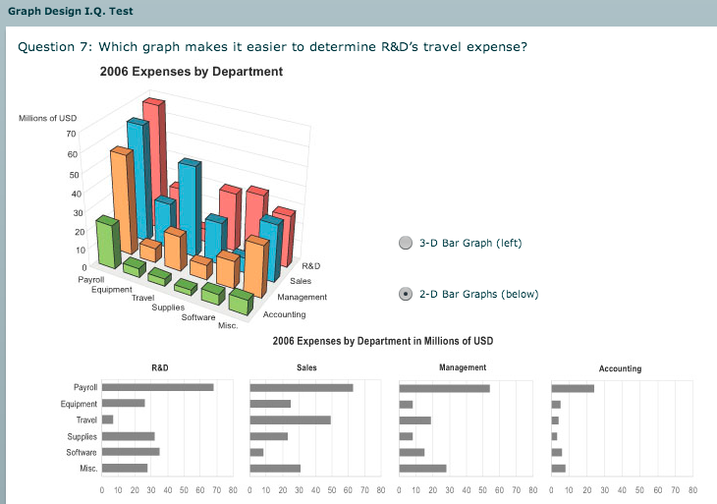
3D vs 2D bar charts
3D bars never a good idea!
[http://perceptualedge.com/files/GraphDesignIQ.html]

Slide 8
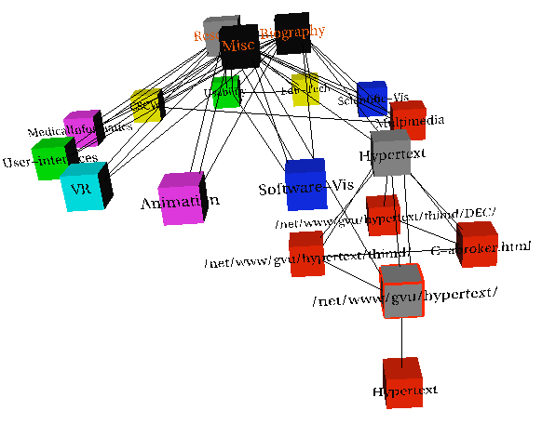
Tilted text isn’t legible
text legibility
  far worse when tilted from image plane
further reading
[Exploring and Reducing the Effects of Orientation on Text Readability in Volumetric Displays.
Grossman et al. CHI 2007]
[Visualizing the World-Wide Web with the Navigational View Builder.
Mukherjea and Foley. Computer Networks and ISDN Systems, 1995.]

Slide 9
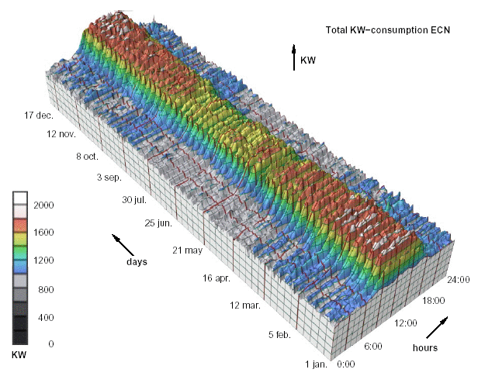
No unjustified 3D example: Time-series data
extruded curves: detailed comparisons impossible
[Cluster and Calendar based Visualization of Time Series Data. van Wijk and van Selow, Proc. InfoVis 99.]
Notes:
start with axes explain: power, time of day, day of year
then explain problems

Slide 10
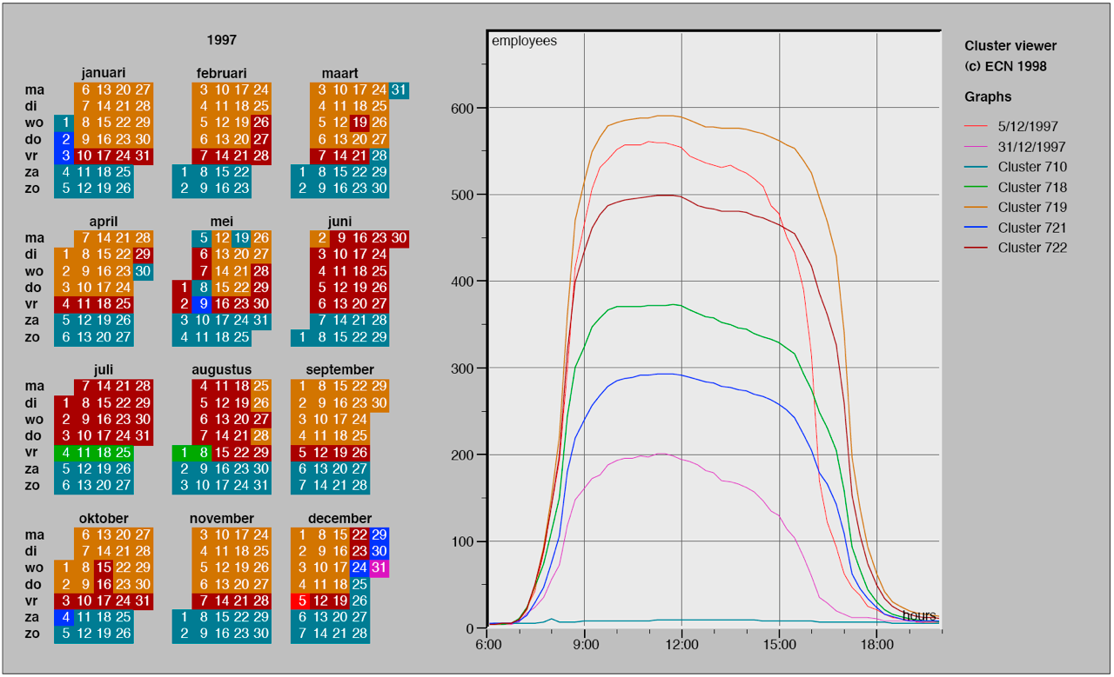
No unjustified 3D example: Transform for new data abstraction
derived data: cluster hierarchy
juxtapose multiple views: calendar, superimposed 2D curves
[Cluster and Calendar based Visualization of Time Series Data. van Wijk and van Selow, Proc. InfoVis 99.]

Slide 11
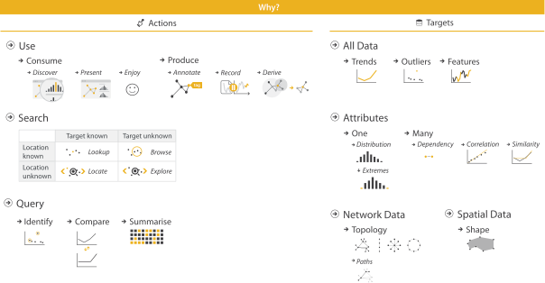
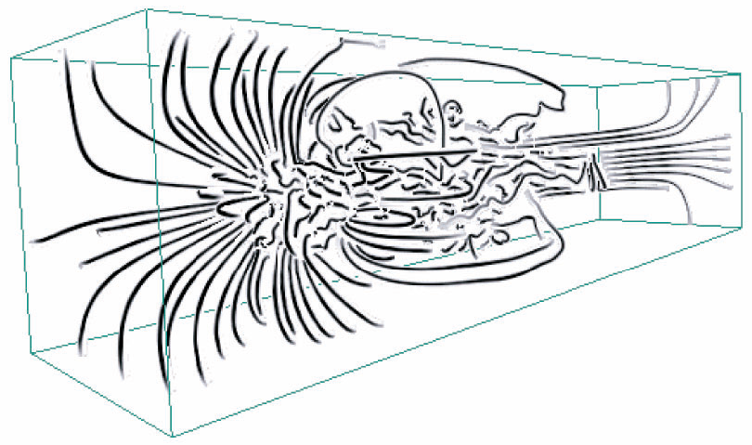
Justified 3D: shape perception
benefits outweigh costs when task is shape perception for 3D spatial data
  interactive navigation supports synthesis across many viewpoints
[Image-Based Streamline Generation and Rendering. Li and Shen. IEEE Trans. Visualization and Computer Graphics (TVCG) 13:3 (2007), 630–640.]

Slide 12
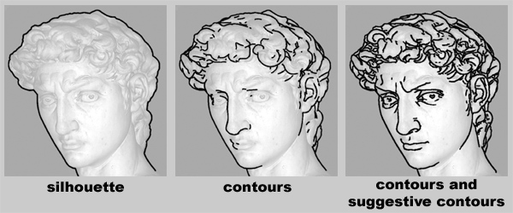
Suggestive Contours for Conveying Shape
[Doug DeCarlo et al. 2003]

Slide 13
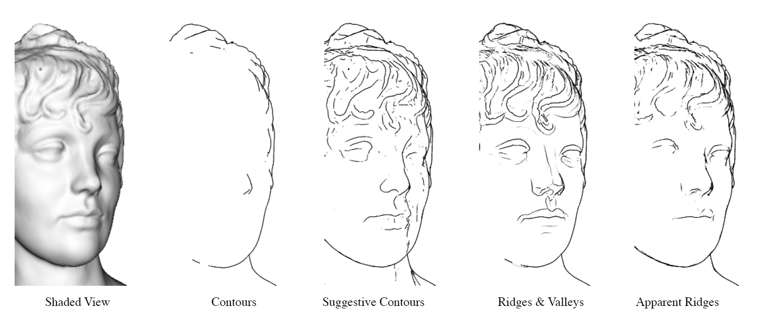
Apparent Ridges for Line Drawing
[Tilke Judd et al. 2007]
The maxima of the normal variation with respect to the viewing plane.

Slide 14
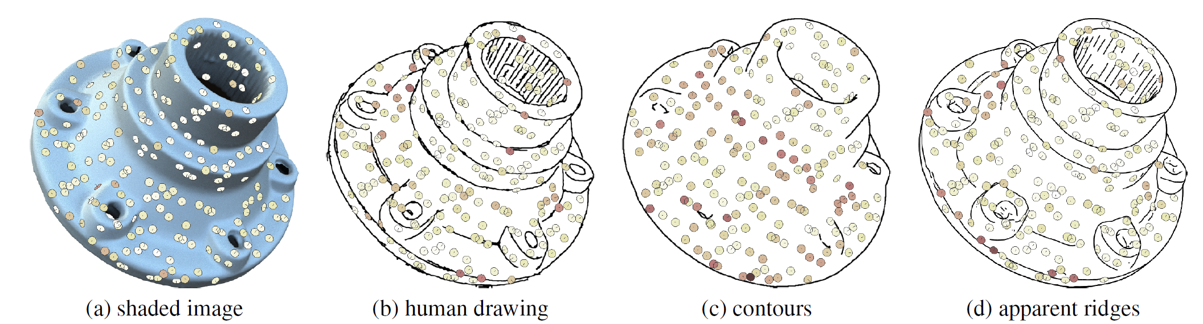
How Well Do Line Drawings Depict Shape?
[Forrester Cole et al. 2009]

Slide 15
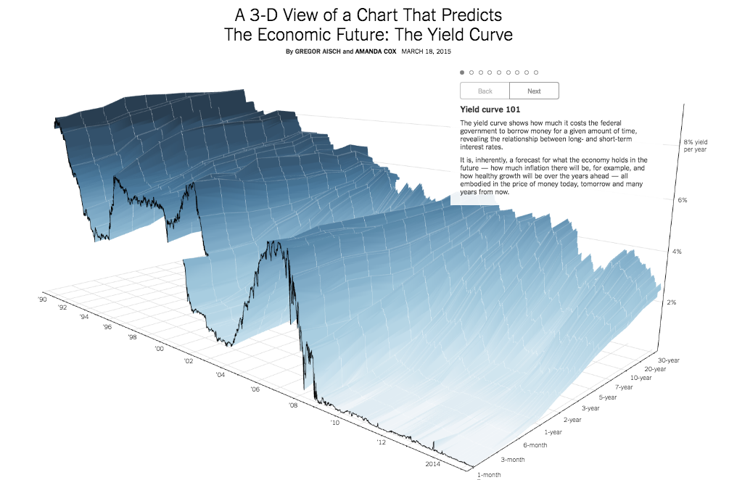
Justified 3D: Economic growth curve
http://www.nytimes.com/interactive/2015/03/19/upshot/3d-yield-curve-economic-growth.html

Slide 16
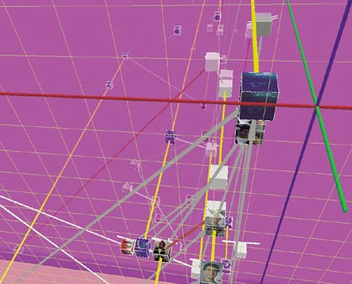
No unjustified 3D
3D legitimate for true 3D spatial data
3D needs very careful justification for abstract data
  enthusiasm in 1990s, but now skepticism
  be especially careful with 3D for point clouds or networks
[WEBPATH-a three dimensional Web history. Frecon and Smith. Proc. InfoVis 1999]

Slide 17
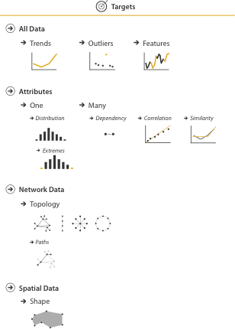
No unjustified 2D
consider whether network data requires 2D spatial layout
  especially if reading text is central to task!
  arranging as network means lower information density and harder label lookup compared to text lists
benefits outweigh costs when topological structure/context important for task
  be especially careful for search results, document collections, ontologies

Slide 18
Eyes beat memory
principle: external cognition vs. internal memory
  easy to compare by moving eyes between side-by-side views
  harder to compare visible item to memory of what you saw
implications for animation
  great for choreographed storytelling
  great for transitions between two states
  poor for many states with changes everywhere
    consider small multiples instead
literal
abstract
animation
small multiples
show time with time
show time with space

Slide 19

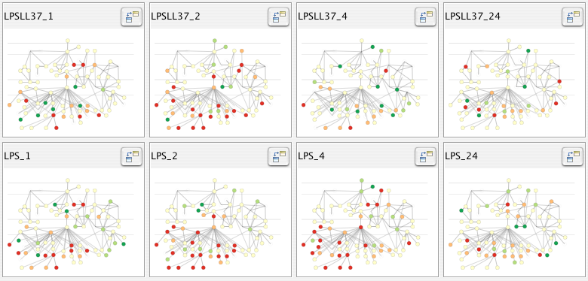
Eyes beat memory example: Cerebral
small multiples: one graph instance per experimental condition
  same spatial layout
  color differently, by condition
[Cerebral: Visualizing Multiple Experimental Conditions on a Graph with Biological Context. Barsky, Munzner, Gardy, and Kincaid. IEEE Trans. Visualization and Computer Graphics (Proc. InfoVis 2008) 14:6 (2008), 1253–1260.]

Slide 20
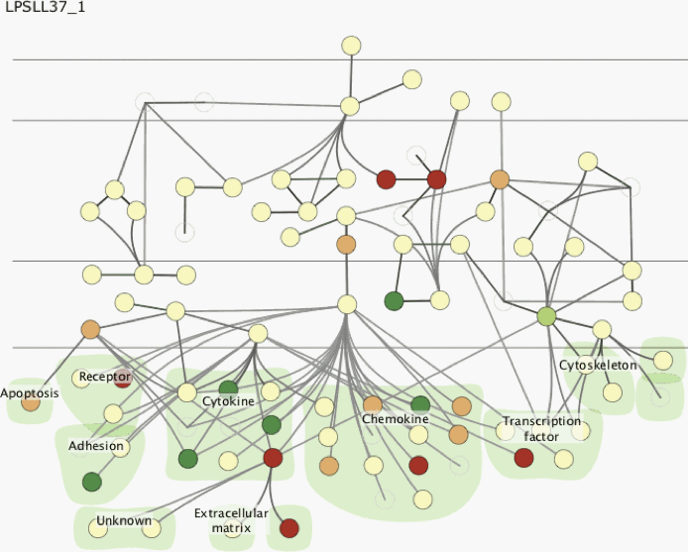
Why not animation?
disparate frames and regions: comparison difficult
  vs contiguous frames
  vs small region
  vs coherent motion of group
safe special case
  animated transitions

Slide 21
Change blindness
if attention is directed elsewhere, even drastic changes not noticeable
  door experiment
change blindness demos
  mask in between images

Slide 22
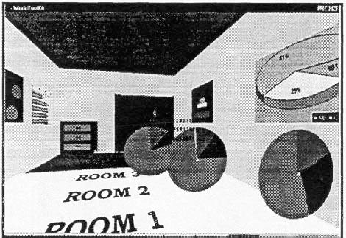
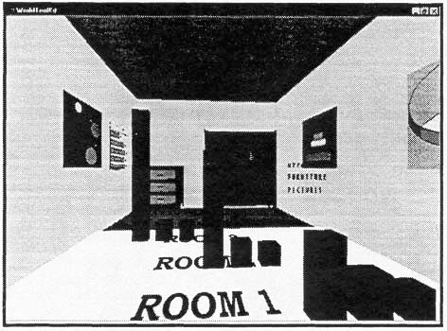
Resolution beats immersion
immersion typically not helpful for abstract data
  do not need sense of presence or stereoscopic 3D
resolution much more important
  pixels are the scarcest resource
  desktop also better for workflow integration
virtual reality for abstract data very difficult to justify
[Development of an information visualization tool using virtual reality. Kirner and Martins. Proc. Symp. Applied Computing 2000]

Slide 23
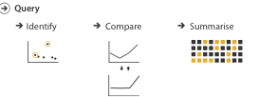
Overview first, zoom and filter, details on demand
influential mantra from Shneiderman
overview = summary
  microcosm of full vis design problem
[The Eyes Have It: A Task by Data Type Taxonomy for Information Visualizations. Shneiderman. Proc. IEEE Visual Languages, pp. 336–343, 1996.]

Slide 24
Responsiveness is required
three major categories
  0.1 seconds: perceptual processing
  1 second: immediate response
  10 seconds: brief tasks
importance of visual feedback

Slide 25
Function first, form next
start with focus on functionality
  straightforward to improve aesthetics later on, as refinement
  if no expertise in-house, find good graphic designer to work with
dangerous to start with aesthetics
  usually impossible to add function retroactively

Slide 26
Further reading
Visualization Analysis and Design. Tamara Munzner. CRC Press, 2014.
  Chap 6: Rules of Thumb

