Slide 1
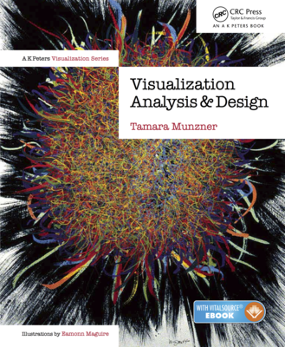
Information Visualization
Reduce
Slides refer to https://www.cs.ubc.ca/~tmm/

Slide 2
Guidelines
Reduce: Filter, Aggregate
Embed: Focus + Context

Slide 3
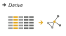
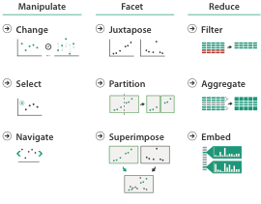
How to handle complexity
derive new data to show within view
change view over time
facet across multiple views
reduce items/attributes within single view
embed focus and context

Slide 4
Reduce: Filter, Aggregate

Slide 5
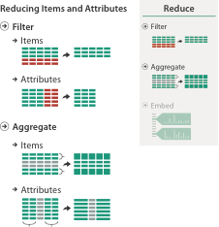
Reduce items and attributes
reduce/increase: inverses
filter
  pro: straightforward and intuitive
    to understand and compute
  con: out of sight, out of mind
aggregation
  pro: inform about whole set
  con: difficult to avoid losing signal
not mutually exclusive
  combine filter, aggregate
  combine reduce, change, facet

Slide 6
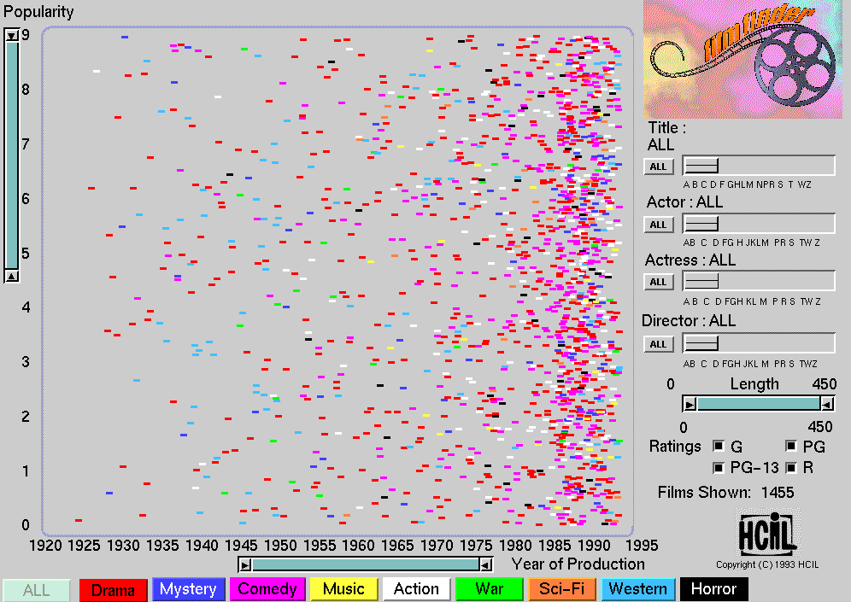
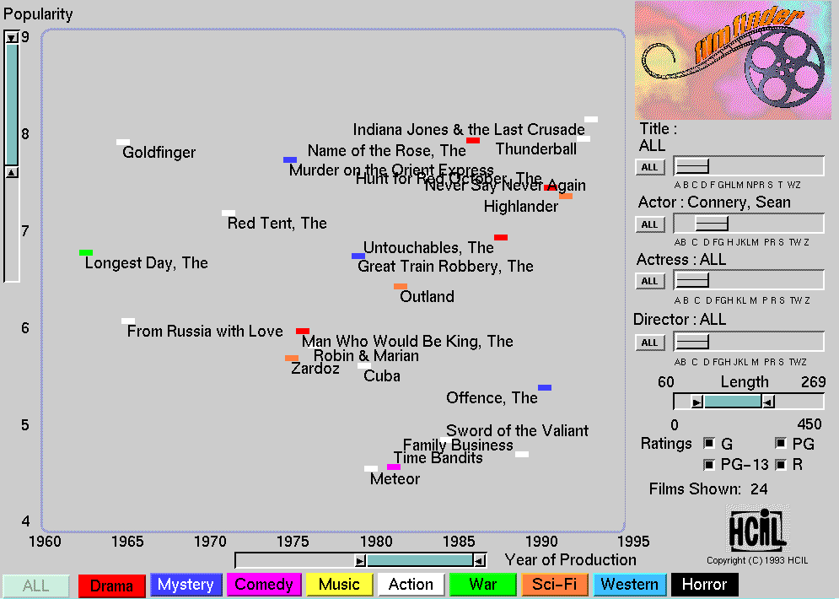
Idiom: dynamic filtering
System: FilmFinder
item filtering
browse through tightly coupled interaction
  alternative to queries that might return far too many or too few
[Visual information seeking: Tight coupling of dynamic query filters with starfield displays. Ahlberg and Shneiderman. Proc. ACM Conf. on Human Factors in Computing Systems (CHI), pp. 313–317, 1994.]

Slide 7
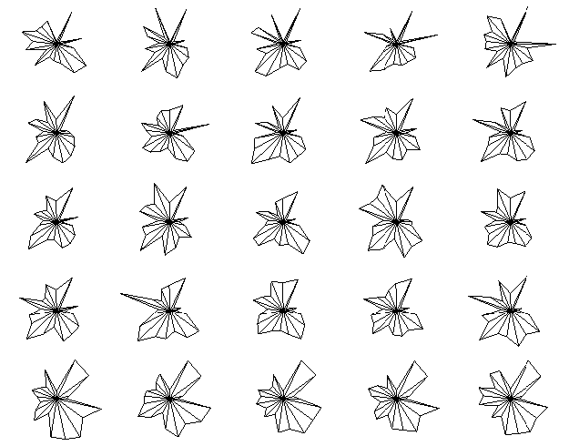
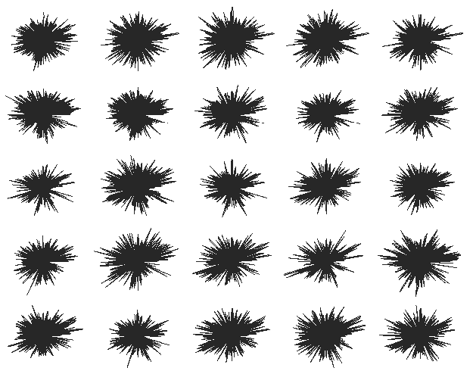
Idiom: DOSFA
attribute filtering
encoding: star glyphs
[Interactive Hierarchical Dimension Ordering, Spacing and Filtering for Exploration Of High Dimensional Datasets. Yang, Peng,Ward, and. Rundensteiner. Proc. IEEE Symp. Information Visualization (InfoVis), pp. 105–112, 2003.]
Notes:
215 attributes representing word counts and 298 points representing documents in a collection of medical abstracts.
plots after the dimensions are ordered by similarity and filtered by both similarity and importance thresholds. The filtered display does show clear visual patterns.

Slide 8
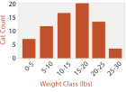
Idiom: histogram
static item aggregation
task: find distribution
data: table
derived data
  new table: keys are bins, values are counts
bin size crucial
  pattern can change dramatically depending on discretization
  opportunity for interaction: control bin size on the fly

Slide 9
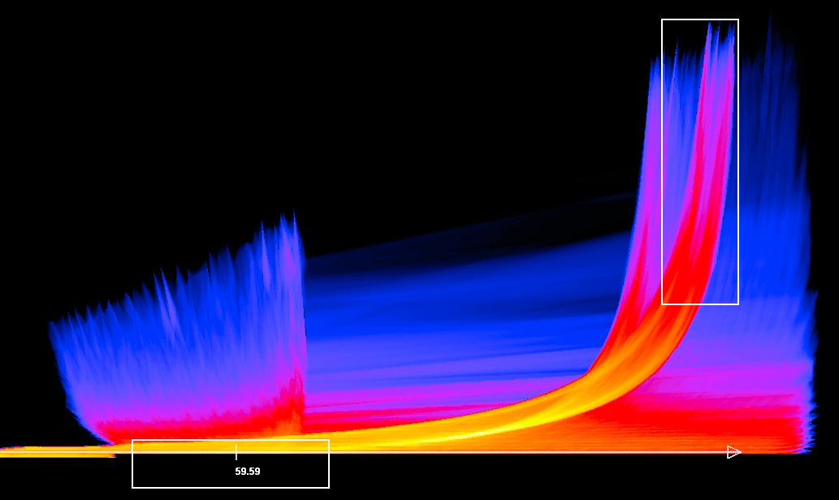
Continuous scatterplot
static item aggregation
data: table
derived data: table
  key attribs x,y for pixels
  quant attrib: overplot density
dense space-filling 2D matrix
color: sequential categorical hue + ordered luminance colormap
[Continuous Scatterplots. Bachthaler and Weiskopf. IEEE TVCG (Proc. Vis 08) 14:6 (2008), 1428–1435. 2008. ]

Slide 10
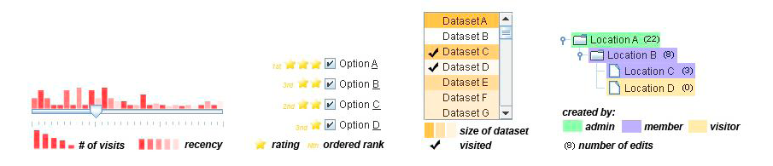

Idiom: scented widgets
augment widgets for filtering to show information scent
  cues to show whether value in drilling down further vs looking elsewhere
concise, in part of screen normally considered control panel
[Scented Widgets: Improving Navigation Cues with Embedded Visualizations. Willett, Heer, and Agrawala. IEEE Trans. Visualization and Computer Graphics (Proc. InfoVis 2007) 13:6 (2007), 1129–1136.]

Slide 11
Idiom: scented widgets
augmented widgets show information scent
  cues to show whether value in drilling down
  further vs looking elsewhere
• concise use of space: histogram on slider
[Multivariate Network Exploration and Presentation: From Detail to Overview via Selections and Aggregations. van den Elzen and van Wijk, TVCG 20(12) 2014.]

Slide 13
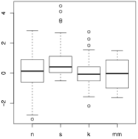
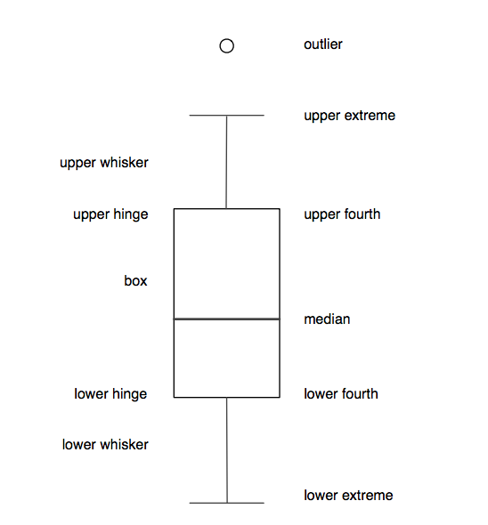
Idiom: boxplot
static item aggregation
task: find distribution
data: table
derived data
  5 quant attribs
    median: central line
    lower and upper quartile: boxes
    lower upper fences: whiskers
      values beyond which items are outliers
  outliers beyond fence cutoffs explicitly shown
[40 years of boxplots. Wickham and Stryjewski. 2012. had.co.nz]
Notes:
10 pages pdf

Slide 14
standard normal (n), right-skewed (s), leptikurtic (k), and bimodal (mm)
box plot, vase plot, violin plot, bean plot
Notes:
http://www.saigesp.es/d3js-graficos-boxplots/

Slide 15
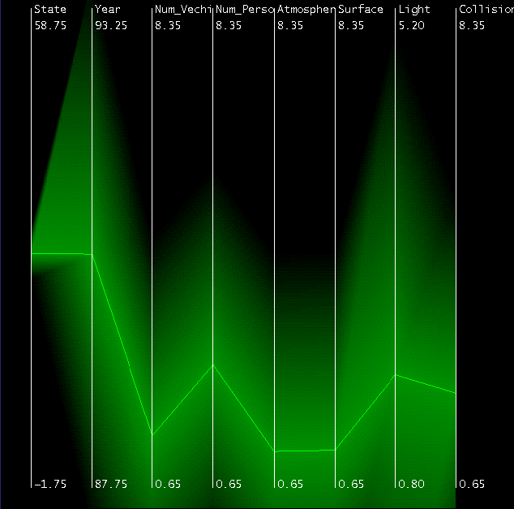
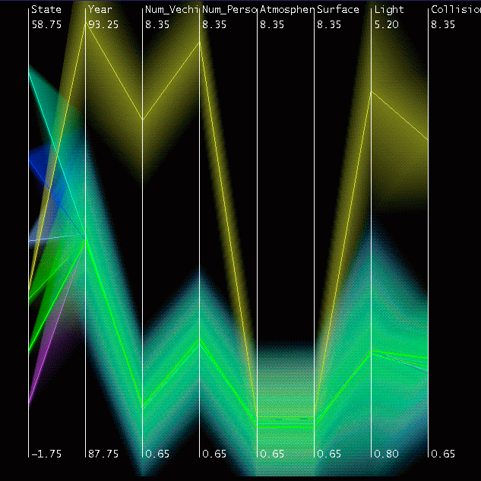
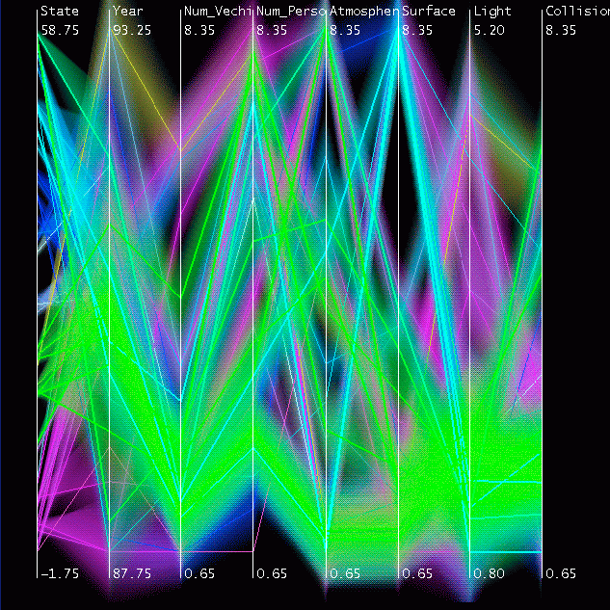
Idiom: Hierarchical parallel coordinates
dynamic item aggregation
derived data: hierarchical clustering
encoding:
  cluster band with variable transparency, line at mean, width by min/max values
  color by proximity in hierarchy
[Hierarchical Parallel Coordinates for Exploration of Large Datasets. Fua, Ward, and Rundensteiner. Proc. IEEE Visualization Conference (Vis ’99), pp. 43– 50, 1999.]
Notes:
8 attribs, 230K items

Slide 16
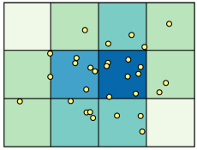
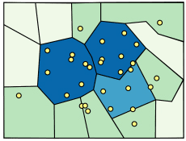
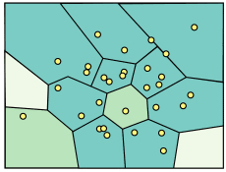
Spatial aggregation
MAUP: Modifiable Areal Unit Problem
  gerrymandering (manipulating voting district boundaries) is one example!
  Zone effects
  Scale effects
[http://www.e-education.psu/edu/geog486/l4_p7.html, Fig 4.cg.6]
https://blog.cartographica.com/blog/2011/5/19/the-modiﬁable-areal-unit-problem-in-gis.html

Slide 17
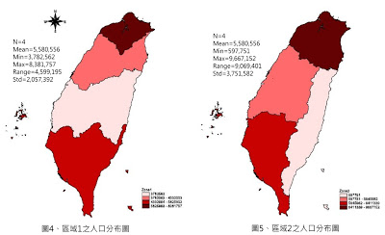
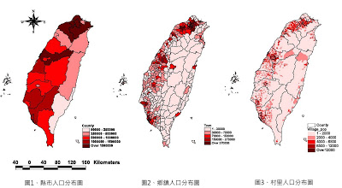
Spatial aggregation
  Zone effects
  Scale effects
http://utopia1234.blogspot.tw/2009/11/maup.html
Notes:
http://utopia1234.blogspot.tw/2009/11/maup.html

Slide 18

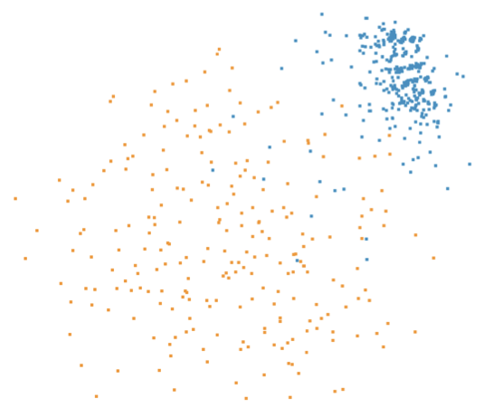

Dimensionality reduction
attribute aggregation
  derive low-dimensional target space from high-dimensional measured space
  use when you can’t directly measure what you care about
    true dimensionality of dataset conjectured to be smaller than dimensionality of measurements
    latent factors, hidden variables
Malignant
Benign
Tumor
Measurement Data
DR
data: 9D measured space
derived data: 2D target space
46

Slide 19
Dimensionality reduction & visualization
why do people do DR?
  improve performance of downstream algorithm
avoid curse of dimensionality
  data analysis
if look at the output: visual data analysis
abstract tasks when visualizing DR data
  dimension-oriented tasks
naming synthesized dims, mapping synthesized dims to original dims
  cluster-oriented tasks
verifying clusters, naming clusters, matching clusters and classes
46

Slide 20
Dimension-oriented tasks
naming synthesized dims: inspect data represented by lowD points
[A global geometric framework for nonlinear dimensionality reduction. Tenenbaum, de Silva, and Langford. Science, 290(5500):2319–2323, 2000.]

Slide 21
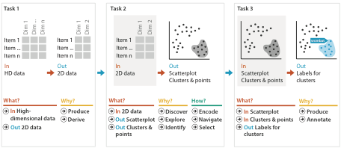
Idiom: Dimensionality reduction for documents

Slide 22
Linear dimensionality reduction
principal components analysis (PCA)
  ﬁnding axes: ﬁrst with most variance, second with next most, …
  describe location of each point as linear combination of weights for each axis
mapping synthesized dims to original dims
[http://en.wikipedia.org/wiki/File:GaussianScatterPCA.png]

Slide 23
Nonlinear dimensionality reduction
pro: can handle curved rather than linear structure
cons: lose all ties to original dims/attribs
  new dimensions often cannot be easily related to originals
  mapping synthesized dims to original dims task is difﬁcult
many techniques proposed
  many literatures: visualization, machine learning, optimization, psychology, ...
  techniques: t-SNE, MDS (multidimensional scaling), charting, isomap, LLE,…
    t-SNE: excellent for clusters
      but some trickiness remains: http://distill.pub/2016/misread-tsne/
    MDS: confusingly, entire family of techniques, both linear and nonlinear
      minimize stress or strain metrics
      early formulations equivalent to PCA

Slide 24
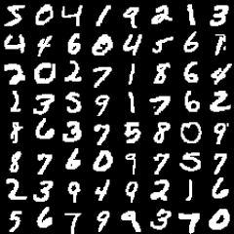
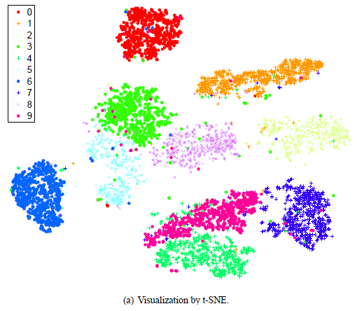
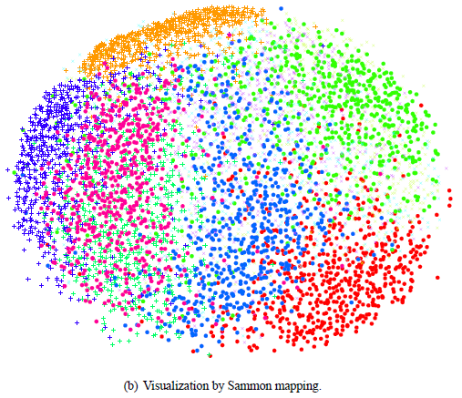
t-sne
MNIST data set

Slide 25


Slide 26
Reduce items and attributes

Slide 27
Further reading
Visualization Analysis and Design. Munzner. AK Peters Visualization Series, CRC Press, 2014.
  Chap 13: Reduce Items and Attributes
Hierarchical Aggregation for Information Visualization: Overview, Techniques and Design Guidelines. Elmqvist and Fekete. IEEE Transactions on Visualization and Computer Graphics 16:3 (2010), 439–454.
A Review of Overview+Detail, Zooming, and Focus+Context Interfaces. Cockburn, Karlson, and Bederson. ACM Computing Surveys 41:1 (2008), 1–31.
A Guide to Visual Multi-Level Interface Design From Synthesis of Empirical Study Evidence. Lam and Munzner. Synthesis Lectures on Visualization Series, Morgan Claypool, 2010.

Slide 28
Embed

Slide 29
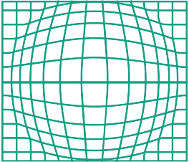
Embed: Focus+Context
Embed
Elide Data
combine information within single view
elide
– selectively filter and aggregate
superimpose layer
– local lens
distortion design choices
– region shape: radial, rectilinear, complex
– how many regions: one, many
– region extent: local, global
– interaction metaphor
Superimpose Layer
Distort Geometry
31

Slide 30
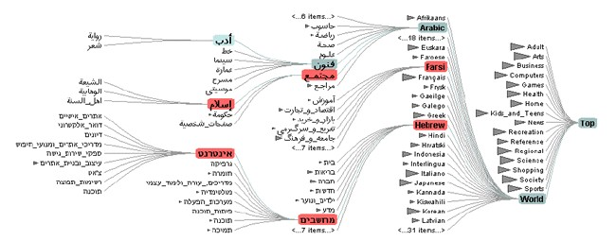
Idiom: DOITrees Revisited
elide
– some items dynamically filtered out
– some items dynamically aggregated together
– some items shown in detail
[DOITrees Revisited: Scalable, Space-Constrained Visualization of Hierarchical Data. Heer and Card. Proc. Advanced Visual Interfaces (AVI), pp. 421–424, 2004.]
32

Slide 31
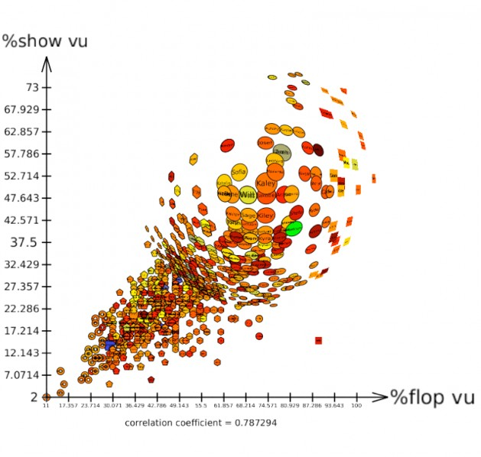
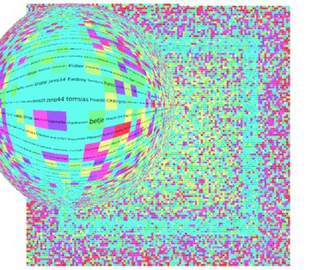
Idiom: Fisheye Lens
distort geometry
– shape: radial
– focus: single extent
– extent: local
– metaphor: draggable lens
http://tulip.labri.fr/TulipDrupal/?q=node/351 http://tulip.labri.fr/TulipDrupal/?q=node/371
33

Slide 32
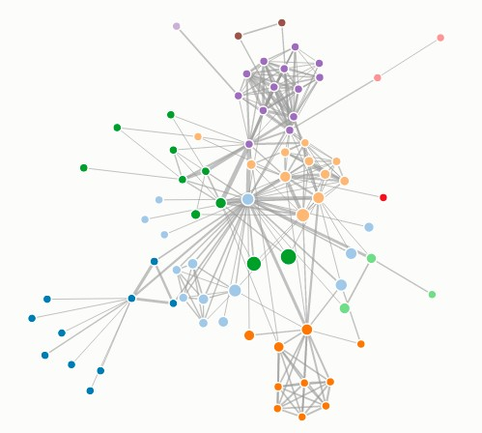
Idiom: Fisheye Lens
System: D3
[D3 Fisheye Lens]
( https://bost.ocks.org/mike/fisheye/ )
34

Slide 33
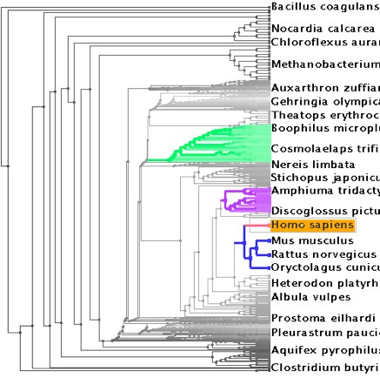
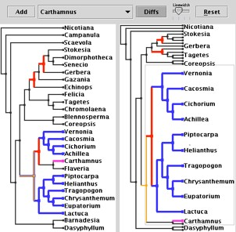
Idiom: Stretch and Squish Navigation
distort geometry
– shape: rectilinear
– foci: multiple
– impact: global
System: TreeJuxtaposer
– metaphor: stretch and squish, borders fixed
[TreeJuxtaposer: Scalable Tree Comparison Using Focus+Context With Guaranteed Visibility. Munzner, Guimbretiere,Tasiran, Zhang, and Zhou. ACM Transactions on Graphics (Proc. SIGGRAPH) 22:3 (2003), 453– 462.]
35

Slide 34
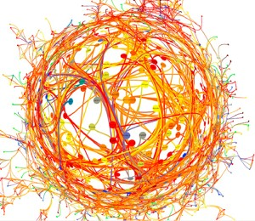
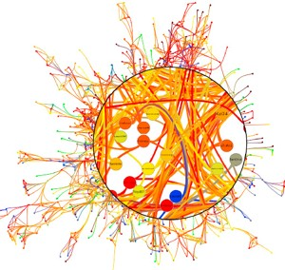
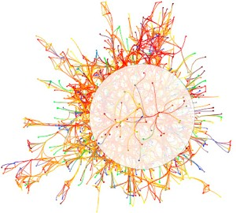
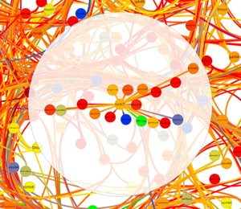
Distortion costs and benefits
fisheye lens
magnifying lens
benefits
– combine focus and context information in single view
costs
– length comparisons impaired
  network/tree topology comparisons unaffected: connection, containment
– effects of distortion unclear if original structure unfamiliar
– object constancy/tracking maybe impaired
neighborhood layering
Bring and Go
[Living Flows: Enhanced Exploration of Edge-Bundled Graphs Based on GPU-Intensive Edge Rendering. Lambert, Auber, and Melançon. Proc. Intl. Conf. Information Visualisation (IV), pp. 523–530, 2010.]
36

