Slide 1
Computer Graphics
From Vertex to Fragment
Notes:
2019

Slide 2
Clipping I

Slide 3
Objectives
Introduce basic implementation strategies
Clipping
Scan conversion

Slide 4
Overview
At end of the geometric pipeline, vertices have been assembled into primitives
Must clip out primitives that are outside the view frustum
  Algorithms based on representing primitives by lists of vertices
Must find which pixels can be affected by each primitive
  Fragment generation
  Rasterization or scan conversion

Slide 5
Required Tasks
Clipping
Rasterization or scan conversion
Transformations
Some tasks deferred until fragement processing
  Hidden surface removal
  Antialiasing

Slide 6
Rasterization Meta Algorithms
Consider two approaches to rendering a scene with opaque objects
For every pixel, determine which object that projects on the pixel is closest to the viewer and compute the shade of this pixel
  Ray tracing paradigm
For every object, determine which pixels it covers and shade these pixels
  Pipeline approach
  Must keep track of depths

Slide 7
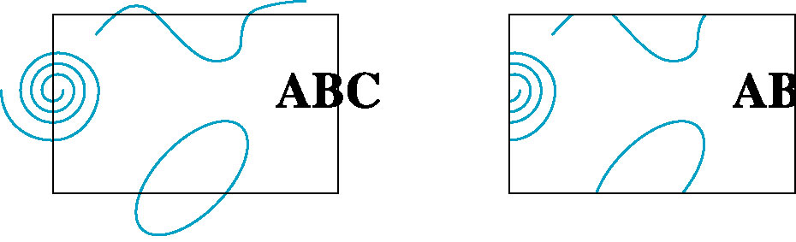
Clipping
2D against clipping window
3D against clipping volume
Easy for line segments polygons
Hard for curves and text
  Convert to lines and polygons first

Slide 8
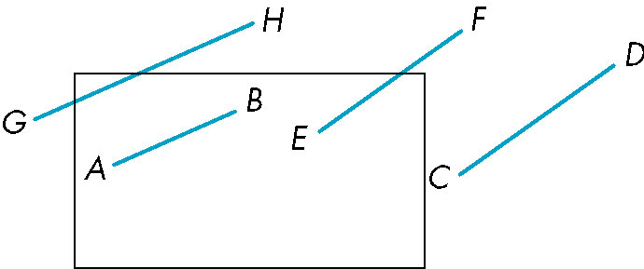
Clipping 2D Line Segments
Brute force approach: compute intersections with all sides of clipping window
  Inefficient: one division per intersection

Slide 9
Cohen-Sutherland Algorithm
Idea: eliminate as many cases as possible without computing intersections
Start with four lines that determine the sides of the clipping window
y = y_{max}
x = x_{min}
x = x_{max}
y = y_{min}

Slide 10
The Cases
Case 1: both endpoints of line segment inside all four lines
  Draw (accept) line segment as is
Case 2: both endpoints outside all lines and on same side of a line
  Discard (reject) the line segment
y = y_{max}
x = x_{min}
x = x_{max}
y = y_{min}

Slide 11
The Cases
Case 3: One endpoint inside, one outside
  Must do at least one intersection
Case 4: Both outside
  May have part inside
  Must do at least one intersection
y = y_{max}
x = x_{min}
x = x_{max}

Slide 12
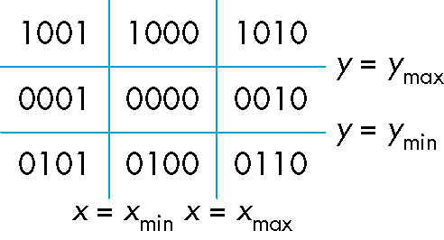
Defining Outcodes
For each endpoint, define an outcode
Outcodes divide space into 9 regions
Computation of outcode requires at most 4 subtractions
b₀b₁b₂b₃
b₀ = 1 if y > y_{max}, 0 otherwise
b₁ = 1 if y < y_{min}, 0 otherwise
b₂ = 1 if x > x_{max}, 0 otherwise
b₃ = 1 if x < x_{min}, 0 otherwise

Slide 13
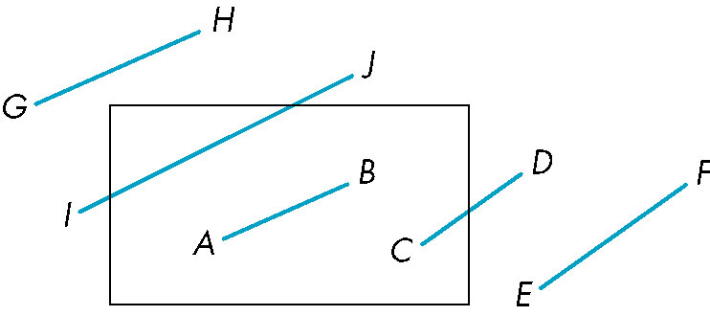
Using Outcodes
Consider the 5 cases below
AB: outcode(A) = outcode(B) = 0
  Accept line segment

Slide 14
Using Outcodes
CD: outcode (C) = 0, outcode(D) ≠ 0
  Compute intersection
  Location of 1 in outcode(D) determines which edge to intersect with
  Note if there were a segment from A to a point in a region with 2 ones in outcode, we might have to do two interesections

Slide 15
Using Outcodes
EF: outcode(E) logically ANDed with outcode(F) (bitwise) ≠ 0
  Both outcodes have a 1 bit in the same place
  Line segment is outside of corresponding side of clipping window
  reject

Slide 16
Using Outcodes
GH and IJ: same outcodes, neither zero but logical AND yields zero
Shorten line segment by intersecting with one of sides of window
Compute outcode of intersection (new endpoint of shortened line segment)
Reexecute algorithm

Slide 17
Efficiency
In many applications, the clipping window is small relative to the size of the entire data base
  Most line segments are outside one or more side of the window and can be eliminated based on their outcodes
Inefficiency when code has to be reexecuted for line segments that must be shortened in more than one step

Slide 18
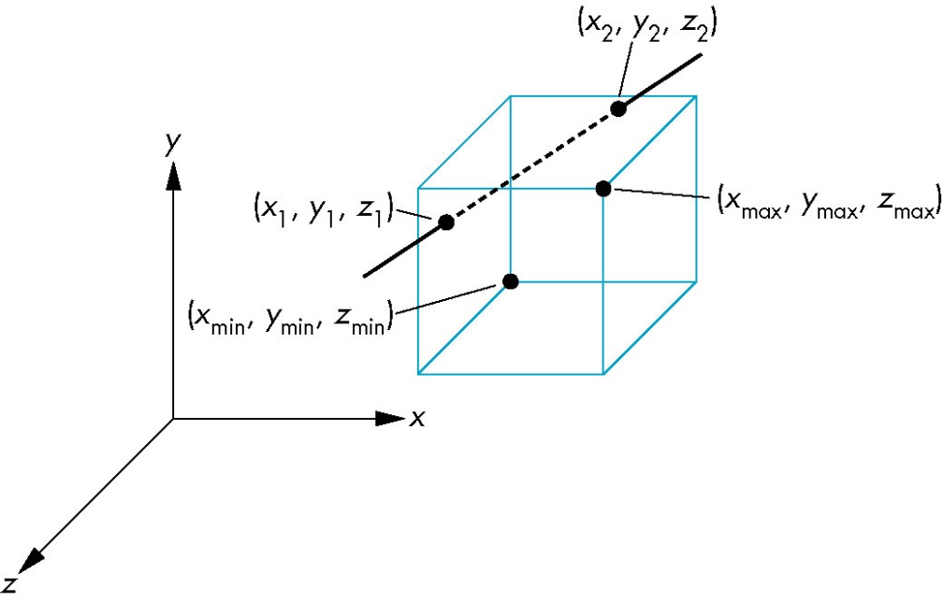
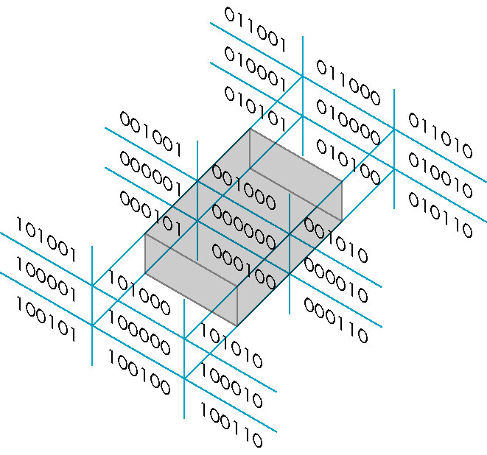
Cohen Sutherland in 3D
Use 6-bit outcodes
When needed, clip line segment against planes

Slide 19
Liang-Barsky Clipping
Consider the parametric form of a line segment
We can distinguish between the cases by looking at the ordering of the values of α where the line determined by the line segment crosses the lines that determine the window
p(α) = (1-α)p₁+ αp₂ 1 ≥ α ≥ 0
p₂
p₁

Slide 20
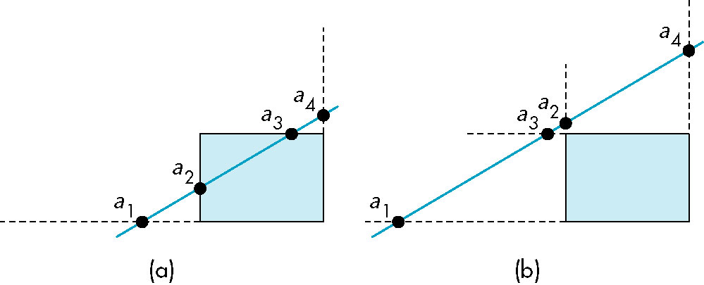
Liang-Barsky Clipping
In (a): α₄ > α₃ > α₂ > α₁
  Intersect right, top, left, bottom: shorten
In (b): α₄ > α₂ > α₃ > α₁
  Intersect right, left, top, bottom: reject

Slide 21
Advantages
Can accept/reject as easily as with Cohen-Sutherland
Using values of α, we do not have to use algorithm recursively as with C-S
Extends to 3D

Slide 22
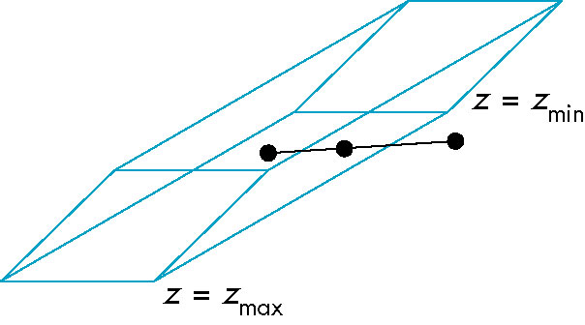
Clipping and Normalization
General clipping in 3D requires intersection of line segments against arbitrary plane
Example: oblique view

Slide 23
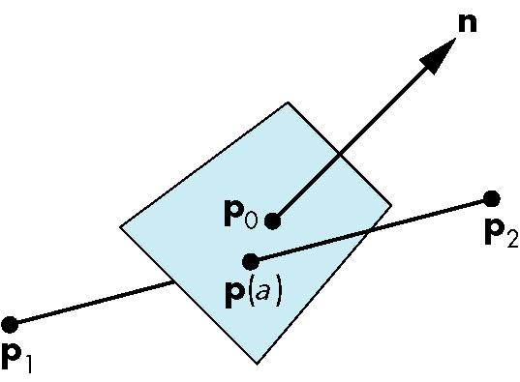
Plane-Line Intersections

Slide 24
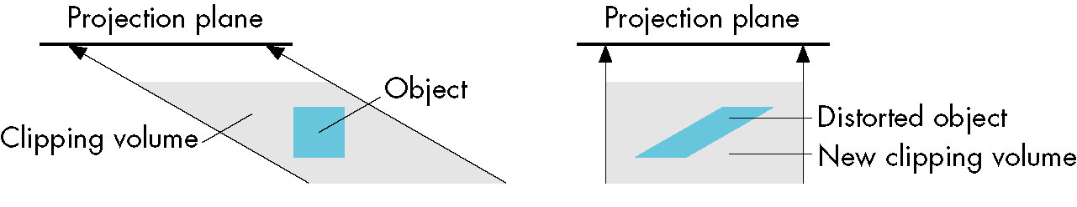
Normalized Form
top view
before normalization
after normalization
Normalization is part of viewing (pre clipping)
but after normalization, we clip against sides of
right parallelepiped
Typical intersection calculation now requires only
a floating point subtraction, e.g. is x > x_{max} ?

Slide 25
Clipping II

Slide 26
Objectives
Introduce clipping algorithms for polygons
Survey hidden-surface algorithms

Slide 27
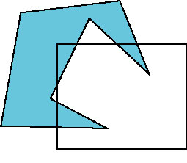
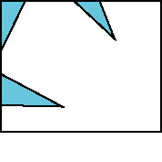
Polygon Clipping
Not as simple as line segment clipping
  Clipping a line segment yields at most one line segment
  Clipping a polygon can yield multiple polygons
However, clipping a convex polygon can yield at most one other polygon

Slide 28

Tessellation and Convexity
One strategy is to replace nonconvex (concave) polygons with a set of triangular polygons (a tessellation)
Also makes fill easier
Tessellation code in GLU library

Slide 29
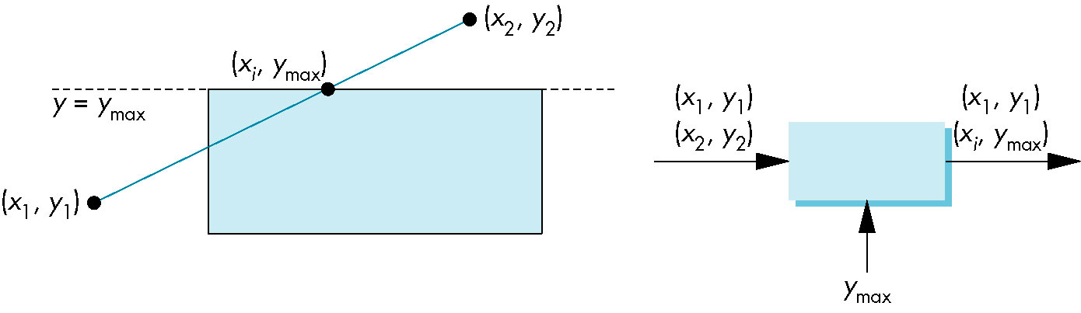
Clipping as a Black Box
Can consider line segment clipping as a process that takes in two vertices and produces either no vertices or the vertices of a clipped line segment

Slide 30
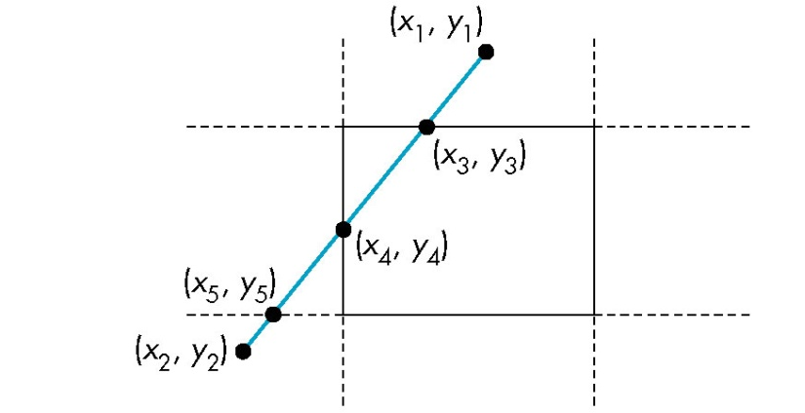
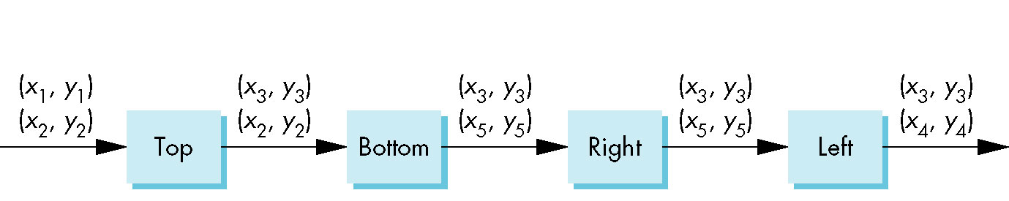
Pipeline Clipping of Line Segments
Clipping against each side of window is independent of other sides
  Can use four independent clippers in a pipeline

Slide 31
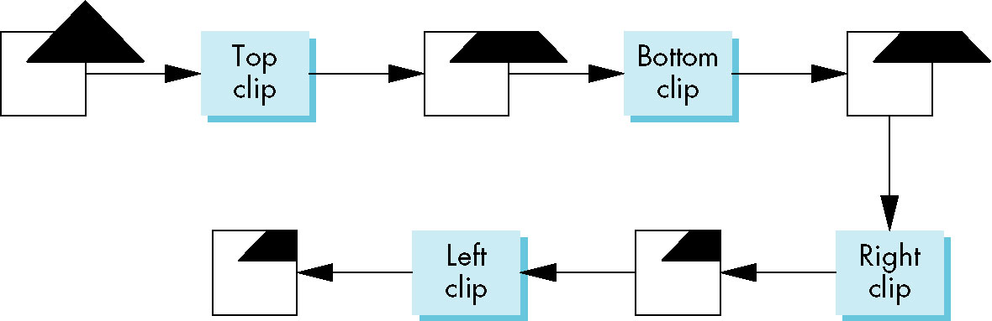
Pipeline Clipping of Polygons
Three dimensions: add front and back clippers
Strategy used in SGI Geometry Engine
Small increase in latency

Slide 32
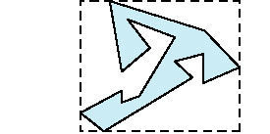
Bounding Boxes
Rather than doing clipping on a complex polygon, we can use an axis-aligned bounding box or extent
  Smallest rectangle aligned with axes that encloses the polygon
  Simple to compute: max and min of x and y

Slide 33
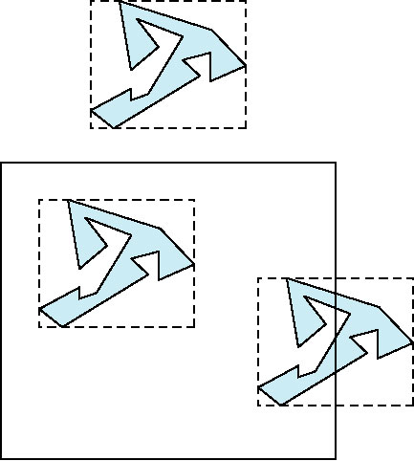
Bounding boxes
Can usually determine accept/reject based only on bounding box
reject
accept
requires detailed
clipping

Slide 34
Axis Aligned Bounding Box
bool AABBtest(
float ax1, float ay1, float ax2, float ay2,
float bx1, float by1, float bx2, float by2) { return ax1 > bx2 || ax2 < bx1 ||
ay1 > by2 || ay2 < by1;
}
When intersection, return false.
Notes:
排除法 在這四個條件時任一個成立時，不會有交錯，

Slide 35
Clipping and Visibility
Clipping has much in common with hidden-surface removal
In both cases, we are trying to remove objects that are not visible to the camera
Often we can use visibility or occlusion testing early in the process to eliminate as many polygons as possible before going through the entire pipeline

Slide 36
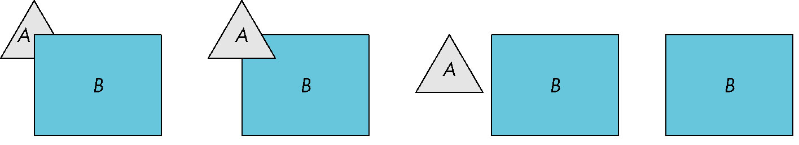
Hidden Surface Removal
Object-space approach: use pairwise testing between polygons (objects)
Worst case complexity O(n²) for n polygons
partially obscuring
can draw independently

Slide 37
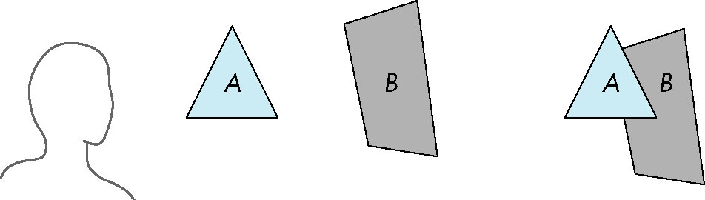
Painter’s Algorithm
Render polygons a back to front order so that polygons behind others are simply painted over
B behind A as seen by viewer
Fill B then A

Slide 38
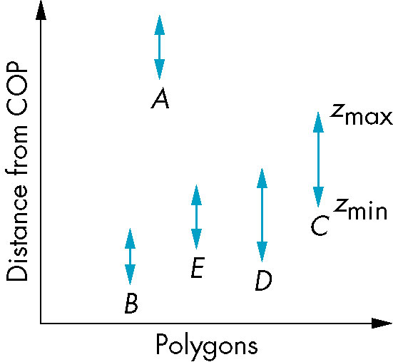
Depth Sort
Requires ordering of polygons first
  O(n log n) calculation for ordering
  Not every polygon is either in front or behind all other polygons
Order polygons and deal with
easy cases first, harder later
Polygons sorted by
distance from COP

Slide 39
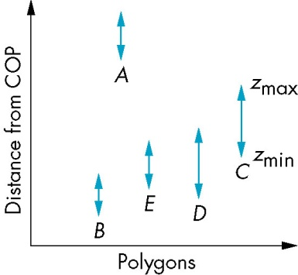
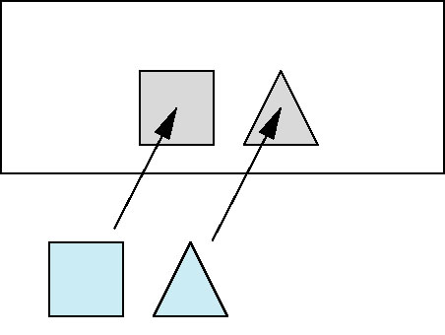
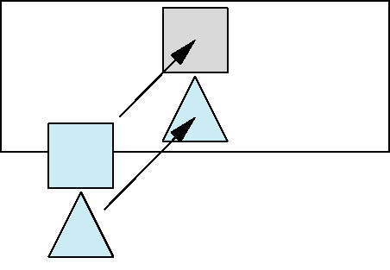
Easy Cases
A lies behind all other polygons
  Can render
Polygons overlap in z but not in either x or y
  Can render independently

Slide 40
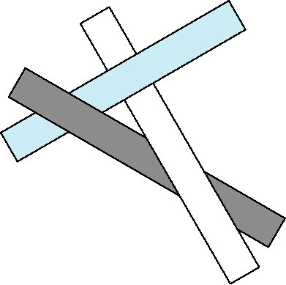
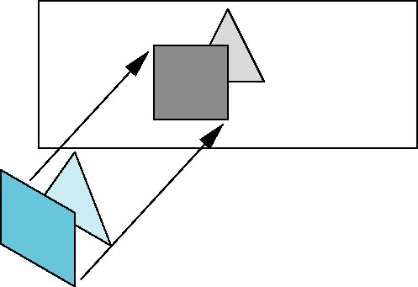
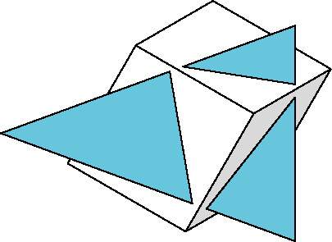
Hard Cases
cyclic overlap
Overlap in all directions
but can one is fully on
one side of the other
penetration

Slide 41
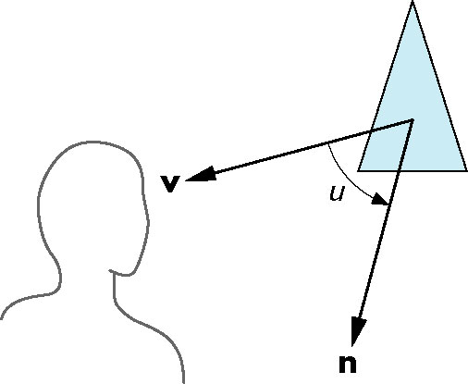
Back-Face Removal (Culling)
face is visible iff 90 ≥ θ ≥ -90
equivalently cos θ ≥ 0
or v • n ≥ 0
θ
plane of face has form ax + by +cz +d =0
but after normalization n = ( 0 0 1 0)^{T}
need only test the sign of c
In OpenGL we can simply enable culling
but may not work correctly if we have nonconvex objects

Slide 42
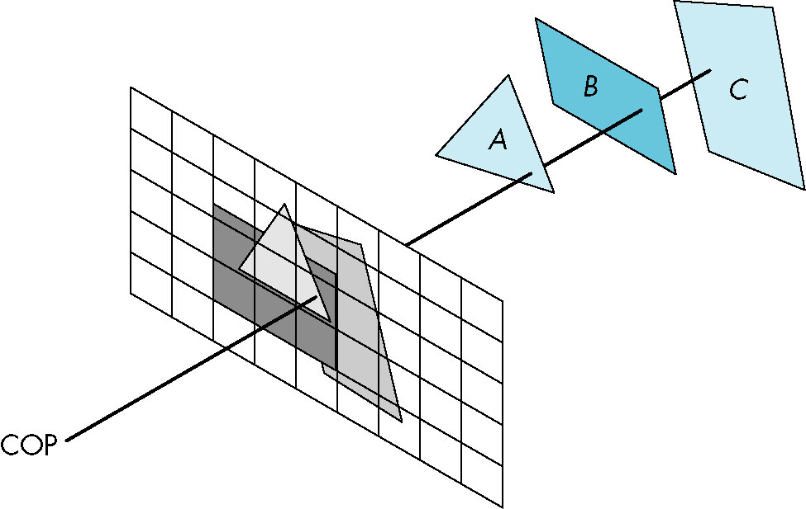
Image Space Approach
Look at each projector (nm for an n x m frame buffer) and find closest of k polygons
Complexity O(nmk)
Ray tracing
z-buffer

Slide 43
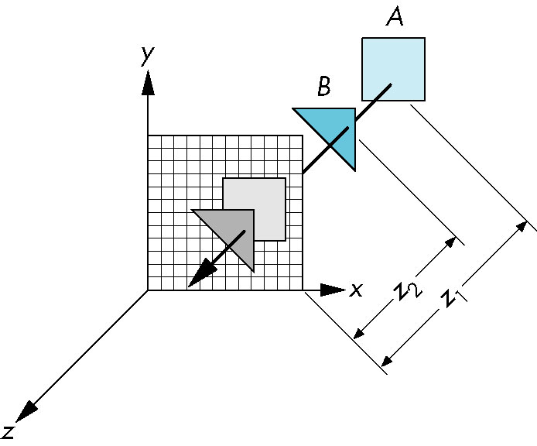
z-Buffer Algorithm
Use a buffer called the z or depth buffer to store the depth of the closest object at each pixel found so far
As we render each polygon, compare the depth of each pixel to depth in z buffer
If less, place shade of pixel in color buffer and update z buffer

Slide 44
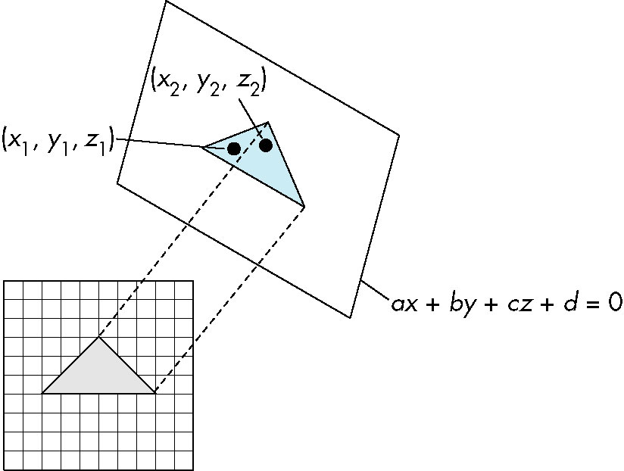
Efficiency
If we work scan line by scan line as we move across a scan line, the depth changes satisfy aΔx+bΔy+cΔz=0
Along scan line
Δy = 0
Δz = - Δx
In screen space Δx = 1

Slide 45
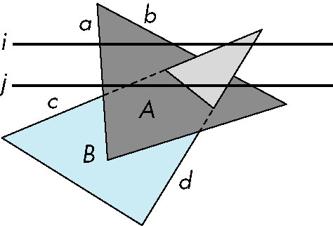
Scan-Line Algorithm
Can combine shading and hsr through scan line algorithm
scan line i: no need for depth
information, can only be in no
or one polygon
scan line j: need depth
information only when in
more than one polygon

Slide 46
Implementation
Need a data structure to store
  Flag for each polygon (inside/outside)
  Incremental structure for scan lines that stores which edges are encountered
  Parameters for planes

Slide 47
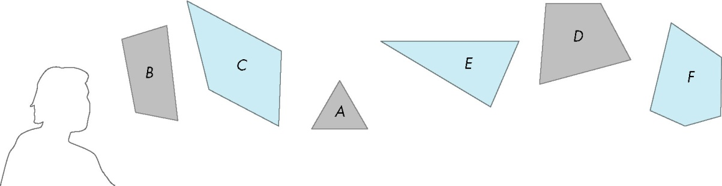
Visibility Testing
In many realtime applications, such as games, we want to eliminate as many objects as possible within the application
  Reduce burden on pipeline
  Reduce traffic on bus
Partition space with Binary Spatial Partition (BSP) Tree

Slide 48
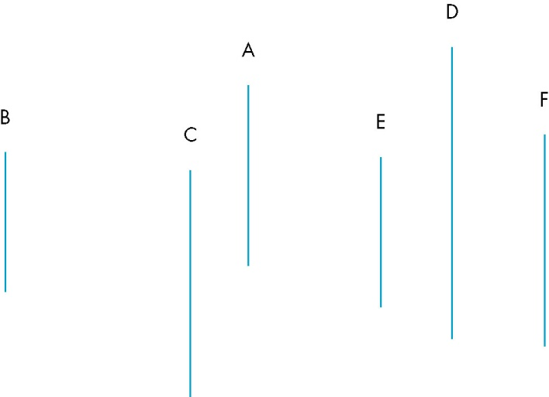
Simple Example
consider 6 parallel polygons
top view
The plane of A separates B and C from D, E and F

Slide 49
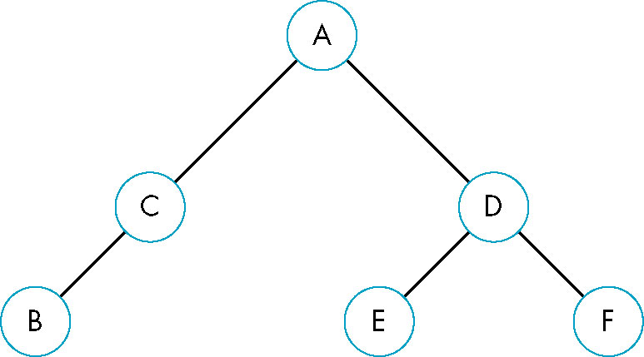
BSP Tree
Can continue recursively
  Plane of C separates B from A
  Plane of D separates E and F
Can put this information in a BSP tree
  Use for visibility and occlusion testing
Notes:
BSP trees are used to improve rendering performance in calculating visible triangles for the painter's algorithm for instance. The tree can be traversed in linear time from an arbitrary viewpoint.
Since a painter's algorithm works by drawing polygons farthest from the eye first, the following code recurses to the bottom of the tree and draws the polygons. As the recursion unwinds, polygons closer to the eye are drawn over far polygons. Because the BSP tree already splits polygons into trivial pieces, the hardest part of the painter's algorithm is already solved - code for back to front tree traversal.^{[1]}

Slide 50
Clipping III

Slide 51
Objectives
Survey Line Drawing Algorithms
  DDA
  Bresenham
Polygon rasterization

Slide 52
Rasterization
Rasterization (scan conversion)
  Determine which pixels that are inside primitive specified by a set of vertices
  Produces a set of fragments
  Fragments have a location (pixel location) and other attributes such color and texture coordinates that are determined by interpolating values at vertices
Pixel colors determined later using color, texture, and other vertex properties

Slide 53
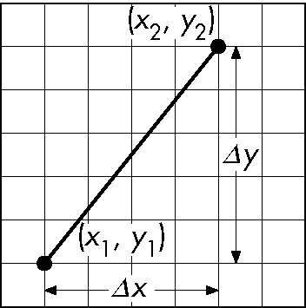
Scan Conversion of Line Segments
Start with line segment in window coordinates with integer values for endpoints
Assume implementation has a write_pixel function
y = mx + h

Slide 54
DDA Algorithm
Digital Differential Analyzer
  DDA was a mechanical device for numerical solution of differential equations
  Line y=mx+ h satisfies differential equation
  dy/dx = m = Δy/Δx = y₂-y₁/x₂-x₁
Along scan line Δx = 1
For(x=x1; x<=x2,ix++) {
y+=m;
write_pixel(x, round(y), line_color)
}

Slide 55
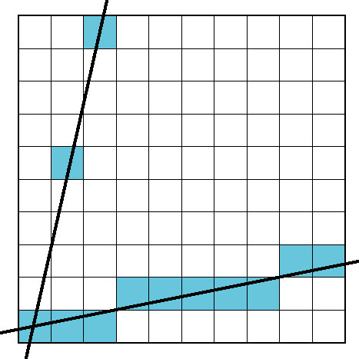
Problem
DDA = for each x plot pixel at closest y
  Problems for steep lines

Slide 56
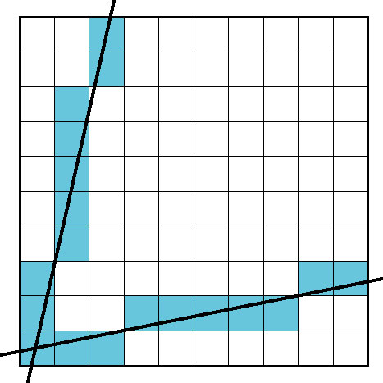
Using Symmetry
Use for 1 ≥ m ≥ 0
For m > 1, swap role of x and y
  For each y, plot closest x

Slide 57
Bresenham’s Algorithm (1962)
DDA requires one floating point addition per step
We can eliminate all fp through Bresenham’s algorithm
Consider only 1 ≥ m ≥ 0
  Other cases by symmetry
Assume pixel centers are at half integers
If we start at a pixel that has been written, there are only two candidates for the next pixel to be written into the frame buffer
Notes:
Jack E. Bresenham, "Algorithm for computer control of a digital plotter", IBM Systems Journal, Vol. 4, No.1, January 1965, pp. 25–30

Slide 58
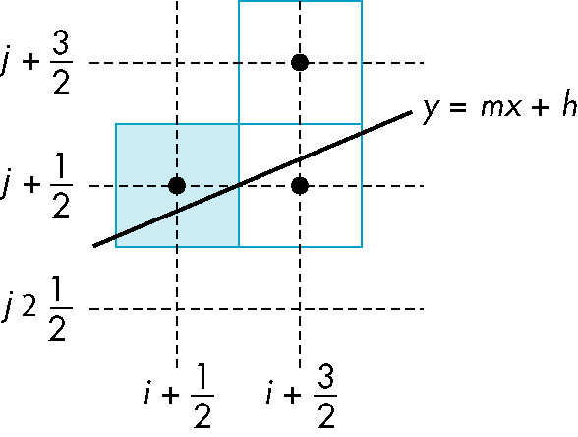
Candidate Pixels
1 ≥ m ≥ 0
candidates
last pixel
-
Note that line could have
passed through any
part of this pixel

Slide 59
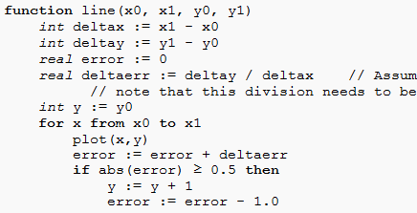

Slide 60
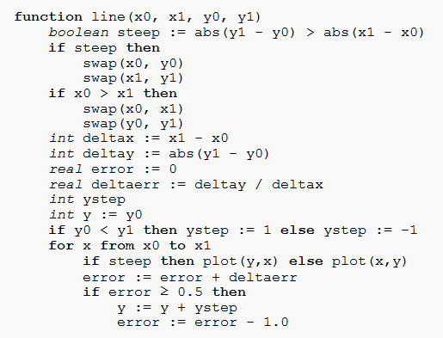
Generalization

Slide 61
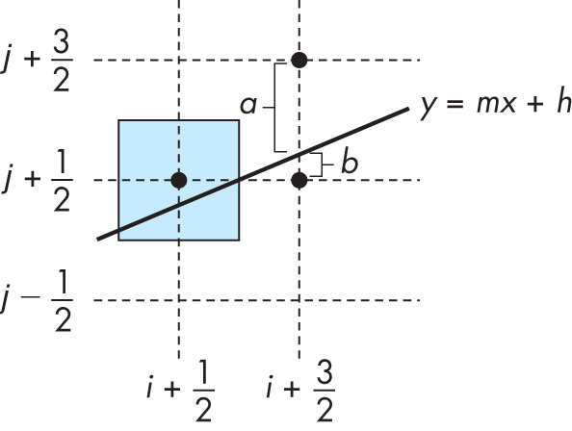
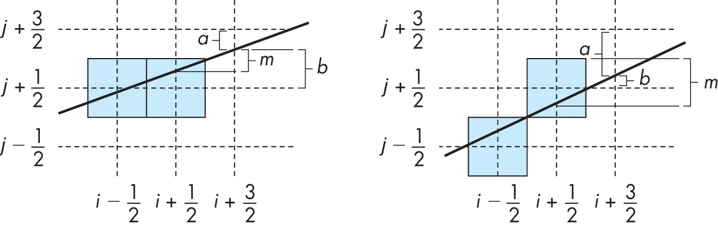

Slide 62
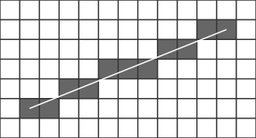
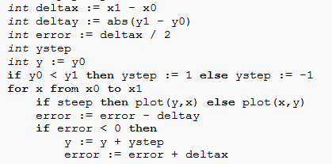
Remove the float point computation
Notes:
To deal with this we modify how error is initialized and used so that rather than starting at zero and counting up towards 0.5, it starts at 0.5 and counts down to zero.

Slide 63

Polygon Scan Conversion
Scan Conversion = Fill
How to tell inside from outside
  Convex easy
  Nonsimple difficult
  Odd even test
    Count edge crossings
  Winding number
odd-even fill

Slide 64
Filling in the Frame Buffer
Fill at end of pipeline
  Convex Polygons only
  Nonconvex polygons assumed to have been tessellated
  Shades (colors) have been computed for vertices (Gouraud shading)
  Combine with z-buffer algorithm
    March across scan lines interpolating shades
    Incremental work small

Slide 65
Flood Fill
Fill can be done recursively if we know a seed point located inside (WHITE)
Scan convert edges into buffer in edge/inside color (BLACK)
Then, flood fill it starting from (x, y)
flood_fill(int x, int y) {
if(read_pixel(x,y)= = WHITE) {
write_pixel(x,y,BLACK);
flood_fill(x-1, y);
flood_fill(x+1, y);
flood_fill(x, y+1);
flood_fill(x, y-1);
} }

Slide 66
Using Interpolation
C₁ C₂ C₃ specified by glColor or by vertex shading
C₄ determined by interpolating between C₁ and C₂
C₅ determined by interpolating between C₂ and C₃
interpolate between C₄ and C₅ along span
C₁
C₄
C₂
scan line
C₅
span
C₃

Slide 67
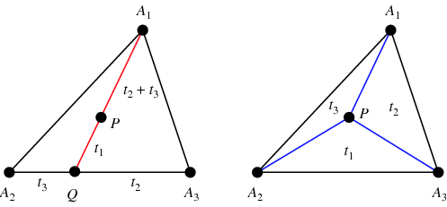
Barycentric coordinates
Notes:
http://mathworld.wolfram.com/BarycentricCoordinates.html

Slide 68
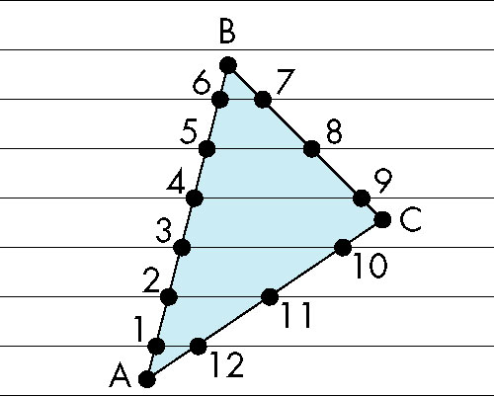
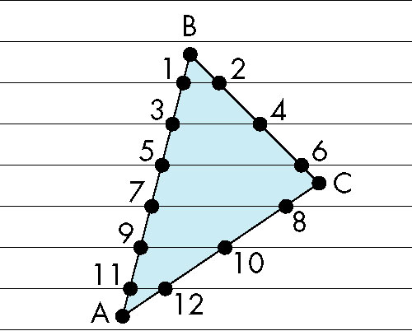
Scan Line Fill
Can also fill by maintaining a data structure of all intersections of polygons with scan lines
  Sort by scan line
  Fill each span
vertex order generated
by vertex list
desired order

Slide 69
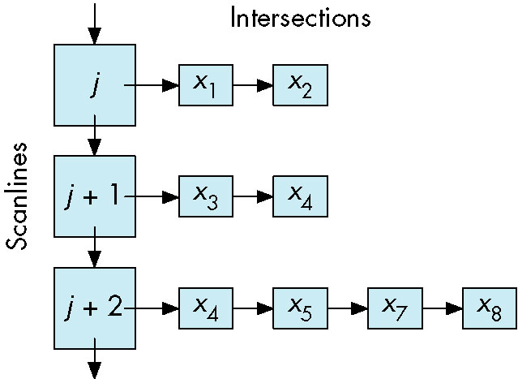
Data Structure

Slide 70
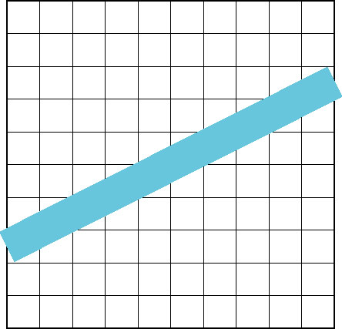
Aliasing
Ideal rasterized line should be 1 pixel wide
Choosing best y for each x (or visa versa) produces aliased raster lines

Slide 71

Antialiasing by Area Averaging
Color multiple pixels for each x depending on coverage by ideal line
original
antialiased
magnified
Notes:
How to specific the alpha of pixels?
- Xiaolin Wu's line algorithm is an algorithm for line antialiasing Wu, Xiaolin (July 1991). "An efficient antialiasing technique". Computer Graphics 25 (4): 143–152.
Multi-sampling
Use blending

Slide 72

Polygon Aliasing
Aliasing problems can be serious for polygons
  Jaggedness of edges
  Small polygons neglected
  Need compositing so color
  of one polygon does not
  totally determine color of
  pixel
All three polygons should contribute to color

