Slide 1
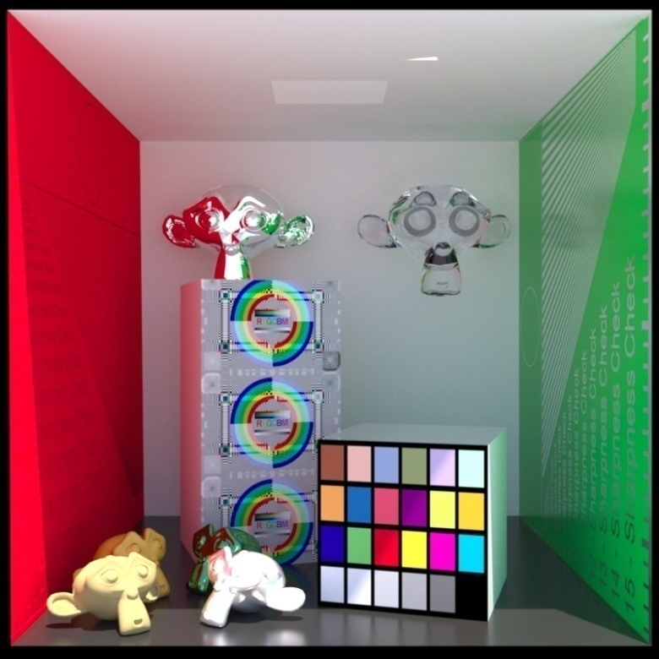
Advanced Computer Graphics
Least-Squares Solutions
Ming-Te Chi
Department of Computer Science,
National Chengchi University
Notes:
2016
The image is made by LuxRender. http://www.luxrender.net/

Slide 2
Outline
Simple problem
Line fitting
LS polynomial fits
Solving Linear systems in the LS sense
Outliners

Slide 3


intersection
$$a_{1}x+b_{1}y+c_{1}=0$$
(x,y)
$$a_{2}x+b_{2}y+c_{2}=0$$

Slide 4


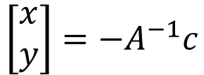
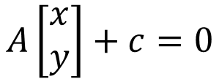
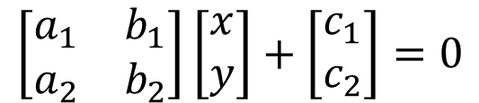
$$a_{1}x+b_{1}y+c_{1}=0$$
$$a_{2}x+b_{2}y+c_{2}=0$$
$$\left[\begin{matrix}a_{1} & b_{1} \\ a_{2} & b_{2}\end{matrix}\right]\left[\begin{matrix}x \\ y\end{matrix}\right]+\left[\begin{matrix}c_{1} \\ c_{2}\end{matrix}\right]=0$$
$$A\left[\begin{matrix}x \\ y\end{matrix}\right]+c=0$$
$$\left[\begin{matrix}x \\ y\end{matrix}\right]={−A}^{−1}c$$

Slide 5
intersection

Slide 6
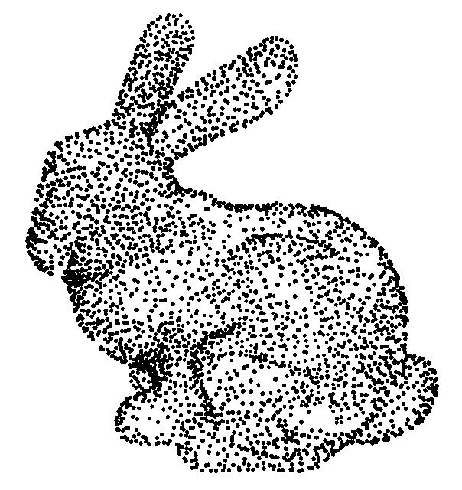
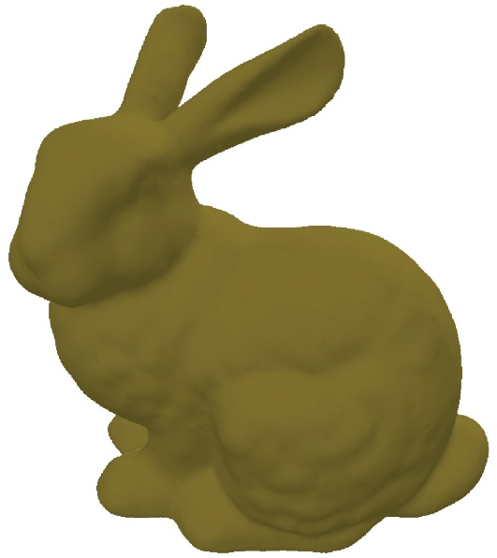
Surface reconstruction

Slide 7
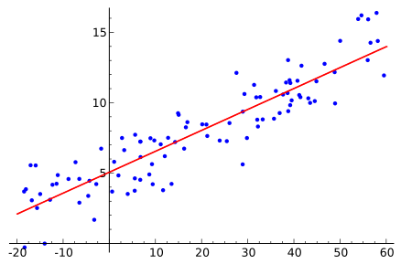
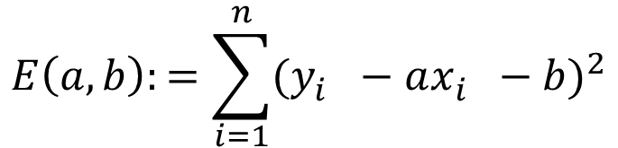


Line fitting
$$y=ax+b$$
$${{D\left(l,p_{i}\right)=(y_{i}−ax_{i}−b )}_{}^{2} }_{}$$
D
$$E\left(a,b\right):=\sum_{i=1}^{n}{{(y_{i}^{}−ax_{i}^{}−b)}^{2}}$$
Notes:
D: distance

Slide 8
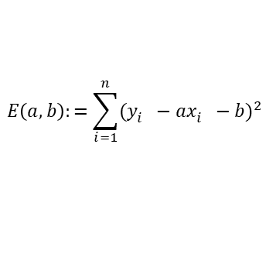
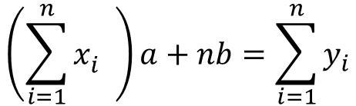
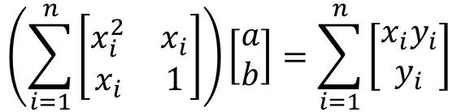
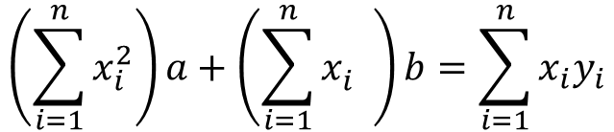
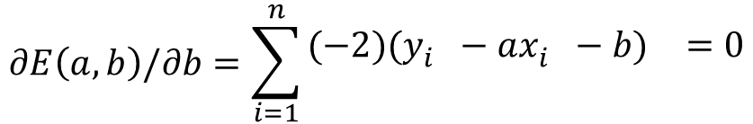
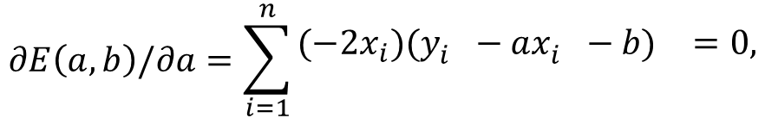
$$E\left(a,b\right):=\sum_{i=1}^{n}{{(y_{i}^{}−ax_{i}^{}−b)}^{2}}$$
$$∂E\left(a,b\right)/∂a=\sum_{i=1}^{n}{\begin{aligned}(−2{x_{i})(y_{i}^{}−ax_{i}^{}−b)}^{}=0, \\ \end{aligned}}$$
$$∂E\left(a,b\right)/∂b=\sum_{i=1}^{n}{\begin{aligned}(−2{)(y_{i}^{}−ax_{i}^{}−b)}^{}=0 \\ \end{aligned}}$$
$$\left(\sum_{i=1}^{n}{x_{i}^{2}}\right)a+\left(\sum_{i=1}^{n}{x_{i}^{}}\right)b=\sum_{i=1}^{n}{x_{i}y_{i}}$$
$$\left(\sum_{i=1}^{n}{x_{i}^{}}\right)a+nb=\sum_{i=1}^{n}{y_{i}}$$
$$\left(\sum_{i=1}^{n}{\left[\begin{matrix}x_{i}^{2} & x_{i} \\ x_{i} & 1\end{matrix}\right]}\right)\left[\begin{matrix}a \\ b\end{matrix}\right]=\sum_{i=1}^{n}{\left[\begin{matrix}x_{i}y_{i} \\ y_{i}\end{matrix}\right]}$$

Slide 9
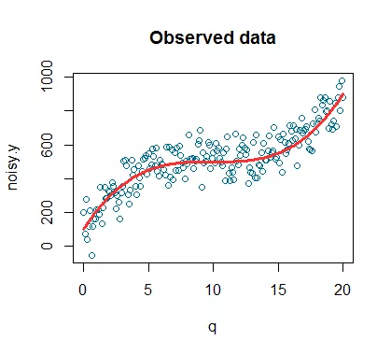

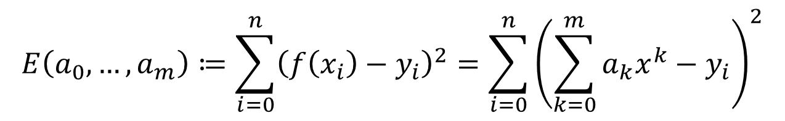
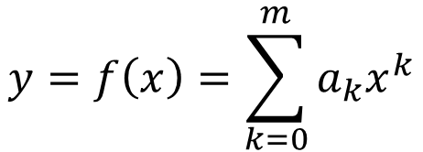

LS polynomial fits
$$y=ax+b$$
$$y=f(x)$$
$$y=f\left(x\right)=\sum_{k=0}^{m}{a_{k}x^{k}}$$
$$E\left(a_{0},…,a_{m}\right)≔\sum_{i=0}^{n}{{\left(f\left(x_{i}\right)−y_{i}\right)}^{2}}=\sum_{i=0}^{n}{{\left(\sum_{k=0}^{m}{a_{k}x^{k}}−y_{i}\right)}^{2}}$$

Slide 10
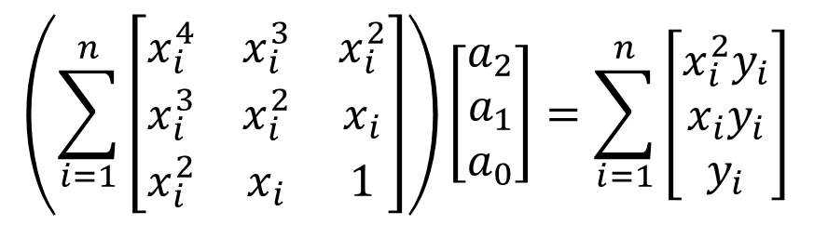
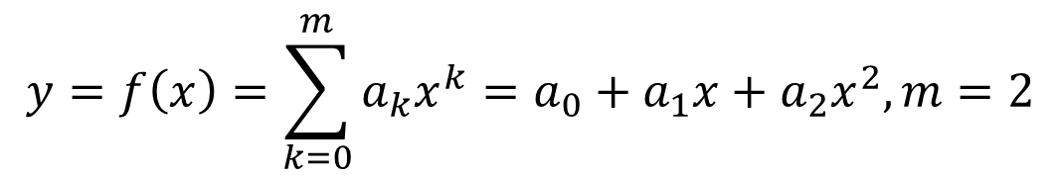
$$y=f\left(x\right)=\sum_{k=0}^{m}{a_{k}x^{k}}=a_{0}+a_{1}x+a_{2}x^{2}, m=2$$
$$\left(\sum_{i=1}^{n}{\left[\begin{matrix}x_{i}^{4} & x_{i}^{3} & x_{i}^{2} \\ x_{i}^{3} & x_{i}^{2} & x_{i} \\ x_{i}^{2} & x_{i} & 1\end{matrix}\right]}\right)\left[\begin{matrix}a_{2} \\ a_{1} \\ a_{0}\end{matrix}\right]=\sum_{i=1}^{n}{\left[\begin{matrix}x_{i}^{2}y_{i} \\ x_{i}y_{i} \\ y_{i}\end{matrix}\right]}$$

Slide 11




Solving Linear systems in the LS sense
$$Ax=b$$
$$x=A^{−1}b$$
$$\min_{x}{{\left\|Ax−b\right\|}^{2}=\min_{x}\left(x^{T}A^{T}Ax−2x^{T}A^{T}b+b^{T}b\right)}$$
An overdetermined system
$$A^{T}Ax=A^{T}b$$
$$x={{(A}^{T}Ax)}^{−1}A^{T}b$$

Slide 12
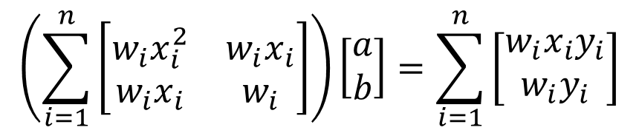
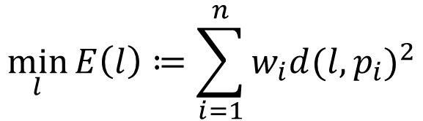
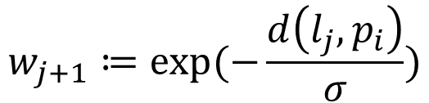
Outliners
$$w_{j+1}≔exp⁡(−\frac{d\left(l_{j},p_{i}\right)}{σ})$$
$$\min_{l}{E\left(l\right)≔\sum_{i=1}^{n}{w_{i}d{(l,p_{i})}^{2}}}$$
$$\left(\sum_{i=1}^{n}{\left[\begin{matrix}{w_{i}x}_{i}^{2} & {w_{i}x}_{i} \\ w_{i}x_{i} & w_{i}\end{matrix}\right]}\right)\left[\begin{matrix}a \\ b\end{matrix}\right]=\sum_{i=1}^{n}{\left[\begin{matrix}{w_{i}x}_{i}y_{i} \\ w_{i}y_{i}\end{matrix}\right]}$$

Slide 13

As-Rigid-As-Possible Shape Manipulation
Notes:
http://www-ui.is.s.u-tokyo.ac.jp/~takeo/research/rigid/

Slide 14
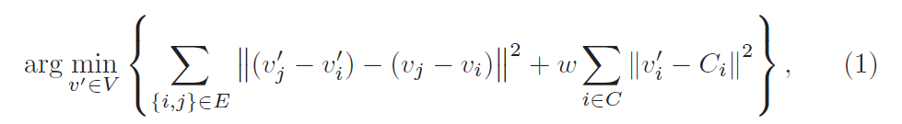
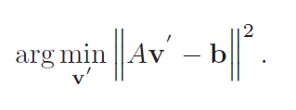
Baseline Algorithm

Slide 16
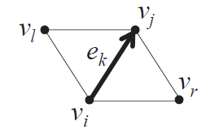
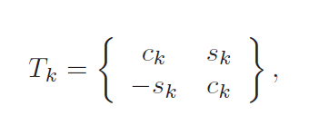
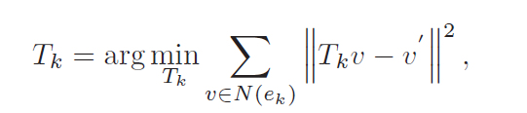

First Step: Similarity Transformation

Slide 17
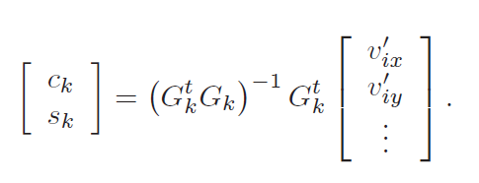

Slide 19
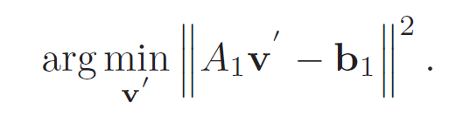

Slide 21
Second Step: Scale Adjustment

Slide 23

Reference
A Sampler of Useful Computational Tools for Applied Geometry, Computer Graphics, and Image Processing (2015)

