Slide 1
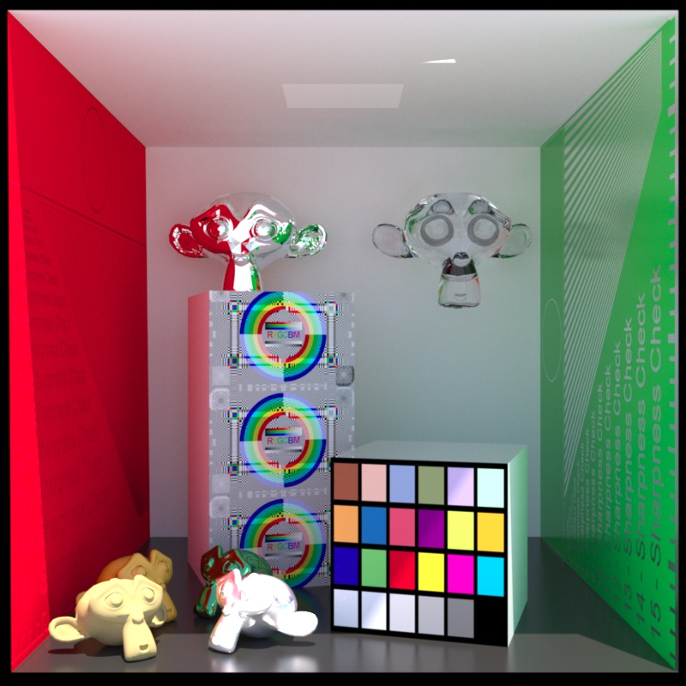
Computer Graphics
Image warping and morphing
紀明德 mtchi@cs.nccu.edu.tw
Department of Computer Science,
National Chengchi University
Notes:
2016

Slide 2
Image warping

Slide 3
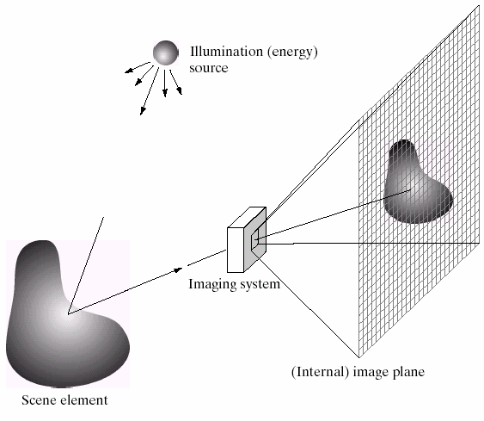
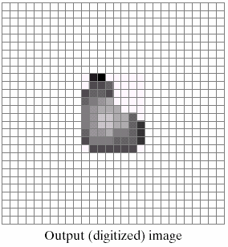
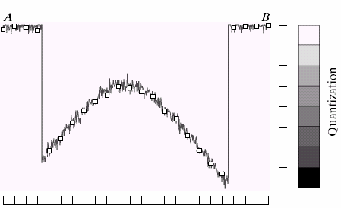
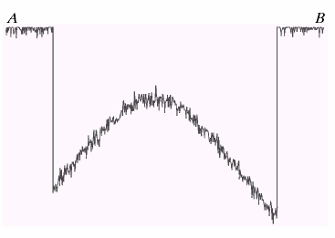
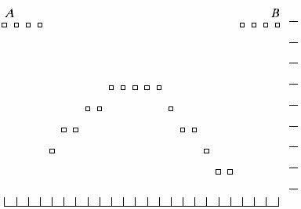
Image formation
B
A

Slide 4
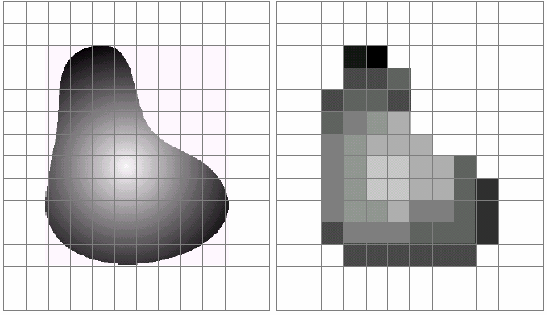
Sampling and quantization

Slide 5
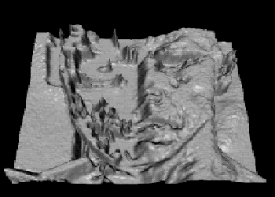
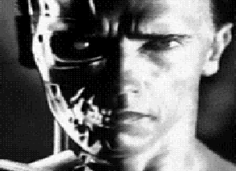
What is an image
We can think of an image as a function, f: R²→R:
  f(x, y) gives the intensity at position (x, y)
  defined over a rectangle, with a finite range:
    f: [a,b]x[c,d] → [0,1]
A color image
f
x
y

Slide 6

A digital image
We usually operate on digital (discrete) images:
  Sample the 2D space on a regular grid
  Quantize each sample (round to nearest integer)
If our samples are D apart, we can write this as:
f[i ,j] = Quantize{ f(i D, j D) }
The image can now be represented as a matrix of integer values

Slide 7
Image warping
image filtering: change range of image
g(x) = h(f(x))
h(y)=0.5y+0.5
f
g
h
x
x
image warping: change domain of image
g(x) = f(h(x))
h(y)=2y
f
g
h
x
x

Slide 8
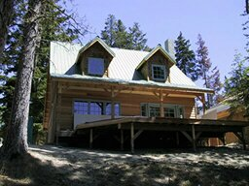
Image warping
image filtering: change range of image
f(x) = h(g(x))
h(y)=0.5y+0.5
f
g
h
image warping: change domain of image
f(x) = g(h(x))
h([x,y])=[x,y/2]
f
h
g

Slide 9
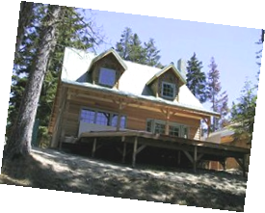
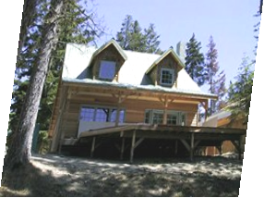
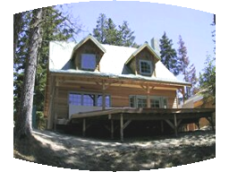
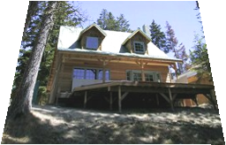
Parametric (global) warping
Examples of parametric warps:
translation
rotation
aspect
affine
perspective
cylindrical

Slide 10
Parametric (global) warping
T
p = (x,y)
p’ = (x’,y’)
Transformation T is a coordinate-changing machine: p’ = T(p)
What does it mean that T is global?
  Is the same for any point p
  can be described by just a few numbers (parameters)
Represent T as a matrix: p’ = M*p

Slide 11
Scaling
Scaling a coordinate means multiplying each of its components by a scalar
Uniform scaling means this scalar is the same for all components:
g
f
× 2

Slide 12
Scaling
Non-uniform scaling: different scalars per component:
x × 2,
y × 0.5

Slide 13
All 2D Linear Transformations
Linear transformations are combinations of …
  Scale,
  Rotation,
  Shear, and
  Mirror
Properties of linear transformations:
  Origin maps to origin
  Lines map to lines
  Parallel lines remain parallel
  Ratios are preserved
  Closed under composition

Slide 14
2x2 Matrices
What types of transformations can not be
represented with a 2x2 matrix?
2D Translation?
NO!
Only linear 2D transformations
can be represented with a 2x2 matrix

Slide 15
Translation
Example of translation
Homogeneous Coordinates
t_{x} = 2
t_{y} = 1

Slide 16
Affine Transformations
Affine transformations are combinations of …
  Linear transformations, and
  Translations
Properties of affine transformations:
  Origin does not necessarily map to origin
  Lines map to lines
  Parallel lines remain parallel
  Ratios are preserved
  Closed under composition
  Models change of basis

Slide 17
Projective Transformations
Projective transformations …
  Affine transformations, and
  Projective warps
Properties of projective transformations:
  Origin does not necessarily map to origin
  Lines map to lines
  Parallel lines do not necessarily remain parallel
  Ratios are not preserved
  Closed under composition
  Models change of basis

Slide 18
Image warping
Given a coordinate transform x’ = T(x) and a source image I(x), how do we compute a transformed image I’(x’) = I(T(x))?
T(x)
x
x’
I(x)
I’(x’)

Slide 19
Forward warping
Send each pixel I(x) to its corresponding location x’ = T(x) in I’(x’)
T(x)
x
x’
I(x)
I’(x’)

Slide 20
Forward warping
fwarp(I, I’, T)
{
for (y=0; y<I.height; y++)
for (x=0; x<I.width; x++) {
(x’,y’)=T(x,y);
I’(x’,y’)=I(x,y);
}
}
I
I’
T
x
x’

Slide 21
Forward warping
Send each pixel I(x) to its corresponding location x’ = T(x) in I’(x’)
What if pixel lands “between” two pixels?
Will be there holes?
Answer: add “contribution” to several pixels, normalize later (splatting)
h(x)
x
x’
f(x)
g(x’)

Slide 22
Forward warping
fwarp(I, I’, T)
{
for (y=0; y<I.height; y++)
for (x=0; x<I.width; x++) {
(x’,y’)=T(x,y);
Splatting(I’,x’,y’,I(x,y),kernel);
}
}
I
I’
T
x
x’

Slide 23
Inverse warping
Get each pixel I’(x’) from its corresponding location x = T⁻¹(x’) in I(x)
T⁻¹(x’)
x
x’
I(x)
I’(x’)

Slide 24
Inverse warping
iwarp(I, I’, T)
{
for (y’=0; y’<I’.height; y’++)
for (x’=0; x’<I’.width; x’++) {
(x,y)=T⁻¹(x’,y’);
I’(x’,y’)=I(x,y);
}
}
I
T⁻¹
I’
x
x’

Slide 25
Inverse warping
Get each pixel I’(x’) from its corresponding location x = T⁻¹(x’) in I(x)
What if pixel comes from “between” two pixels?
Answer: resample color value from interpolated (prefiltered) source image
x
x’
f(x)
g(x’)

Slide 26
Inverse warping
iwarp(I, I’, T)
{
for (y=0; y<I’.height; y++)
for (x=0; x<I’.width; x++) {
(x,y)=T⁻¹(x’,y’);
I’(x’,y’)=Reconstruct(I,x,y,kernel);
}
}
I
T⁻¹
I’
x
x’

Slide 27
Reconstruction
Computed weighted sum of pixel neighborhood; output is weighted average of input, where weights are normalized values of filter kernel k
color=0;
weights=0;
for all q’s dist < width
d = dist(p, q);
w = kernel(d);
color += w*q.color;
weights += w;
p.Color = color/weights;
p
width
d
q

Slide 28
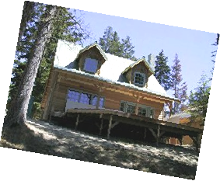
Reconstruction (interpolation)
Possible reconstruction filters (kernels):
  nearest neighbor
  bilinear
  bicubic
  sinc (optimal reconstruction)

Slide 29





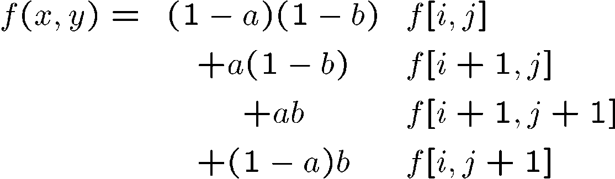
Bilinear interpolation
A simple method for resampling images

Slide 30
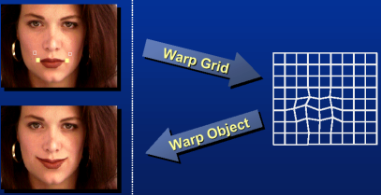
Non-parametric image warping
Specify a more detailed warp function
Splines, meshes, optical flow (per-pixel motion)

Slide 31
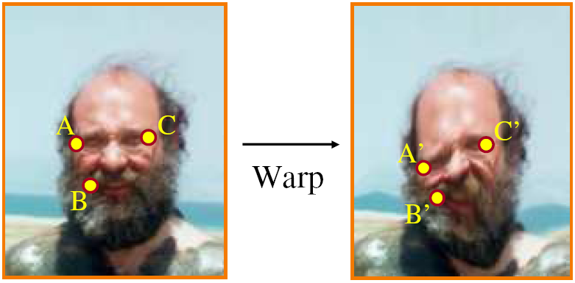
Non-parametric image warping
Mappings implied by correspondences
Inverse warping
P’
?

Slide 32
Non-parametric image warping
Barycentric coordinate
P
P’

Slide 33
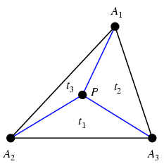
Barycentric coordinates

Slide 34
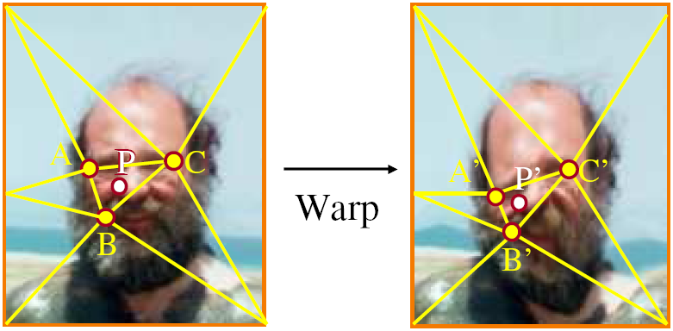
Non-parametric image warping
Barycentric coordinate

Slide 35
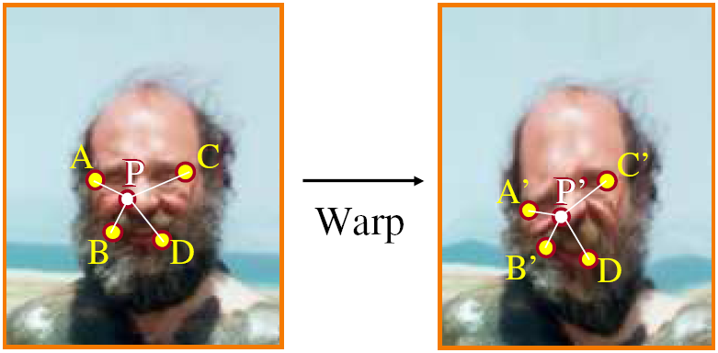
Non-parametric image warping
Gaussian
thin plate
spline
radial basis function

Slide 36
Demo
http://www.colonize.com/warp/warp04-2.php
Warping is a useful operation for mosaics, video matching, view interpolation and so on.

Slide 37
Image morphing

Slide 38
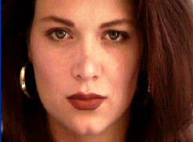
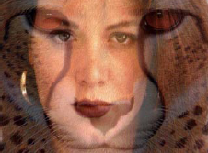
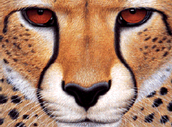
Image morphing
The goal is to synthesize a fluid transformation from one image to another.
Cross dissolving is a common transition between cuts, but it is not good for morphing because of the ghosting effects.
image #1
dissolving
image #2

Slide 39
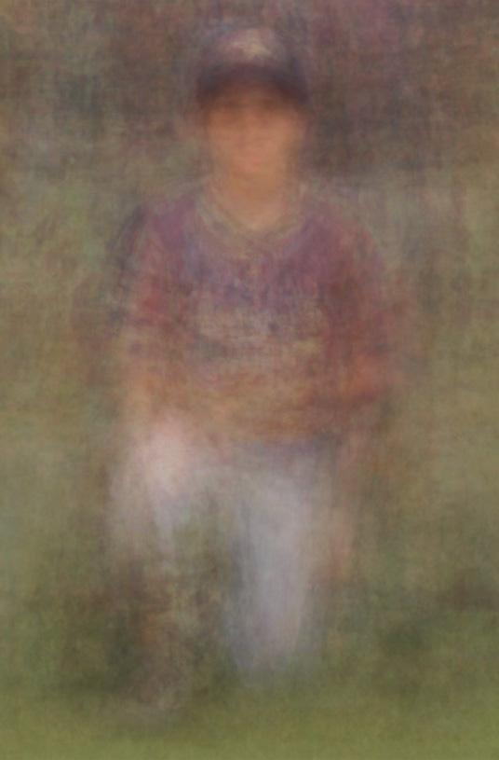
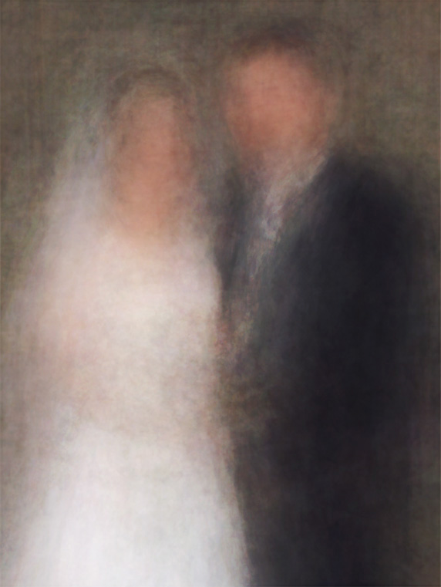
Artifacts of cross-dissolving
http://www.salavon.com/

Slide 40
Image morphing
Why ghosting?
Morphing = warping + cross-dissolving
shape
(geometric)
color
(photometric)

Slide 41
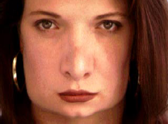
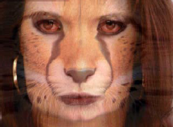
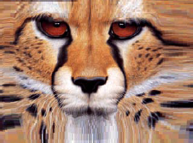
Image morphing
image #1
cross-dissolving
image #2
warp
morphing
warp

Slide 42
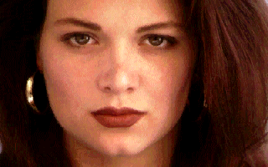
Morphing sequence

Slide 43
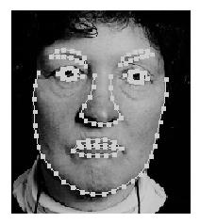
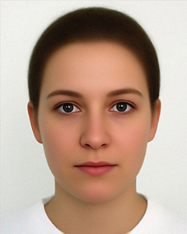
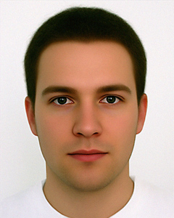
Face averaging by morphing
average faces

Slide 44
Image morphing
create a morphing sequence: for each time t
  Create an intermediate warping field (by interpolation)
  Warp both images towards it
  Cross-dissolve the colors in the newly warped images
t=0
t=0.33
t=1

Slide 45
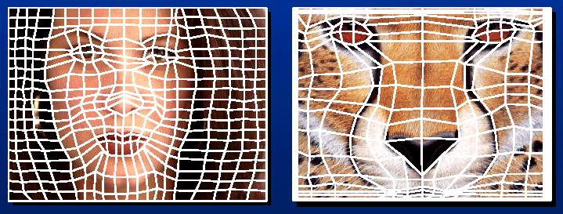
Warp specification (mesh warping)
How can we specify the warp?
  1. Specify corresponding spline control points
    interpolate to a complete warping function
easy to implement, but less expressive

Slide 46
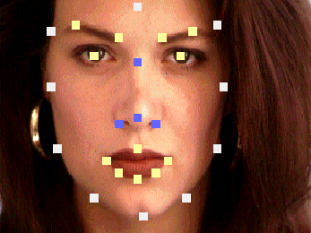
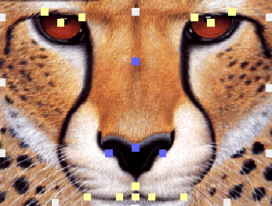
Warp specification
How can we specify the warp
  2. Specify corresponding points
    interpolate to a complete warping function

Slide 47
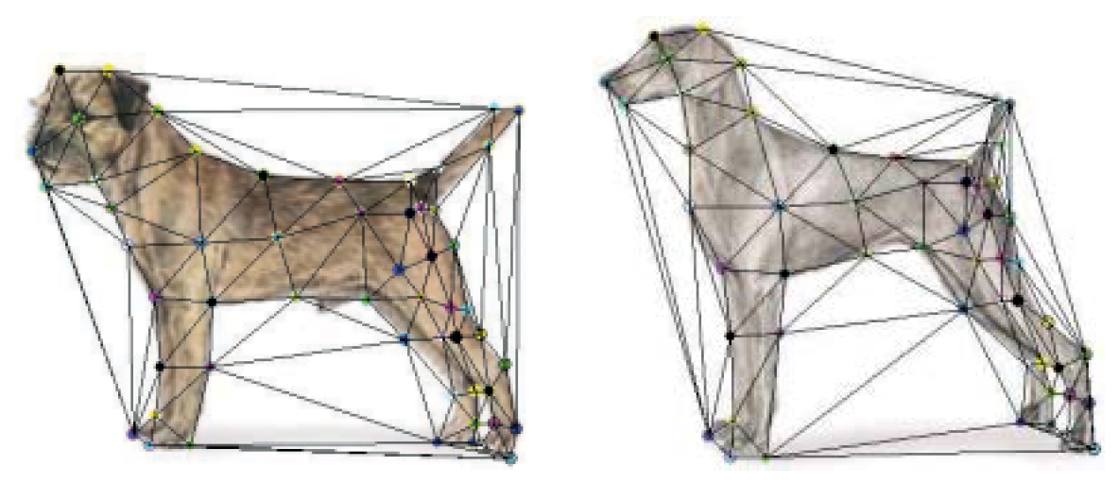
Solution: convert to mesh warping
Define a triangular mesh over the points
  Same mesh in both images!
  Now we have triangle-to-triangle correspondences
Warp each triangle separately from source to destination
  How do we warp a triangle?
  3 points = affine warp!
  Just like texture mapping

Slide 48
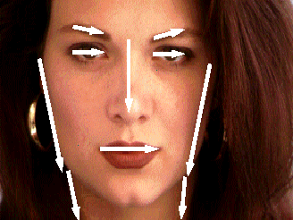
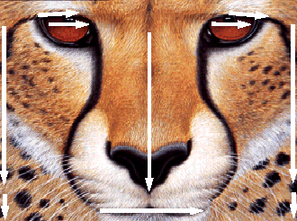
Warp specification (field warping)
How can we specify the warp?
  Specify corresponding vectors
    interpolate to a complete warping function
    The Beier & Neely Algorithm

Slide 49
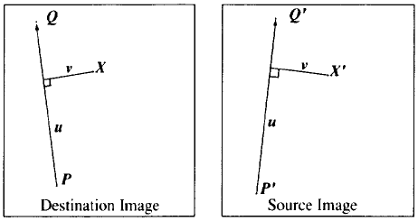
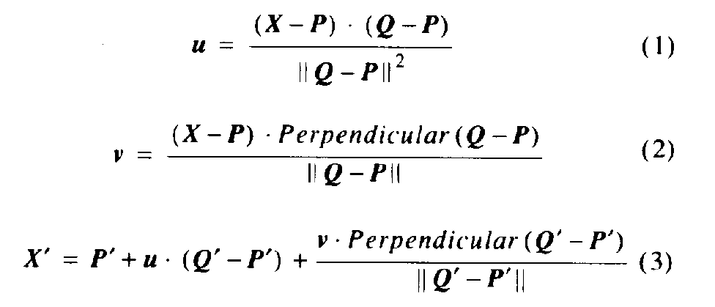
Beier&Neely (SIGGRAPH 1992)
Single line-pair PQ to P’Q’:

Slide 50
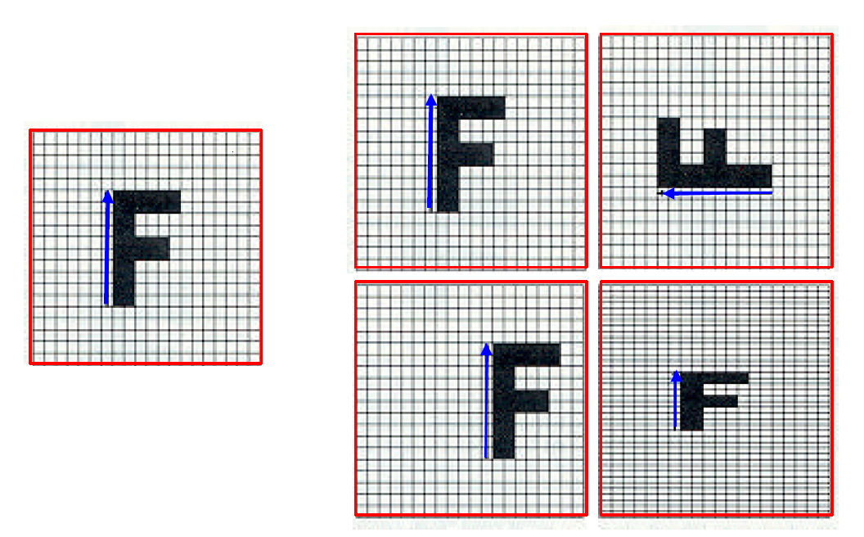
Algorithm (single line-pair)
For each X in the destination image:
  Find the corresponding u,v
  Find X’ in the source image for that u,v
  destinationImage(X) = sourceImage(X’)
Examples:
Affine transformation

Slide 51
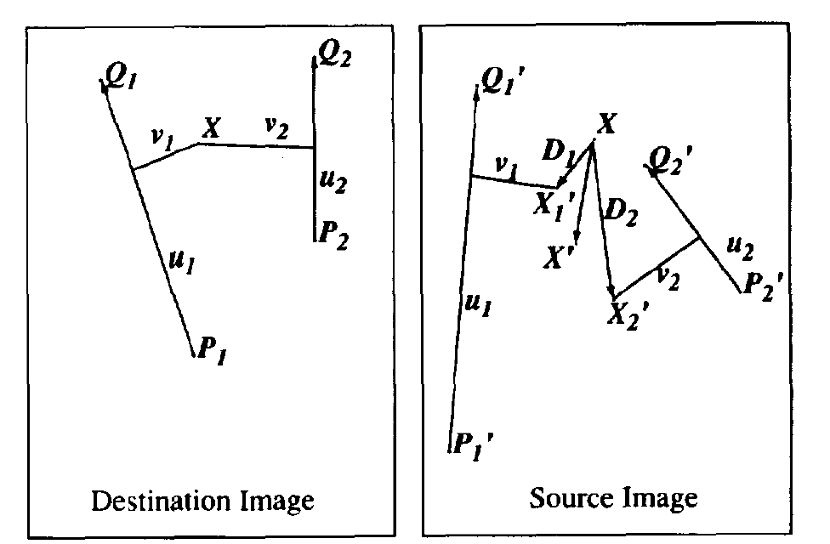
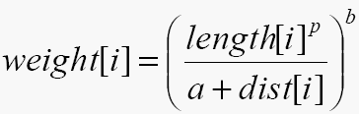
Multiple Lines
length = length of the line segment,
dist = distance to line segment
The influence of a, p, b. The same as the average of X_{i}’

Slide 52
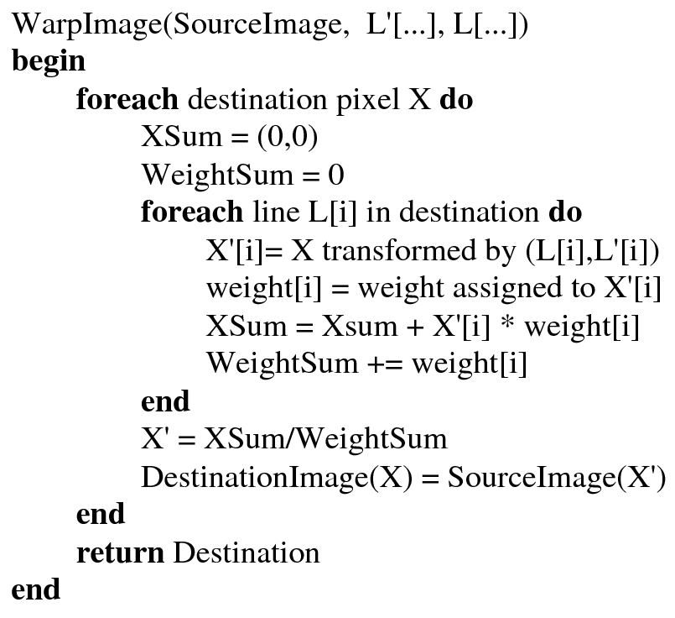
Full Algorithm

Slide 53
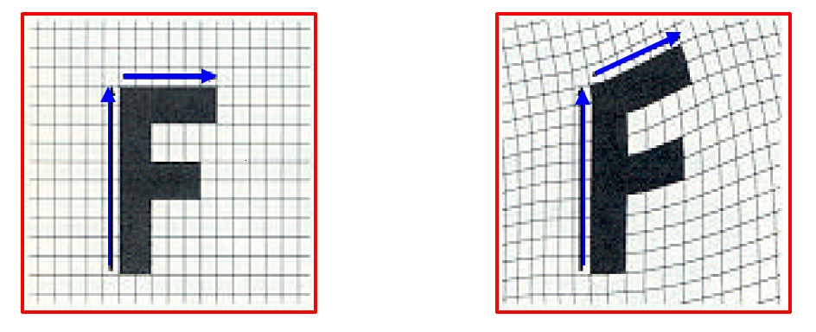
Resulting warp

Slide 54
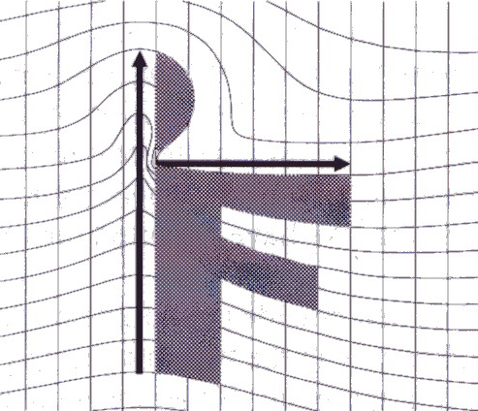
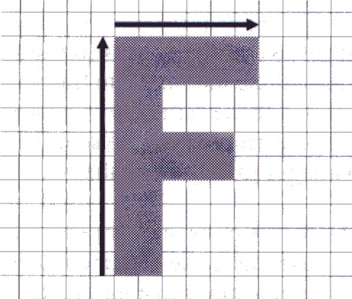
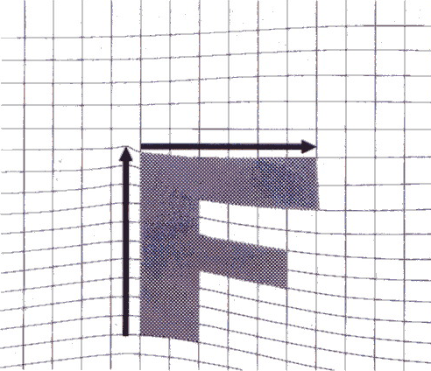
Comparison to mesh morphing
Pros: more expressive
Cons: speed and control

Slide 55
Warp interpolation
How do we create an intermediate warp at time t?
  linear interpolation for line end-points
  But, a line rotating 180 degrees will become 0 length in the middle
  One solution is to interpolate line mid-point and orientation angle
t=0
t=1

Slide 56
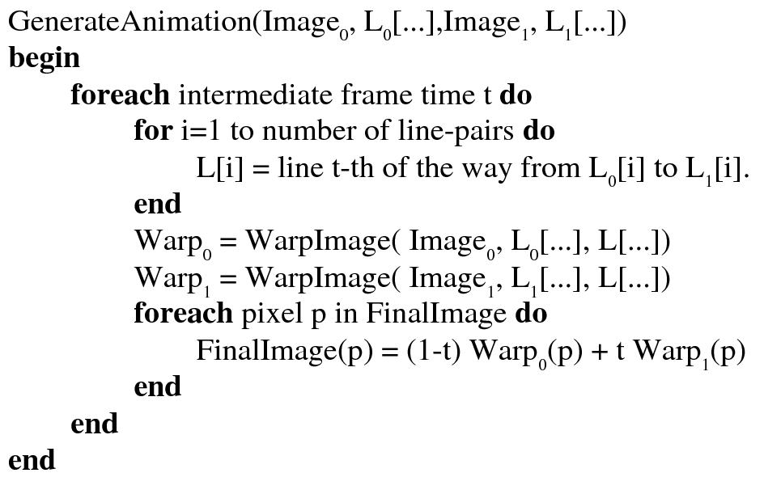
Animation

Slide 57
Animated sequences
Specify keyframes and interpolate the lines for the inbetween frames
Require a lot of tweaking

Slide 58

Results
Michael Jackson’s MTV “Black or White”

Slide 59

Multi-source morphing

Slide 60

Multi-source morphing

Slide 61


As-Rigid-As-Possible Shape Manipulation
Notes:
http://www-ui.is.s.u-tokyo.ac.jp/~takeo/research/rigid/index.html

Slide 62
References
Thaddeus Beier, Shawn Neely, Feature-Based Image Metamorphosis, SIGGRAPH 1992, pp35-42.
Detlef Ruprecht, Heinrich Muller, Image Warping with Scattered Data Interpolation, IEEE Computer Graphics and Applications, March 1995, pp37-43.
Seung-Yong Lee, Kyung-Yong Chwa, Sung Yong Shin, Image Metamorphosis Using Snakes and Free-Form Deformations, SIGGRAPH 1995.
Seungyong Lee, Wolberg, G., Sung Yong Shin, Polymorph: morphing among multiple images, IEEE Computer Graphics and Applications, Vol. 18, No. 1, 1998, pp58-71.
Peinsheng Gao, Thomas Sederberg, A work minimization approach to image morphing, The Visual Computer, 1998, pp390-400.
George Wolberg, Image morphing: a survey, The Visual Computer, 1998, pp360-372.

