Slide 1
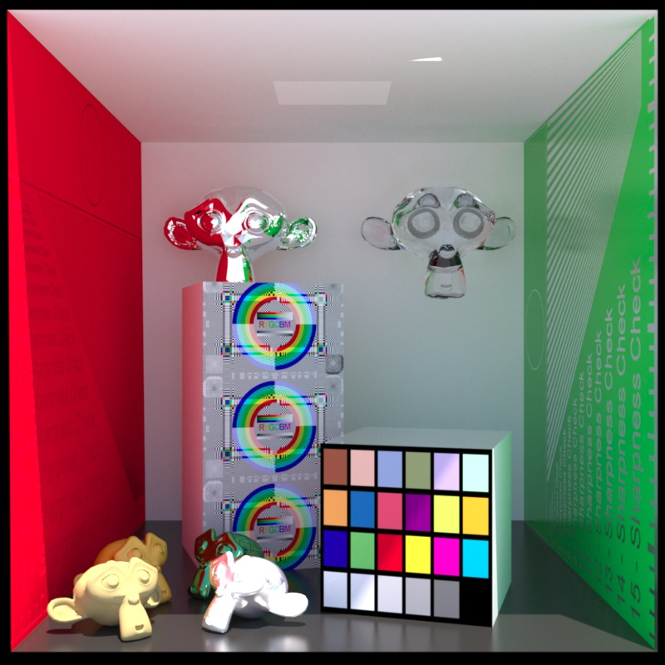
Computer Graphics
Image processing
紀明德 mtchi@cs.nccu.edu.tw
Department of Computer Science,
National Chengchi University
Notes:
2016

Slide 2
Outlines
Color space
Filter
  Low / high pass filter
  Space / frequency domain
  Hybrid images

Slide 3
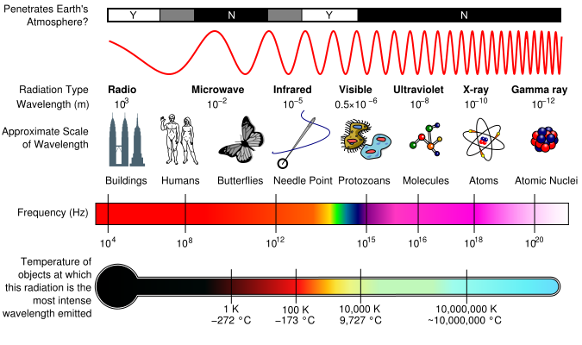
Electromagnetic spectrum
Notes:
http://en.wikipedia.org/wiki/Electromagnetic_spectrum

Slide 4

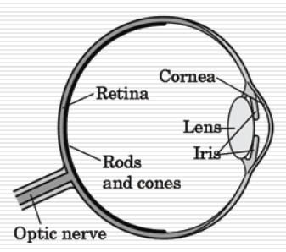
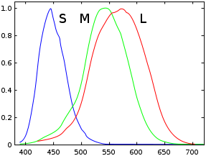
Three-Color Theory
Human visual system has two types of sensors
  Rods: monochromatic, night vision􀂄
  Cones􀂆
    Color sensitive􀂆
    Three types of cone􀂆
    Only three values (the tristimulusvalues) are sent to the brain

Slide 5
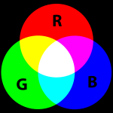

Additive / Subtractive color
Y
M
C

Slide 6
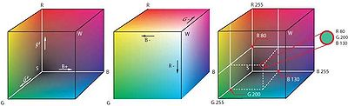
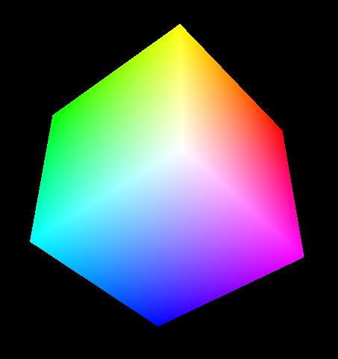
RGB color space
Green
Black
(0, 0, 0)
Red
Blue

Slide 7
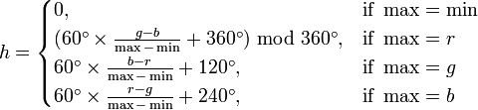

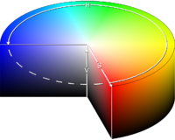
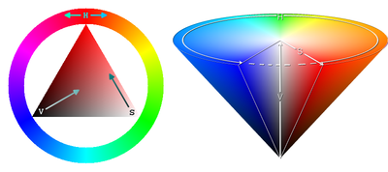
HSV color space
HSV
  hue,
  Saturation,
  Value,
HSV
UI

Slide 8
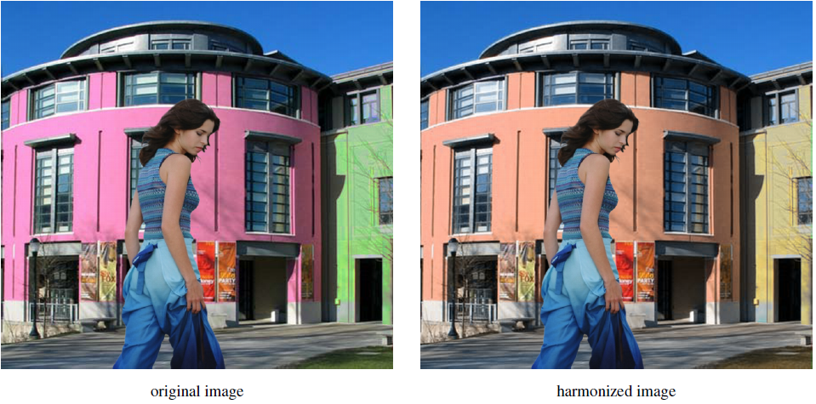
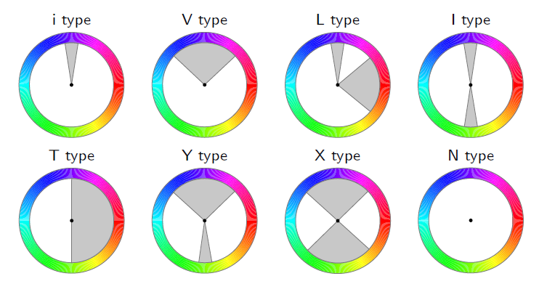
Color Harmonization
SIGGRAPH 2006
Harmonic templates on the hue wheel.

Slide 9
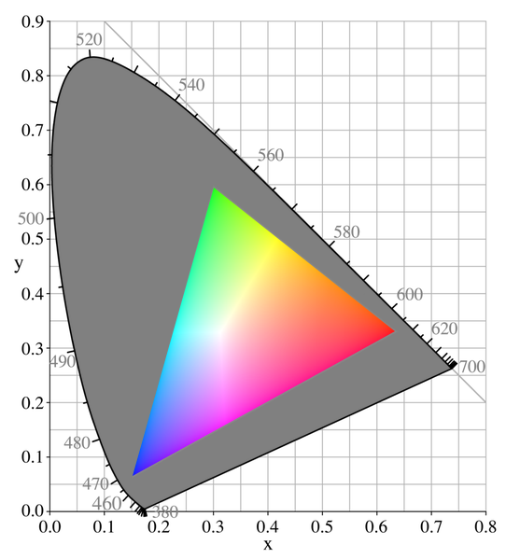
Gamut
a certain complete subset of colors.
the subset of colors which can be accurately represented in a given circumstance.

Slide 10
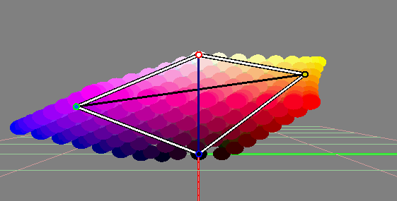
CIELAB color space
Perception uniform
L
a
b

Slide 11
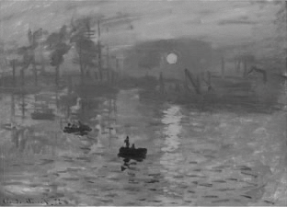
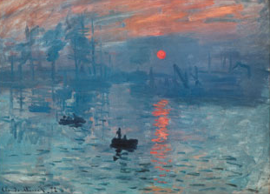
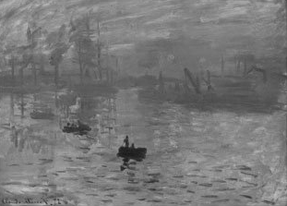
New Algorithm
Color
Grayscale

Slide 12




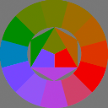



Color2Gray: Salience-Preserving Color Removal siggraph 2005
Photoshop
Grey
Color2Grey
+ Color
Original
Color2Grey

Slide 13

brightness contrast

Slide 14
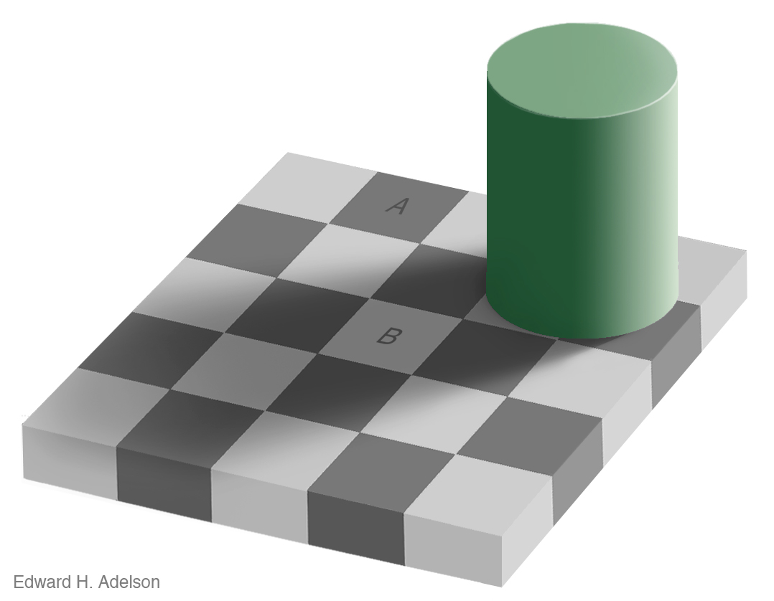
Checker shadow Illusion

Slide 15
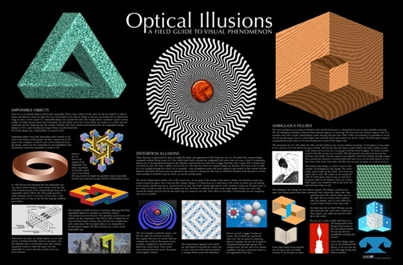

Slide 16
Image PRE-PROcessing
Filter

Slide 17
Low-pass filter
  Smoothing, denoise
High-pass filter
  Gradient operators, edge detection

Slide 18
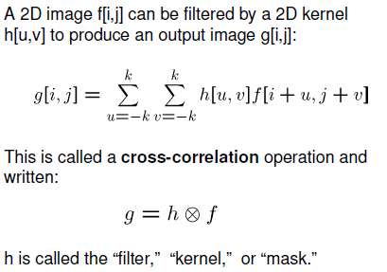
convolution

Slide 19
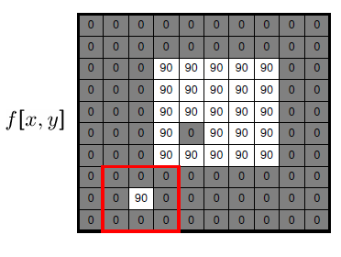
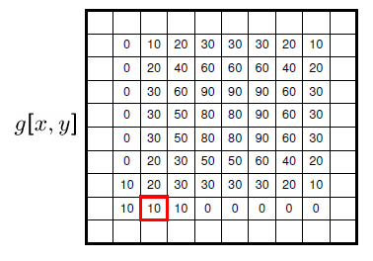
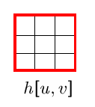
Low-pass filter
Mean filter

Slide 20
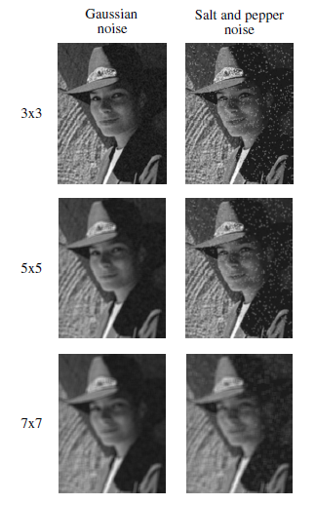
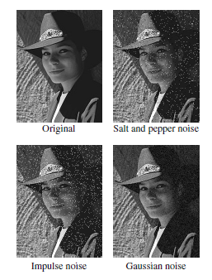

Slide 21
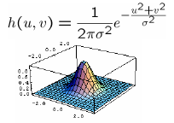
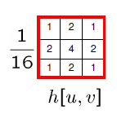
Gaussian Filtering

Slide 22
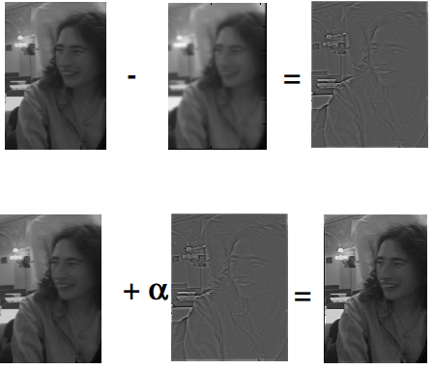
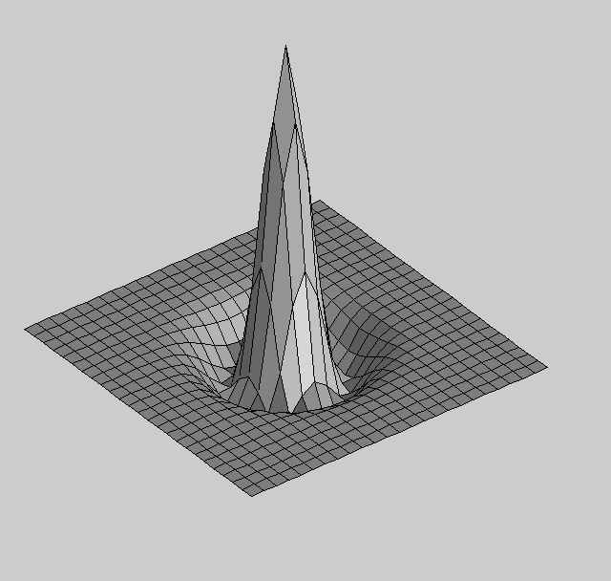
Unsharp Masking

Slide 23
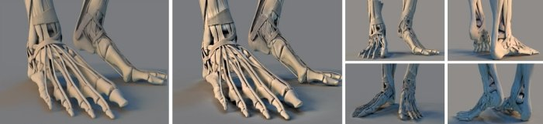
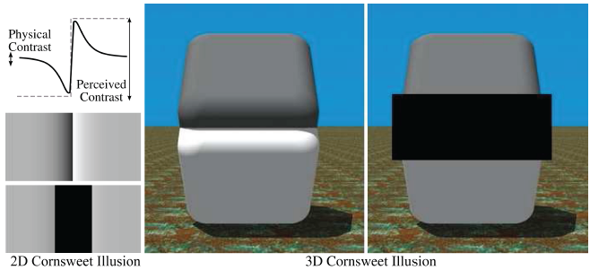
3D Unsharp Masking for Scene Coherent Enhancement
SIGGRAPH '08

Slide 24
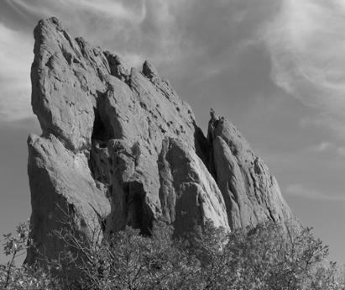

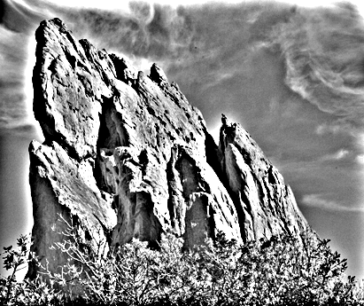
Naïve Approach: Gaussian Blur
BLUR
HALOS
smoothed
(structure, large scale)
residual
(texture, small scale)
input
Gaussian Convolution

Slide 25
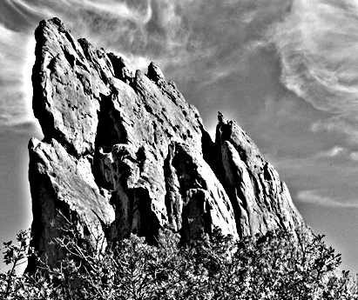
Impact of Blur and Halos
If the decomposition introduces blur and halos, the final result is corrupted.
Sample manipulation:
increasing texture
(residual × 3)

Slide 26
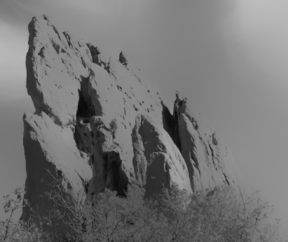
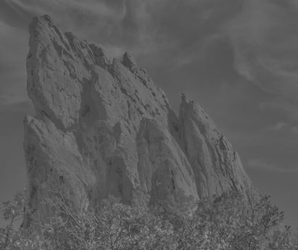
Bilateral Filter: no Blur, no Halos
smoothed
(structure, large scale)
residual
(texture, small scale)
input
edge-preserving: Bilateral Filter

Slide 27


Bilateral Filter Definition: an Additional Edge Term
Same idea: weighted average of pixels.
new
not new
new
normalization
factor
space weight
range weight
I

Slide 28
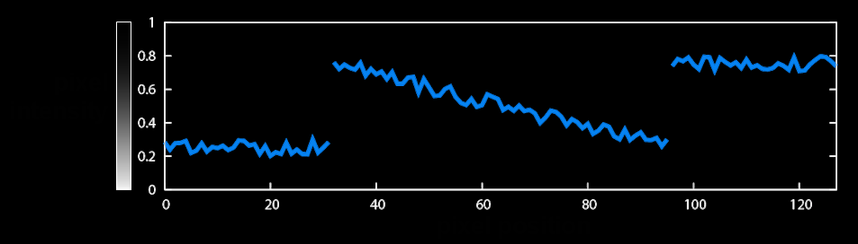
Illustration a 1D Image
1D image = line of pixels
Better visualized as a plot
pixel
intensity
pixel position

Slide 29
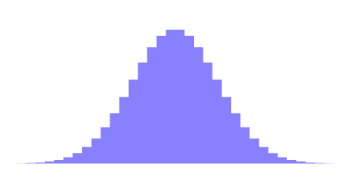

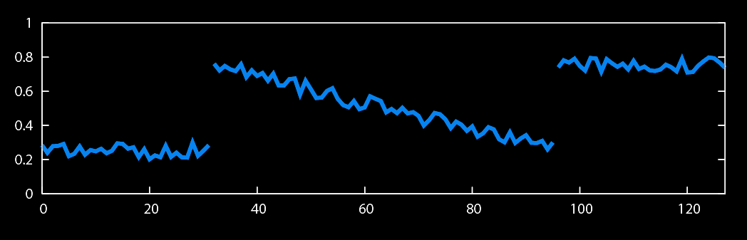
Gaussian Blur and Bilateral Filter
Gaussian blur
p
q
space
space
Bilateral filter
[Aurich 95, Smith 97, Tomasi 98]
p
range
q
space
range
normalization
space

Slide 30
Differentiation and convolution
Recall
Now this is linear and shift invariant, so must be the result of a convolution.
We could approximate this as
(which is obviously a convolution; it’s not a very good way to do things, as we shall see)
Notes:
I tend not to prove “Now this is linear and shift invariant, so must be the result of a convolution” but
leave it for people to look up in the chapter.

Slide 31

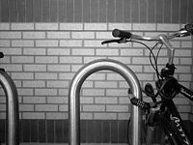
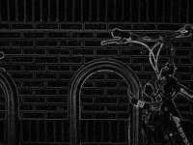


High-pass filter
Sobel operator

Slide 32
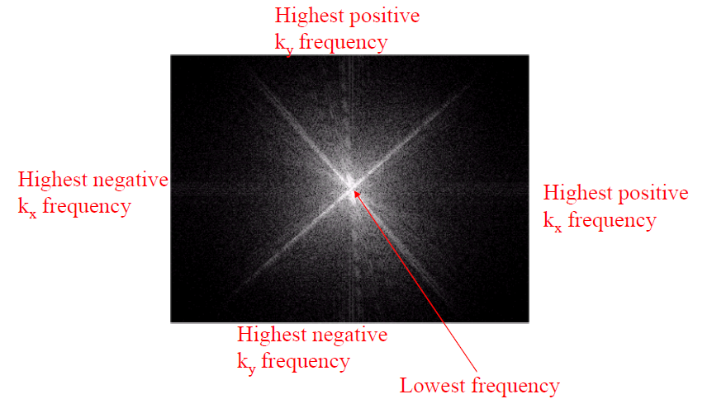
The Fourier space image

Slide 33
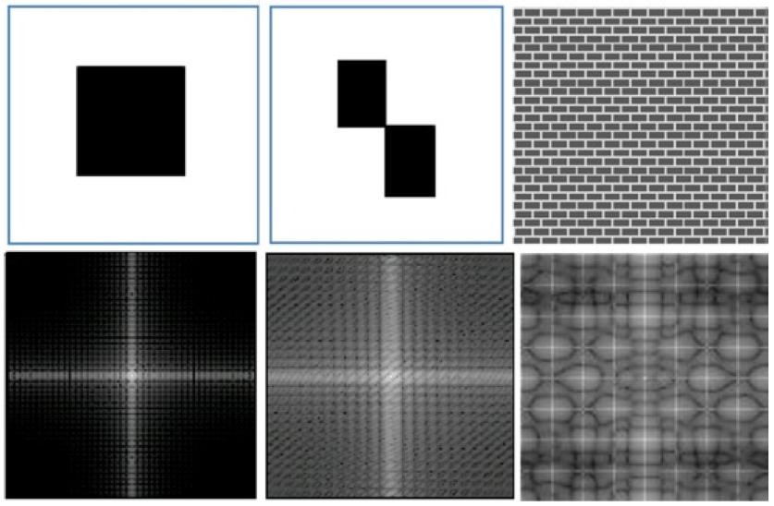

Slide 34
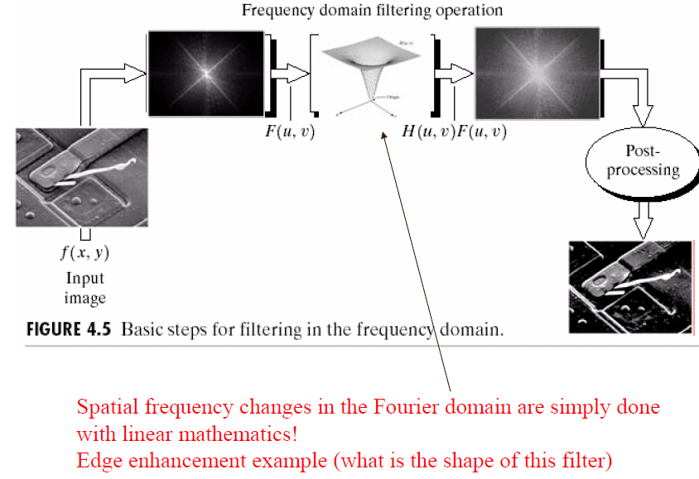
Fourier space filtering

Slide 35
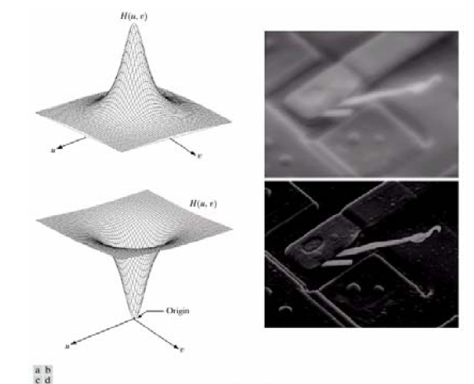
Fourier space filtering

Slide 36
Hybrid Images siggraph 06

Slide 37
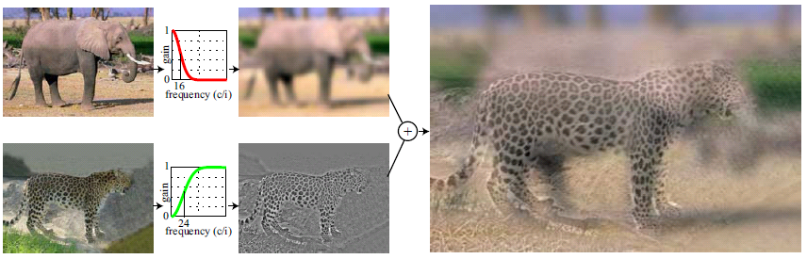



Hybrid Images

Slide 38

Opacity and Transparency
Opaque surfaces permit no light to pass through
Transparent surfaces permit all light to pass
Translucent surfaces pass some light
translucency = 1 – opacity (α)
opaque surface α =1

Slide 39
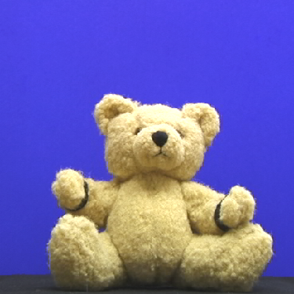
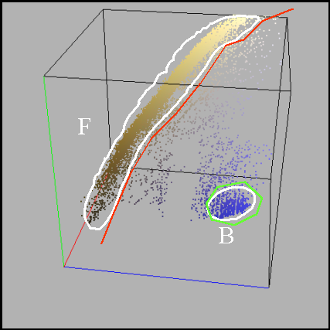
Chroma-keying (Primatte)

Slide 40
Blending
glBlendFunc(Glenum S, Glenum D);
  Cf = (Cs*S) + (Cd*D)
glBlendFunc(GL_SRC_ALPHA, GL_ONE_MINUS_SRC_ALPHA);

Slide 41
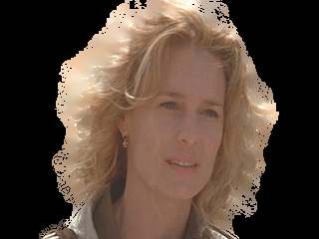




Compositing
F
α
B
foreground color
alpha matte
background plate
composite
C
F
C
compositing
equation
α=0
B
Notes:
We first look at how conventional compositing is done.
During composting, given a foreground element including the foregound color F and an opacity image called alpha matte, and the background B, the composte C is computed by the composting equation shown here.
Here, alpha matte acts like a switch to select foregound if it is white, background if it is black.
Most importantly, it is soft around the boundaries. The fractional alpha describe how much foreground and how much background should be taken. A soft alpha matte is very important for seamless composite.

Slide 42
Compositing
F
α
B
composite
C
F
compositing
equation
C
α=1
B
Notes:
We first look at how conventional compositing is done.
During composting, given a foreground element including the foregound color F and an opacity image called alpha matte, and the background B, the composte C is computed by the composting equation shown here.
Here, alpha matte acts like a switch to select foregound if it is white, background if it is black.
Most importantly, it is soft around the boundaries. The fractional alpha describe how much foreground and how much background should be taken. A soft alpha matte is very important for seamless composite.

Slide 43

Order Dependency
Is this image correct?
  Probably not
  Polygons are rendered
  in the order they pass
  down the pipeline
  Blending functions
  are order dependent

Slide 44
Deferred Shading
A shading algorithm is calculated by dividing it into smaller parts that are written to intermediate buffer storage to be combined later, instead of immediately writing the shader result to the color framebuffer.

Slide 45




Deferred Shading in Killzone2
Notes:
http://game.watch.impress.co.jp/docs/series/3dcg/20090417_125909.html

Slide 46





