Slide 1
Computer Graphics
Viewing and Projection
Notes:
2016

Slide 2
Classical Viewing

Slide 3
Objectives
Introduce the classical views
Compare and contrast image formation by computer with how images have been formed by architects, artists, and engineers
Learn the benefits and drawbacks of each type of view

Slide 4
Classical Viewing
Viewing requires three basic elements
  One or more objects
  A viewer with a projection surface
  Projectors that go from the object(s) to the projection surface
Classical views are based on the relationship among these elements
  The viewer picks up the object and orients it how she would like to see it
Each object is assumed to constructed from flat principal faces
  Buildings, polyhedra, manufactured objects

Slide 5
Planar Geometric Projections
Standard projections project onto a plane
Projectors are lines that either
  converge at a center of projection
  are parallel
Such projections preserve lines
  but not necessarily angles
Nonplanar projections are needed for applications such as map construction

Slide 6
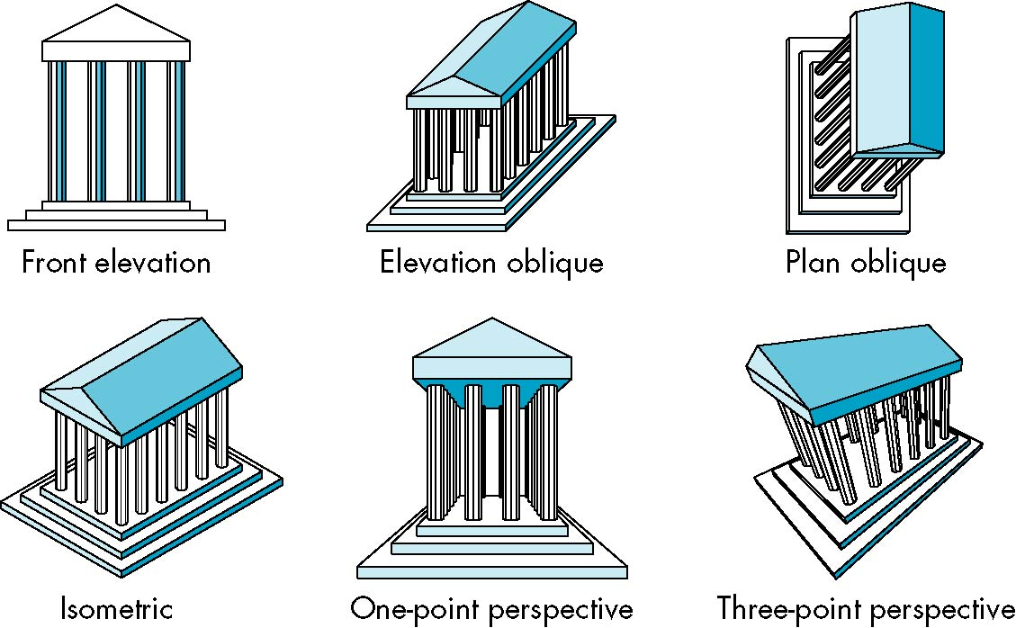
Classical Projections

Slide 7
Perspective vs Parallel
Computer graphics treats all projections the same and implements them with a single pipeline
Classical viewing developed different techniques for drawing each type of projection
Fundamental distinction is between parallel and perspective viewing even though mathematically parallel viewing is the limit of perspective viewing

Slide 8
Taxonomy of Planar Geometric Projections
planar geometric projections
parallel
perspective
1 point
2 point
3 point
multiview
orthographic
axonometric
oblique
isometric
dimetric
trimetric

Slide 9
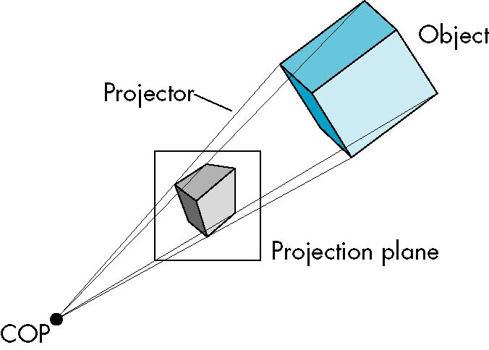
Perspective Projection

Slide 10
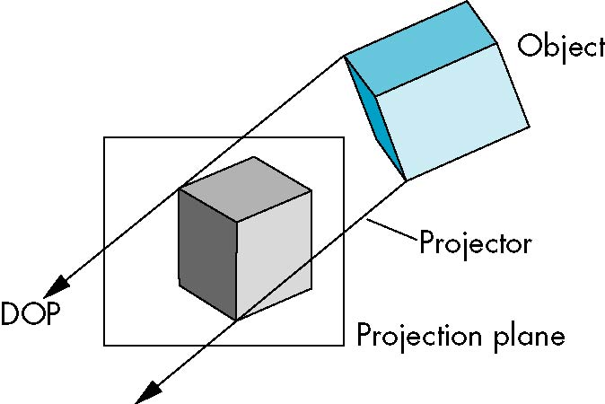
Parallel Projection

Slide 11
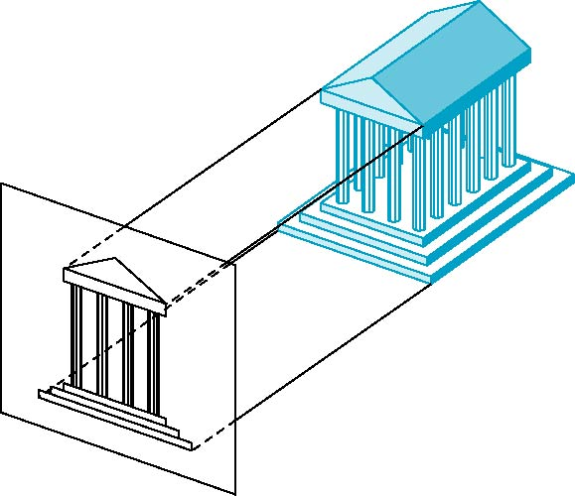
Orthographic Projection
Projectors are orthogonal to projection surface

Slide 12

Multiview Orthographic Projection
Projection plane parallel to principal face
Usually form front, top, side views
isometric (not multiview
orthographic view)
front
in CAD and architecture,
we often display three
multiviews plus isometric
side
top

Slide 13
Advantages and Disadvantages
Preserves both distances and angles
  Shapes preserved
  Can be used for measurements
    Building plans
    Manuals
Cannot see what object really looks like because many surfaces hidden from view
  Often we add the isometric

Slide 14
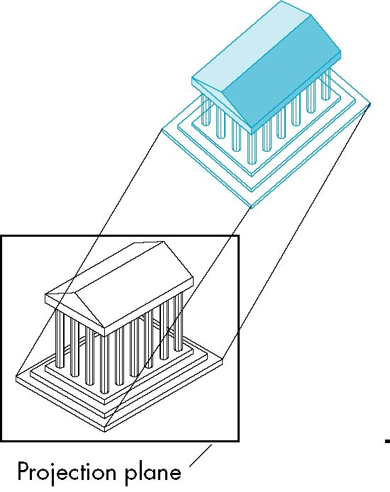
Axonometric Projections
Allow projection plane to move relative to object
classify by how many angles of
a corner of a projected cube are
the same
none: trimetric
two: dimetric
three: isometric
θ ₁
θ ₂
θ ₃

Slide 15
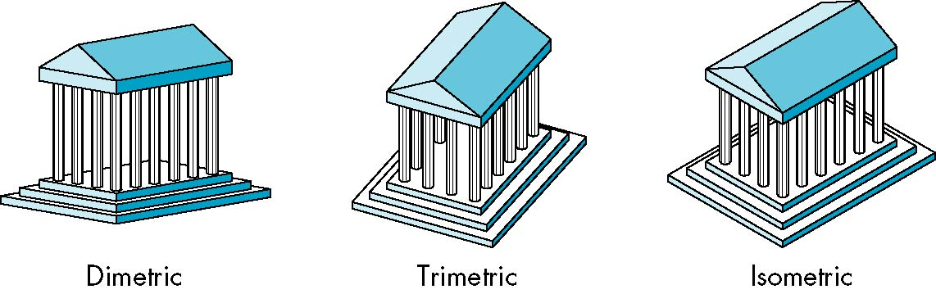
Types of Axonometric Projections

Slide 16
Advantages and Disadvantages
Lines are scaled (foreshortened) but can find scaling factors
Lines preserved but angles are not
  Projection of a circle in a plane not parallel to the projection plane is an ellipse
Can see three principal faces of a box-like object
Some optical illusions possible
  Parallel lines appear to diverge
Does not look real because far objects are scaled the same as near objects
Used in CAD applications

Slide 17
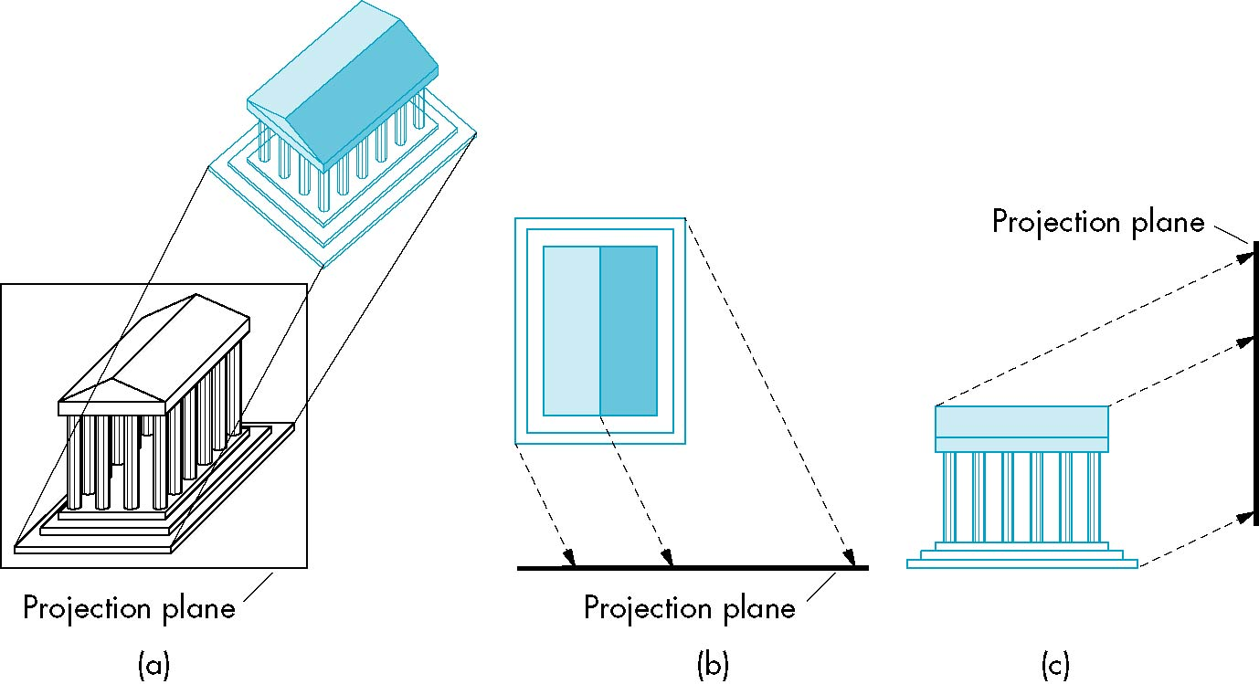
Oblique Projection
Arbitrary relationship between projectors and projection plane

Slide 18
Advantages and Disadvantages
Can pick the angles to emphasize a particular face
  Architecture: plan oblique, elevation oblique
Angles in faces parallel to projection plane are preserved while we can still see “around” side
In physical world, cannot create with simple camera; possible with bellows camera or special lens (architectural)

Slide 19
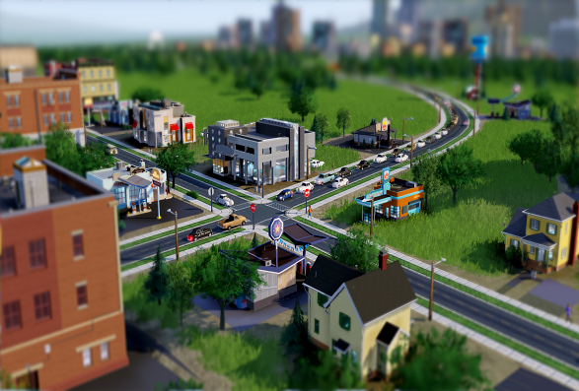
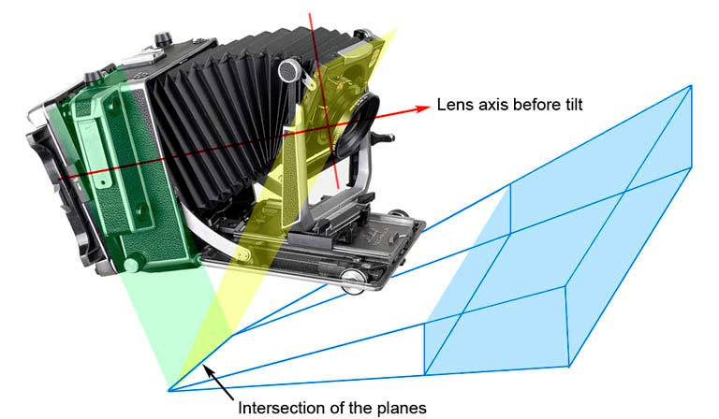
Tilt–shift photography
(photo by http://www.luminous-landscape.com/tutorials/focusing-ts.shtml)
Simcity EA

Slide 20
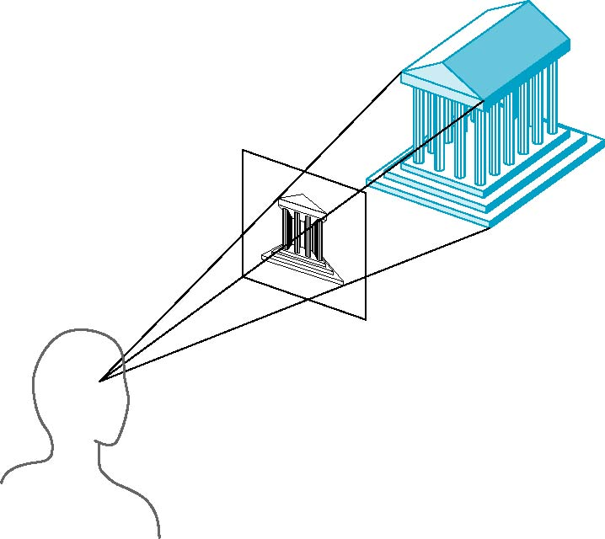
Perspective Projection
Projectors coverge at center of projection

Slide 21
Vanishing Points
Parallel lines (not parallel to the projection plan) on the object converge at a single point in the projection (the vanishing point)
Drawing simple perspectives by hand uses these vanishing point(s)
vanishing point

Slide 22
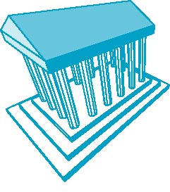
Three-Point Perspective
No principal face parallel to projection plane
Three vanishing points for cube

Slide 23
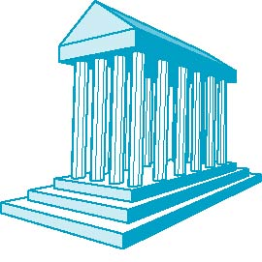
Two-Point Perspective
On principal direction parallel to projection plane
Two vanishing points for cube

Slide 24
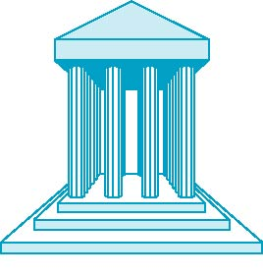
One-Point Perspective
One principal face parallel to projection plane
One vanishing point for cube

Slide 25
Advantages and Disadvantages
Objects further from viewer are projected smaller than the same sized objects closer to the viewer (diminution)
  Looks realistic
Equal distances along a line are not projected into equal distances (nonuniform foreshortening)
Angles preserved only in planes parallel to the projection plane
More difficult to construct by hand than parallel projections (but not more difficult by computer)

Slide 26
Computer Viewing
Ed Angel
Professor of Computer Science, Electrical and Computer Engineering, and Media Arts
University of New Mexico

Slide 27
Objectives
Introduce the mathematics of projection
Introduce OpenGL viewing functions
Look at alternate viewing APIs

Slide 28
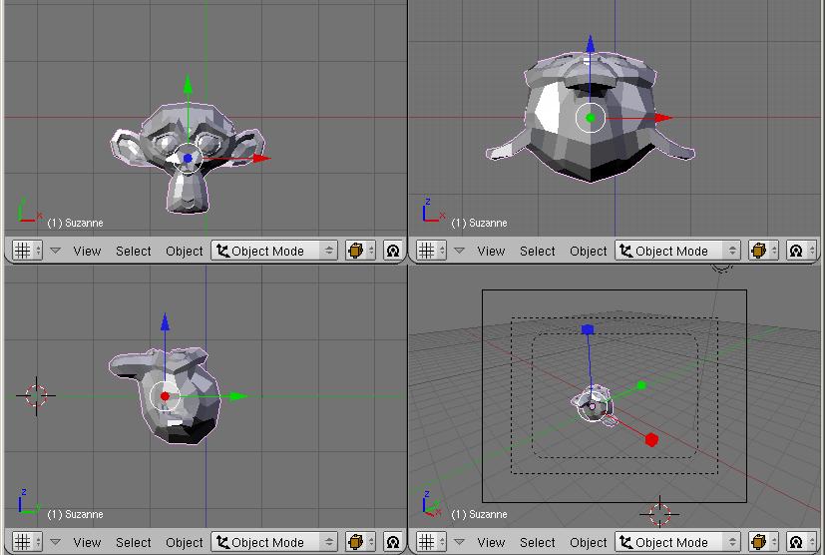

Slide 29
Computer Viewing
There are three aspects of the viewing process, all of which are implemented in the pipeline,
  Positioning the camera
    Setting the model-view matrix
  Selecting a lens
    Setting the projection matrix
  Clipping
    Setting the view volume

Slide 30
The OpenGL Camera
In OpenGL, initially the object and camera frames are the same
  Default model-view matrix is an identity
The camera is located at origin and points in the negative z direction
OpenGL also specifies a default view volume that is a cube with sides of length 2 centered at the origin
  Default projection matrix is an identity

Slide 31
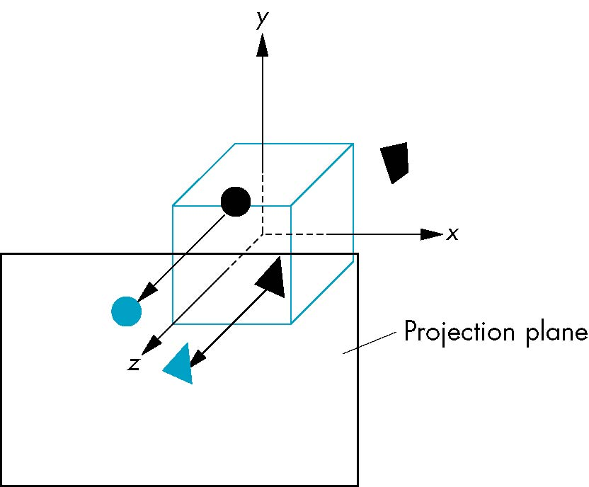
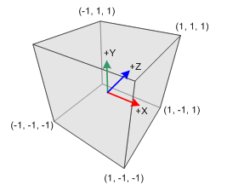
Default Projection
Default projection is orthogonal
clipped out
2
z=0
Notes:
http://www.songho.ca/opengl/gl_projectionmatrix.html

Slide 32
Moving the Camera Frame
If we want to visualize object with both positive and negative z values we can either
  Move the camera in the positive z direction
    Translate the camera frame
  Move the objects in the negative z direction
    Translate the world frame
Both of these views are equivalent and are determined by the model-view matrix
  Want a translation (glTranslatef(0.0,0.0,-d);)
  d > 0

Slide 33
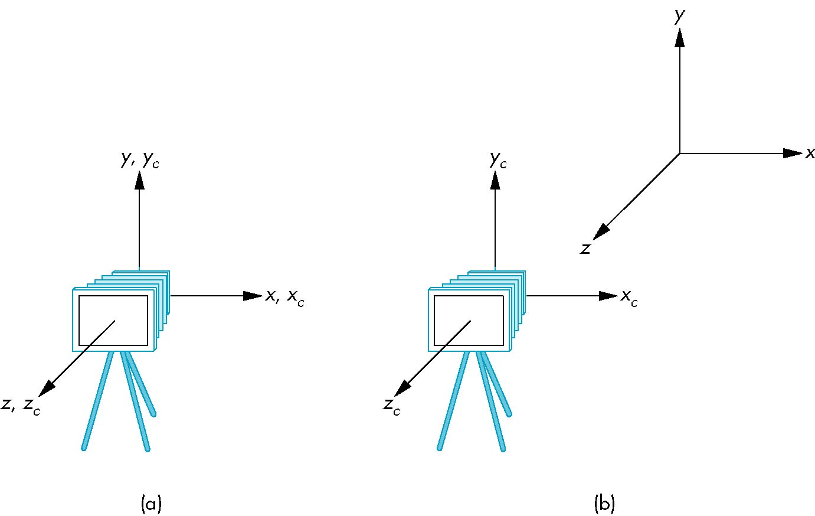
Moving Camera back from Origin
frames after translation by –d
d > 0
default frames

Slide 34
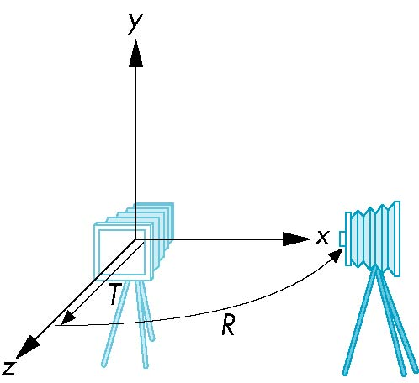
Moving the Camera
We can move the camera to any desired position by a sequence of rotations and translations
Example: side view
  Rotate the camera
  Move it away from origin
  Model-view matrix C = TR

Slide 35
OpenGL code
Remember that last transformation specified is first to be applied
glMatrixMode(GL_MODELVIEW)
glLoadIdentity();
glTranslatef(0.0, 0.0, -d);
glRotatef(90.0, 0.0, 1.0, 0.0);

Slide 36
The LookAt Function
The GLU library contains the function gluLookAt to form the required modelview matrix through a simple interface
Note the need for setting an up direction
Still need to initialize
  Can concatenate with modeling transformations
Example: isometric view of cube aligned with axes
glMatrixMode(GL_MODELVIEW):
glLoadIdentity();
gluLookAt(1.0, 1.0, 1.0, 0.0, 0.0, 0.0, 0., 1.0. 0.0);

Slide 37
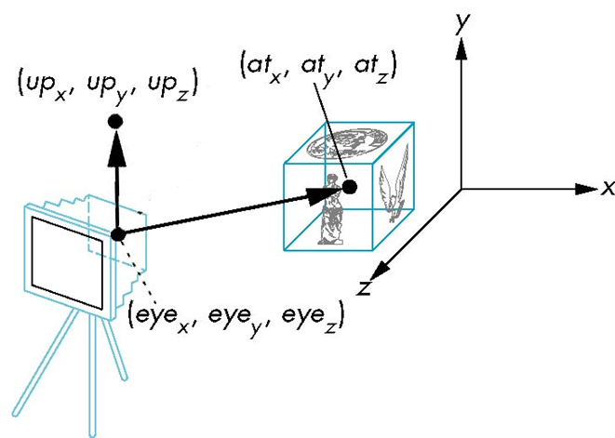
gluLookAt
gluLookAt(eyex, eyey, eyez, atx, aty, atz, upx, upy, upz)

Slide 38
Other Viewing APIs
The LookAt function is not only one possible API for positioning the camera
Others include
  View reference point, view plane normal, view up (PHIGS, GKS-3D)
  Yaw, pitch, roll
  Elevation, azimuth, twist
  Direction angles

Slide 39
Projections Basic

Slide 40
Projections and Normalization
The default projection in the eye (camera) frame is orthogonal
For points within the default view volume
Most graphics systems use view normalization
  All other views are converted to the default view by transformations that determine the projection matrix
  Allows use of the same pipeline for all views
x_{p} = x
y_{p} = y
z_{p} = 0

Slide 41
Homogeneous Coordinate Representation
default orthographic projection
x_{p} = x
y_{p} = y
z_{p} = 0
w_{p} = 1
p_{p} = Mp
M =
In practice, we can let M = I and set
the z term to zero later

Slide 42
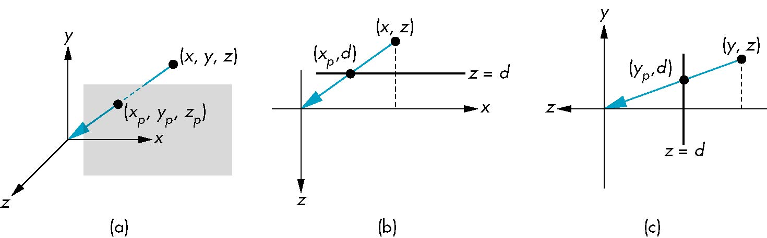
Simple Perspective
Center of projection at the origin
Projection plane z = d, d < 0

Slide 43
Perspective Equations
Consider top and side views
x_{p} =
y_{p} =
z_{p} = d

Slide 44
Homogeneous Coordinate Form
consider q = Mp where
M =
q =
⇒ p =

Slide 45
Perspective Division
However w ≠ 1, so we must divide by w to return from homogeneous coordinates
This perspective division yields
the desired perspective equations
We will consider the corresponding clipping volume with the OpenGL functions
x_{p} =
y_{p} =
z_{p} = d

Slide 46
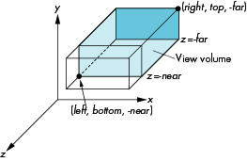
OpenGL Orthogonal Viewing
glOrtho(left,right,bottom,top,near,far)
near and far measured from camera

Slide 47
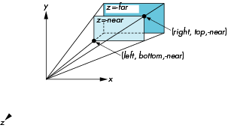
OpenGL Perspective
glFrustum(left,right,bottom,top,near,far)

Slide 48
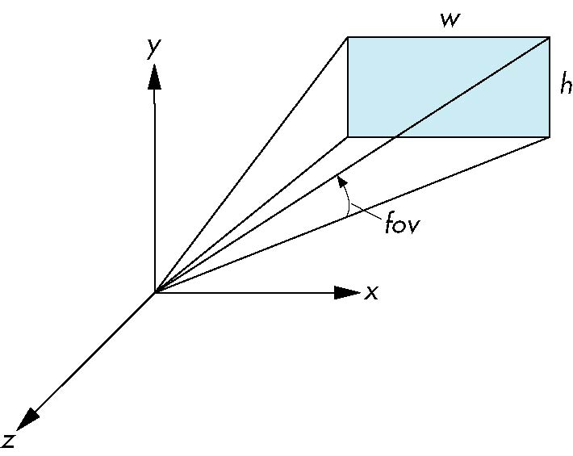
Using Field of View
With glFrustum it is often difficult to get the desired view
gluPerpective(fovy, aspect, near, far) often provides a better interface
front plane
aspect = w/h

Slide 49
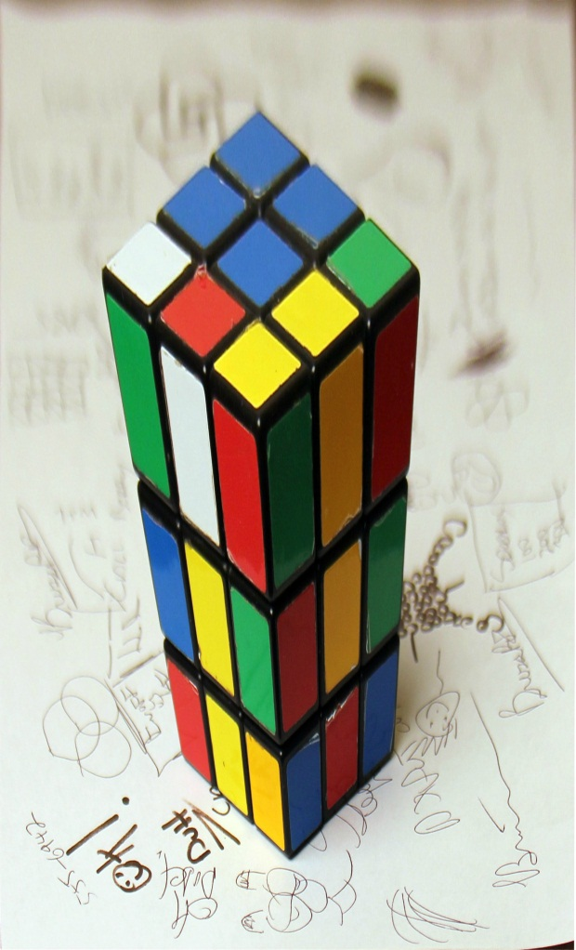
Amazing Anamorphic Illusions!
Notes:
https://www.youtube.com/watch?NR=1&v=tBNHPk-Lnkk&feature=endscreen

Slide 50
Projection Matrices

Slide 51
Objectives
Derive the projection matrices used for standard OpenGL projections
Introduce oblique projections
Introduce projection normalization

Slide 52
Normalization
Rather than derive a different projection matrix for each type of projection, we can convert all projections to orthogonal projections with the default view volume
This strategy allows us to use standard transformations in the pipeline and makes for efficient clipping

Slide 53
Pipeline View
modelview
transformation
projection
transformation
perspective
division
4D → 3D
Non-singular
clipping
projection
3D → 2D
against default cube

Slide 54
Notes
We stay in four-dimensional homogeneous coordinates through both the modelview and projection transformations
  Both these transformations are nonsingular
  Default to identity matrices (orthogonal view)
Normalization lets us clip against simple cube regardless of type of projection
Delay final projection until end
  Important for hidden-surface removal to retain depth information as long as possible

Slide 55
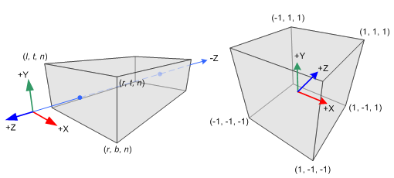
Orthogonal Normalization
glOrtho(left,right,bottom,top,near,far)
normalization ⇒ find transformation to convert
specified clipping volume to default

Slide 56
Orthogonal Matrix
Two steps
  Translate from center to origin
    T(-(right+left)/2, -(top+bottom)/2, -(far+near)/2))
  Scale to have sides of length 2
    S( 2/(right-left), 2/(top-bottom), -2/(far-near) )

Slide 57
Final Projection
Set z =0
Equivalent to the homogeneous coordinate transformation
Hence, general orthogonal projection in 4D is
M_{orth} =
P = M_{orth}ST

Slide 58
Oblique Projections
The OpenGL projection functions cannot produce general parallel projections such as
However if we look at the example of the cube it appears that the cube has been sheared
Oblique Projection = Shear + Orthogonal Projection

Slide 59
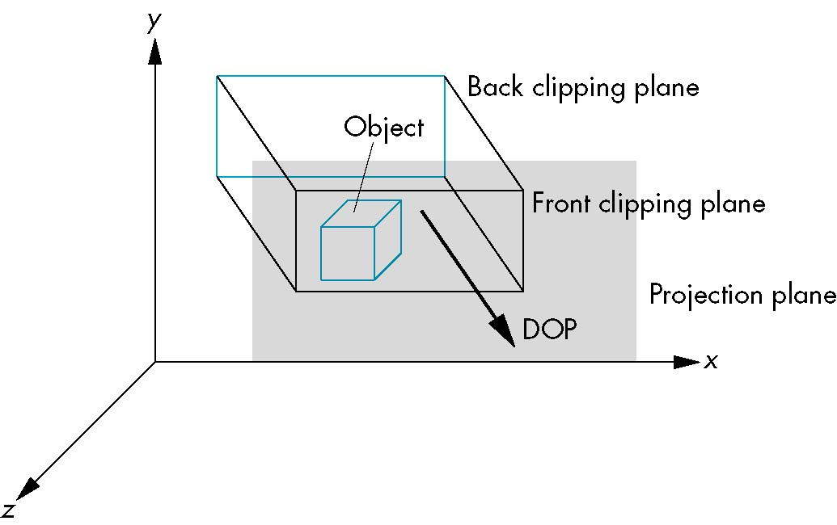
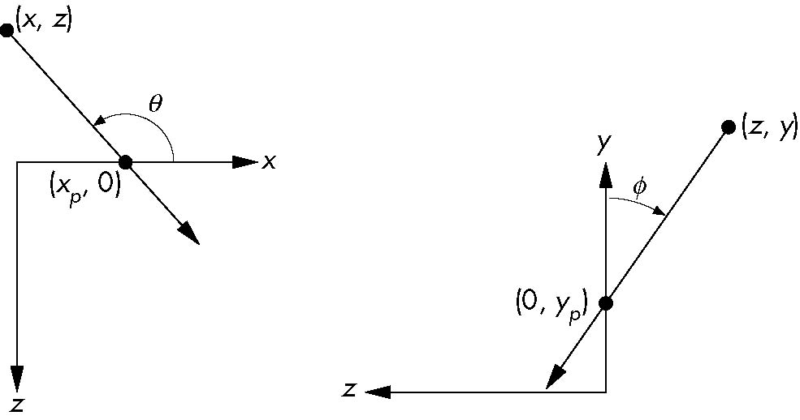
General Shear
top view
side view

Slide 60
Shear Matrix
xy shear (z values unchanged)
Projection matrix
General case:
H(θ,φ) =
P = M_{orth} H(θ,φ)
P = M_{orth} STH(θ,φ)

Slide 61
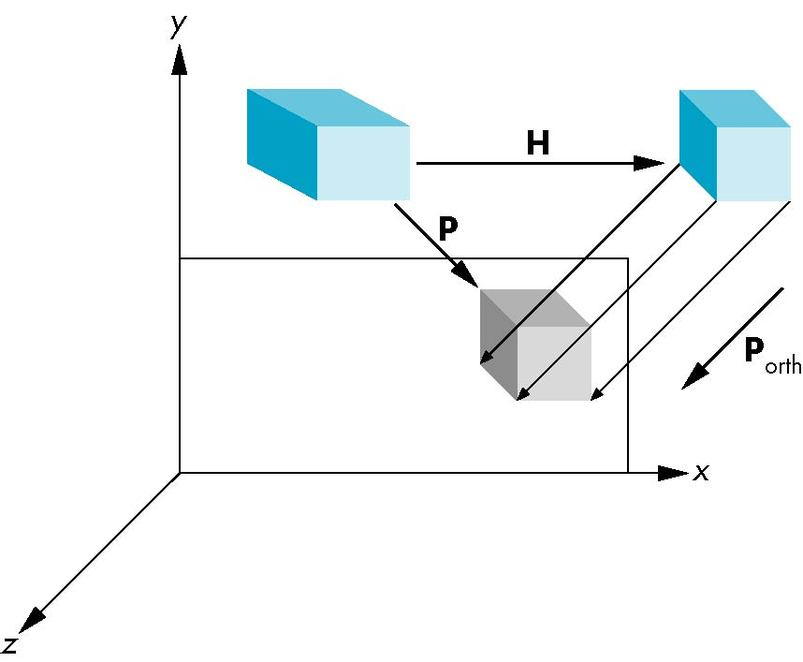
Equivalency

Slide 62
Effect on Clipping
The projection matrix P = STH transforms the original clipping volume to the default clipping volume
object
top view
z = 1
DOP
DOP
x = -1
x = 1
far plane
z = -1
clipping
volume
distorted object
(projects correctly)
near plane
Notes:
DOP = Direction of Projection

Slide 63
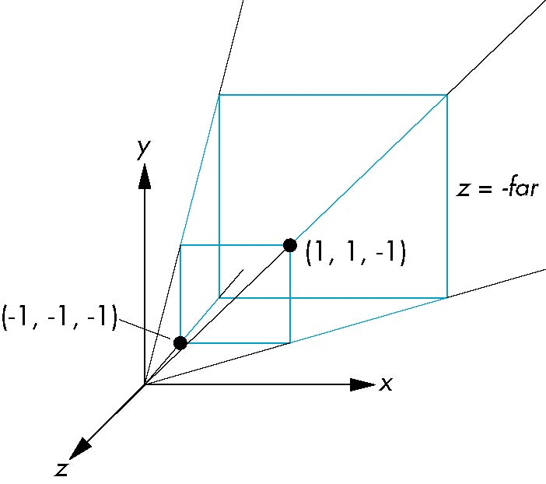
Simple Perspective
Consider a simple perspective with the COP at the origin, the near clipping plane at z = -1, and a 90 degree field of view determined by the planes
x = ± z, y = ± z
Notes:
COP = Center of Projection

Slide 64
Perspective Matrices
Simple projection matrix in homogeneous coordinates
Note that this matrix is independent of the far clipping plane
M =
Notes:
Assume the projection plane at z = -1;

Slide 65
Generalization
N =
after perspective division, the point (x, y, z, 1) goes to
x’’ = -x/z
y’’ = -y/z
Z’’ = -(α+β/z)
which projects orthogonally to the desired point
regardless of α and β

Slide 66
Picking α and β
If we pick
the near plane is mapped to z = -1
the far plane is mapped to z =1
and the sides are mapped to x = ± 1, y = ± 1
Hence the new clipping volume is the default clipping volume
Notes:
Both nearVal and farVal must be positive.
http://www.opengl.org/sdk/docs/man/xhtml/glFrustum.xml
http://www.opengl.org/sdk/docs/man/xhtml/gluPerspective.xml

Slide 67
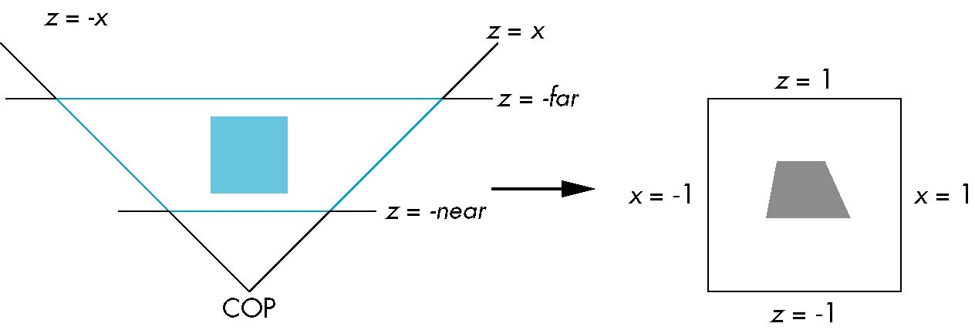
Normalization Transformation
distorted object
projects correctly
original clipping
volume
original object
new clipping
volume

Slide 68
Normalization and Hidden-Surface Removal
Although our selection of the form of the perspective matrices may appear somewhat arbitrary, it was chosen so that if z₁ > z₂ in the original clipping volume then the for the transformed points z₁’ > z₂’
Thus hidden surface removal works if we first apply the normalization transformation
However, the formula z’’ = -(α+β/z) implies that the distances are distorted by the normalization which can cause numerical problems especially if the near distance is small

Slide 69
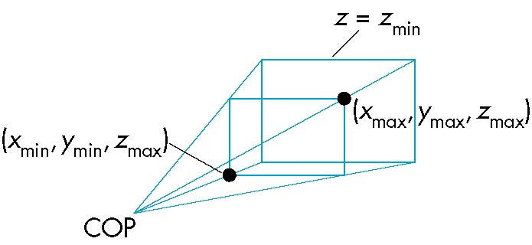
OpenGL Perspective
glFrustum allows for an unsymmetric viewing frustum (although gluPerspective does not)

Slide 70
OpenGL Perspective Matrix
The normalization in glFrustum requires an initial shear to form a right viewing pyramid, followed by a scaling to get the normalized perspective volume. Finally, the perspective matrix results in needing only a final orthogonal transformation
P = NSH
our previously defined
perspective matrix
shear and scale

Slide 71
Why do we do it this way?
Normalization allows for a single pipeline for both perspective and orthogonal viewing
We stay in four dimensional homogeneous coordinates as long as possible to retain three-dimensional information needed for hidden-surface removal and shading
We simplify clipping

Slide 72
Building Models

Slide 73
Objectives
Introduce simple data structures for building polygonal models
  Vertex lists
  Edge lists
OpenGL vertex arrays

Slide 74
Representing a Mesh
Consider a mesh
There are 8 nodes and 12 edges
  5 interior polygons
  6 interior (shared) edges
Each vertex has a location v_{i} = (x_{i} y_{i} z_{i})
e₂
v₅
v₆
e₉
e₃
e₈
v₈
v₄
e₁
e₁₁
e₁₀
e₇
v₇
e₄
v₁
e₁₂
e₆
v₂
v₃
e₅

Slide 75
3D model format
SIMPLE
Triangle
vertex1_X vertex1_Y vertex1_Z normal1_X normal1_Y normal1_Z
vertex2_X vertex2_Y vertex2_Z normal2_X normal2_Y normal2_Z
vertex3_X vertex3_Y vertex3_Z normal3_X normal3_Y normal3_Z
COLOR
Triangle
frontcolor_R frontcolor_G frontcolor_B backcolor_R backcolor_G backcolor_B
vertex1_X vertex1_Y vertex1_Z normal1_X normal1_Y normal1_Z
vertex2_X vertex2_Y vertex2_Z normal2_X normal2_Y normal2_Z
vertex3_X vertex3_Y vertex3_Z normal3_X normal3_Y normal3_Z
Notes:
http://graphics.csie.ntu.edu.tw/~ming/courses/icg/models.html

Slide 76
Simple Representation
Define each polygon by the geometric locations of its vertices
Leads to OpenGL code such as
Inefficient and unstructured
  Consider moving a vertex to a new location
  Must search for all occurrences
glBegin(GL_POLYGON);
glVertex3f(x1, x1, x1);
glVertex3f(x6, x6, x6);
glVertex3f(x7, x7, x7);
glEnd();

Slide 77
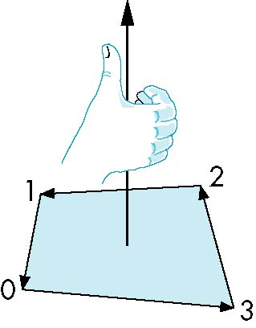
Inward and Outward Facing Polygons
The order {v₁, v₆, v₇} and {v₆, v₇, v₁} are equivalent in that the same polygon will be rendered by OpenGL but the order {v₁, v₇, v₆} is different
The first two describe outwardly
facing polygons
Use the right-hand rule =
counter-clockwise encirclement
of outward-pointing normal
OpenGL can treat inward and
outward facing polygons differently

Slide 78
Wavefront obj format
#example obj file
v -1.63326156 -3.04798102 -8.81131839
vn 0.00379090 0.40057179 0.01256634
vt 0.22390614 0.97395277
f 4/2/4 3/1/3 2/2/2 (index to v/t/n)

Slide 79
Geometry vs Topology
Generally it is a good idea to look for data structures that separate the geometry from the topology
  Geometry: locations of the vertices
  Topology: organization of the vertices and edges
  Example: a polygon is an ordered list of vertices with an edge connecting successive pairs of vertices and the last to the first
  Topology holds even if geometry changes

Slide 80
Vertex Lists
Put the geometry in an array
Use pointers from the vertices into this array
Introduce a polygon list
x₁ y₁ z₁
x₂ y₂ z₂
x₃ y₃ z₃
x₄ y₄ z₄
x₅ y₅ z_{5.}
x₆ y₆ z₆
x₇ y₇ z₇
x₈ y₈ z₈
v₁
v₇
v₆
P1
P2
P3
P4
P5
v₈
v₅
v₆
topology
geometry

Slide 81
Shared Edges
Vertex lists will draw filled polygons correctly but if we draw the polygon by its edges, shared edges are drawn twice
Can store mesh by edge list

Slide 82
Edge List
e₂
v₅
x₁ y₁ z₁
x₂ y₂ z₂
x₃ y₃ z₃
x₄ y₄ z₄
x₅ y₅ z_{5.}
x₆ y₆ z₆
x₇ y₇ z₇
x₈ y₈ z₈
v₆
e₃
e1
e2
e3
e4
e5
e6
e7
e8
e9
v1
v6
e₉
e₈
v₈
e₁
e₁₁
e₁₀
e₇
v₇
e₄
v₁
v₂
e₁₂
e₆
v₃
e₅
Note polygons are
not represented

Slide 83
Modeling a Cube
Model a color cube for rotating cube program
Define global arrays for vertices and colors
GLfloat vertices[][3] =
{{-1.0,-1.0,-1.0},{1.0,-1.0,-1.0},
{1.0,1.0,-1.0}, {-1.0,1.0,-1.0}, {-1.0,-1.0,1.0},
{1.0,-1.0,1.0}, {1.0,1.0,1.0}, {-1.0,1.0,1.0}};
GLfloat colors[][3] =
{{0.0,0.0,0.0},{1.0,0.0,0.0},
{1.0,1.0,0.0}, {0.0,1.0,0.0}, {0.0,0.0,1.0},
{1.0,0.0,1.0}, {1.0,1.0,1.0}, {0.0,1.0,1.0}};
Notes:
8 vertexs

Slide 84
Drawing a polygon from a list of indices
Draw a quadrilateral from a list of indices into the array vertices and use color corresponding to first index
void polygon(int *a, int *b, int *c , int *d)
{
glBegin(GL_POLYGON);
glColor3fv(colors[a]);
glVertex3fv(vertices[a]);
glVertex3fv(vertices[b]);
glVertex3fv(vertices[c]);
glVertex3fv(vertices[d]);
glEnd();
}

Slide 85
Draw cube from faces
void colorcube( )
{
polygon(0,3,2,1);
polygon(2,3,7,6);
polygon(0,4,7,3);
polygon(1,2,6,5);
polygon(4,5,6,7);
polygon(0,1,5,4);
}
5
6
2
1
7
4
0
3
Note that vertices are ordered so that
we obtain correct outward facing normals

Slide 86
Efficiency
The weakness of our approach is that we are building the model in the application and must do many function calls to draw the cube
Drawing a cube by its faces in the most straight forward way requires
  6 glBegin, 6 glEnd
  6 glColor
  24 glVertex
  More if we use texture and lighting

Slide 87
Vertex Arrays
OpenGL provides a facility called vertex arrays that allows us to store array data in the implementation
Six types of arrays supported
  Vertices
  Colors
  Color indices
  Normals
  Texture coordinates
  Edge flags
We will need only colors and vertices

