Slide 1
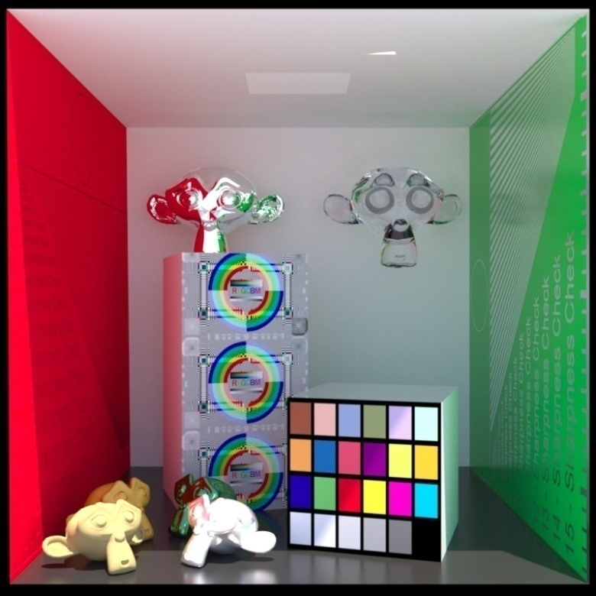
Advanced Computer Graphics
Least-Squares Solutions
Ming-Te Chi
Department of Computer Science,
National Chengchi University
Notes:
2021 acg
2020 cg
2018 acg
The image is made by LuxRender. http://www.luxrender.net/

Slide 2
Outline
Simple problem – line intersection
Line fitting
LS polynomial fits
Solving Linear systems in the LS sense
Outliners

Slide 3


intersection
$$a_{1}x+b_{1}y+c_{1}=0$$
(x, y)
$$a_{2}x+b_{2}y+c_{2}=0$$
Notes:
斜截式 slope intercept form
代數解

Slide 4
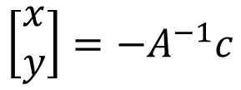

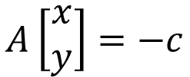
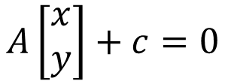
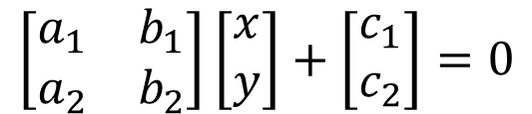

$$a_{1}x+b_{1}y+c_{1}=0$$
$$a_{2}x+b_{2}y+c_{2}=0$$
$$\left[\begin{matrix}a_{1} & b_{1} \\ a_{2} & b_{2}\end{matrix}\right]\left[\begin{matrix}x \\ y\end{matrix}\right]+\left[\begin{matrix}c_{1} \\ c_{2}\end{matrix}\right]=0$$
$$A\left[\begin{matrix}x \\ y\end{matrix}\right]+c=0$$
$$A\left[\begin{matrix}x \\ y\end{matrix}\right]=−c$$
$$\left[\begin{matrix}x \\ y\end{matrix}\right]={−A}^{−1}c$$
Notes:
矩陣
Det(A)=0 無解 平行

Slide 5
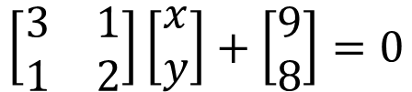
Numpy.linalg.solve(a, b)
Computes the “exact” solution, x, of the well-determined, i.e., full rank, linear matrix equation ax = b.
import numpy as np
a = np.array([[3,1], [1,2]])
b = np.array([9,8])
x = np.linalg.solve(a, b)
$$\left[\begin{matrix}3 & 1 \\ 1 & 2\end{matrix}\right]\left[\begin{matrix}x \\ y\end{matrix}\right]+\left[\begin{matrix}9 \\ 8\end{matrix}\right]=0$$

Slide 6
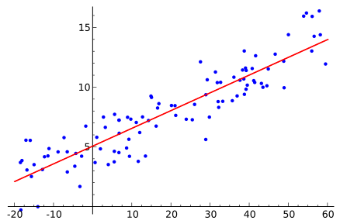
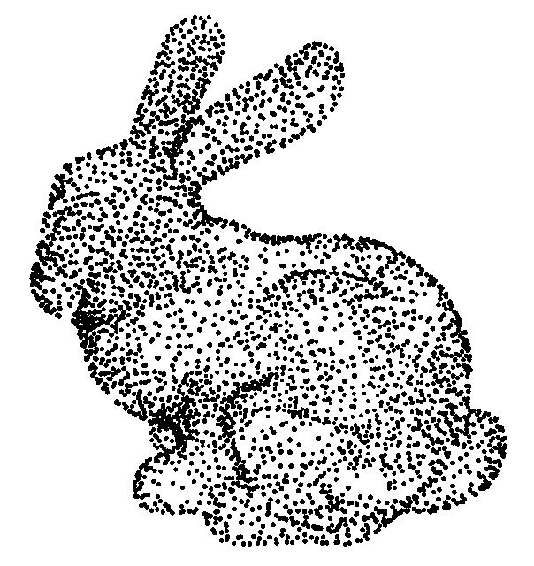
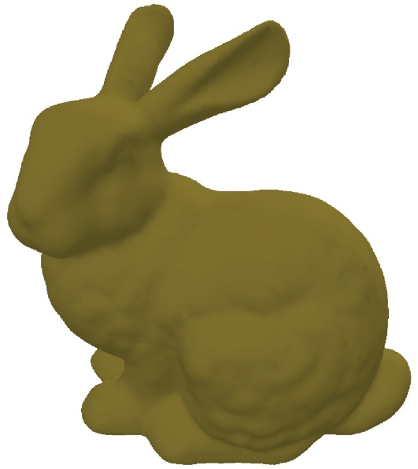
Similar problems
Line fitting
Surface reconstruction

Slide 7
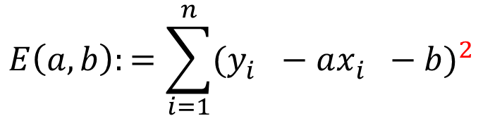

Line fitting
$$y=ax+b$$
$${{D\left(l,p_{i}\right)=(y_{i}−(ax_{i}+b\text{)} )}_{}^{2} }_{}$$
D
$$E\left(a,b\right):=\sum_{i=1}^{n}{{(y_{i}^{}−ax_{i}^{}−b)}^{2}}$$
Notes:
D: distance
Least squares | MIT 18.02SC Multivariable Calculus https://www.youtube.com/watch?v=YwZYSTQs-Hk

Slide 8
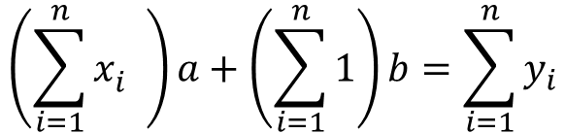
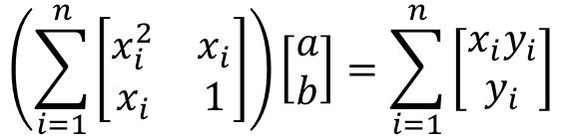
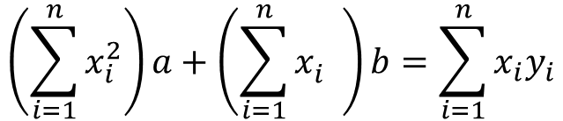
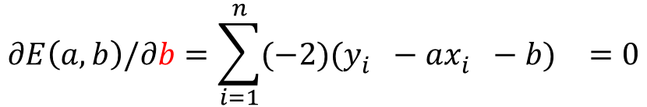
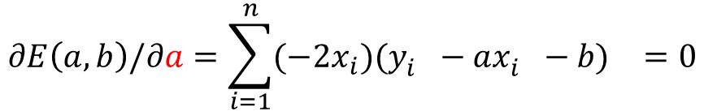
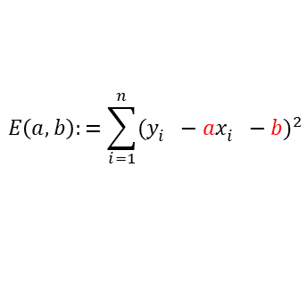
$$E\left(a,b\right):=\sum_{i=1}^{n}{{(y_{i}^{}−ax_{i}^{}−b)}^{2}}$$
$$∂E\left(a,b\right)/∂a=\sum_{i=1}^{n}{(−2{x_{i})(y_{i}^{}−ax_{i}^{}−b)}^{}=0}$$
$$∂E\left(a,b\right)/∂b=\sum_{i=1}^{n}{(−2{)(y_{i}^{}−ax_{i}^{}−b)}^{}=0}$$
$$\left(\sum_{i=1}^{n}{x_{i}^{2}}\right)a+\left(\sum_{i=1}^{n}{x_{i}^{}}\right)b=\sum_{i=1}^{n}{x_{i}y_{i}}$$
$$\left(\sum_{i=1}^{n}{x_{i}^{}}\right)a+\left(\sum_{i=1}^{n}{1}\right)b=\sum_{i=1}^{n}{y_{i}}$$
$$\left(\sum_{i=1}^{n}{\left[\begin{matrix}x_{i}^{2} & x_{i} \\ x_{i} & 1\end{matrix}\right]}\right)\left[\begin{matrix}a \\ b\end{matrix}\right]=\sum_{i=1}^{n}{\left[\begin{matrix}x_{i}y_{i} \\ y_{i}\end{matrix}\right]}$$
Notes:
Unknow: a, b
透過偏微分得到公式解

Slide 9
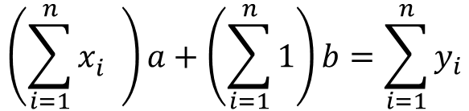
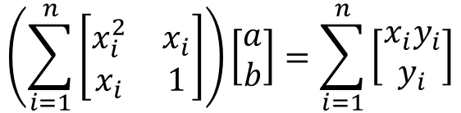
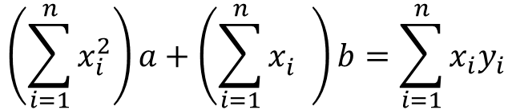
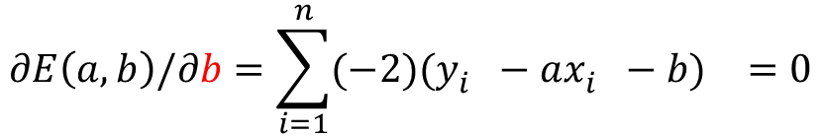

$$E\left(a,b\right):=\sum_{i=1}^{n}{{(y_{i}^{}−ax_{i}^{}−b)}^{2}}$$
(0, 1), (2, 1), (3,4)
$$∂E\left(a,b\right)/∂a=\sum_{i=1}^{n}{(−2{x_{i})(y_{i}^{}−ax_{i}^{}−b)}^{}=0}$$
$$∂E\left(a,b\right)/∂b=\sum_{i=1}^{n}{(−2{)(y_{i}^{}−ax_{i}^{}−b)}^{}=0}$$
$$\left(\sum_{i=1}^{n}{x_{i}^{2}}\right)a+\left(\sum_{i=1}^{n}{x_{i}^{}}\right)b=\sum_{i=1}^{n}{x_{i}y_{i}}$$
$$\left(\sum_{i=1}^{n}{x_{i}^{}}\right)a+\left(\sum_{i=1}^{n}{1}\right)b=\sum_{i=1}^{n}{y_{i}}$$
$$\left(\sum_{i=1}^{n}{\left[\begin{matrix}x_{i}^{2} & x_{i} \\ x_{i} & 1\end{matrix}\right]}\right)\left[\begin{matrix}a \\ b\end{matrix}\right]=\sum_{i=1}^{n}{\left[\begin{matrix}x_{i}y_{i} \\ y_{i}\end{matrix}\right]}$$

Slide 10
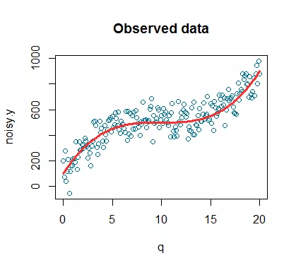

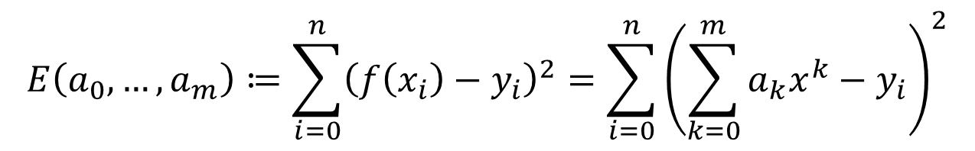
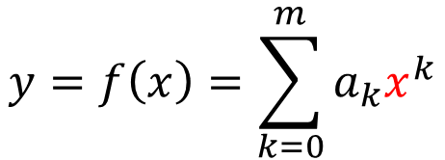

LS polynomial fits
$$y=ax+b$$
$$y=f(x)$$
$$y=f\left(x\right)=\sum_{k=0}^{m}{a_{k}x^{k}}$$
$$E\left(a_{0},…,a_{m}\right)≔\sum_{i=0}^{n}{{\left(f\left(x_{i}\right)−y_{i}\right)}^{2}}=\sum_{i=0}^{n}{{\left(\sum_{k=0}^{m}{a_{k}x^{k}}−y_{i}\right)}^{2}}$$

Slide 11
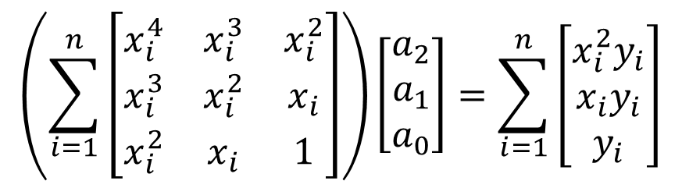
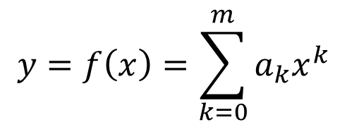
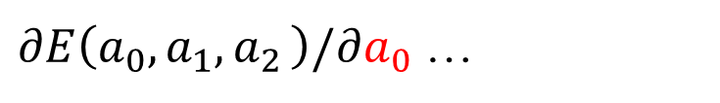
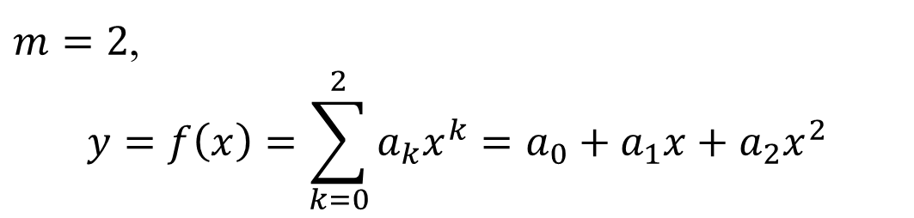
$$y=f\left(x\right)=\sum_{k=0}^{m}{a_{k}x^{k}}$$
$m=2$,
$$y=f\left(x\right)=\sum_{k=0}^{2}{a_{k}x^{k}}=a_{0}+a_{1}x+a_{2}x^{2}$$
$∂E\left(a_{0},a_{1}{,a}_{2}\right)/∂a_{0}$ …
$$\left(\sum_{i=1}^{n}{\left[\begin{matrix}x_{i}^{4} & x_{i}^{3} & x_{i}^{2} \\ x_{i}^{3} & x_{i}^{2} & x_{i} \\ x_{i}^{2} & x_{i} & 1\end{matrix}\right]}\right)\left[\begin{matrix}a_{2} \\ a_{1} \\ a_{0}\end{matrix}\right]=\sum_{i=1}^{n}{\left[\begin{matrix}x_{i}^{2}y_{i} \\ x_{i}y_{i} \\ y_{i}\end{matrix}\right]}$$

Slide 12
Multiple lines intersection

Slide 13






Solving Linear systems in the LS sense
$$Ax=b$$
$$x=A^{−1}b$$
An overdetermined system
$$\min_{x}{{\left\|Ax−b\right\|}^{2}=\min_{x}\left(x^{T}A^{T}Ax−2x^{T}A^{T}b+b^{T}b\right)}$$
$$∀i, a_{i}^{T}(x−b)=0$$
$$A^{T}(Ax−b)=0$$
$$A^{T}Ax=A^{T}b$$
$$x={{(A}^{T}Ax)}^{−1}A^{T}b$$
Notes:
If A = nxn matrix, x = A^{-1}*b

Slide 14

Numpy.linalg.lstsq(a, b)
Return the least-squares solution to a linear matrix equation
Fit a line, y = ax + b, through some noisy data-points:
x = np.array([0, 2, 3])
y = np.array([1, 1, 4])
A = np.vstack([x, np.ones(len(x))]).T
a, b = np.linalg.lstsq(A, y, rcond=None)[0]
$$\left[\begin{matrix}0 & 1 \\ 2 & 1 \\ 3 & 1\end{matrix}\right]\left[\begin{matrix}a \\ b\end{matrix}\right]=\left[\begin{matrix}1 \\ 1 \\ 4\end{matrix}\right]$$
Notes:
(0.8571428571428571, 0.5714285714285711)

Slide 15
Solution of linear system
Ax = b
Solver
  Direct method: Gaussian elimination and LU
  Iterative method: ConjugateGradient
Dense or Sparse Matrix

Slide 16
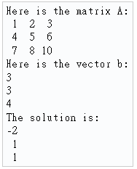
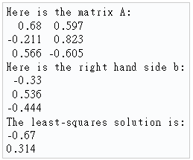
Eigen c++
Ax=b
Matrix3f A;
Vector3f b;
A << 1,2,3, 4,5,6, 7,8,10;
b << 3, 3, 4;
Vector3f x = A.colPivHouseholderQr().solve(b);
cout << "The solution is:\n" << x << endl;
MatrixXf A = MatrixXf::Random(3, 2);
VectorXf b = VectorXf::Random(3);
cout << "The solution using normal equations is:\n"
<< (A.transpose() * A).ldlt().solve(A.transpose() * b)
<< endl;
Notes:
The solution is: -2 1 1
LDL^T Cholesky decomposition
The solution using normal equations is: -0.67 0.314

Slide 17
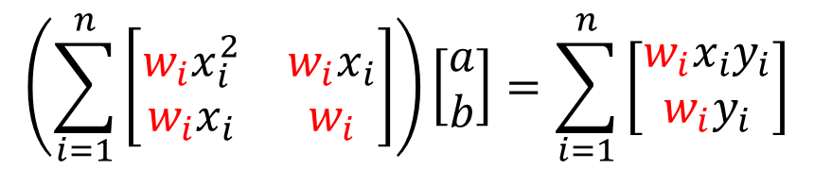
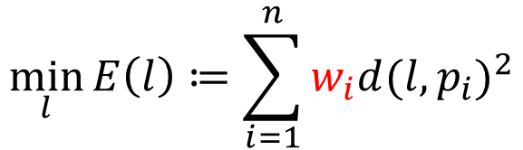
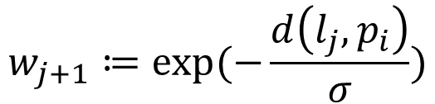

Outliners
$$w_{j+1}≔exp⁡(−\frac{d\left(l_{j},p_{i}\right)}{σ})$$
$$σ:user parameter$$
$$\min_{l}{E\left(l\right)≔\sum_{i=1}^{n}{w_{i}d{(l,p_{i})}^{2}}}$$
$$\left(\sum_{i=1}^{n}{\left[\begin{matrix}{w_{i}x}_{i}^{2} & {w_{i}x}_{i} \\ w_{i}x_{i} & w_{i}\end{matrix}\right]}\right)\left[\begin{matrix}a \\ b\end{matrix}\right]=\sum_{i=1}^{n}{\left[\begin{matrix}{w_{i}x}_{i}y_{i} \\ w_{i}y_{i}\end{matrix}\right]}$$
Notes:
E^(0) = 1
D越大 W越小

Slide 18

As-Rigid-As-Possible Shape Manipulation
SIGGRAPH 2005
Notes:
http://www-ui.is.s.u-tokyo.ac.jp/~takeo/research/rigid/

Slide 19
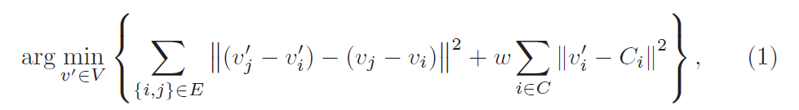
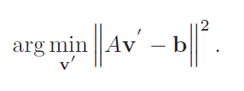
Baseline Algorithm

Slide 21
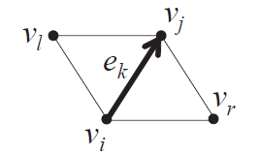
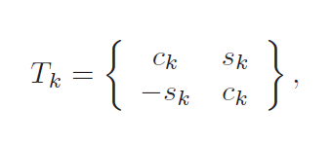
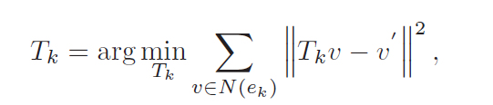

First Step: Similarity Transformation

Slide 22
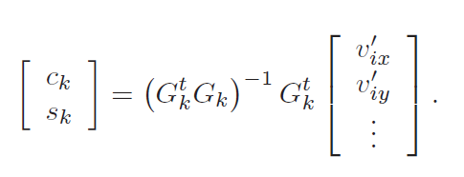

Slide 24
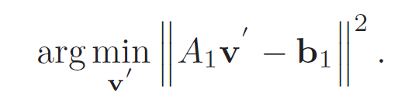

Slide 26
Second Step: Scale Adjustment

Slide 28
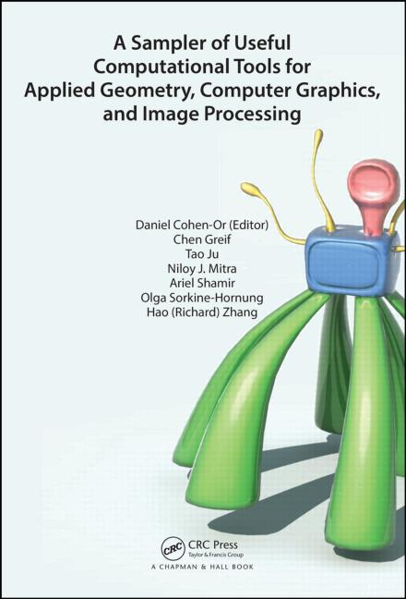
Reference
CH. 3 in A Sampler of Useful Computational Tools for Applied Geometry, Computer Graphics, and Image Processing (2015)

