Slide 1
Deep Learning style transfer

Slide 2

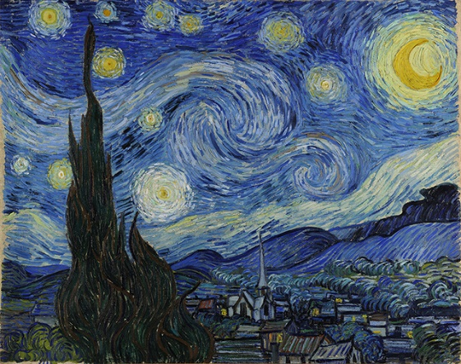
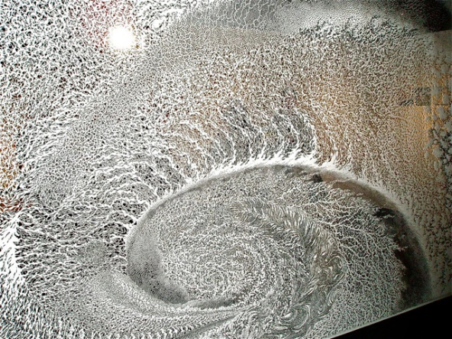
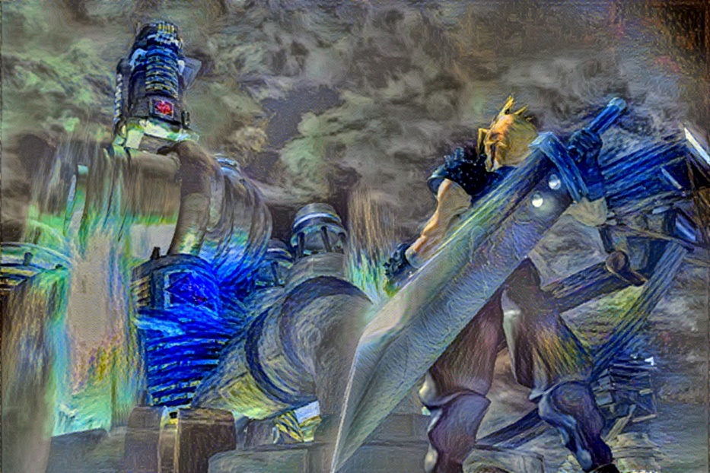
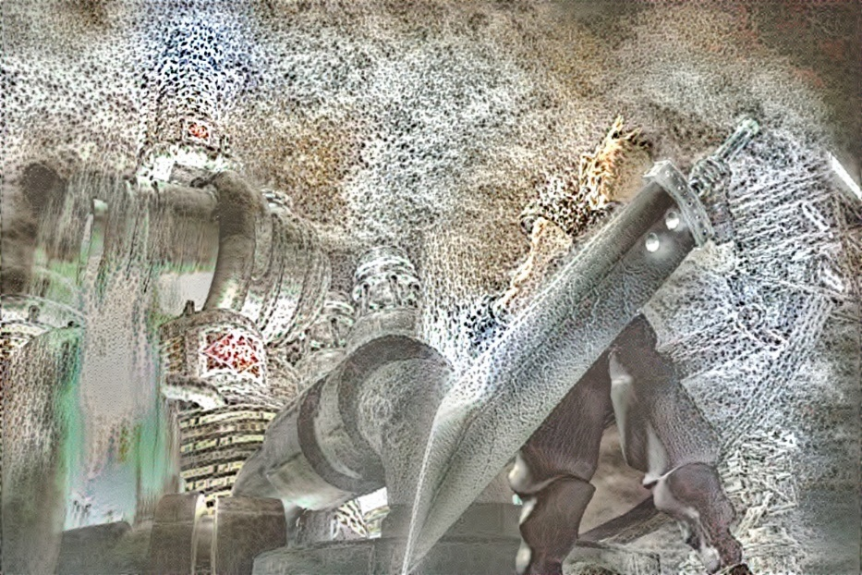
content
Style 1
Style 2
result 1
result 2

Slide 3
outline
CNN
CNN Visualization
Neural Art

Slide 4
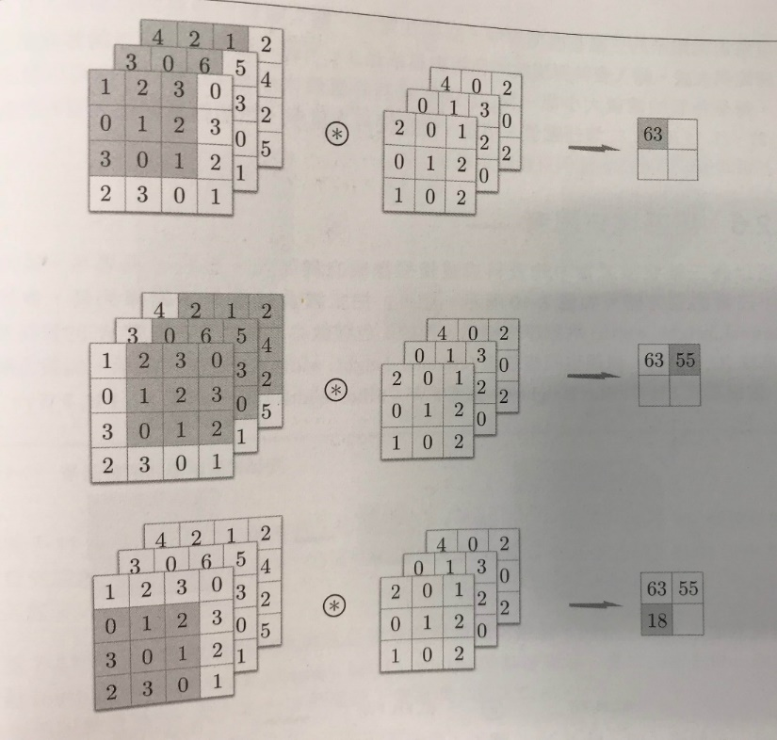
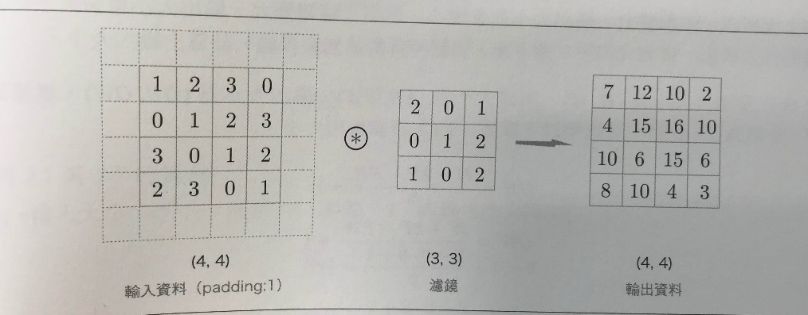
Padding, Stride, color

Slide 5
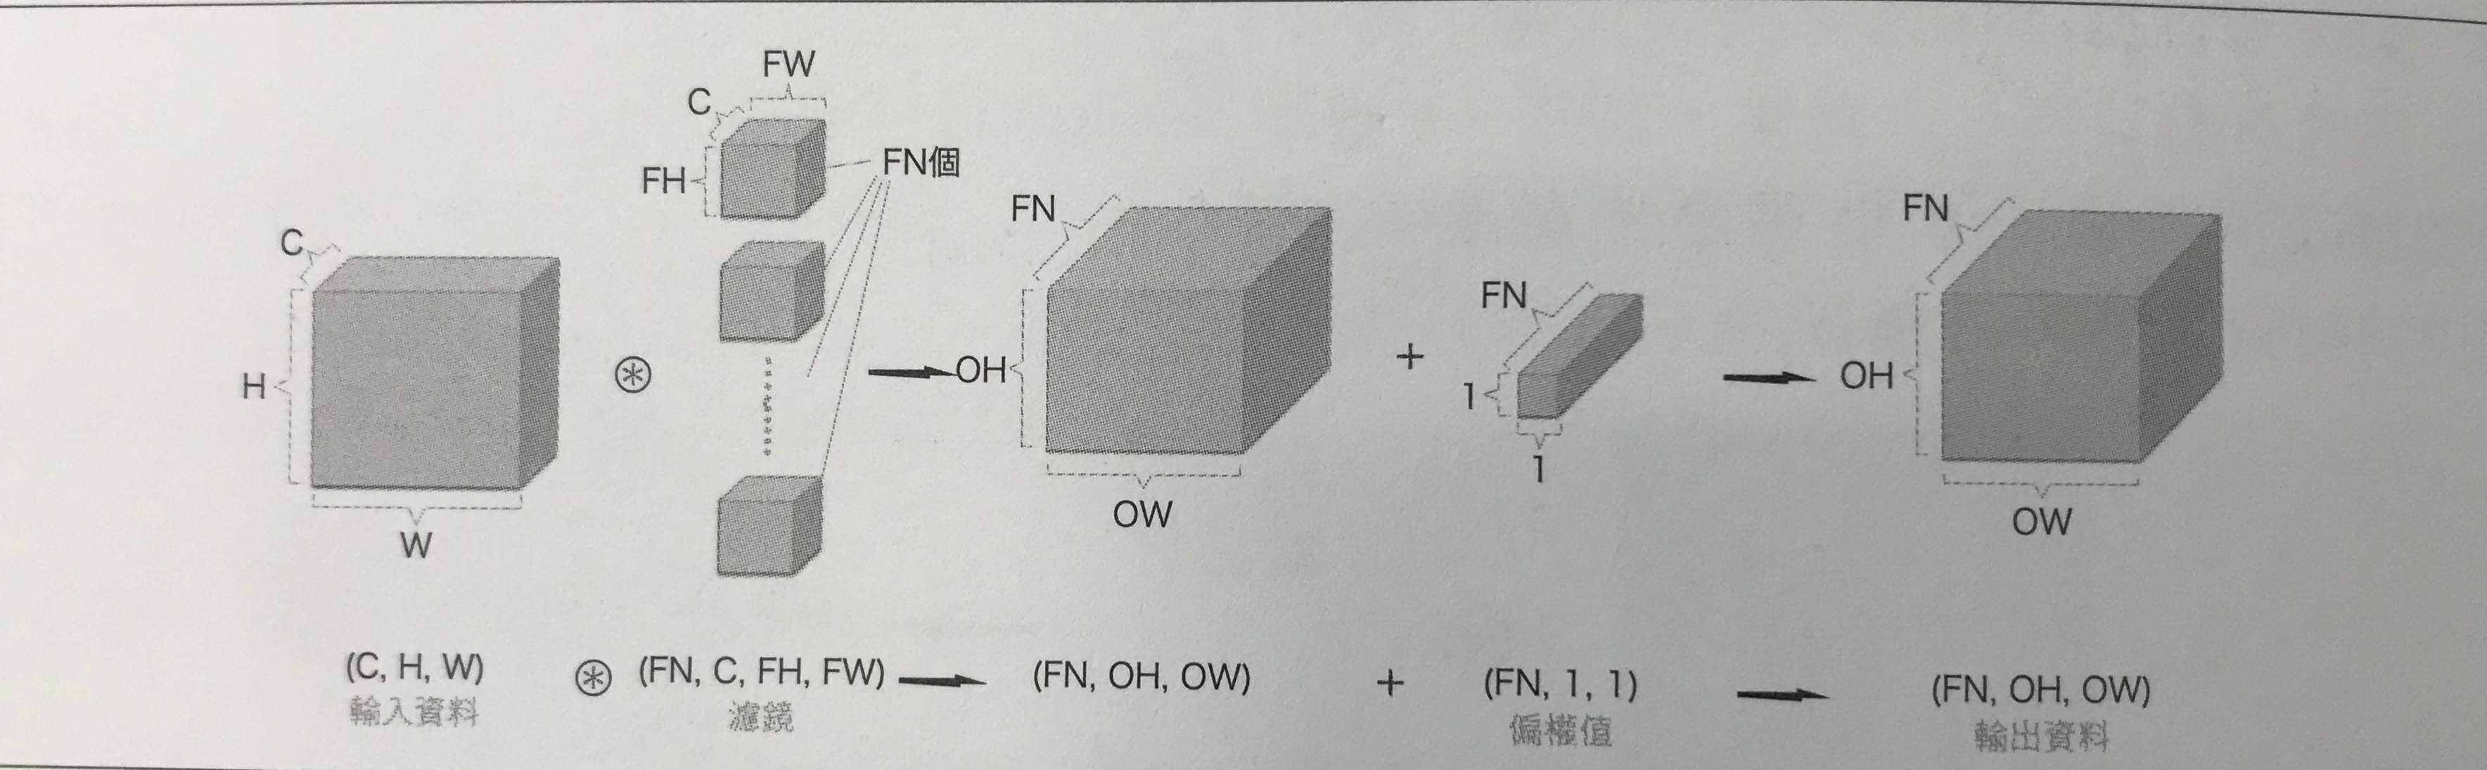
Hyperparameter, feature image
Notes:
Hyperparameters are the variables which determines the network structure(Eg: Number of Hidden Units)
the variables which determine how the network is trained(Eg: Learning Rate).
Hyperparameters are set before training(before optimizing the weights and bias).

Slide 6
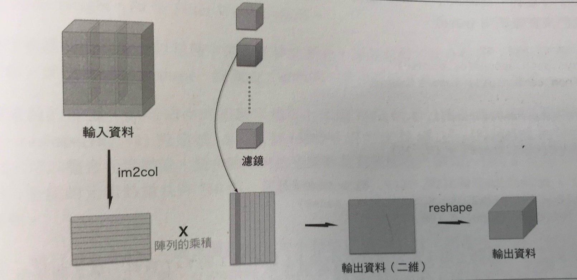

Slide 7
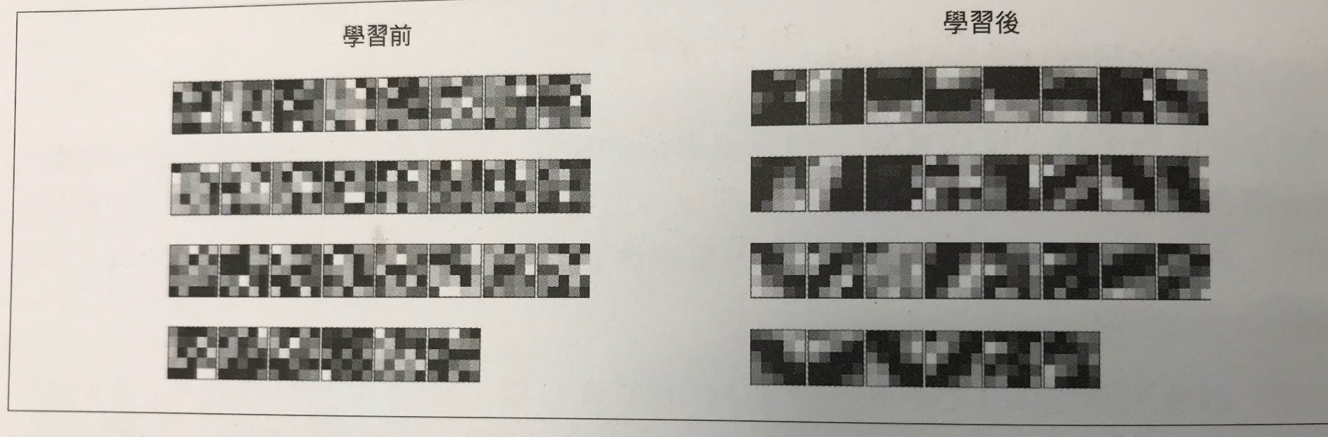
Kernel weights (and biases)

Slide 8
Visual Perception of Computer

Slide 9
Visualization

Slide 10
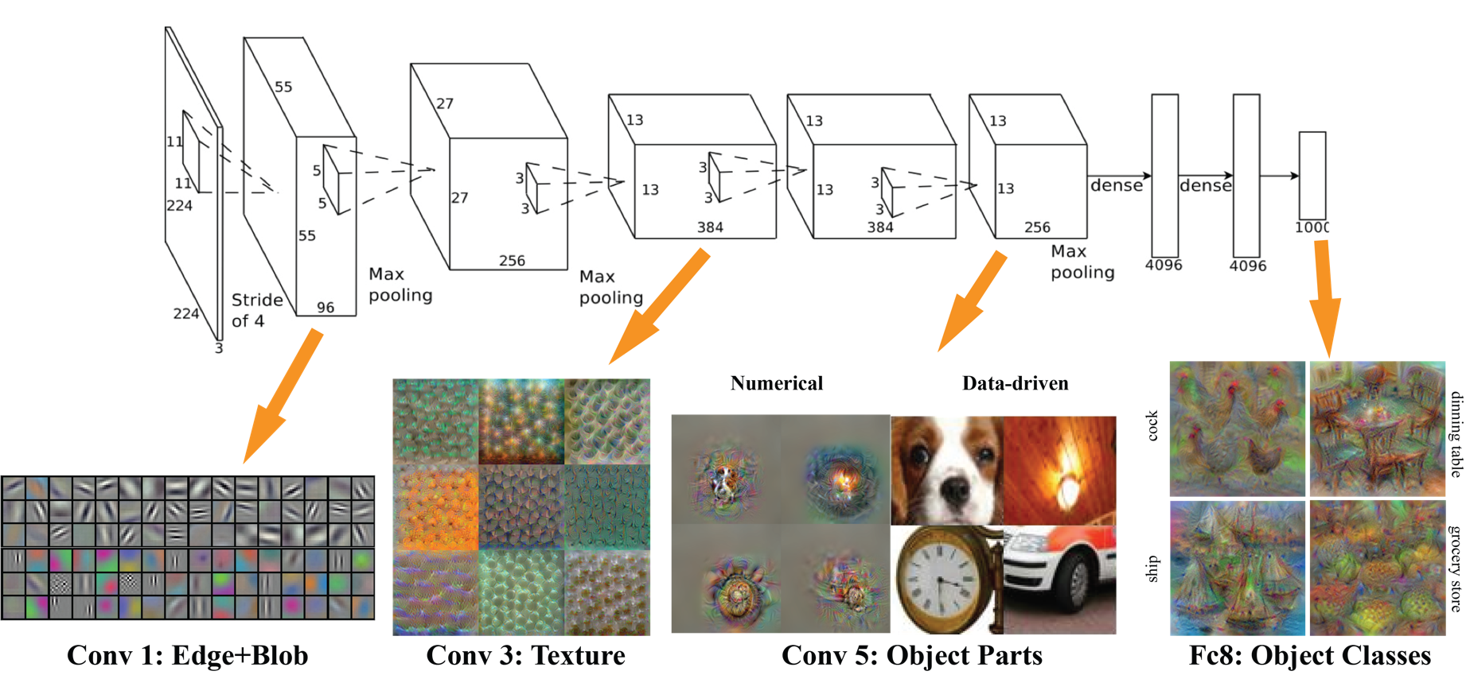
Visualizing CNN
http://vision03.csail.mit.edu/cnn_art/data/single_layer.png
Notes:
http://vision03.csail.mit.edu/cnn_art/

Slide 11
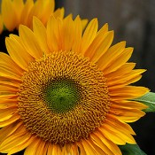
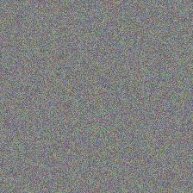
Visualizing CNN
flower
filter response
CNN
random noise
filter response
CNN

Slide 12
Gradient Ascent

Slide 13
Gradient Ascent

Slide 14
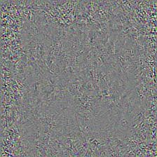
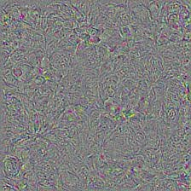
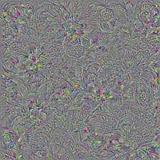
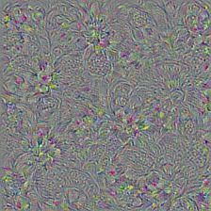
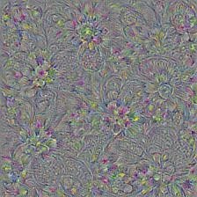
Gradient Ascent
80

Slide 15

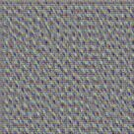
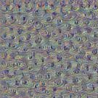
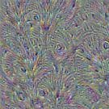
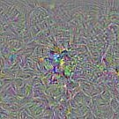
Different Layers of Visualization
CNN

Slide 16
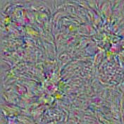
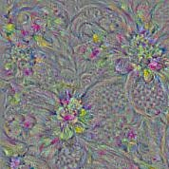
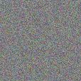
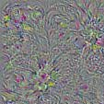
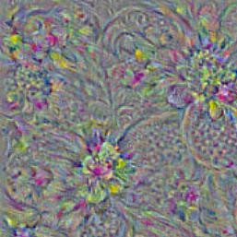
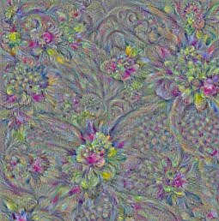
Multiscale Image Generation
visualize
resize
visualize
resize
visualize

Slide 17
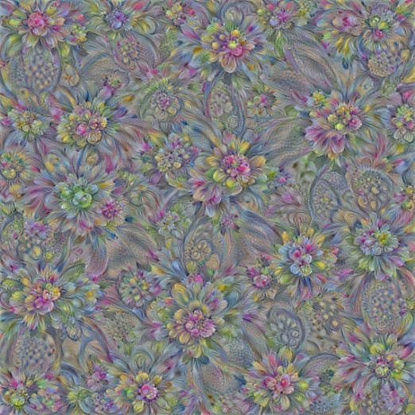
Multiscale Image Generation

Slide 18
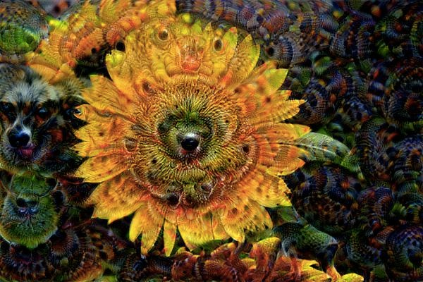
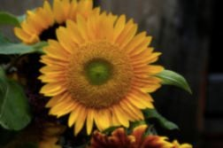
Deep Dream
https://research.googleblog.com/2015/06/inceptionism- going-deeper-into-neural.html
Source code: https://github.com/tensorflow/tensorflow/blob/master/tensorflow/ex amples/tutorials/deepdream/deepdream.ipynb
ht tp://download.tensorflow.org/example_images
/flower_photos.tgz

Slide 19
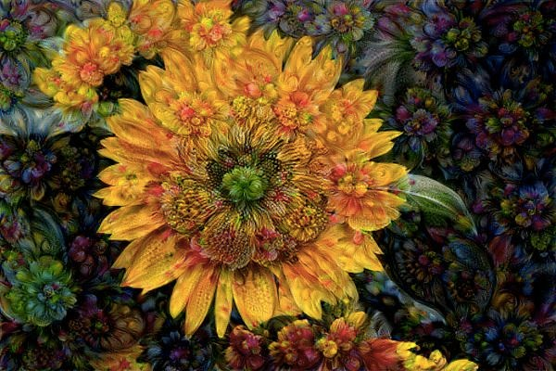
Deep Dream

Slide 20
Deep Dream

Slide 21
Neural Art

Slide 22
Hybrid Images [siggraph 06]

Slide 23
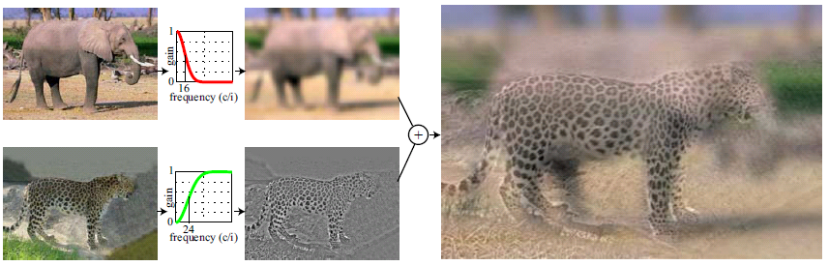



Hybrid Images

Slide 24
VGGNet (2014)
Paper: https://arxiv.org/abs/1409.1556

Slide 25
VGG19

Slide 26
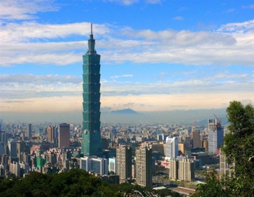
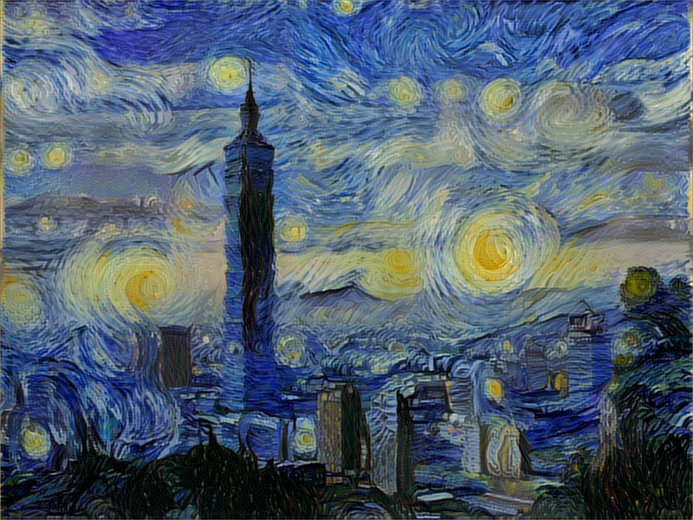
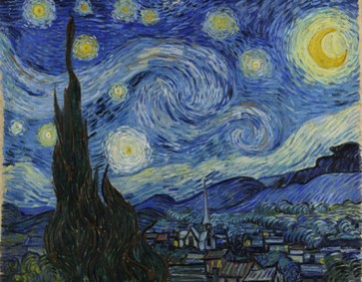
Neural Art
Paper: https://arxiv.org/abs/1508.06576
Source code : https://github.com/ckmarkoh/neuralart_tensorflow
content
artwork
ht tp://www.taipei- 101.com.tw/upload/news/201502/2015 021711505431705145.J PG
style
ht tps://github.com/andersbll/neur al_ar tistic_style/blob/master/images/starry_ night .jpg ?raw=true

Slide 27
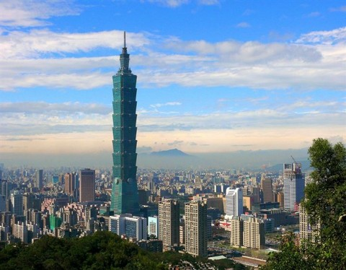



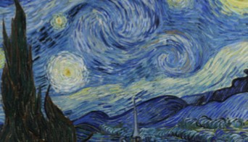


The Mechanism of Painting
Artist Brain
Scene
Style
ArtWork
Computer
Neural Networks

Slide 28
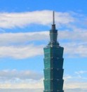







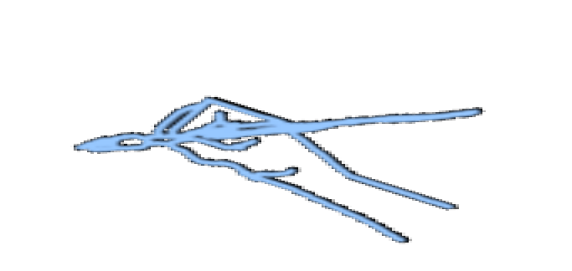



Content Generation
Content
Neural
Artist
Brain
Stimulation
Minimize the difference
Canvas
Draw

Slide 29
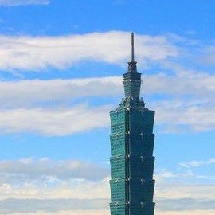

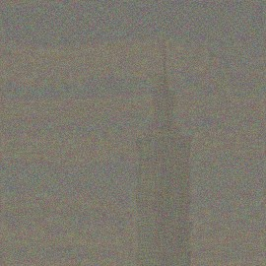
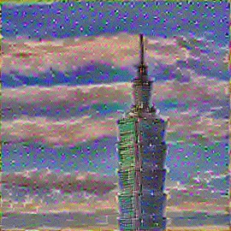
Content Generation
Content
Width*Height
Filter Responses
VGG19
Depth
Minimize the difference
Canvas
Update the color of the pixels
Result

Slide 30

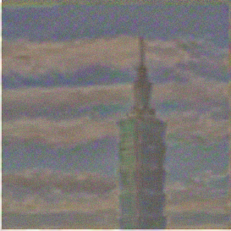



Content Generation
Input Photo:
Layer l’s Filter Responses:
Input Canvas:
Layer l’s Filter l Responses:
Depth (i)
Depth (i)
Width*Height (j)
Width*Height (j)

Slide 31


Content Generation
Backward Propagation
Layer l’s Filter l Responses:
VGG19
Input Canvas:
Update Canvas
Learning Rate

Slide 32
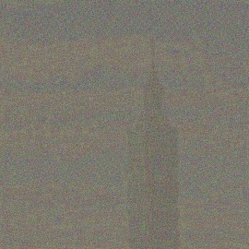
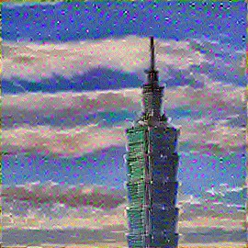
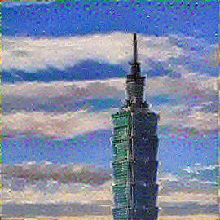
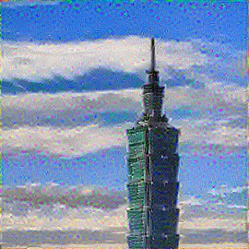
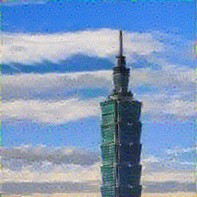
Content Generation

Slide 33
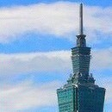
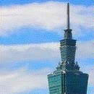




Content Generation
VGG19
conv1_2
conv2_2
conv3_4
conv4_4
conv5_1
conv5_2

Slide 34


Style Generation
Artwork
VGG19
Filter Responses
Gram Matrix
G
Depth
Depth
G
Depth
Position- independent
Width*Height
Position- dependent

Slide 35


Style Generation
Layer l’s Filter Responses
Width*Height
Gram Matrix
1. | .5
.5
 | .5
1.
1. | .5 | .25 | 1.
.5 | .25 |  | .5
.25 |  | .25
1. | .5 |  | 1.
G
Depth
Depth
Depth
k

Slide 36







Style Generation
Input Artwork:
Layer l’s Gram Matrix
Input Canvas:
Layer l’s Gram Matrix
Layer l’s Filter Responses

Slide 37

Style Generation
Filter Responses
Gram Matrix
Style
VGG19
G
Minimize the difference
Canvas
G
Update the color of the pixels
Result
100

Slide 38






Style Generation

Slide 39





Style Generation
VGG19
Conv1_1
Conv1_1 Conv2_1
Conv1_1 Conv2_1 Conv3_1
Conv1_1 Conv2_1 Conv3_1 Conv4_1
Conv1_1 Conv2_1 Conv3_1 Conv4_1 Conv5_1

Slide 40





Artwork Generation
VGG19
Filter Responses
Gram Matrix

Slide 41
Artwork Generation
VGG19
VGG19
Conv1_1 Conv2_1 Conv3_1 Conv4_1 Conv5_1
Conv4_2

Slide 42






Artwork Generation

Slide 43




Content v.s. Style
0.15
0.05
0.02
0.007

Slide 44

Neural Doodle
Image analogy
Notes:
https://github.com/alexjc/neural-doodle

Slide 45





Neural Doodle
Paper: https://arxiv.org/abs/1603.01768
Source code: https://github.com/alexjc/neural-doodle
content
semantic maps
result
style

Slide 46




Neural Doodle
Image analogy

Slide 47

Real-time Texture Synthesis
Paper: https://arxiv.org/pdf/1604.04382v1.pdf
  GAN: https://arxiv.org/pdf/1406.2661v1.pdf
  VAE: https://arxiv.org/pdf/1312.6114v10.pdf
Source Code : https://github.com/chuanli11/MGANs
110

Slide 48
Reference
斎藤康毅 Deep Learning：用Python進行深度學習的基礎理論實作
https://www.csie.ntu.edu.tw/~yvchen/f105-adl/doc/161103_ConvolutionalNN.pdf
https://github.com/hunter-heidenreich/ML-Open-Source-Implementations/blob/master/Style-Transfer/Style%20Transfer.ipynb

