Slide 1
Advance Computer Graphics
Renderman

Slide 2
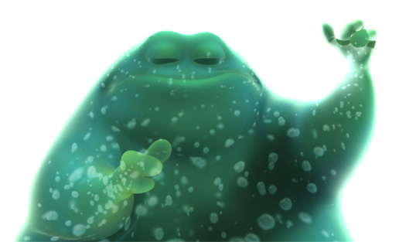
Renderman
Image Courtesy by Pixar

Slide 3
Overview
Two “languages”
Geometry - set of C subroutines
Shading - a C-like language
Geometry code can be run directly, or output to RIB file
Shading code is compiled to byte-code

Slide 4
Process
RIB
File
Rman
Geom
Code
cc
Rman
Program
render
Program
Rman
Shader
.sl
shader
Byte-code
Shader
.slo
TIFF
image
txmake
Image
File
Rman
texture

Slide 5
REYES Renders Everything You Ever Saw
Splitting and Dicing Geometry
Notes:
Robert L. Cook, Loren Carpenter, and Edwin Catmull. 1987. The Reyes image rendering architecture. In Proceedings of the 14th annual conference on Computer graphics and interactive techniques (SIGGRAPH '87), Maureen C. Stone (Ed.). ACM, New York, NY, USA, 95-102.

Slide 6
RenderMan code
#include <ri.h>
RtPoint Square[4] = { {.5,.5,.5}, {.5,-.5,.5}, {-.5,-.5,.5}, {-.5,.5,.5} };
main(void){
RiBegin(RI_NULL); /* Start the renderer */
RiDisplay("RenderMan", RI_FRAMEBUFFER, "rgb", RI_NULL);
RiFormat((RtInt) 256, (RtInt) 192, -1.0);
RiShadingRate(1.0);
RiWorldBegin();
RiSurface("constant", RI_NULL);
RiPolygon( (RtInt) 4, /* Declare the square */
RI_P, (RtPointer) Square, RI_NULL);
RiWorldEnd();
RiEnd(); /* Clean up */
}

Slide 7
RIB – simple example
Display "RenderMan" "framebuffer" "rgb"
Format 256 192 -1
ShadingRate 1
WorldBegin
Surface "constant"
Polygon "P" [0.5 0.5 0.5 0.5 -0.5 0.5 -0.5 -0.5 0.5 -0.5 0.5 0.5]
WorldEnd

Slide 8
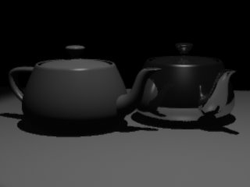
testray.rib (1)
# testray.rib
Format 320 240 1
PixelSamples 2 2
Display "testray.tif" "file" "rgba"
Projection "perspective" "fov" [18]
ShadingRate 1
Option "searchpath" "shader" [".:../shaders:&:../lib"]
ConcatTransform [0.995037 -0.0170699 -0.0980286 0 -.0995037 -0.170699 -0.980286 0 1.86265e-09 0.985175 -0.17155 0 0 0 0 1]
Translate -2 -20 -5

Slide 9
testray.rib (2)
WorldBegin
LightSource "ambientlight" 0 "intensity" [0.025]
TransformBegin
Translate 2 4.5 20
ConcatTransform [-0.995037 -0.0284619 -0.0953463 0 1.86265e-09 0.958218 -0.286039 0 0.0995037 -0.284619 -0.953463 0 0 0 0 1]
LightSource "uberlight" 1 "intensity" [300] "float width" [0.5] "float height" [0.5] "float falloff" [2] "float raytraceshadow" [1]
TransformEnd
….
WorldEnd

Slide 10
testray.rib (3)
AttributeBegin
Surface "plastic"
Color [ .75 .75 .75 ]
Translate -2 -1.5 0
Rotate 20 0 0 1
ReadArchive "teapot.rib"
AttributeEnd

Slide 11
testray.rib (4)
AttributeBegin
Surface "shiny" "Kd" [.1] "float Kr" [0.7] "Ks" [0.75] "Ka" [0.1]
#"string envname" ["tp.env"]
Translate 2 -3 0
Rotate 60 0 0 1
ReadArchive "teapot.rib"
AttributeEnd

Slide 12
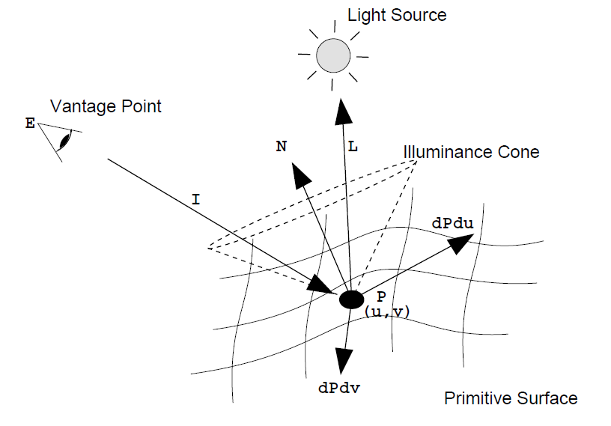
Renderman Surface Shader
surface constant()
{
Oi = Os;
Ci = Os * Cs;
}

Slide 13
surface
matte( float Ka = 1,
Kd = 1 )
{
normal Nf = faceforward(normalize(N),I);
Oi = Os;
Ci = Os * Cs *(Ka*ambient()
+ Kd*diffuse(Nf));
}

Slide 14
I = k_{d} I_{d} l · n + k_{s} I_{s} (v · r )^{α} + k_{a} I_{a}
diffuse
specular
ambient
surface plastic( float Ks = .5, Kd = .5,
Ka = 1, roughness = .1;
color specularcolor = 1 )
{
normal Nf = faceforward(normalize(N), I );
vector V = normalize(-I);
Oi = Os;
Ci = Os*( Cs * (Ka*ambient()+ Kd*diffuse(Nf))+
specularcolor * Ks * specular(Nf,V,roughness) );
}

Slide 15
Texture Mapping
y
z
x
geometry
display
t
image
s

Slide 16
surface paintedplastic( float Ks = .5, Kd = .5,
Ka = 1, roughness = .1;
color specularcolor = 1 )
{
color Ct = Cs;
if(texturename != “”)
Ct = color texture(texturename);
normal Nf = faceforward(normalize(N), I );
vector V = normalize(-I);
Oi = Os;
Ci = Os*( Ct * (Ka*ambient()+ Kd*diffuse(Nf))+
specularcolor * Ks * specular(Nf,V,roughness) );
}

Slide 17
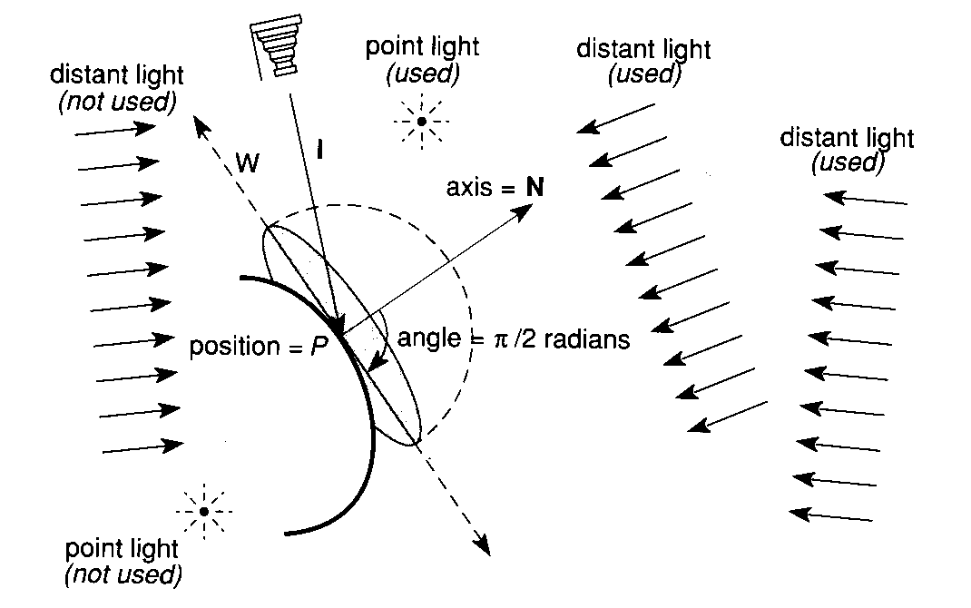
Predefined Global Variables
Position “P”
Normal “N”
Surface color “Cs”
Output color “Ci”
Output opacity “Oi”
Others: P.292 of RenderMan Companion
Notes:
Page 121 Table 12.1: Predefined Surface Shader Variables

Slide 18
Surface Shader – plastic.sl
surface
plastic (float Ka = 1, Kd = 0.5, Ks = 0.5, roughness = 0.1;
color specularcolor = 1;)
{
normal Nf = faceforward (normalize(N),I);
Ci = Cs *
(Ka*ambient()
+ Kd*diffuse(Nf))
+ specularcolor * Ks*specular(Nf,-normalize(I),roughness);
Oi = Os; Ci *= Oi;
}

Slide 19
Surface Shader – Metal surface
surface
metal(
float Ka = 1;
float Ks = 1;
float roughness =.1;)
{
normal Nf = faceforward(normalize(N), I);
vector V = -normalize(I);
Oi = Os;
Ci = Os * Cs * (Ka*ambient()+Ks
*specular(Nf, V, roughness));
}

Slide 20
surface
shinymetal(
float Ka = 1;
float Ks = 1;
float Kr = 1;
float roughness = .1;
string texturename = ””; )
{
normal Nf = faceforward(normalize(N), I);
vector V = -normalize(I);
vector D = reflect(I, normalize(Nf));
D = vtransform(”current”, ”world”, D);
Oi = Os;
Ci = Os * Cs * (Ka*ambient() + Ks*specular(Nf, V, roughness)
+ Kr*color environment(texturename, D));
}
Notes:
in Pixie, mirror surface shader

Slide 21
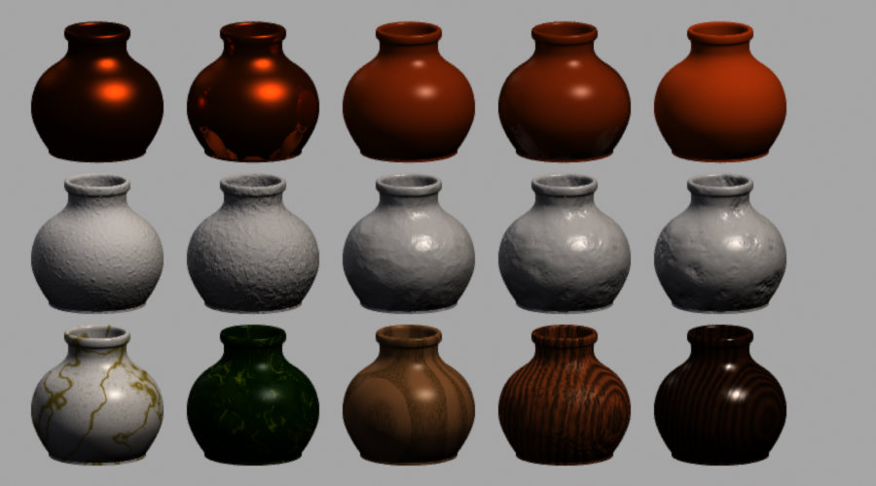
Shader - vasegallery1.rib
Notes:
In BMRT2.6 example

Slide 22
Basic Displacement
P += offsetvector;
N = calculatenormal(P);
Or
P += bumpheight *
normalize(N);
N = calculatenormal(P);
Surface shader state
Notes:
The upper right figure come from renderman spec

Slide 23
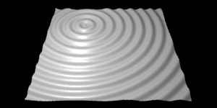
Displacement shader
displacement ripple(float Km = 0.03, numripples = 8,
a = 0.3, b = 0.25)
{
float sdist = s - a,
tdist = t - b,
dist = sqrt(sdist * sdist + tdist * tdist),
hump = sin(dist * 2 * PI * numripples);
normal n = normalize(N);
P = P - n * hump * Km;
N = calculatenormal(P);
}

Slide 24
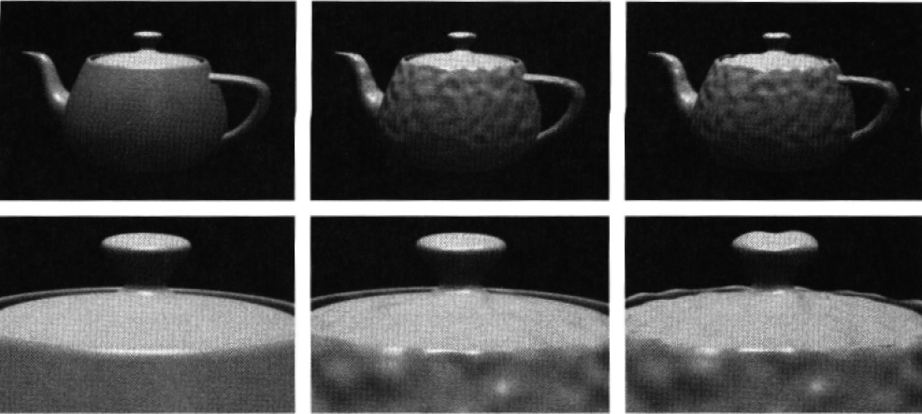
Bump mapping
N = calculatenormal( P + amp * normalize(N) );
bump
displacement

Slide 25
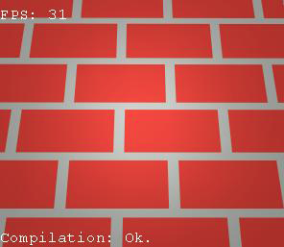
Procedure texture
7
0
7
V % 2

Slide 26
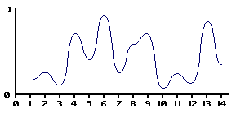
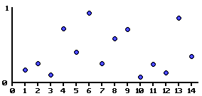
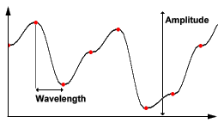
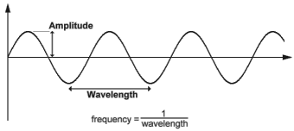
Perlin noise
noise(x)
amp * noise(x)
noise(freq*x)
noise(x+offset)
Notes:
1983: First noise
1984: First shader language
1985: SIGGRAPH paper
1986-88: Pixar, Alias, SoftImage, RenderMan, Dynamation,

Slide 27
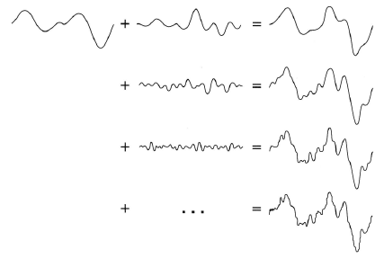
Summing Octaves

Slide 28
Summing Octaves 2D
float sum=0, amp=1;
point pp =p;
for( i=0; i < octaves; i+=1) {
sum += amp* snoise(pp);
amp*=gain; pp *= lacunarity;
}
return sum;
sum

Slide 29
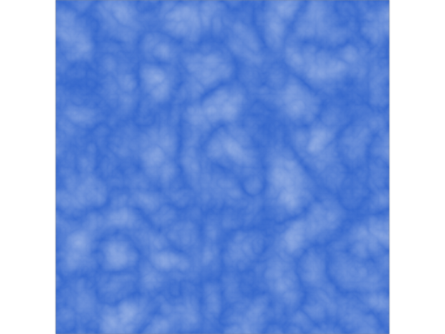
Shader Example
surface clouds(float Kd=.8, Ka=.2 )
{
float sum ;
float i, freq;
color white = color(1.0, 1.0, 1.0);
point Psh = transform("shader", P);
sum = 0;
freq = 4.0;
for (i = 0; i < 6; i = i + 1) {
sum = sum + 1/freq * abs(.5 - noise(freq * Psh));
freq = 2 * freq;
}
Ci = mix(Cs, white, sum*4.0);
Oi = 1.0; /* Always make the surface opaque */
}

Slide 30
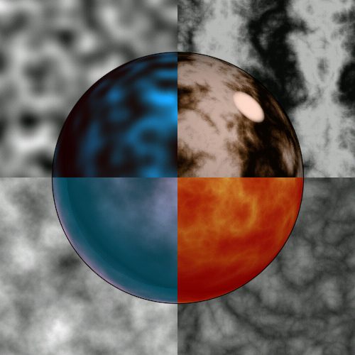
sin(x + sum 1/f( |noise| ))
noise()
Sum 1/f(noise)
Sum 1/f((|noise|)
fractal sum of noise calls:
noise(p) + ½ noise(2p) + ¼ noise(4p) ...
Fron Ken Perlin’s GDC’99 talk
Notes:
http://www.noisemachine.com/talk1/index.html

Slide 31
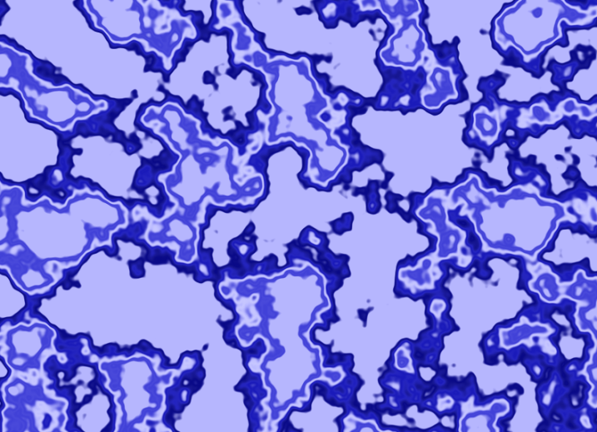
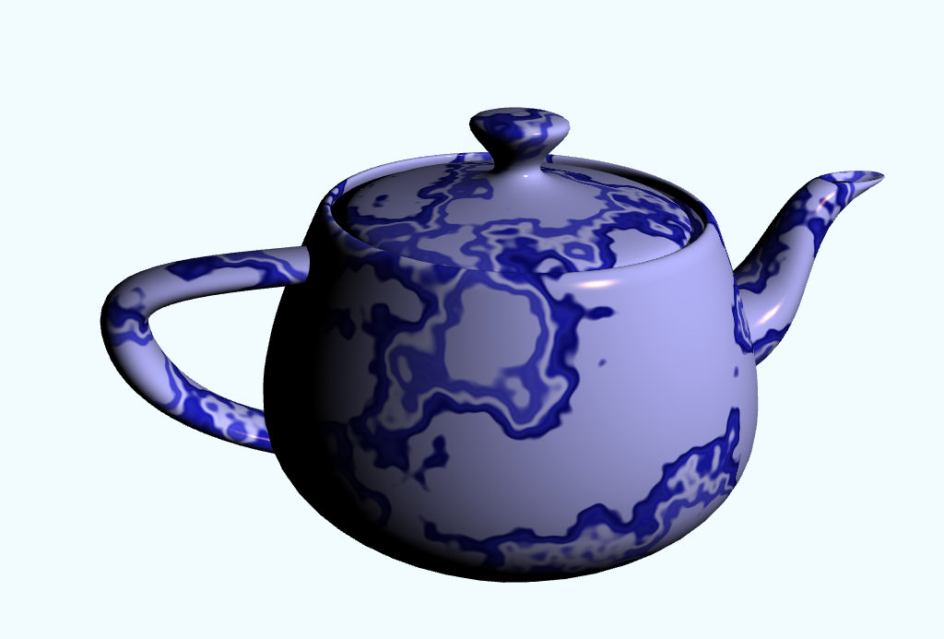
Tone mapping

Slide 32
displacement
test11c(float Km = 0.1, freq = 1, layers = 3; string space = "object")
{
float hump = 0;
normal n = normalize(N);
point p = transform(space, P);
float j, f = freq, amplitude = 1;
for(j = 0; j < layers; j += 1) {
hump += abs(noise(p * f) - 0.5) * amplitude;
f *= 2;
amplitude *= 0.5;
}
P = P - n * hump * Km;
N = calculatenormal(P);
}
Layer = 4, 5, 6
Notes:
Siggraph asia 2009 course note

