Slide 1
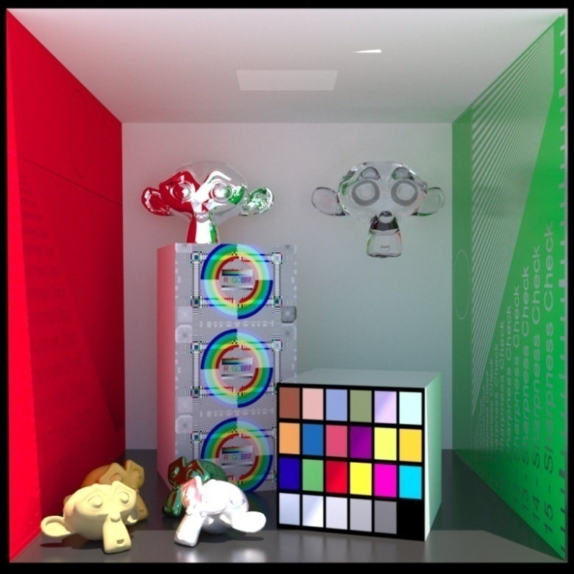
Advanced Computer Graphics
Point-based rendering
Ming-Te Chi
Department of Computer Science, National Chengchi University
Slides refer to http://graphics.stanford.edu/~mapauly/Pdfs/SigCourse04.pdf
Notes:
http://graphics.stanford.edu/~mapauly/Pdfs/SigCourse04.pdf
The image is made by LuxRender. http://www.luxrender.net/

Slide 2
So…Points
Point primitives have experienced a major “renaissance“ in Graphics
Two reasons for that:
Dramatic increase in polygonal complexity
Upcoming 3D digital photography
Researchers start to question the utility of polygons as “the one and only“ fundamental graphics primitive
Points complement triangles !

Slide 3
Polynomials....

Slide 4
Polynomials -> Triangles

Slide 5
Triangles...

Slide 6
Triangles -> Points

Slide 7
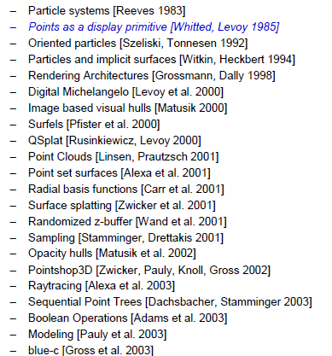
(Incomplete) History of Points

Slide 8
A Motivation…
3D content creation pipeline

Slide 9
Taxonomy
Rendering
Acquisition
Point-Based Graphics
Processing &
Editing
Representation

Slide 10
Acquisition of Point-Sampled Geometry and Appearance

Slide 11
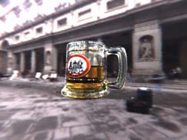
How can we capture reality?

Slide 12
Goals
Fully-automated 3D model creation
Faithful representation of appearance
Placement into new virtual environments

Slide 13
Previous Work
Contact digitizers – intensive manual labor
Passive methods – require texture, Lambertian BRDF
Active light imaging systems – restrict types of materials
Fuzzy, transparent, and refractive objects are difficult
4 million pts.
[Levoy et al. 2000]

Slide 14
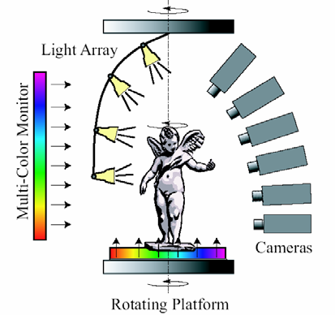
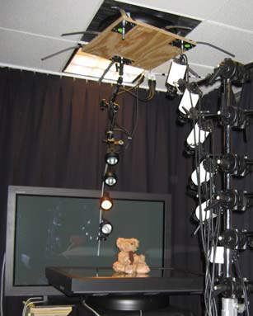
Acquisition System

Slide 15
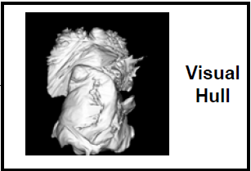
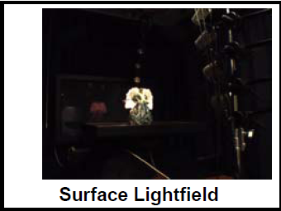
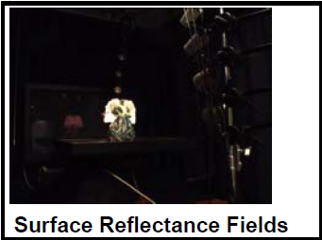
Acquisition Process

Slide 16
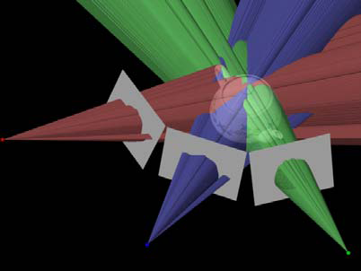
Visual Hull
The maximal object consistent with a given set of silhouettes

Slide 17
View-Dependent Textures
Capture concavities, reflections, and transparency with view-dependent textures [Pulli 97, Debevec 98]

Slide 18
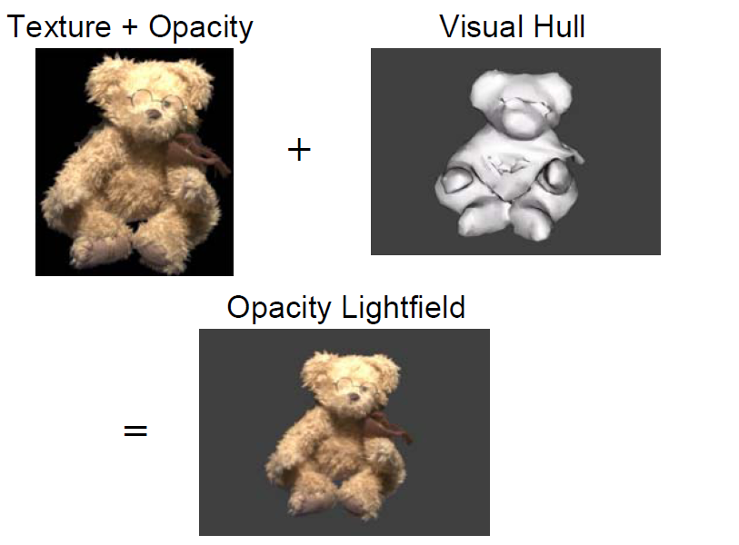
Opacity Lightfield

Slide 19
Why Points?
Generating a consistent triangle mesh or texture parameterization is time consuming and difficult
Points represent organic models (feathers, tree) much more readily than polygon models

Slide 20
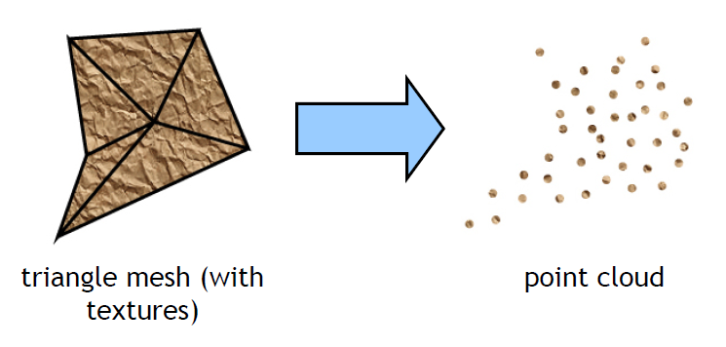
Points as Rendering Primitives
Point clouds instead of triangle meshes [Levoy and Whitted 1985]
2D vector versus pixel graphics

Slide 21
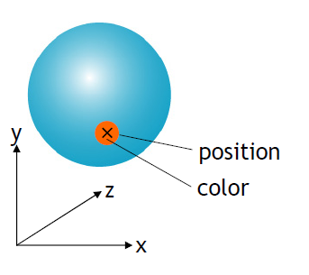
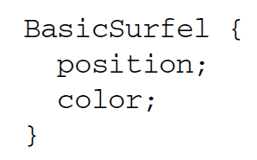
Surface Elements - Surfels
Each point corresponds to a surface element, or surfel, describing the surface in a small neighborhood
• Basic surfels:

Slide 22
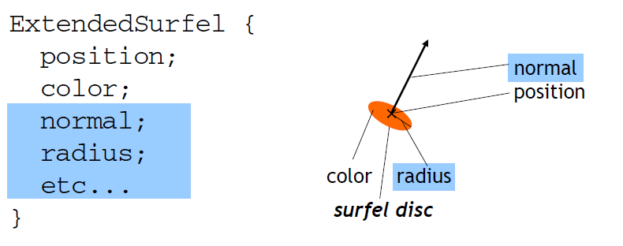
Surfels
Surfels can be extended by storing additional attributes

Slide 23
Point Rendering Pipeline
Simple, pure forward mapping pipeline
Surfels carry all information through the pipeline („surfel stream“)
See Zwicker, Point-Based Rendering

Slide 24
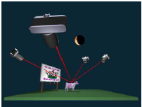
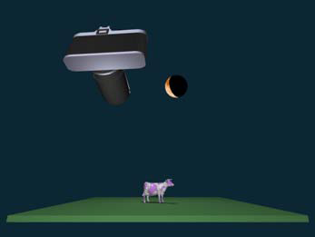
Color Blending
Unstructured Lumigraph blending [Buehler 2001]
Weights are based on angles between camera vectors and the new viewpoint

Slide 25
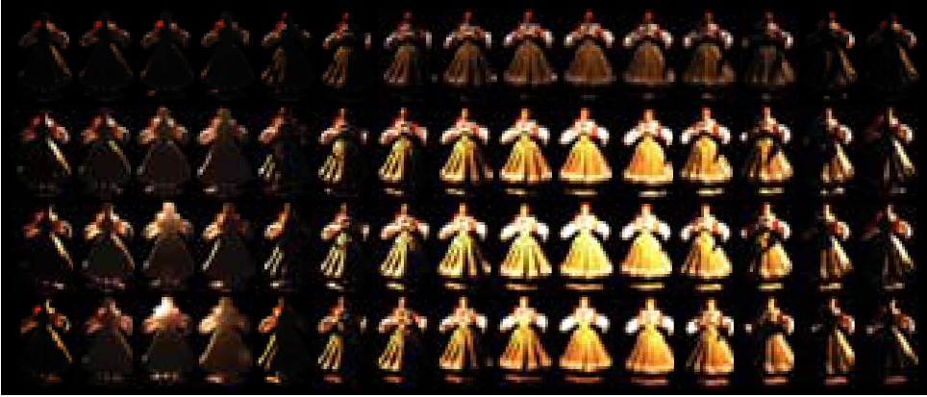
Relighting

Slide 26
Surface Reflectance Field

Slide 27
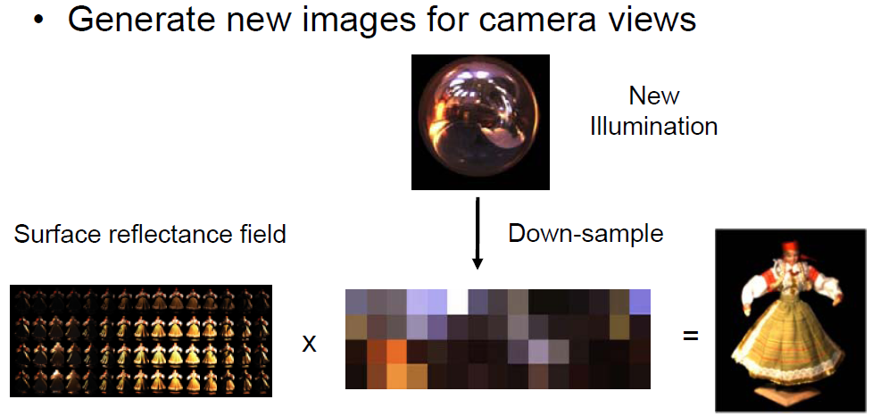
Relighting – 1st Step

Slide 28
Point-Based Rendering

Slide 29
Motivation
Performance of 3D hardware has exploded (e.g., GeForce FX: up to 338 million vertices per second, GeForce 6: 600 million vertices per second)
Projected triangles are very small (i.e., cover only a few pixels)
Overhead for triangle setup increases (initialization of texture filtering, rasterization)

Slide 30
3090
FX 5200
https://technical.city/en/video/GeForce-RTX-3090-vs-GeForce-FX-5200

Slide 31
Motivation
Simplifying the rendering pipeline by unifying vertex and fragment processing
A simpler, more efficient rendering primitive than triangles?

Slide 32
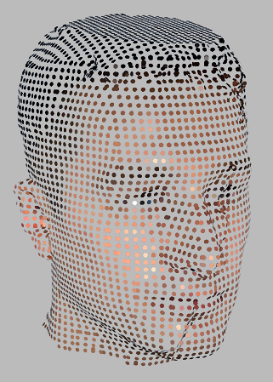
Point-Based Surface representation
Points are nonuniform samples of the surface
The point cloud describes:
3D geometry of the surface
Surface reflectance properties (e.g., diffuse
color, etc.)
Points discretize geometry and appearance at the same rate
• There is no additional information, such as
connectivity (i.e., explicit neighborhood information between points)
texture maps, bump maps, etc.

Slide 33
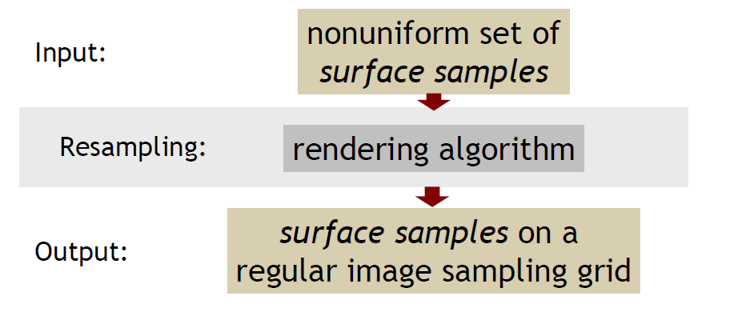
Rendering by Resampling
Resampling involves reconstruction, filtering, and sampling
The resampling approach prevents artifacts such as holes and aliasing

Slide 34
Rendering pipeline

Slide 35
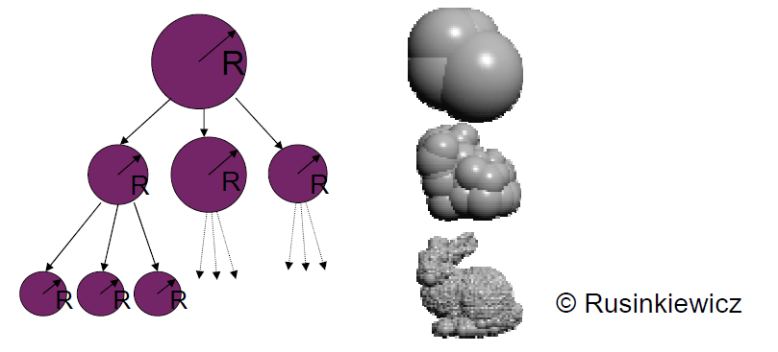
Qsplat
Q-Splat
Rusinkiewicz et al., Siggraph 2000
hierarchical point rendering
based on bounding sphere hierarchy

Slide 36
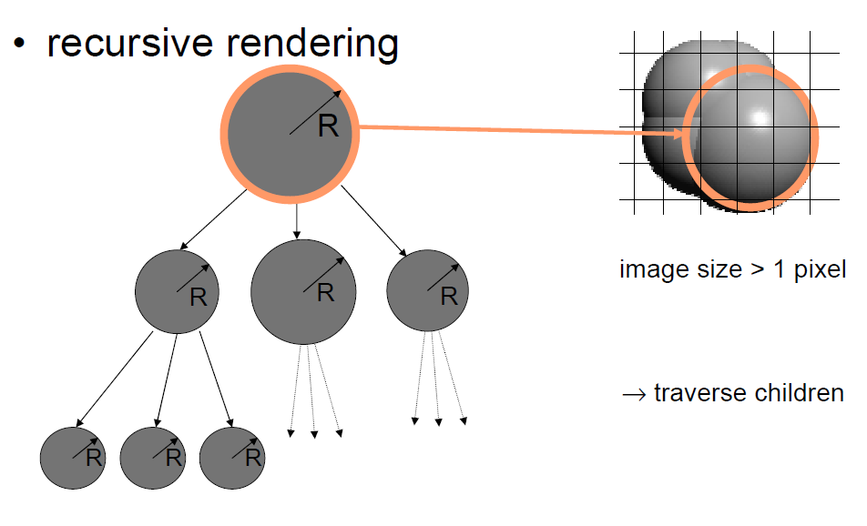

Slide 37
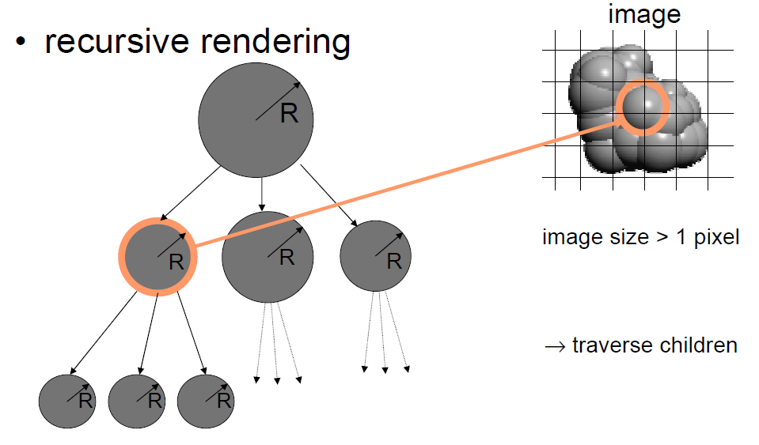

Slide 38
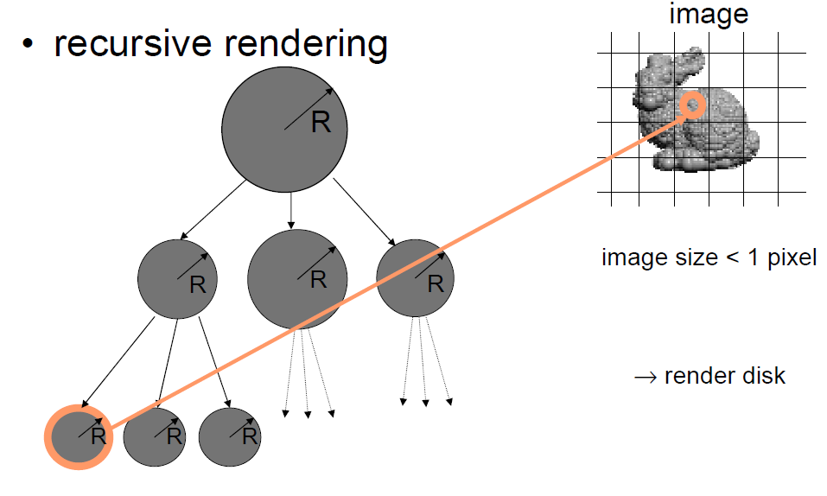

Slide 39
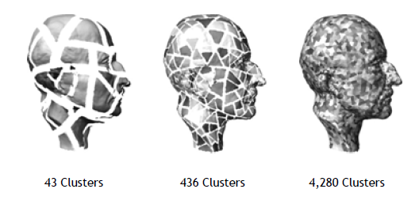
Hierarchical Clustering

Slide 40
Hierarchical Processing
straightforward, but drawbacks
not continuously stored in array
not sequential
traversal by CPU, rendering by GPU
CPU is bottleneck
→ sequential version ?

Slide 41
Sequential Point Trees
Q-Splat: render node if
image size ≤ threshold and
image size of parent > threshold
image size = radius / view distance
store with node n.dmin = n.radius / threshold
render node n if
view distance(n) ≥ n.dmin and
view distance(parent) < parent.dmin

Slide 42
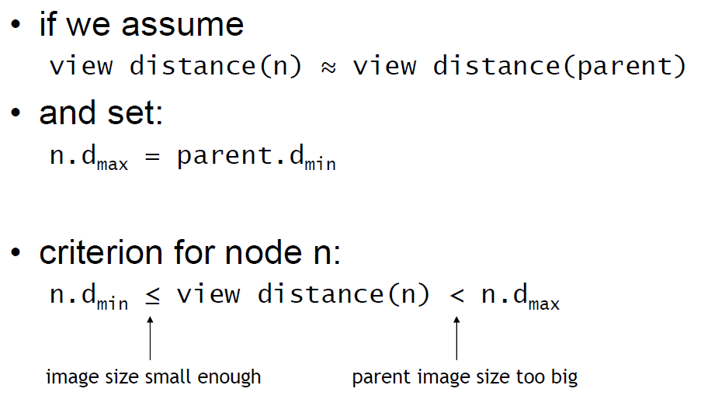
Sequential Point Trees

Slide 43
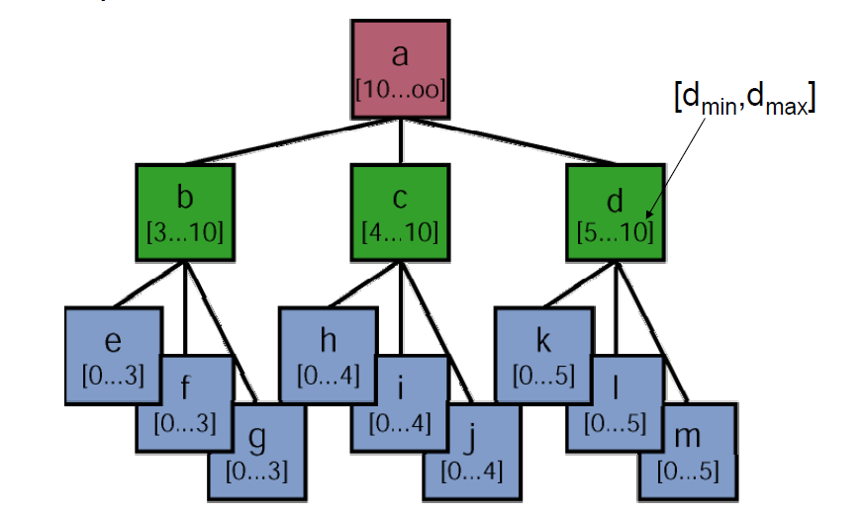

Slide 44
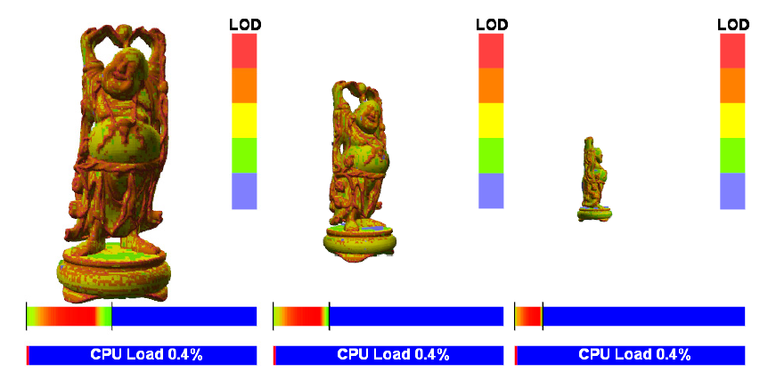
Sequential Point Trees

Slide 45
Neighborhood

Slide 46
Neighborhood

Slide 47
Neighborhood

Slide 48
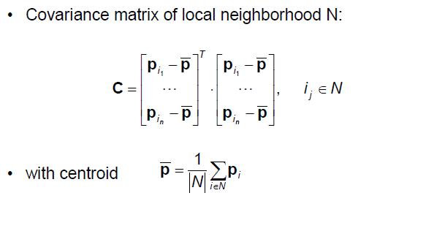
Covariance Analysis

Slide 49
Covariance Analysis

Slide 50
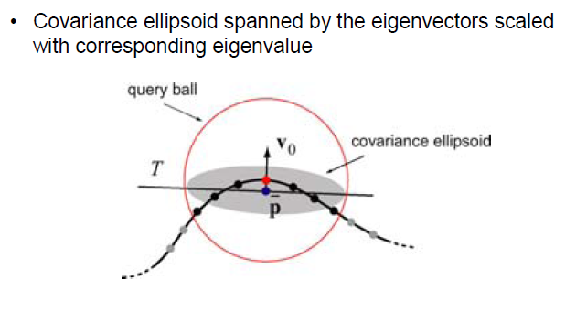
Covariance Analysis

Slide 51
Covariance Analysis

Slide 52
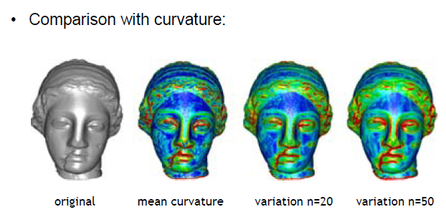
Covariance Analysis

Slide 53
Rendering pipeline

Slide 54
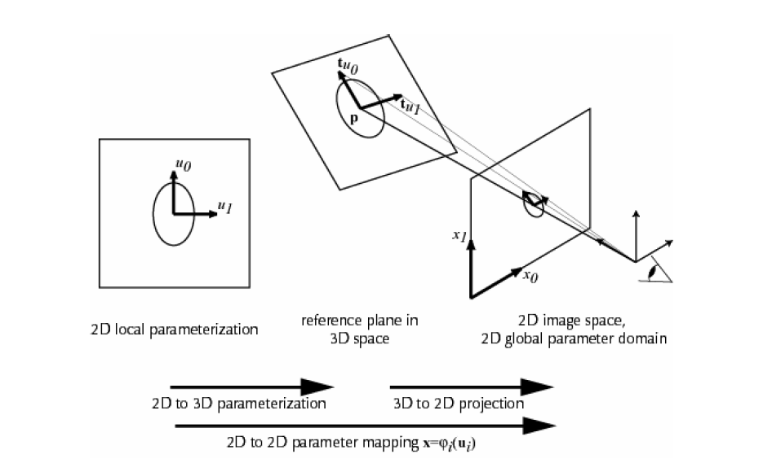
Wraping

Slide 55
Rendering pipeline

Slide 56
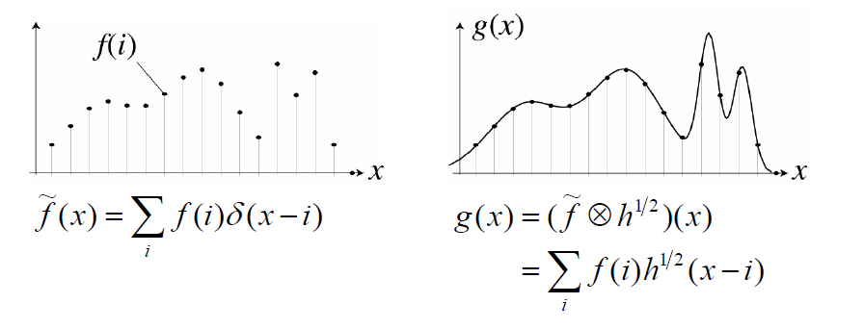
Continuous Reconstruction
For uniform samples, use signal processing theory
Reconstruction by convolution with low-pass (reconstruction) filter
Exact reconstruction of band-limited signals using ideal low-pass filters

Slide 57
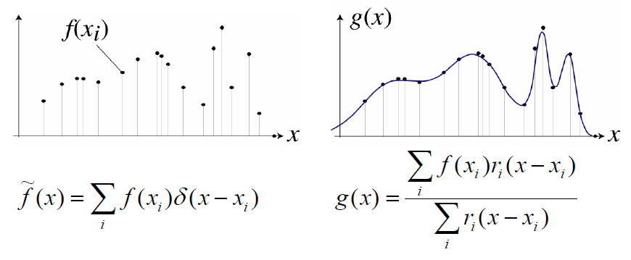
Continuous Reconstruction
Signal processing theory not applicable for nonuniform samples
Local weighted average filtering
Normalized sum of local reconstruction kernels

Slide 58
Nonuniform Reconstruction
Local weighted average filtering
Simple
Efficient
No guarantees about reconstruction error
Normalization division ensures perfect flat field response
Choice of reconstruction kernels based on local sampling density [Zwicker 2003]

Slide 59
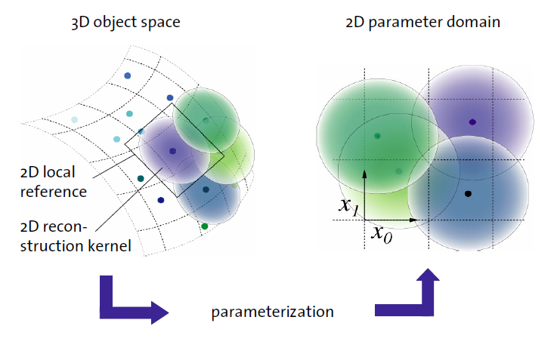
Parameterized Reconstruction

