Slide 1
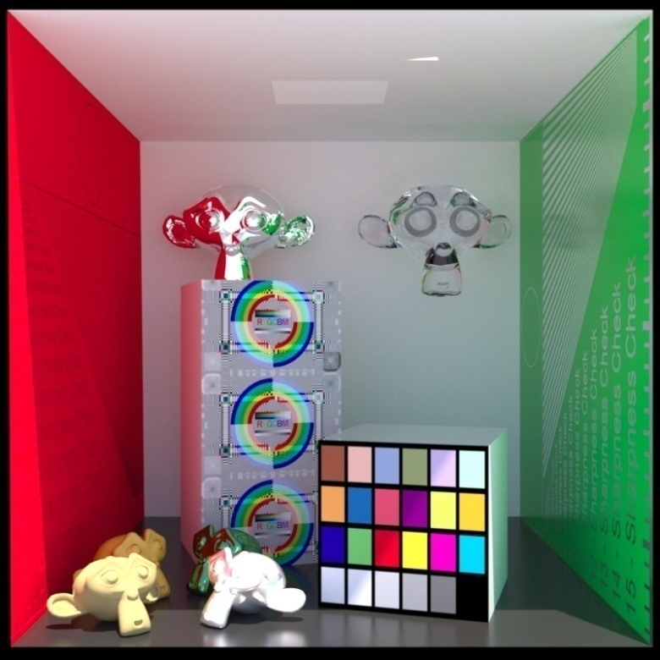
Advanced Computer Graphics
Global Illumination - OptiX
Ming-Te Chi
Department of Computer Science,
National Chengchi University
Notes:
2021
The image is made by LuxRender. http://www.luxrender.net/

Slide 2
Outline
Parallel computing
  CUDA (Compute Unified Device Architecture)
OptiX
Notes:
CUDA (formerly Compute Unified Device Architecture) is a parallel computing platform and programming model
Optix 3.9 in dec/2015

Slide 3
Parallel computing

Slide 4
OpenMP
#include <omp.h> //note: set compiler flag: /openmp
#include <stdio.h>
#include <stdlib.h>
void Test( int n ) {
for( int i = 0; i < 10000; ++i ) { //do nothing, just waste time }
printf( "%d, ", n );
}
int main(int argc, char* argv[])
{
#pragma omp parallel for
for( int i = 0; i < 10; ++ i )
Test( i );
system( "pause" );
}
Notes:
http://openmp.org/wp/
http://kheresy.wordpress.com/tag/openmp/

Slide 5
add
void add( float a[], float b[], float c[], int N ) {
for( int i = 0; i < N; ++i ) {
c[i] = a[i]+b[i];
}
}

Slide 6
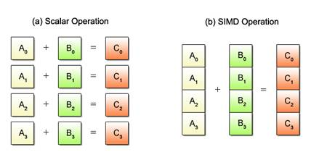
SIMD
int a[4] __attribute__((aligned(16))) = { 1, 3, 5, 7 };
int b[4] __attribute__((aligned(16))) = { 2, 4, 6, 8 };
int c[4] __attribute__((aligned(16)));
__vector signed int *va = (__vector signed int *) a;
__vector signed int *vb = (__vector signed int *) b;
__vector signed int *vc = (__vector signed int *) c;
*vc = vec_add(*va, *vb); // 1 + 2, 3 + 4, 5 + 6, 7 + 8
From cell
Notes:
https://www.kernel.org/pub/linux/kernel/people/geoff/cell/ps3-linux-docs/CellProgrammingTutorial/BasicsOfSIMDProgramming.html

Slide 7
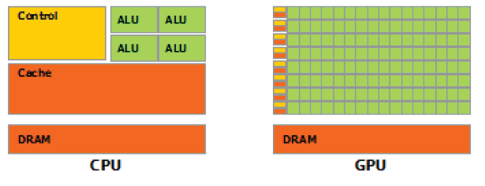
CPU vs GPU
Notes:
http://www.youtube.com/watch?v=fKK933KK6Gg
http://www.youtube.com/watch?v=poEm3NswYVg
NVIDIA: Mythbusters Adam & Jamie draw mona in 80 milliseconds

Slide 8
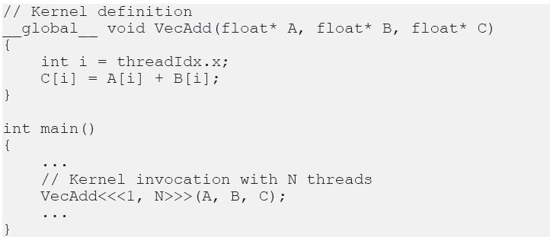
CUDA - Kernels and Thread
Notes:
Host vs Device

Slide 9
NVCC
nvcc: nVidia Cuda Compiler:
  Compile cu into PTX
cu: c language with extension
PTX: binary in CUDA instruction set architecture. (virtual assemble language)
Notes:
PTX: PARALLEL THREAD EXECUTION

Slide 10
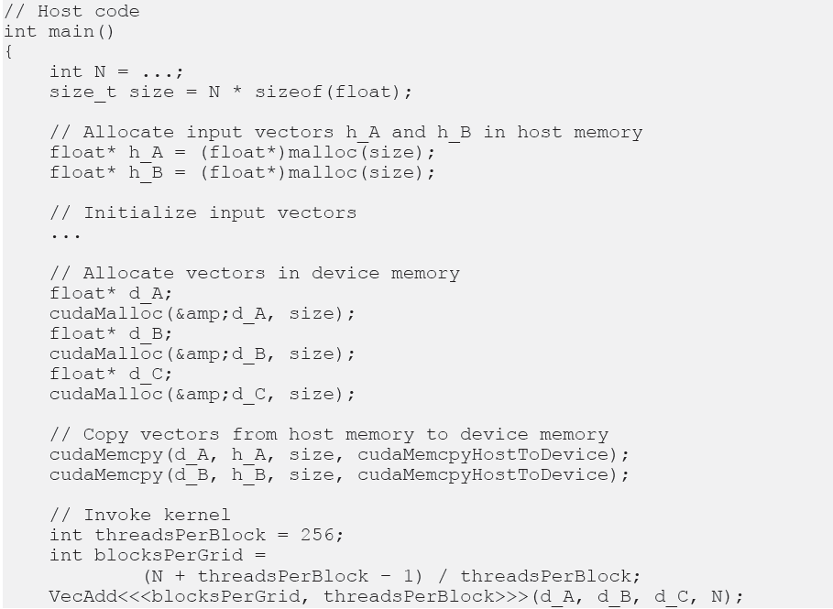
CPU to GPU

Slide 11
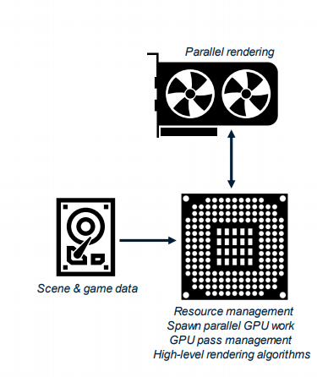
Modern Graphics APIs
Two main parts:
GPU device code (aka “shaders”):
  Includes parallel rendering and other parallel tasks
  Simplified; writing parallel code looks like serial code
CPU host code (often “DirectX API”):
  Manages memory resources (disk → CPU ↔ GPU)
  Sets up, controls, manages, spawns GPU tasks
  Defines shared graphics data structures (like ray accelerations structures)
  Allows higher-level graphics algorithms requiring multiple passes
Icons: CC-Attribution-3.0, by Matthias Smit, Mahmure Alp, and Georgiana Ionescu
Notes:
s2018_IntroDXR_RaytracingShaders.pdf

Slide 12
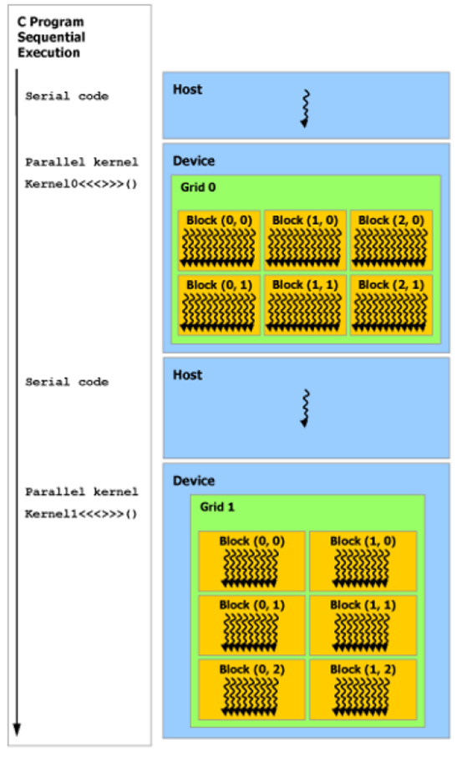
Execution flow
Icons: CC-Attribution-3.0, by Matthias Smit, Mahmure Alp, and Georgiana Ionescu

Slide 13
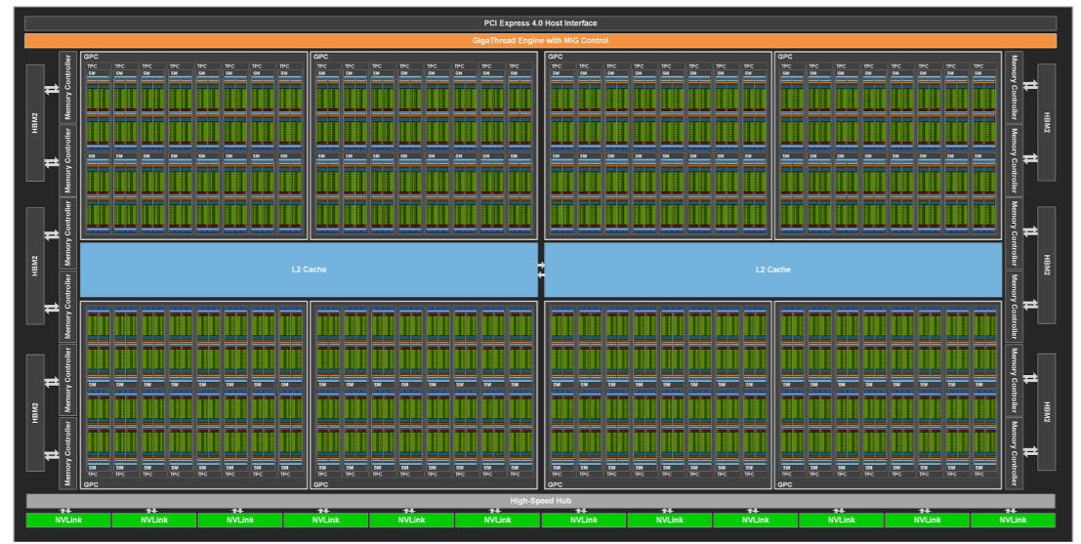
GA100 Full GPU with 128 SMs

Slide 14
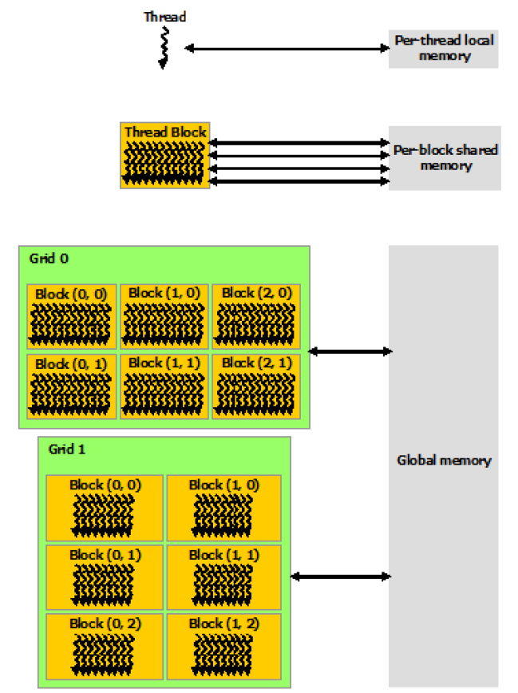
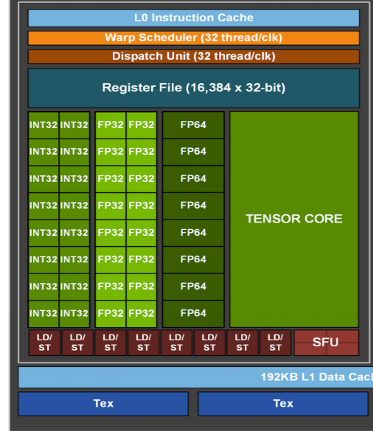
Memory Hierarchy
Notes:
Left: memory hierarchy
Right: execution flow

Slide 15
Introduction to DirectX RayTracing
ACM SIGGRAPH 2018 Courses

Slide 16
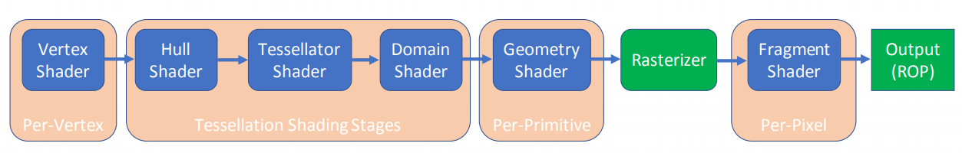
DirectX Rasterization Pipeline

Slide 17
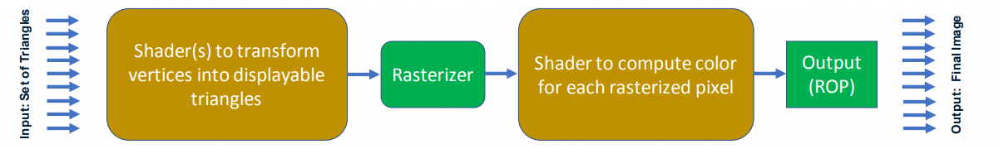
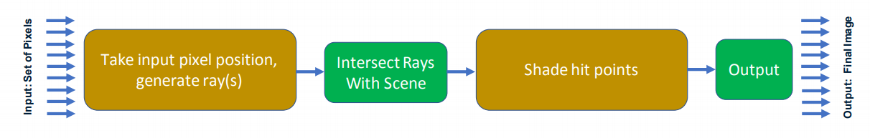
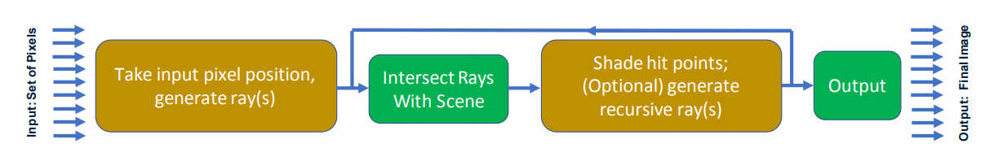

Slide 18
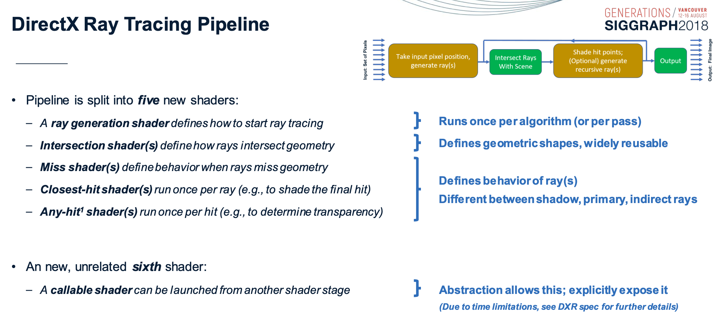

Slide 19
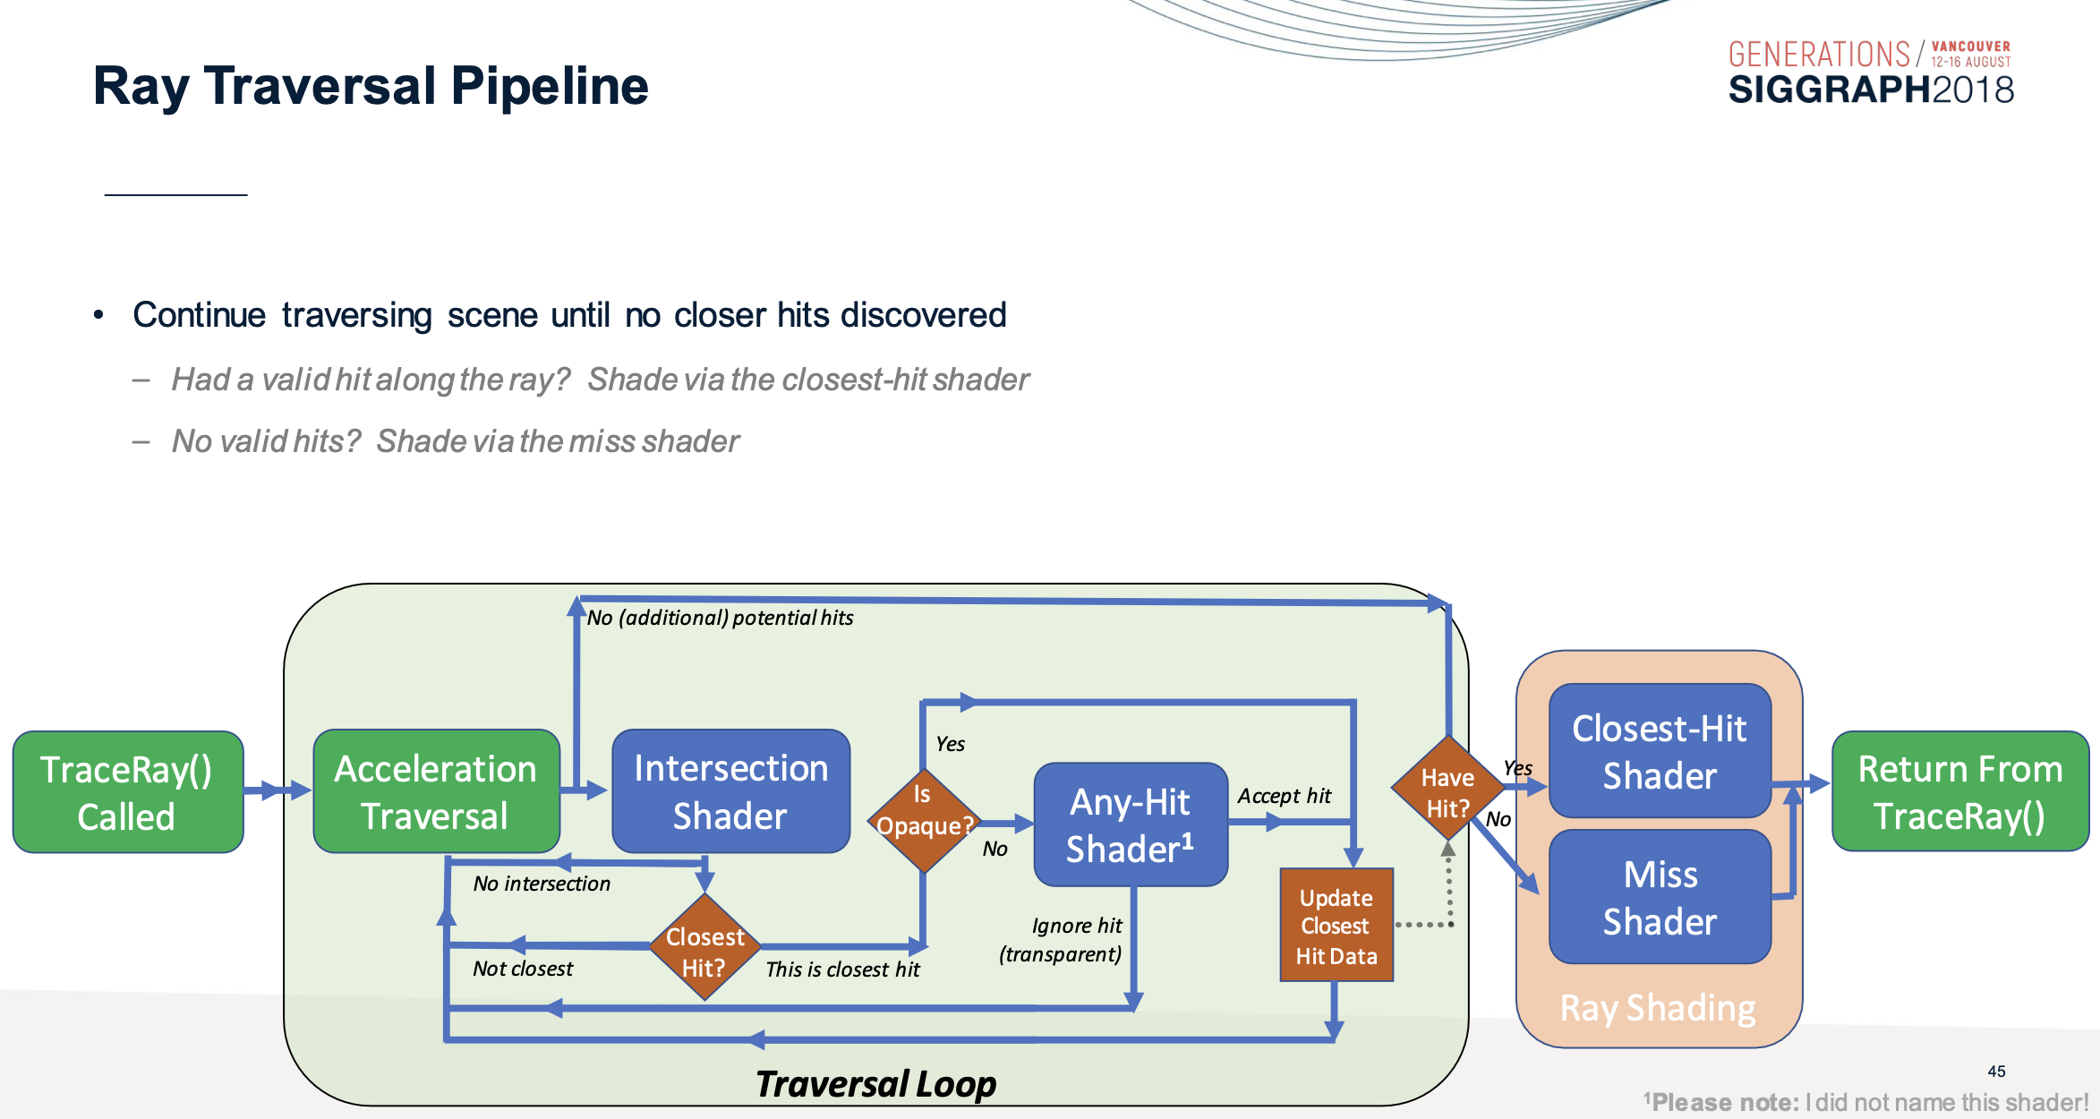

Slide 20
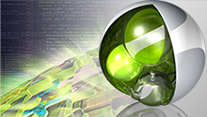
OptiX 5 current: 7.2.0 (Oct 2020)
Notes:
http://www.nvidia.com/object/optix.html
https://developer.nvidia.com/blog/how-to-get-started-with-optix-7/

Slide 21
Document
OptiX: A scalable framework for ray-tracing based application.
OptiX Programming Guide
  Host-based API
  CUDA c-based system that produce ray, intersection, …
OptiX Quickstart Guide
  How to implement several basic ray tracing effects, from trivially simple to moderately complex.

Slide 22
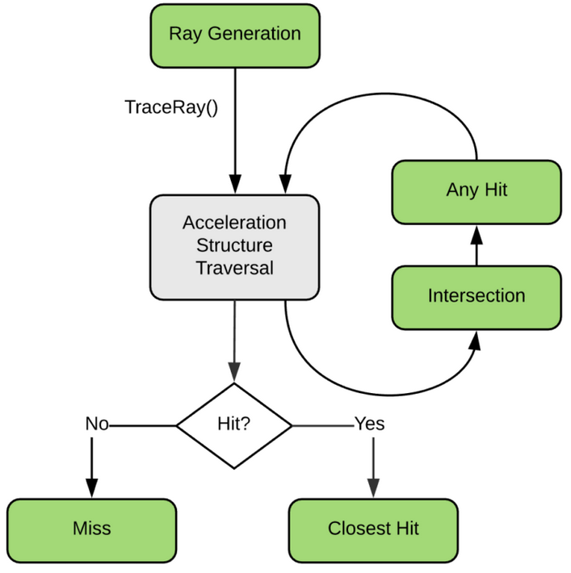
Document

Slide 23
Object model
Context
Program
Variable
Buffer
Texture sampler
Group
  Geometry Group
  Transform
  Selector
  Acceleration
Geometry Instance
  Geometry
  Material

Slide 24
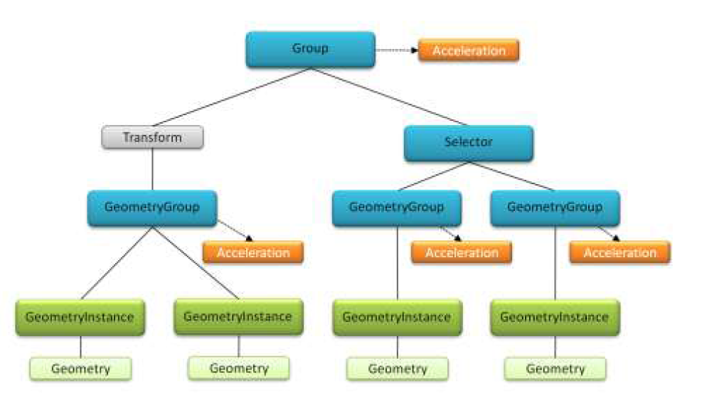
Node graph - Scence

Slide 25
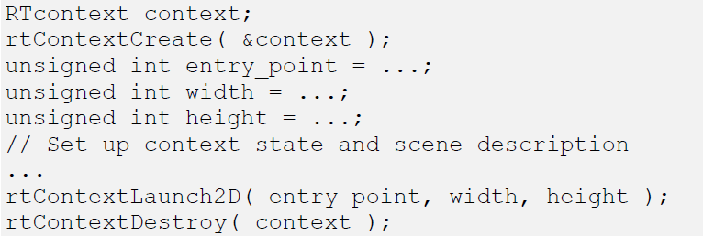
Host - Context
Notes:
Primary Ray

Slide 26
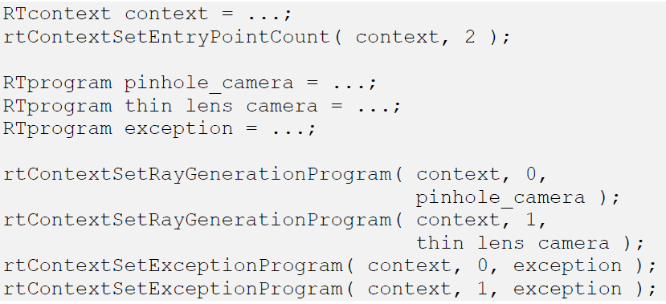
Host – entry points
Notes:
http://en.wikipedia.org/wiki/Thin_lens

Slide 27
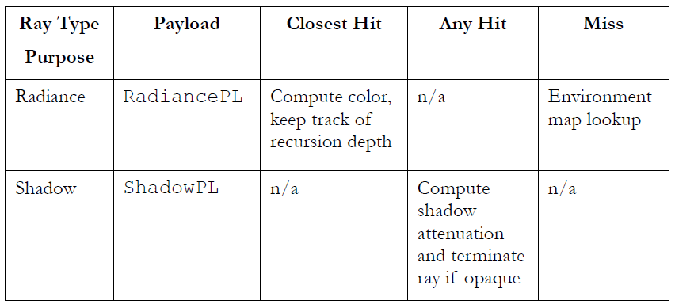
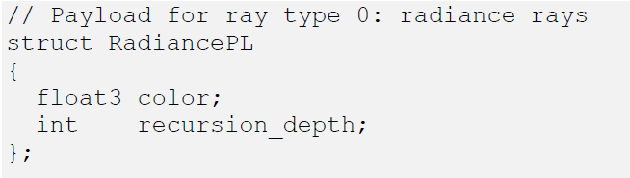
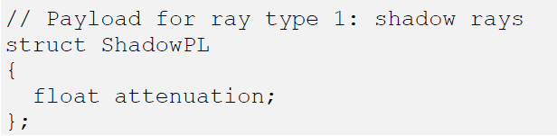
Programs - Ray Type
Notes:
Whitted style ray tracer

Slide 28
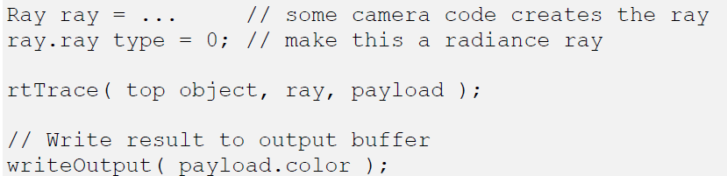
Radiance

Slide 29
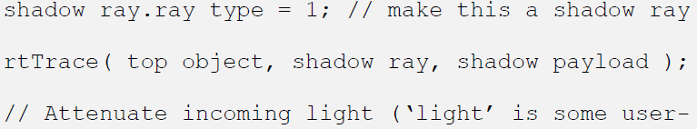
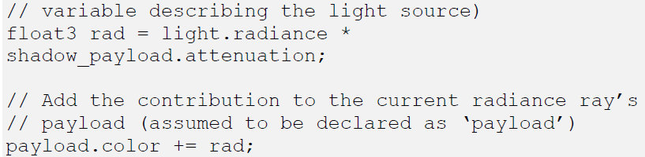
Shadow ray

Slide 30
Geometry Instance
Geometry Instance
  Geometry
    IntersectionProgram
    BoundingBoxProgram
  Material
    ClosestHitProgram
    AnyHitProgram

Slide 31
Programs
Ray Generation
  camera
Closest Hit
  shading
Any Hit
  Shadow ray
Miss
  background/environment
Exception
  Bad pixel / Print error
Intersection
  ray-primitive
Bounding Box
  Ray-bounding box
Visit
Notes:
Written in CUDA c

Slide 32
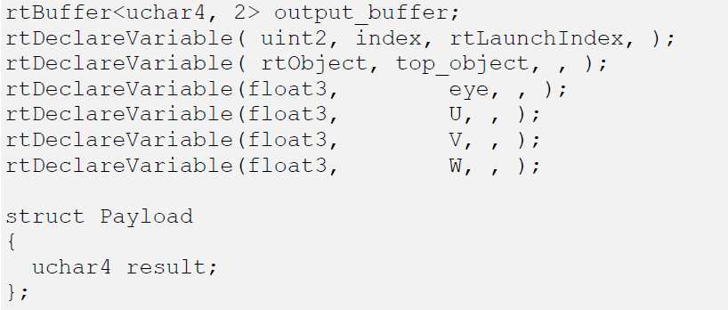
Programs – Ray Generation(1)

Slide 33
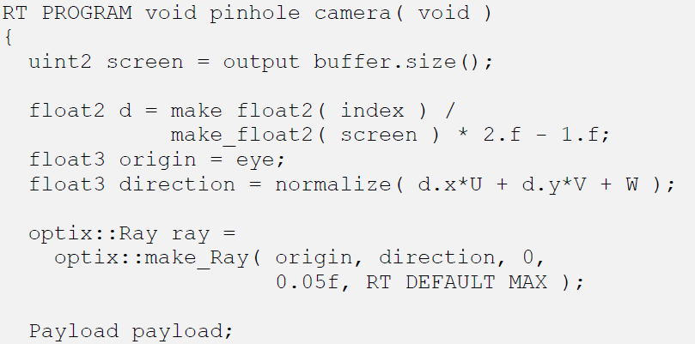
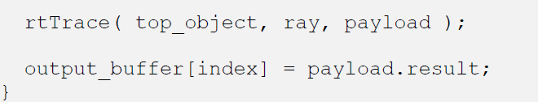
Programs – Ray Generation(2)
Notes:
// Set up camera
camera_data = InitialCameraData( make_float3( 14.0f, 14.0f, 14.0f ), // eye
make_float3( 0.0f, 7.0f, 0.0f ), // lookat
make_float3( 0.0f, 1.0f, 0.0f ), // up
45.0f ); // vfov
// Declare camera variables. The values do not matter, they will be overwritten in trace.
m_context["eye"]->setFloat( make_float3( 0.0f, 0.0f, 0.0f ) );
m_context["U"]->setFloat( make_float3( 0.0f, 0.0f, 0.0f ) );
m_context["V"]->setFloat( make_float3( 0.0f, 0.0f, 0.0f ) );
m_context["W"]->setFloat( make_float3( 0.0f, 0.0f, 0.0f ) );

Slide 34
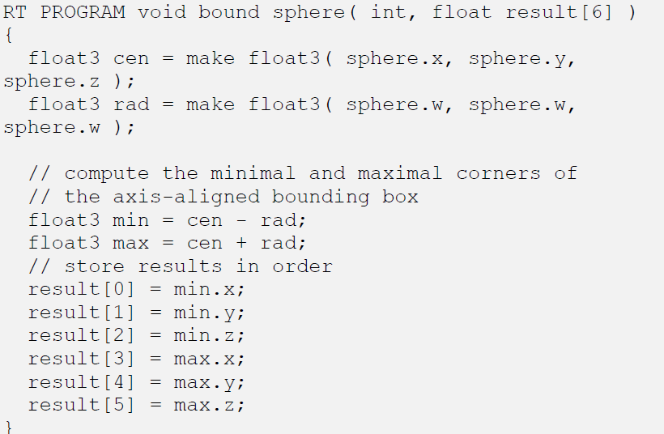
Programs – bounding box

Slide 35
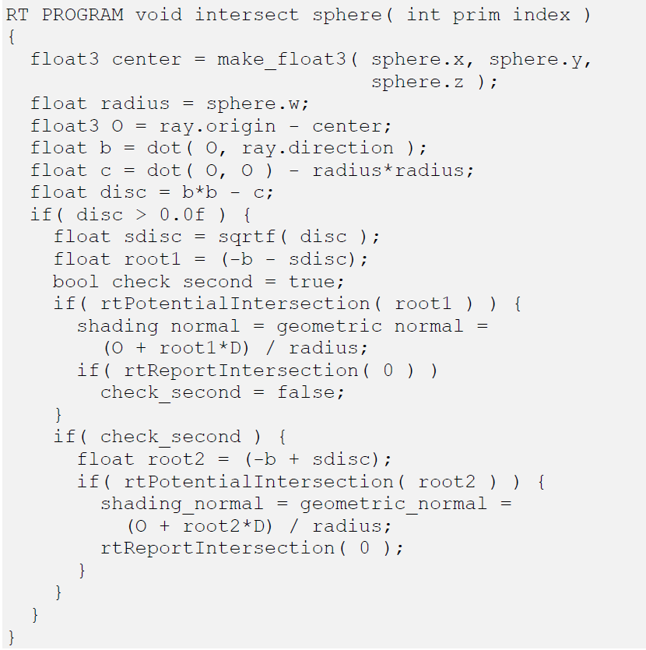
Programs – Intersection
Notes:
rtDeclareVariable(float4, sphere, , );
rtDeclareVariable(float3, geometric_normal, attribute geometric_normal, );
rtDeclareVariable(float3, shading_normal, attribute shading_normal, );
rtDeclareVariable(optix::Ray, ray, rtCurrentRay, );

Slide 36
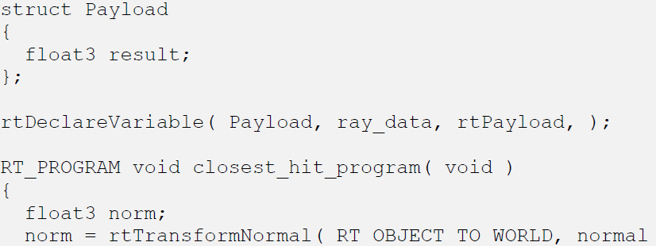

Programs – Closest Hit

Slide 37
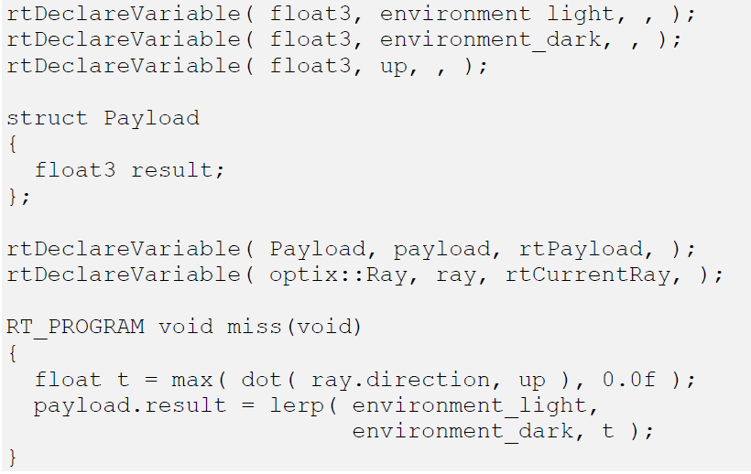
Programs – Miss

Slide 38
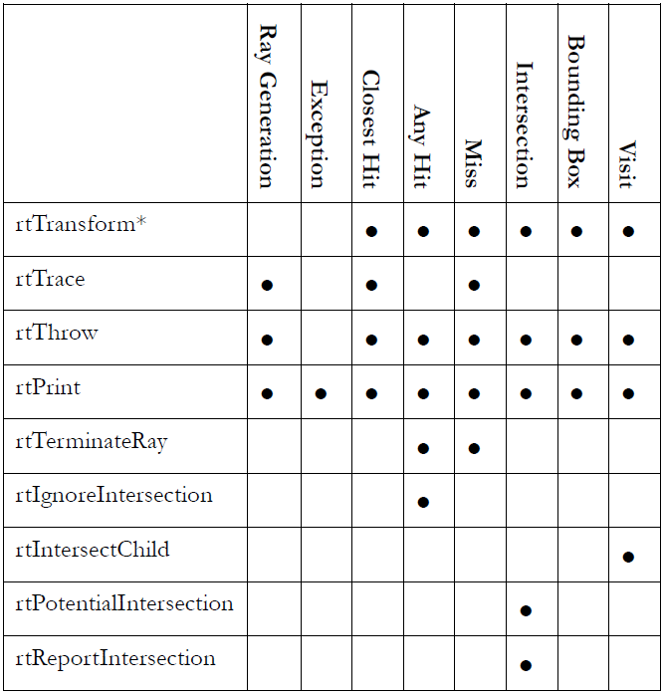
Supported OptiX call

Slide 39

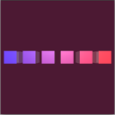
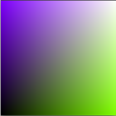

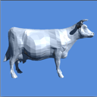
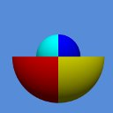
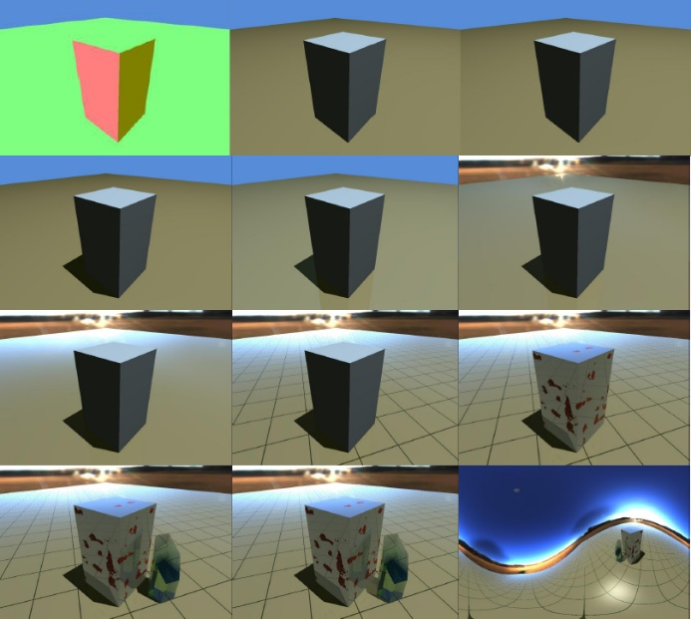
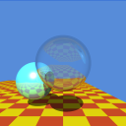
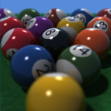
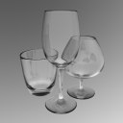
sample
Sample 1~8
Whitted, Cook, glass, Tutorial

Slide 40
Host - SampleScene.h
class SampleScene {
// Create the optix scene and return initial viewing parameters
virtual void initScene( InitialCameraData& camera_data )=0;
// Update camera shader with new viewing params and then trace
virtual void trace( const RayGenCameraData& camera_data )=0;
// Return the output buffer to be displayed
virtual optix::Buffer getOutputBuffer()=0;
// Optional virtual interface
virtual void cleanUp();
virtual void resize(unsigned int width, unsigned int height);
virtual bool keyPressed(unsigned char key, int x, int y)
}
Notes:
In SDK/sutil/GLUTDisplay.h, include “SampleScene.h”
sutil = samples_util

Slide 41
void Tutorial::trace( const RayGenCameraData& camera_data )
{
m_context["eye"]->setFloat( camera_data.eye );
m_context["U"]->setFloat( camera_data.U );
m_context["V"]->setFloat( camera_data.V );
m_context["W"]->setFloat( camera_data.W );
Buffer buffer = m_context["output_buffer"]->getBuffer();
RTsize buffer_width, buffer_height;
buffer->getSize( buffer_width, buffer_height );
m_context->launch( 0, static_cast<unsigned int>(buffer_width),
static_cast<unsigned int>(buffer_height) );
}

Slide 42
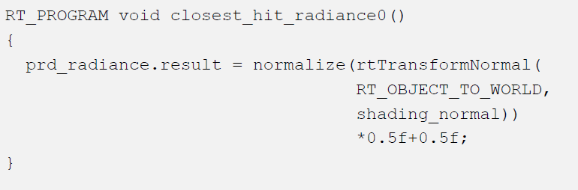
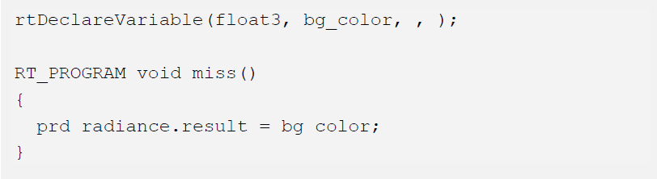
Tutorial 0 – Normal shader
Intersection()
rtTrace()

Slide 43
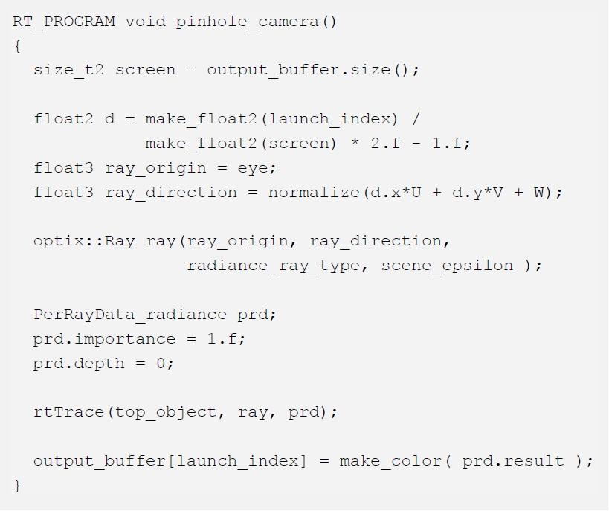

Slide 44
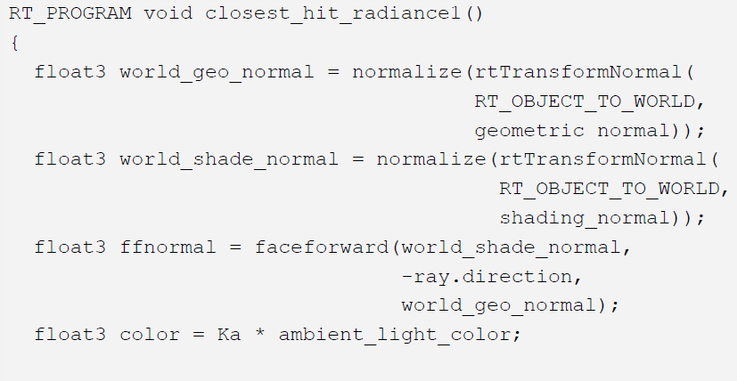
Tutorial 1 – Diffuse shader
Notes:
float3 faceforward( float3 N, float3 I, float Ng )
{ return dot(I, Ng) < 0 ? N : -N; }
NPeturbed normal vector.
IIncidence vector (typically a direction vector from the eye to a vertex).
NgGeometric normal vector (for some facet the peturbed normal belongs).

Slide 45
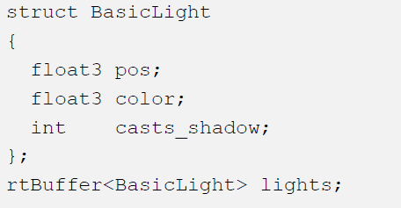
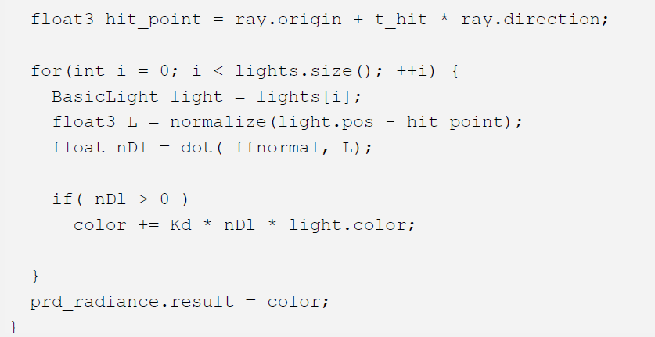
Light
ffnormal
Ray.origin
L
hit_point

Slide 46
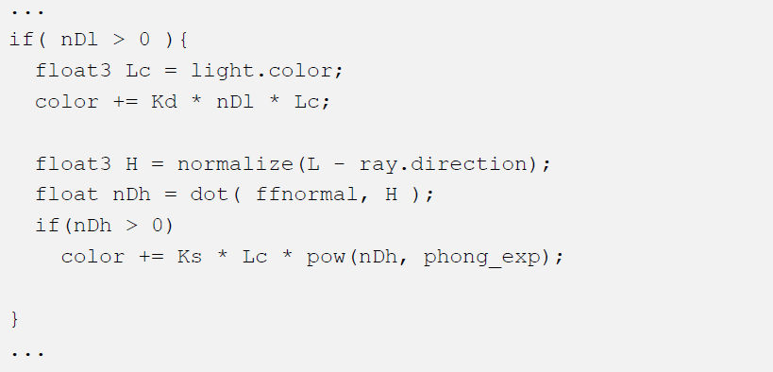
Tutorial 2 – Phong Highlight
Half vector
Light
ffnormal
Ray.origin
L
hit_point

Slide 47

Tutorial 3 - Shadows

Slide 48

Light
ffnormal
Ray.origin
L
hit_point

Slide 49
Tutorial 7 - Simple Procedural Texture

Slide 51
Tutorial 8 - Complex Procedural Texture

