Slide 1
Advanced Computer Graphics
Introduction
Ming-Te Chi
Department of Computer Science,
National Chengchi University
Notes:
2018

Slide 2
Rendering pipeline

Slide 3
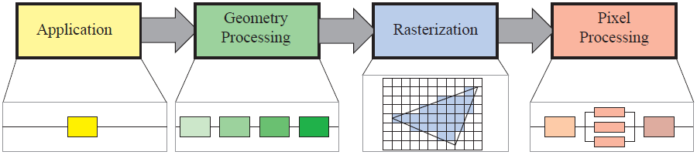
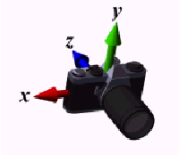
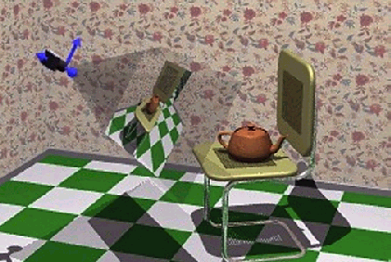
Graphics Rendering pipeline
from
Real-Time Rendering, by Tomas Akenine-Möller, Eric Haines

Slide 4
Following the Pipeline:
Transformations
Much of the work in the pipeline is in converting object representations from one coordinate system to another
  World coordinates
  Camera coordinates
  Screen coordinates
Every change of coordinates is equivalent to a matrix transformation

Slide 5
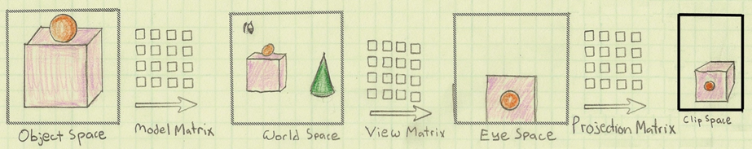
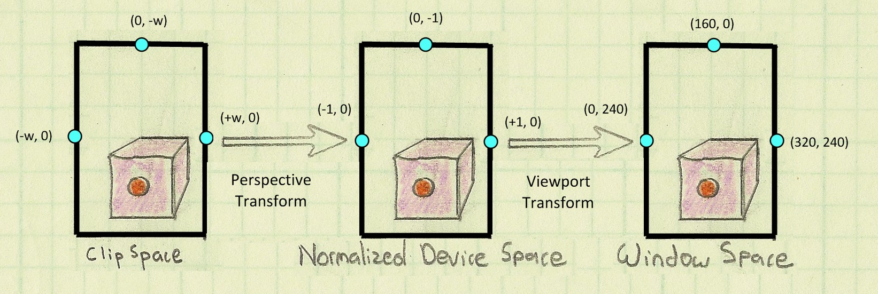
The Life of a vertex
Image by Philp Rideout

Slide 6
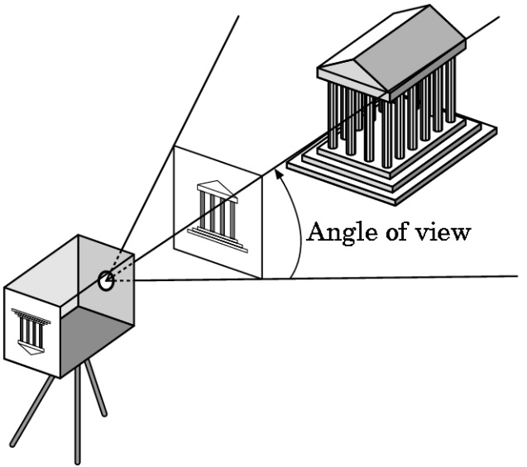
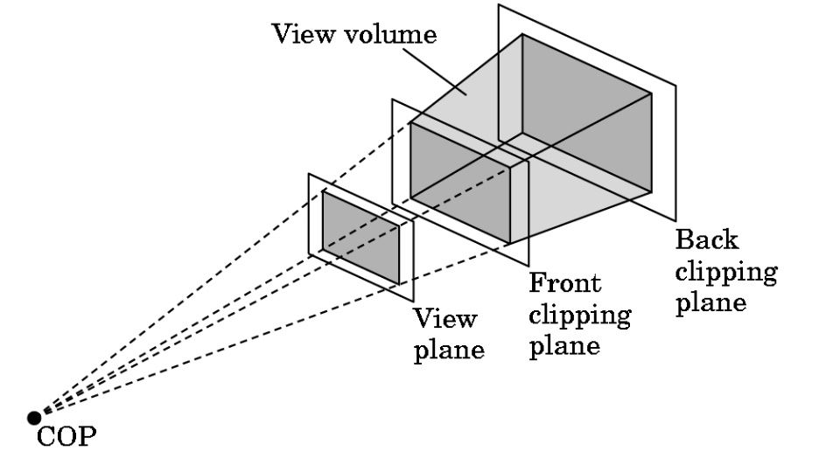
Clipping
Just as a real camera cannot “see” the whole world, the virtual camera can only see part of the world space
  Objects that are not within this volume are said to be clipped out of the scene

Slide 7
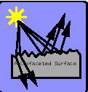
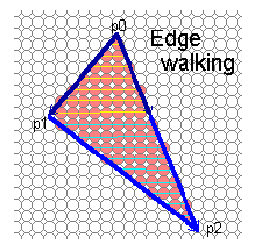
Rasterization
If an object is visible in the image, the appropriate pixels in the frame buffer must be assigned colors
  Vertices assembled into objects
  Effects of lights and materials must be determined
  Polygons filled with interior colors/shades
  Must have also determine which objects are in front (hidden surface removal)

Slide 8
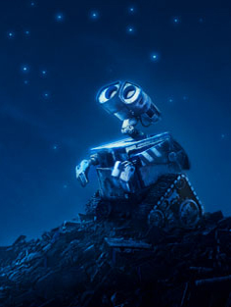
What is next?
Notes:
Image copyright by TM & © 1995- 2009 Disney/Pixar.

Slide 9
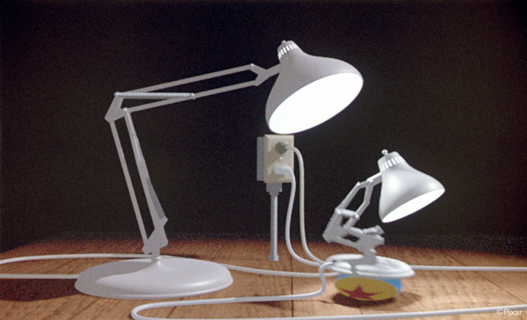
Luxo Jr. 1988. by Pixar

Slide 10
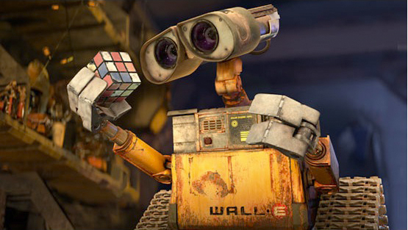
Devil is in the detail
Wall E 2008. by Disney/Pixar

Slide 11


Inside out 2015 by Disney/Pixar
Coco 2017 by Disney/Pixar

Slide 12
Topics
  (Real-time) Physically based rendering
  Style transfer/generation (NPR)
  Texture synthesis
  Computational photography
  Interactive Computer Graphics
  Valkun
  Information Visualization

Slide 13
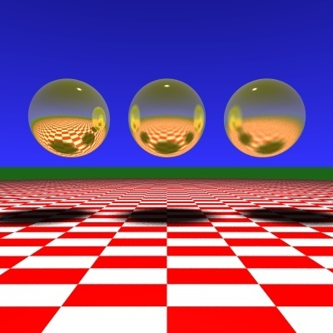
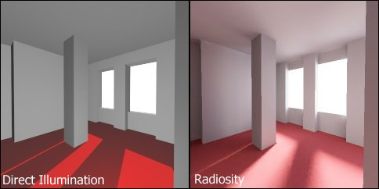
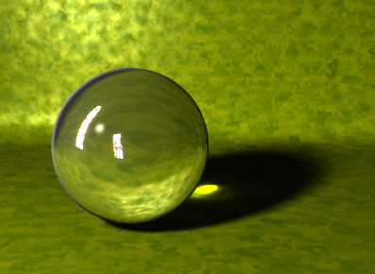
  Physically based rendering
Ray tracing
Radiosity
Photon mapping

Slide 14
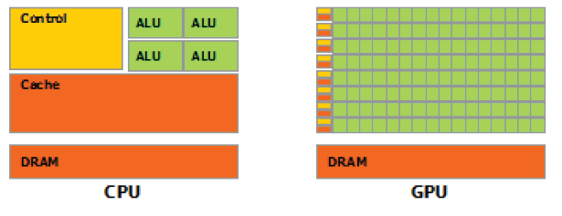
Real-time Physically based rendering
GPGPU
NVIDIA® OptiX™ Ray Tracing Engine

Slide 15
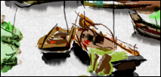
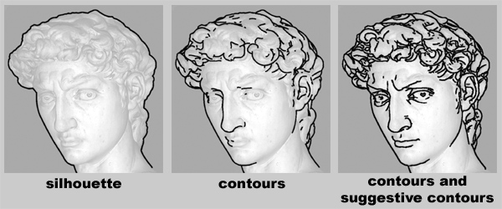
  Non-Photorealistic Rendering
Feature Edges
Stroke-based illustrations
Lighting models for NPR
Simulating Natural Media

Slide 16
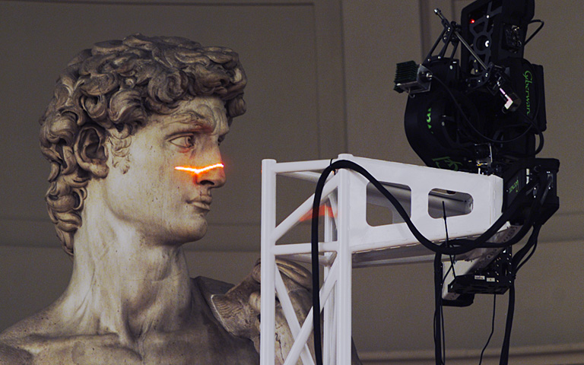
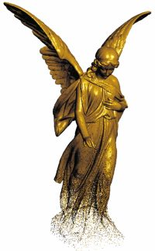
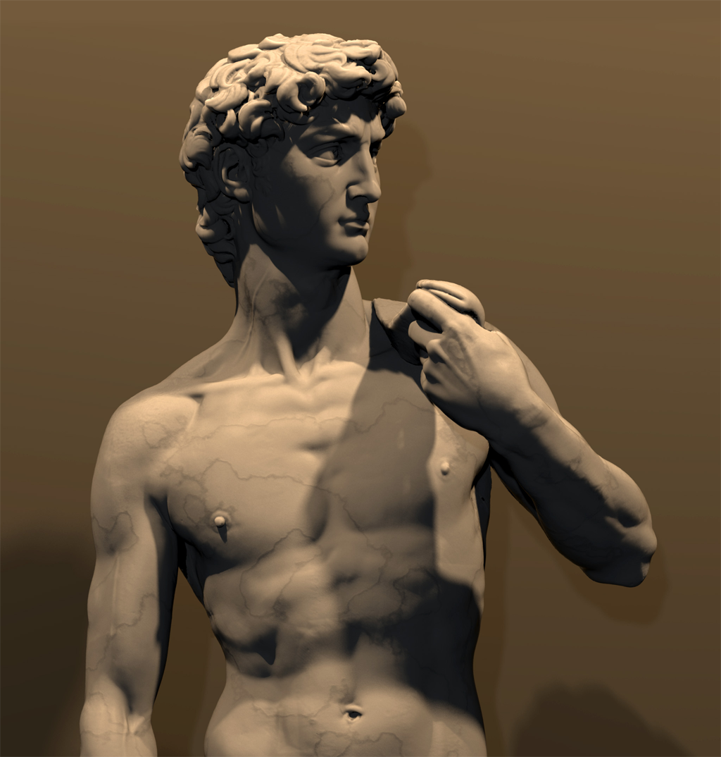
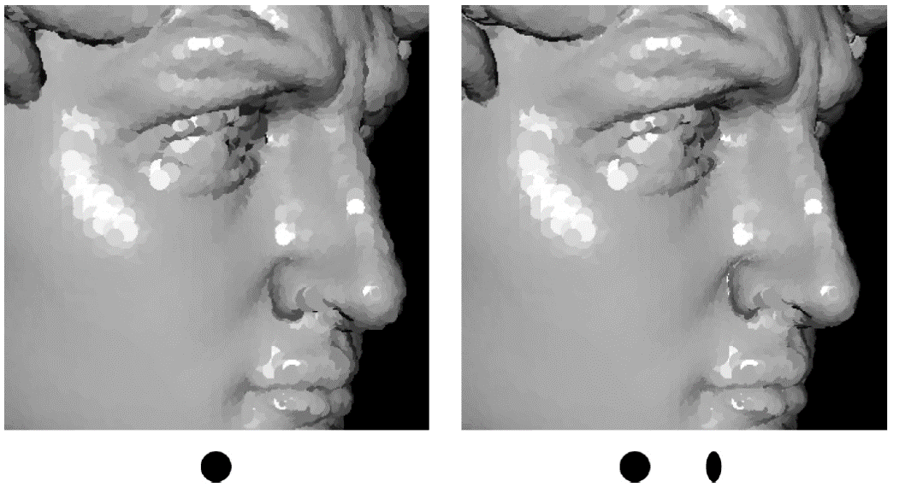
  Point-based rendering

Slide 17
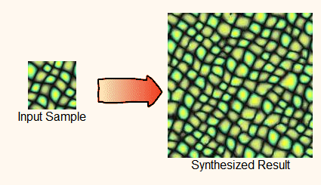
  Texture synthesis

Slide 18
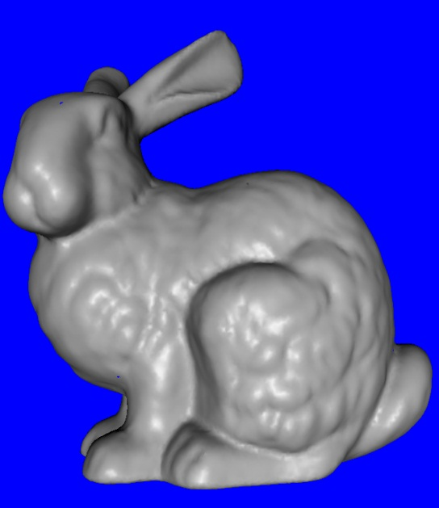
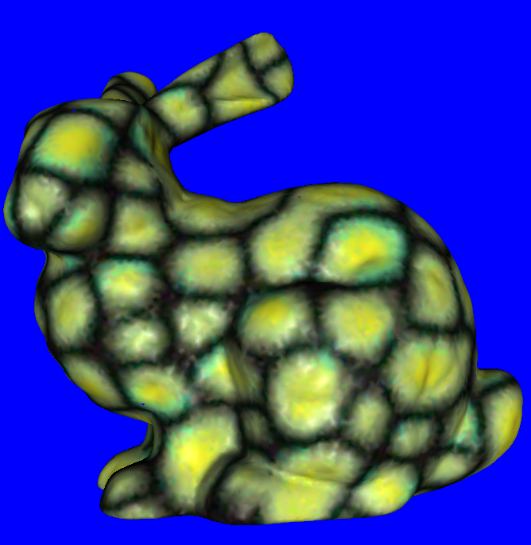

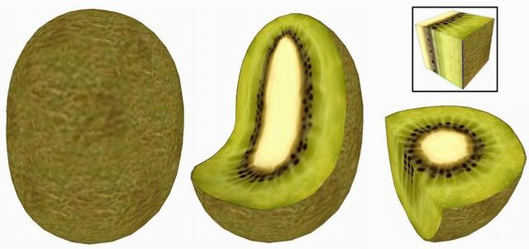
+
Input Texture
Input Mesh
Result
Notes:
Lapped Solid Textures: Filling a Model with Anisotropic Textures

Slide 19
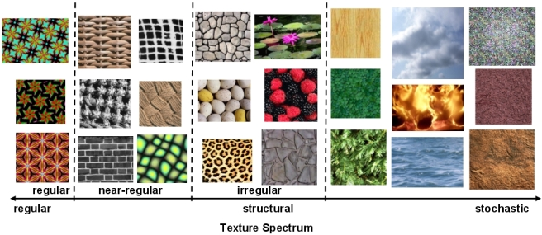
Texture Spectrum

Slide 20
Style transfer
A Neural Algorithm of Artistic Style
Notes:
https://arxiv.org/abs/1508.06576

Slide 21
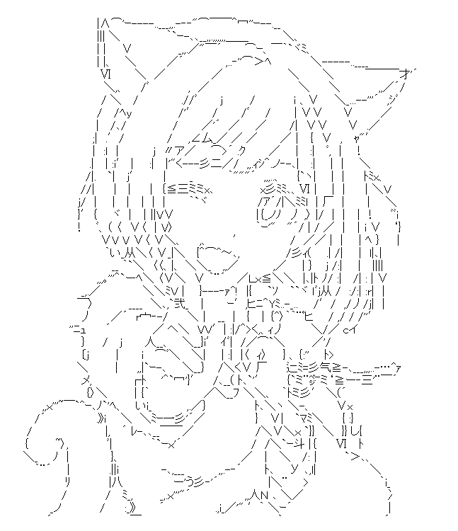
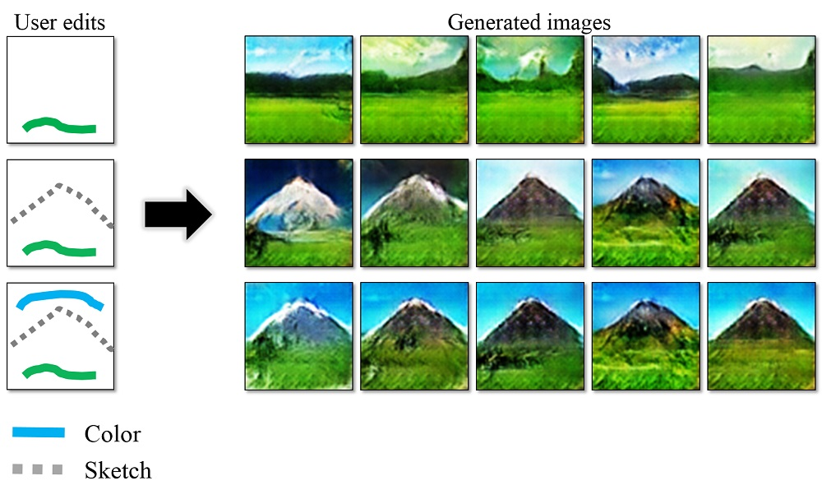
Style generation
Notes:
https://github.com/junyanz/iGAN

Slide 22
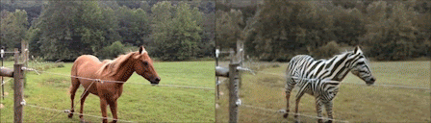
CycleGAN [2017]

Slide 23
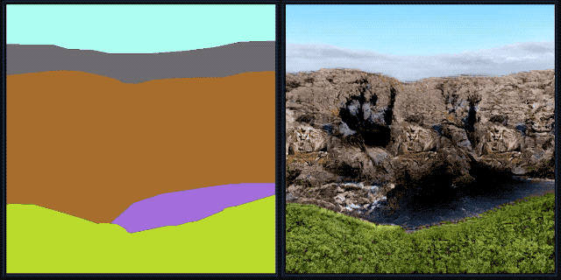
GauGAN [2019]
https://blogs.nvidia.com/blog/2019/03/18/gaugan-photorealistic-landscapes-nvidia-research/

Slide 24
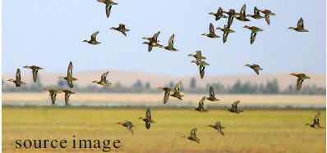
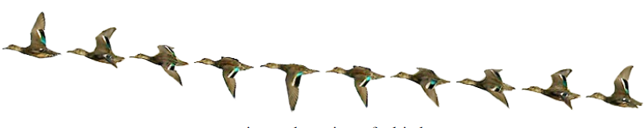
  Computation photography

Slide 25
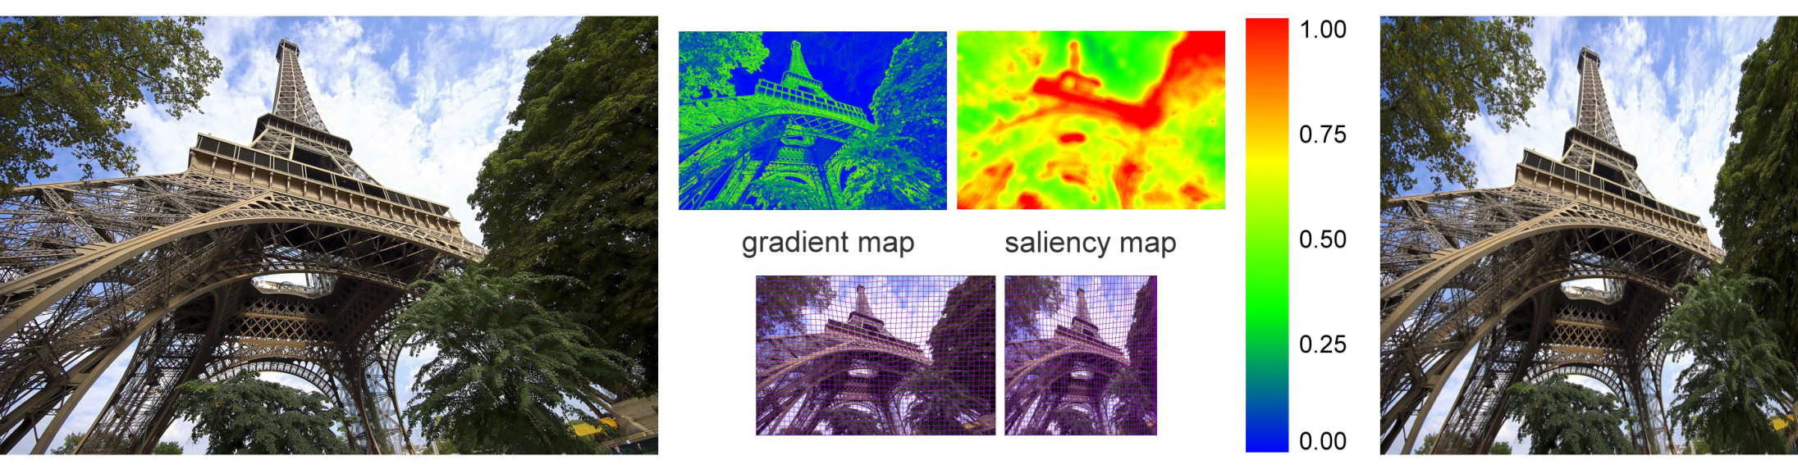
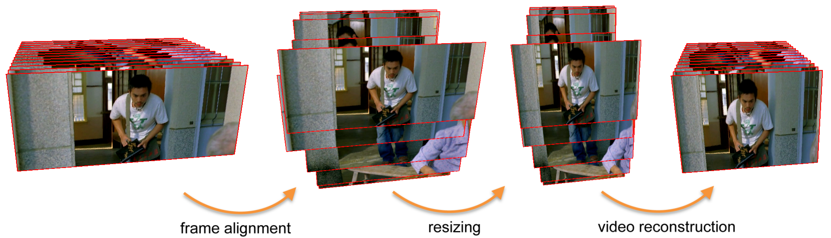
Optimized Scale-and-Stretch for Image Resizing [Wang et. al. 2008]
Motion-Aware Temporal Coherence for Video Resizing[Wang et. al. 2009]

Slide 26
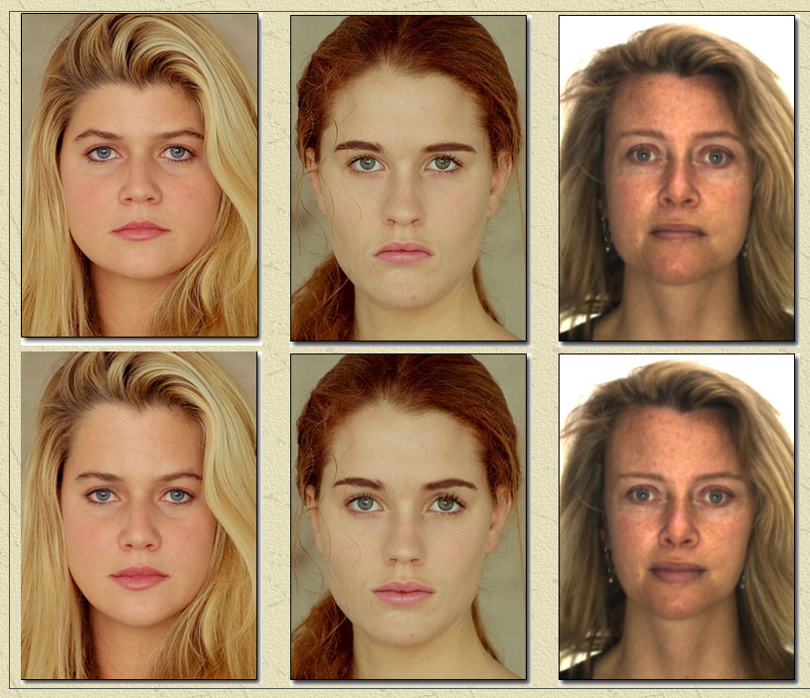
Data-Driven Enhancement of Facial Attractiveness
Notes:
Data-Driven Enhancement of Facial Attractiveness

Slide 27
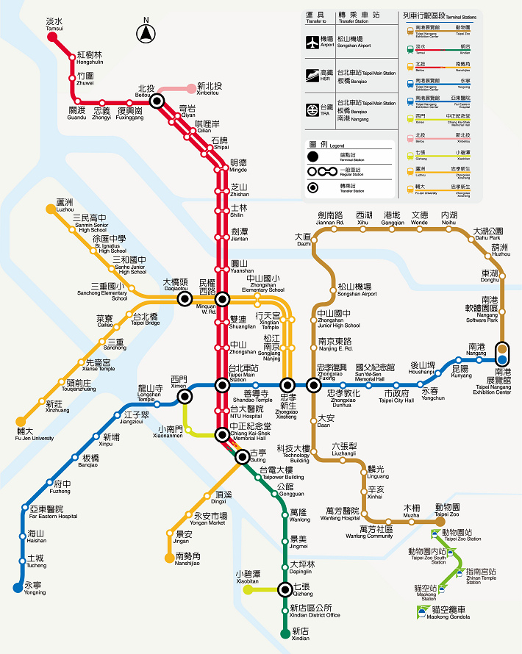
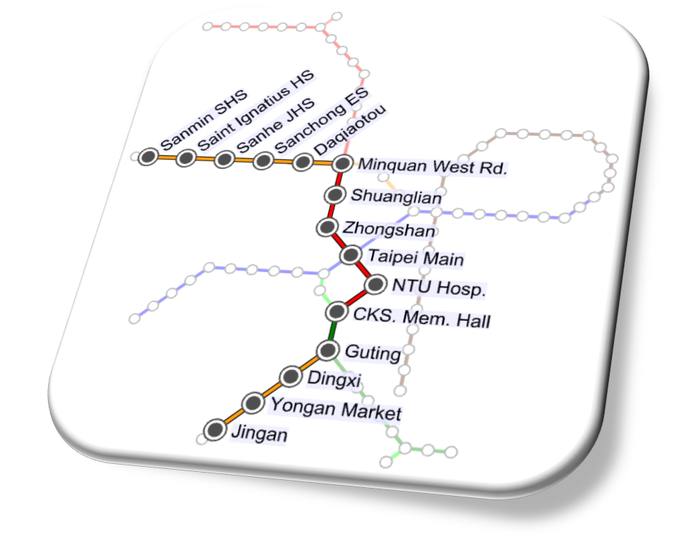
Visualization
Focus+Context Metro Maps

Slide 28
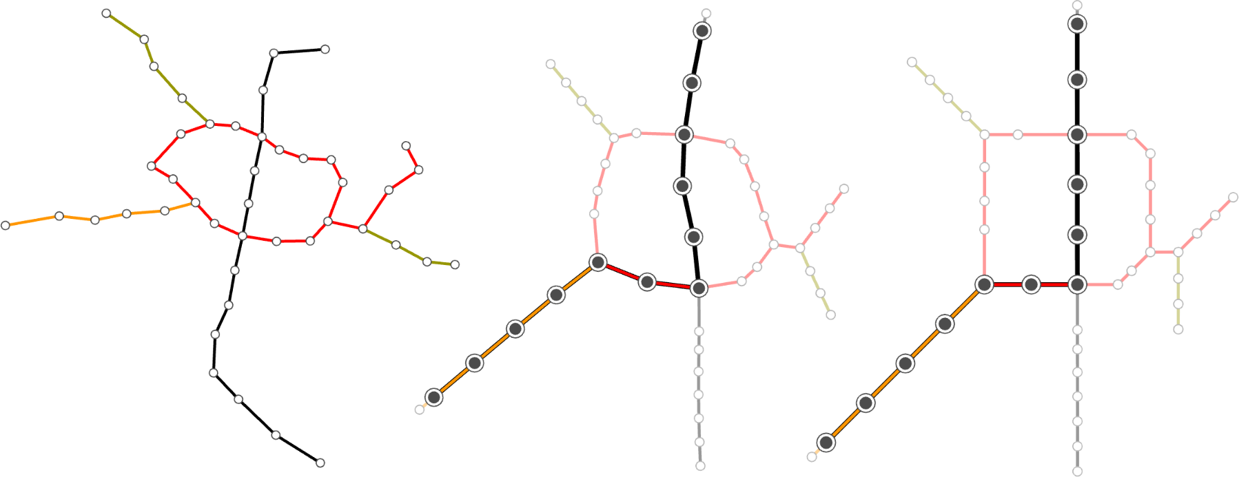
smooth edge direction
octilinear edge direction

Slide 29
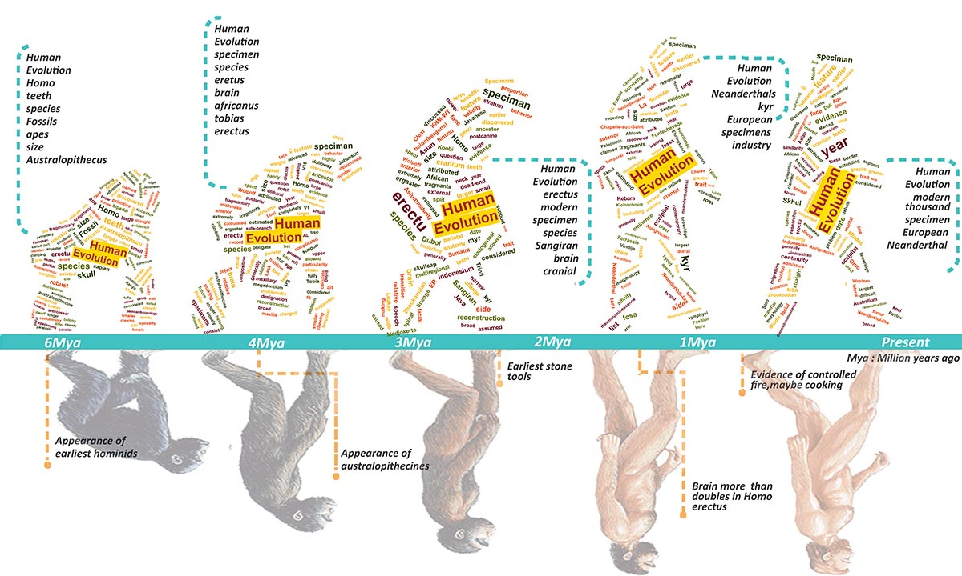
Morphable Word Clouds

Slide 30
Valkun
Notes:
Vk_201602_Overview_Feb16.pdf

Slide 31
Homework

Slide 32
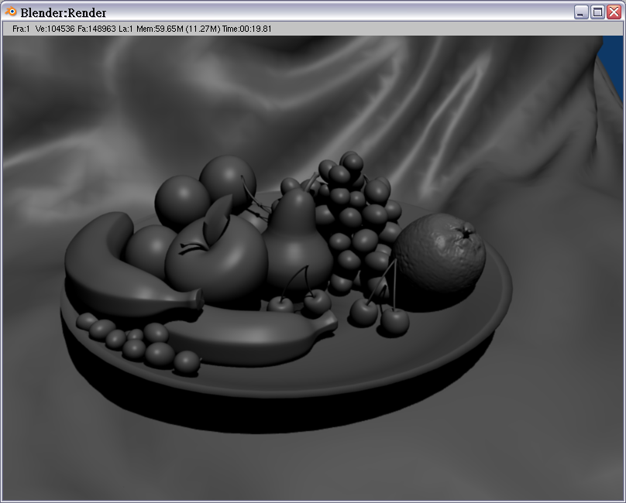
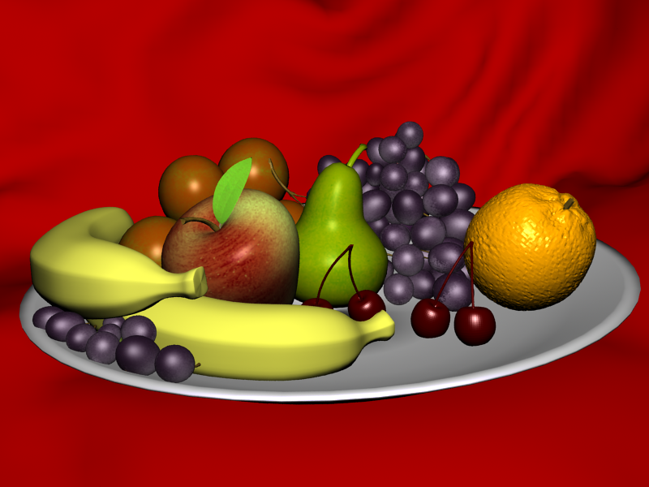
Midterm Project 09
96753501
Notes:
acg09

Slide 33
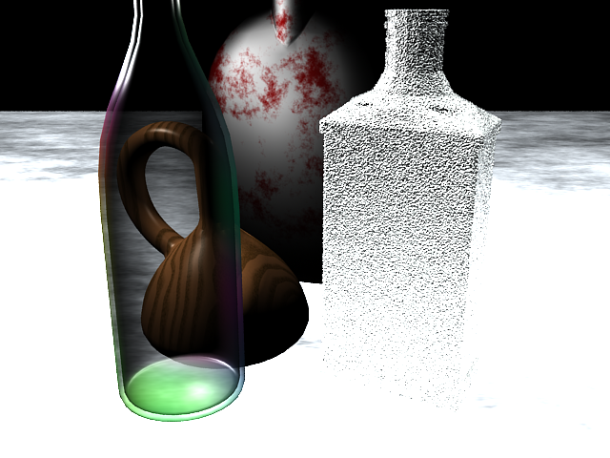
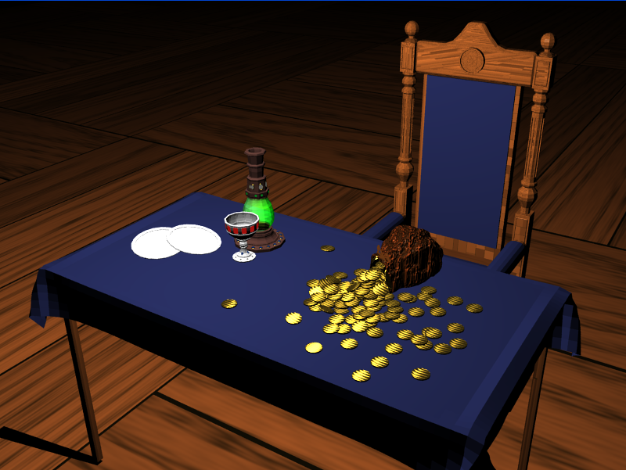
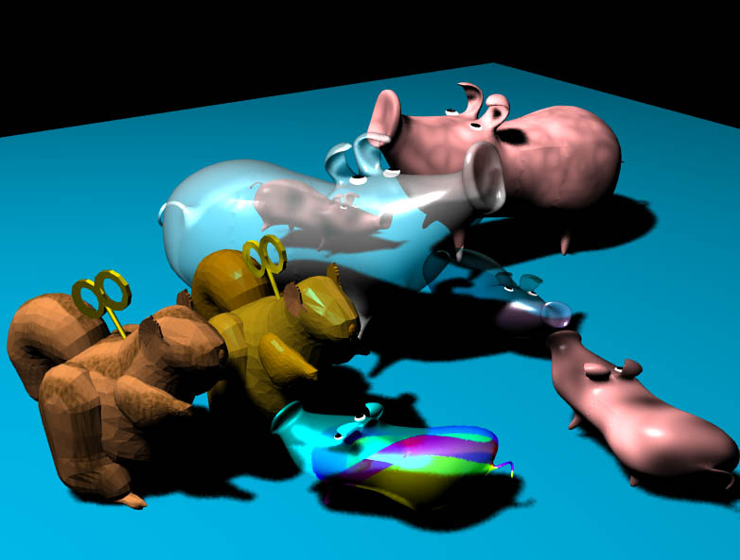
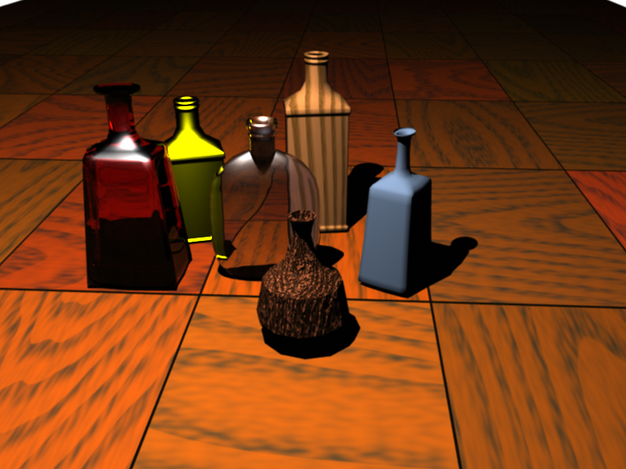
97753003
97753006
97753010
97753033

Slide 34
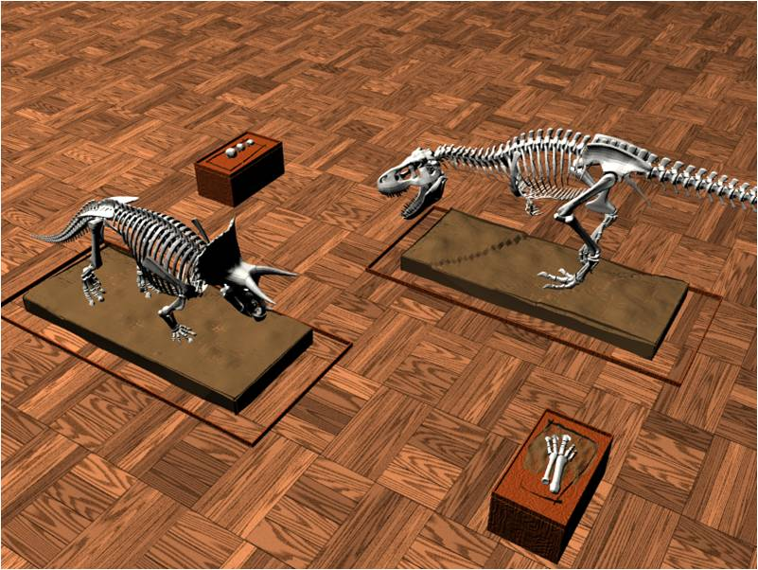
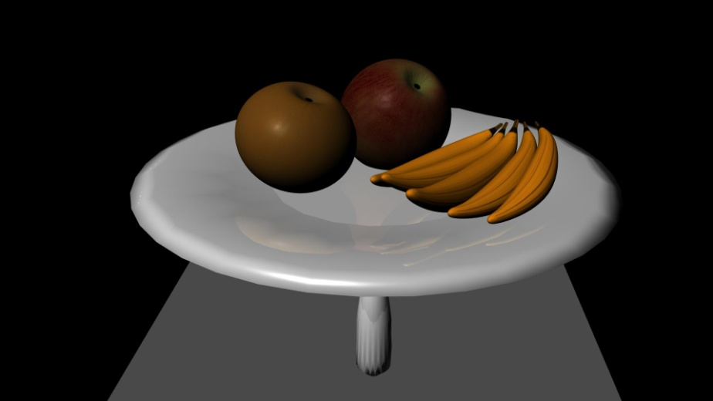
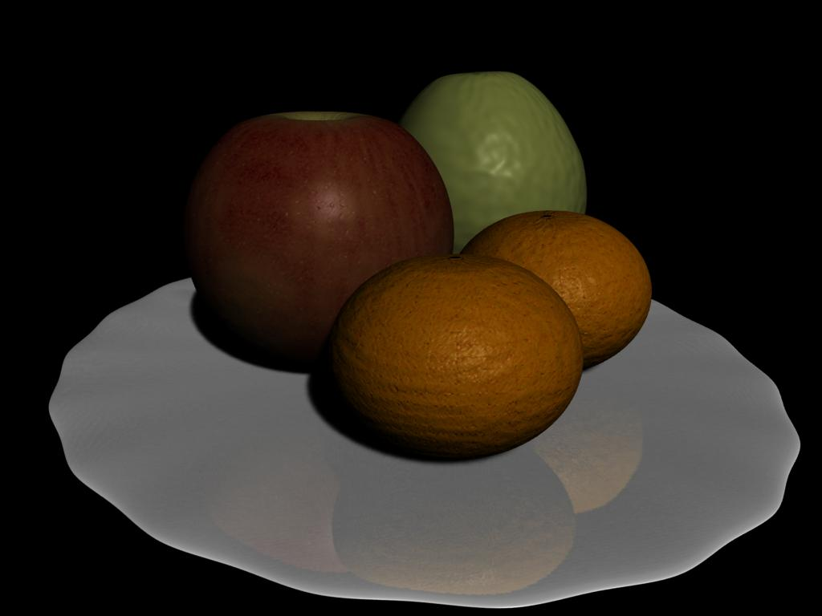
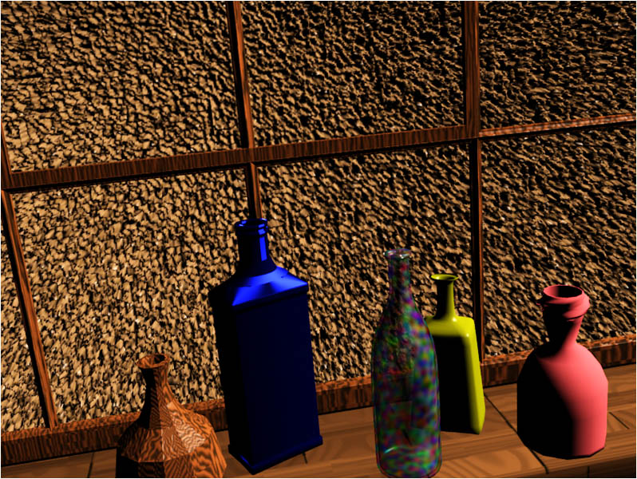
Midterm Project 10
98753022
98753003
98753006
98753019

Slide 35


Midterm Project 11
99753002
99753019

Slide 36




Midterm Project 12

Slide 37




Midterm Project 13

Slide 38



Midterm Project 14

Slide 39



Midterm Project 16

Slide 40




Hw1 18

Slide 41
Reference

Slide 42


Textbooks
Fundamentals of Computer Graphics, 4/e (Hardcover)
Steve Marschner, Peter Shirley
2015

Slide 43

A Sampler of Useful Computational Tools for Applied Geometry, Computer Graphics, and Image Processing: Foundations for Computer Graphics, Vision, and Image Processing
Daniel Cohen-Or, Chen Greif, Tao Ju, Niloy J. Mitra, Ariel Shamir, Olga Sorkine-Hornung, Hao (Richard) Zhang
2015

Slide 44




PR vs NPR
2019
github
2019
pdf

Slide 45




Refernce

Slide 46
Resource
ACM SIGGRAPH
Graphics Conference Paper list
  http://kesen.realtimerendering.com/
http://www.opengl.org
http://developer.nvidia.com/page/home.html
Notes:
http://dl.acm.org/event.cfm?id=RE214&tab=pubs&CFID=67027492

Slide 47


GAME

