Slide 1
Gradient based approach
with slides by Yung-Yu Chuang, Fredo Durand, Ramesh Raskar, Amit Agrawal
Notes:
Acg 2013

Slide 2
Outline
Gradient domain operations
1D
2D
  Image complete
  Image clone / editing
Applications

Slide 3
Gradient Domain Manipulations
Images/Videos/
Meshes/Surfaces
Manipulation of
Gradients
Estimation
of Gradients
Non-Integrable
Gradient Fields
Reconstruction
from
Gradients
Images/Videos/
Meshes/Surfaces

Slide 4
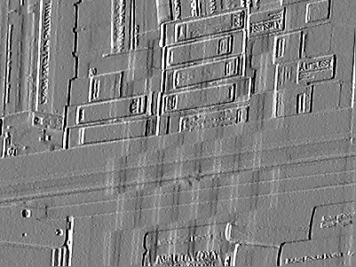
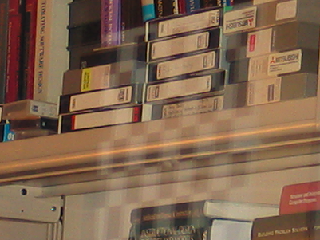
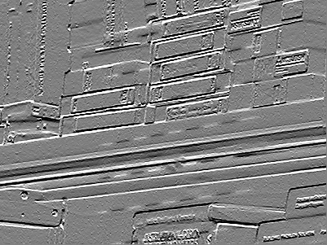
Image Intensity Gradients in 2D
Grad X
2D
Integration
Solve
Poisson Equation,
2D linear system
Grad Y

Slide 5
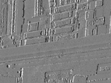
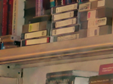
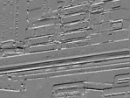
Intensity Gradient Manipulation
A Common Pipeline
Grad X
Gradient
Processing
New Grad X
2D
Integration
Grad Y
New Grad Y
Gradient manipulation
Reconstruction from gradients

Slide 6
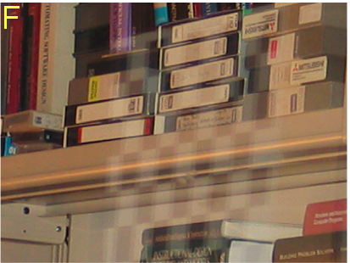
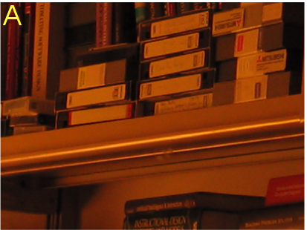
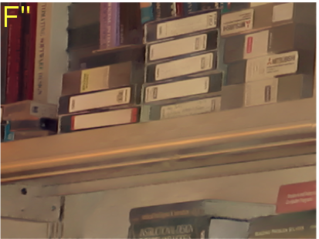
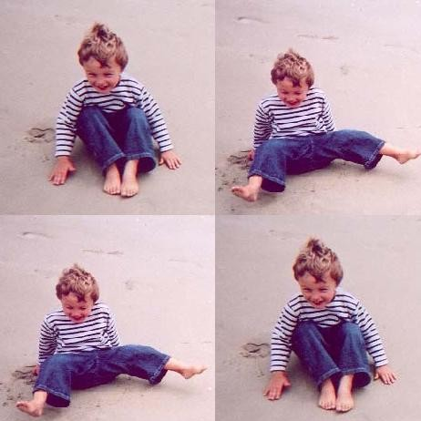
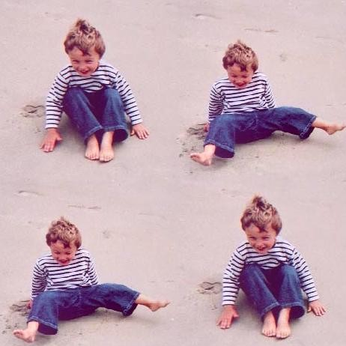
Example Applications
Removing Glass Reflections
Seamless Image Stitching

Slide 7
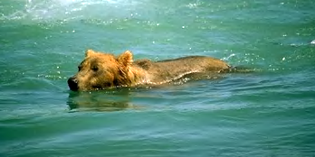
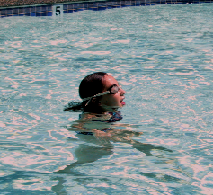
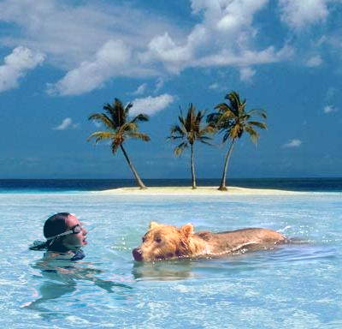
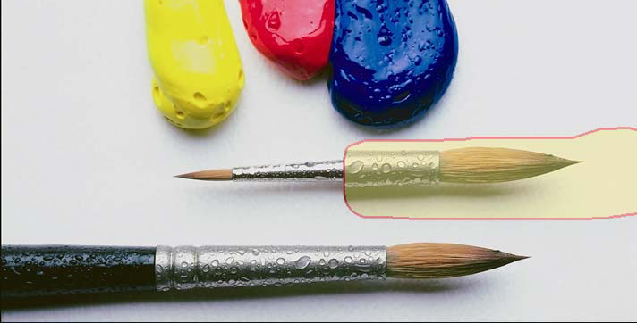
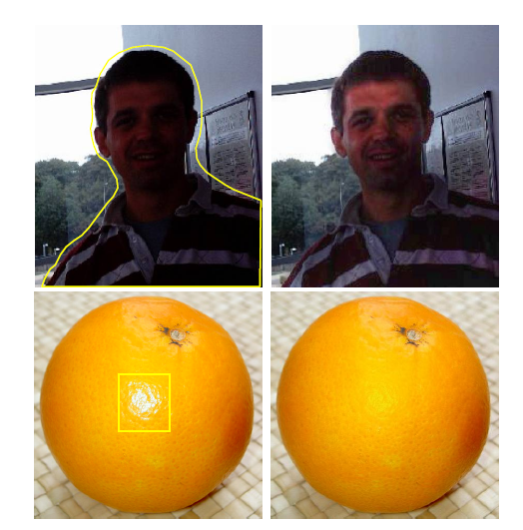
Image Editing
Changing Local Illumination

Slide 8
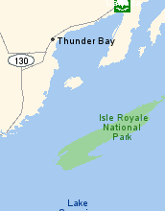
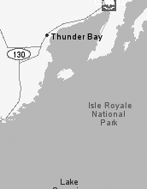
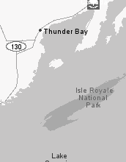
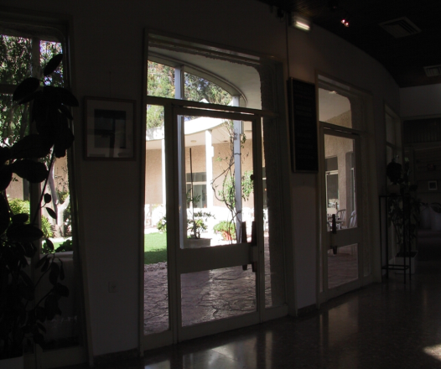
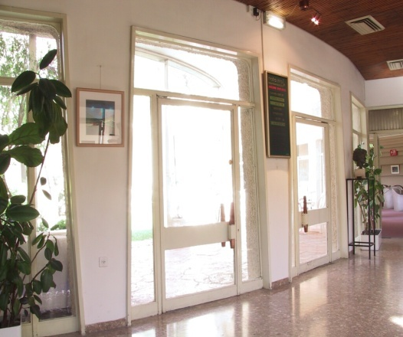
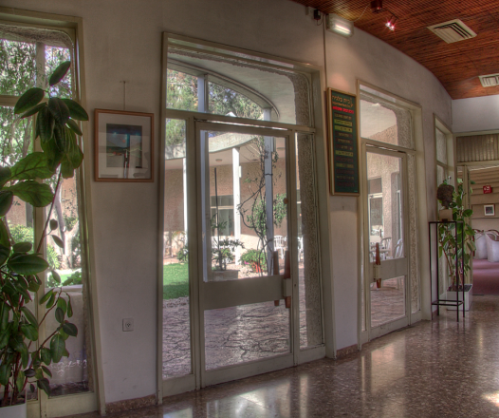
Original
PhotoshopGrey
Color2Gray
Color to Gray Conversion
High Dynamic Range Compression

Slide 9
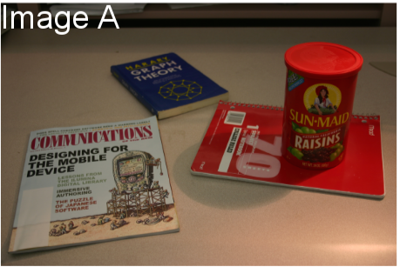
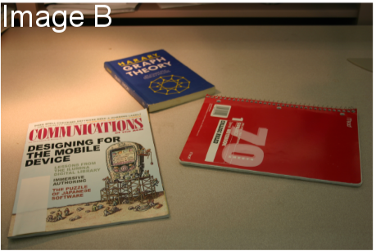
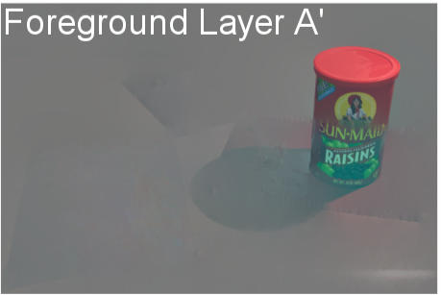
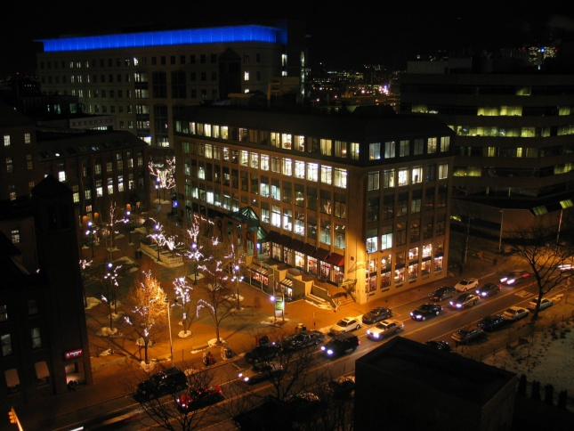
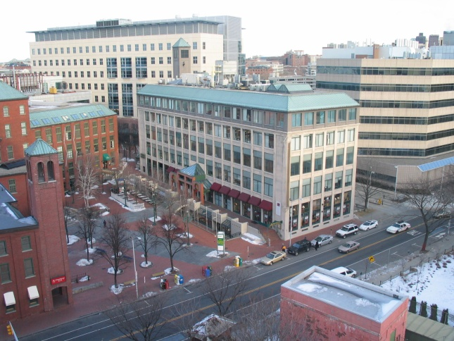
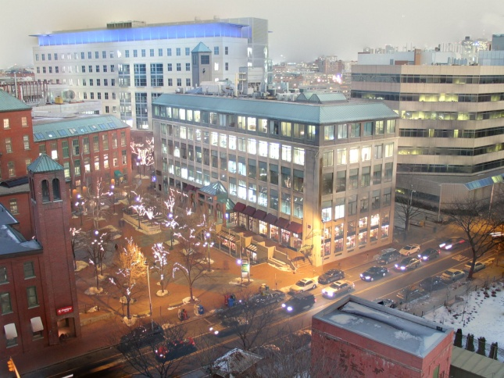
Edge Suppression under Significant Illumination Variations
Fusion of day and night images

Slide 10
Intensity Gradient Manipulation
A Common Pipeline
Grad X
Gradient
Processing
New Grad X
2D
Integration
Grad Y
New Grad Y

Slide 11
Intensity Gradient in 1D
Intensity
Gradient
10⁵
10⁵
1
1
I(x)
G(x)
Gradient at x,
G(x) = I(x+1)- I(x)
Forward Difference

Slide 12
Reconstruction from Gradients
Gradient
Intensity
10⁵
10⁵
?
?
1
1
G(x)
I(x)
For n intensity values, about n gradients

Slide 13
Reconstruction from Gradients
Gradient
Intensity
10⁵
10⁵
?
1
1
G(x)
I(x)
1D Integration
I(x) = I(x-1) + G(x)
Cumulative sum

Slide 14
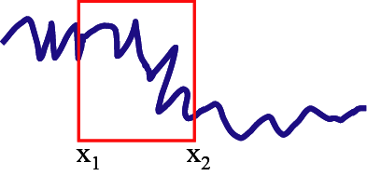

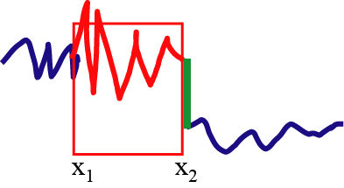
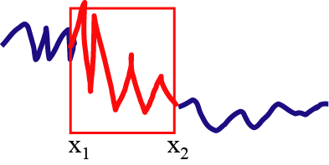
1D case with constraints
Seamlessly paste
onto
Just add a linear function so that the boundary condition is respected

Slide 15
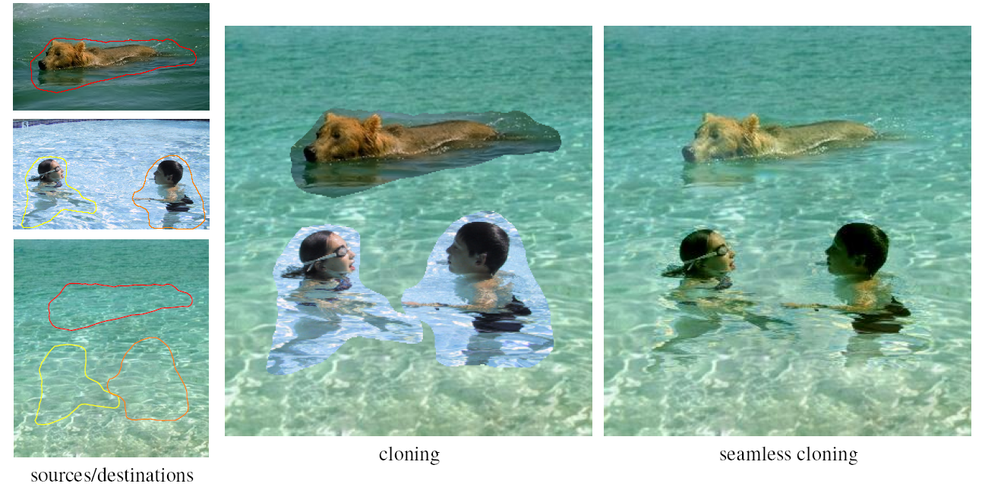
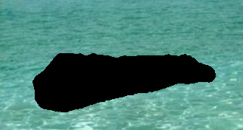
Discrete 1D example: minimization
Copy to
Min ((f₂-f₁)-1)²
Min ((f₃-f₂)-(-1))²
Min ((f₄-f₃)-2)²
Min ((f₅-f₄)-(-1))²
Min ((f6-f₅)-(-1))²
With
f₁=6
f₆=1

Slide 16
1D example: minimization
Copy to
Min ((f₂-6)-1)² ==> f₂²+49-14f₂
Min ((f₃-f₂)-(-1))² ==> f₃²+f₂²+1-2f₃f₂ +2f₃-2f₂
Min ((f₄-f₃)-2)² ==> f₄²+f₃²+4-2f₃f₄ -4f₄+4f₃
Min ((f₅-f₄)-(-1))² ==> f₅²+f₄²+1-2f₅f₄ +2f₅-2f₄
Min ((1-f₅)-(-1))² ==> f₅²+4-4f₅

Slide 17
1D example: big quadratic
Copy to
Min (f₂²+49-14f₂
+ f₃²+f₂²+1-2f₃f₂ +2f₃-2f₂
+ f₄²+f₃²+4-2f₃f₄ -4f₄+4f₃
+ f₅²+f₄²+1-2f₅f₄ +2f₅-2f₄
+ f₅²+4-4f₅)
Denote it Q

Slide 18
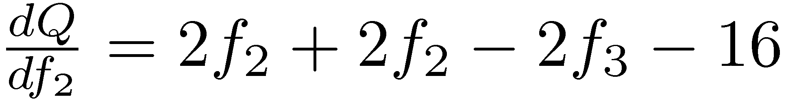
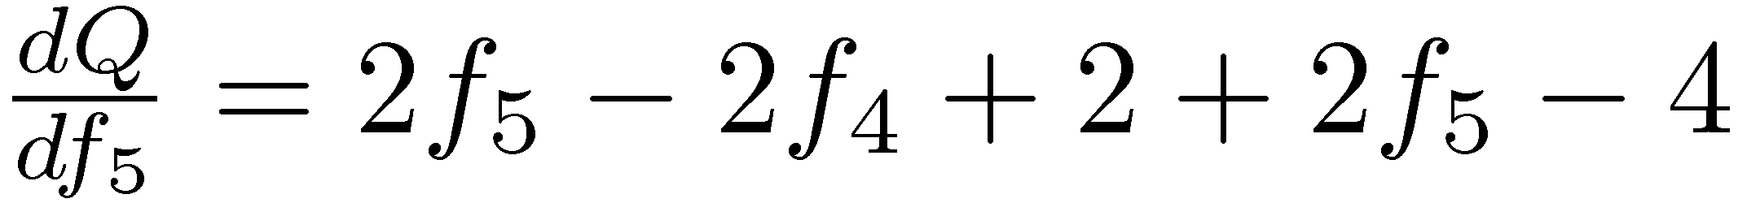
1D example: derivatives
Copy to
Min (f₂²+49-14f₂
+ f₃²+f₂²+1-2f₃f₂ +2f₃-2f₂
+ f₄²+f₃²+4-2f₃f₄ -4f₄+4f₃
+ f₅²+f₄²+1-2f₅f₄ +2f₅-2f₄
+ f₅²+4-4f₅)
Denote it Q

Slide 19
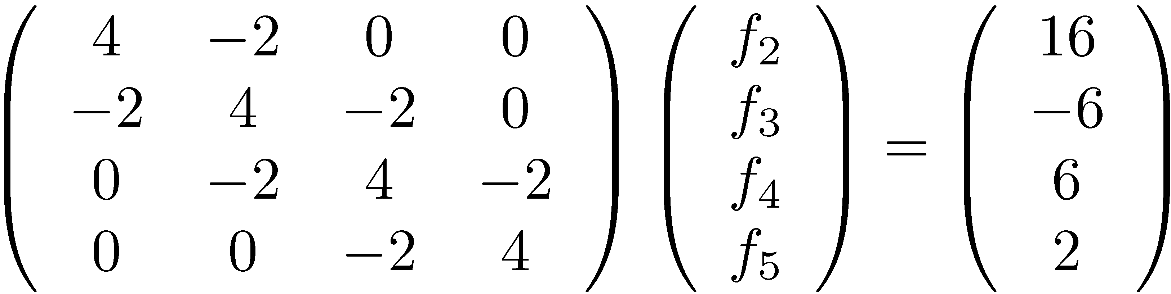
1D example: set derivatives to zero
Copy to
==>

Slide 20
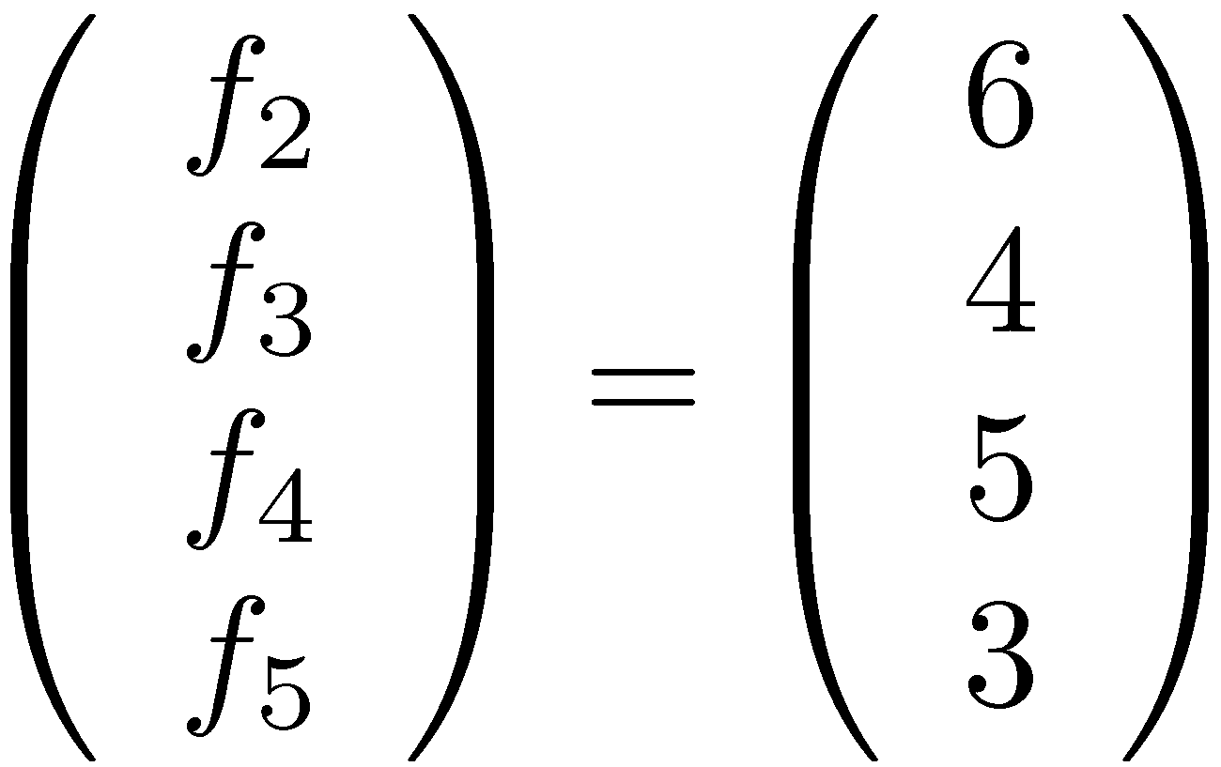
1D example
Copy to

Slide 21
1D example: remarks
Copy to
Matrix is sparse
Matrix is symmetric
Everything is a multiple of 2
  because square and derivative of square
Matrix is a convolution (kernel -2 4 -2)
Matrix is independent of gradient field. Only RHS is
Matrix is a second derivative

Slide 22
Gradient Operation in 2D

Slide 23
Part 1
Smooth Completion

Slide 24
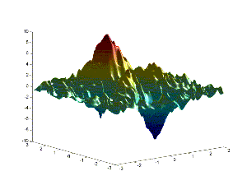
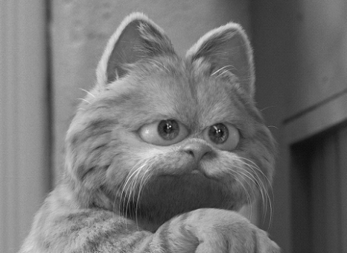
Image as a 2D Function

Slide 25
Smooth Image Completion
What if there is a missing area ?
f* – the known image
Scalar 2D function from (x,y)
to grayscale value.
f - the image in the unknown area
Ω – the unknown area (domain of f)
Will complete the area as smoothly
as possible.

Slide 26
Smooth Image Completion
(Cont.)
Finding the minimum:
Euler-Lagrange
Discrete Aprx:

Slide 27
Discrete Derivate in 1D
Given a discrete function f(x_{i})=f_{i}
f
f(x_{i})
f(x_{j})
x

Slide 28
Smooth Image Completion
(Solving)
Each f_{x,y} is an unknown variable x_{i}, total of N variables (covering the unknown pixels)
Reduces to the sparse algebraic system:
f_{x,y-1}+f_{x-1,y}-4f_{x,y}+f_{x+1,y}+f_{x,y+1}=0 => x_{i-w}+x_{i-1}-4x_{i}+x_{i+1}+x_{i+w}=0
x₁
x₂
…
x_{N}
0
0
b₁
b₂
0
0
0
b₃
0
1 1 -4 1 1
Known values of f()
contribute to the left side
1 1 -4 1 1
1 1 -4 1 1
=
x_{i-w}+x_{i-1}-4x_{i}+x_{i+1}=-f(x,y+1)
N x N

Slide 29
Program Usage
The program generates one output image
Ex1 –complete <input image>
R G B
<output>
Where R,G,B are the RGB values [0..255] of the unknown color (usually best as black 0,0,0)
Example:
  Ex1 –complete in1.bmp 0 0 0 out1.bmp

Slide 30
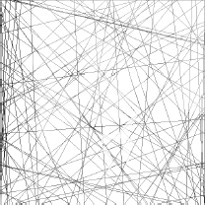
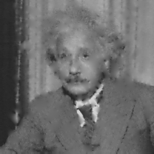
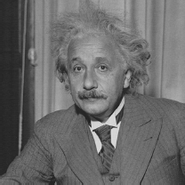
Wow result
input
result
ground truth

Slide 31
Part 2
Poisson Cloning

Slide 32
Poisson Cloning:
“Guiding” the completion
We can guide the completion from part1 to fill the hole using gradients from another source image
Reverse: Seek a function f whose gradients are closest to the gradients of the source image

Slide 33
Poisson Cloning
(forward difference)
(backward difference)

Slide 34
Poisson Cloning
(Solving)
Each f_{x,y} is a variable x_{i} as before, solving
As before this reduces to a sparse algebraic system
f_{x,y-1}+f_{x-1,y}-4f_{x,y}+f_{x+1,y}+f_{x,y+1}=divG(x,y)
=> x_{i-w}+x_{i-1}-4x_{i}+x_{i+1}+x_{i+w}=divG(x,y)

Slide 35
Program Usage
The program generates one output image
Ex1 –clone <source image>
<source mask>
<target image> x y
<output>
Where x y are the offset for the paste

Slide 36
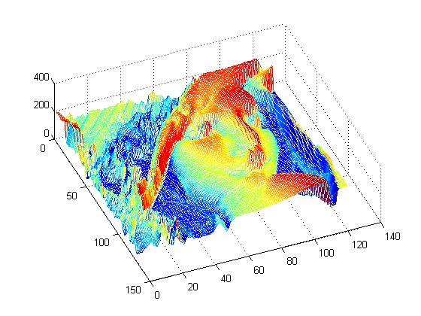
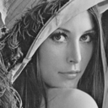
2D example: images
Images as scalar fields
  R² -> R

Slide 37
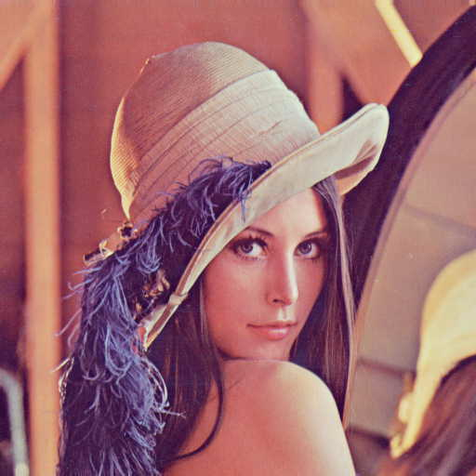

Gradients
Vector field (gradient field)
  Derivative of a scalar field
Direction
  Maximum rate of change of scalar field
Magnitude
  Rate of change

Slide 38
Gradient Field
Components of gradient
  Partial derivatives of scalar field
Notes:
Nabla symbol, vector differential operator

Slide 39
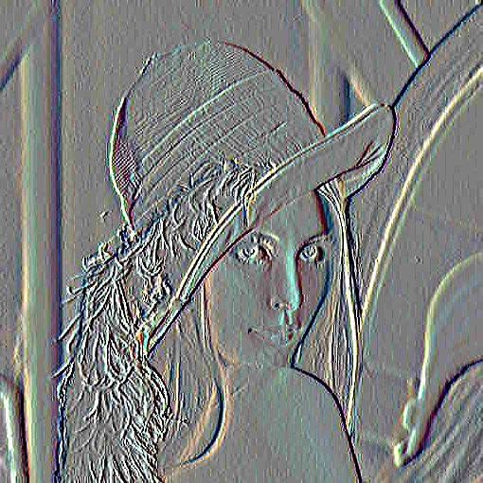
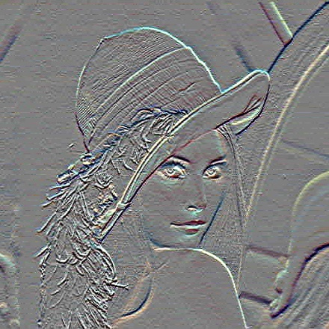
Example
Image I(x,y)
I_{x}
I_{y}
Gradient at x,y as Forward Differences
G_{x}(x,y) = I(x+1 , y)- I(x,y)
G_{y}(x,y) = I(x , y+1)- I(x,y)
G(x,y) = (G_{x} , G_{y})

Slide 40
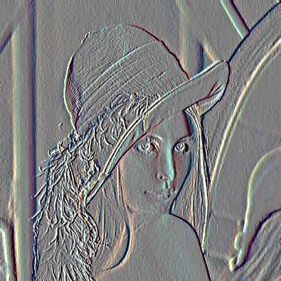


Reconstruction from Gradients
Sanity Check:
Recovering Original Image
I_{x}
2D
Integration
I_{y}
Solve
Poisson Equation
2D linear system
Same

Slide 41


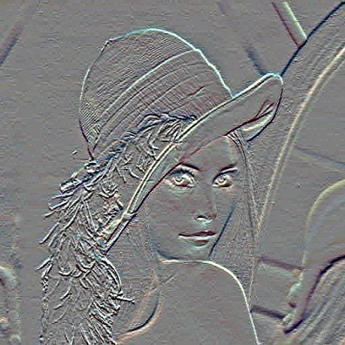
Reconstruction from Gradients
Given G(x,y) = (G_{x} , G_{y})
How to compute I(x,y) for the image ?
For n ² image pixels, 2 n ² gradients !
G_{x}
2D
Integration
G_{y}

Slide 42
2D Integration is non-trivial
df/dx
f(x)
y
f(x,y)
x
Reconstruction depends on chosen path

Slide 43
Reconstruction from Gradient Field G
Look for image I with gradient closest to G in the least squares sense.
I minimizes the integral:
Poisson
equation
Notes:
The way we chose to overcome this problem is by searching for an image I, whose gradient field is closest to our field G, in the least squares sense.
This is done by minimizing the following integral taken over the entire image. The functional F inside the integral simply measures the L2 distance between the gradient field of I and the vector field G.

Slide 44
.. 1 … 1 -4 1 … 1 ..
I

Slide 45
Linear System
x,y-1
H
H
x-1,y
x,y
H
W
A
x
b

Slide 46
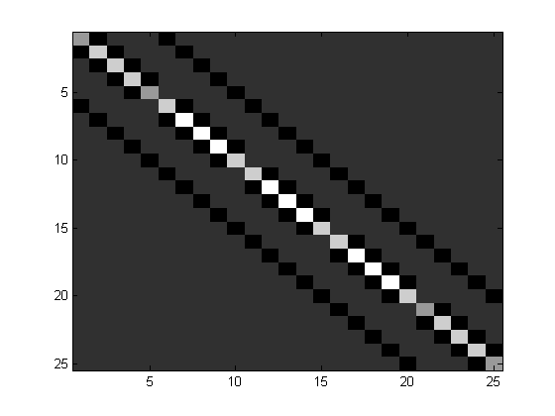
Sparse Linear system
A matrix

Slide 47
Solving Linear System
Image size N*N
Size of A ~ N² by N²
Impractical to form and store A
Direct Solvers
Basis Functions
Multigrid
Conjugate Gradients

Slide 48
Implement Detail

Slide 49
Taucs
a Library of Sparse Linear Solvers

Slide 50

compressed-column-storage (CCS)

Slide 51


Slide 52
Smooth completion
// Build the matrix
// ----------------
// We solve Ax = b for all 3 channels at once
// Create the sparse matrix, we have at least 5 non-zero elements
// per column
taucs_ccs_matrix *pAt = taucs_ccs_create(N,N,5*N,TAUCS_DOUBLE);
double* b = new double[3*N]; // All 3 channels at once
uint n = 0;
int index = 0;
double* vals = pAt->taucs_values;
int* rowptr = pAt->colptr;
int* colind = pAt->rowind;

Slide 53
// Populate matrix
for (y = 1; y < h-1; y++) {
for (x = 1; x < w-1; x++) {
if (I.getPixel(x,y) == c) { // Variable
uint id = y*w+x;
rowptr[n] = index;
// Right hand side is initialized to zero
imagelib::tBGRf bb(0.0f, 0.0f, 0.0f);
if (I.getPixel(x,y-1) == c) {
vals[index] = 1.0f;
colind[index] = mp[id-w];
index++;
} else {
// Known pixel, update right hand side
bb -= I.getPixel(x,y-1);
}

Slide 54
uint i = mp[id];
// Spread the right hand side so we can solve using TAUCS for
// 3 channels at once.
b[i] = bb.b;
b[i+N] = bb.g;
b[i+2*N] = bb.r;
n++;
}
}
}

Slide 55
taucs_ccs_matrix *pA = MatrixTranspose(pAt);
double* u = new double[3*N];
char* options[] = { "taucs.factor.LU=true", NULL };
if (taucs_linsolve(pA, NULL, 3, u, b, options, NULL) != TAUCS_SUCCESS) {
cout << "Solving failed\n";
}

Slide 56
Applications

Slide 57
Intensity Gradient Manipulation
A Common Pipeline
Grad X
Gradient
Processing
New Grad X
2D
Integration
Grad Y
New Grad Y

Slide 58
Gradient Domain Manipulations: Overview
(A) Per pixel
Corresponding gradients in two images
Corresponding gradients in multiple images
Combining gradients along seams

Slide 59
Gradient Domain Manipulations: Overview
(A) Per pixel
  Non-linear operations (HDR compression, local illumination change)
  Set to zero (shadow removal, intrinsic images, texture de-emphasis)
  Poisson Matting
(B) Corresponding gradients in two images
  Vector operations (gradient projection)
    Combining flash/no-flash images, Reflection removal
  Projection Tensors
    Reflection removal, Shadow removal
  Max operator
    Day/Night fusion, Visible/IR fusion, Extending DoF
  Binary, choose from first or second, copying
    Image editing, seamless cloning

Slide 60
Gradient Domain Manipulations
(C) Corresponding gradients in multiple images
  Median operator
    Specularity reduction
    Intrinsic images
  Max operation
    Extended DOF
(D) Combining gradients along seams
  Weighted averaging
  Optimal seam using graph cut
    Image stitching, Mosaics, Panoramas, Image fusion
    A usual pipeline: Graph cut to find seams + gradient domain fusion

Slide 61



A. Per Pixel Manipulations
Non-linear operations
  HDR compression, local illumination change
Set to zero
  Shadow removal, intrinsic images, texture de-emphasis
Poisson Matting
Notes:
(matte gradient proportional to image gradient)

Slide 62





High Dynamic Range Imaging
Images from Raanan Fattal
Notes:
Show HDR image here using HDRshop

Slide 63


Gradient Domain Compression
Gradients L_{x},L_{y}
HDR Image L
2D
Integration
Log L
Multiply
Gradient Attenuation Function G

Slide 64

Local Illumination Change
Original Image: f
Original gradient field:
Modified gradient field: v
Perez et al. Poisson Image editing, SIGGRAPH 2003

Slide 65

Illumination Invariant Image
Original Image
Illumination invariant image
Assumptions
  Sensor response = delta functions R, G, B in wavelength spectrum
  Illumination restricted to Outdoor Illumination
G. D. Finlayson, S.D. Hordley & M.S. Drew, Removing Shadows From Images, ECCV 2002
Notes:
If sensors can be represented as delta functions (they respond only at a single wavelength) and illumination is restricted to the Planckian locus then we can find a 1-D co-ordinate, a function of image chromaticities, which is invariant to illuminant colour and intensity this gives us a grey-scale representation of our original image, but without the shadows

Slide 66




Shadow Removal Using Illumination Invariant Image
Original Image
Edge Map
Integrate
Shadow Edge Locations
Illumination invariant image
G. D. Finlayson, S.D. Hordley & M.S. Drew, Removing Shadows From Images, ECCV 2002

Slide 67




Illumination invariant image
Original
Image
Invariant
Image
Detected Shadow Edges
Shadow Removed
G. D. Finlayson, S.D. Hordley & M.S. Drew, Removing Shadows From Images, ECCV 2002

Slide 68



Intrinsic Image
Photo = Illumination Image * Intrinsic Image
Retinex [Land & McCann 1971, Horn 1974]
  Illumination is smoothly varying
  Reflectance, piece-wise constant, has strong edges
  Keep strong image gradients, integrate to obtain reflectance
low-frequency
attenuate more
high-frequency
attenuate less

Slide 69
Poisson Matting
Background B
Alpha
Foreground F
Trimap: User specified
Jian Sun, Jiaya Jia, Chi-Keung Tang, Heung-Yeung Shum, Poisson Matting, SIGGRAPH 2004

Slide 70
Poisson Matting
Approximate: Assume F and B are smooth
F and B in tri-map using nearest pixels
Poisson Equation

Slide 71
Poisson Matting
Steps
  Approximate F and B in trimap
  Solve for ,
  Refine F and B using
  Iterate

Slide 72
Gradient Domain Manipulations: Overview
(A) Per pixel
Corresponding gradients in two images
Corresponding gradients in multiple images
Combining gradients along seams

Slide 73


Photography Artifacts: Flash Hotspot
Ambient
Flash
Flash Hotspot

Slide 74


Reflections due to Flash
Underexposed
Reflections
Ambient
Flash

Slide 75




Self-Reflections and Flash Hotspot
Ambient
Flash
Face
Hands
Tripod

Slide 76




Ambient
Result
Reflection Layer
Flash
Face
Hands
Tripod

Slide 77


Intensity Gradient Vectors in Flash and Ambient Images
Same gradient vector direction
Flash Gradient Vector
Ambient Gradient Vector
Ambient
Flash
No reflections

Slide 78


Reflection Ambient Gradient Vector
Different gradient vector directions
Flash Gradient Vector
Ambient
Flash
With reflections

Slide 79
Intensity Gradient Vector Projection
Reflection Ambient Gradient Vector
Residual Gradient Vector
Flash Gradient Vector
Result Gradient Vector
Ambient
Flash
Result
Residual

Slide 80
Projection = Result
Residual = Reflection Layer
Ambient
Flash
Notes:
Talk about limitations: Colocated artifacts, color coherency, ref can’t be obtain by subtraction

Slide 81



Flash
Ambient
Checkerboard outside glass window
Reflections on glass window

Slide 82









Forward Differences
Checkerboard
Gradient Difference
Residual X
X
Checkerboard
Residual Y
Y
removed
Flash
Result X
2D Integration
Intensity Gradient
Vector Projection
2D
Integration
Result Y
Result
X
Result
Reflection Layer
Y
Ambient

Slide 83
Image Fusion for
Context Enhancement
and Video Surrealism
Ramesh Raskar
Mitsubishi Electric Research Labs,
(MERL)
Adrian Ilie
UNC Chapel Hill
Jingyi Yu
MIT
Notes:
<Title>
Hello. My name is Mike Brown, and I am here to present a paper by Adrian Ilie, Ramesh Raskar and Jingyi Yu on Gradient-Domain Context Enhancement for Fixed Cameras.
I will try to answer your questions, but I suggest that you address the more specific ones to the authors themselves, by email.

Slide 84


Slide 85
Dark Bldgs
Reflections on bldgs
Unknown shapes

Slide 86



Night Image
Background is captured from day-time scene using the same fixed camera
Context Enhanced Image
Day Image

Slide 87

Mask is automatically computed from scene contrast

Slide 88


But, Simple Pixel Blending Creates
Ugly Artifacts

Slide 89

Pixel Blending

Slide 90

Pixel Blending
solution:
Integration of
blended Gradients

Slide 91










Nighttime image
Gradient field
x
Y
I₁
G₁
G₁
Mixed gradient field
x
Y
Importance image W
G
G
I₂
x
Y
G₂
G₂
Final result
Daytime image
Gradient field
Notes:
<Algorithm>
The algorithm consists of the following steps:
First, we compute the gradient fields of the daytime and nighttime input images by using simple forward differencing in the x and y direction.
Thresholding the gradient field images allows us to compute the locally-important areas. These are areas of high variance in the nighttime image, shown here in white. The pixels of the importance image are white in the locally-important areas that are taken from the nighttime image and black in the context areas that are taken from the daytime image. We use prost-processing (eroding, fattening and feathering) to consolidate the selected areas and ensure smooth transitions.
A mixed gradient field is computed as a weighted mean of the input gradient fields, using the pixel values in the importance image as weights.
The final result is obtained by integrating the mixed gradient field.

Slide 92




Poisson Image Editing
  Precise selection: tedious and unsatisfactory
  Alpha-Matting: powerful but involved
  Seamless cloning: loose selection but no seams?

Slide 93


Conceal
Copy Background gradients (user strokes)

Slide 94


Compose
Source Images
Target Image

Slide 95








Transparent Cloning
Largest variation from source and destination at each point

Slide 96
Gradient Domain Manipulations: Overview
(A) Per pixel
Corresponding gradients in two images
Corresponding gradients in multiple images
Combining gradients along seams

Slide 97

Intrinsic images
I = L * R
L = illumination image
R = reflectance image

Slide 98
Intrinsic images
  Use multiple images under different illumination
  Assumption
    Illumination image gradients = Laplacian PDF
    Under Laplacian PDF, Median = ML estimator
  At each pixel, take Median of gradients across images
  Integrate to remove shadows
Yair Weiss, “Deriving intrinsic images from image sequences”, ICCV 2001

Slide 99
Shadow free Intrinsic Image
Result = Illumination Image * (Label in Intrinsic Image)

Slide 100




Specularity Reduction in Active Illumination
Line Specularity
Point Specularity
Area Specularity
Multiple images with same viewpoint, varying illumination
How do we remove highlights?

Slide 101



Specularity Reduced Image

Slide 102
Gradient Domain Manipulations: Overview
(A) Per pixel
Corresponding gradients in two images
Corresponding gradients in multiple images
Combining gradients along seams

Slide 103
Seamless Image Stitching
Anat Levin, Assaf Zomet, Shmuel Peleg and Yair Weiss, “Seamless Image Stitching in the Gradient Domain”, ECCV 2004

