Slide 1
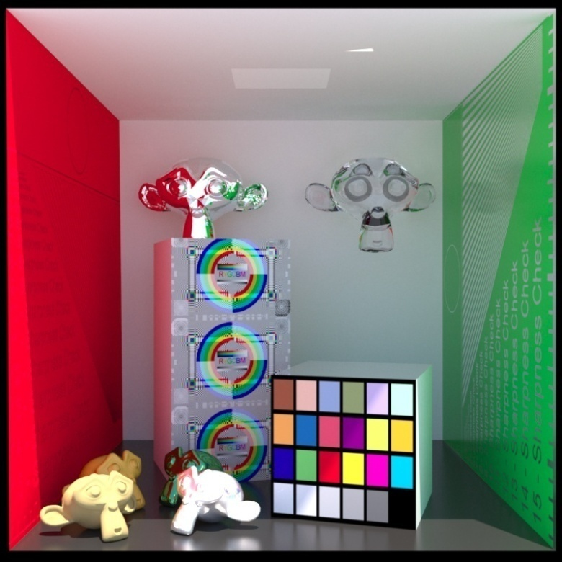
Advanced Computer Graphics
Global Illumination (3)
Image courtesy of Luxrender
Ming-Te Chi
Department of Computer Science,
National Chengchi University
Notes:
2013

Slide 2
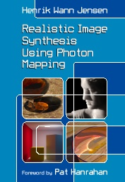
Global Illumination
Rendering equation
  Ray tracing
  Radiosity
  Photon mapping
Selected Topics
  Environment Lighting
Notes:
LS*DS*E

Slide 3
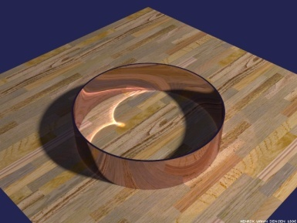
Photon Mapping
Notes:
Caustics
Diffuse interreflection
Subsurface scattering

Slide 4
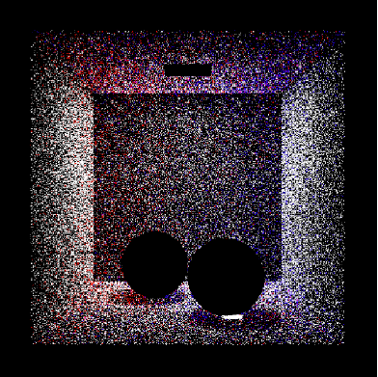
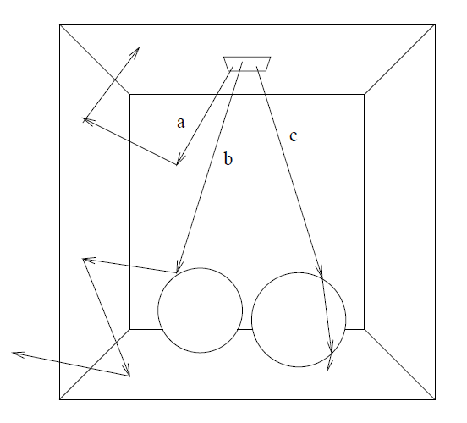
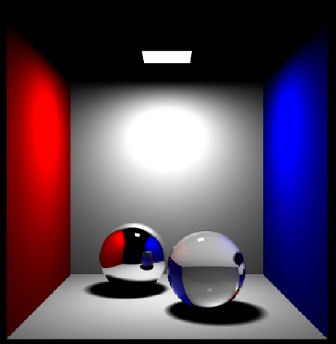
A
D
D
Photon map
D
S
S
S
D
A
D: diffuse reflections
S: specular reflection
A: absorption
result

Slide 5
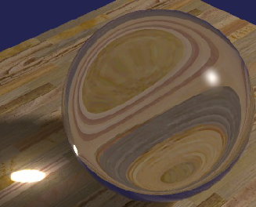
Refraction of a Caustic
Monte-Carlo ray tracing handles all paths of light: L(D|S)*E, but not equally well
Has difficulty sampling LS*DS*E paths, e.g. refraction of a caustic
Path tracing would need a very lucky first hit
Bidirectional ray tracing can find caustic, but reflection of caustic still needs lucky first hit during path tracing
Metropolis light transport can find a caustic path, but would need lucky perturbation to find its reflection
Notes:
In optics, a caustic or caustic network ^{[1]} is the envelope of light rays reflected or refracted by a curved surface or object, or the projection of that envelope of rays on another surface.

Slide 6
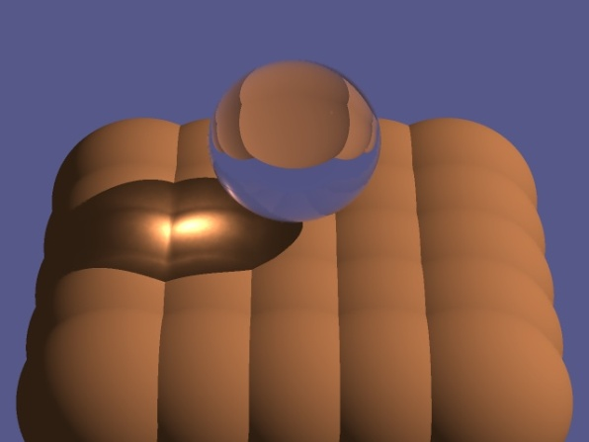
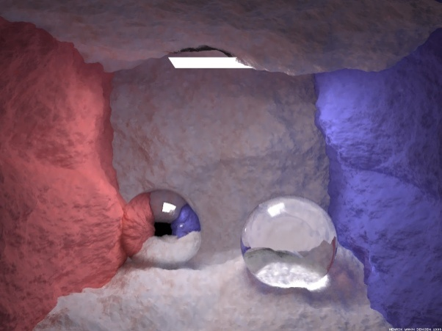
Photon Mapping
Jensen EGRW 95, 96
Simulates the transport of individual photons
Photons emitted from light sources
Photons bounce off of specular surfaces
Photons deposited on diffuse surfaces
  Held in a 3-D spatial data structure
  Surfaces need not be parameterized
Photons collected by path tracing from eye

Slide 7
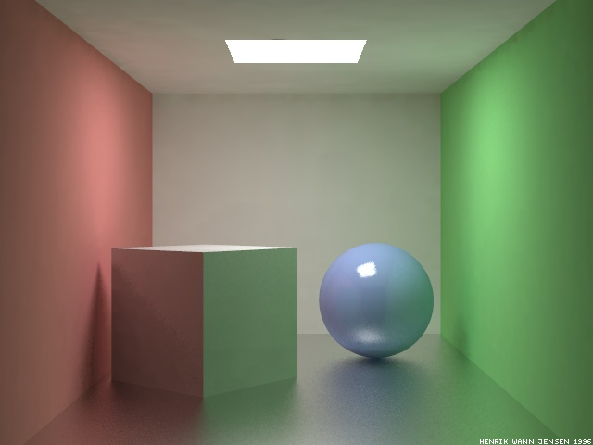
Why Map Photons?
High variance in Monte-Carlo renderings results in noise
Collection of deposited photons into a “photon map” (a 3-D spatial data structure) provides a flux density estimate
Flux samples filtered easier than path samples, resulting in error at lower frequencies
Error is a result of bias, which decreases as the number of samples increase
And, oh yeah, it’s a lot faster
The scene above contains glossy surfaces, and was rendered in 50 minutes using photon mapping. The same scene took 6 hours for render with Radiance, a rendering system that used radiosity for diffuse reflection and path tracing for glossy reflection.

Slide 8
What is a Photon?
A photon p is a particle of light that carries flux ΔΦ_{p}(x_{p}, ω_{p})
  Power: ΔΦ_{p} – magnitude (in Watts) and color of the flux it carries, stored as an RGB triple
  Position: x_{p} – location of the photon
  Direction: ω_{p} – the incident direction ω_{i} used to compute irradiance
Photons vs. rays
  Photons propogate flux
  Rays gather radiance
ω_{p}
ΔΦ_{p}
x_{p}

Slide 9
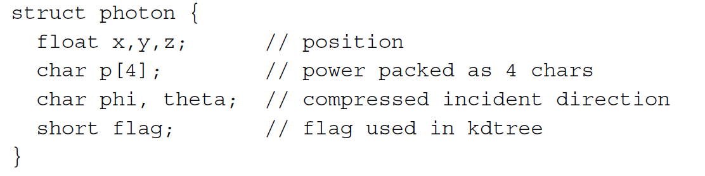
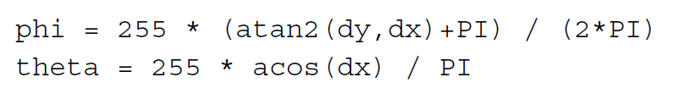
Photo
Notes:
Encode to 65,536 (256*256) possible directions

Slide 10
Light Sources
Point source
  Photons emitted uniformly in all directions
Power of source (W) distributed evenly among photons
Flux of each photon equal to source power divided by total # of photons
For example, a 60W light bulb would send out a total of 100K photons, each carrying a flux ΔΦ of 0.6 mW
Photons sent out once per simulation, not continuously as in radiosity

Slide 11
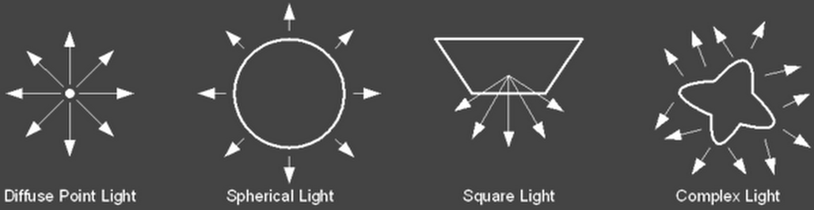
Lightsource

Slide 12
Russian Roulette
Tradition apparoch
  Reflected flux only a fraction of incident flux
  After several reflections, spending a lot of time keeping track of very little flux
Instead, completely absorb some photons and completely reflect others at full power
Spend time tracing fewer full power photons
Probability of reflectance is the reflectance ρ.
Probability of absorption is 1 – ρ.
?
ρ = 60%

Slide 13
Mixed Surfaces
Surfaces have specular and diffuse components
  ρ_{d} – diffuse reflectance
  ρ_{s} – specular reflectance
  ρ_{d} + ρ_{s} < 1 (conservation of energy)
Let ζ be a uniform random value from 0 to 1
If ζ < ρ_{d} then reflect diffuse
Else if ζ < ρ_{d} + ρ_{s} then reflect specular
Otherwise absorb
ρ_{d} = 50%
ρ_{s} = 30%

Slide 14
Storing Photons
Uses a kd-tree – a sequence of axis-aligned partitions
  2-D partitions are lines
  3-D partitions are planes
Axis of partitions alternates wrt depth of the tree
Average access time is O(log n)
Worst case O(n) when tree is severely lopsided
Need to maintain a balanced tree, which can be done in O(n log n)
Can find k nearest neighbors in
O(k + log n) time using a heap

Slide 15
Build kd-tree
Kdtree * balance(points) {
find bounding box for points
select dimension dim in box’s largest axis
find the median of the points in dim
s1 = all points below median
s2 = all points above median
node = median
node.left = balance( s1)
node.right = balance(s2)
return node
}

Slide 17
Reflected Radiance
Recall the reflected radiance equation
Convert incident radiance into incident flux
Reflected radiance in terms of incident flux
Numerically
ΔA = πr²

Slide 18
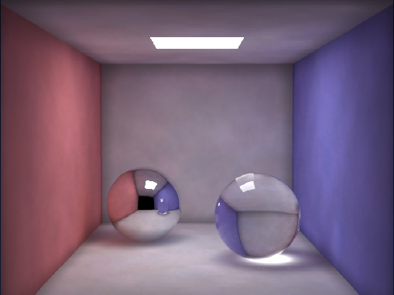
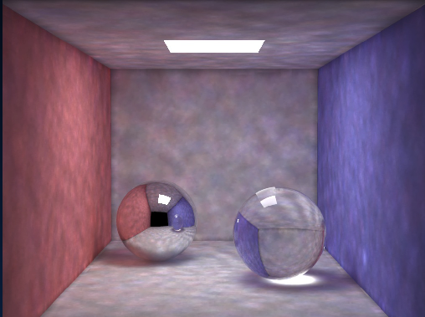
How Many Photons?
How big is the disk radius r?
Large enough that the disk surrounds the n nearest photons.
The number of photons used for a radiance estimate n is usually between 50 and 500.
Radiance estimate using 50 photons
Radiance estimate using 500 photons
ΔA = πr²

Slide 19
Filtering
Too few photons cause blurry results
Simple averaging produces a box filtering of photons
Photons nearer to the sample should be weighted more heavily
Results in a cone filtering of photons

Slide 20
Multiple Photon Maps
Global L(S|D)*D photon map
  Photon sticks to diffuse surface and bounces to next surface (if it survives Russian roulette)
  Photons don’t stick to specular surfaces
Caustic LSS*D photon map
  High resolution
  Light source usually emits photons only in directions that hit the thing creating the caustic
Caustic map
photons
Global map
photons

Slide 21
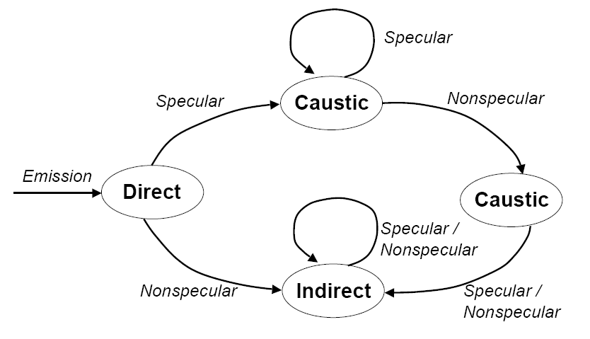
3 photon maps
Ex. LSSSDSSSSD
Caustic map
Indirect map

Slide 22
Rendering
Rendered by glossy-surface distributed ray tracing
When ray hits first diffuse surface…
  Compute reflected radiance of caustic map photons
  Ignore global map photons
  Importance sample BRDF f_{r} as usual
  Use global photon map to importance sample incident radiance function L_{i}
  Evaluate reflectance integral by casting rays and accumulating radiances from global photon map
First diffuse intersection. Return radiance of caustic map photons here, but ignore global map photons
Use global map photons to return radiance when evaluating Li at first diffuse intersection.
Notes:
For each pixel, the scene is ray traced until the closest surface of intersection is found.
At this point, the rendering equation is used to calculate the surface radiance leaving the point of intersection in the direction of the ray that struck it. To facilitate efficiency, the equation is decomposed into four separate factors: direct illumination, specular reflection, caustics, and soft indirect illumination.
*For an accurate estimate of direct illumination, a ray is traced from the point of intersection to each light source. As long as a ray does not intersect another object, the light source is used to calculate the direct illumination. For an approximate estimate of indirect illumination, the photon map is used to calculate the radiance contribution.
* Specular reflection can be, in most cases, calculated using ray tracing procedures (as it handles reflections well).
* The contribution to the surface radiance from caustics is calculated using the caustics photon map directly. The number of photons in this map must be sufficiently large, as the map is the only source for caustics information in the scene.
* For soft indirect illumination, radiance is calculated using the photon map directly. This contribution, however, does not need to be as accurate as the caustics contribution and thus uses the global photon map.

Slide 23
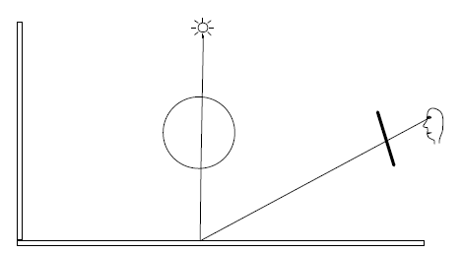
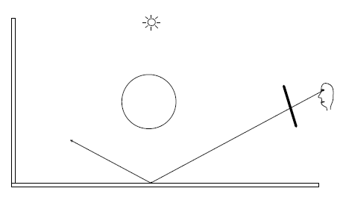
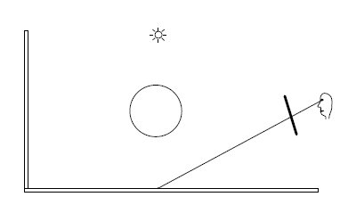
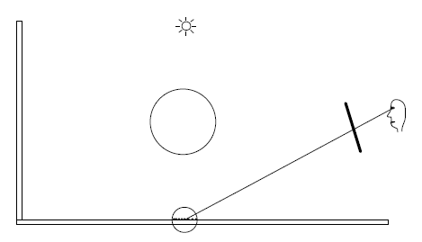
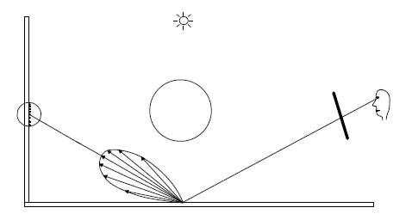
Direct illumination
Specular reflection
Caustic
Indirect diffuse
Notes:
* photon mapping handles caustics which removes the high frequency noise typically seen in path traced images.
* In addition, we can use information from the photon map to help us importance sample the hemisphere.
* the photon maps provides information that can be used as heuristics for other parts of the rendering equation. For example, with a little extra work, information from the photon map can provide information as to whether shadow rays are needed at a location.

Slide 24
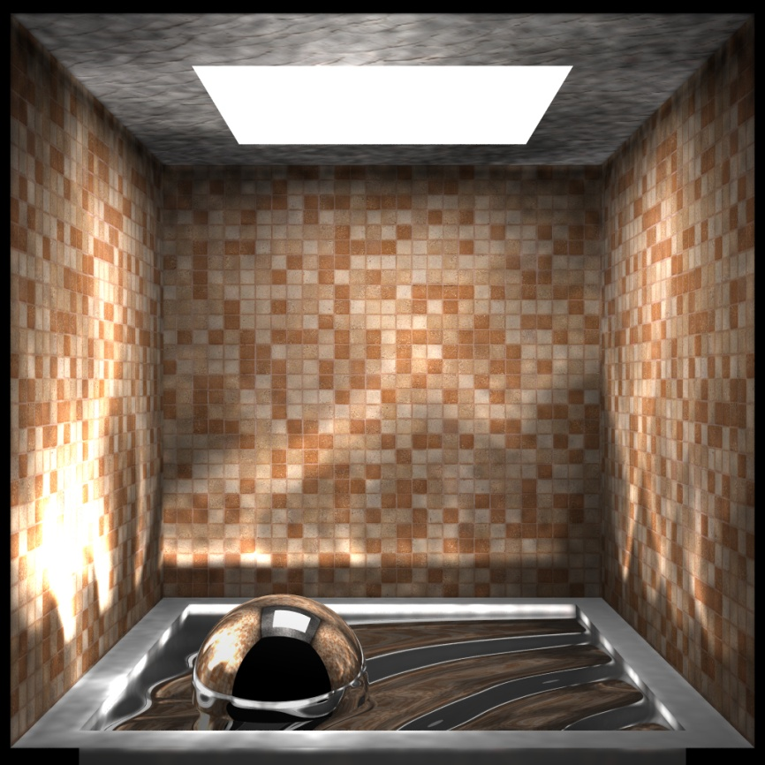
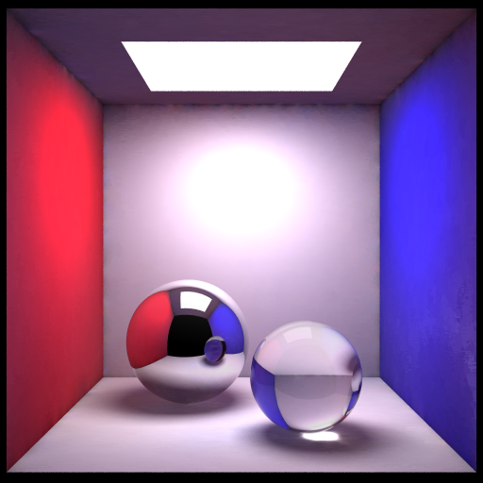
Caustic

Slide 25
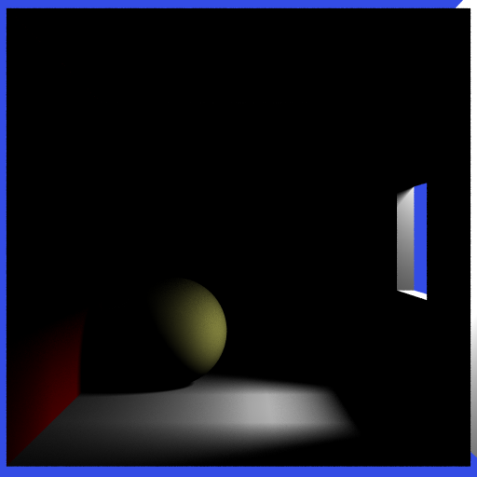
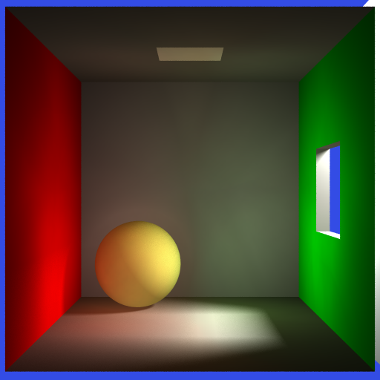
Indirect Illumination
direct lighting only
photon mapping
Total: 26,000 photons
500 were used in the radiance estimate.

Slide 26
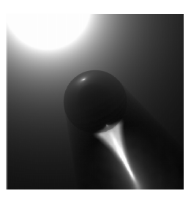
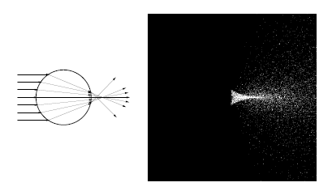
Participating media
Notes:
"Efficient Simulation of Light Transport in Scenes with Participating Media using Photon Maps"
Henrik Wann Jensen and Per H. Christensen
Proceedings of SIGGRAPH'98, pages 311-320, Orlando, July 1998

Slide 27
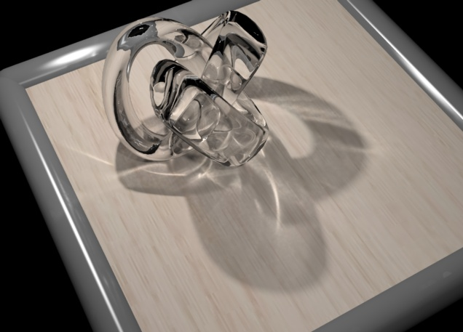
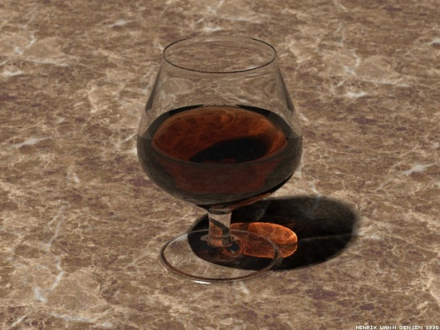
Rendering Result
http://graphics.cs.kuleuven.be/renderpark/intro.html

Slide 28
Environment Lighting

Slide 29
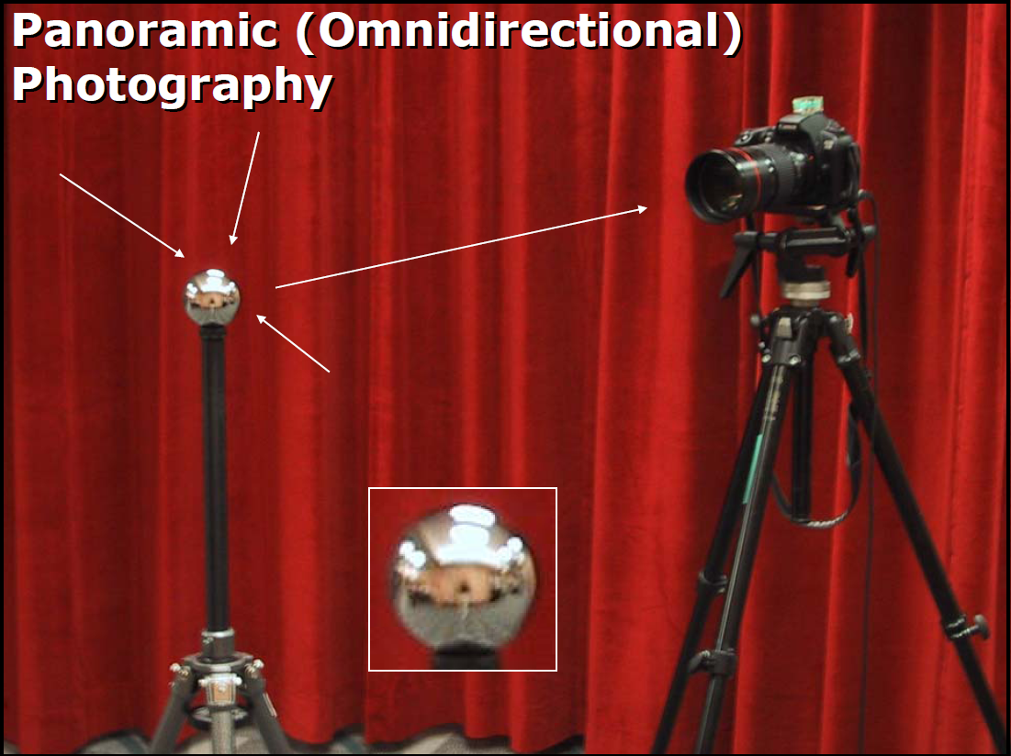

Slide 30
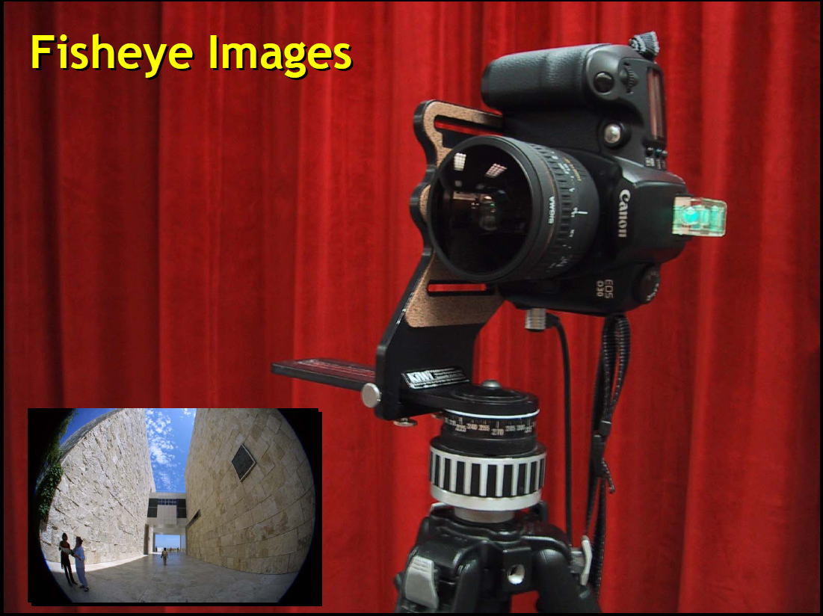

Slide 31
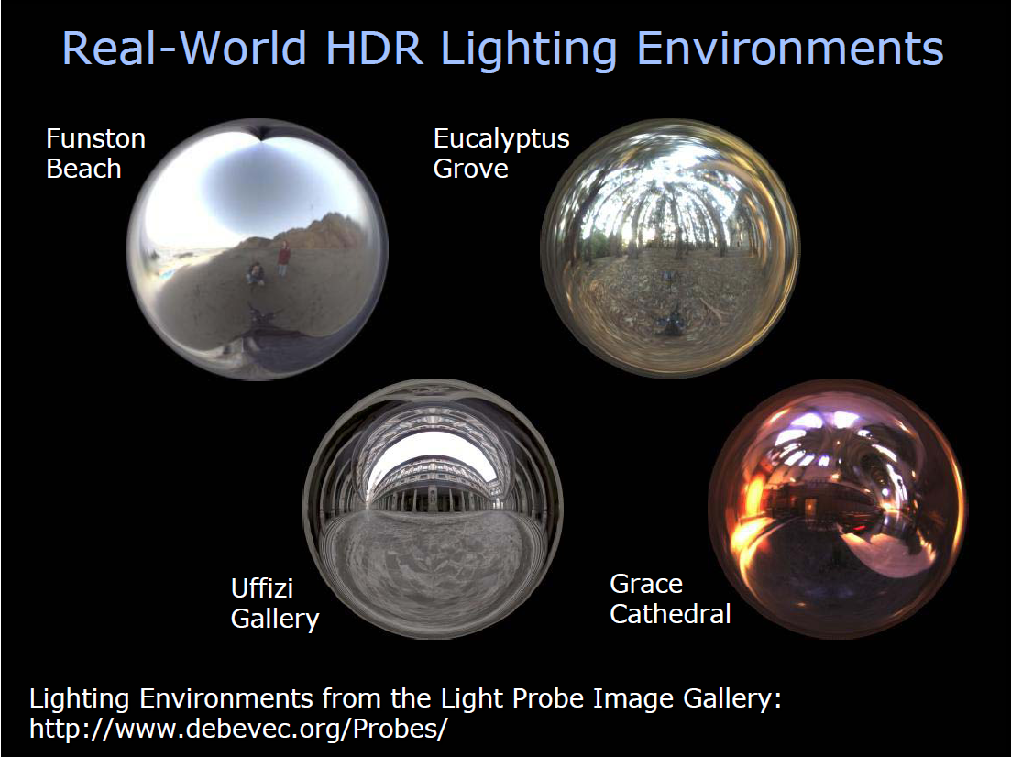

Slide 32
