Slide 1
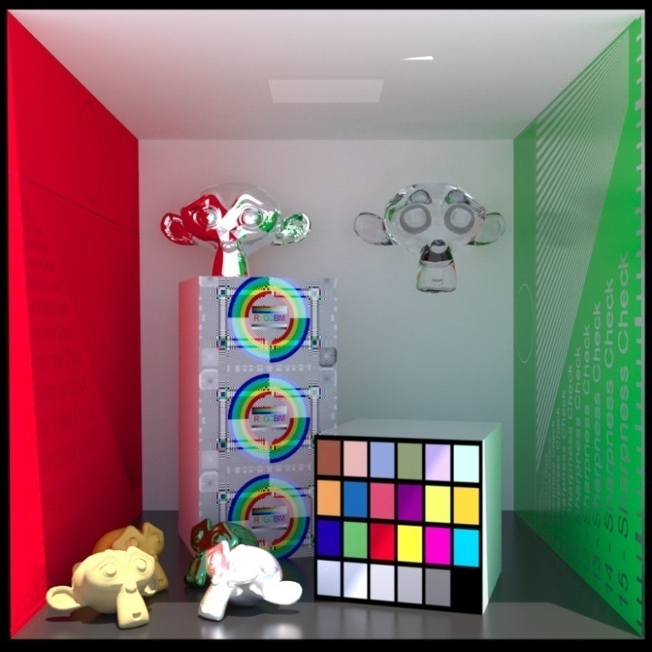
Advanced Computer Graphics
Global Illumination (2)
Image courtesy of of Luxrender
Ming-Te Chi
Department of Computer Science,
National Chengchi University
Notes:
2021
Global Illumination (2) - Radiosity

Slide 2
Global Illumination (2)
Radiosity
Definition
Solver: Matrix / Progress
Case
Form factor / Hemisphere
Application on Game Engine

Slide 3
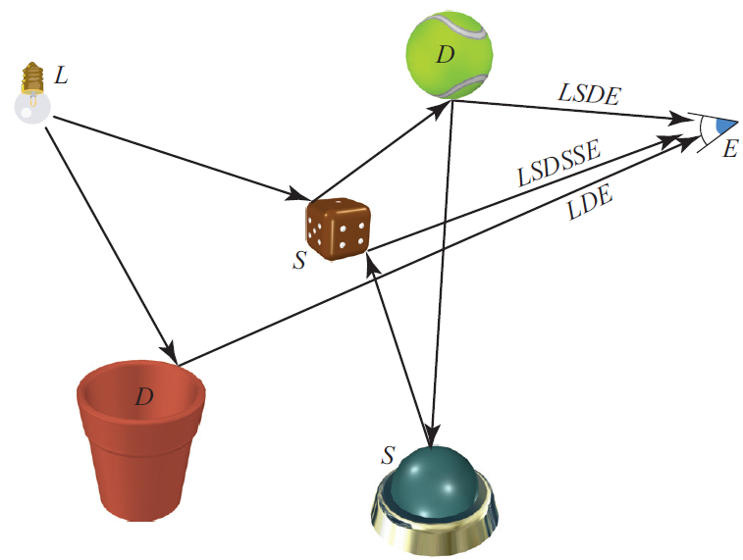
Regular expression notation
courtesy of Realtime Rendering 3rd
Notes:
Realtime Rendering 3rd p. 329

Slide 4
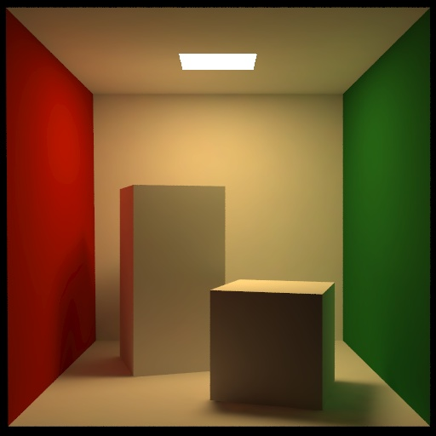
Radiosity
Cornell Box
courtesy of Cornell
Notes:
The slide is based on
http://www.siggraph.org/education/materials/HyperGraph/radiosity/overview_1.htm
* Handling cases such as LD*E
*“Color Bleeding”

Slide 7
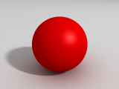
Cornell Box
Notes:
Color bleeding

Slide 8
Radiosity
Consider objects to be broken up into flat patches (which may correspond to the polygons in the model)
Assume that patches are perfectly diffuse reflectors
Radiosity = flux = energy/unit area/ unit time leaving patch

Slide 9
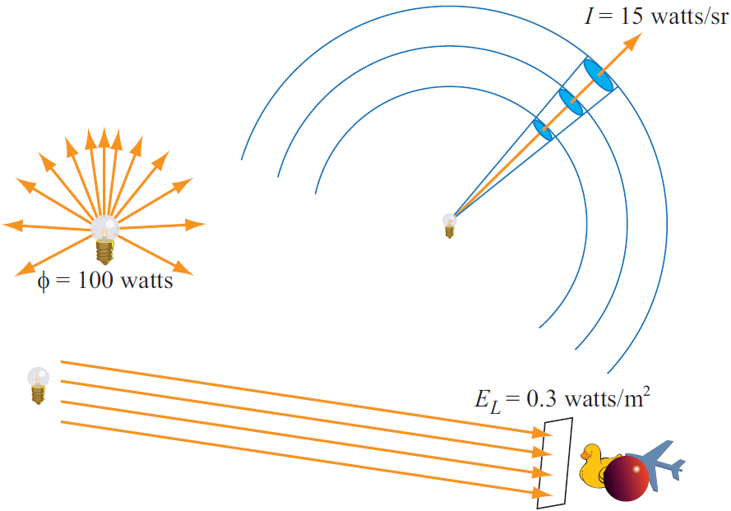
steradian
Radiant flux
irradiance
Image courtesy of of Real time rendering 3rd

Slide 10
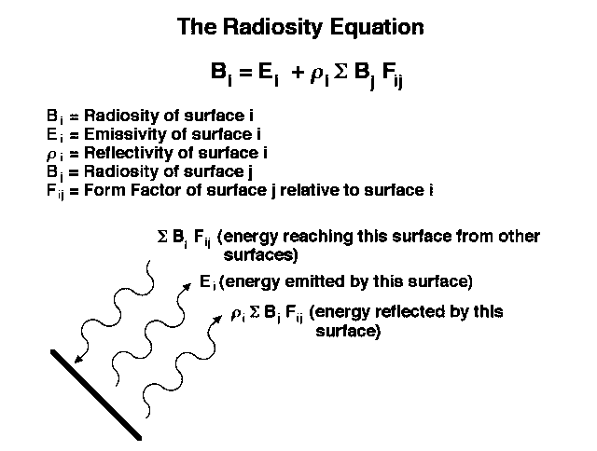

Slide 11
Radiosity Equation
energy balance
B_{i d}A_{i} = E_{i d}A_{i} + ρ_{i} ∑ B_{j}F_{ji d}A_{j}
reciprocity
F_{ij d}A_{i} = F_{ji d}A_{j}
Radiosity equation
B_{i} = E_{i} + ρ_{i} ∑ B_{j}F_{ij}

Slide 14
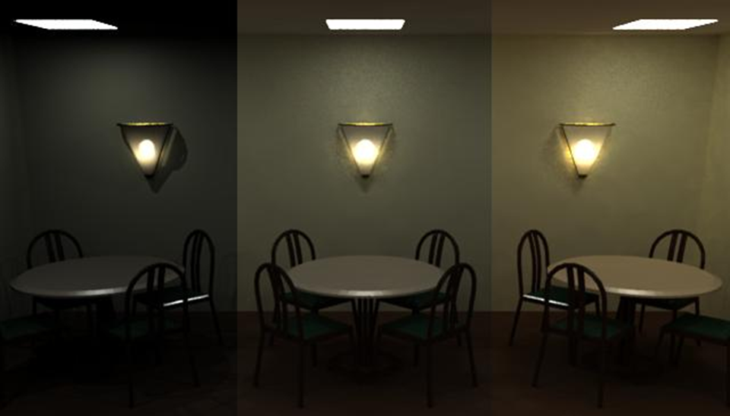
Progressive solution
0 bounces
1 bounces
3 bounces
Notes:
Reference: SIGGRAPH 1993 Education Slide Set, by Stephen Spencer

Slide 15
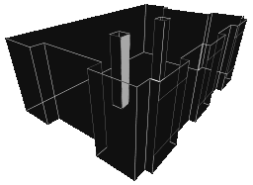
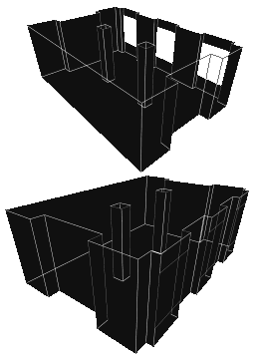
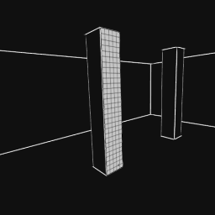
Progressive solution step by step
Consider one surface
A simple scene in different view
Surface -> patches
Notes:
http://freespace.virgin.net/hugo.elias/radiosity/radiosity.htm

Slide 16
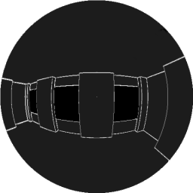
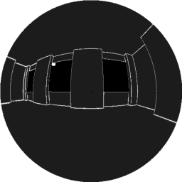
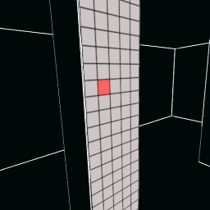
View from red patch
View from lower patch

Slide 17
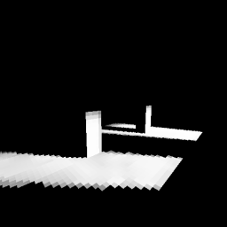
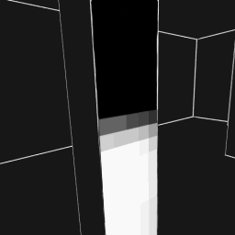
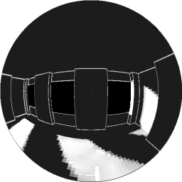

Slide 18
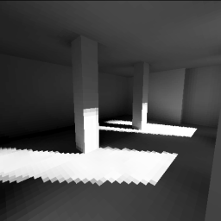
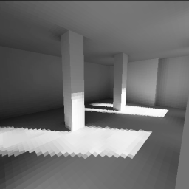
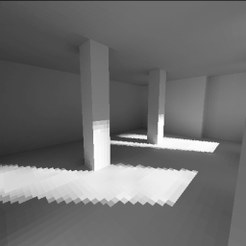
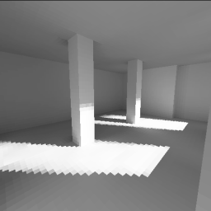
1st pass
2nd pass
3rd pass
4th pass
16th pass

Slide 19
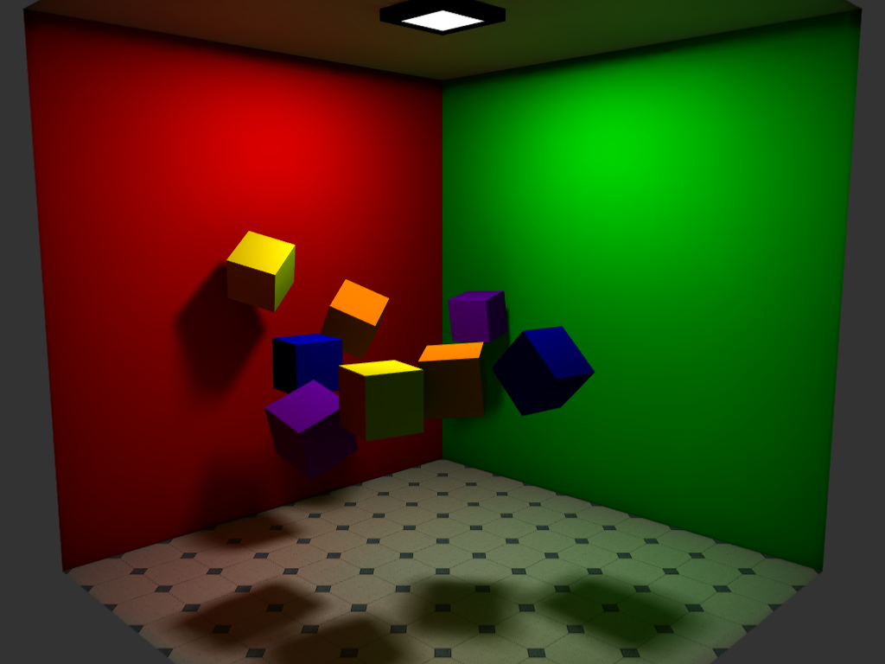
Rendered Image

Slide 20
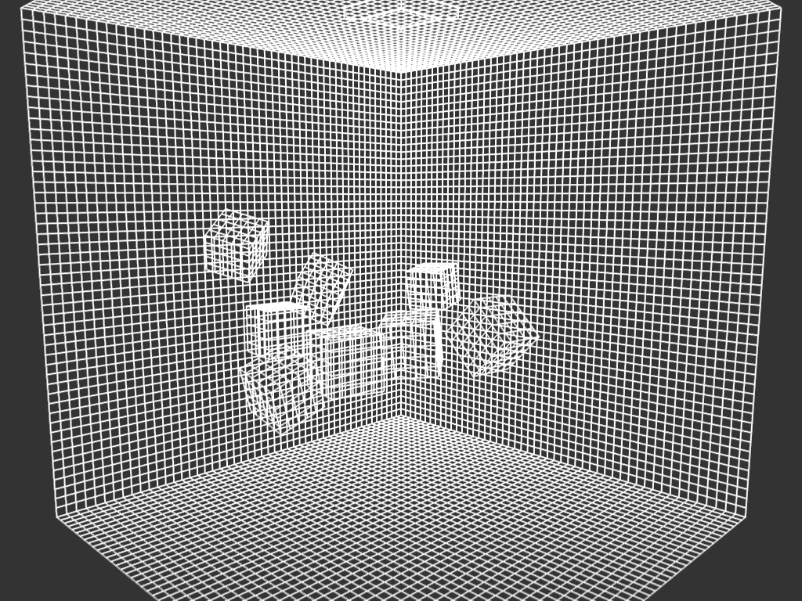
Patches

Slide 22
Solving the Intergral
There are very few cases where the integral has a (simple) closed form solution
Occlusion further complicates solution
Alternative is to use numerical methods
Two step process similar to texture mapping
Hemisphere
Hemicube

Slide 23
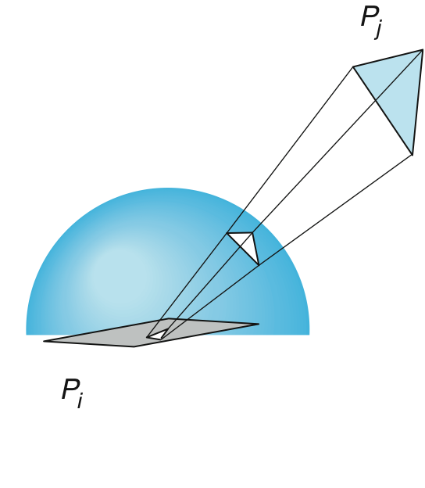
Hemisphere
Use illuminating hemisphere
Center hemisphere on patch with normal pointing up
Must shift hemisphere for each point on patch

Slide 25
Hemicube
Easier to use a hemicube instead of a hemisphere
Rule each side into “pixels”
Easier to project on pixels which give delta form factors that can be added up to give desired from factor
To get a delta form factor we need only cast a ray through each pixel

Slide 26
The Hemicube approximation

Slide 27
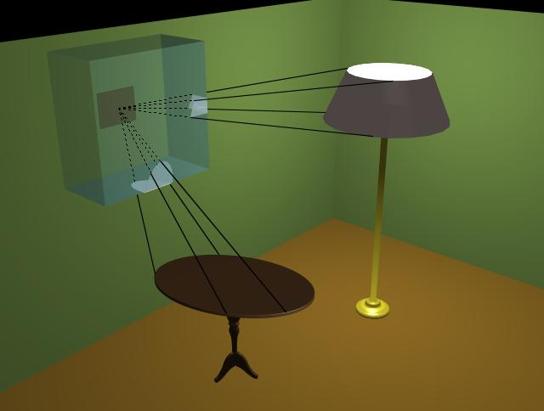

Slide 28
Application

Slide 29
Two pass solution
View independent global diffuse illumination computed with radiosity pre-process
View dependent global specular illumination computed with ray tracing post-process

Slide 30
Advantages
Photorealistic image quality
Accurate simulation of energy transfer
Soft shadows and diffuse interreflection
Disadvantages
Large computational and storage costs
Must preprocess polygonal environments
Non-diffuse components of light not represented

Slide 31
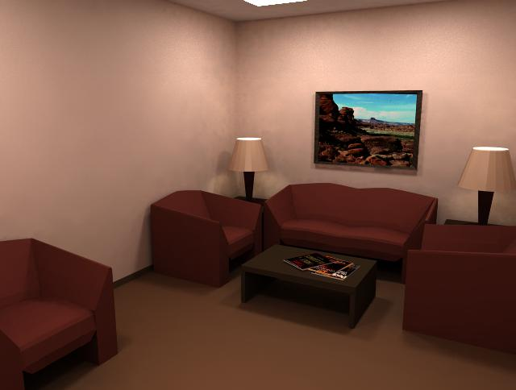

Slide 32
Ambient Occlusion

Slide 33
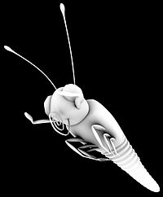
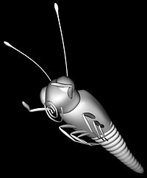
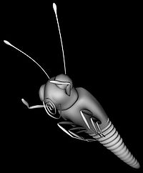
Ambient Occlusion
ambient occlusion
combined ambient and diffuse
diffuse only

Slide 34
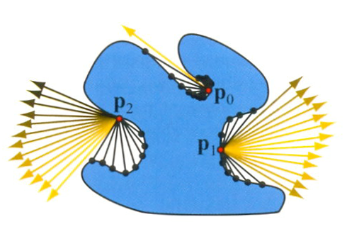
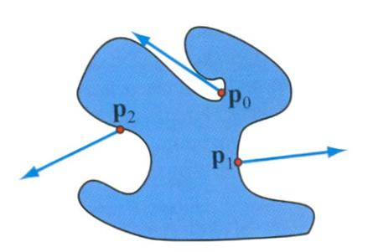
Ambient Occlusion "Production-Ready Global Illumination", SIGGRAPH 2002
On Lambertian surface
Define ambient occlusion value
bent normal

Slide 35
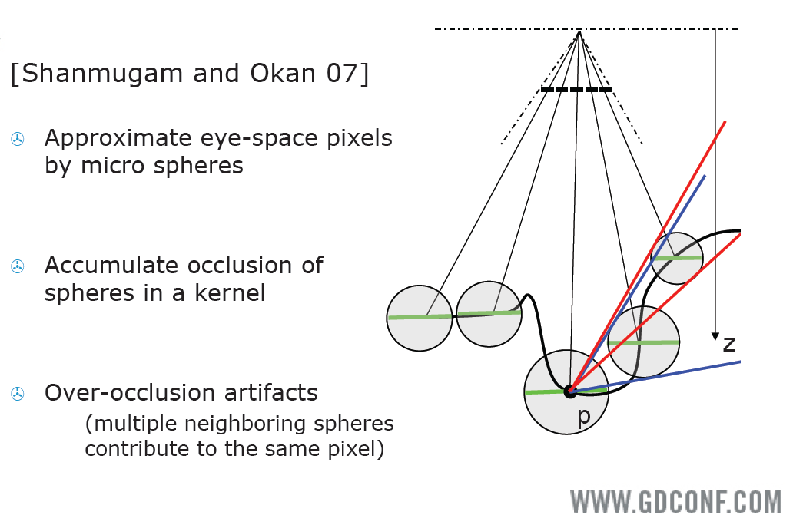
Screen space
Notes:
http://developer.download.nvidia.com/presentations/2008/GDC/GDC08_Ambient_Occlusion.pdf

Slide 36
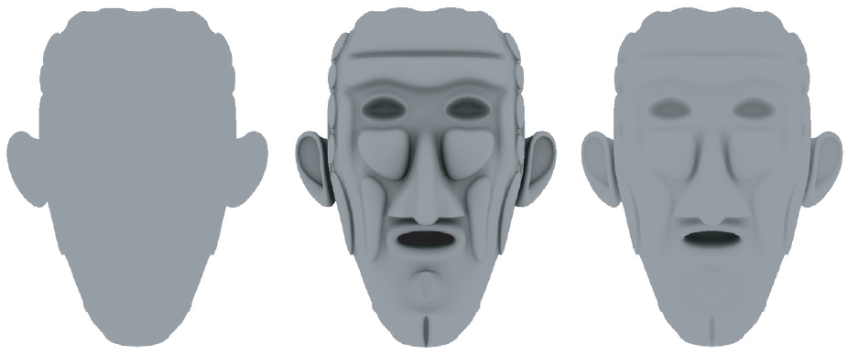
Without shadow
Ambient occlusion
Full global illumination
Images generated using the Microsoft SDK sample “PRTDemo”
Notes:
Do not depend on light direction

Slide 37
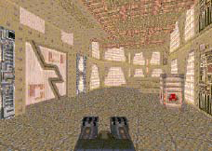
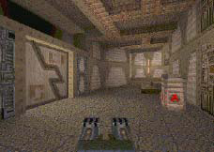
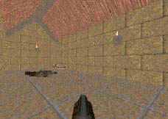
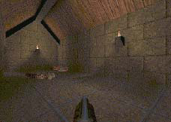
Texture Mapping in Quake
Light Map
Texture Only
Texture & Light Maps

Slide 38
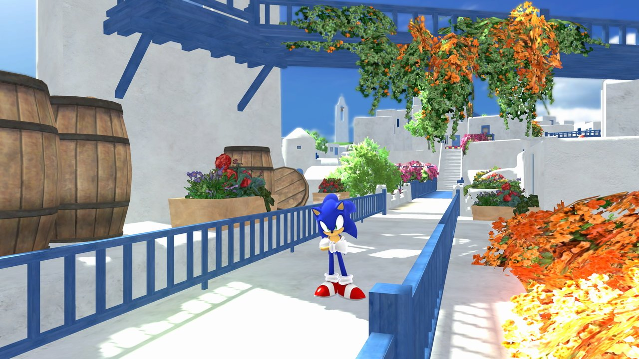
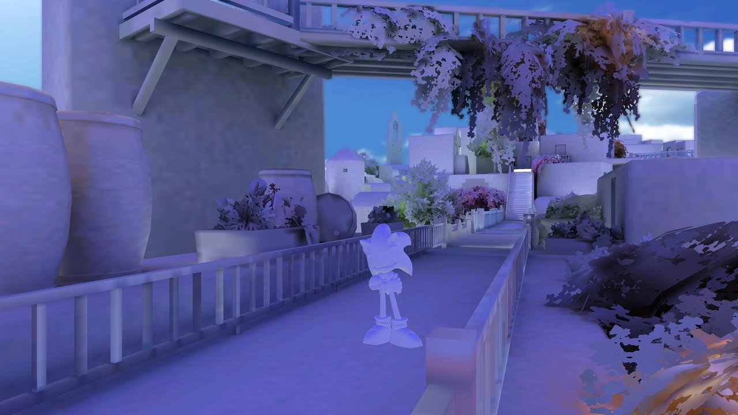
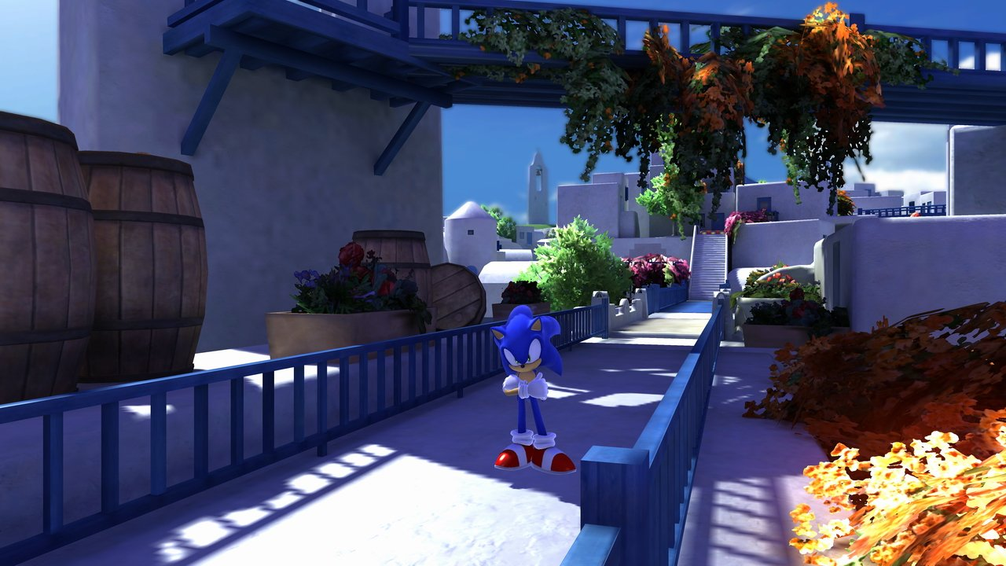
GI texture using radiosity
Notes:
http://game.watch.impress.co.jp/docs/series/3dcg/20090410_110682.html

Slide 39
Deferred Shading
A shading algorithm is calculated by dividing it into smaller parts that are written to intermediate buffer storage to be combined later, instead of immediately writing the shader result to the color framebuffer.

Slide 40
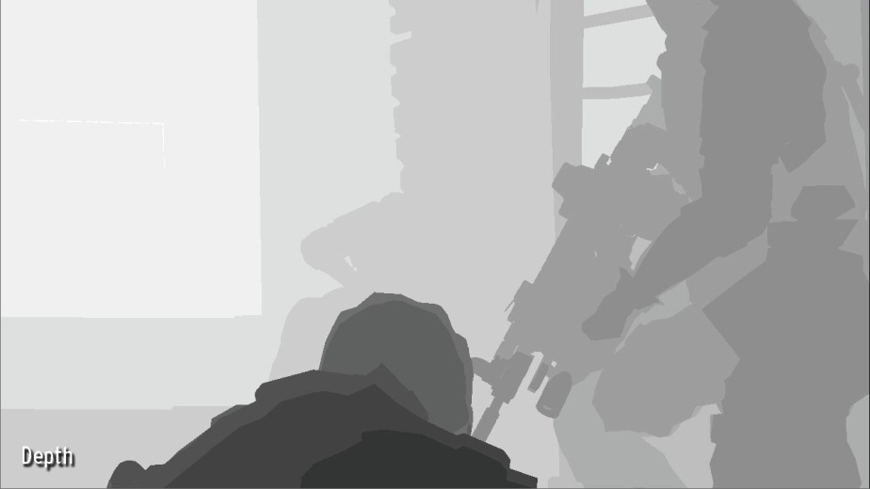
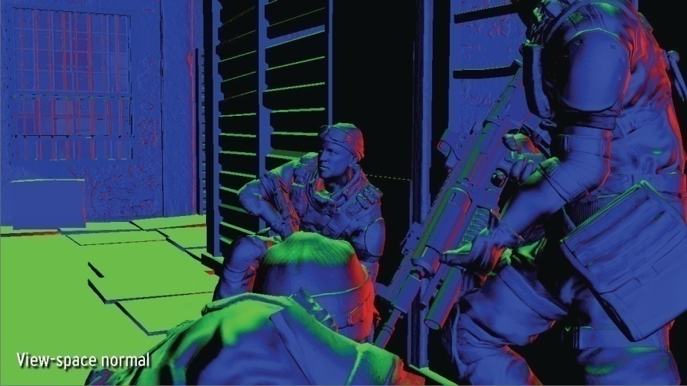
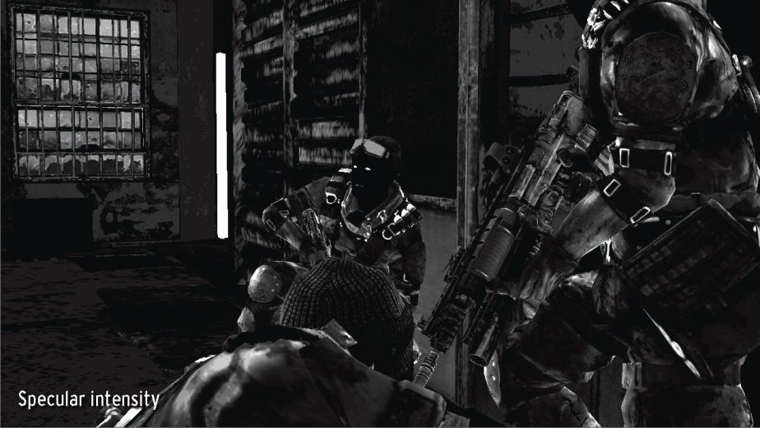
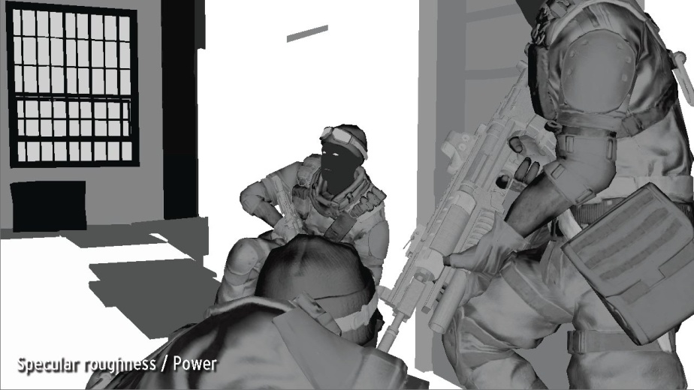
Deferred Shading in Killzone2
Notes:
http://game.watch.impress.co.jp/docs/series/3dcg/20090417_125909.html

Slide 41
