Slide 1
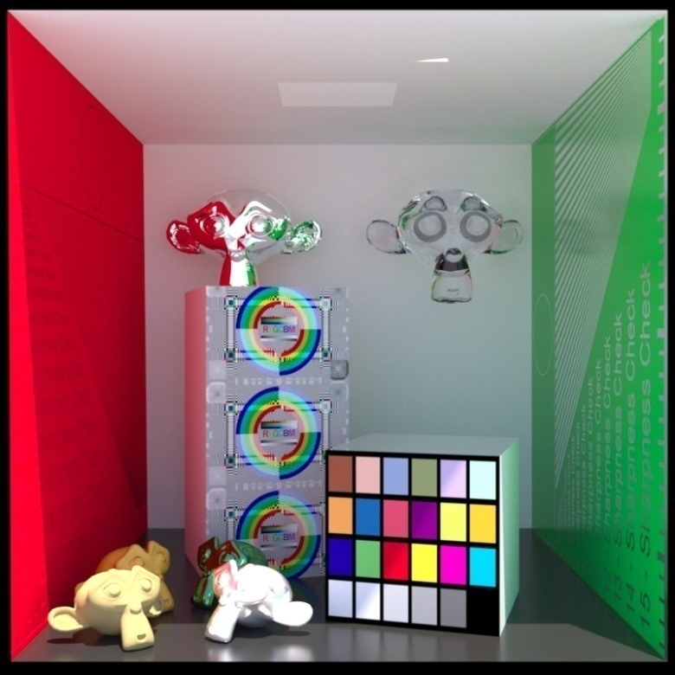
Advanced Computer Graphics
Global Illumination (1)
Ming-Te Chi
Department of Computer Science,
National Chengchi University
Notes:
2021
The image is made by LuxRender. http://www.luxrender.net/

Slide 2
Global Illumination
Rendering equation
  Ray tracing / Radisoity / Photon mapping
Ray tracing
  Primary ray / intersection
Distributed Ray Tracing

Slide 3
Rendering Equation (Kajiya 1986)
Consider a point on a surface
N
I_{in}(Φ_{in})
I_{out}(Φ_{out})

Slide 4
Rendering Equation
Outgoing light is from two sources
  Emission
  Reflection of incoming light
Must integrate over all incoming light
  Integrate over hemisphere
Must account for foreshortening of incoming light

Slide 5
Rendering Equation
I_{out}(Φ_{out}) = E(Φ_{out}) + ∫ _{2π}R_{bd}(Φ_{out}, Φ_{in} )I_{in}(Φ_{in}) cos θ dω
emission
angle between Normal and Φin
bidirectional reflection coefficient
Note that angle is really two angles in 3D and wavelength is fixed

Slide 6
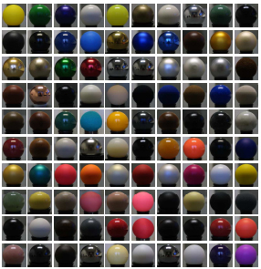
BRDF database
http://www.merl.com/brdf/
Notes:
33MB per material
#define BRDF_SAMPLING_RES_THETA_H 90
#define BRDF_SAMPLING_RES_THETA_D 90
#define BRDF_SAMPLING_RES_PHI_D 360
RGB 3 float
// Read BRDF data
bool read_brdf(const char *filename, double* &brdf)
{
FILE *f = fopen(filename, "rb");
if (!f)
return false;
int dims[3];
fread(dims, sizeof(int), 3, f);
int n = dims[0] * dims[1] * dims[2];
if (n != BRDF_SAMPLING_RES_THETA_H *
BRDF_SAMPLING_RES_THETA_D *
BRDF_SAMPLING_RES_PHI_D / 2)
{
fprintf(stderr, "Dimensions don't match\n");
fclose(f);
return false;
}
brdf = (double*) malloc (sizeof(double)*3*n);
fread(brdf, sizeof(double), 3*n, f);
fclose(f);
return true;
}

Slide 7
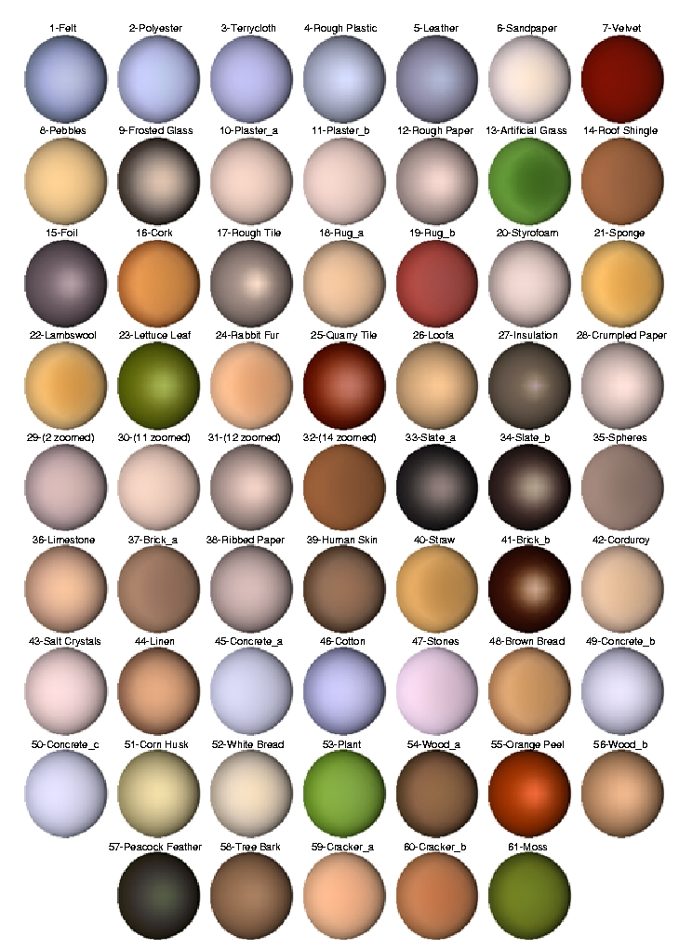
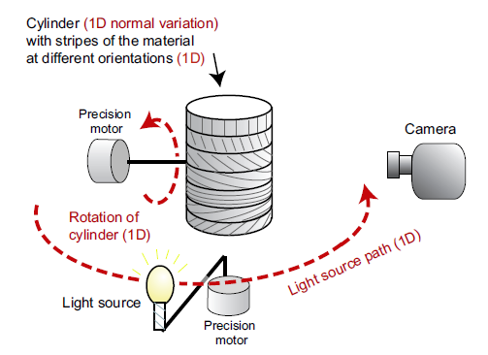
Notes:
http://people.csail.mit.edu/addy/research/ngan05_brdf_eval.pdf

Slide 8
Rendering Equation
Rendering equation is an energy balance
  Energy in = energy out
Integrate over hemisphere
Fredholm integral equation
  Cannot be solved analytically in general
Various approximations of R_{bd} give standard rendering models
Should also add an occlusion term in front of right side to account for other objects blocking light from reaching surface

Slide 9
Another version
Consider light at a point p arriving from p’
i(p, p’) = υ(p, p’)(ε(p,p’)+ ∫ ρ(p, p’, p’’)i(p’, p’’)dp’’)
emission from p’ to p
occlusion = 0
or
attenuation =1/d²
light reflected at p’ from all
points p’’ towards p

Slide 10
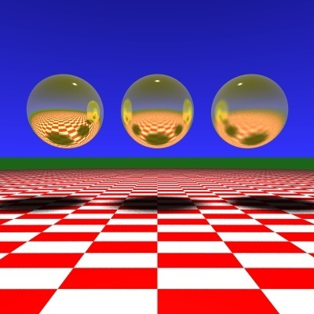
Ray Tracing
Slide Courtesy of Roger Crawfis, Ohio State

Slide 11
Early History
Whitted 1980: shiny
reflection rays off perfect surfaces
shadow rays to point sources
Cook 1984 (distribution ray tracing): fuzzy
reflection rays are randomly perturbed off pure specular direction
soft shadows by sending rays to random points on area light source
Kajiya 1986 (path tracing): diffuse inter-reflection
Now go fully random for diffuse surfaces
Notes:
From http://intro-to-dxr.cwyman.org/presentations/IntroDXR_RayTracingOverview.pdf

Slide 12
Ray Tracing
Follow rays of light from a point source
Can account for reflection and transmission

Slide 13
Computation
Should be able to handle all physical interactions
Ray tracing paradigm is not computational
Most rays do not affect what we see
Scattering produces many (infinite) additional rays
Alternative: ray casting

Slide 14
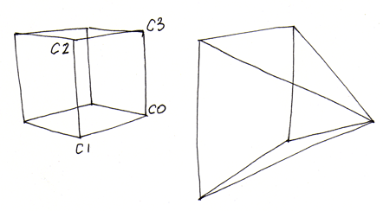
Ray Casting
Only rays that reach the eye matter
Reverse direction and cast rays
Need at least one ray per pixel

Slide 15
Ray Casting Quadrics
Ray casting has become the standard way to visualize quadrics which are implicit surfaces in CSG systems
Constructive Solid Geometry
  Primitives are solids
  Build objects with set operations
  Union, intersection, set difference

Slide 16
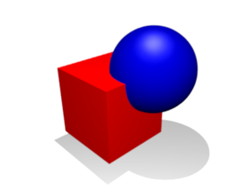
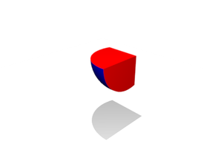
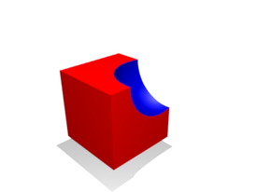
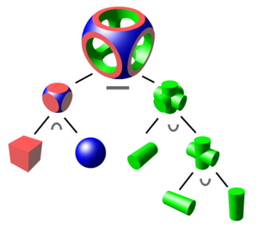
Constructive solid geometry (CSG)
  union
  intersection
  difference
Notes:
Ricci 1973

Slide 17
Ray Casting a Sphere
Ray is parametric
Sphere is quadric
Resulting equation is a scalar quadratic equation which gives entry and exit points of ray (or no solution if ray misses)

Slide 18
Shadow Rays
Even if a point is visible, it will not be lit unless we can see a light source from that point
Cast shadow or feeler rays

Slide 19
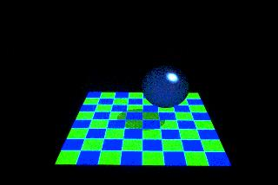
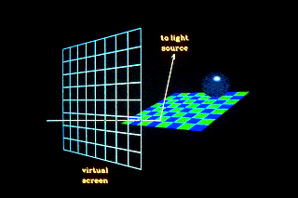
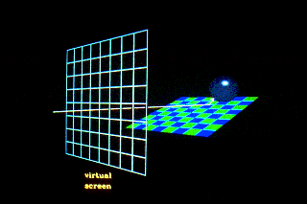
Shadow Rays
Notes:
http://www.siggraph.org/education/materials/HyperGraph/raytrace/rtrace1.htm

Slide 20
Reflection
Must follow shadow rays off reflecting or transmitting surfaces
Process is recursive

Slide 21
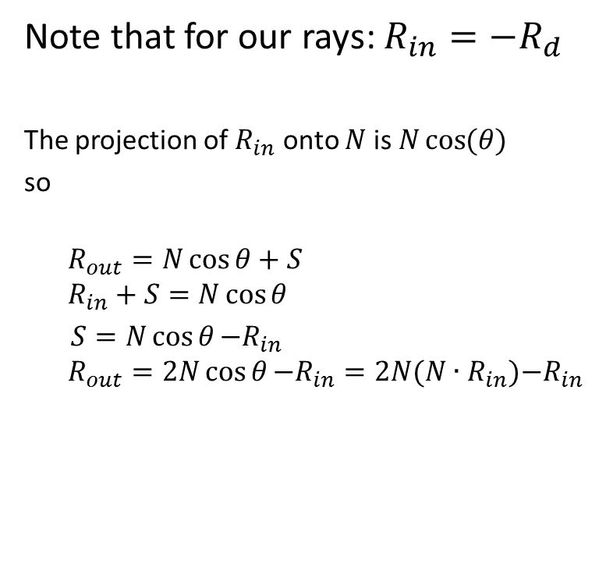
Computing a Reflected Ray
N
S
S
Rin
Rout
Ɵ
Ɵ
Notes:
http://www.opengl.org/sdk/docs/manglsl/xhtml/reflect.xml

Slide 22
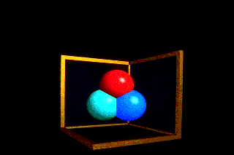
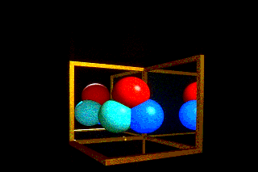
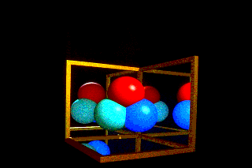
Scene with no reflection rays
Scene with one layer of reflection
Scene with two layer of reflection

Slide 23
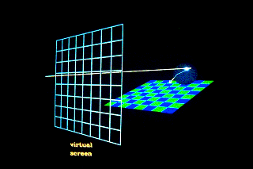
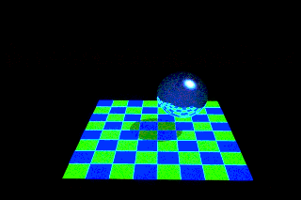
Transmission
Notes:
http://www.opengl.org/sdk/docs/manglsl/xhtml/refract.xml

Slide 24
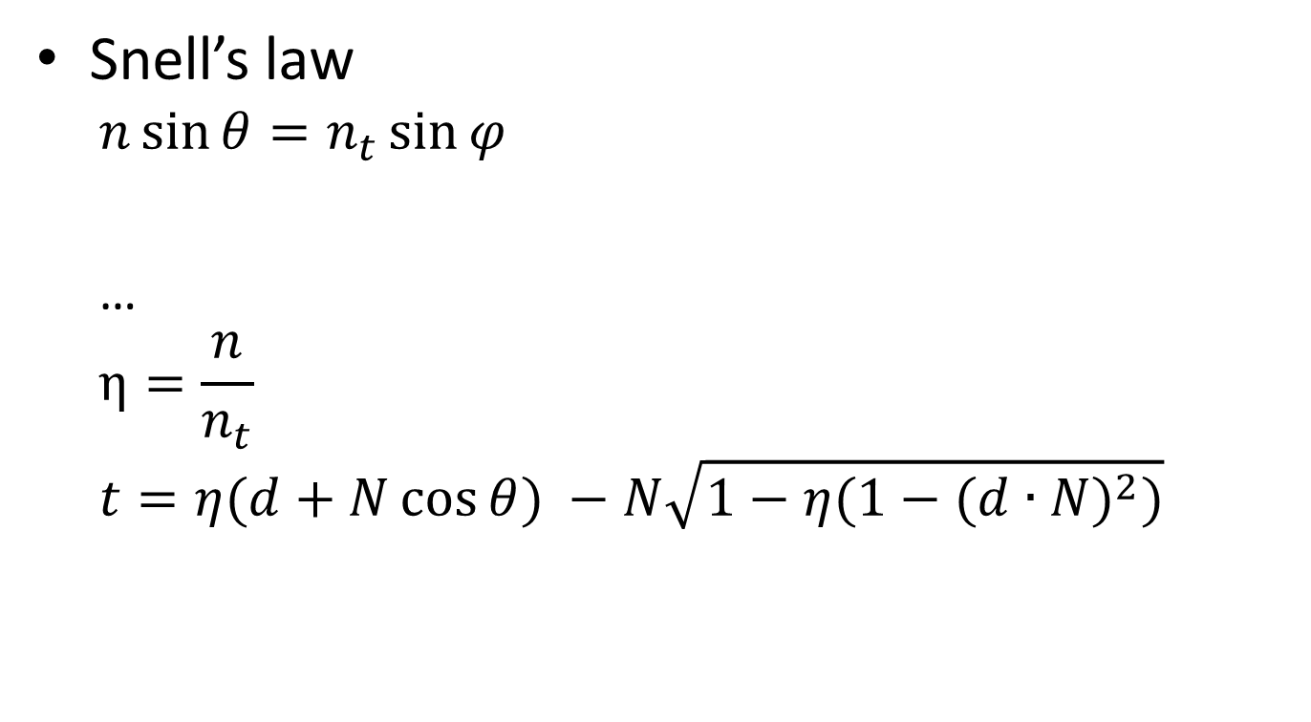

Transformed ray
d
θ
N
θ
r
t
Notes:
http://www.opengl.org/sdk/docs/manglsl/xhtml/refract.xml

Slide 25
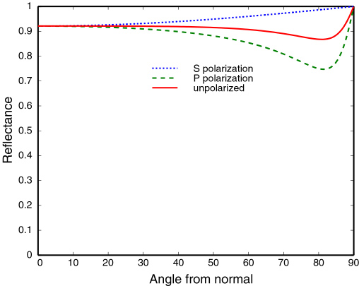
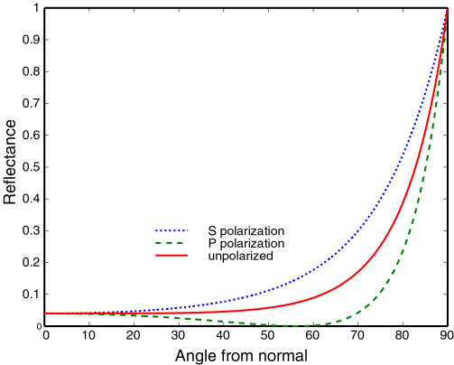
Fresnel Reflectance
Fresnel equation describe the behaviour of light when moving between media of differing refractive indices.
conductive materials
aluminum
dielectric
glasses
Notes:
http://www.graphics.cornell.edu/~westin/misc/fresnel.html

Slide 26
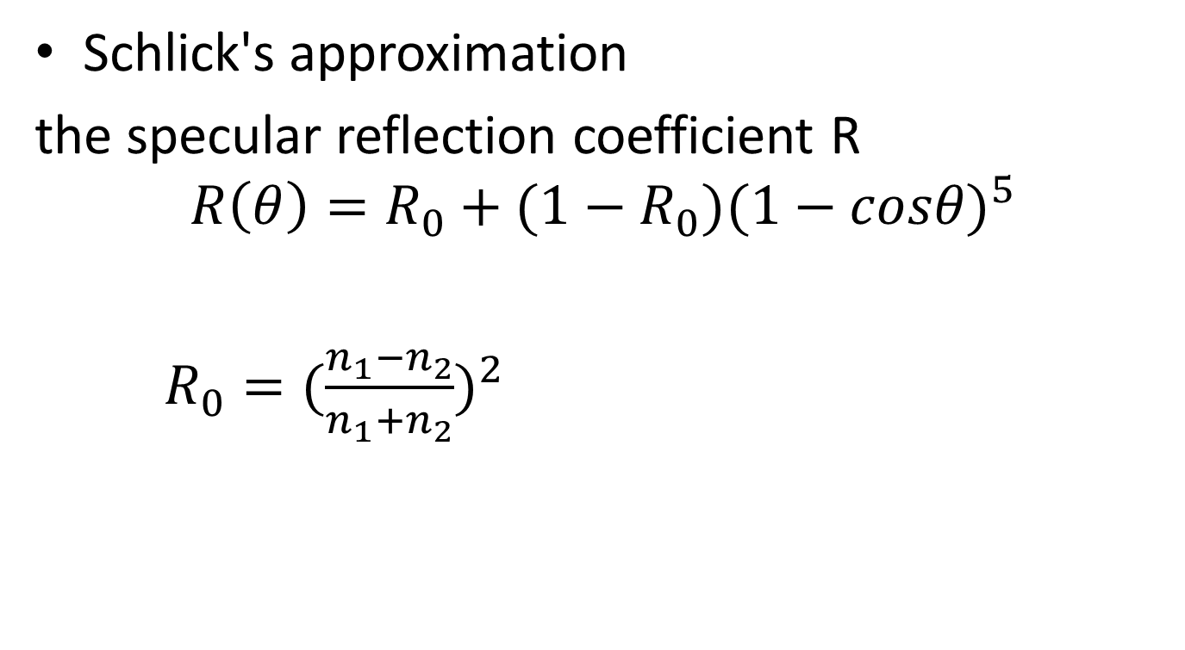
Schlick's approximation
the specular reflection coefficient R
$$R\left(θ\right)=R_{0}+(1−R_{0}){(1−cosθ)}^{5}$$
$R_{0}={(\frac{n_{1}−n_{2}}{n_{1}+n_{2}})}^{2}$
Notes:
Schlick, C. (1994). "An Inexpensive BRDF Model for Physically-based Rendering". Computer Graphics Forum 13 (3): 233

Slide 27
Ray Trees

Slide 28
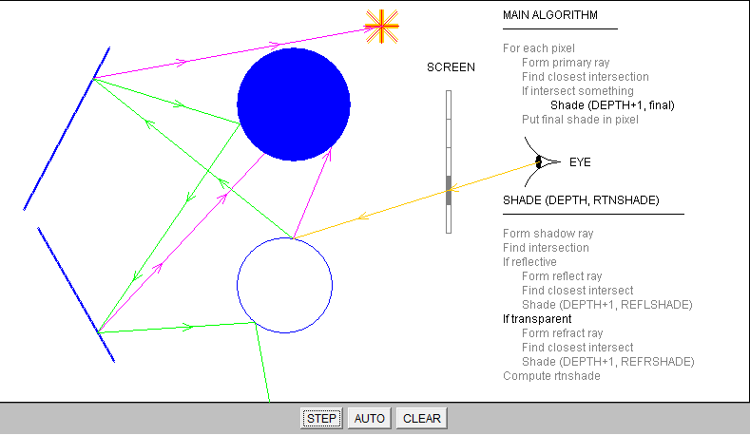
A Ray Tracing demonstration program
Notes:
http://www.siggraph.org/education/materials/HyperGraph/raytrace/rt_java/raytrace.html

Slide 29
Diffuse Surfaces
Theoretically the scattering at each point of intersection generates an infinite number of new rays that should be traced
In practice, we only trace the transmitted and reflected rays, but use the Phong model to compute shade at point of intersection
Radiosity works best for perfectly diffuse (Lambertian) surfaces

Slide 30
Building a Ray Tracer
Best expressed recursively
Can remove recursion later
Image based approach
  For each ray …….
Find intersection with closest surface
  Need whole object database available
  Complexity of calculation limits object types
Compute lighting at surface
Trace reflected and transmitted rays

Slide 31
When to stop
Some light will be absorbed at each intersection
  Track amount left
Ignore rays that go off to infinity
  Put large sphere around problem
Count steps

Slide 32
Recursive Ray Tracer(1/3)
color c = trace(point p, vector d, int step)
{
color local, reflected, transmitted;
point q;
normal n;
if(step > max) return(background_color);
p
d

Slide 33
Recursive Ray Tracer (2/3)
N
p
r
q = intersect(p, d, status);
if(status==light_source) return(light_source_color);
if(status==no_intersection) return(background_color);
n = normal(q);
r = reflect(q, n);
t = transmit(q,n);
d
q
t

Slide 34
Recursive Ray Tracer (3/3)
local = phong(q, n, r);
reflected = trace(q, r, step+1);
transmitted = trace(q,t, step+1);
return(local + reflected + transmitted);
}
N
p
r
d
q
t

Slide 35
Computing Intersections
Implicit Objects
  Quadrics
Planes
Polyhedra
Parametric Surfaces

Slide 36
Implicit Surfaces
Ray from o in direction d
p(t) = o +t d
General implicit surface
f(p) = 0
Solve scalar equation
f(p(t)) = 0
General case requires numerical methods

Slide 37



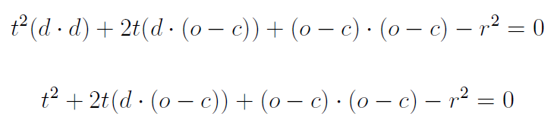

Sphere

Slide 38
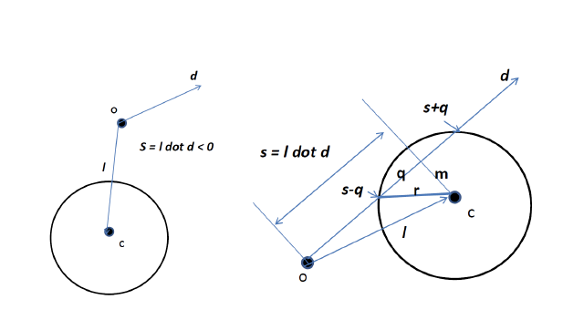

Slide 39
Planes
p • n + c = 0
p(t) = p₀ +t d
t = -(p₀ • n + c)/ d • n

Slide 40
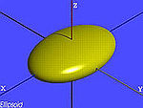
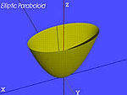
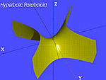
Quadrics
General quadric can be written as
  p^{T}Ap + b^{T}p +c = 0
Substitute equation of ray
p(t) = p₀ +t d
to get quadratic equation
Ellipsoid
Elliptic paraboloid
Hyperbolic paraboloid
…..
Notes:
http://en.wikipedia.org/wiki/Quadric

Slide 41
Polyhedra
Generally we want to intersect with closed objects such as polygons and polyhedra rather than planes
Hence we have to worry about inside/outside testing
For convex objects such as polyhedra there are some fast tests

Slide 42
Ray Tracing Polyhedra
If ray enters an object, it must enter a front facing polygon and leave a back facing polygon
Polyhedron is formed by intersection of planes
Ray enters at furthest intersection with front facing planes
Ray leaves at closest intersection with back facing planes
If entry is further away than exit, ray must miss the polyhedron

Slide 43
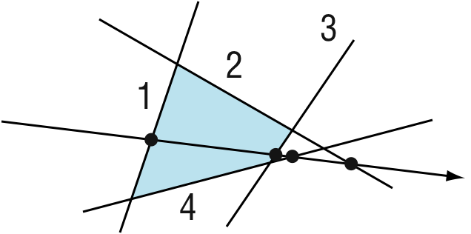
Ray Tracing a Polygon

Slide 44
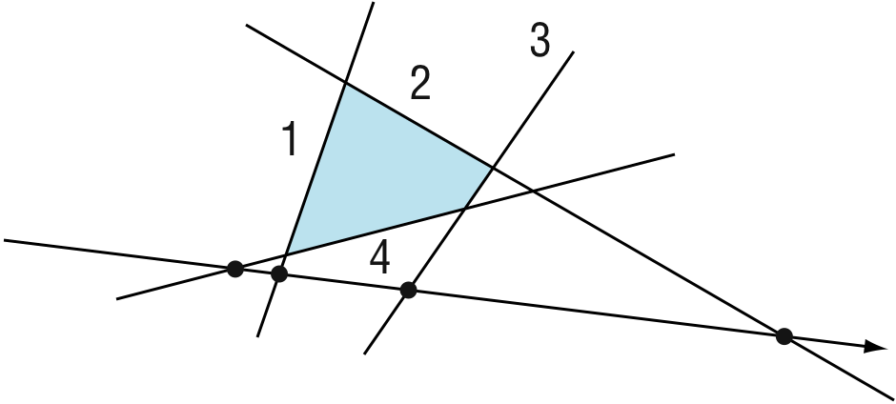
Ray Tracing a Polygon

Slide 45
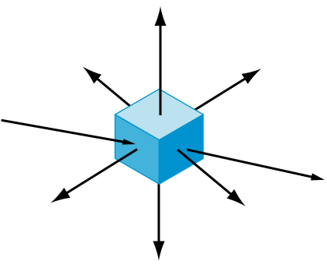
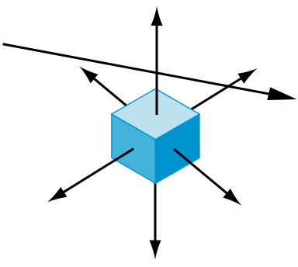
Ray Tracing Polyhedra

Slide 46
Distributed Ray Tracing
Robert L. Cook, Thomas Porter, Loren Carpenter
1984

Slide 47
Shadows
Ray tracing casts shadow feelers to a point light source.
Many light sources are illuminated over a finite area.
The shadows between these are substantially different.
Area light sources cast soft shadows
  Penumbra
  Umbra

Slide 48
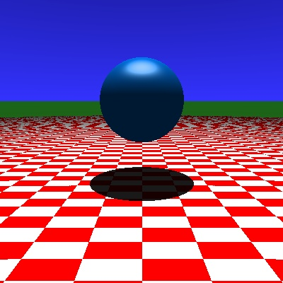

Soft Shadows
Slide Courtesy of Roger Crawfis, Ohio State

Slide 49
Soft Shadows
Penumbra
Umbra
Slide Courtesy of Roger Crawfis, Ohio State

Slide 50
Camera Models
Up to now, we have used a pinhole camera model.
These has everything in focus throughout the scene.
The eye and most cameras have a larger lens or aperature.
Notes:
Slide Courtesy of Roger Crawfis, Ohio State

Slide 51
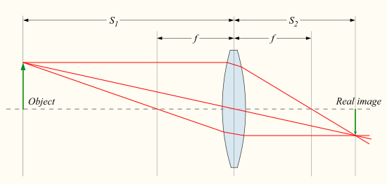

thin lens formula
$\frac{1}{S_{1}}+\frac{1}{S_{2}}=\frac{1}{f}$

Slide 52
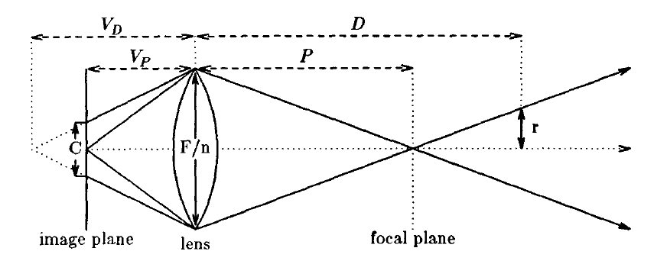

Circle of confusion
F: Focal length; n: aperture number
$V_{P}=\frac{FP}{P−F},$ for P>F, $V_{D}=\frac{FD}{D−F},$ for D>F
$C=\left|V_{D}−V_{P}\right|\frac{F}{nV_{D}}$

Slide 53
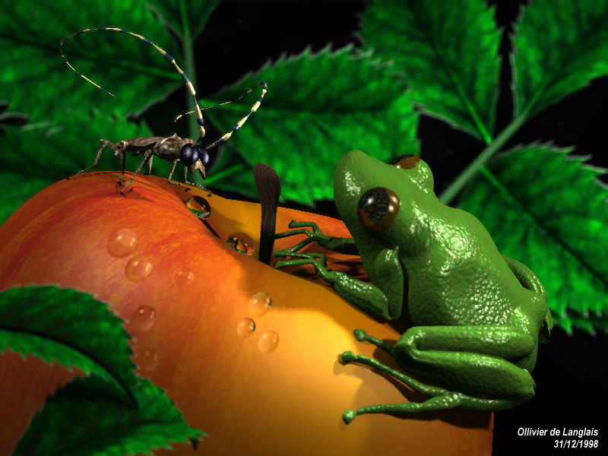
Depth-of-Field

Slide 54
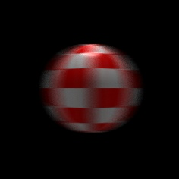
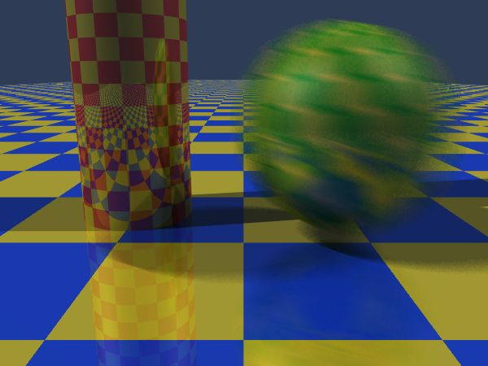
Motion Blur
Slide Courtesy of Roger Crawfis, Ohio State

Slide 55
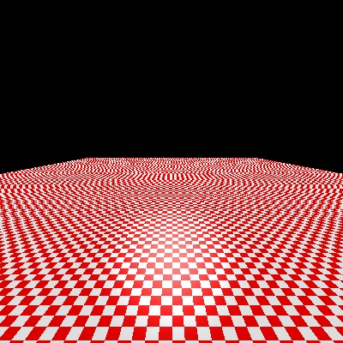
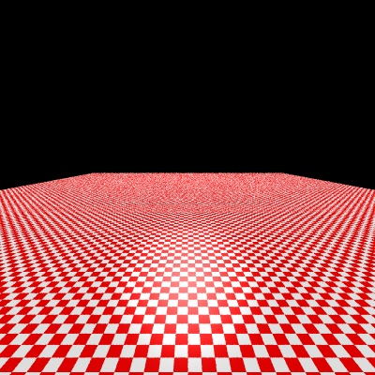
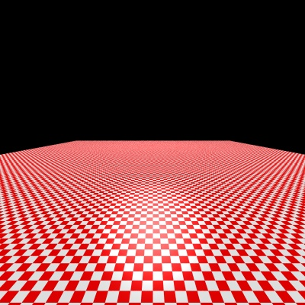
Supersampling
1 sample per pixel
16 sample per pixel
256 sample per pixel
Slide Courtesy of Roger Crawfis, Ohio State

Slide 56
More On Ray-Tracing
Already discussed recursive ray-tracing!
Improvements to ray-tracing!
  Area sampling variations to address aliasing
Distributed ray-tracing!

Slide 57
Area Subdivision (Warnock)
(mixed object/image space)
Clipping used to subdivide polygons that are across regions

Slide 58
Softwares
POV-ray (http://www.povray.org/)
  A free rendering tool (not a modeling tool)
    Uses a text based scene description language (SDL)
Blender (http://www.blender3d.org)
  Modeling, Animation, rendering tool
    Especially useful in 3D game creation

