Slide 1
Advance Computer Graphics
Non-photorealistic rendering – media simulation
Notes:
2021
http://www.cs.princeton.edu/courses/archive/spr03/cs426/lectures/19-npr.pdf

Slide 2
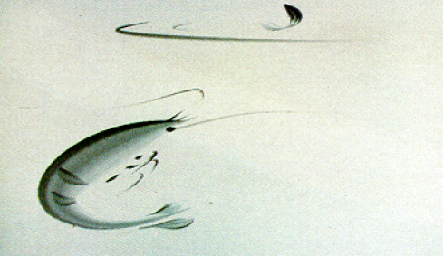
Hairy Brushes 1986
Strassmann (1986)
Described the hairy brush as a 1D array of bristles

Slide 3
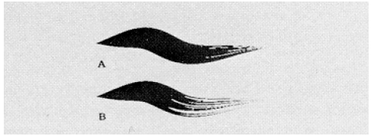
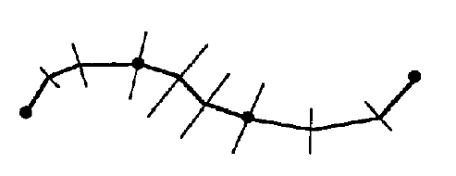
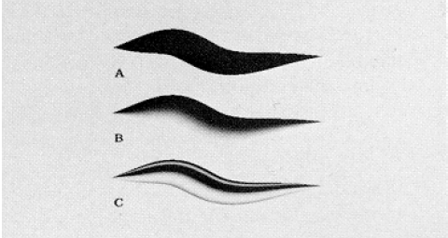

Slide 4
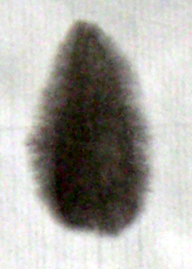
Properties of Chinese Ink Painting [Kunii 1995]
Four treasures
Brush
Ink stick
Paper
Ink stone
Fluffy and blurred
Capillary phenomenon
Ink Diffusion Effect
Notes:
A diffusion model for computer animation of diffuse ink painting 1995
擴散特徵是複雜的物理現象，難用普通的圖形技巧表示
毛細現象
數層纖維，纖維內空間帶著墨水到特定區域，當開始擴散時
影響擴散因素：水分子、水和碳之間、重力
水和碳是中國水墨兩個主要元素

Slide 5
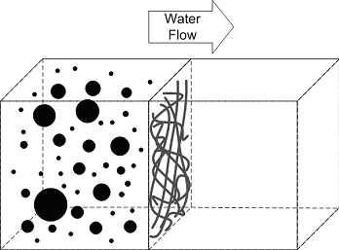
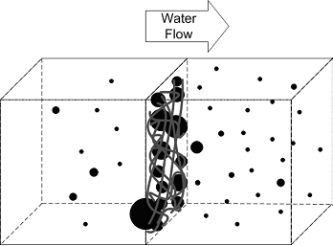
Properties of Chinese Ink Painting
Carbon Particles
Filter Effect
if(Carbon_Diameter > Hole_Diameter(p)) then
Carbon_Position ← p
else
Carbon_Position ← Water_Outflow_Direction(p)
Notes:
碳粒子：黑色且為固體顆粒，能懸浮於水並被水分子攜帶。
碳粒子，小的通過，大的卡在纖維處。
P:the papel in which the carbon particle is located

Slide 6
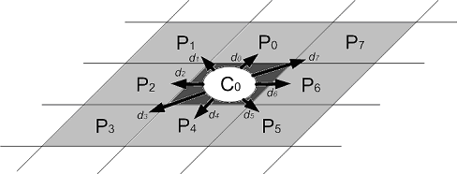
Motion of Water
Factors that dominate the flow of water
Gradient of water between neighboring papels
Absorbency of neighboring papels
Paper texture of neighboring papels
Inertia of water
Notes:
流動方向取決於四項因素

Slide 7
Formalization
Dring
Notes:
g: the surface density of water in the point (z,y]

Slide 8
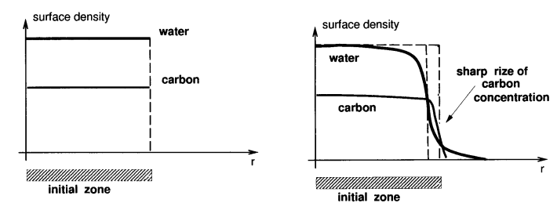

Slide 9
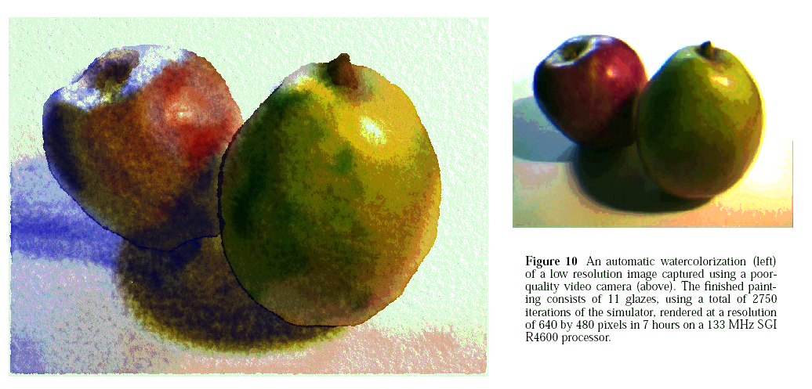
Computer-Generated Watercolor [Curtis et al 1997]
Notes:
https://grail.cs.washington.edu/projects/watercolor/

Slide 10
Watercolor Effects

Slide 11
Basic model
Ordered set of translucent glazes
Shallow-water fluid simulation
Kubelka-Munk compositing model for the optical effect

Slide 12
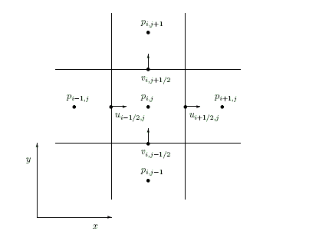
Representing Glaze Using Staggered Grid

Slide 13
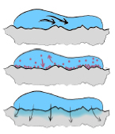
Creating Glazes
For each time step,
Move water in shallow layer (update velocities, relax divergence, flow outward)
Move pigments
Transfer pigment
Simulate capillary flow

Slide 14
The wet-area mask M
The velocity u, v
The pressure p of water
The concertration of each pigment k in water
The slope of rough paper surface

Slide 15
The physical properties of the individual pigments, including their density, staining power and granularity.

Slide 16
The water saturation s of the paper
The fluid-holding capacity c of paper
Paper texture

Slide 17
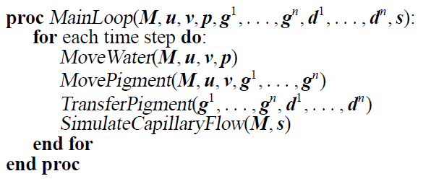
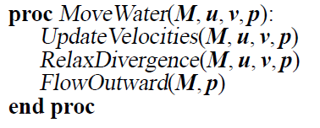
Shallow-water
Deposition
Capillary

Slide 18
Kubelka-Munk model
Absorption coefficient K (Kr, Kg, Kb)
Scattering coefficient S (Sr, Sg, Sb)
density, staining power and granularity.

Slide 19
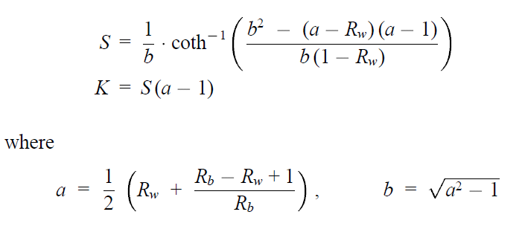
Specifying the optical properties of pigments
Given these two user-selected RGB colors Rw and Rb, respectively, the K and S values can be computed by a simple inversion of the KM equations:

Slide 20
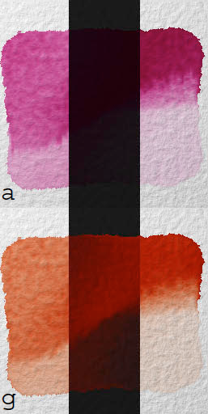
Opaque and Transparent pigment
Transparent:
Appear colored on white, and near black on black
Low scattering in all colors, high absorption in their color.
Opaque:
exhibit a similar color on both white and black
High scattering in the same colors, high absorption in complementary color.

Slide 21
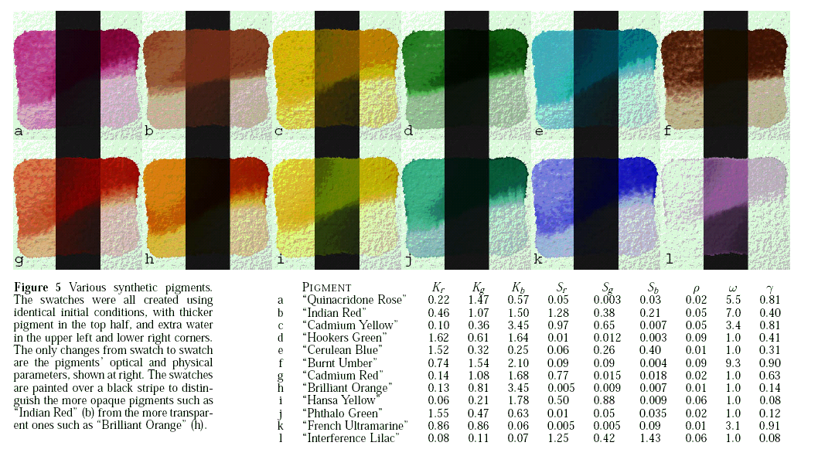
Watercolor Pigments

Slide 22
Optical compositing of layers
Given scattering and absorption coefficients S and K for a pigmented layer of given thickness x, the KM model allows us to compute reflectance R and transmittance T
Composition

Slide 23
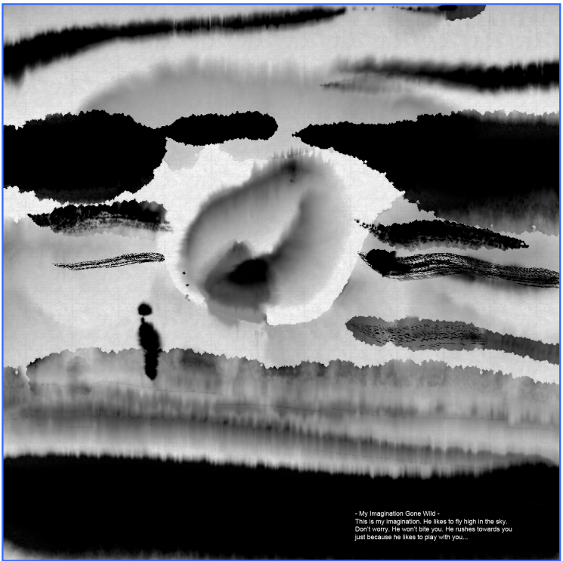
MoXi: Real-Time Ink Dispersion in Absorbent Paper [2005]

Slide 24
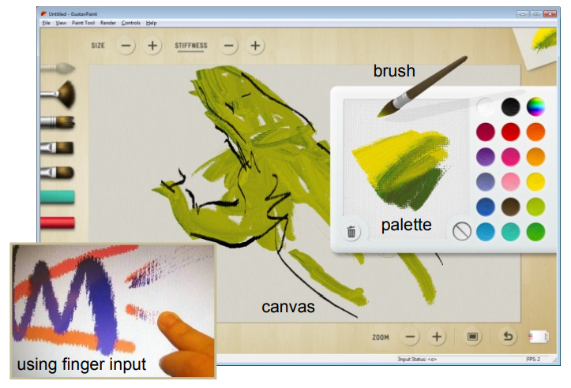
Project Gustav: immersive digital painting [2010]
Detail-Preserving Paint Modeling for 3D Brushes
Notes:
https://www.microsoft.com/en-us/research/wp-content/uploads/2010/06/PaintModel_NPAR_2010.pdf
https://www.billbaxter.com/publications/

Slide 25
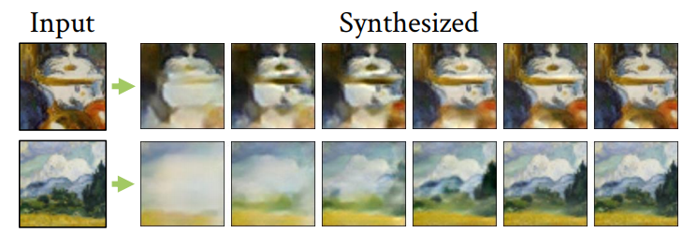
Painting Many Pasts: Synthesizing Time Lapse Videos of Paintings CVPR 2020
Notes:
https://xamyzhao.github.io/timecraft/

Slide 26
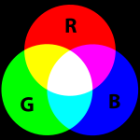
Additive / Subtractive color
Y
M
C

Slide 27
Pigments
淡鎘黃(cadmium yellow pale)
鎘橙(cadmium orange)
中鎘紅(cadmium red medium)
茜紅(alizarin crimson)
鈷紫(cobalt violet)
群青(ultramarine blue)
永固綠(permanent green)
鈦白(titanium white)
象牙黑(ivory black)

Slide 28
Color Wheel
Johannes Itten (1961)

Slide 29
Primary color
淡鎘黃
群青
中鎘紅
Notes:
印刷三原色 青cyan 黃 洋紅 magenta

Slide 30
Secondary color
永固綠
鎘橙
鈷紫

Slide 31
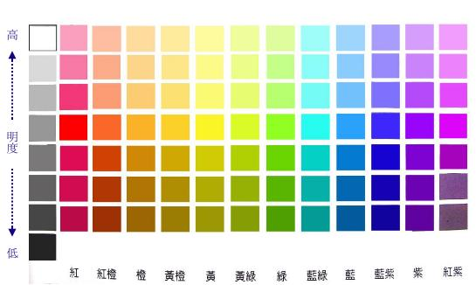

Slide 32
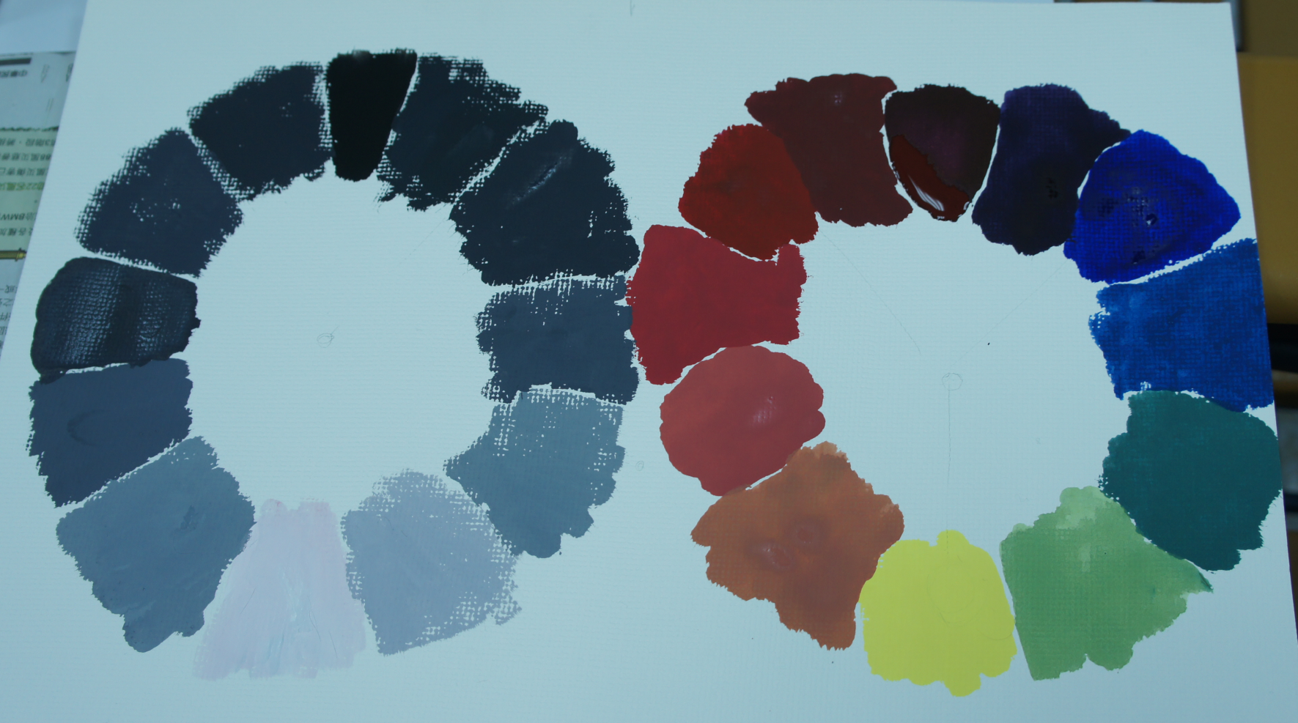
明度環
色環

Slide 33
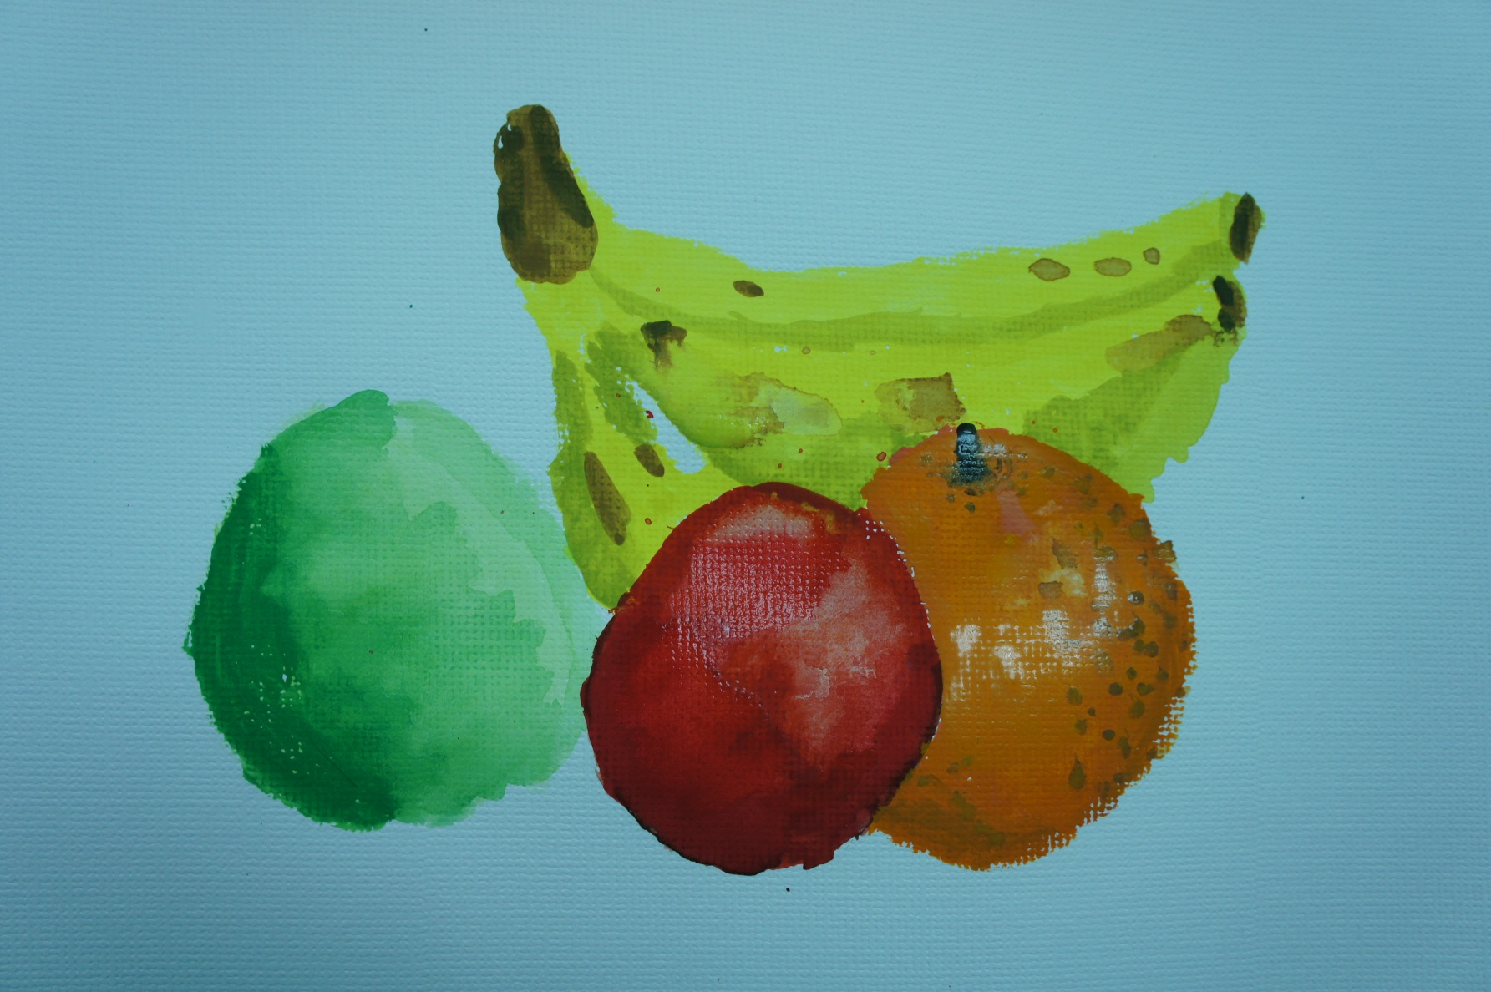
Example

Slide 34
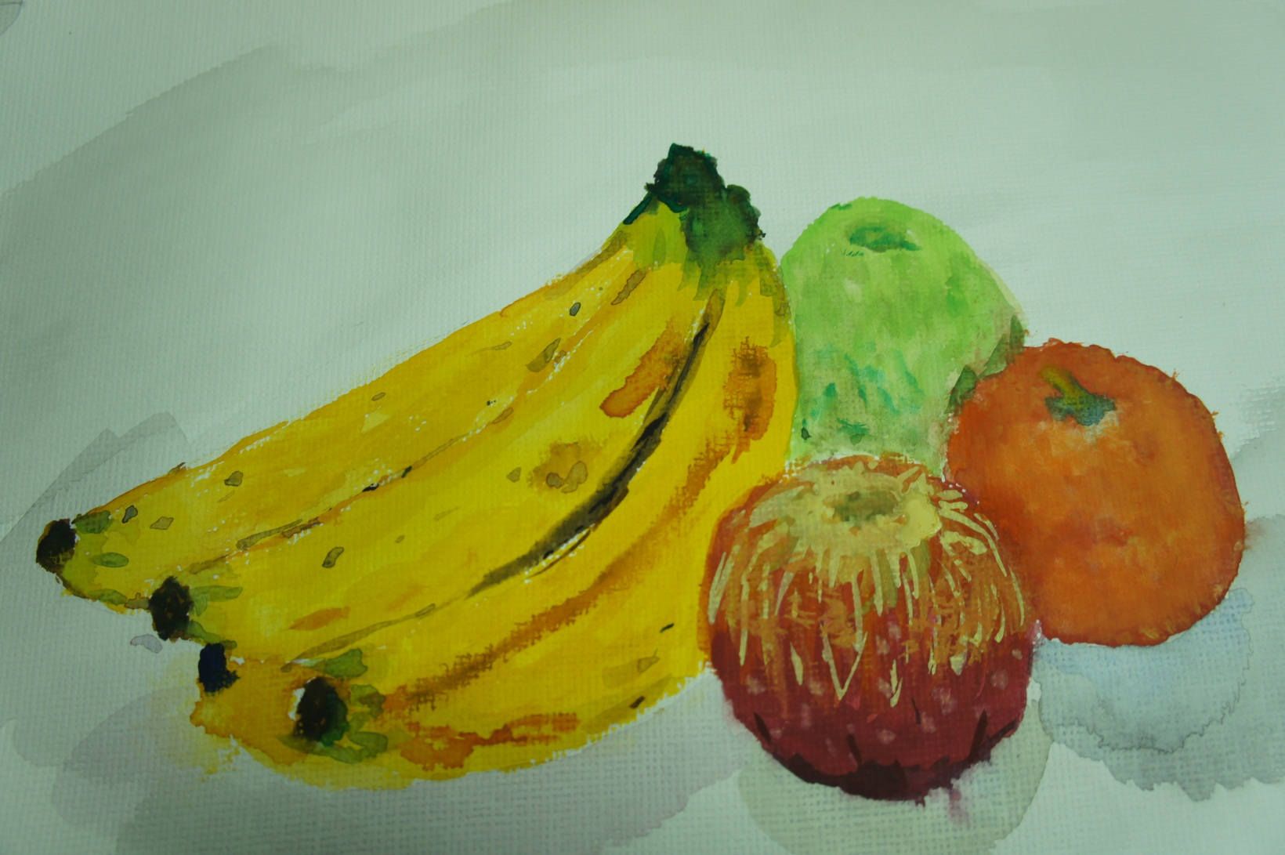
Example

Slide 35
Reference
Steve Strassmann. 1986. Hairy brushes. SIGGRAPH Comput. Graph. 20, 4 (August 1986), 225-232.
T. L. Kunii, G. V. Nosovskij, and T. Hayashi. 1995. A diffusion model for computer animation of diffuse ink painting. In Proceedings of the Computer Animation (CA '95).
Cassidy J. Curtis, Sean E. Anderson, Joshua E. Seims, Kurt W. Fleischer, and David H. Salesin. 1997. Computer-generated watercolor. In Proceedings of the 24th annual conference on Computer graphics and interactive techniques (SIGGRAPH '97). ACM Press, 421-430
Nelson S. H. Chu and Chiew-Lan Tai. 2004. Real-Time Painting with an Expressive Virtual Chinese Brush. IEEE Comput. Graph. Appl. 24, 5 (September 2004), 76-85.
Nelson S.-H. Chu and Chiew-Lan Tai. 2005. MoXi: real-time ink dispersion in absorbent paper. InACM SIGGRAPH 2005 Sketches (SIGGRAPH '05), Juan Buhler (Ed.). ACM, New York, NY, USA, , Article 62

