Slide 1
Advance Computer Graphics
Non-photorealistic rendering – Feature Edge
Notes:
2021
Reference
http://www.cs.princeton.edu/courses/archive/spr03/cs426/lectures/19-npr.pdf
http://www.docstoc.com/docs/4533660/Interactive-Illustrative-Graphics-and-Visualization-Shape-Depiction-Object-Representation

Slide 2
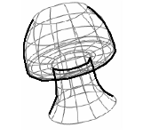
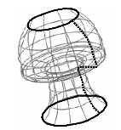
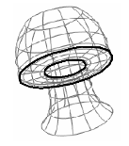
Outline
Feature Edge
  Silhouettes
  Boundaries
  Crease

Slide 4
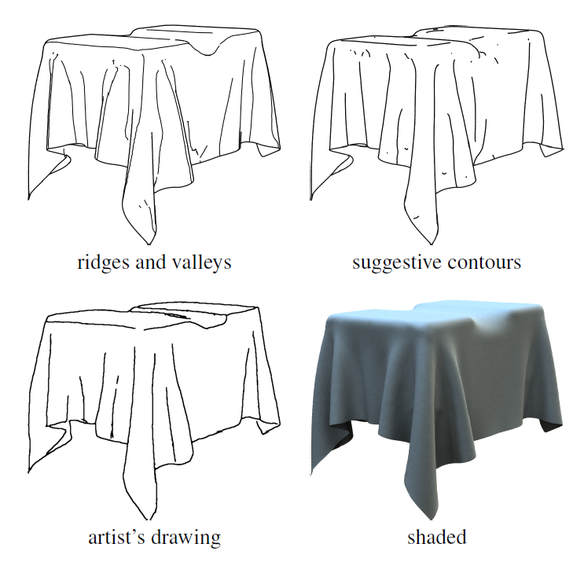

Slide 5
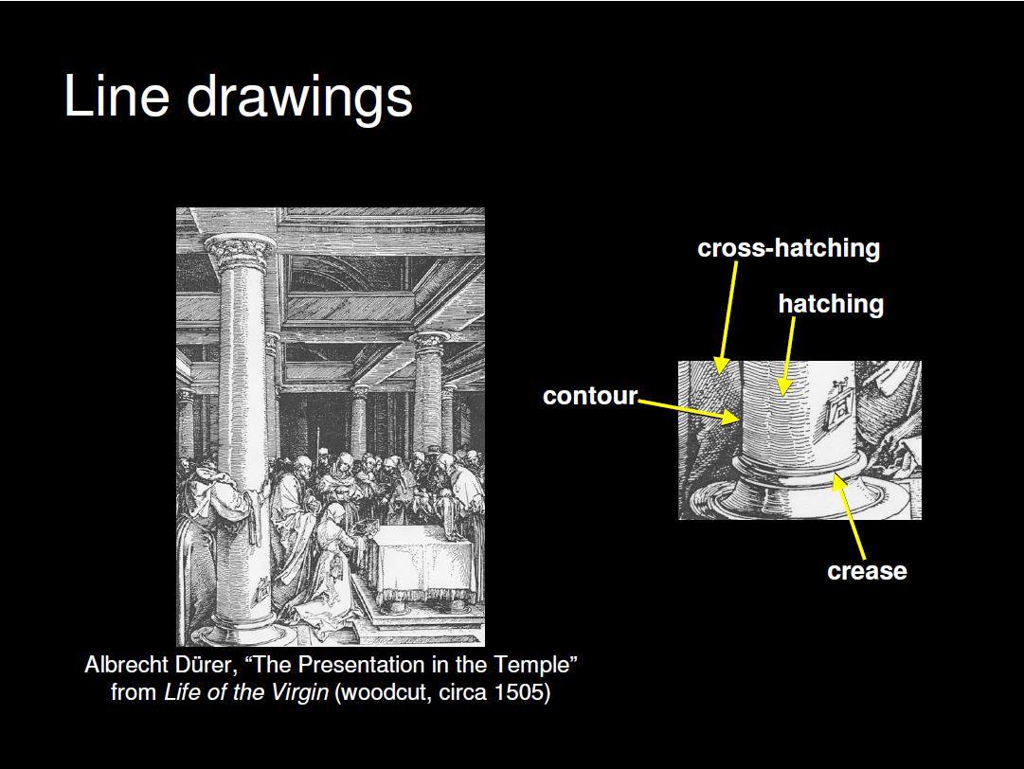

Slide 6
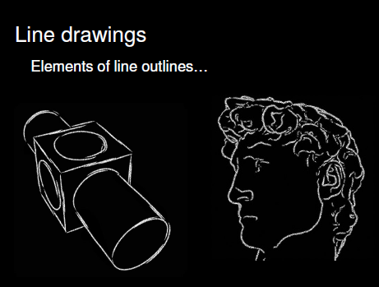

Slide 7
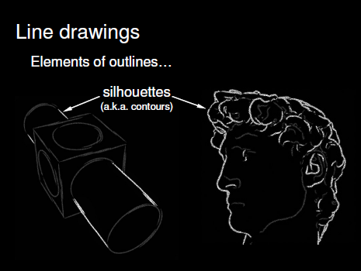

Slide 8
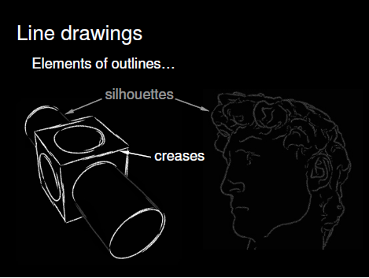

Slide 9
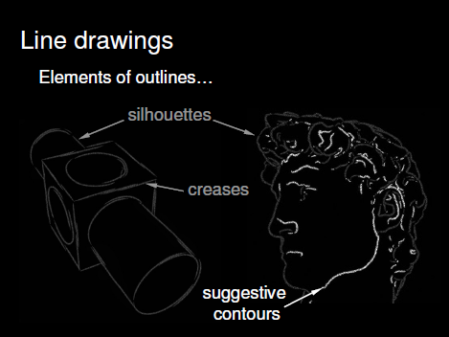

Slide 10
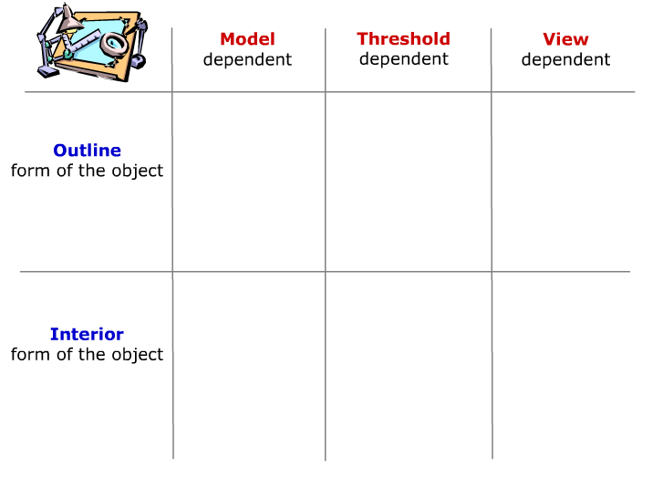

Slide 11
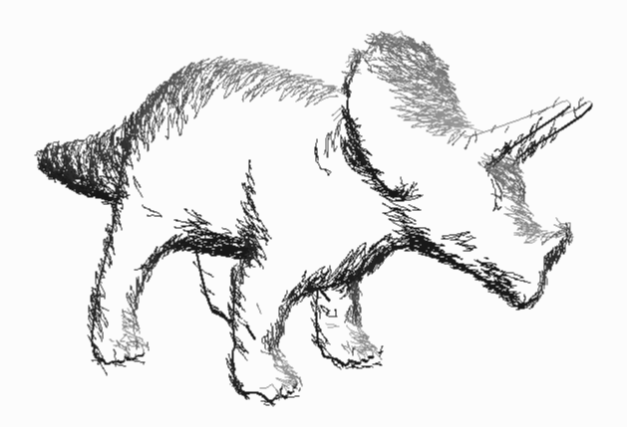
Silhouette detection
Real-Time Nonphotorealistic Rendering. Markosian, Kowalski,
Trychin, Bourdev, Goldstein, & Hughes. SIGGRAPH 1997.

Slide 12
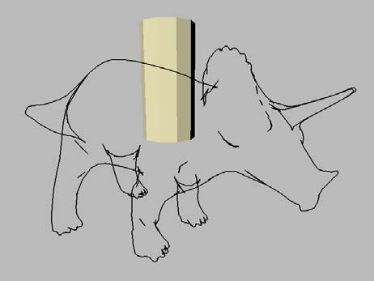
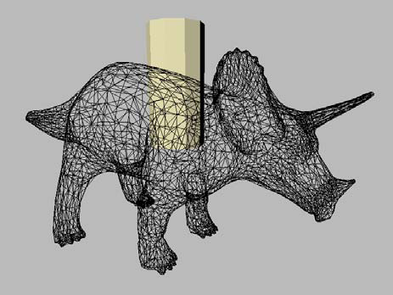
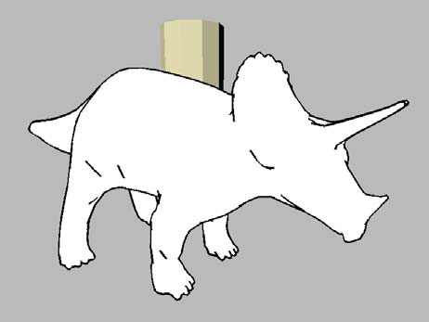
Applications
Visualization
Fast, simple “line drawing” style

Slide 13
Observation:
silhouette edges are
  Sparse
  Connected in long chains
  Temporally coherent

Slide 14
Definition of a silhouette
Normal
View vector

Slide 15
Definition of a silhouette
N dot V <0: front face
N dot V >0: back face
N dot V =0: silhouette
silhouette
front face
back face

Slide 16
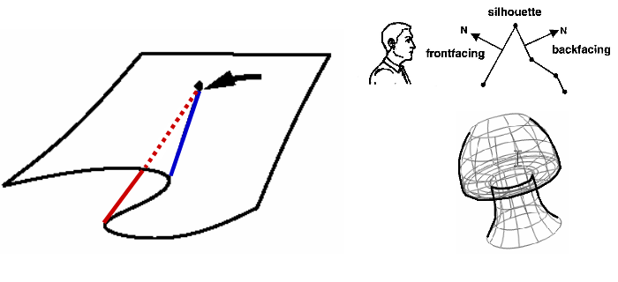
Cusp
The vertex is adjacent exactly 2 silhouette edge on front-facing and the other back-facing

Slide 17
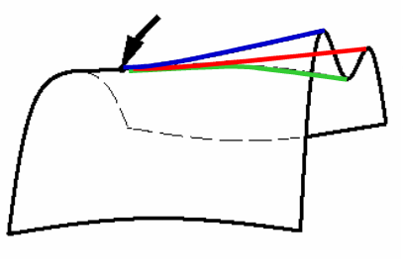
More than 2 silhoutte edges

Slide 18
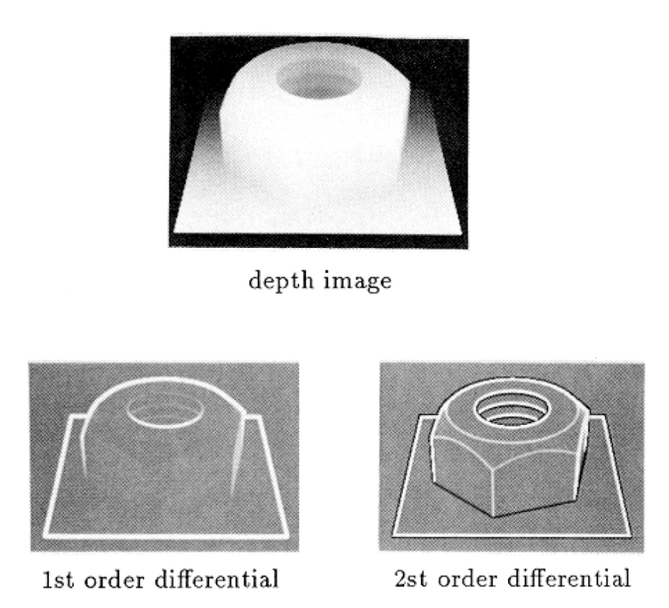
Images space algorithm
A | B | C
D | X | E
F | G | H
First order discontinuities
  G(X) = ( |A + 2B + C – F - 2G – H| +
|C + 2E + H – A - 2D – R|) / 8;
Second order discontinuities
  l = (8X-A-B-C-D-E-F-G-H)/3
Notes:
Comprehensible Rendering of 3-D Shapes. Siggraph 1990
Sobel operator
We can also use normal map

Slide 19
Randomized silhouette detection
Check a fraction of edges.
  Find one, find whole chain
Check old silhouettes

Slide 20
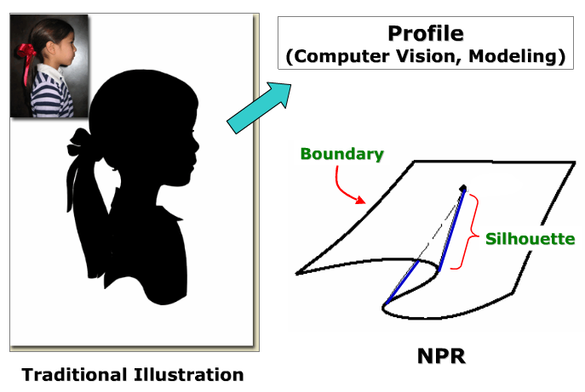
Terminology on silhouettes

Slide 21
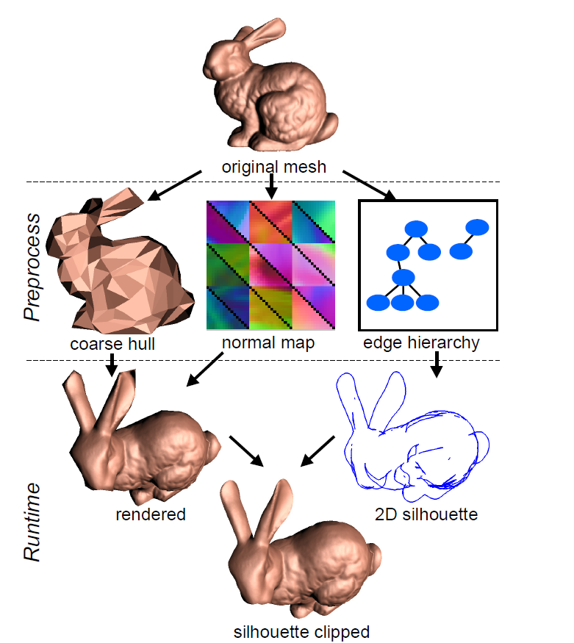
Silhouette Clipping
[Pedro V. Sander et al. 2000]

Slide 22
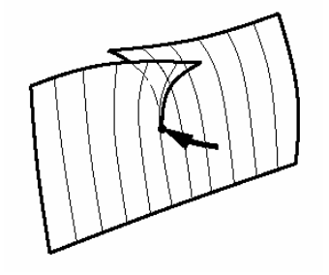
Definition of a surface boundary
It occurs on an non-close model. At least one polygon has at least one edge that is not shared with any other polygon.
Cusps:
  The vertex is adjacent to a boundary edge
Notes:
http://research.microsoft.com/en-us/um/people/hoppe/proj/silclip/

Slide 23
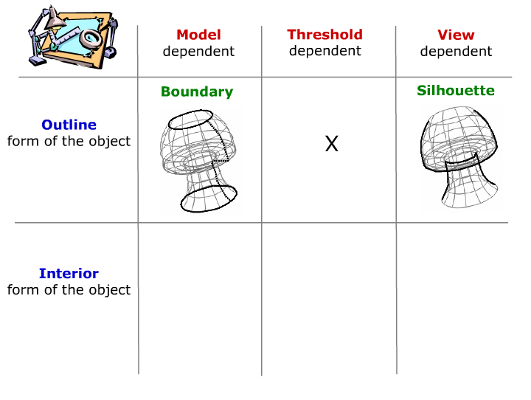

Slide 24
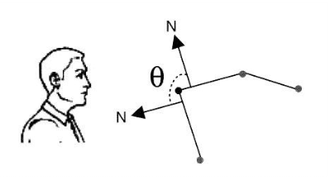
Definition of a crease
A crease can be define
  An edge between two front-facing polygons whose dihedral angle theta is above some threshold.
  C^1 discontinuities

Slide 25
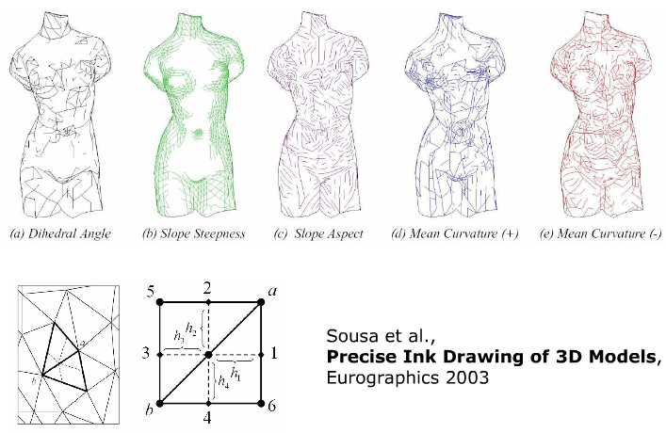
Other Discontinuities

Slide 26
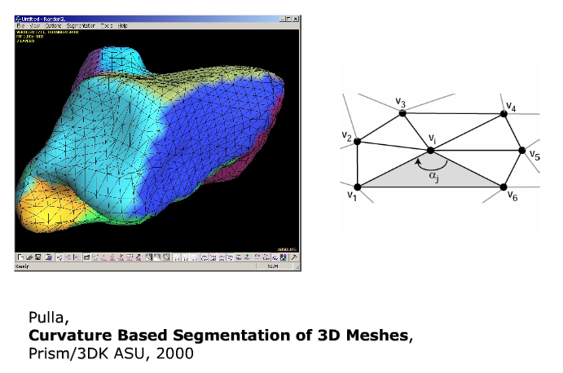
Other Discontinuities

Slide 27
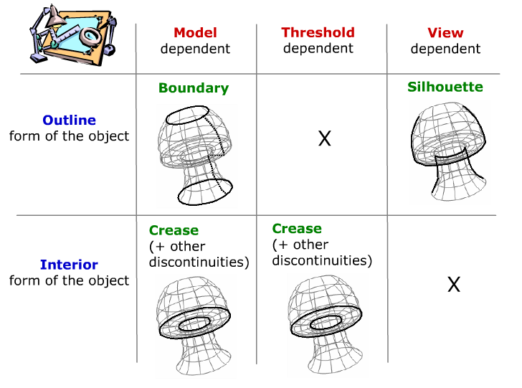

Slide 28
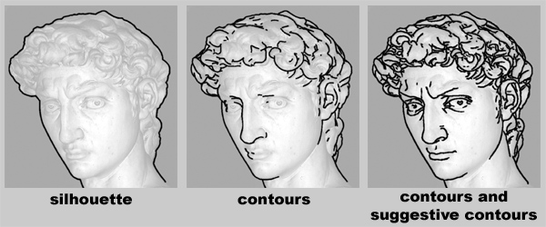
Suggestive Contours for Conveying Shape
[Doug DeCarlo et al. 2003]
“Almost contours”:
  Points that become contours in nearby views

Slide 29
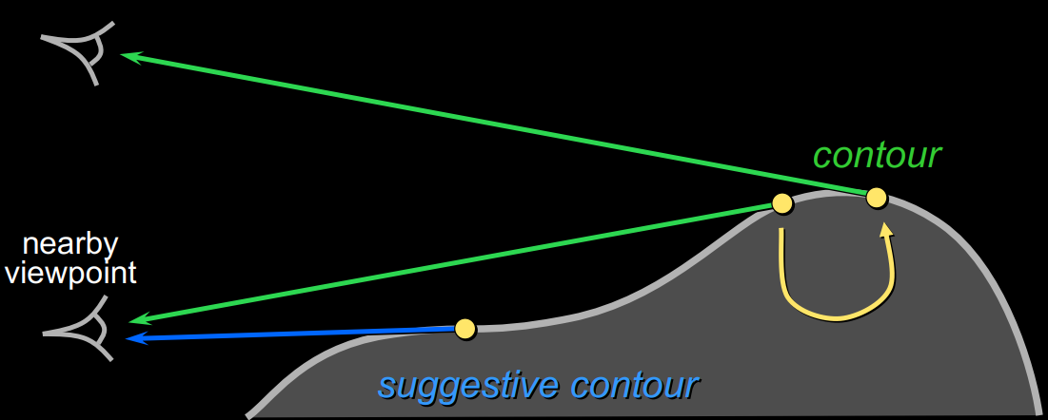
Suggestive Contours: Definition 1
Contours in nearby viewpoints
  (not corresponding to contours in closer views)

Slide 30
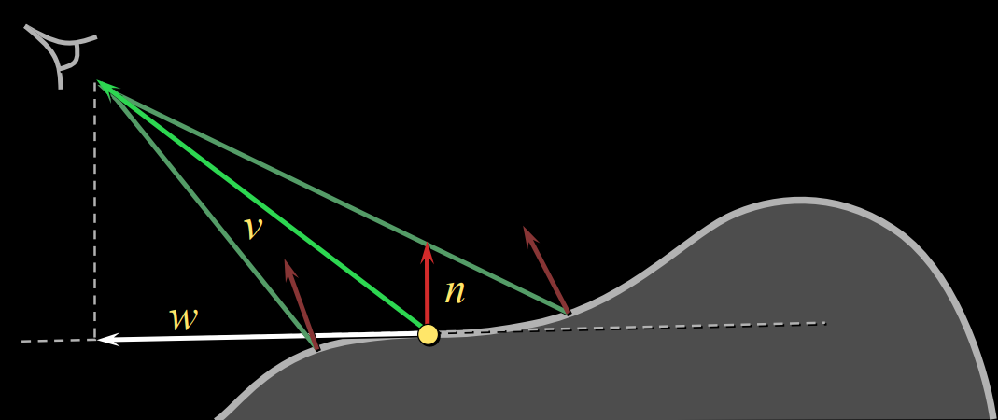
Suggestive Contours: Definition 2
n · v not quite zero, but a local minimum
  (in the projected view direction w)

Slide 31
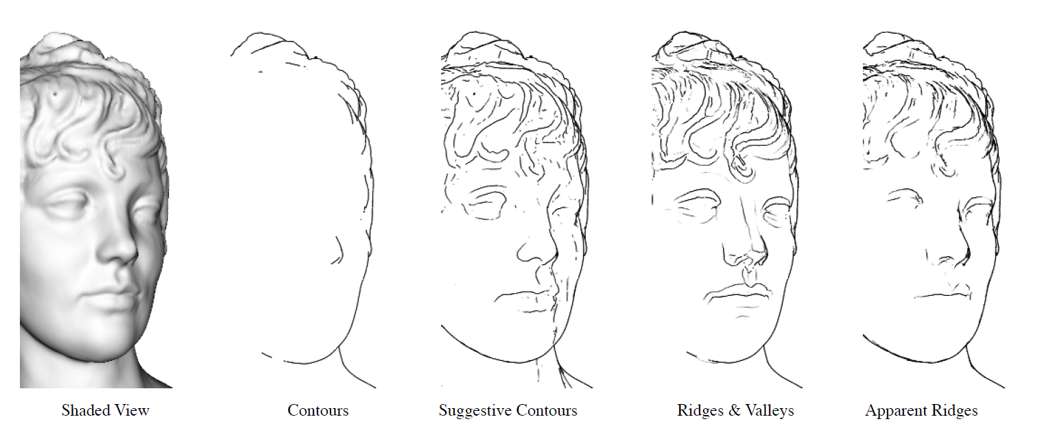
Apparent Ridges for Line Drawing
[Tilke Judd et al. 2007]
The maxima of the normal variation with respect to the viewing plane.

Slide 32
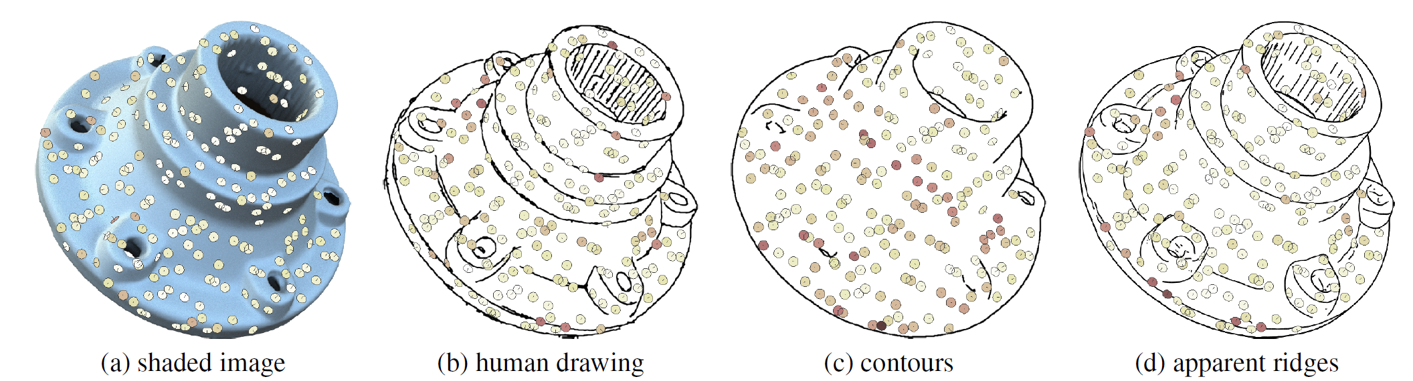
How Well Do Line Drawings Depict Shape?
[Forrester Cole et al. 2009]

