Slide 1
Advance Computer Graphics
Non-photorealistic rendering – Stroke based rendering
Notes:
2021
http://www.cs.princeton.edu/courses/archive/spr03/cs426/lectures/19-npr.pdf

Slide 2
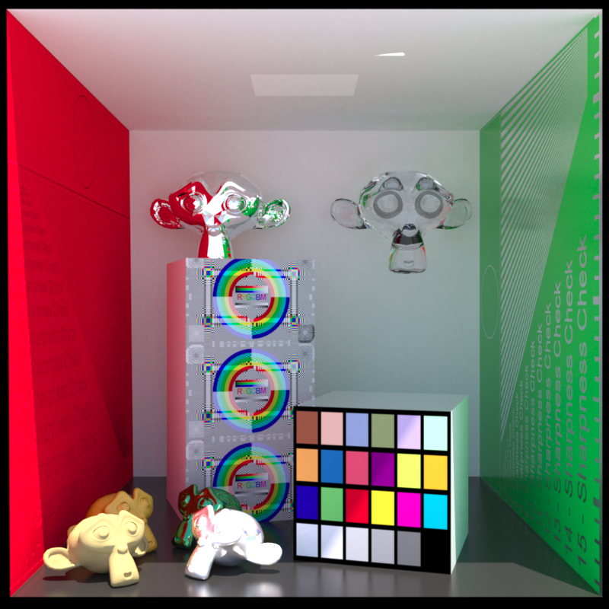
Realistic rendering
Miraculous performance leaps
Stunning price cuts
Curiously low impact
Games
Movies
By Luxrender

Slide 3
Problem: Content Creation
Available tools are difficult (Maya, 3DS…)
  Evolved from CAD (precise modeling)
  Requires special skills
  Geared toward trained experts
  Realism – no stylization or abstraction
Realism is expensive!

Slide 4
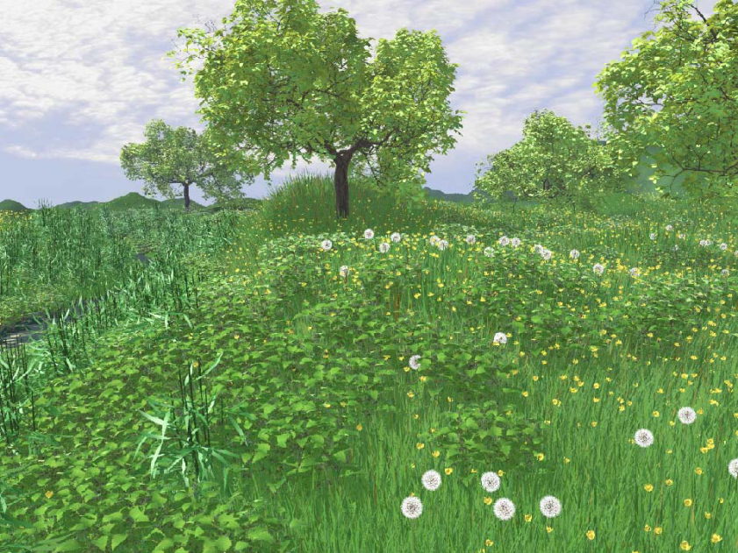
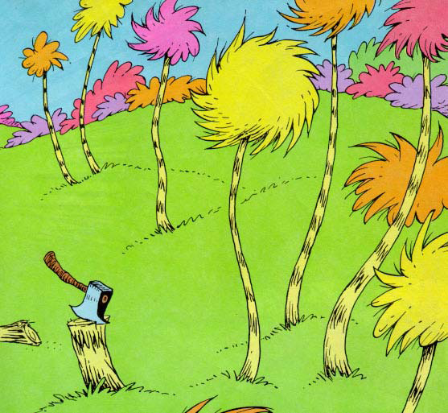
Non-photorealistic rendering (NPR)
Extreme reduction of details
Selective enhancement
Stylization and abstraction
  Complexity is suggested
Realistic Modeling and Rendering of Plant Ecosystem
Deussen, Hanrahan, Lintermann, Mech,
Pharr, & Prusinkiewicz. SIGGRAPH 1998.
The Lorax. Dr. Seuss.
Notes:
Another P and NP

Slide 5
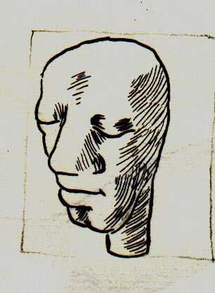
Proposal: Model by Drawing
Draw shape and style
Permit abstraction / Stylization
Stroke-based NPR

Slide 6
Potential Advantages
Gain abstraction, stylization
Re-use drawing skills
Re-use existing images
Re-use existing shapes
Fast, lightweight modeling
New applications, users
  education, architecture, design, animation,
  advertising, games…

Slide 7
Research Challenges: NPR
Stroke generation
  Levels of detail
  Temporal coherence
  Pattern synthesis
Media simulation
Direct user control
Picture element: pixel or stroke?

Slide 8
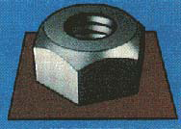
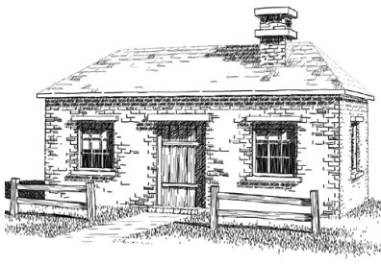
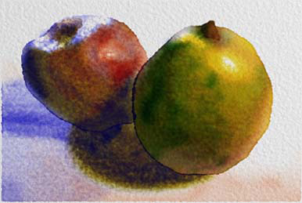
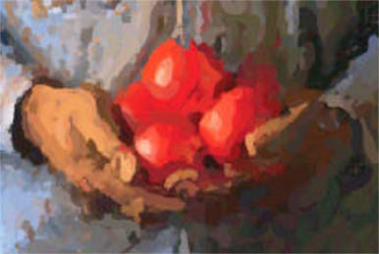
Previous work
Technical Illustration [Saito 90]
Pen & Ink [Winkenbach 94]
Watercolor [Curtis 97]
Paint [Hertzmann 98]

Slide 9
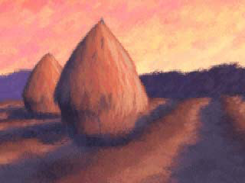
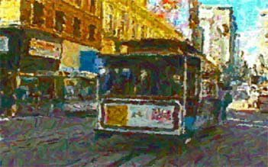
Previous work
Painterly rendering for
3D models [Meier 96]
Painterly rendering for
video [Litwinowicz 97]

Slide 10
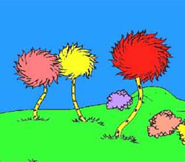
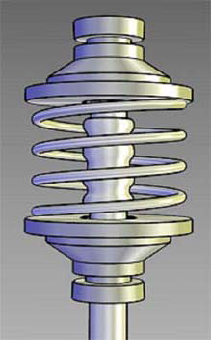
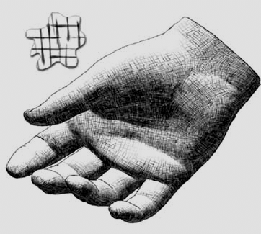
Previous work
[Kowalski 99]
[Gooch 98]
[Praun 01]

Slide 11
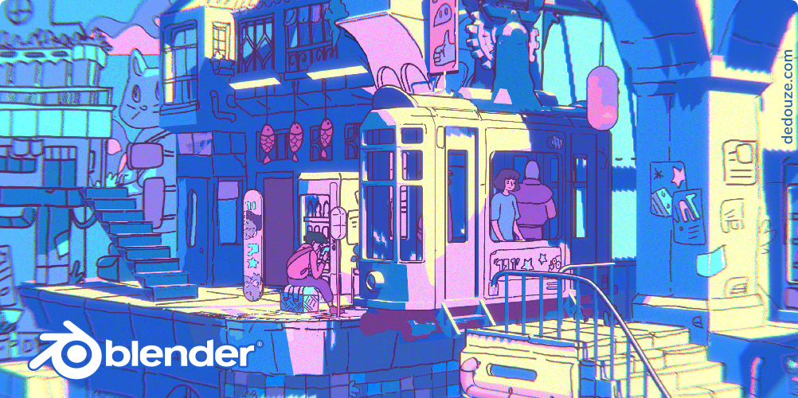
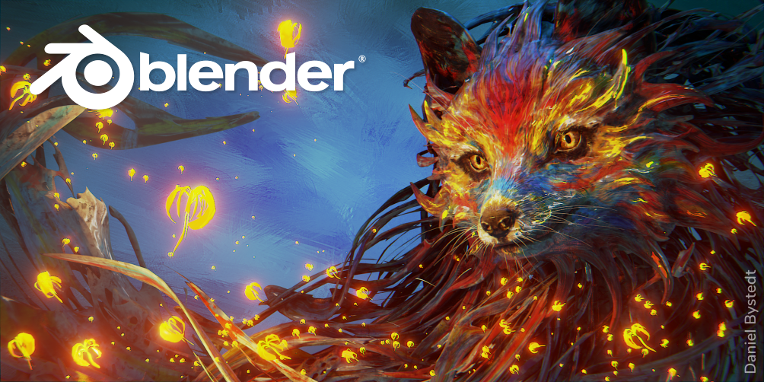
Blender in NPR
Blender 2.82
Blender 2.90

Slide 12
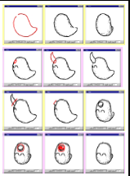
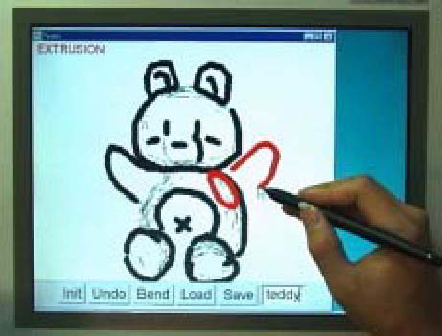
Previous work - interaction
Teddy [Igarashi et al 1999]
Notes:
http://www-ui.is.s.u-tokyo.ac.jp/~takeo/teddy/teddy.htm

Slide 13
Overview
Simulating Artist Media
Assisting a User in the Artistic Process
Automatic Systems

Slide 14
Pen and Ink
Winkenbach and Salesin, Siggraph 94
Purpose: render 3D models as pen & ink drawings
Method:
  • annotate model with procedural “textures”
  • Render tonal “reference image”
  • Use it to guide pen and ink textures

Slide 15
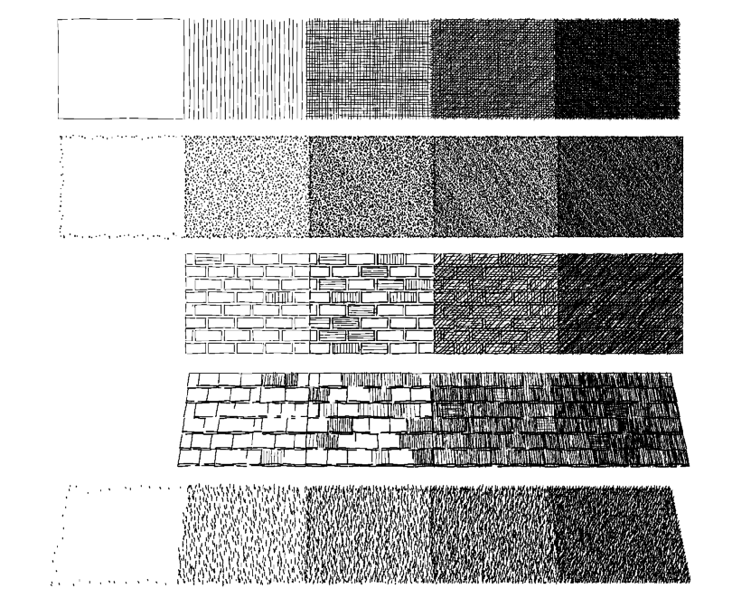

Slide 16
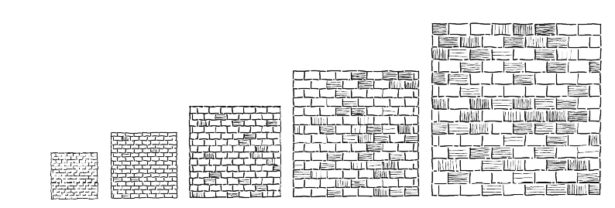
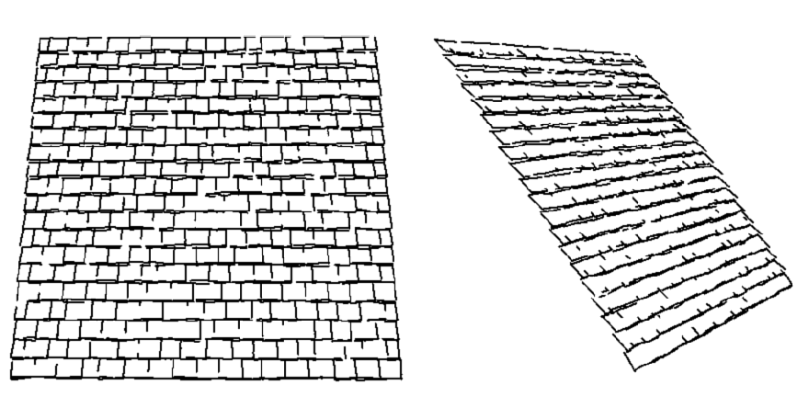

Slide 17
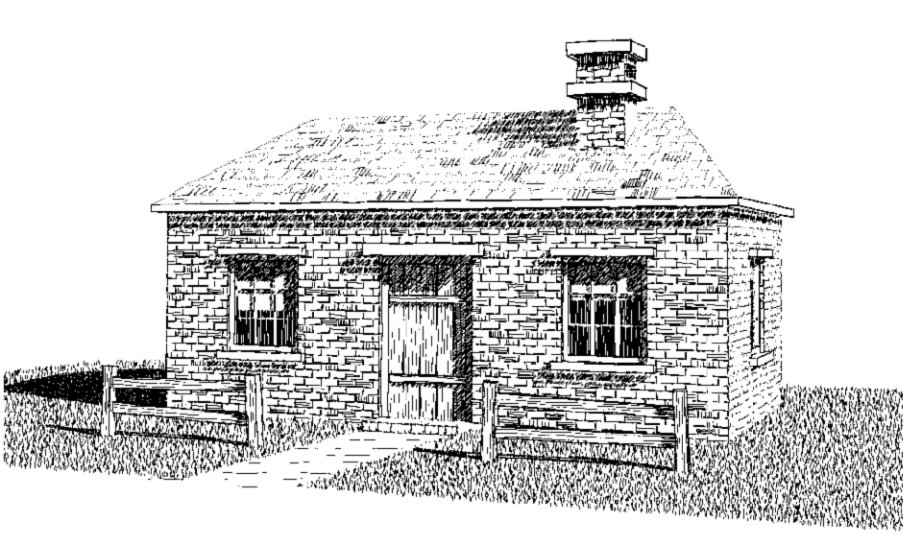
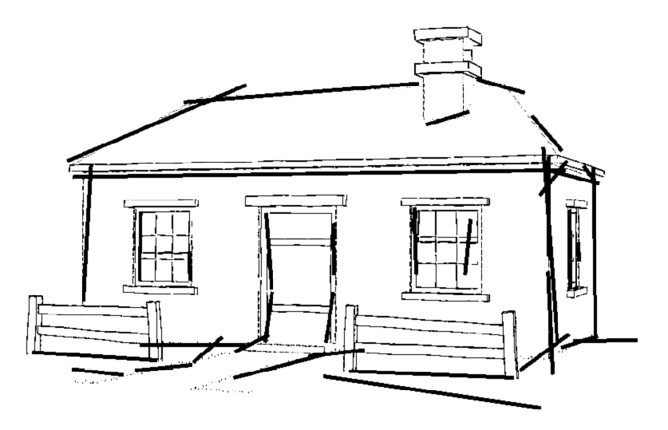
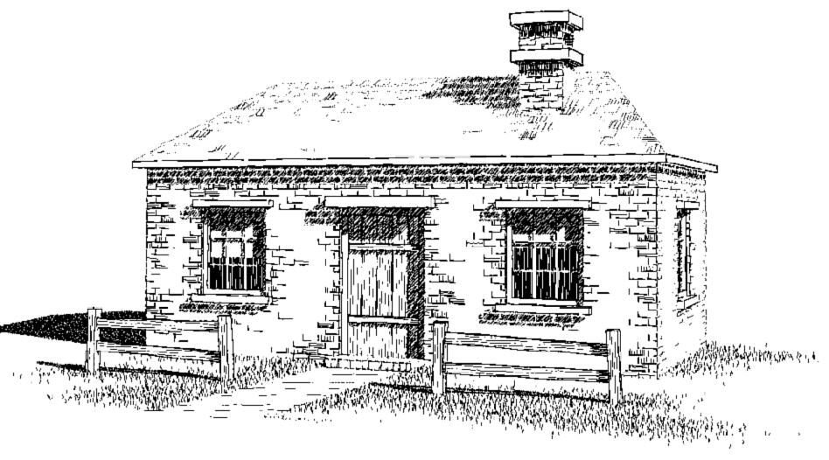

Slide 18
Pen and Ink
Salisbury, Anderson, Lischinski and Salesin,
Scale-dependent reproduction of pen-and-ink illustrations.
Siggraph 96
Purpose:
  define a scale-independent representation for pen & ink images
Notes:
http://www.cs.huji.ac.il/labs/cglab/research/penink/

Slide 19
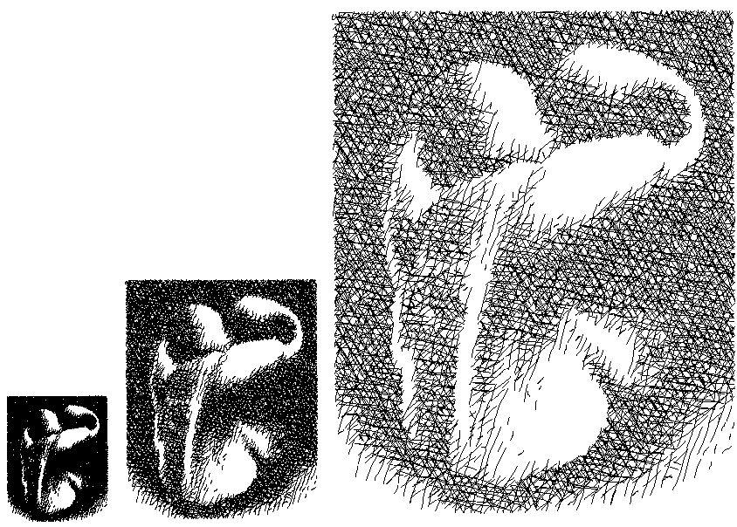
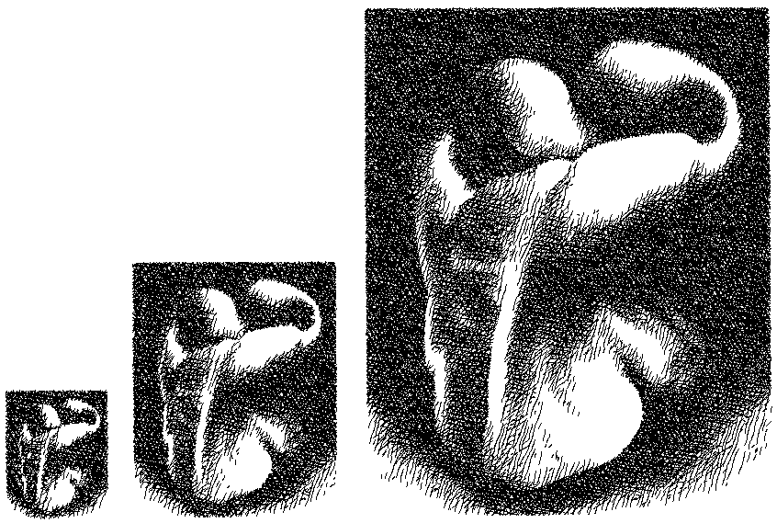

Slide 20
Salisbury et al., cont’d
Method:
  Store lo-res greyscale image annotated with discontinuities
  filter greyscale image to desired size, run stroke generation algorithm on it

Slide 21
Problems
Only produces still images
  Would not provide temporal coherence
What’s the application?

Slide 22
Painterly rendering
Meier, Siggraph 96
Problem:
  produce animations in a “painterly” style with temporal coherence of strokes
Method:
  Populate surfaces with stroke “particles”
  Render with the help of reference images
Notes:
Barbara J. Meier, Painterly Rendering for Animation, Siggraph 1996, August, 1996..

Slide 23
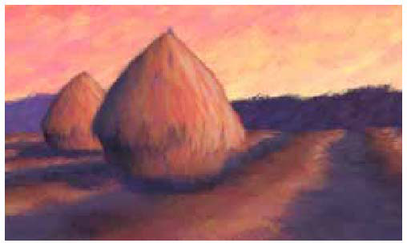

Slide 24
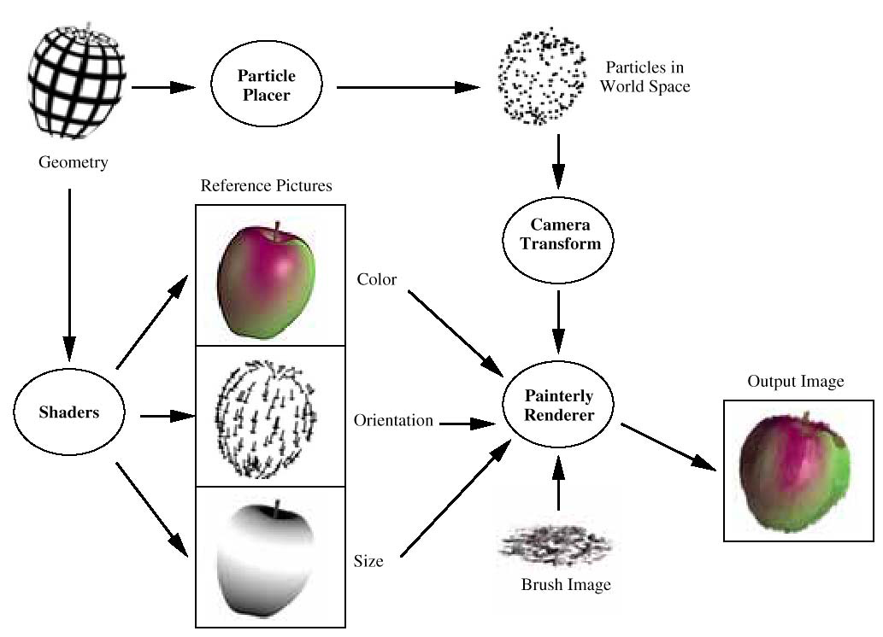

Slide 25
Problem
Particles have fixed distribution
  Need prescribed camera path

Slide 26
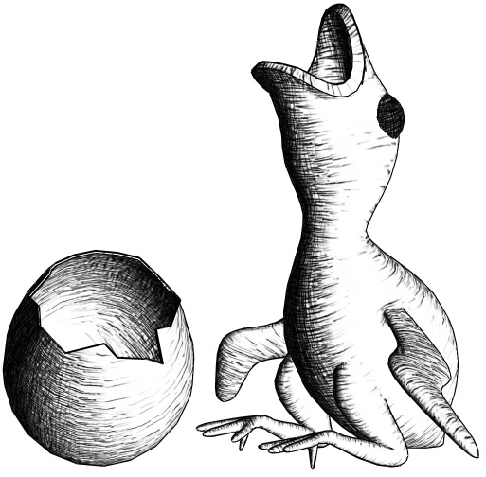
Realtime Hatching
Stroke-based rendering of 3D models
Strokes convey:
  tone
  material
  shape
Demo
Notes:
The goal of our project is the interactive rendering of 3D models in a non-photorealistic style based on strokes. We consider strokes interesting since, in addition to providing pleasant imagery, the simultaneously convey tone and material. As you can see in the figure, the arrangement of strokes can also enhance our perception of the object’s shape.
Here is what our system looks like.

Slide 27




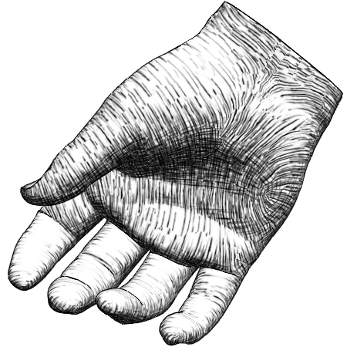
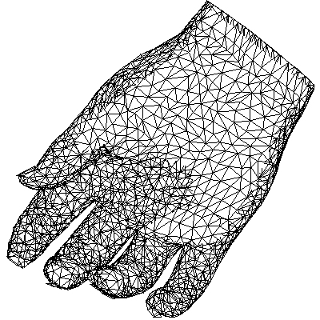
Realtime Hatching
Set of textures
Example stroke
Result
Mesh
Preprocess
Real-Time
Notes:
Here is an overview of our approach.
The main idea is to leverage the texturing power of recent graphics hardware, and to bundle strokes together in textures, rather than draw them as individual primitives.
We start with a bitmap of a stroke that an artist draws, or that we import from a drawing package. As a preprocess, we create a set of textures using several instances of our example stroke.
At runtime, we select and blend a subset of these texture images, applying them to the mesh surface.

Slide 28
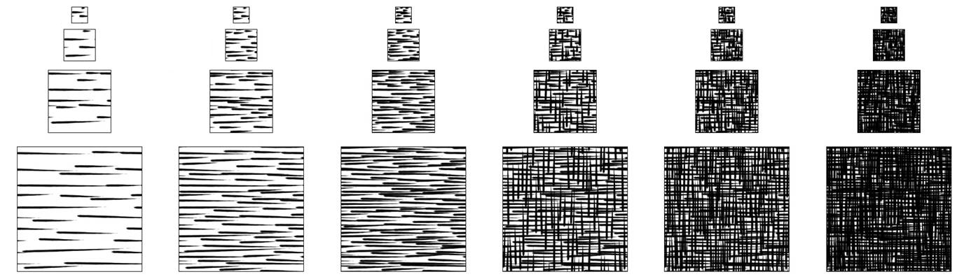
Tonal Art Maps
Collection of stroke images
Will blend → design with high coherence
Stroke nesting property
demo
← scale →
← tone →
Notes:
Combining the 2 approaches, we produce Tonal Art Maps, a collection of stroke textures parameterized by both tone and resolution. When rendering a 3D object we will blend some of these textures, so we need to design them with a very high degree of coherence, in order to avoid blending artifacts.
Specifically, we impose a stroke nesting property: all the strokes in one image appear in all the finer resolution images, and all the darker tone images. By transitive closure, they appear in ann the images to the right or down, in the Tonal Art Map array.
[Demo] You can see that as the square gets darker, all the strokes persist, and a few others are gradually blended in. The same thing happens as we zoom in.

Slide 29
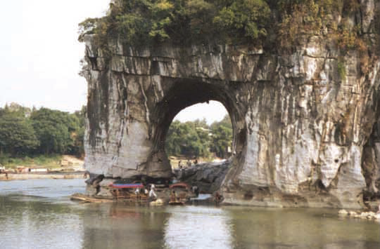
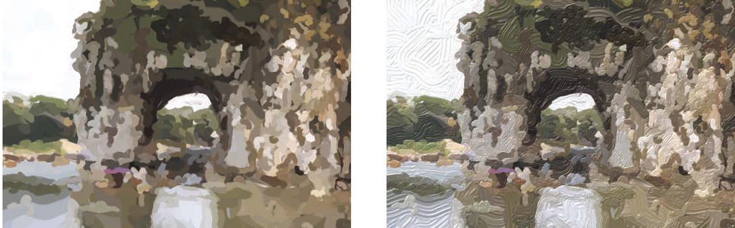
Stroke-based rendering
photo
Painterly rendering

Slide 30
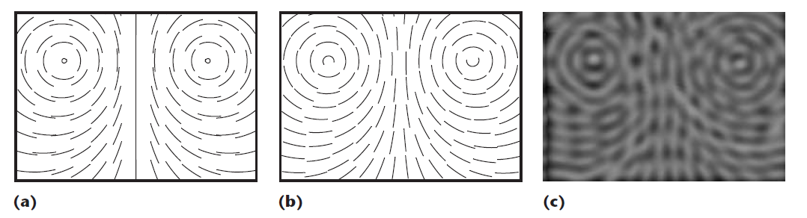
Vector Field
Image-guided streamline placement 1996

Slide 31
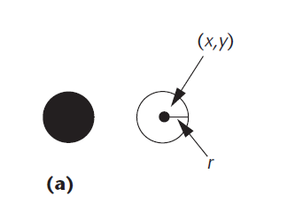
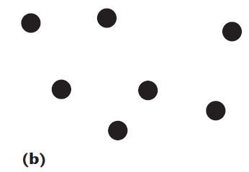
Stipple stroke

Slide 32
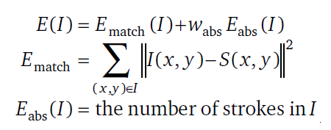
SBR energy function
Definition:
An SBR energy function is a function E : I→R, where I is the set of possible image structures and R is the set of real numbers.

Slide 33
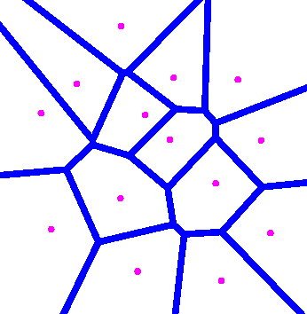
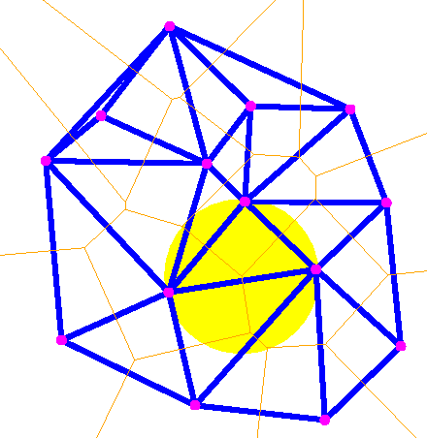
Voronoi diagram
Notes:
http://www.cs.cornell.edu/home/chew/Delaunay.html

Slide 34
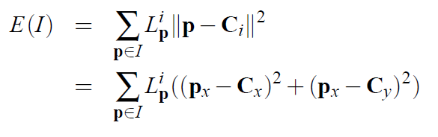
Lloyd’s method
How can we create a set of evenly-spaced points within an image?

Slide 35
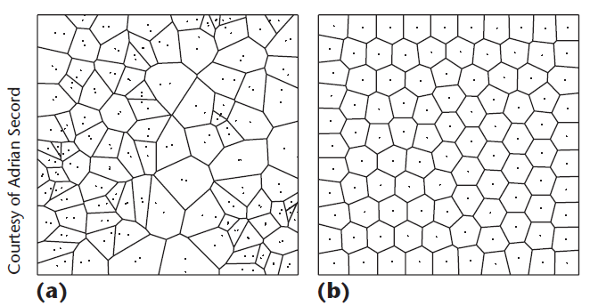

Slide 36
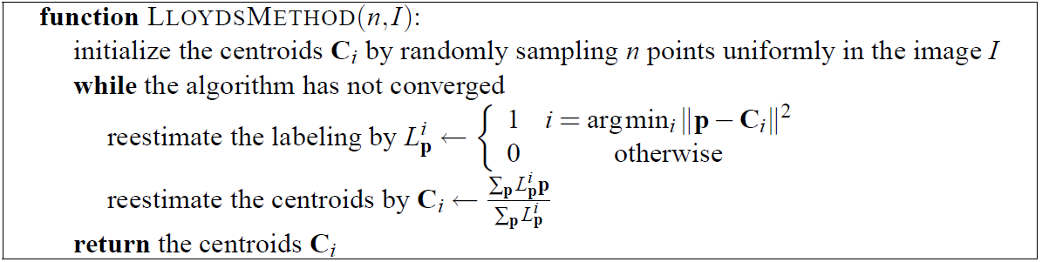

Slide 37
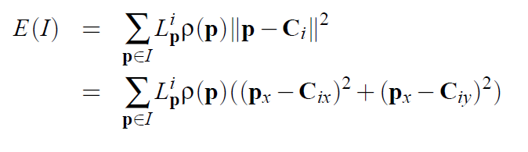
VARIATIONS ON LLOYD’S METHOD FOR SBR
Tho(p) = 1 – T(p)/m
the tones of the target image T(p),
m is the max gray level in T

Slide 38
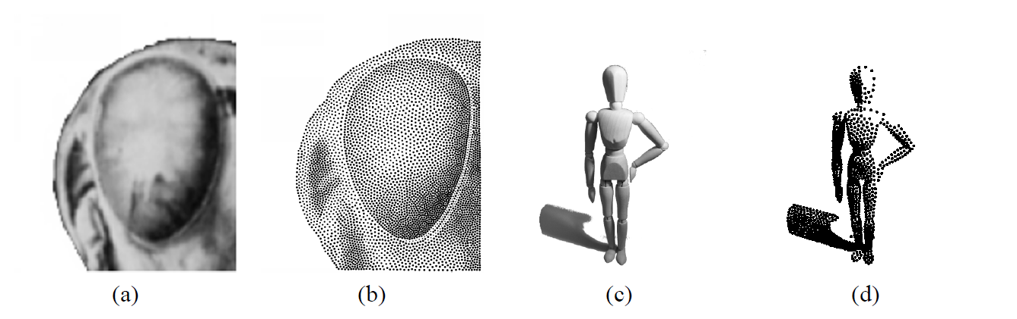
Stippling algorithms
Results from [DHvOS00]
from [Sec02]

Slide 39
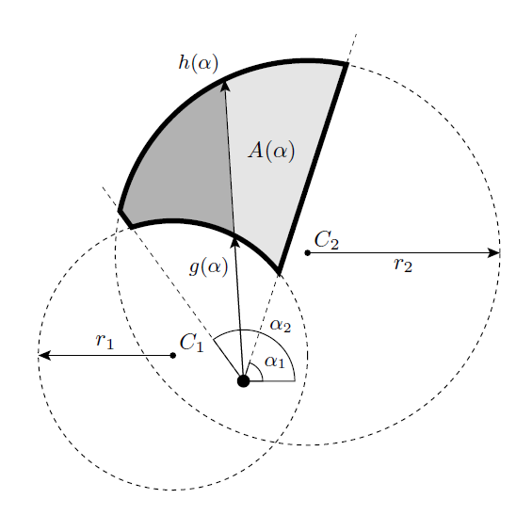
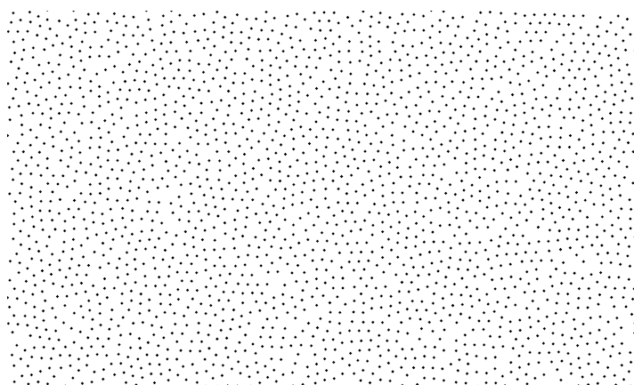
A Spatial Data Structure for Fast Poisson-Disk Sample Generation

Slide 40
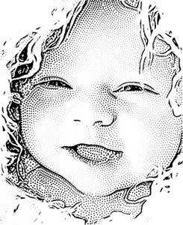
Feature-guided Image Stippling
Notes:
http://cg.postech.ac.kr/research/stippling/

Slide 41
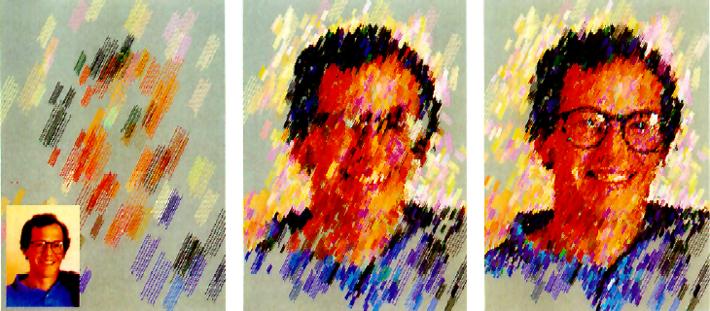
Interactive painterly rendering system
Interactive painterly rendering system, from [Hae90].

Slide 42
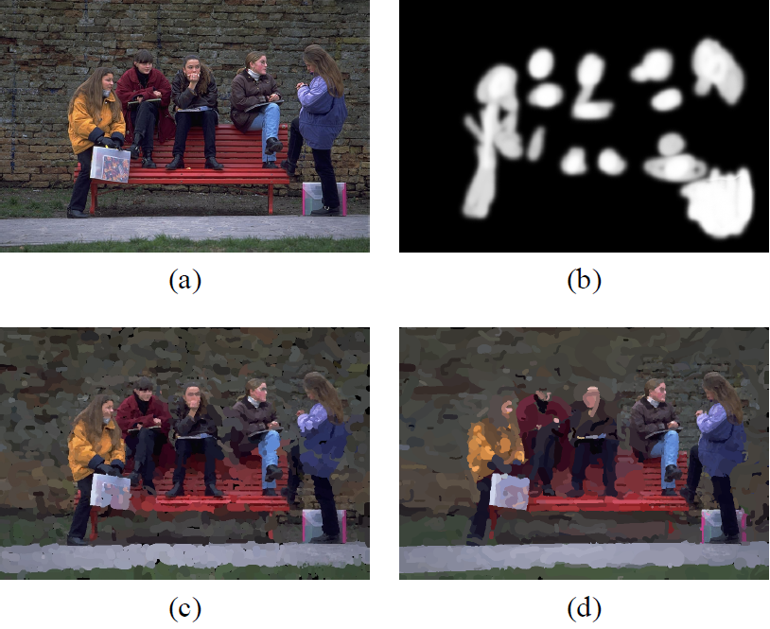
Spatially-varying style
Spatially-varying style, from [Her01].

Slide 43
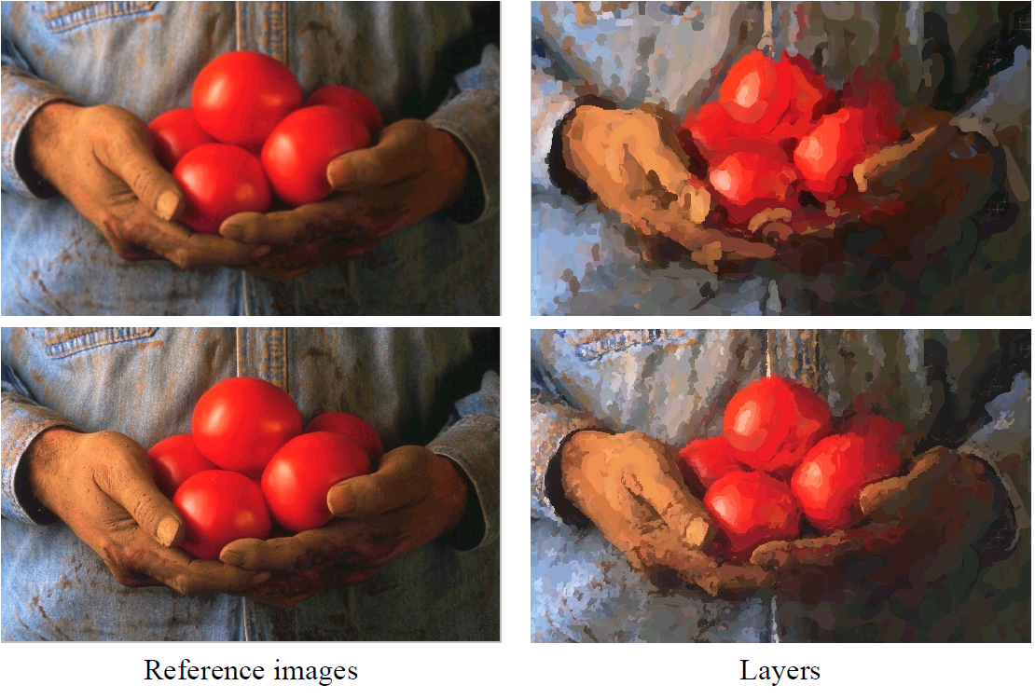
Painterly Rendering with Curved Brush Strokes of Multiple Sizes. [Her98]

Slide 44

stipple
stroke

Slide 45

Directional Field Design
intuitive control over the directions in the field and
robust management of its topology.
Yao et al
Region-based Line Field Design Using Harmonic Functions
IEEE TVCG 2011 preprint

Slide 46

Strokes in OpenGL
Based on “Skeletal strokes”
Hsu et al., UIST ’93

Slide 47

Source code
  http://www.dgp.toronto.edu/~hertzman/stroke/

