Slide 1
Deep Learning
Generative Adversarial Nets

Slide 2
Generative Adversarial Nets (2014)
D: X -> R
G: code -> X
Train D
Maximize
Train G
Minimize

Slide 3
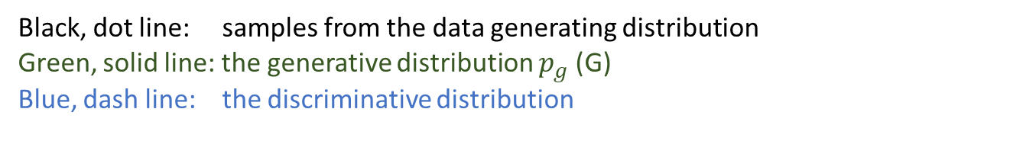
update
Black, dot line: samples from the data generating distribution
Green, solid line: the generative distribution $p_{g}$ (G)
Blue, dash line: the discriminative distribution

Slide 4
Algorithm

Slide 5
摘自 李宏毅老師投影片

Slide 6
摘自 李宏毅老師投影片

Slide 7
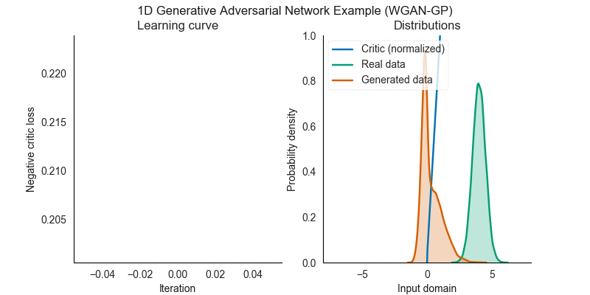
1D Generative Adversarial Network Example
https://github.com/kremerj/gan

Slide 8
2D
Green: P_data
Blud: G(z)
摘自 李宏毅老師投影片

Slide 9
Exercise
Give a 2D data set
Draw the result in previous page using VAE and GAN.

Slide 10
Resource
https://github.com/mattya/chainer-DCGAN
https://github.com/eriklindernoren/Keras-GAN

