Slide 1
Gamification
Notes:
2019
遊戲化(Gamification ) 人本設計: 優化人類動機
行為設計(Behavioral Design)

Slide 2
How Uber Uses Psychological Tricks to Push Its Drivers' Buttons
Notes:
https://www.nytimes.com/interactive/2017/04/02/technology/uber-drivers-psychological-tricks.html

Slide 3
Outline
Octalysis (八角分析法)
  左腦 vs 右腦
  白帽 vs 黑帽
Skinner Box
Bartle’s player types

Slide 4
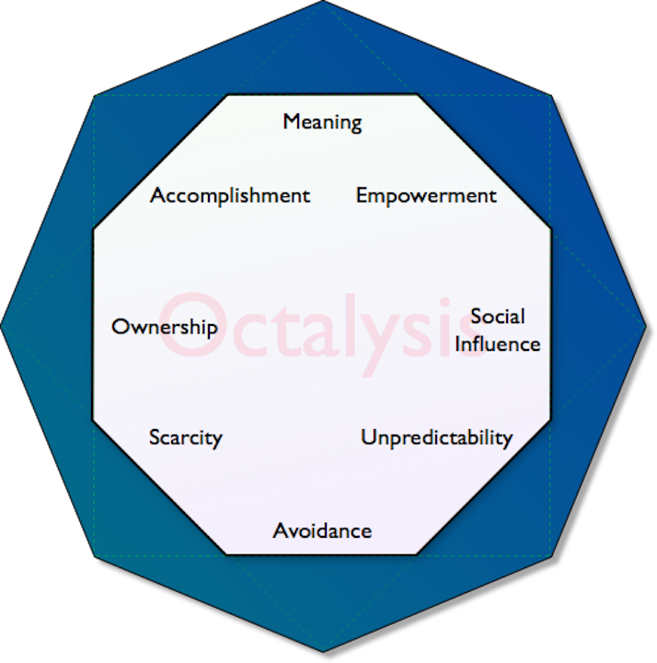
Octalysis
Yu-Kai Chou
Notes:
Yu-Kai Chou
心理動機

Slide 5
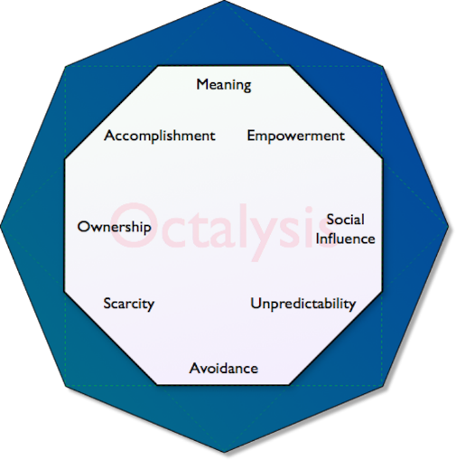
1. 重大使命與呼召
Wikipedia
Narrative
Hero

Slide 6
2. 發展與成就
Status Points
Badges
Leaderboard

Slide 7
3. 賦與創造力與回饋
Lego
Real-time control
Instant feedback

Slide 8
4. 所有權與占有欲
Exchangeable Points
Avatar

Slide 9
5. 社會影響力與同理心
Friending
Social treasure

Slide 10
6. 稀缺性與迫切
Appointment Dynamics
Torture breaks

Slide 11
7. 不確定性與好奇心
Random rewards

Slide 12
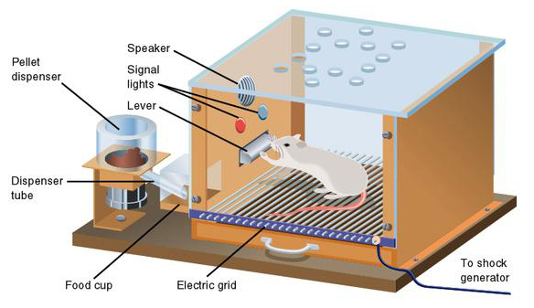
Skinner Box
Notes:
操控反射（operant conditioning）

Slide 13
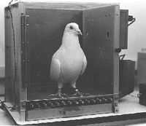

Slide 14
8. 損失與避免
Sunk cost Prison

Slide 15
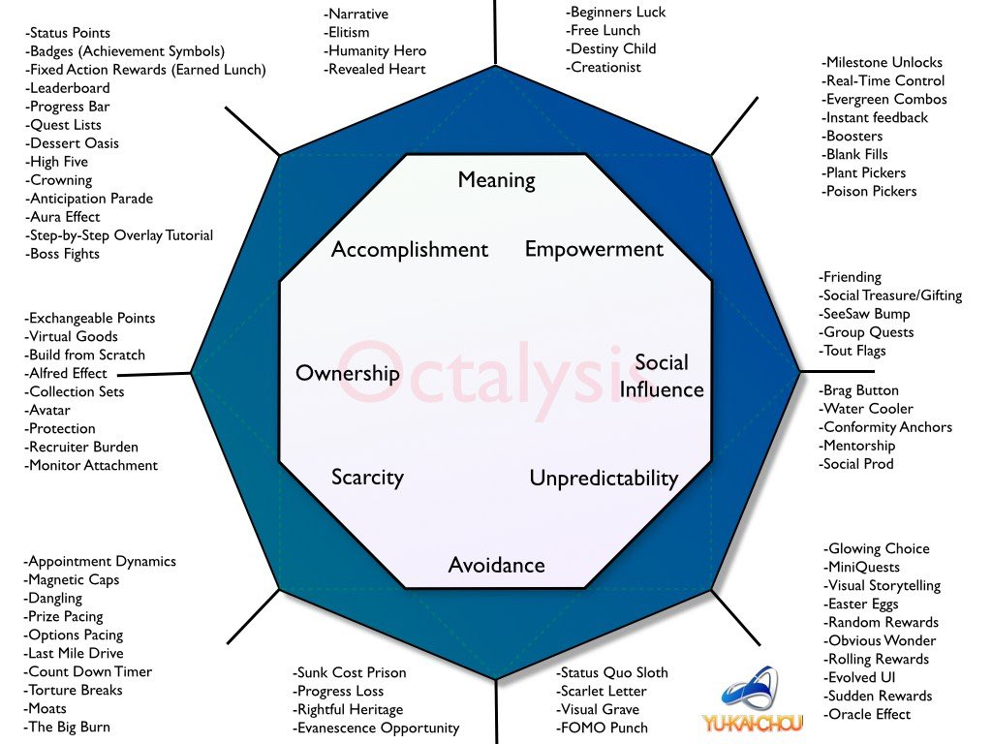

Slide 16
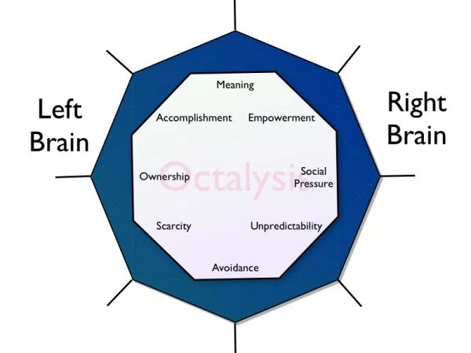
外部傾向 vs. 內部傾向
Notes:
Left: goal, reward
Right: enjoyable

Slide 17
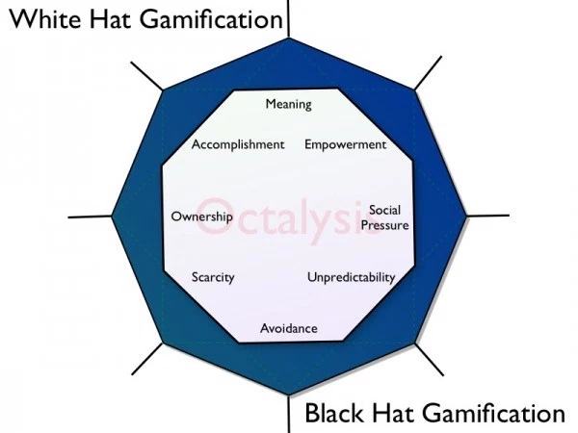
白帽遊戲化 vs.黑帽遊戲化

Slide 18
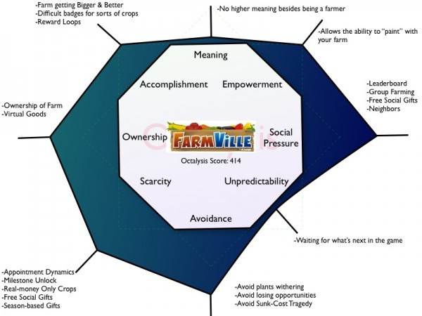
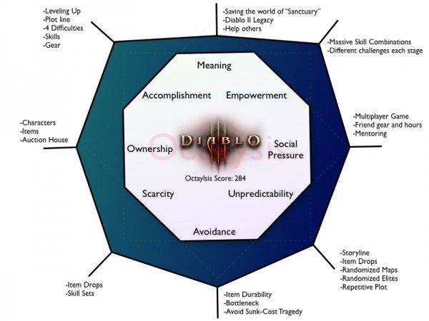

Slide 19
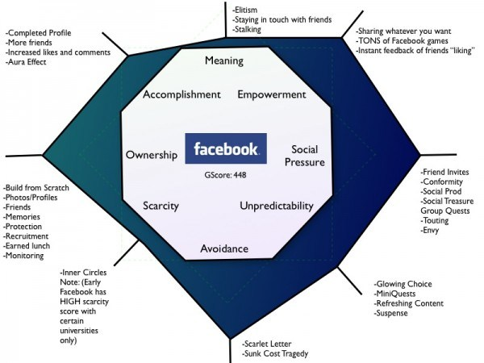
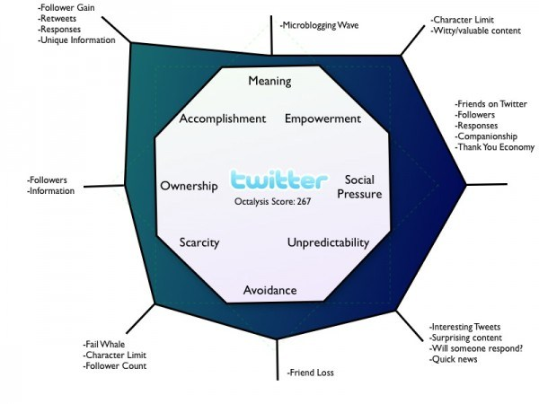
Notes:
http://yukaichou.com/octalysis-tool/

Slide 20
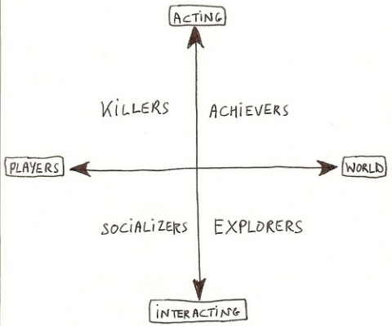
Bartle taxonomy of player types(1996)
Notes:
https://en.wikipedia.org/wiki/Bartle_taxonomy_of_player_types
https://www.interaction-design.org/literature/article/bartle-s-player-types-for-gamification

Slide 21
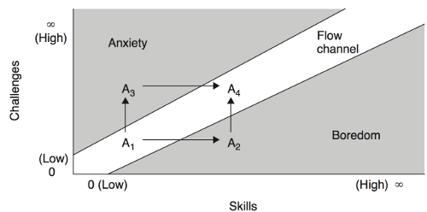
Flow (1990)
Notes:
Mihaly Csikszent
Mihaly Csikszentmihályi (1990). Flow: The Psychology of Optimal Experience. Harper & Row. ISBN 978-0-06-016253-5.mihalyi

Slide 22
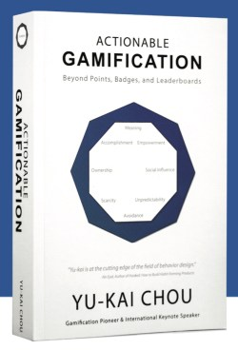
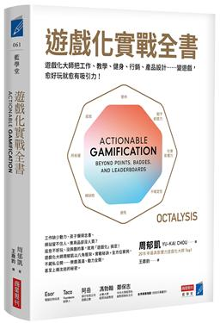
Reference
Actionable Gamification: Beyond Points, Badges, and Leaderboards
2015

