Slide 1
3D Game Programming
Texture Mapping
Ming-Te Chi
Department of Computer Science,
National Chengchi University
Notes:
2019

Slide 2
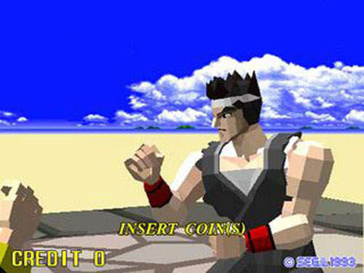
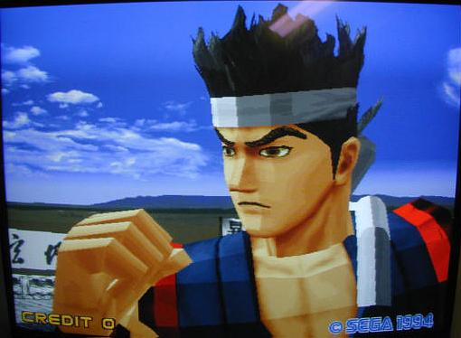
Virtua Fighter
1993
Virtua Fighter 2
1994
Notes:
Virtua Fighter

Slide 3
Outline
Texture Mapping: The Basics
  Mapping textures to geometry
  Change the texture environment
  texture mapping parameter
  mipmaps

Slide 4
Basic Stragegy
Three steps to applying a texture
  specify the texture
    read or generate image
    assign to texture
    enable texturing
  assign texture coordinates to vertices
    Proper mapping function is left to application
  specify texture parameters
    wrapping, filtering

Slide 5
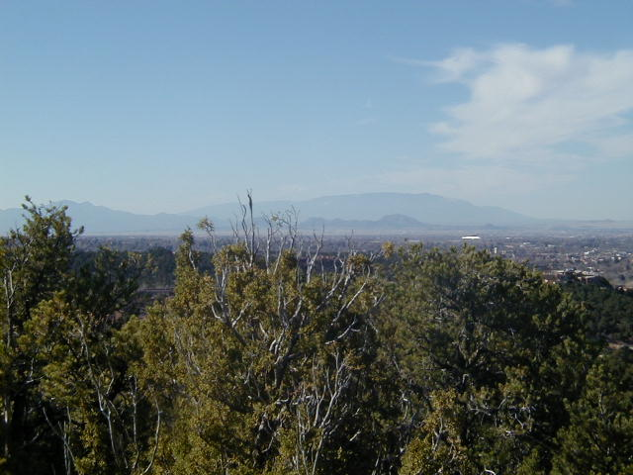
Texture Mapping
y
z
x
geometry
display
t
image
s

Slide 6
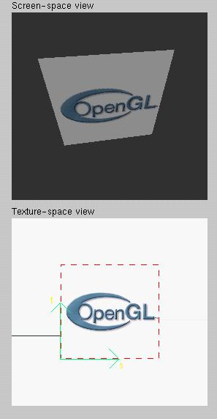
Texture Example
The texture (below) is a 256 x 256 image that has been mapped to a rectangular polygon which is viewed in perspective

Slide 7
Texture Mapping and the OpenGL Pipeline
Images and geometry flow through separate pipelines that join during fragment processing
  “complex” textures do not affect geometric complexity
vertices
geometry pipeline
Fragment processor
image
pixel pipeline

Slide 8
Specifying a Texture Image
Define a texture image from an array of
texels (texture elements) in CPU memory
  Glubyte my_texels[512][512][3]; //3:rgb
Define as any other pixel map
  Scanned image
  Generate by application code
Enable texture mapping
  glEnable(GL_TEXTURE_2D)
  OpenGL supports 1-4 dimensional texture maps

Slide 9
Define Image as a Texture
glTexImage2D( target, level, components,
w, h, border, format, type, texels );
target: type of texture, e.g. GL_TEXTURE_2D
level: used for mipmapping (discussed later)
components: elements per texel
w, h: width and height of texels in pixels
border: used for smoothing (discussed later)
format and type: describe texels
texels: pointer to texel array
glTexImage2D(GL_TEXTURE_2D, 0, 3, 512, 512, 0, GL_RGB, GL_UNSIGNED_BYTE, my_texels);

Slide 10
Typical Usage
glTexImage2D(GL_TEXTURE_2D, 0, 3, 512, 512, 0, GL_RGB,
GL_UNSIGNED_BYTE, my_texels);
target: GL_TEXTURE_2D
level: no mipmapping
components: R, G, B
w, h: 512 X 512
border: no border
format and type: GL_RGB and unsigned byte (0~255)
texels: actual data!

Slide 11
Converting A Texture Image
OpenGL requires texture dimensions to be powers of 2. (Note: after OpenGL 2.0, texture dimensions can be non-power-of two.)
If dimensions of image are not powers of 2
gluScaleImage( format, w_in, h_in,
type_in, *data_in, w_out, h_out,
type_out, *data_out );
  data_in is source image
  data_out is for destination image
Image interpolated and filtered during scaling

Slide 12
Mapping a Texture
t
s

Slide 13
Mapping a Texture
t
s

Slide 14
Mapping a Texture
Based on parametric texture coordinates
glTexCoord*() specified at each vertex
t
1, 1
(s, t) = (0.2, 0.8)
0, 1
A
a
c
(0.4, 0.2)
b
B
C
0, 0
1, 0
s
(0.8, 0.4)
Texture Space
Object Space

Slide 15
Load texture
// Load texture
GLbyte *pBytes;
glPixelStorei(GL_UNPACK_ALIGNMENT, 1);
pBytes = gltLoadTGA("Stone.tga", &iWidth, &iHeight, &iComponents, &eFormat);
glTexImage2D(GL_TEXTURE_2D, 0, iComponents, iWidth, iHeight, 0, eFormat, GL_UNSIGNED_BYTE, pBytes);
free(pBytes);
Notes:
TGA 格式可詳見 http://en.wikipedia.org/wiki/Truevision_TGA 的說明
Texture可從多種影像格式匯入，之前2D遊戲範例所利用的bmp格式也可用來讀入貼圖

Slide 16
Typical Code
glBegin(GL_TRIANGLES);
glColor3f(1.0f, 1.0f, 1.0f); //if no shading used
glNormal3f(0.0f, -1.0f, 0.0f); // if shading used
glTexCoord2f(1.0f, 1.0f);
glVertex3fv(vCorners[2]);
glTexCoord2f(0.0f, 0.0f);
glVertex3fv(vCorners[4]);
glTexCoord2f(0.0f, 1.0f);
glVertex3fv(vCorners[1]);
glEnd();
Note that we can use vertex arrays to increase efficiency

Slide 17
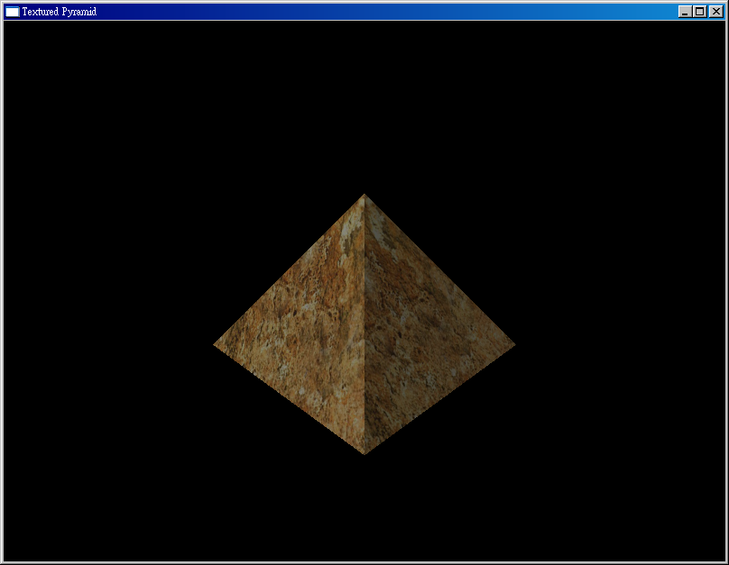
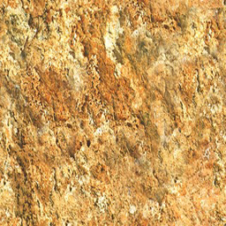
Texture image

Slide 18
Mipmapped Textures
Mipmapping allows for prefiltered texture maps of decreasing resolutions
Lessens interpolation errors for smaller textured objects
Declare mipmap level during texture definition
  glTexImage2D( GL_TEXTURE_*D, level, … )
GLU mipmap builder routines will build all the textures from a given image
  gluBuild*DMipmaps( … )

Slide 19
Cartoons with texture
//Set 1D Texture image for toonmap
GLbyte toonTable[4][3] = { { 0, 32, 0 }, { 0, 64, 0 },
{ 0, 128, 0 }, { 0, 192, 0 } };
glTexImage1D(GL_TEXTURE_1D, 0, GL_RGB, 4, 0, GL_RGB, GL_UNSIGNED_BYTE, toonTable);
// Texture coordinate is set by intensity of light
glTexCoord1f(m3dDotProduct(vNewLight, vNormal));
glVertex3f(x0*r, y0*r, z);

Slide 20
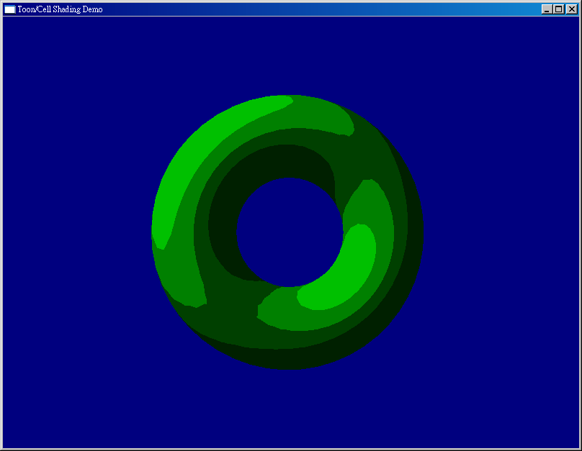
1D Texture

Slide 21
Texture Objects
Texture is part of the OpenGL state
  If we have different textures for different objects, OpenGL will be moving large amounts data from processor memory to texture memory
Recent versions of OpenGL have texture objects
  one image per texture object
  Texture memory can hold multiple texture objects

Slide 22
Applying Textures II
specify textures in texture objects
set texture filter
set texture function
set texture wrap mode
set optional perspective correction hint
bind texture object
enable texturing
supply texture coordinates for vertex
  coordinates can also be generated

Slide 23
Managing Multiple textures
#define NUM_TEXTURES 3
GLuint textureObjects[NUM_TEXTURES];
----------------------------------------------------------------------------------
//In init()
int TEXTURE_COUNT = NUM_TEXTURES ;
glGenTextures(TEXTURE_COUNT, textureObjects);
for(iLoop = 0; iLoop < TEXTURE_COUNT; iLoop++)
{
// Bind to next texture object
glBindTexture(GL_TEXTURE_2D, textureObjects[iLoop]);
// Load texture, set filter and wrap modes
pBytes = gltLoadTGA(szTextureFiles[iLoop],&iWidth, &iHeight,
&iComponents, &eFormat);
// Load texture, set filter and wrap modes
gluBuild2DMipmaps(GL_TEXTURE_2D, iComponents, iWidth, iHeight, eFormat, GL_UNSIGNED_BYTE, pBytes);
// Don't need original texture data any more
free(pBytes);
}

Slide 24
// In display()
glBindTexture(GL_TEXTURE_2D, textures[TEXTURE_FLOOR]);
glBegin(GL_QUADS);
glTexCoord2f(0.0f, 0.0f);
glVertex3f(-10.0f, -10.0f, z);
glTexCoord2f(1.0f, 0.0f);
glVertex3f(10.0f, -10.0f, z);
glTexCoord2f(1.0f, 1.0f);
glVertex3f(10.0f, -10.0f, z - 10.0f);
glTexCoord2f(0.0f, 1.0f);
glVertex3f(-10.0f, -10.0f, z - 10.0f);
glEnd();
Notes:
回頭再看obj format 有關於texture coordinate的部份

Slide 25
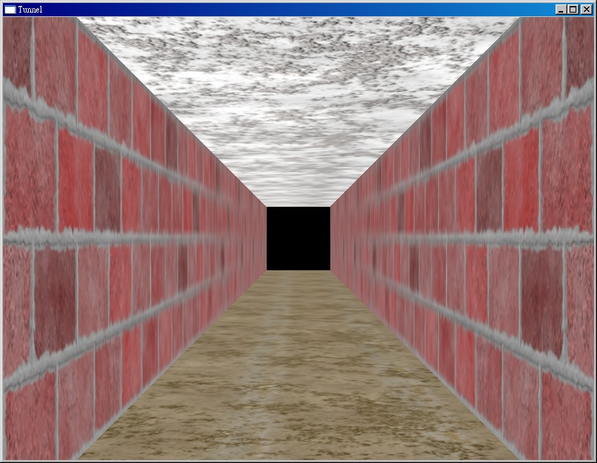
Managing Multiple textures

Slide 26
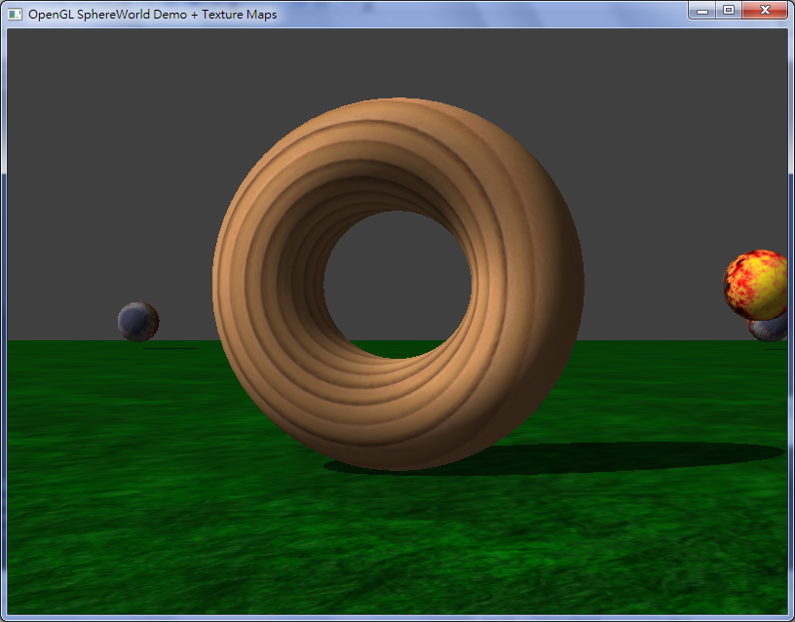
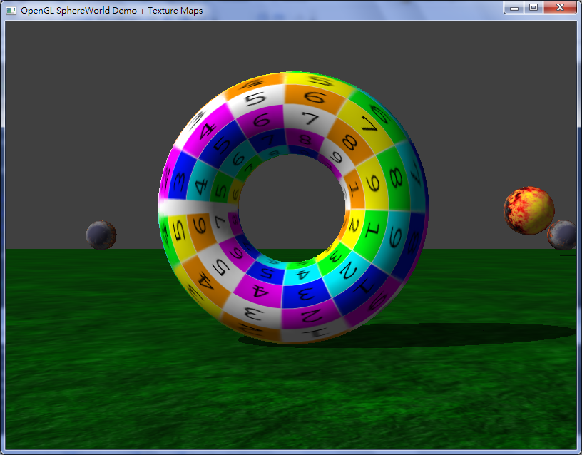
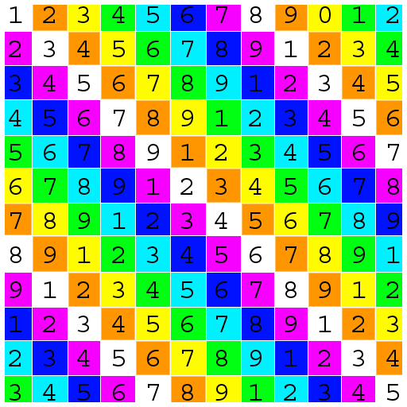
UV mapping

Slide 27
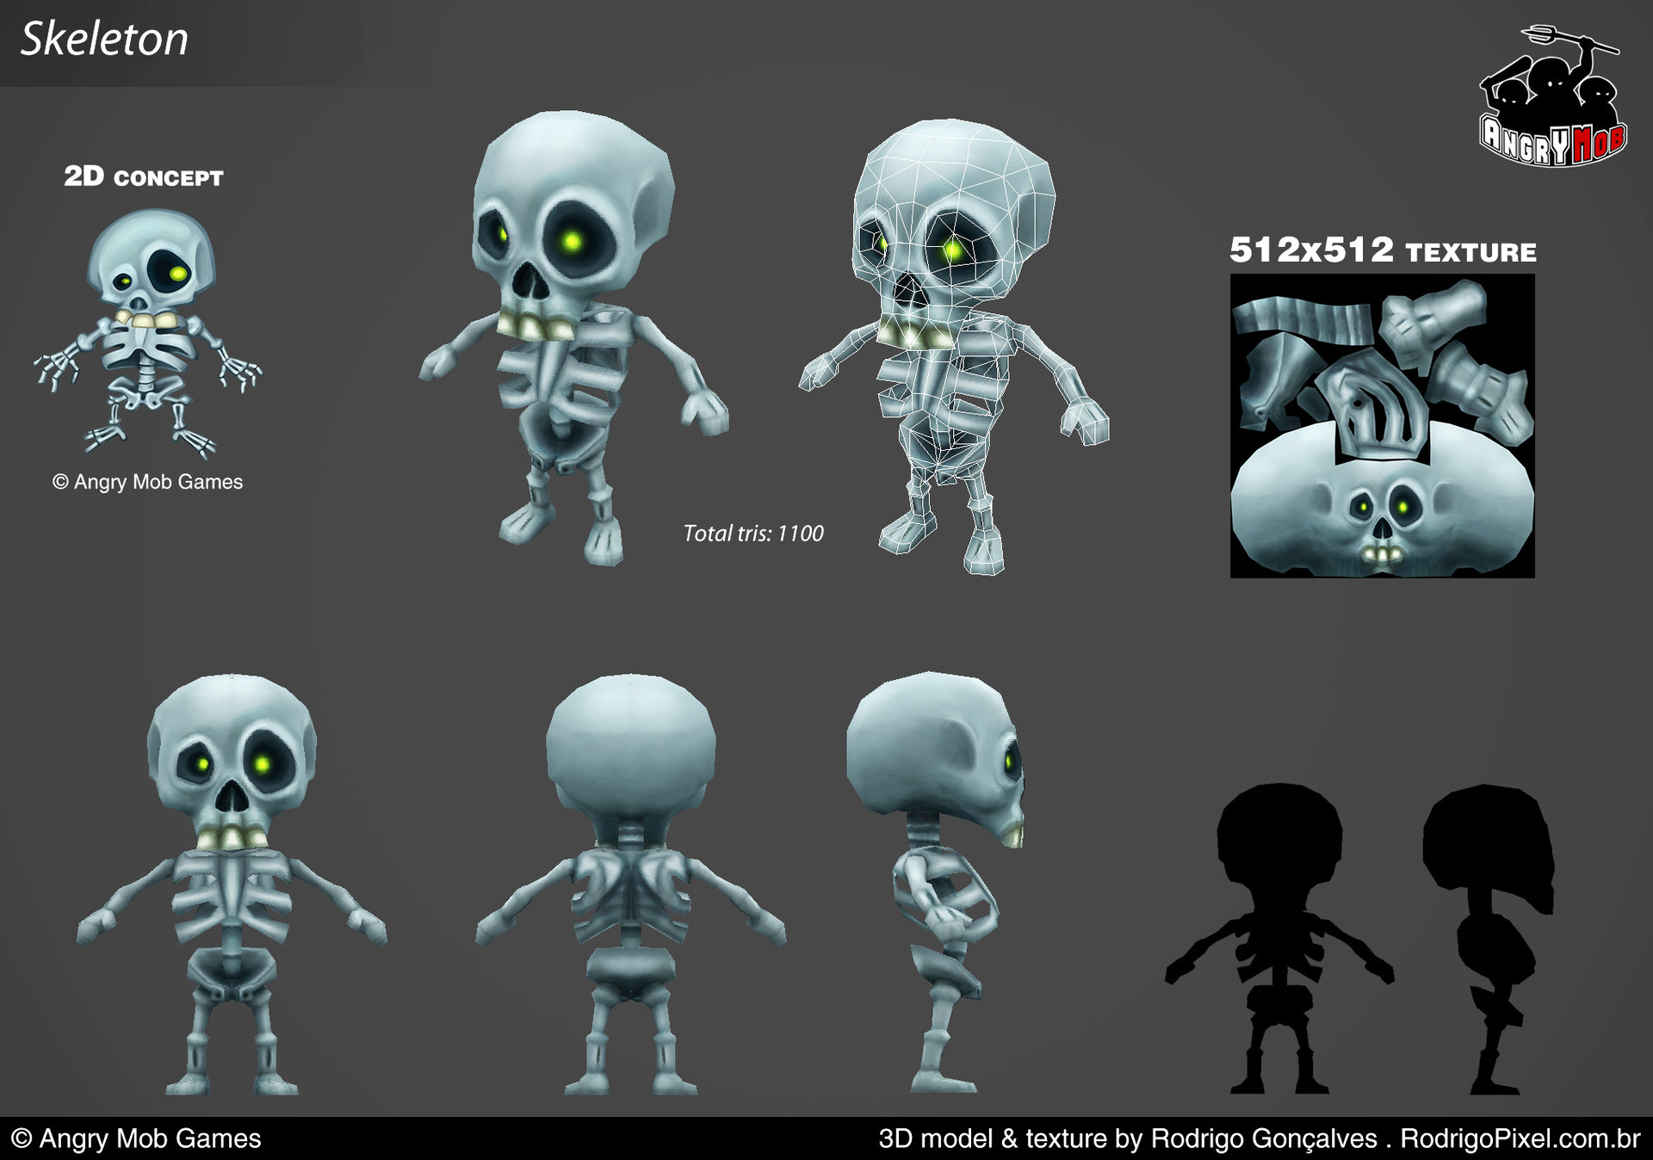

Slide 28
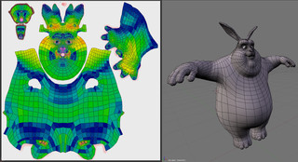
Complex model
Blender uv mapping

Slide 29
Build your TexObject class
Class TexObj {
TexObj(const char *filename);
bindtexture();
private:
Gluint texid;
}
Notes:
OpenGL 提供的是最基本的函式呼叫，請試圖整理相關的功能，讓使用能更方便

Slide 30
Texture Functions
Controls how texture is applied
glTexEnv{fi}[v]( GL_TEXTURE_ENV, prop, param )
GL_TEXTURE_ENV_MODE modes
  GL_MODULATE: modulates with computed shade
  GL_BLEND: blends with an environmental color
  GL_REPLACE: use only texture color
  GL_TEXTURE_ENV, GL_TEXTURE_ENV_MODE, GL_MODULATE);
Set blend color with GL_TEXTURE_ENV_COLOR

Slide 31
Perspective Correction Hint
Texture coordinate and color interpolation
  either linearly in screen space
  or using depth/perspective values (slower)
Noticeable for polygons “on edge”
glHint( GL_PERSPECTIVE_CORRECTION_HINT, hint )
  where hint is one of
    GL_DONT_CARE
    GL_NICEST
    GL_FASTEST

Slide 32
Generating Texture Coordinates
OpenGL can generate texture coordinates automatically
  glTexGen{ifd}[v]()
specify a plane
  generate texture coordinates based upon distance from the plane
generation modes
  GL_OBJECT_LINEAR
  GL_EYE_LINEAR
  GL_SPHERE_MAP (used for environmental maps)

Slide 33
Other Texture Features
Environment Maps
  Start with image of environment through a wide angle lens
    Can be either a real scanned image or an image created in OpenGL
  Use this texture to generate a spherical map
  Use automatic texture coordinate generation
Multitexturing
  Apply a sequence of textures through cascaded texture units

Slide 34
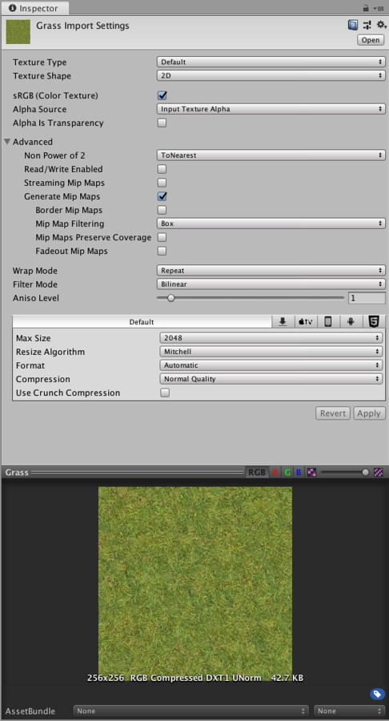
Texture

Slide 35
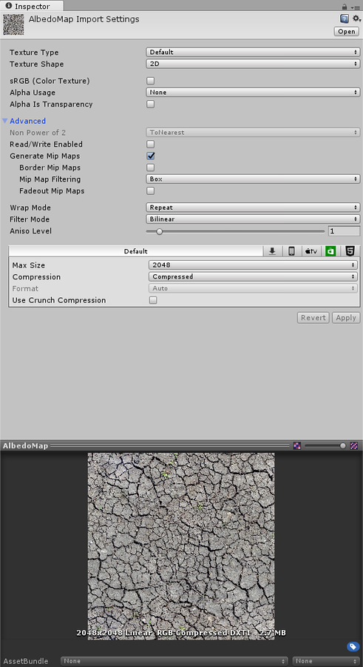
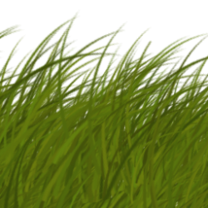
Texture Types
Alpha Source
  None
  Input Texture Alpha
  From Gray Scale
Alpha is Transparency
Notes:
enable Alpha is Transparency to dilate the color and avoid filtering artifacts on the edges.

Slide 36
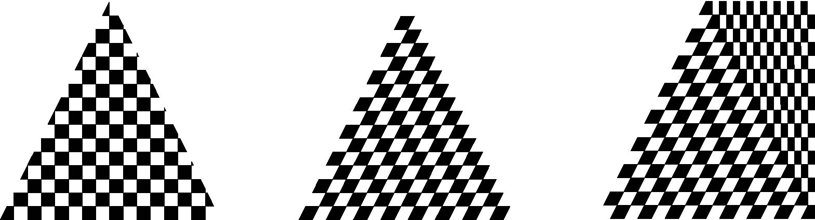
Interpolation
OpenGL uses interpolation to find proper texels from specified texture coordinates
Can be distortions
texture stretched
over trapezoid
showing effects of
bilinear interpolation
good selection
of tex coordinates
poor selection
of tex coordinates

Slide 37
Texture Parameters
OpenGL has a variety of parameters that determine how texture is applied
  Wrapping parameters determine what happens if s and t are outside the (0,1) range
  Filter modes allow us to use area averaging instead of point samples
  Mipmapping allows us to use textures at multiple resolutions
  Environment parameters determine how texture mapping interacts with shading

Slide 38
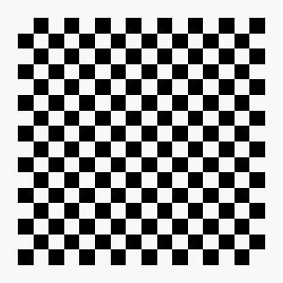
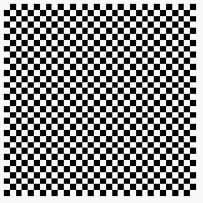
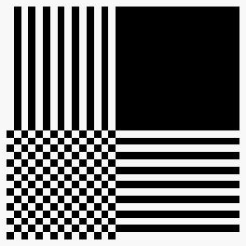
Wrapping Mode
Clamping: if s,t > 1 use 1, if s,t <0 use 0
Wrapping: use s,t modulo 1
  glTexParameteri( GL_TEXTURE_2D,
  GL_TEXTURE_WRAP_S, GL_CLAMP )
  glTexParameteri( GL_TEXTURE_2D,
  GL_TEXTURE_WRAP_T, GL_REPEAT )
t
s
GL_REPEAT
wrapping
GL_CLAMP
wrapping
texture

Slide 39
Magnification and Minification
Texture
Polygon
Texture
Polygon
Magnification
Minification
more than one pixel can cover a texel (magnification)
Can use point sampling (nearest texel)
More than one texel can cover a pixel (minification)
linear filtering
( 2 x 2 filter) to obtain texture values

Slide 40
Filter Modes
Modes determined by
  glTexParameteri( target, type, mode )
glTexParameteri(GL_TEXTURE_2D, GL_TEXURE_MAG_FILTER, GL_NEAREST);
glTexParameteri(GL_TEXTURE_2D, GL_TEXURE_MIN_FILTER, GL_LINEAR);
Note that linear filtering requires a border of an
extra texel for filtering at edges (border = 1)

Slide 41
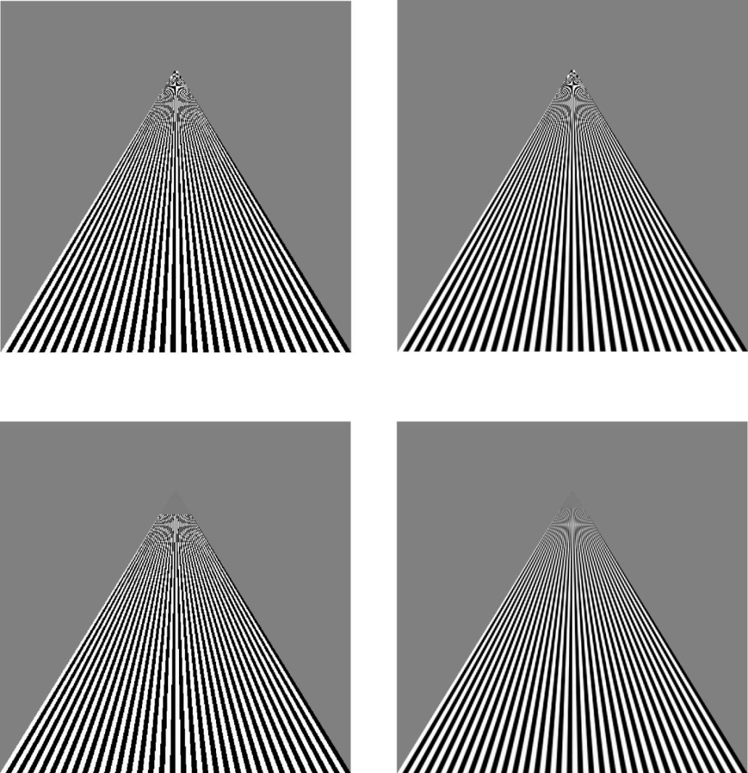
Example
point
sampling
linear
filtering
mipmapped point
sampling
mipmapped
linear
filtering

Slide 42
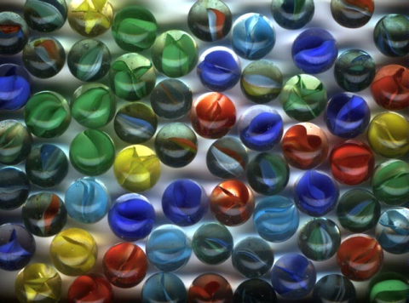
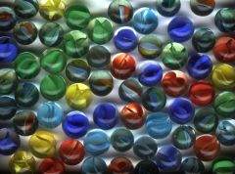


Multiple level of Detail
Mipmaps – many things in a small place

Slide 43
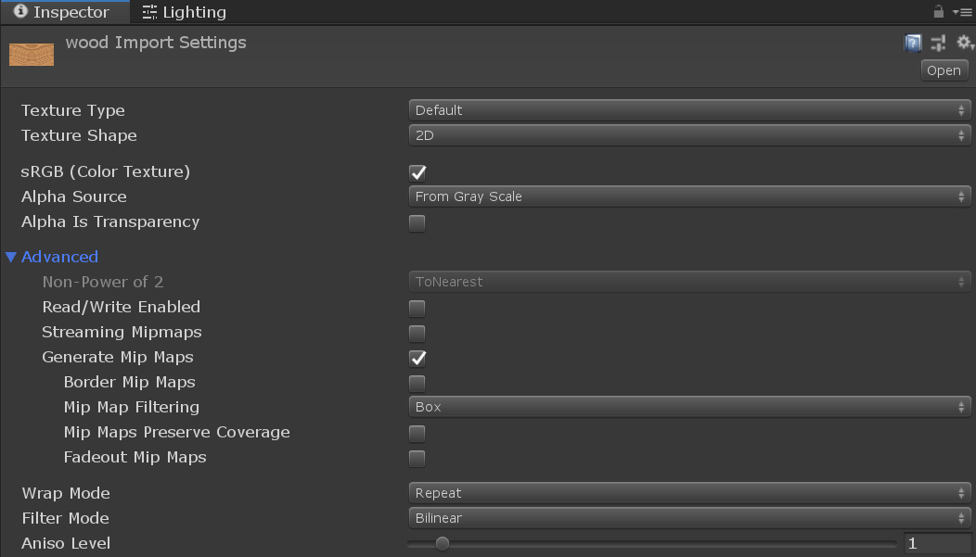
Multiple level of Detail

Slide 44
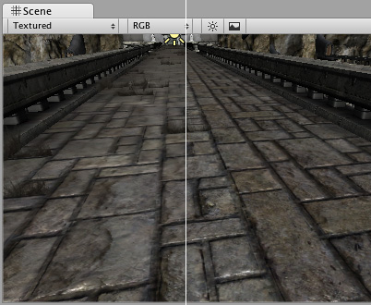
Anisotropic filtering
Anisotropic filtering increases Texture quality when viewed from a grazing angle.

Slide 45
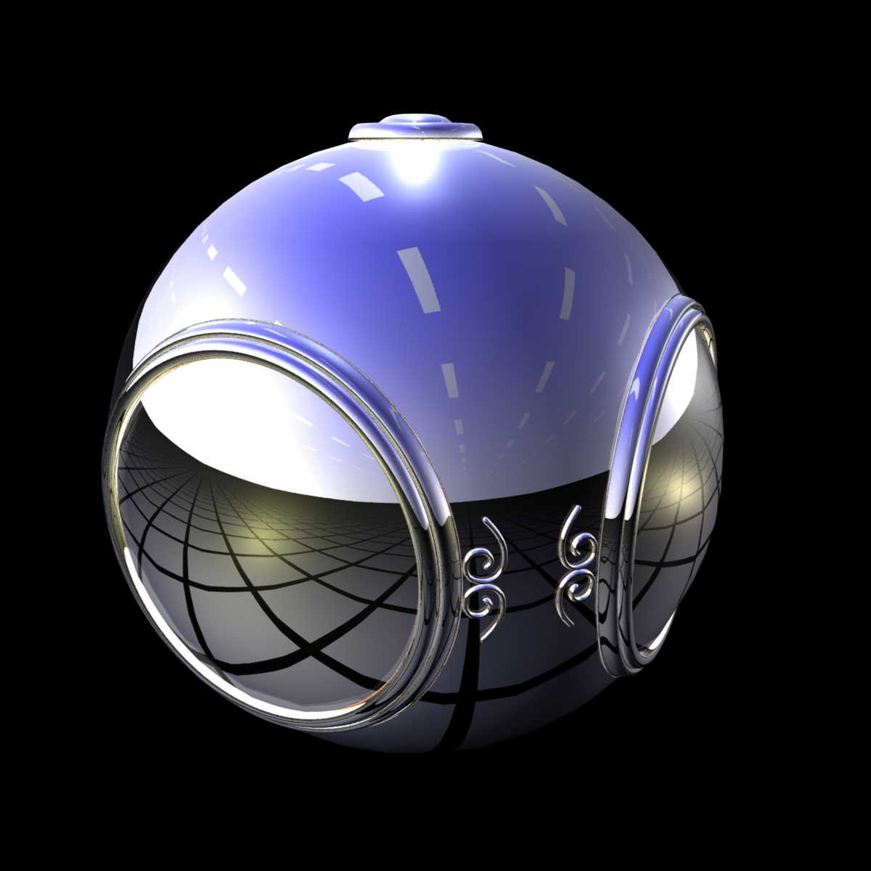
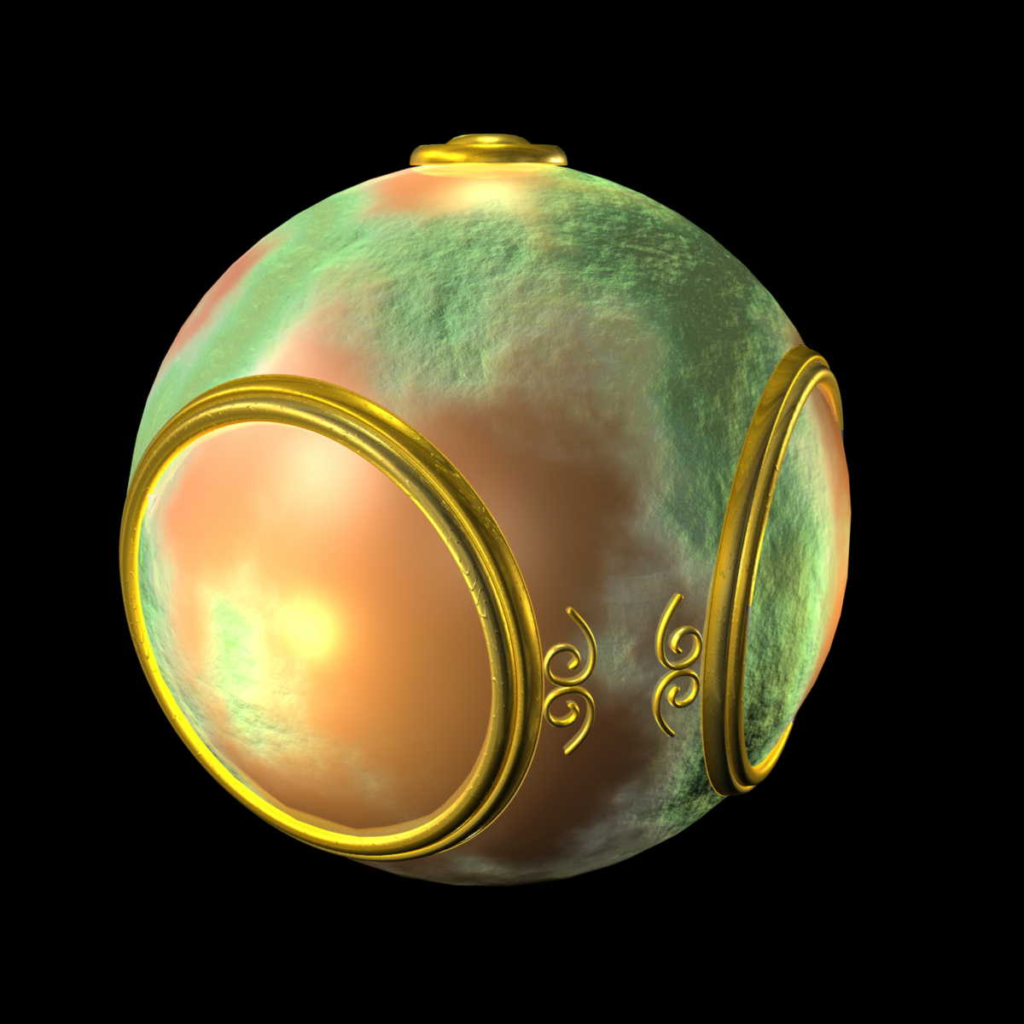
Environment Mapping
Skybox / Reflection Probe
Bump Mapping

Slide 46
Standard
Metallic

Slide 47
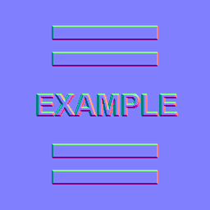
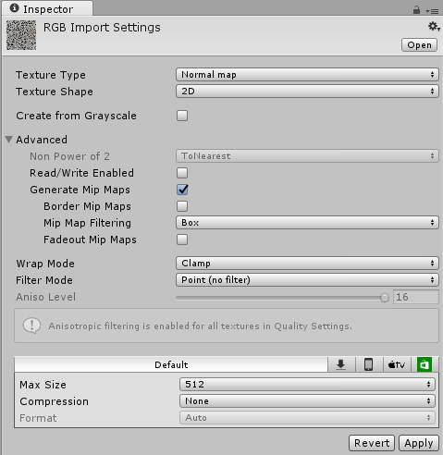
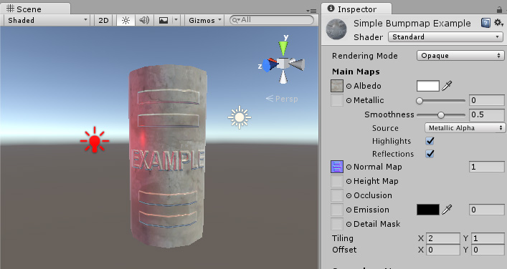
Texture type: Normal Map

Slide 48
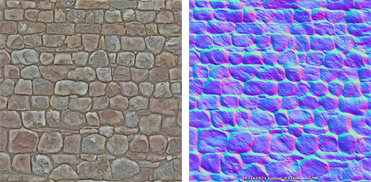
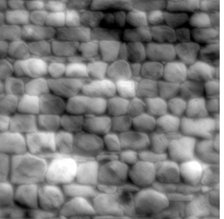
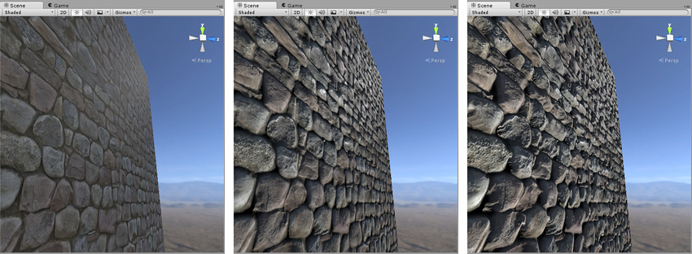
Height Maps
albedo
Normal
Height
Notes:
https://docs.unity3d.com/Manual/StandardShaderMaterialParameterHeightMap.html

Slide 49
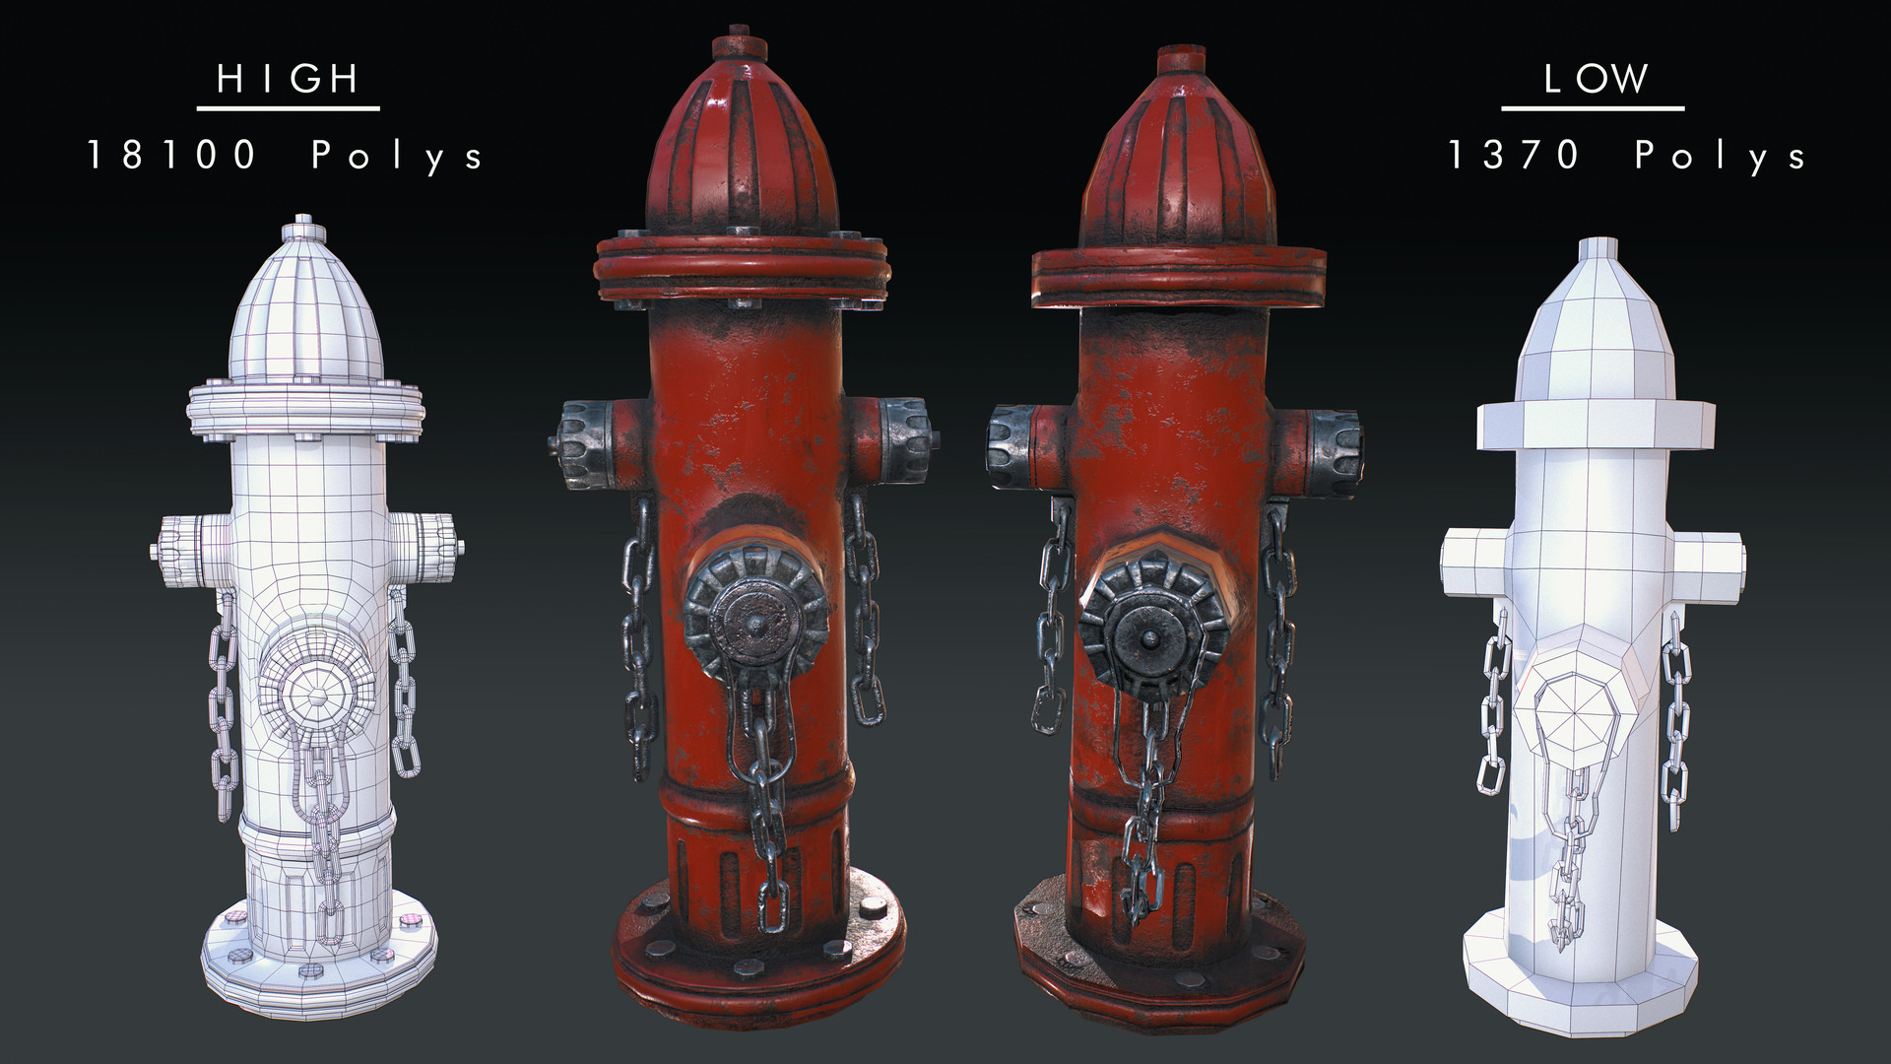
High Poly -> Low Poly

Slide 50
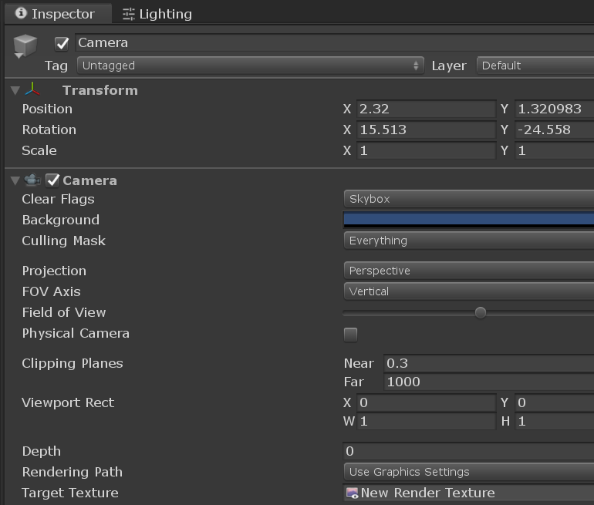
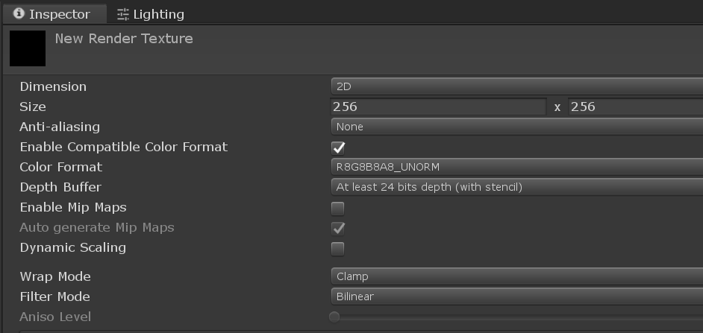
Render Texture

Slide 51
