Slide 1
3D Game Programming
Projection
Ming-Te Chi
Department of Computer Science,
National Chengchi University
Notes:
2019

Slide 2
Projection

Slide 3
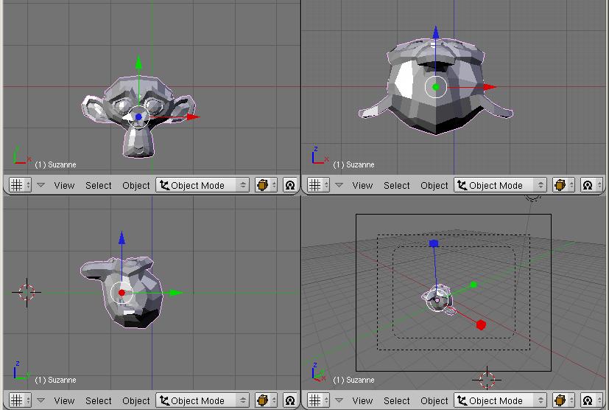
Multi-view
Notes:
一般的建模軟體都提供多重視角的畫面，方便理解與建立3D model
從左上順時鐘方向依序為，正面正交投影、下方正交投影，相機視點透視投影和側面視點正交投影

Slide 4
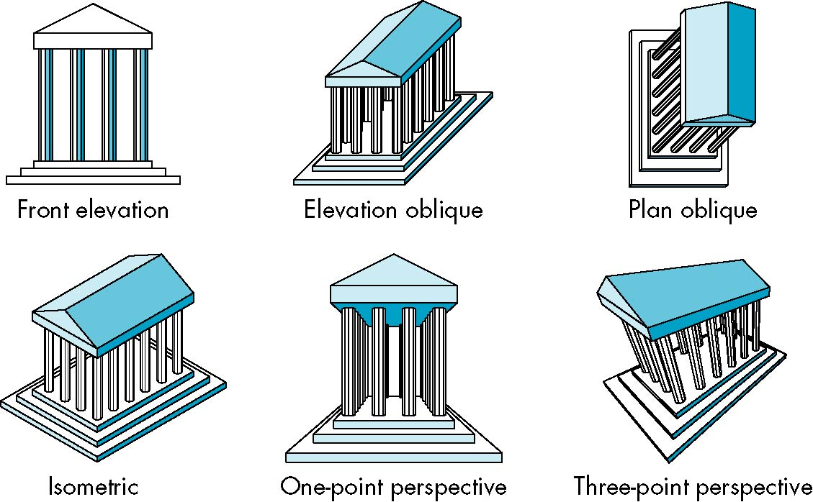
Classical Projections
Notes:
幾種工程繪圖中常見的透視方法

Slide 5
Eye coordinates
+y
+x
+z
Notes:
由於成像是會依相機(觀察者)的位置和角度進行繪圖，
故整體來說程式碼由下而上需經歷從object space轉換成world space再轉到view space (camera space或Eye coordinates)
之後再經投影，rasterization

Slide 6
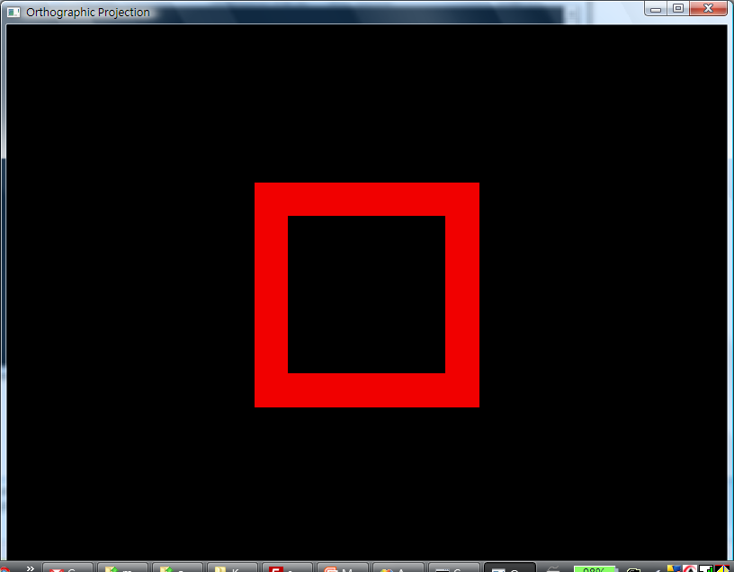
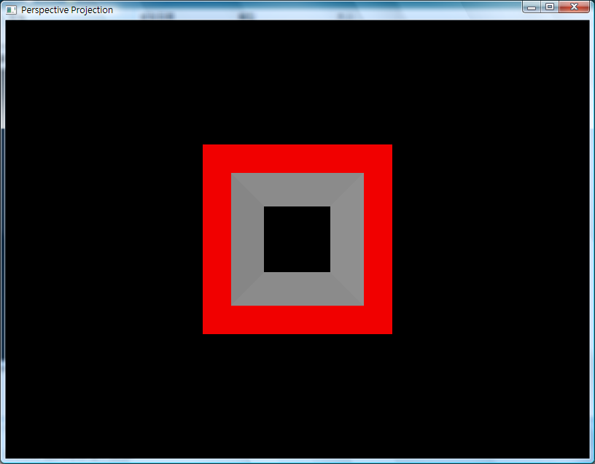
Projections
Orthographic Projections
Perspective Projections
Notes:
以一個中空的立方體模型為例，相同相機觀察角度
在正交投影中，看不到中空內側的部份
但在透視投影中，距離越遠長度差距越小的透視觀點，便可觀察到中空內側表面的部份

Slide 7
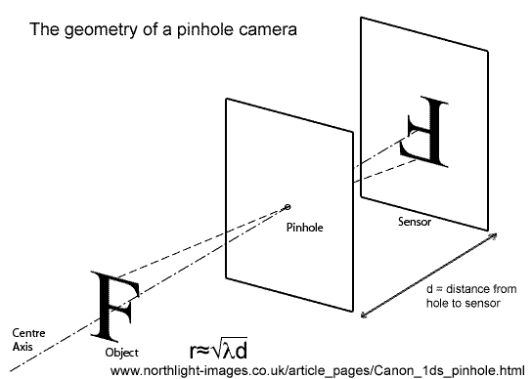
Pinhole camera
A pinhole camera is a simple camera without a lens and with a single small aperture – effectively a light-proof box with a small hole in one side.
Notes:
電腦圖學通常以Pinhole camera(針孔成像原理)，呈現出3D場景、鏡頭和成像平面間的關係

Slide 8
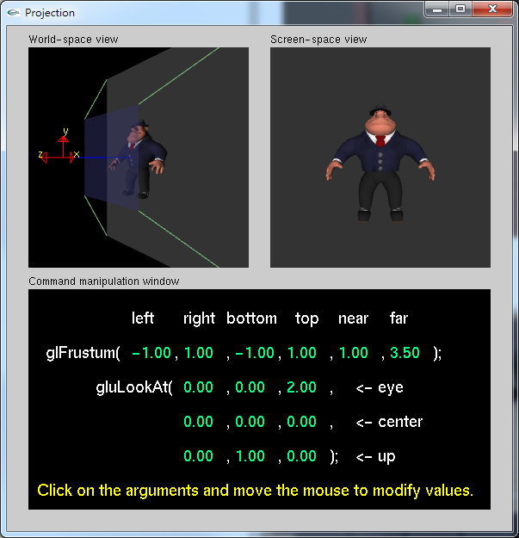
Frustum
void glFrustum(
  GLdouble left, GLdouble right, GLdouble bottom, GLdouble top, GLdouble nearVal, GLdouble farVal
);
far
near
Notes:
Frustum 平面截頭體
可視為由相機為頂點，far plane為底面的大金字塔，截去以near plane為底面的小金字塔
這個形狀描述了針孔成像透視頭影的視野範圍(view volume)

Slide 9
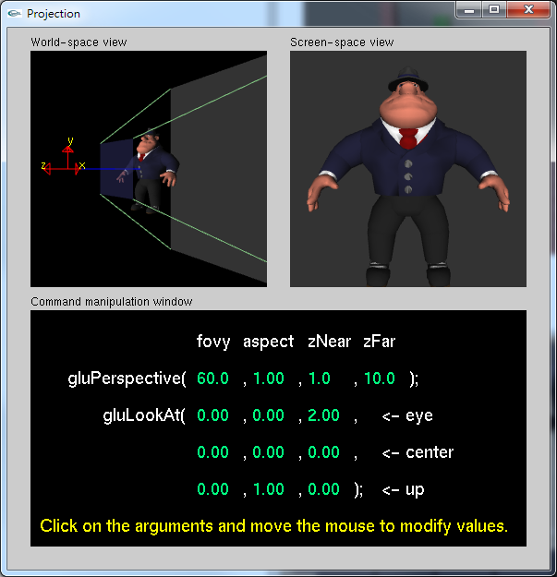
Perspective Projections
// Produce the perspective projection
Perspective(45.0f, fAspect, 1.0, 400.0);
void gluPerspective(
GLdouble fovy, GLdouble aspect, GLdouble zNear, GLdouble zFar);
far
near
Fovy
Field of View in Y axis
Notes:
Frustum的參數設定較不直覺
gluPerspective提供了更方便的方式，讓開發者使用，內部再轉成Frustum的參數
Fovy 視角的大小，一般會設在30~60度之間
Aspect 長寬的比例，可根據視窗或viewport的長寬比例調整

Slide 10
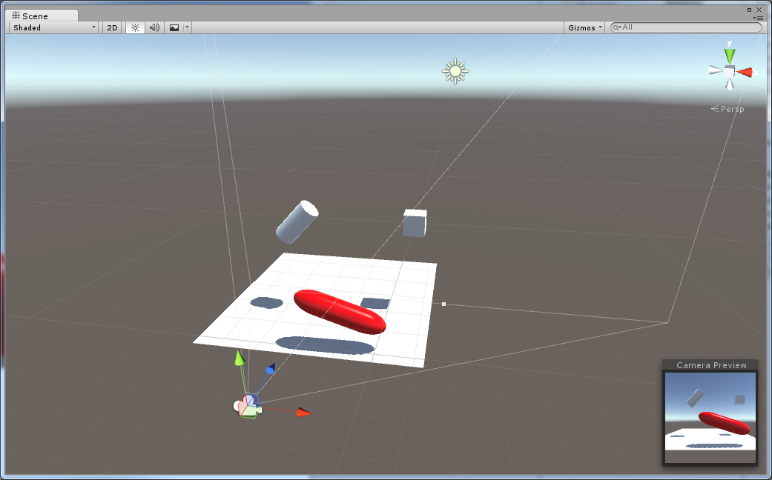
攝影機使用與設定
Main Camera: 遊戲預設視角
  點擊場景中的攝影機，可顯示預覽畫面

Slide 11
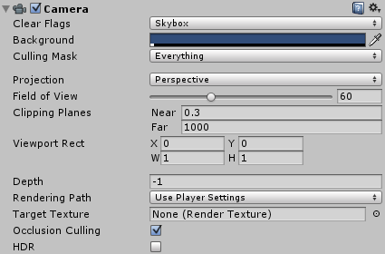
攝影機使用與設定
攝影機屬性
  Background: 背景顏色
  Projection:投影方式
    Perspective: 透視投影
    Orthographic: 正交投影
  Field of View(FOV)
    可見視角範圍
  Clipping Planes
    最近(Near)與最遠(Far)能看到的範圍

Slide 12
Viewport
Modelview space
Clipping space
Viewport transformation
windows space
Notes:
Viewport 定義了Clipping space到視窗位置的轉換關係
一般而言，若只有一個viewport，會將viewport設定與視窗一樣大小，並根據viewport的長寬比例，調整投影的apsect ( gluPerspective()裡的長寬比例 )
另外，一個視窗，可以由多個viewport對視窗進行分割顯示，每個viewport再對應到一個world space

Slide 13
glViewport(…);
glMatrixMode(GL_PROJECTION);
glLoadIdentity();
//projection matrix
gluPrespective()/glOrtho()
glMatrixMode(GL_MODELVIEW);
glLoadIdentity();
//set camera
gluLookat();
//set model transformation
…..
Draw
Usually set in reshape()
Notes:
一般而言，若viewport和投影方式不會在遊戲中改變，會將這部份的程式碼移到reshape()裡，
也就是當視窗大小改變才去更動他
但如果會改變(如:有不同視點切換，或2D/3D切換
)，就應該要放在display()中隨情況調整

Slide 14
graphical perspective

Slide 15
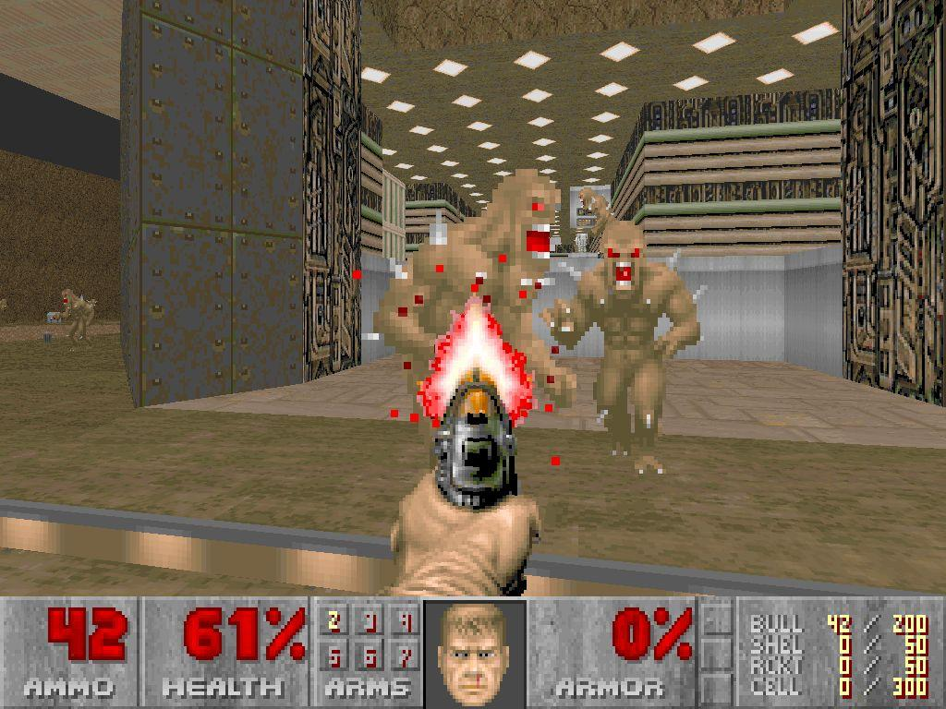
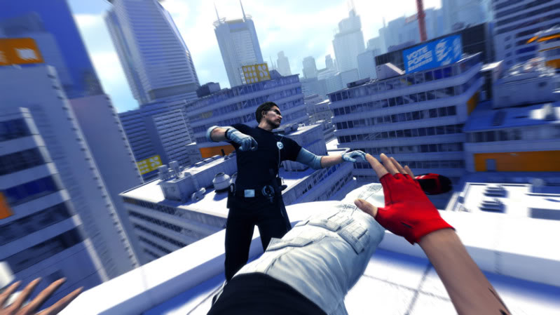
First-Person perspective
A graphical perspective rendered from the viewpoint of the player character
doom
Mirror's Edge
Notes:
http://www.youtube.com/watch?v=2N1TJP1cxmo Mirror's Edge
https://www.youtube.com/watch?v=n5lu4Gyb1KM superhot

Slide 16
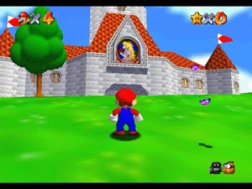
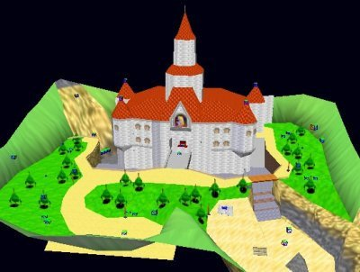
Second-Person Perspective
In second person point of view, the action is shot from the perspective of a character that is not the protagonist.
Let players feel as if they are actually the character they are controlling
Mario 64
Notes:
http://www.youtube.com/watch?v=82TSWzOsPYc mario 64

Slide 17
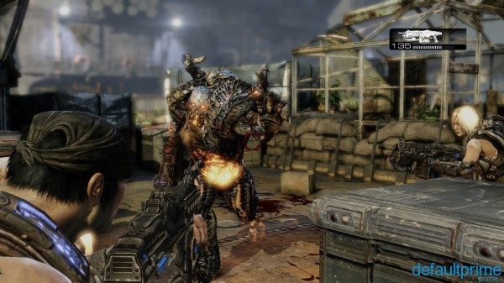
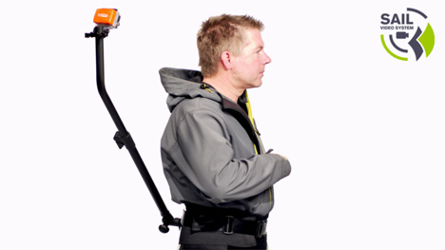
Third-person shooter
The player character is seen at a distance from a number of different possible perspective angles.
the player character is visible on-screen, and the gameplay consists primarily of shooting.
Gear of war 3
Notes:
http://www.youtube.com/watch?v=82TSWzOsPYc mario 64
https://www.youtube.com/watch?v=kFmYbaAjrfo

Slide 18
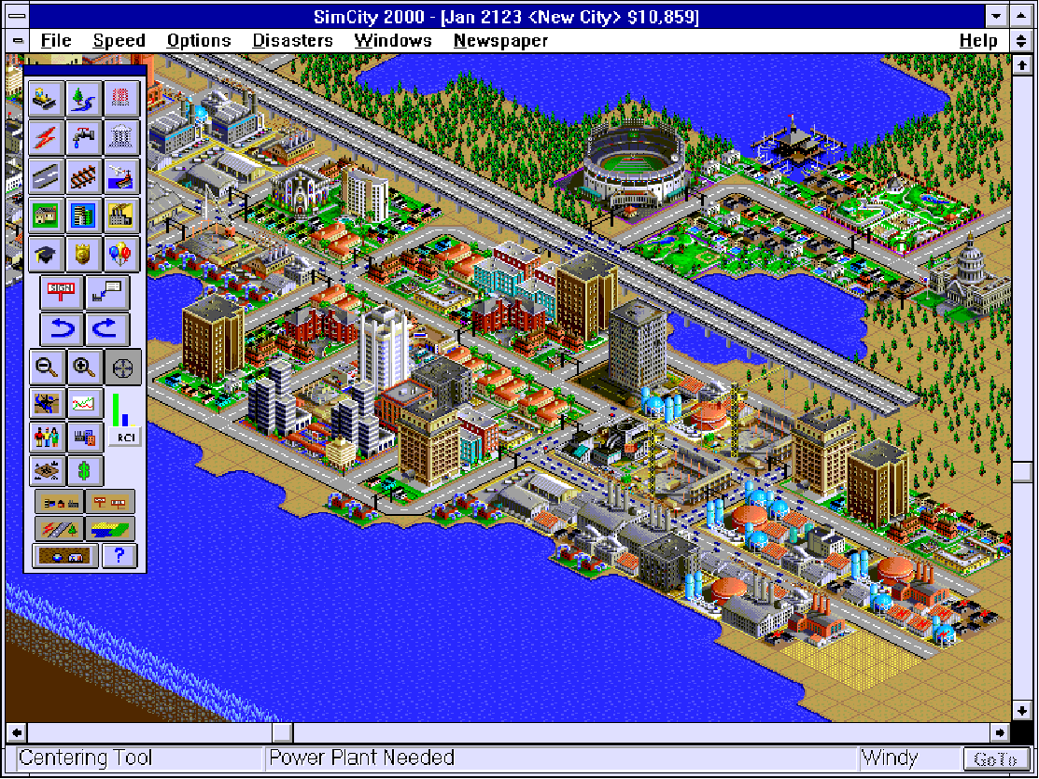
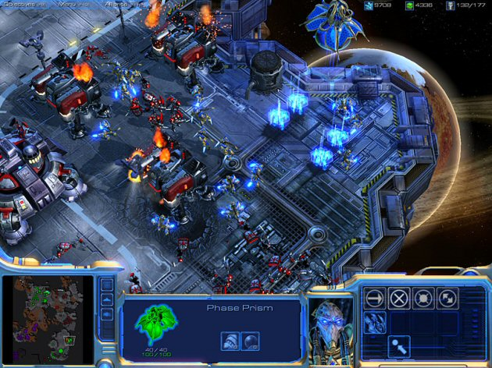
Top-down perspective
From God view
simcity
Star craft 2
Notes:
https://www.youtube.com/watch?v=TqUCmlbkkS0

Slide 19
Cameras and Actors

Slide 20
CameraFollow
public GameObject player;
private Vector3 offset;
void start() {
offset = transform.position –player.transform.position;
}
void LateUpdate() {
transform.position = player.transform.position + offset;
}
Notes:
https://unity3d.com/learn/tutorials/projects/survival-shooter/camera-setup?playlist=17144

Slide 21

Vector3.Lerp
Linearly interpolates
public static Vector3 Lerp(Vector3 a, Vector3 b, float t);
$$out=\left(1−t\right)∗a+t∗b$$
Notes:
https://docs.unity3d.com/ScriptReference/Vector3.Lerp.html

Slide 22
CameraFollow2
public GameObject player;
public float smooth;
private Vector3 offset;
void start() {
offset = transform.position –player.transform.position;
}
void LateUpdate() {
Vector3 targetPos = player.transform.position + offset;
transform.position = Vector3.Lerp (transform.position, targetPos, smooth*Time.deltaTime);
}

Slide 23
Lookat
public void LookAt(Vector3 worldPosition);
public void LookAt(Vector3 worldPosition, Vector3 worldUp = Vector3.up);
+y
+z
up
+x
void Update()
{
// Point the object at the world origin transform.LookAt(Vector3.zero);
}
from
Notes:
https://docs.unity3d.com/ScriptReference/Transform.LookAt.html

Slide 24
An Actor Frame
vUp
Y
vForward
Z
vLocation
vRight
X

Slide 25
Move object
Translate
public void Translate(Vector3 translation, Space relativeTo = Space.Self);
public void Translate(float x, float y, float z, Space relativeTo = Space.Self);
vUp
Y
vForward
Z
vLocation
vRight
X
Notes:
對於3D空間的物件和相機，我們可以透過Frame座標系統描述他在空間中的位置和方向
也就是空間座標(x, y, z)和三軸的向量(前方、上方和側邊)，
這頁提供了一個GLFrame的C++ class，完整的實作可參見實習課的程式範例
由於三個軸是正交垂直，因此在class設計可只設定up和forward兩向量，用外積計算側邊向量
也可以透過這個物件本身座標系統來移動物體，沿著forward vector前進，是比較直覺的作法，
特別在遊戲中，上下左右的移動輸入，應該對應於物體本身的方向，而非對應世界座標軸的方向

Slide 26
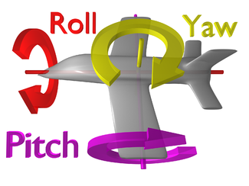
Euler Angles
vUp
Y
vForward
Z
public void Rotate(Vector3 eulers, Space relativeTo = Space.Self);
public void Rotate(float xAngle, float yAngle, float zAngle, Space relativeTo = Space.Self);
vRight
X
Notes:
另外，物體的旋轉可以Euler Angles定義，就如同飛機飛行移動的三個旋轉方向
藉由Frame的定義對三軸做旋轉

Slide 27
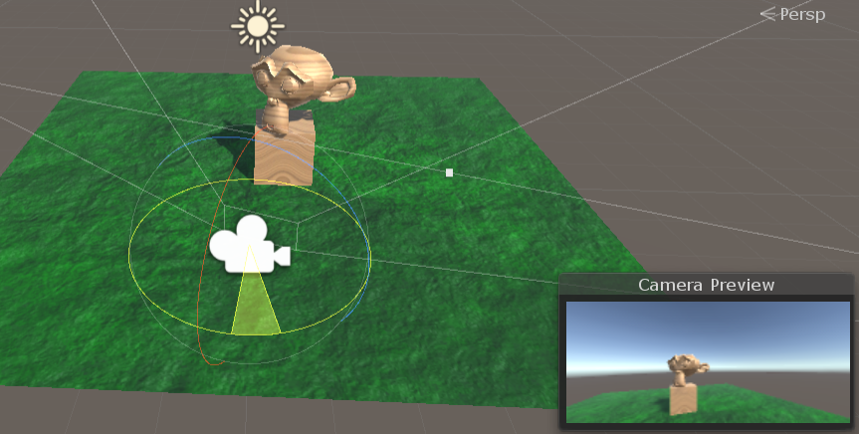
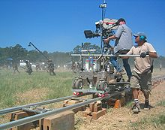
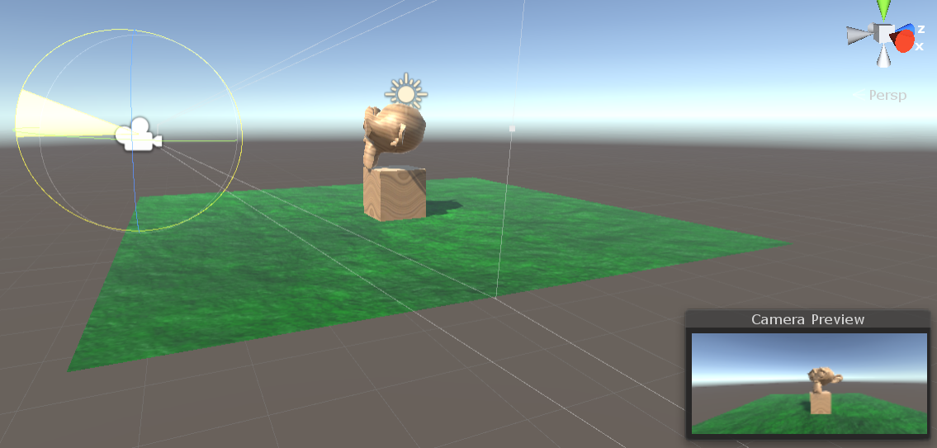
Camera movement
Pan
move your camera horizontally
Tilt
move your camera vertically
Dolly
move the entire camera forwards and backwards
Notes:
https://blog.storyblocks.com/video-tutorials/7-basic-camera-movements/

Slide 28
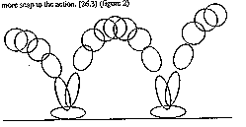
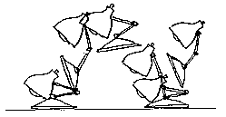
Animation
Squash & stretch
Notes:
The Principles of Animation, Squash and Stretch
For hw2

