Slide 1
3D Game Programming
2D primitive
Ming-Te Chi
Department of Computer Science,
National Chengchi University
Notes:
2019

Slide 2
Outline
Object-Oriented Programming
Physics 2D
  Rigid body
  Collider and trigger
Deformation and skeletal animation

Slide 3
Object-oriented programming

Slide 4
is-a, has-a
Project
  Scene1
    Actor
      Transform
      Sprite Renderer
      Script
      Box Collider
      Rigidbody 2D
    Camera
      Transform
      Camera
Actor is a GameObject.
Actor has a Script.

Slide 5
GameObject
Variables
activeInHierarchy | Is the GameObject active in the scene?
activeSelf | The local active state of this GameObject. (Read Only)
isStatic | Editor only API that specifies if a game object is static.
layer | The layer the game object is in. A layer is in the range [0...31].
scene | Scene that the GameObject is part of.
tag | The tag of this game object.
transform | The Transform attached to this GameObject.
GetComponent<gameManager>()

Slide 6
public
public float speed = 20;
public Sprite[] sprites;
int sprites_index = 0;

Slide 7
Sprite switching
if (Input.GetKey(KeyCode.D))
{
this.transform.position += new Vector3(speed * Time.deltaTime, 0, 0);
this.GetComponent<SpriteRenderer>().sprite = sprites[(++sprites_index)%2];
}

Slide 8
addScore()
public class UFOController: MonoBehaviour {
…
void OnTriggerEnter2D(Collider2D other){
GameObject.Find(“GameManager”).GetComponent<gameManager>().addScore(100);
…
}
}

Slide 9
Physics 2D

Slide 10

Rigidbody
F=ma a=F/m
V$=at$
$$Distance=Vt=at^{2}$$
F
P

Slide 11
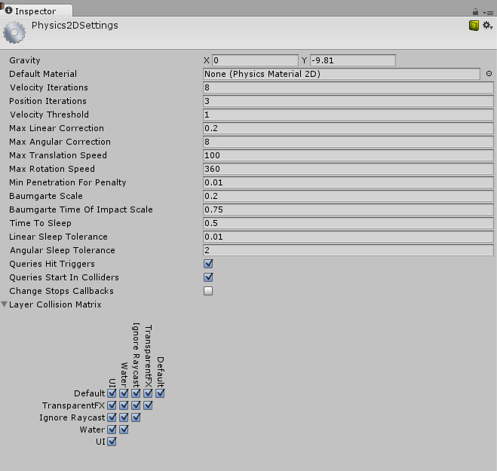
Physics 2D Settings
Edit > Project Settings > Physics 2D

Slide 12
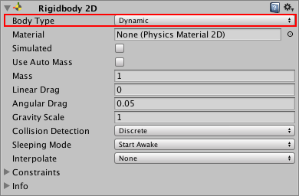

Slide 13
Collision action matrix
 | Static Collider | Rigidbody Collider | Kinematic Rigidbody Collider | Static Trigger Collider | Rigidbody Trigger Collider | Kinematic Rigidbody Trigger Collider
Static Collider |  | Y
Rigidbody Collider | Y | Y | Y
Kinematic Rigidbody Collider |  | Y

Slide 14
 | Static Collider | Rigidbody Collider | Kinematic Rigidbody Collider | Static Trigger Collider | Rigidbody Trigger Collider | Kinematic Rigidbody Trigger Collider
Static Collider |  |  |  |  | Y | Y
Rigidbody Collider |  |  |  | Y | Y | Y
Kinematic Rigidbody Collider |  |  |  | Y | Y | Y
Static Trigger Collider |  | Y | Y |  | Y | Y
Rigidbody Trigger Collider | Y | Y | Y | Y | Y | Y
Kinematic Rigidbody Trigger Collider | Y | Y | Y | Y | Y | Y

Slide 15
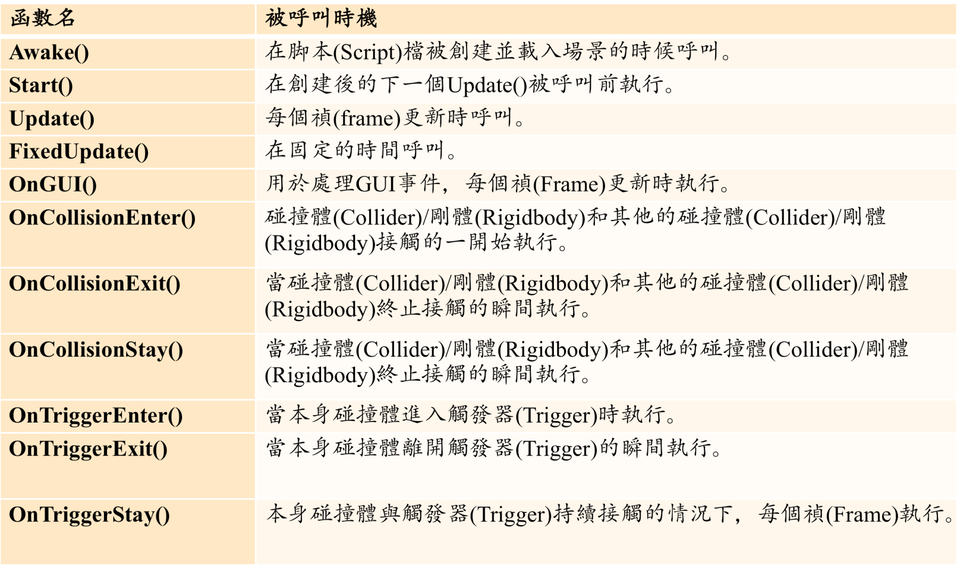
Script-基本函式

Slide 16
Awake VS Start
Awake：遊戲開始後(play鍵以後)，每一個物件在其active的那一刻就會執行這個函式
(有些物件可能一開始不是active的，在其轉變成active狀態的時候會立即執行awake)
Start：物件在其active「後」，遊戲進行的下一偵(frame)前會呼叫此函式
Notes:
便是沒有enable 腳本，Awake函式依然執行了。
Awake的特性讓他很適合用來設定任何腳本間的參考(也就是說在腳本中參考到別的腳本元件)，以及程式的初始化。
Start函式是在Awake之後呼叫，但會在第一個Update呼叫前呼叫。
換句話說，Start()函式呼叫後，會緊接著呼叫第一個Update函式。
所謂的"緊接著"的意思是針對該腳本而言，
事實上當start()執行完後，可能會先執行其他腳本的程式碼，然後再回來執行Update函式。
當然，Start()函式只有在腳本被enable時才會執行。

Slide 17
Update VS FixedUpdate
Update：在遊戲進行的每一禛會執行一次(執行的次數受到電腦實際的速度影響)
FixedUpdate：固定的時間會執行一次，時間可以在Edit→Project settings→Time →Fixed Timestep做更動

Slide 18
Animation

Slide 19
Component, Sprite

Slide 20
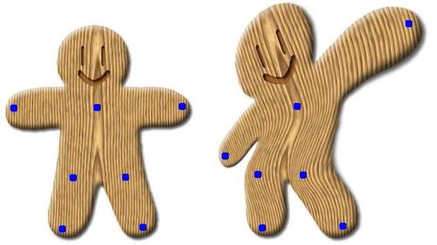

Deformation
As-Rigid-As-Possible Shape Manipulation
Notes:
http://www-ui.is.s.u-tokyo.ac.jp/~takeo/research/rigid/index.html

Slide 21
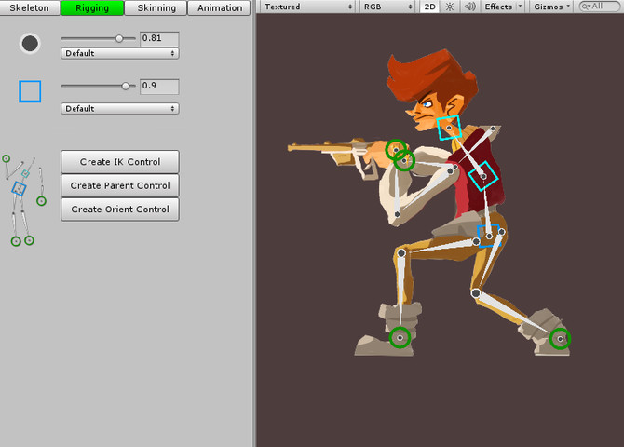
Skeletal animation
Puppet2D
Notes:
Puppet2D

Slide 22


Live2D
Notes:
http://www.live2d.com/ja/

