Slide 1
3D Game Programming
2D game
Ming-Te Chi
Department of Computer Science,
National Chengchi University
Notes:
2019

Slide 2
Outline
2D game history
Coordinate system
Simple 2D game example
Simple 2D game example (OpenGL)
Notes:
將介紹2D經典遊戲的歷史，藉以瞭解遊戲的組成元素
介紹如何由OpenGL製作2D小遊戲

Slide 3
2D Video Game History

Slide 4
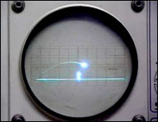
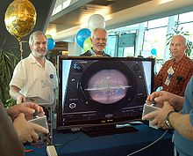
The first video game
Tennis for Two was a game developed in 1958 on an analog computer, which simulates a game of tennis or ping pong on an oscilloscope.
Notes:
The Original Video Game http://www.youtube.com/watch?v=6PG2mdU_i8k

Slide 5
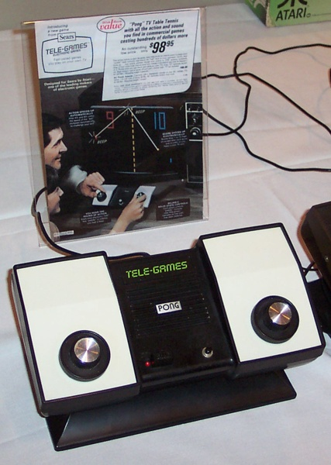
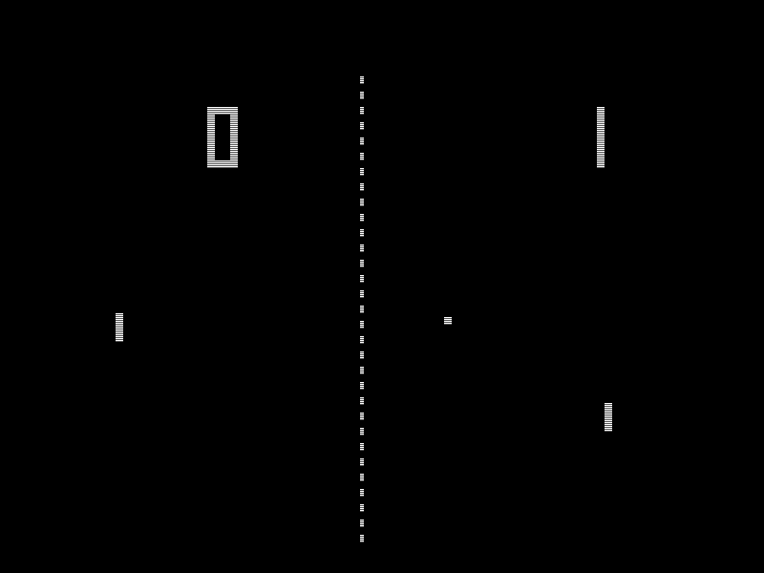
2D GAME
PONG 1972.
  earliest video game
Notes:
Arcade Original Pong http://www.youtube.com/watch?v=LPkUvfL8T1I

Slide 6
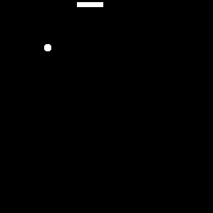
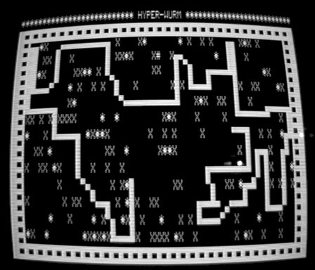
Snake (1970s)
Control a snake to move, and avoid hitting to wall or its growing tail.

Slide 7
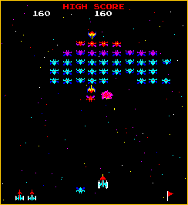
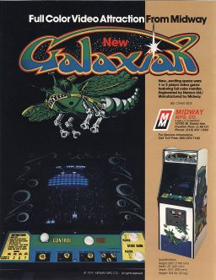
Galaxian (1979 by Namco)
Notes:
小蜜蜂類型的遊戲，
可以看到隨顯示器和硬體的進步，遊戲玩法和畫面的變化，
右邊是當初的海報，可看出其故事性: 迎擊外星侵略者

Slide 8
Basic elements
Elements Tetrads
  Jesse Schell
Aesthetics
Mechanics
Story
Technology
Notes:
Jesse Schell 提出遊戲的組成可以四個的角度去解析。
這四個角度包含機制、技術、故事和美術，每一個向度有其對立和相輔相成的部份。

Slide 9
Mechanics
  the procedures and rules
Story
  the sequence of events that unfolds in your game
Aesthetics
  how your game looks, sounds, tastes, and feels.
Technology
  any materials and interactions that make your game possible

Slide 10
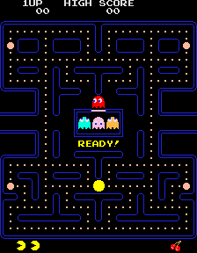
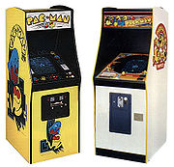
Pac Man 1980 by Namco
Notes:
http://www.google.com/pacman/ google用java script寫的pacman

Slide 11
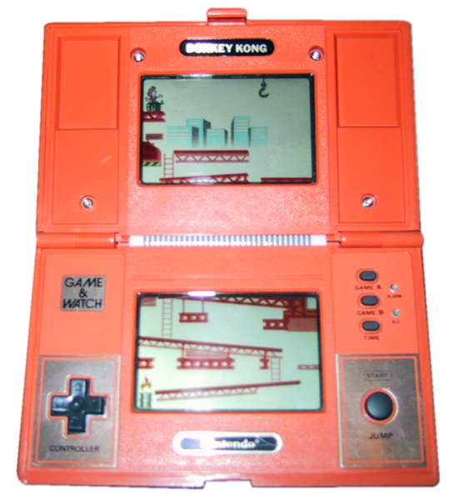
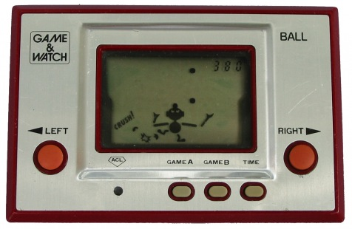
Game & Watch 1980
Game & Watch is a line of handheld electronic games produced by Nintendo from 1980 to 1991.
Ball: the first game & watch game
Notes:
CM http://www.youtube.com/watch?v=oq64s8TmANM

Slide 12
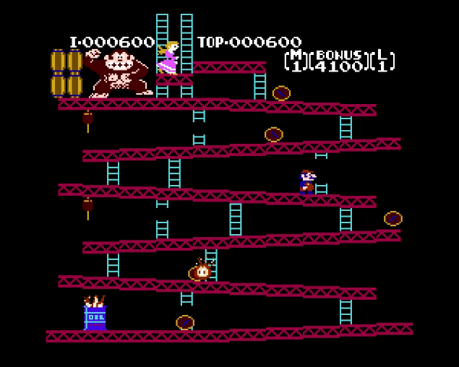
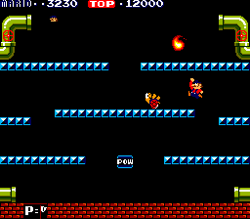
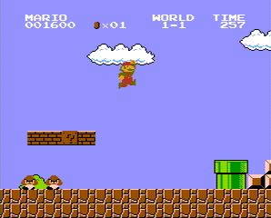
Family Computer(FAMICOM)
Mario series. By Nintendo
Donkey Kong
1981
Mario Bros.
1983
Super Mario Bros.
1985
Notes:
Family Computer(美國: NES)系統限制
48彩色和6灰色的調色盤，
64個sprite以及單一的捲軸
標準解析度256x240 pixel (for NTSC 256x224)

Slide 13
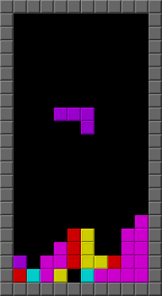
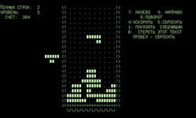
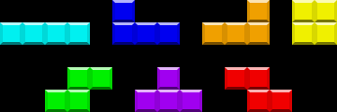
Tetris
Design by 阿列克謝·帕基特諾夫
（Алексей Леонидович Пажитнов）in 1984
Puzzle game
1984 version
Notes:
俄羅斯方塊為益智遊戲的代表之一

Slide 14
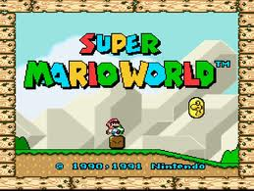
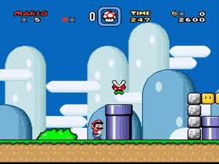
Super Mario World. 1990
Rich color, Parallax scrolling, zoom and rotate sprite.
Notes:
硬體的進步，使得能使用的顏色更多，角色數更多
帶來遊戲的畫面和玩法進步

Slide 15
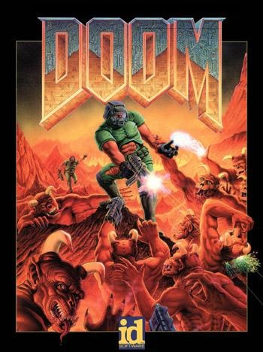
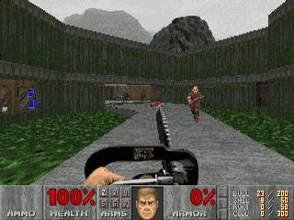
Doom 1993
A landmark 1993 first-person shooter (FPS)video game by id Software.
Notes:
Video games with 2.5D graphics
透過圖片的縮放去模擬出透視的效果，一般歸類到2.5D遊戲

Slide 16
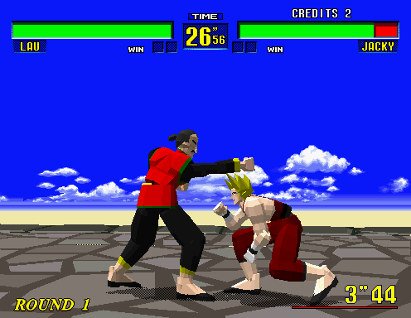
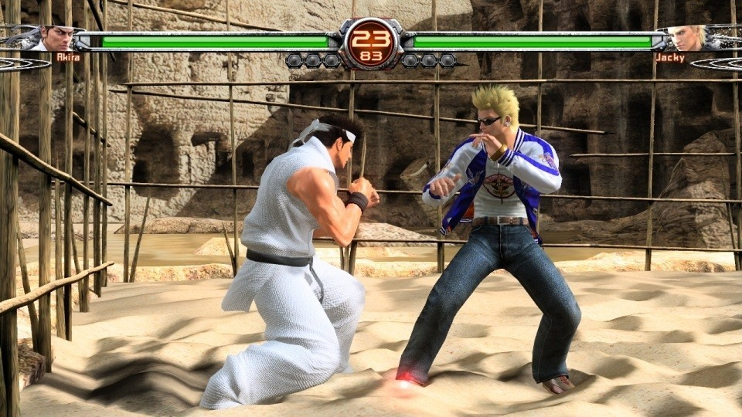
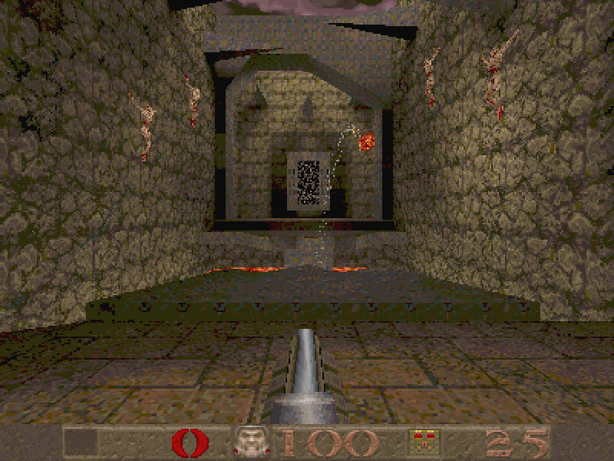
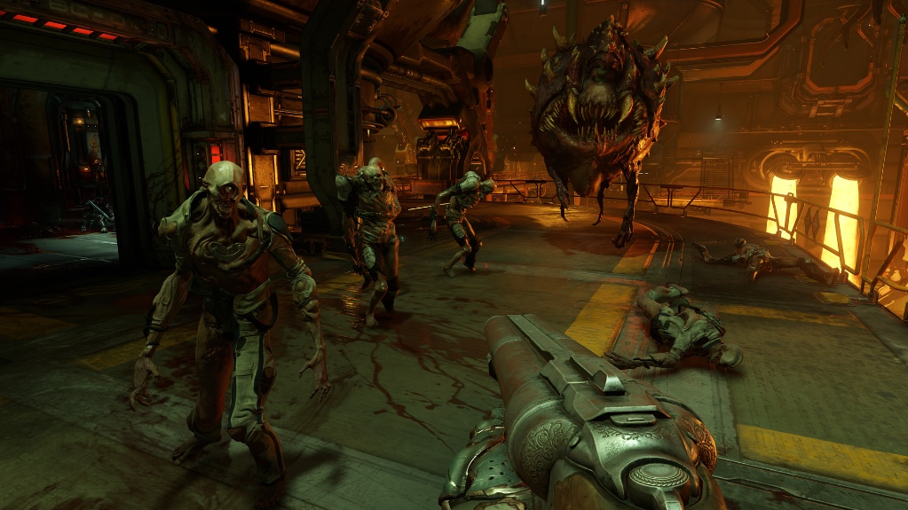
3D Graphics – evolution

Slide 17
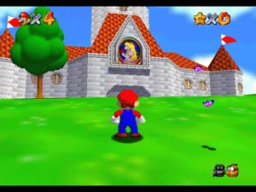
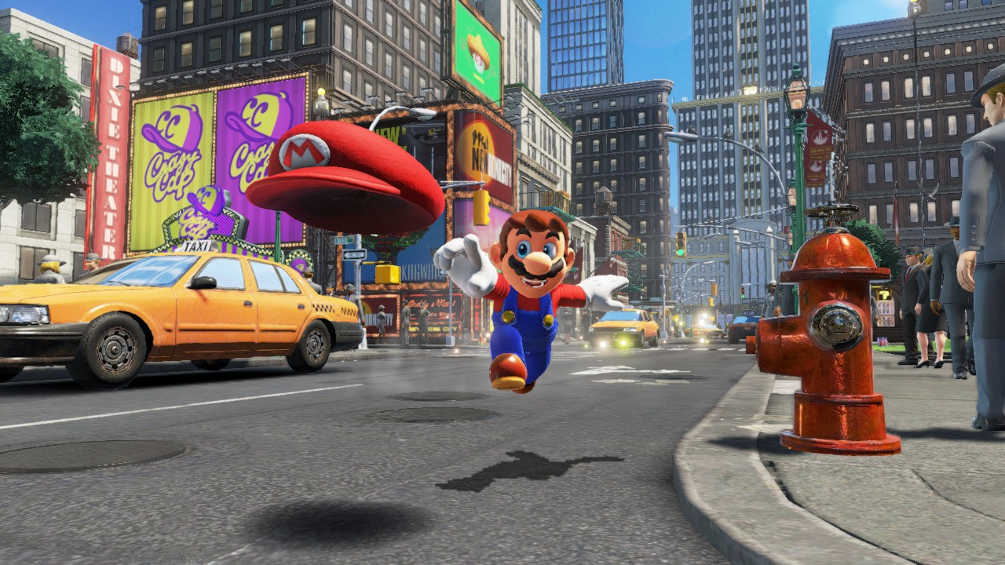
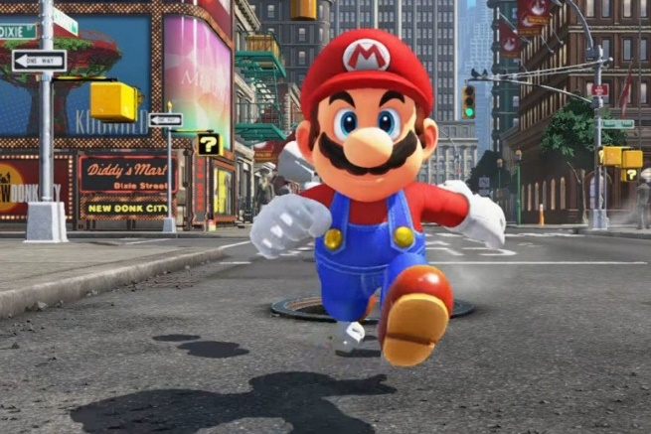
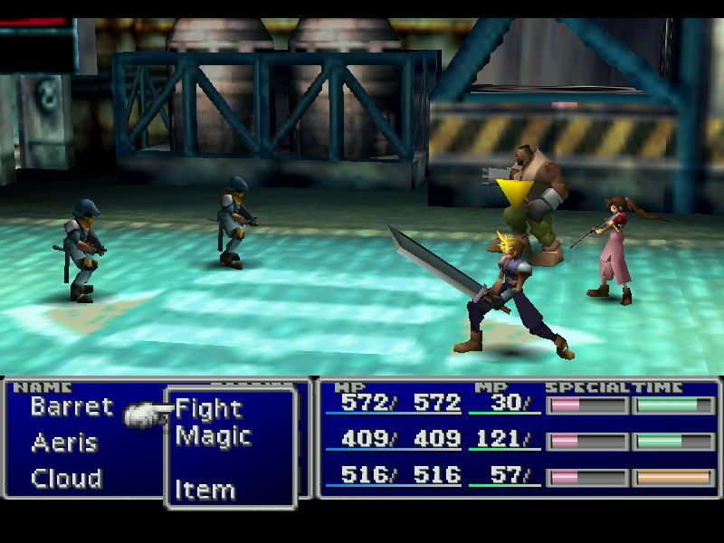
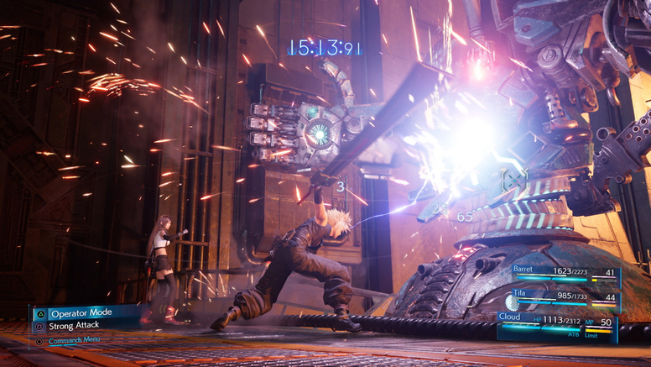
3D Graphics – evolution

Slide 18
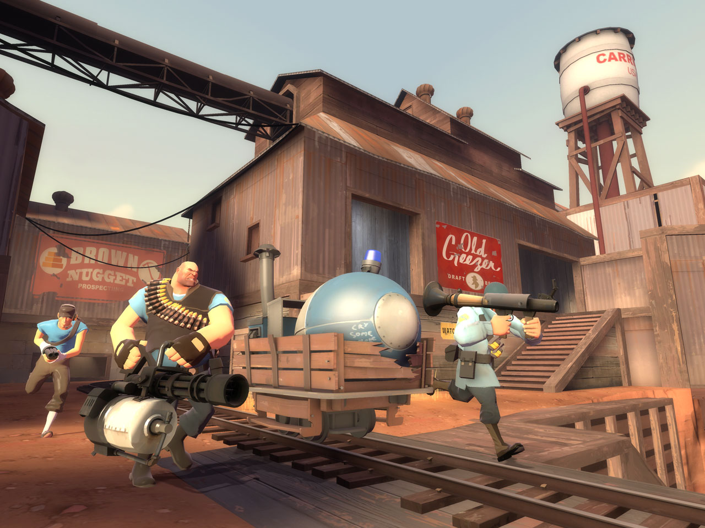
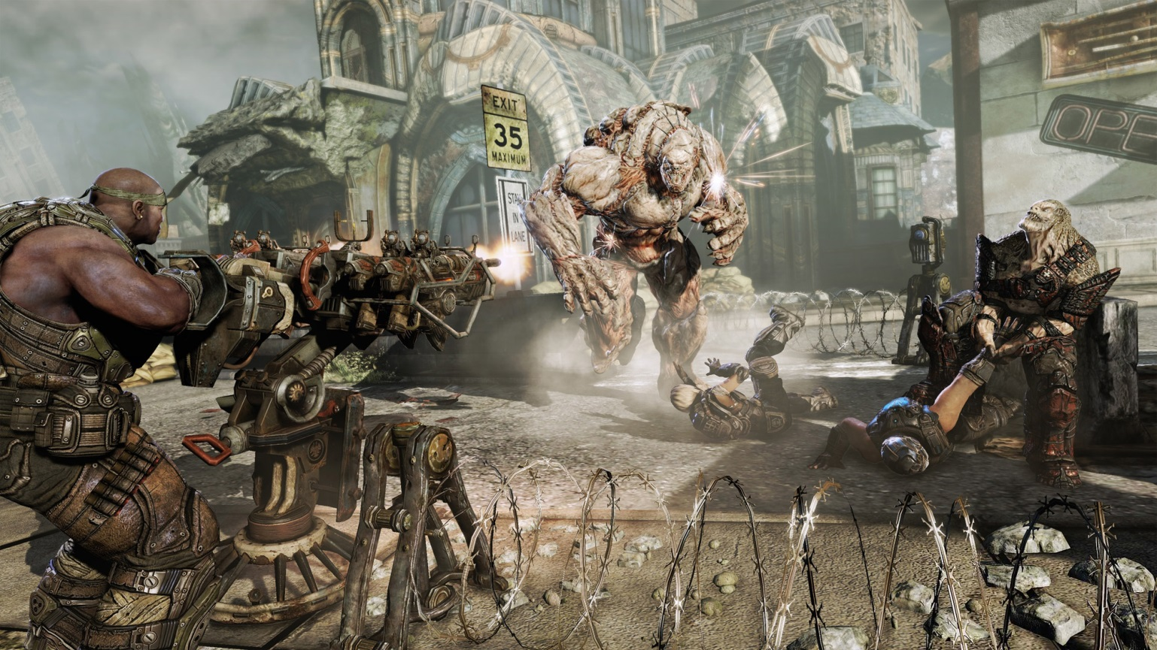
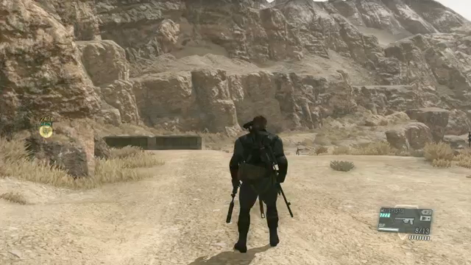
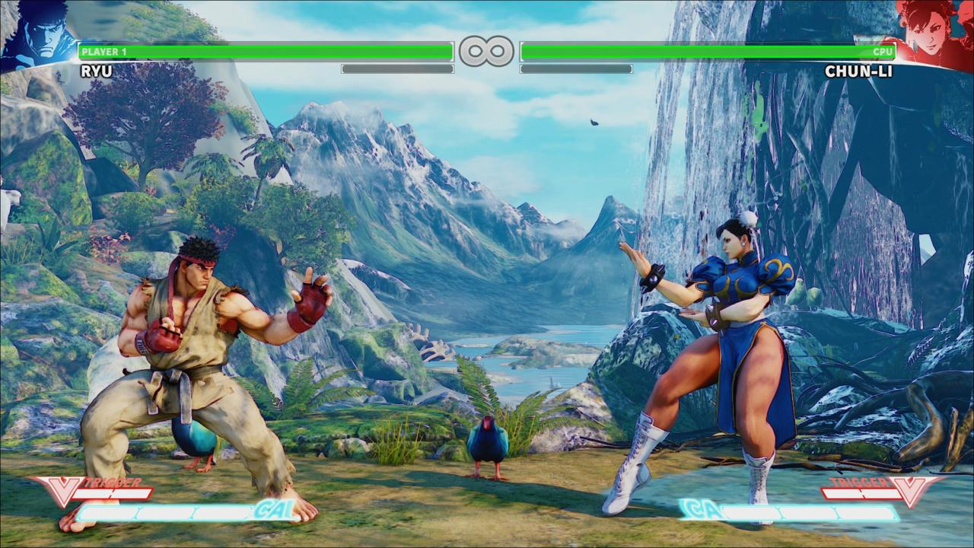
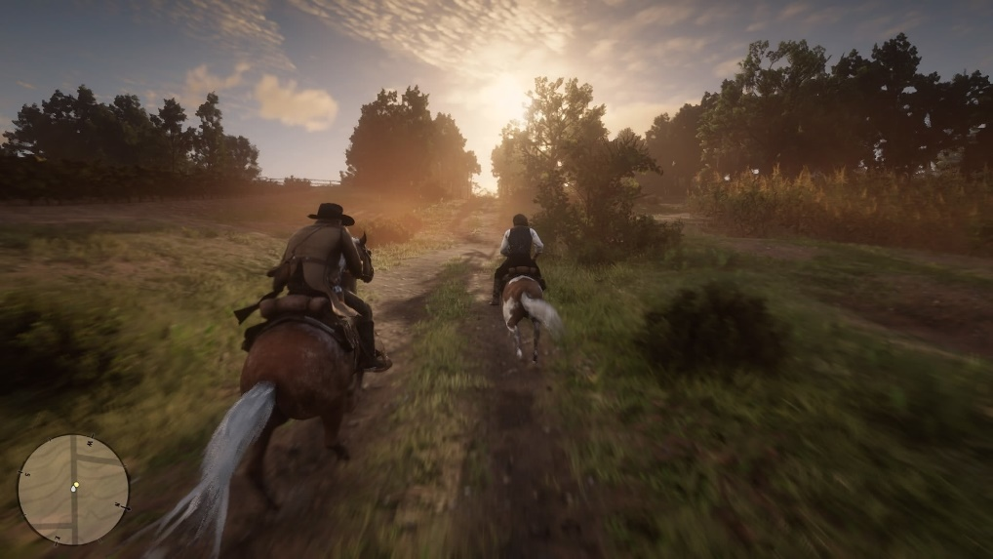
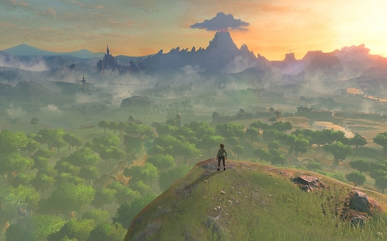
3D Graphics
Notes:
http://www.epicgames.com/
http://www.youtube.com/watch?v=Ky-JUL0SDDs littlebig planet 2

Slide 19

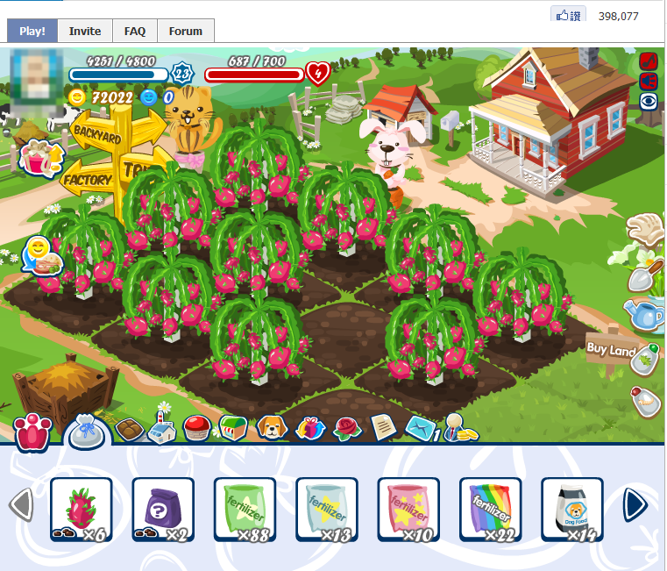
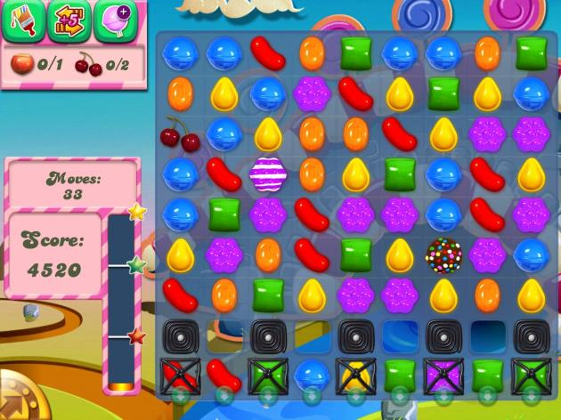
Social game
Happy Farm
Notes:
社群網路的興起，使遊戲可與朋友產生互動，增加遊戲的玩法
http://www.playfish.com/
http://www.zynga.com/

Slide 20
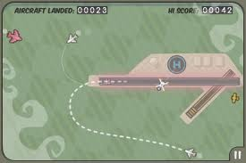
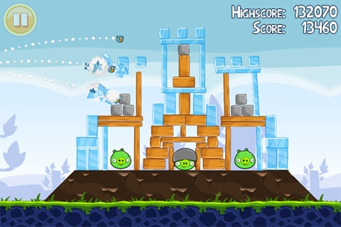
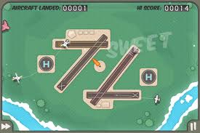
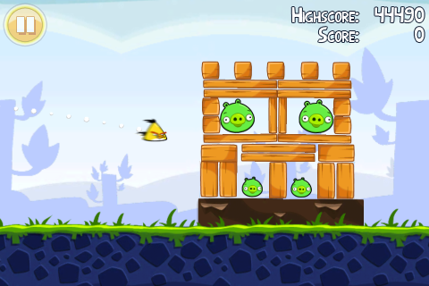
Mobile game – touch
flight control by Firemint
Angry Birds by Rovio
Notes:
Muliti-touch game in mobile device
觸控界面帶來直覺的玩法，
如flight control 畫出降落的規跡引導飛機的降落
像Angry Birds使用手指直接決定彈弓的角度和力度

Slide 21
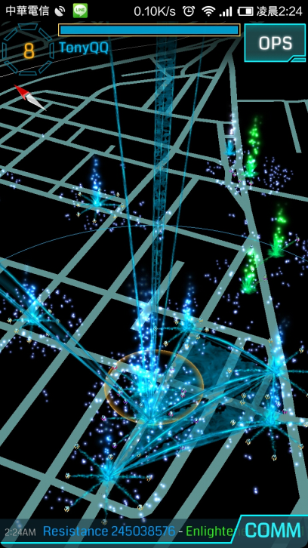

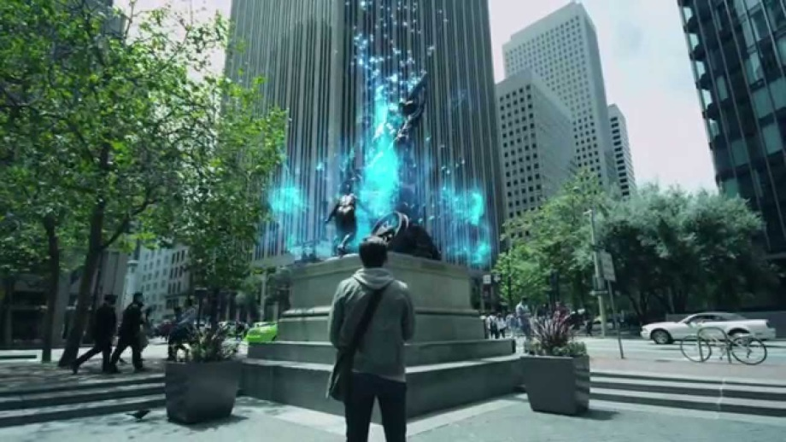
LBS & AR

Slide 22
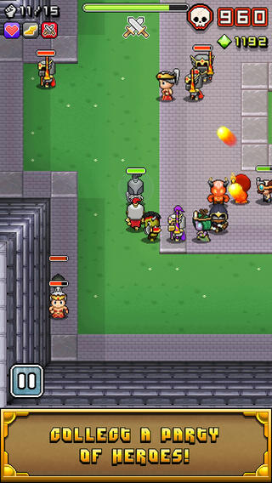
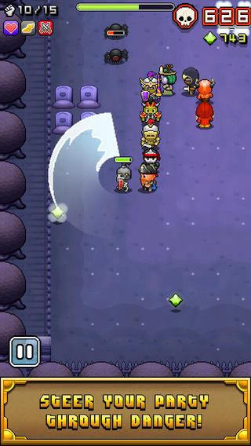
Snake in 2014
Notes:
Nimble Quest Trailer 2013 March
https://www.youtube.com/watch?v=n-QMoe0jzQ8

Slide 23
2D Basic comcept

Slide 24
Cartesian Plane
+y
(4, 3)
(0, 0)
+x
(-3, -2)
+z
Notes:
對於物體位置，採用迪卡爾座標系統描述，以垂直正交的座標軸定義出每個頂點所在的座標位置(x, y)

Slide 25
Coordinate Clipping
+y
(150, 100)
(75, 50)
(0, 0)
+x
(-75, -50)
Notes:
對於3D空間的可視範圍，我們可以定義出所謂的Clipping空間，如紅色虛線框出的立方體
繪圖硬體可根據clipping空間，略過空間外的不可見的物件，用來加速

Slide 26
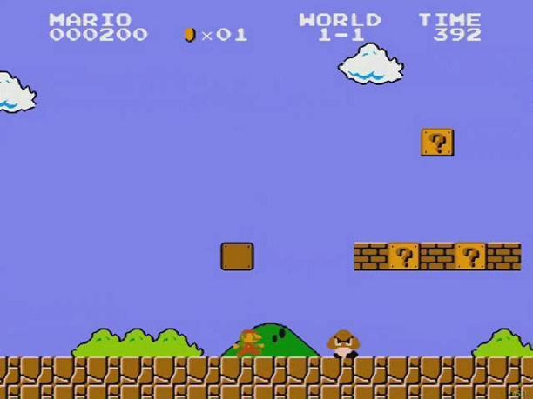
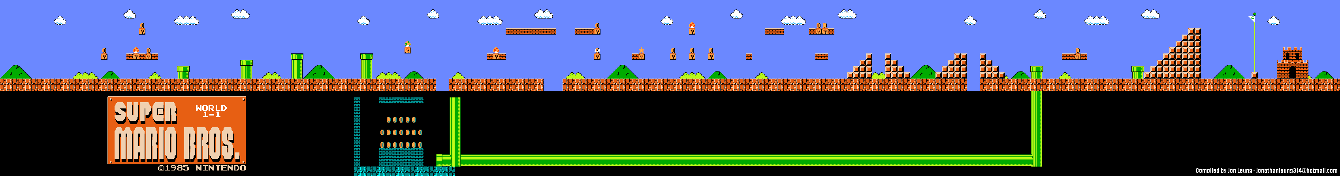
Game World
Super Mario Bros. Nintendo

Slide 27
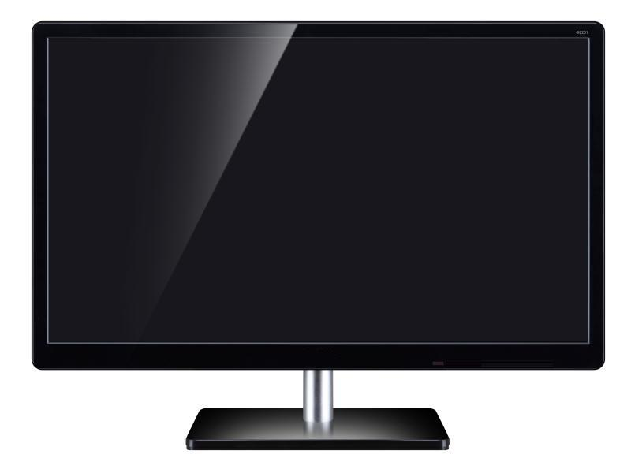
Viewport
Mapping drawing coordinates to windows coordinates
+y
(0, 0)
+x
clipping space
Window space
Notes:
Viewport則是在螢幕(或視窗的顯示範圍)，設定一塊區域，與clipping space做對應
OpenGL中可以指定多個viewport轉換，使同一個視窗畫面呈現不同角度或不同場景的畫面

Slide 28


Projection
Getting 3D to 2D
  Orthographic projections
  Perspective projections
Notes:
投影則是將3D物體從world space投影轉換到image space的過程，常用的有正交投影和透視投影
這幾個名詞，還會在05-Transformation和06-Projection做詳細的介紹

Slide 29

Representing Visuals
3D objects
  Mesh: geometry
  Materials
  Texture maps
Lighting
Shader

Slide 30
2D game

Slide 31
What is a Game?
Games are an exercise of voluntary control systems, in which there is a contest between powers, confined by rules in order to produce a disequilibrial outcome.
– Elliot Avedon and Brian Sutton-Smith
Notes:
遊戲心理學家Brian Sutton-Smith

Slide 32
Game architecture
Asset Management
Game Loop
I/O System
loading
saving
caching
Start()
Update(delta)
Display(delta)
Keyboard, mouse
audio
storage
Notes:
遊戲的架構
遊戲事件的迴圈: 在初始化後，每一個畫格(時間間隔)，更新物間的狀態之後，再將之繪製在畫面上
輸入輸出系統: 管理玩家的輸入，畫面聲音的輸出
資產(asset)管理: 遊戲物件(3D模型、聲音檔)的資源管理

Slide 33
A simple example
A character has three states: stand, walk, and jump
Use “A” and “D”key to move the character
When press “space”, the character will jump, and the score will increase by 1.
Notes:
簡單的遊戲
-單一角色有三個狀態：站立、走路和跳
-利用左或右鍵的輸入移動角色
-按下j 角色會跳躍，並且會增加score變數1

Slide 34
State
Position, Direction, Gamescore
Jump
Press “space” to trigger jump()
Press “space” to trigger jump()
Stand
Walk
Press
“A” or “D”
Notes:
先決定角色的狀態，以及對應不同輸入產生的狀態變化

Slide 35


Slide 36
Debug & moving
// Use this for initialization
void Start () {
Debug.Log("Hello, start!!");
}
// Update is called once per frame
void Update () {
this.transform.position += new Vector3(1, 0, 0);
}

Slide 37
Control speed
float speed = 20;
// Use this for initialization
void Start () {
Debug.Log("Hello, start!!");
}
// Update is called once per frame
void Update () {
this.transform.position += new Vector3(speed*Time.deltaTime, 0, 0);
}
Notes:
Time.deltaTime: The completion time in seconds since the last frame (Read Only).
https://docs.unity3d.com/ScriptReference/Time-deltaTime.html

Slide 38
Walking
void Update () {
if (Input.GetKey(KeyCode.D))
{
this.transform.position += new Vector3(speed*Time.deltaTime, 0, 0);
}
…
}

Slide 39
Jump
float dis = speed * Time.deltaTime;
if (JumpCount >= 0)
{
if(JumpCount < 20)
{
this.transform.position += new Vector3(0, dis, 0);
}
else
{
this.transform.position += new Vector3(0, -dis, 0);
}
JumpCount++;
if (JumpCount>39)
{
IsJump = false;
JumpCount = -1;
}
}
bool IsJump = false;
int JumpCount = -1;
void Update () {
if(Input.GetKey(KeyCode.Space))
{
if(!IsJump)
{
IsJump = true;
JumpCount = 0;
}
}
….
}

Slide 40
Sprite switch
public Sprite[] sprites;
int sprites_index = 0;
// Update is called once per frame
void Update () {
if (Input.GetKey(KeyCode.D))
{
this.transform.position += new Vector3(speed * Time.deltaTime, 0, 0);
int i = (++sprites_index)%2;
this.GetComponent<SpriteRenderer>().sprite = sprites[i];
}
}

Slide 41
Art challenges technology;
technology inspires the art.
- John Lasseter
Notes:
John Lasseter 曾是pixar這家動畫公司的首席創意長，主要是負責美術和動畫創意
Pixar是創作出玩具總動員等長篇電腦動畫的公司，pixar他們嘗試結合工程技術和藝術創造
在他的觀察下，發現，往往工程師熟知技術的極限，因此創造力會較為受限，但是藝術家的創意往往可以挑戰工程上的可能性
另外工程上的突破，也往往激發出藝術上的交流
遊戲的製作往往也如此，由於是跨領域的合作，往往可以激蕩出更多的火花

Slide 42
OpenGL 2D

Slide 43
Glut and game loop
Asset Management
Game Loop
I/O System
Loading & saving
Start()
Update(delta)
Display(delta)
Keyboard, mouse
audio
storage
main()
{
initglut()
init();
RegisterCallback()
update(0);
glutMainLoop()
}
update(int i){
//update state
glutTimerFunc(delta, update, ++i);
glutPostRedisplay();
}
display() {
//draw something
}
keyboard(key) {
switch(key) {
case ’j’:
jump()
break;
}
}
Notes:
將遊戲的架構對應到GLUT的程式架構

Slide 44
class RGBApixmap
RGBApixmap pic;
pic.readBMPFile(“stand.bmp”);
pic.setChromaKey(232, 248, 248);
// draw
pic.blendtex(picX, picY, 1.0, 1.0);
Notes:
RGBpixmap.h in lab2
//alternative draw
glPixelZoom(1.0, 1.0);
glWindowPos2i(picX, picY);
pic.blend();

Slide 45



State and Image
Jump
Stand
Walk
Notes:
設定對應的影像

Slide 46

State
int whichpPic;

Slide 47
Change State
void SpecialKeys(int key, int x, int y)
{
switch(key) {
case GLUT_KEY_LEFT:
picX -= 5;
if (whichPic==0)
whichPic=1;
else
whichPic=0;
DirectState=1; //left
break;
case GLUT_KEY_RIGHT:
picX += 5;
if (whichPic==0)
whichPic=1;
else
whichPic=0;
DirectState=0; //right
break;
}
}
void display() {
…
if (DirectState==0) { //向右
pic[whichPic].blendTex(picX, picY, 1, 1);
} else { //向左
int offset = pic[whichPic].nCols; //圖的寬度
pic[whichPic].blendTex(picX+offset, picY, -1, 1);
//調整x位置，並以x=0為軸翻轉影像
}
…
}

Slide 48
Font rendering
//Font
char mss[30];
sprintf(mss, "Score %d", Gamescore);
glColor3f(1.0, 0.0, 0.0); //set font color
glRasterPos2i(10, 550); //set font start position
void * font = GLUT_BITMAP_9_BY_15;
for(int i=0; i<strlen(mss); i++) {
glutBitmapCharacter(font, mss[i]);
}
Notes:
這段程式碼 可將Gamescore變數所儲存的分數資訊，以bitmap的方式繪在 (10, 550)的位置
需放在display()內

Slide 49
Press Space to Trigger jump()
void myKeys(unsigned char key, int x, int y)
{
switch(key)
{
case ‘ ': if(jumpState==0) {
jumpState=1;
Gamescore++;
jump(0);
}
break;
}
glutPostRedisplay();
}
Notes:
透過鍵盤的輸入 按下space (char 空白鍵 ) 產生對應的動作，並更新Gamescore的變數
這樣可以實作出加分的機制

Slide 50
Jump motion
void jump(int i)
{
whichPic=2; //switch state
if(i<=10) {
if (i<5) picY+=4;
else picY-=4;
i++;
glutTimerFunc( 100, jump, i);
}else {
whichPic=0;
jumpState=0;
}
glutPostRedisplay();
}
picY
0
5
i
Notes:
Jump 是我們設定的TimerFunction
藉此更新角色的位置PicY
並呼叫glutPostRedisplay(); 更新畫面

