Slide 1
3D Game Programming Texture Mapping
Ming-Te Chi
Department of Computer Science,
National Chengchi University
Notes:
2018

Slide 2
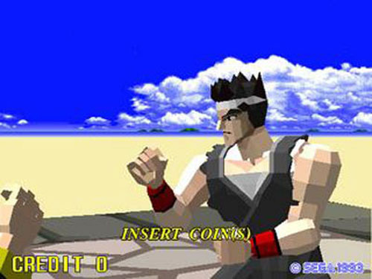
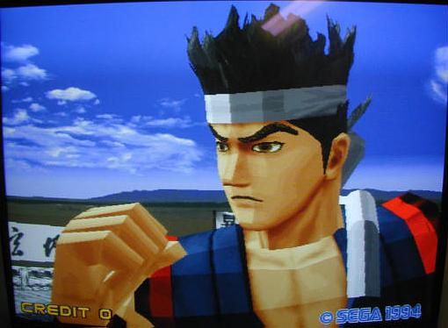

Slide 3
Outline
Texture Mapping: The Basics
Mapping textures to geometry
Change the texture environment
texture mapping parameter
mipmaps

Slide 4
Basic Stragegy
Three steps to applying a texture
specify the texture
read or generate image
assign to texture
enable texturing
assign texture coordinates to vertices
Proper mapping function is left to application
specify texture parameters
wrapping, filtering

Slide 5
Texture Mapping
y
z
x
geometry
display
t
image
s

Slide 6
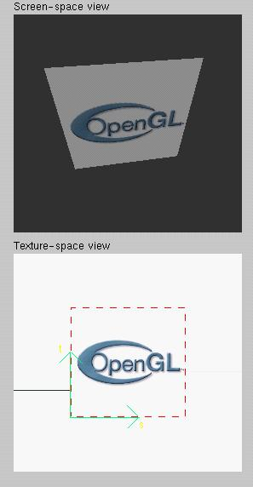
Texture Example
The texture (below) is a 256 x 256 image that has been mapped to a rectangular polygon which is viewed in perspective

Slide 7
Texture Mapping and the OpenGL Pipeline
Images and geometry flow through separate pipelines that join during fragment processing
“complex” textures do not affect geometric complexity
vertices
geometry pipeline
Fragment processor
image
pixel pipeline

Slide 8
Specifying a Texture Image
Define a texture image from an array of texels (texture elements) in CPU memory
Glubyte my_texels[512][512][3]; //3:rgb
Define as any other pixel map
Scanned image
Generate by application code
Enable texture mapping
glEnable(GL_TEXTURE_2D)
OpenGL supports 1-4 dimensional texture maps

Slide 9
Define Image as a Texture
glTexImage2D( target, level, components, w, h, border, format, type, texels );
target: type of texture, e.g. GL_TEXTURE_2D
level: used for mipmapping (discussed later)
components: elements per texel
w, h: width and height of texels in pixels
border: used for smoothing (discussed later)
format and type: describe texels
texels: pointer to texel array
glTexImage2D(GL_TEXTURE_2D, 0, 3, 512, 512, 0, GL_RGB, GL_UNSIGNED_BYTE, my_texels);

Slide 10
Typical Usage
glTexImage2D(GL_TEXTURE_2D, 0, 3, 512, 512, 0, GL_RGB, GL_UNSIGNED_BYTE, my_texels);
target: GL_TEXTURE_2D
level: no mipmapping
components: R, G, B
w, h: 512 X 512
border: no border
format and type: GL_RGB and unsigned byte (0~255)
texels: actual data!

Slide 11
Converting A Texture Image
OpenGL requires texture dimensions to be powers of 2. (Note: after OpenGL 2.0, texture dimensions can be non-power-of two.)
If dimensions of image are not powers of 2
gluScaleImage( format, w_in, h_in, type_in, *data_in, w_out, h_out, type_out, *data_out );
data_in is source image
data_out is for destination image
Image interpolated and filtered during scaling

Slide 12
Mapping a Texture
t
s

Slide 13
Mapping a Texture
t
s

Slide 14
Mapping a Texture
Based on parametric texture coordinates
glTexCoord*() specified at each vertex
t
1, 1
(s, t) = (0.2, 0.8)
0, 1
A
a
c
(0.4, 0.2)
b
B
C
0, 0
1, 0
s
(0.8, 0.4)
Texture Space
Object Space

Slide 15
Load texture
// Load texture
GLbyte *pBytes;
glPixelStorei(GL_UNPACK_ALIGNMENT, 1);
pBytes = gltLoadTGA("Stone.tga", &iWidth, &iHeight, &iComponents, &eFormat);
glTexImage2D(GL_TEXTURE_2D, 0, iComponents, iWidth, iHeight, 0, eFormat, GL_UNSIGNED_BYTE, pBytes);
free(pBytes);
Notes:
TGA 格式可詳見 http://en.wikipedia.org/wiki/Truevision_TGA 的說明
Texture可從多種影像格式匯入，之前2D遊戲範例所利用的bmp格式也可用來讀入貼圖

Slide 16
Typical Code
glBegin(GL_TRIANGLES);
glColor3f(1.0f, 1.0f, 1.0f); //if no shading used
glNormal3f(0.0f, -1.0f, 0.0f); // if shading used
glTexCoord2f(1.0f, 1.0f);
glVertex3fv(vCorners[2]);
glTexCoord2f(0.0f, 0.0f);
glVertex3fv(vCorners[4]);
glTexCoord2f(0.0f, 1.0f);
glVertex3fv(vCorners[1]);
glEnd();
Note that we can use vertex arrays to increase efficiency

Slide 17
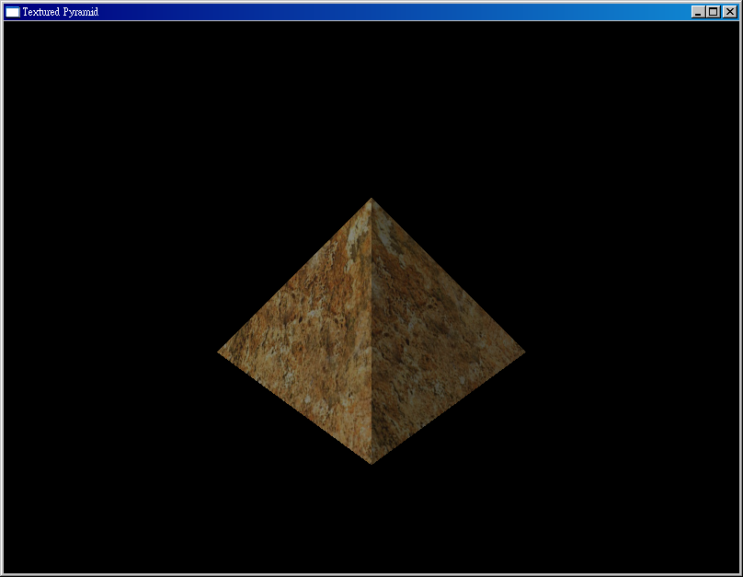
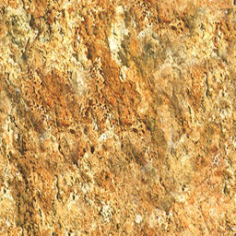
Texture image

Slide 18
Texture Parameter
Texture Parameter

Slide 19
Interpolation
OpenGL uses interpolation to find proper texels from specified texture coordinates
Can be distortions
texture stretched
over trapezoid
showing effects of
bilinear interpolation
good selection
of tex coordinates
poor selection
of tex coordinates

Slide 20
Texture Parameters
OpenGL has a variety of parameters that determine how texture is applied
Wrapping parameters determine what happens if s and t are outside the (0,1) range
Filter modes allow us to use area averaging instead of point samples
Mipmapping allows us to use textures at multiple resolutions
Environment parameters determine how texture mapping interacts with shading

Slide 21
Wrapping Mode
Clamping: if s,t > 1 use 1, if s,t <0 use 0
Wrapping: use s,t modulo 1
glTexParameteri( GL_TEXTURE_2D, GL_TEXTURE_WRAP_S, GL_CLAMP )
glTexParameteri( GL_TEXTURE_2D, GL_TEXTURE_WRAP_T, GL_REPEAT )
t
s
GL_REPEAT
wrapping
GL_CLAMP
wrapping
texture

Slide 22
Magnification and Minification
Texture
Polygon
Texture
Polygon
Magnification
Minification
more than one pixel can cover a texel (magnification)
Can use point sampling (nearest texel)
More than one texel can cover a pixel (minification)
linear filtering
( 2 x 2 filter) to obtain texture values

Slide 23
Filter Modes
Modes determined by
glTexParameteri( target, type, mode )
glTexParameteri(GL_TEXTURE_2D, GL_TEXURE_MAG_FILTER, GL_NEAREST);
glTexParameteri(GL_TEXTURE_2D, GL_TEXURE_MIN_FILTER, GL_LINEAR);
Note that linear filtering requires a border of an
extra texel for filtering at edges (border = 1)

Slide 24
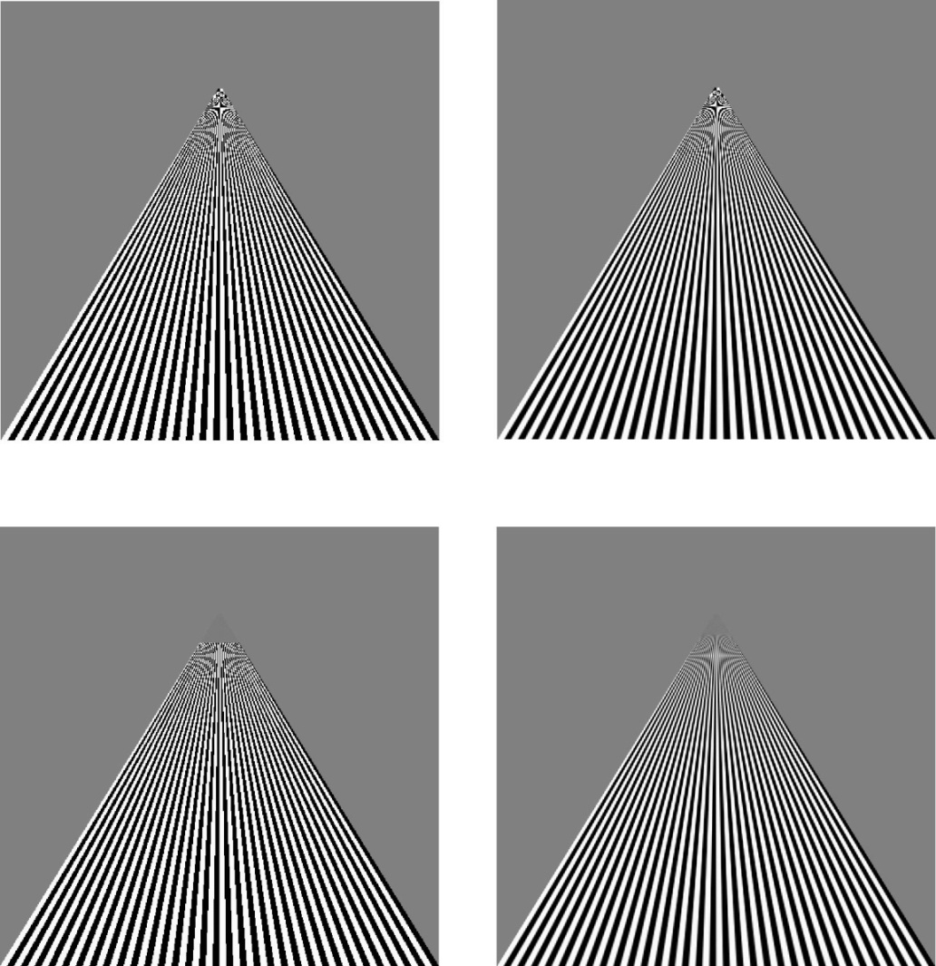
Example
point
sampling
linear
filtering
mipmapped point
sampling
mipmapped
linear
filtering

Slide 25
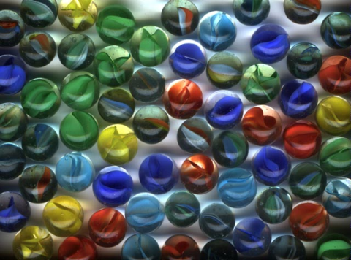
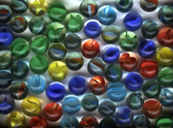
Multiple level of Detail
Mipmaps – many things in a small place

Slide 26
Mipmapped Textures
Mipmapping allows for prefiltered texture maps of decreasing resolutions
Lessens interpolation errors for smaller textured objects
Declare mipmap level during texture definition
glTexImage2D( GL_TEXTURE_*D, level, … )
GLU mipmap builder routines will build all the textures from a given image
gluBuild*DMipmaps( … )

Slide 27
Cartoons with texture
//Set 1D Texture image for toonmap
GLbyte toonTable[4][3] = { { 0, 32, 0 }, { 0, 64, 0 },
{ 0, 128, 0 }, { 0, 192, 0 } };
glTexImage1D(GL_TEXTURE_1D, 0, GL_RGB, 4, 0, GL_RGB, GL_UNSIGNED_BYTE, toonTable);
// Texture coordinate is set by intensity of light
glTexCoord1f(m3dDotProduct(vNewLight, vNormal));
glVertex3f(x0*r, y0*r, z);

Slide 28
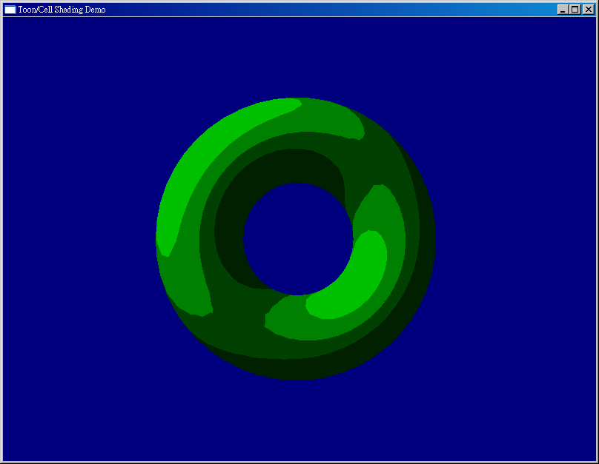
1D Texture

Slide 29
Texture Objects
Texture is part of the OpenGL state
If we have different textures for different objects, OpenGL will be moving large amounts data from processor memory to texture memory
Recent versions of OpenGL have texture objects
one image per texture object
Texture memory can hold multiple texture objects

Slide 30
Applying Textures II
specify textures in texture objects
set texture filter
set texture function
set texture wrap mode
set optional perspective correction hint
bind texture object
enable texturing
supply texture coordinates for vertex
coordinates can also be generated

Slide 31
Managing Multiple textures
#define NUM_TEXTURES 3
GLuint textureObjects[NUM_TEXTURES];
----------------------------------------------------------------------------------
//In init()
int TEXTURE_COUNT = NUM_TEXTURES ;
glGenTextures(TEXTURE_COUNT, textureObjects);
for(iLoop = 0; iLoop < TEXTURE_COUNT; iLoop++)
{
// Bind to next texture object
glBindTexture(GL_TEXTURE_2D, textureObjects[iLoop]);
// Load texture, set filter and wrap modes
pBytes = gltLoadTGA(szTextureFiles[iLoop],&iWidth, &iHeight,
&iComponents, &eFormat);
// Load texture, set filter and wrap modes
gluBuild2DMipmaps(GL_TEXTURE_2D, iComponents, iWidth, iHeight, eFormat, GL_UNSIGNED_BYTE, pBytes);
// Don't need original texture data any more
free(pBytes);
}

Slide 32
// In display()
glBindTexture(GL_TEXTURE_2D, textures[TEXTURE_FLOOR]);
glBegin(GL_QUADS);
glTexCoord2f(0.0f, 0.0f);
glVertex3f(-10.0f, -10.0f, z);
glTexCoord2f(1.0f, 0.0f);
glVertex3f(10.0f, -10.0f, z);
glTexCoord2f(1.0f, 1.0f);
glVertex3f(10.0f, -10.0f, z - 10.0f);
glTexCoord2f(0.0f, 1.0f);
glVertex3f(-10.0f, -10.0f, z - 10.0f);
glEnd();
Notes:
回頭再看obj format 有關於texture coordinate的部份

Slide 33
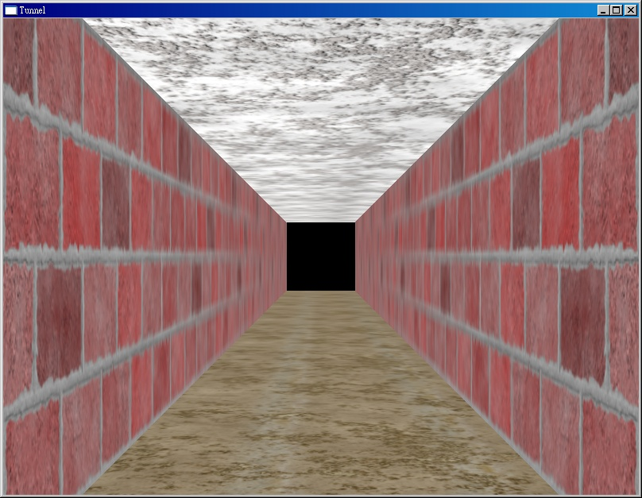
Managing Multiple textures

Slide 34
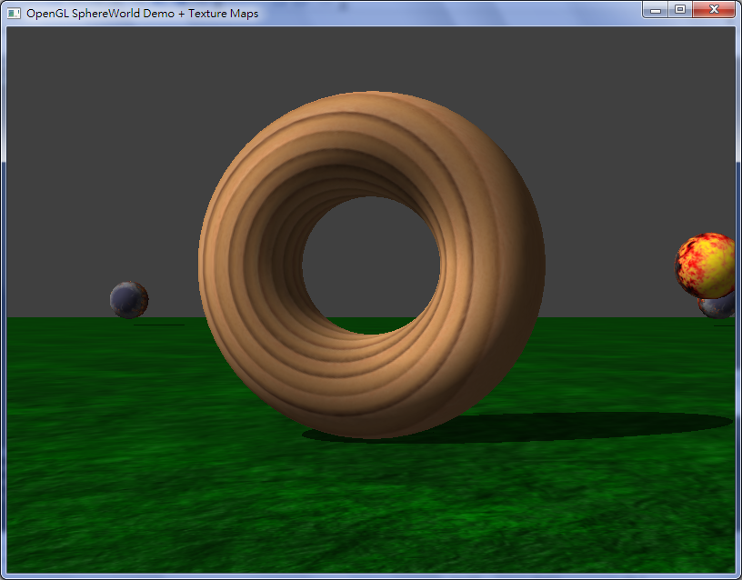
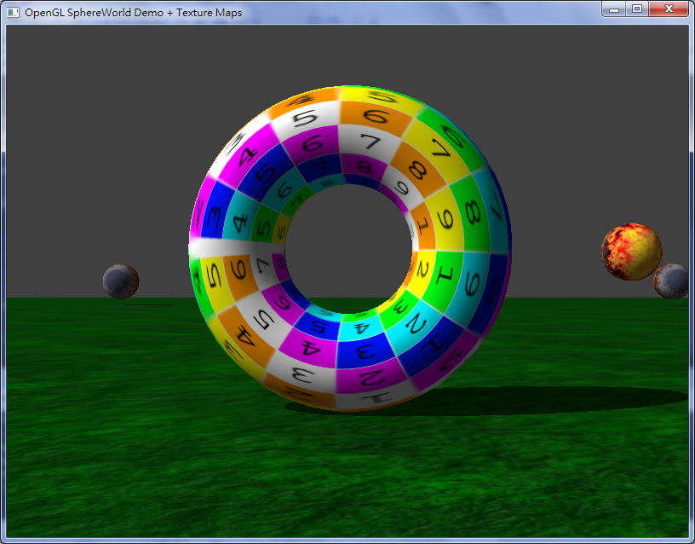
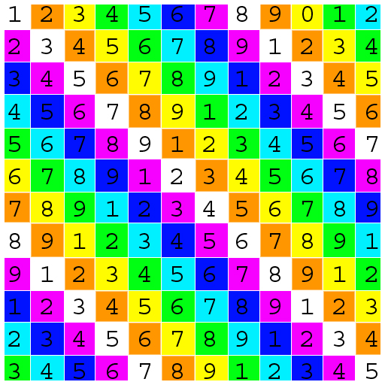
UV mapping

Slide 35
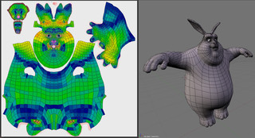
Complex model
Blender uv mapping

Slide 36
Build your TexObject class
Class TexObj {
TexObj(const char *filename);
bindtexture();
private:
Gluint texid;
}
Notes:
OpenGL 提供的是最基本的函式呼叫，請試圖整理相關的功能，讓使用能更方便

Slide 37
Texture Functions
Controls how texture is applied
glTexEnv{fi}[v]( GL_TEXTURE_ENV, prop, param )
GL_TEXTURE_ENV_MODE modes
GL_MODULATE: modulates with computed shade
GL_BLEND: blends with an environmental color
GL_REPLACE: use only texture color
GL_TEXTURE_ENV, GL_TEXTURE_ENV_MODE, GL_MODULATE);
Set blend color with GL_TEXTURE_ENV_COLOR

Slide 38
Perspective Correction Hint
Texture coordinate and color interpolation
either linearly in screen space
or using depth/perspective values (slower)
Noticeable for polygons “on edge”
glHint( GL_PERSPECTIVE_CORRECTION_HINT, hint )
where hint is one of
GL_DONT_CARE
GL_NICEST
GL_FASTEST

Slide 39
Generating Texture Coordinates
OpenGL can generate texture coordinates automatically
glTexGen{ifd}[v]()
specify a plane
generate texture coordinates based upon distance from the plane
generation modes
GL_OBJECT_LINEAR
GL_EYE_LINEAR
GL_SPHERE_MAP (used for environmental maps)

Slide 40
Other Texture Features
Environment Maps
Start with image of environment through a wide angle lens
Can be either a real scanned image or an image created in OpenGL
Use this texture to generate a spherical map
Use automatic texture coordinate generation
Multitexturing
Apply a sequence of textures through cascaded texture units

Slide 41
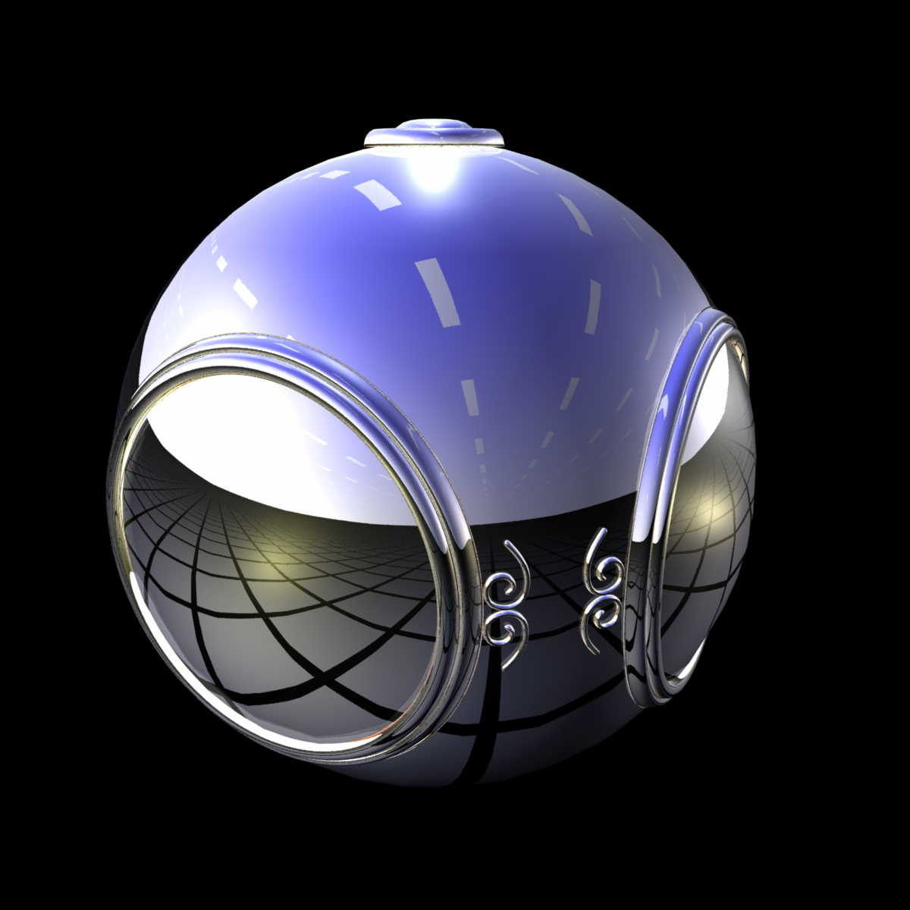
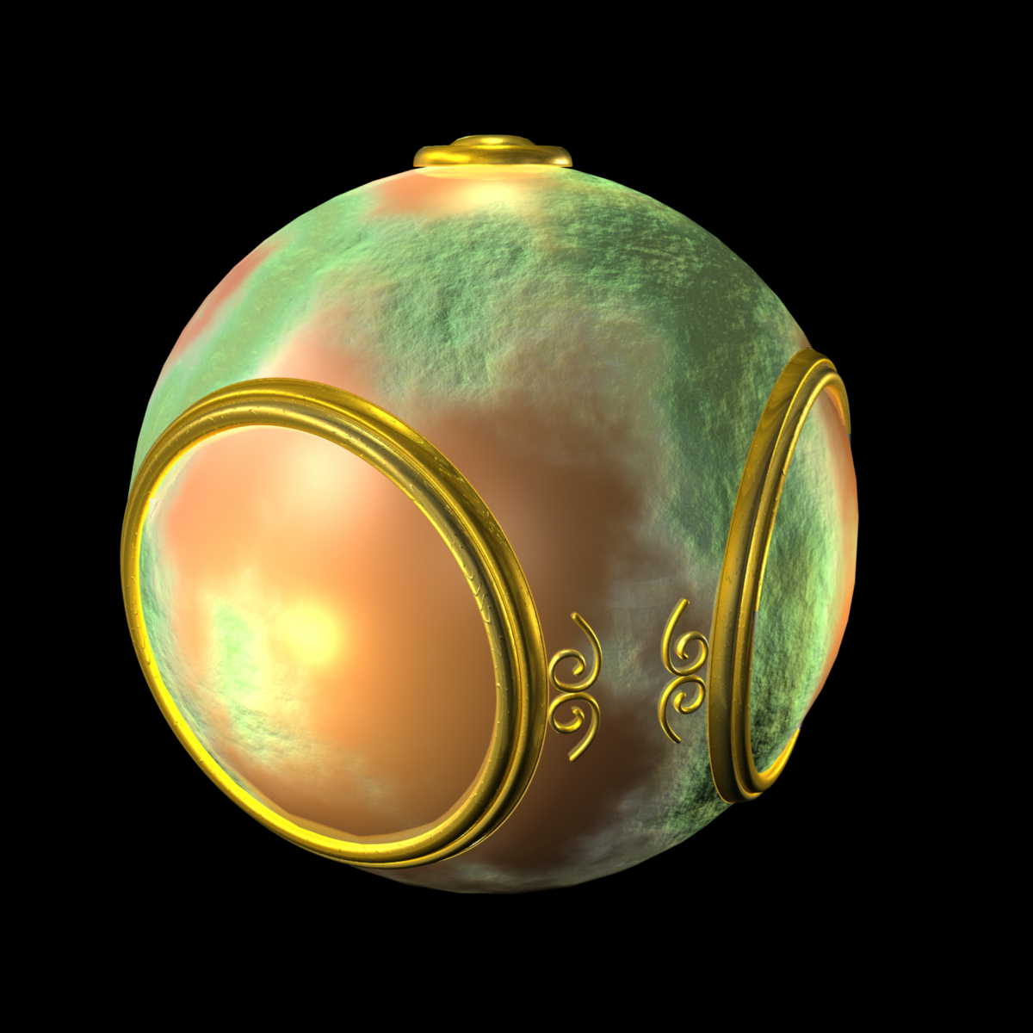
Environment Mapping
Bump Mapping

Slide 42
Standard
Metallic

Slide 43
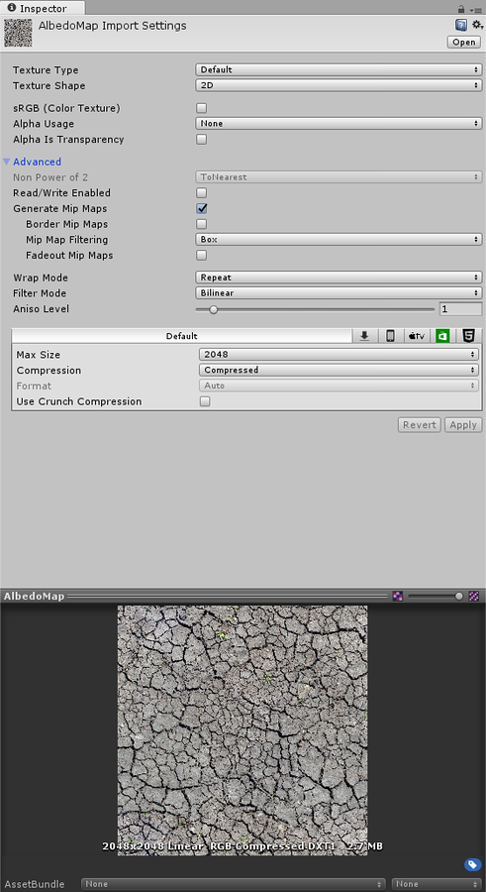
Texture Types
Alpha Source
None
Input Texture Alpha
From Gray Scale
Alpha is Transparency

Slide 44
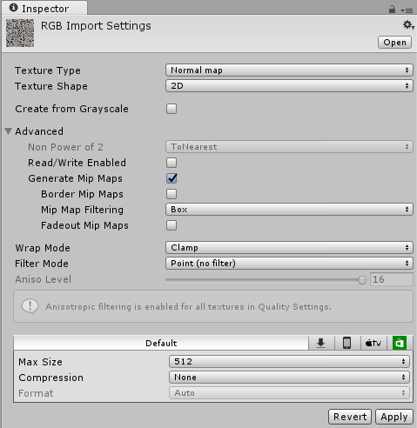
Texture type: Normal Map

