Slide 1
3D Game Programming
3D Primitive
Ming-Te Chi
Department of Computer Science,
National Chengchi University
Notes:
2018

Slide 2
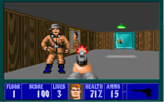


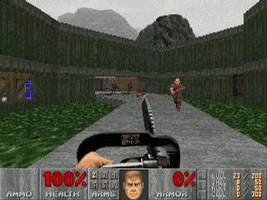
Wolfenstein 3D 1992
Doom 1993
(Top) Wolfenstein 3D
(Bottom) A landmark 1993 first-person shooter (FPS)video game by id Software.
Notes:
Video games with 2.5D graphics
透過圖片的縮放去模擬出透視的效果，一般歸類到2.5D遊戲

Slide 3
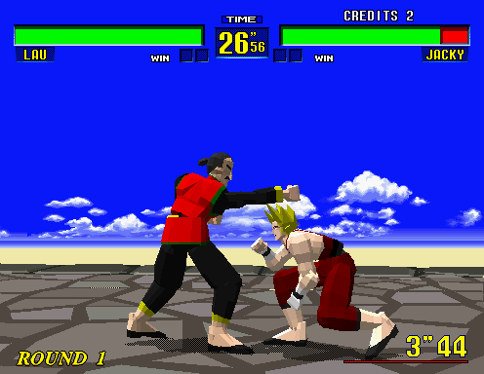
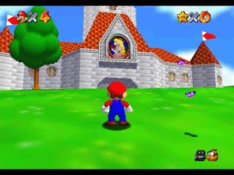
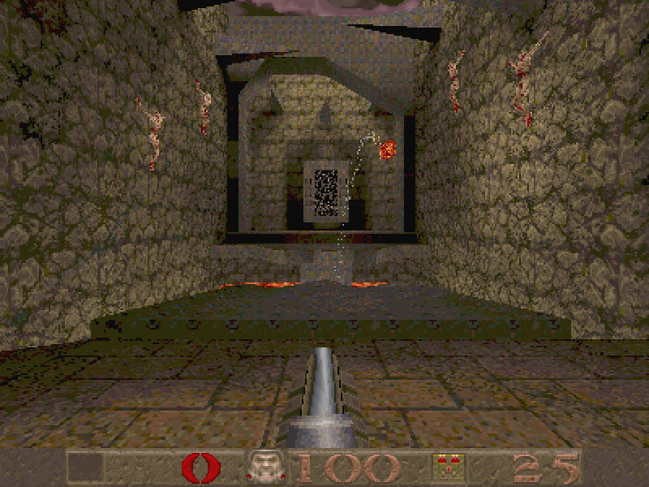
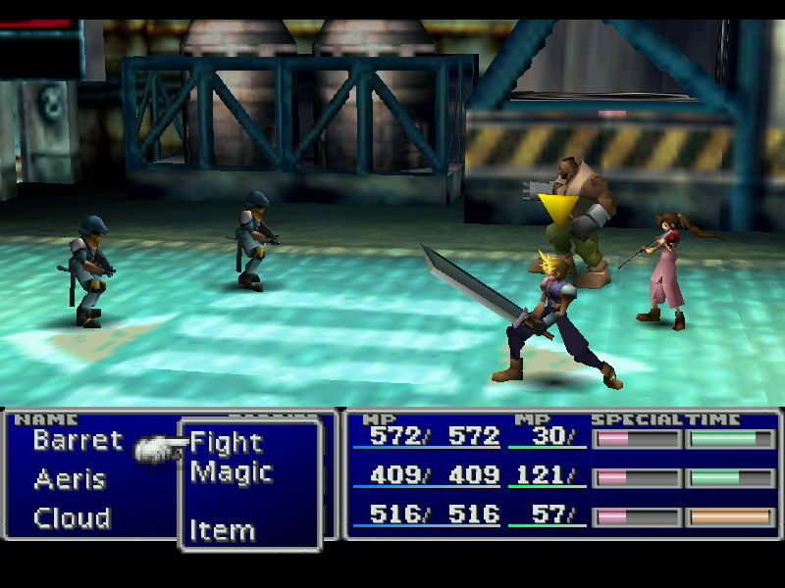
3D Graphics – early stage

Slide 4



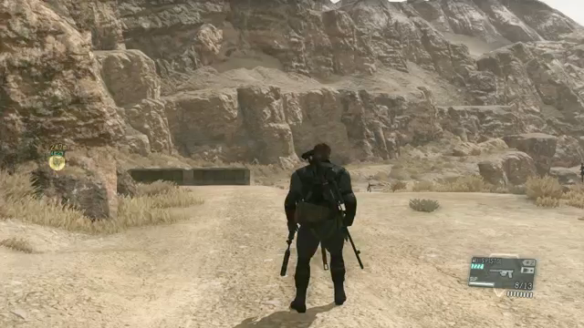
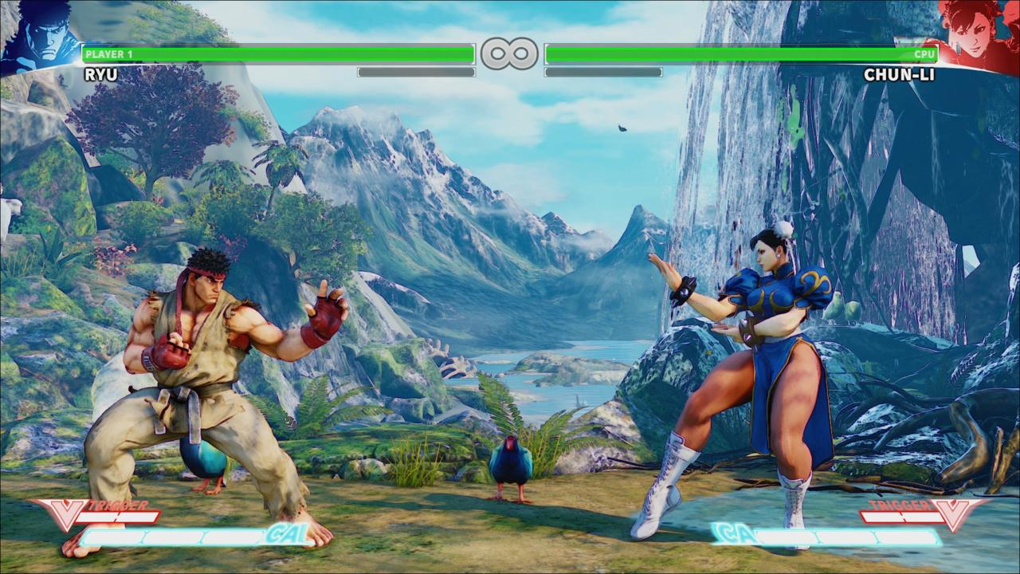
3D Graphics
Notes:
http://www.epicgames.com/
http://www.youtube.com/watch?v=Ky-JUL0SDDs littlebig planet 2

Slide 5
Basic

Slide 6
Cartesian Plane
+y
(4, 3)
(0, 0)
+x
(-3, -2)
+z
Notes:
對於物體位置，採用迪卡爾座標系統描述，以垂直正交的座標軸定義出每個頂點所在的座標位置(x, y)

Slide 7
Coordinate Clipping
+y
(150, 100)
(75, 50)
(0, 0)
+x
(-75, -50)
Notes:
對於3D空間的可視範圍，我們可以定義出所謂的Clipping空間，如紅色虛線框出的立方體
繪圖硬體可根據clipping空間，略過空間外的不可見的物件，用來加速

Slide 8
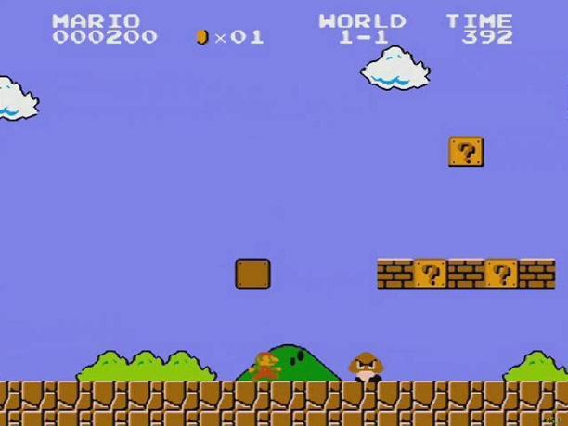
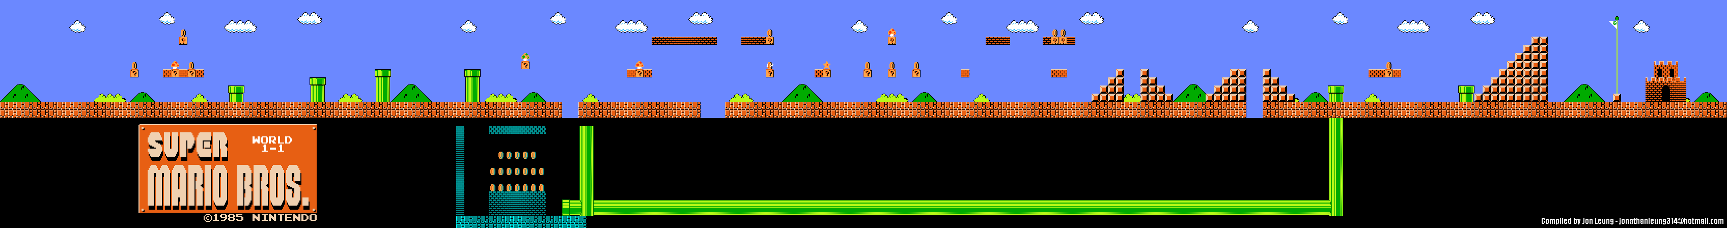
Game world
Super Mario Bros. Nintendo

Slide 9
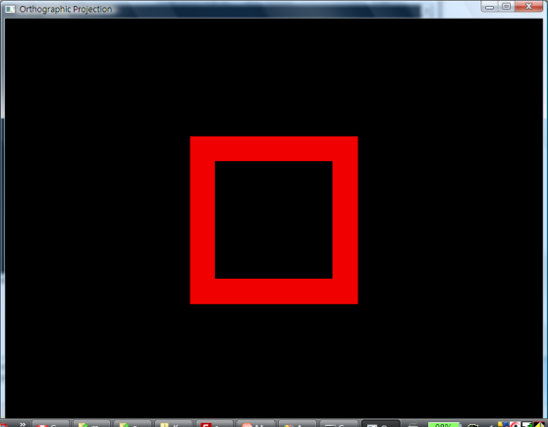
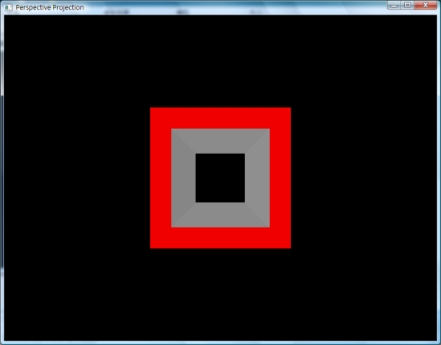
Projection (camera)
Getting 3D to 2D
  Orthographic projections
  Perspective projections
Notes:
投影則是將3D物體從world space投影轉換到image space的過程，常用的有正交投影和透視投影
這幾個名詞，還會在05-Transformation和06-Projection做詳細的介紹

Slide 10
Viewport (camera)
Mapping drawing coordinates to windows coordinates
+y
(0, 0)
+x
clipping space
Window space
Notes:
Viewport則是在螢幕(或視窗的顯示範圍)，設定一塊區域，與clipping space做對應
OpenGL中可以指定多個viewport轉換，使同一個視窗畫面呈現不同角度或不同場景的畫面

Slide 11

Representing Visuals
3D objects
  Mesh: geometry
  Materials
  Texture maps
Lighting
Shader

Slide 12

Start Unity in 3D

Slide 13
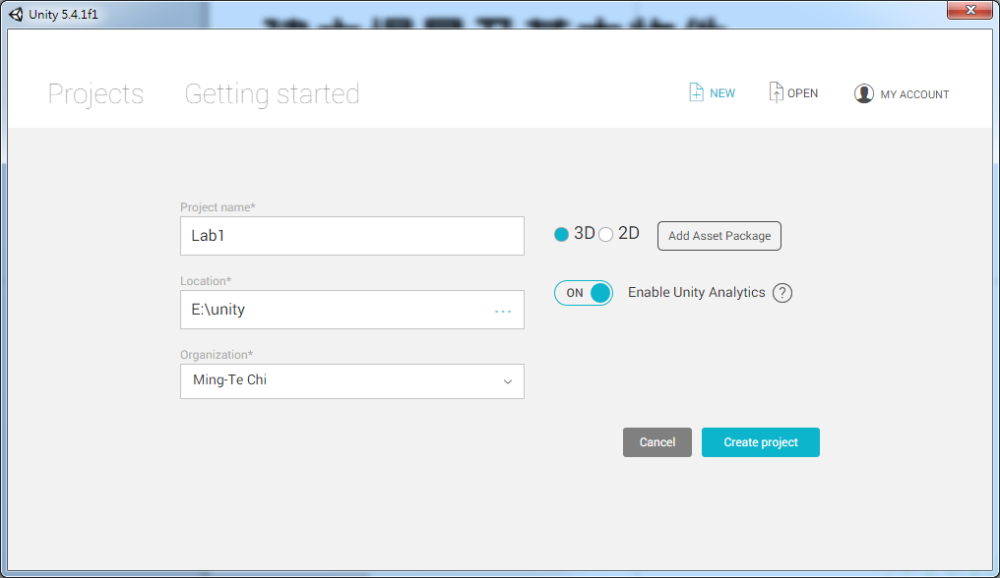
建立場景及基本物件
建立專案
  命名→選擇[3D] →[Create project]

Slide 14
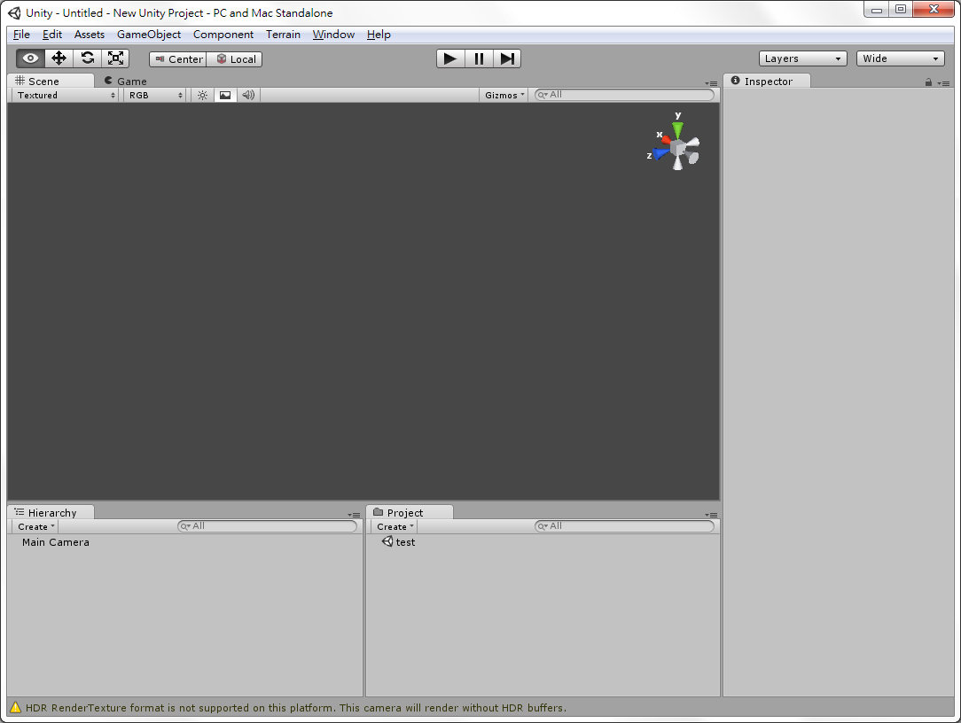
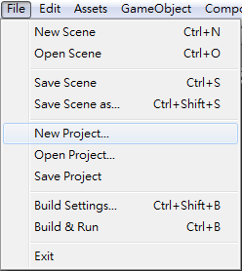
建立場景及基本物件
建立專案
  左上角[File]→[New Project]

Slide 15
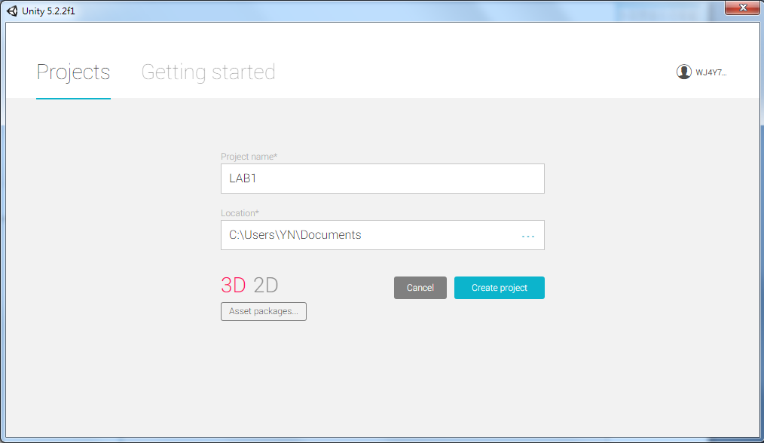
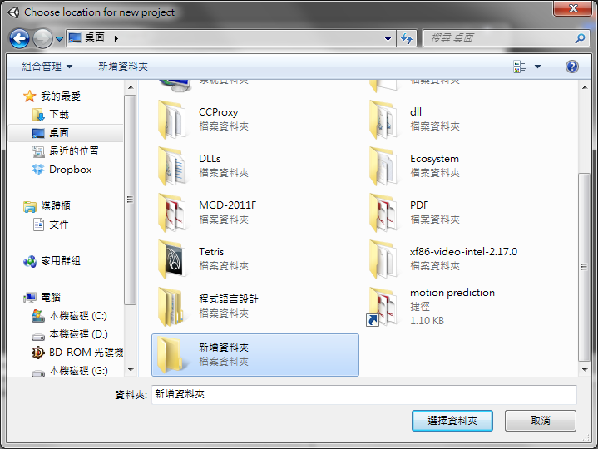
建立場景及基本物件
建立專案
  新增或選擇要存放專案的資料夾→[Create]

Slide 16
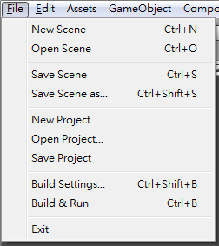
建立場景及基本物件
建立場景
  選擇[File]→[New Scene]
  之後可先儲存場景，[File]→[Save Scene]

Slide 17
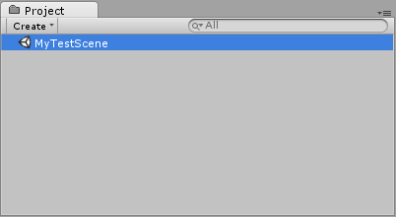
建立場景及基本物件
建立場景
  通常場景內檔案會存放在專案目錄的Assets下
  儲存完成後場景檔案會出現在Project畫面中

Slide 18
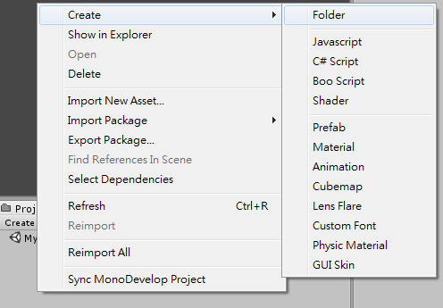
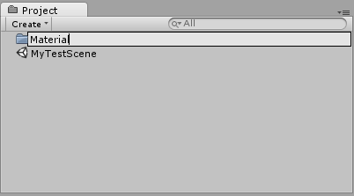
建立場景及基本物件
基本物件與材質
  新增資料夾存放材質以方便管理
    在Project畫面空白處[右鍵]→[Create]→[Folder]
    可取名為Material

Slide 19
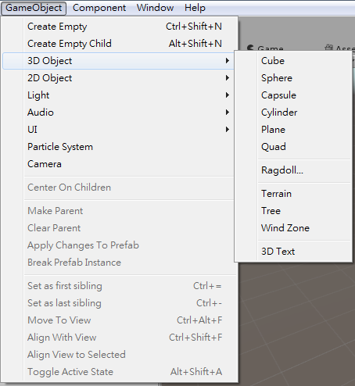
建立場景及基本物件
基本物件與材質
  選擇左上角[GameObject]→[Create Other]→
    [Cube](方體)
    [Sphere](球體)
    [Capsule](膠囊體)
    [Cylinder](圓柱體)
    [Plane](平面)
    [Quad](單位長度的平面)
  也可在[Hierachy]畫面中
  按[Create]新增

Slide 20
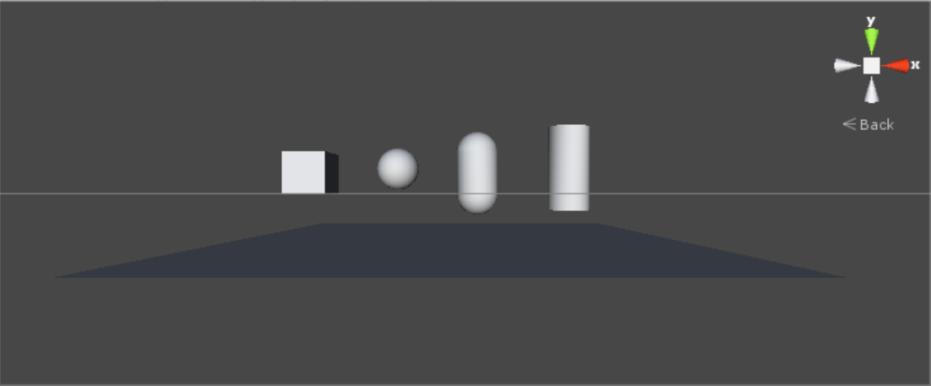
建立場景及基本物件

Slide 21
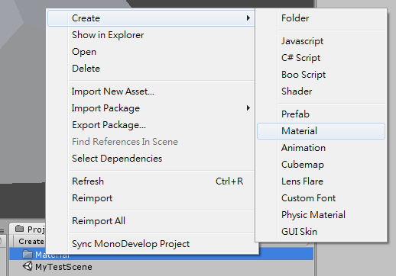
建立場景及基本物件
建立新材質，準備套用到物件上
  在Project畫面中剛剛新增的資料夾上
  按[右鍵]→[Create]→[Material]

Slide 22
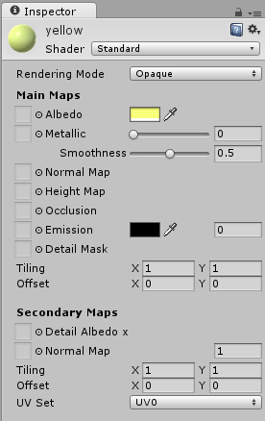
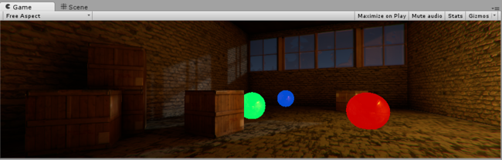
建立場景及基本物件
  可在Inspector畫面中調整材質類型及顏色
    Albedo: 反照率(顏色)
    Emission: 在沒有燈光時仍發光
  之後把材質拖到Hierarchy畫面
  的物件中，或直接拖到畫面中
  的物件，可直接套用材質

Slide 23
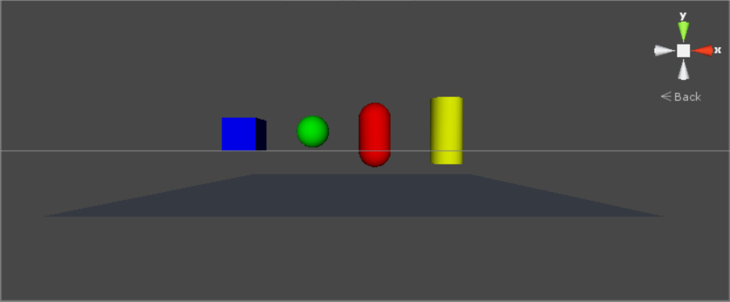
建立場景及基本物件

Slide 24
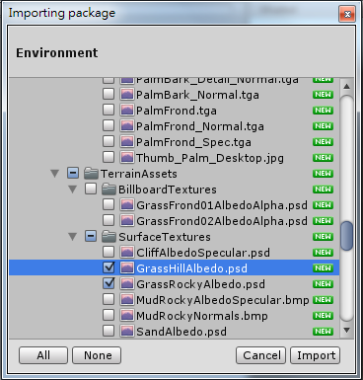
建立場景及基本物件
  預設的地形材質圖可在Project視窗中[右鍵]
  →[Import Package]→[Environment]
  ，之後按[Import]匯入
這次LAB只會用到這兩張其中一張!

Slide 25
建立場景及基本物件
  點選灰[Albedo]左邊的圓圈可設定材質貼圖
  可修改Tiling及Offset來設定材質
  圖的重複次數及貼圖起始位置

Slide 26
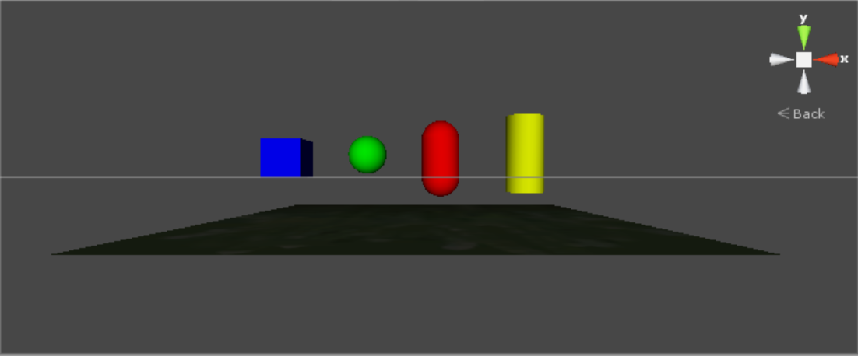
建立場景及基本物件

Slide 27
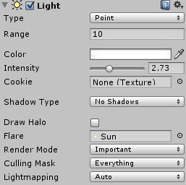
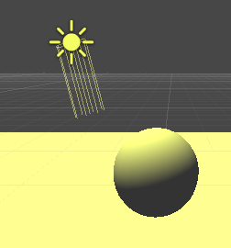
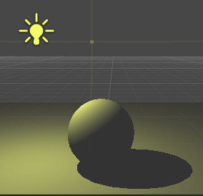
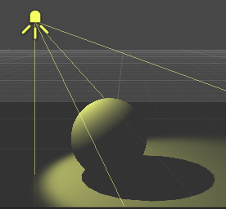
光源使用與設定
左上方[Game Object]→[Light]→
  [Directional Light] (平行光)
  [Point Light] (點光源)
  [Spotlight] (聚光燈)
  [Area light] (區域光)
點擊光源，可以移動、旋轉，Inspector
中可改變各項屬性

Slide 28
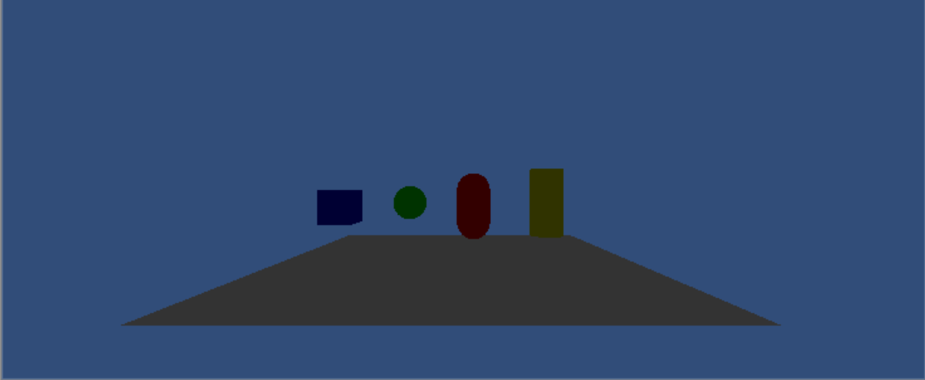
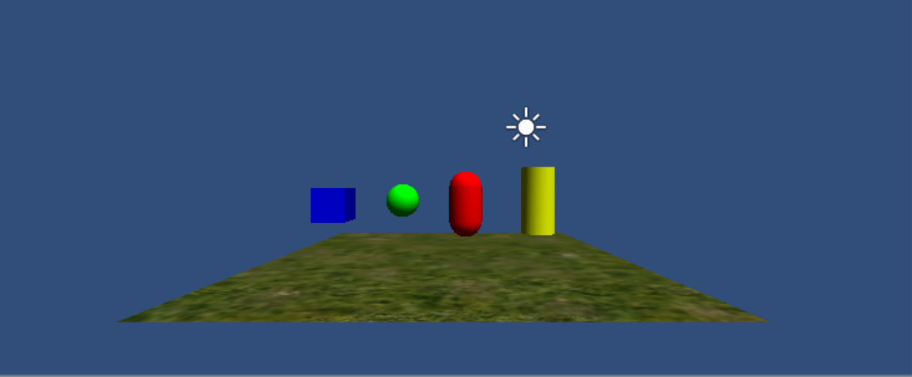

Slide 29
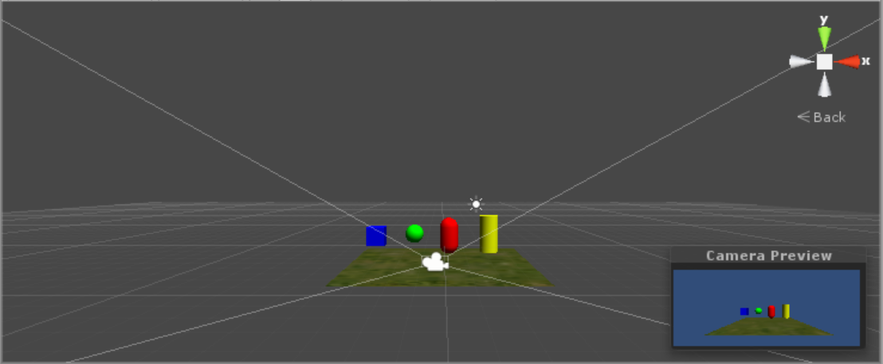
攝影機使用與設定
Main Camera: 遊戲預設視角
  點擊場景中的攝影機，可顯示預覽畫面

Slide 30
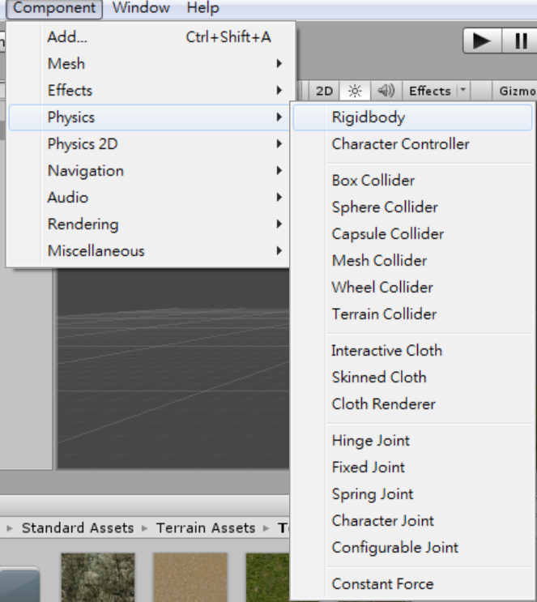
物理元件使用與設定
首先我們先選擇一個物件(立方體)，並從物理選單中，新增一個Rigidbody到所選的物件上

Slide 31
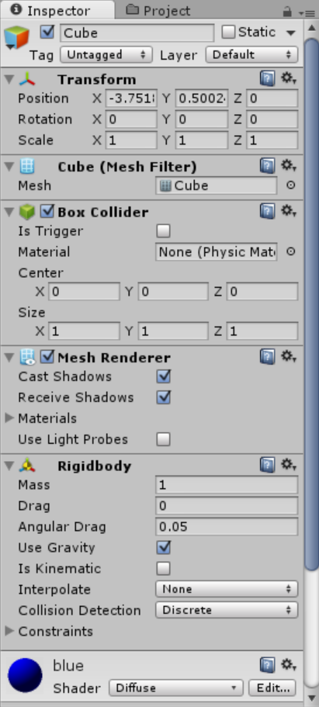
物理元件使用與設定
確認屬性欄中，剛體元件的重力參數(use gravity)是否已勾選。
勾選表示當遊戲開始時，該物體會受重力往下移動

Slide 32
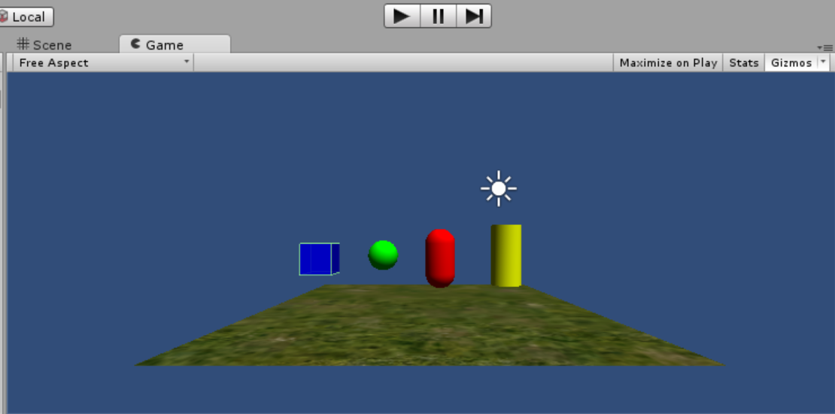
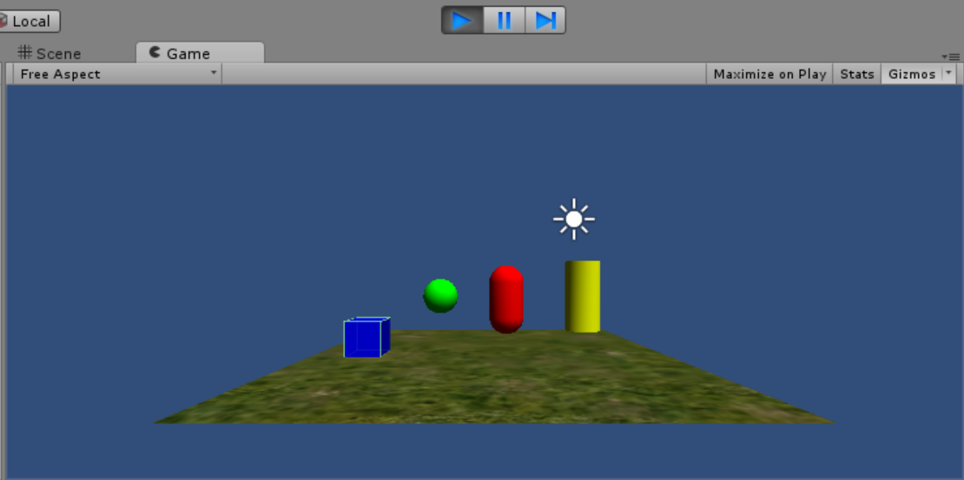

Slide 33
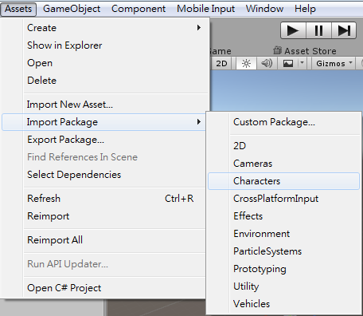
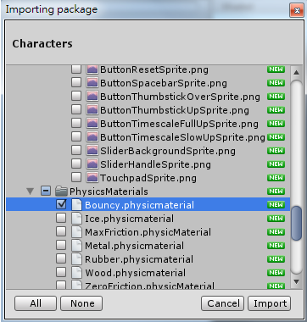
物理元件使用與設定
匯入碰撞材質

Slide 34
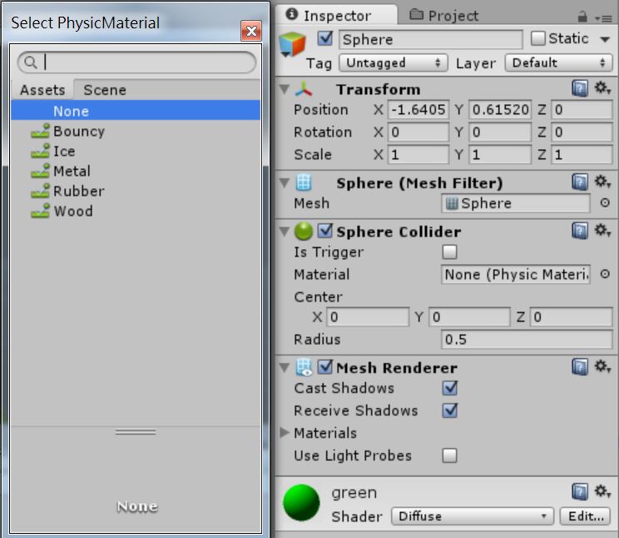
物理元件使用與設定
選取plane
新增物理材質於碰撞器中，選擇bouncy材質來測試
Plane不需要有rigidbody
點這個圈圈

Slide 35
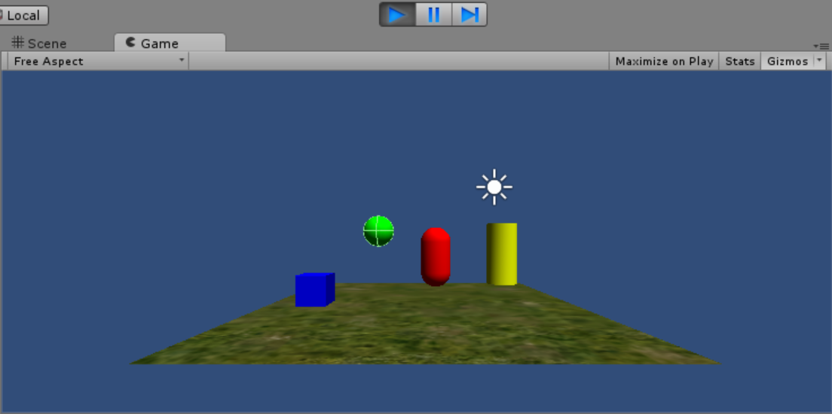
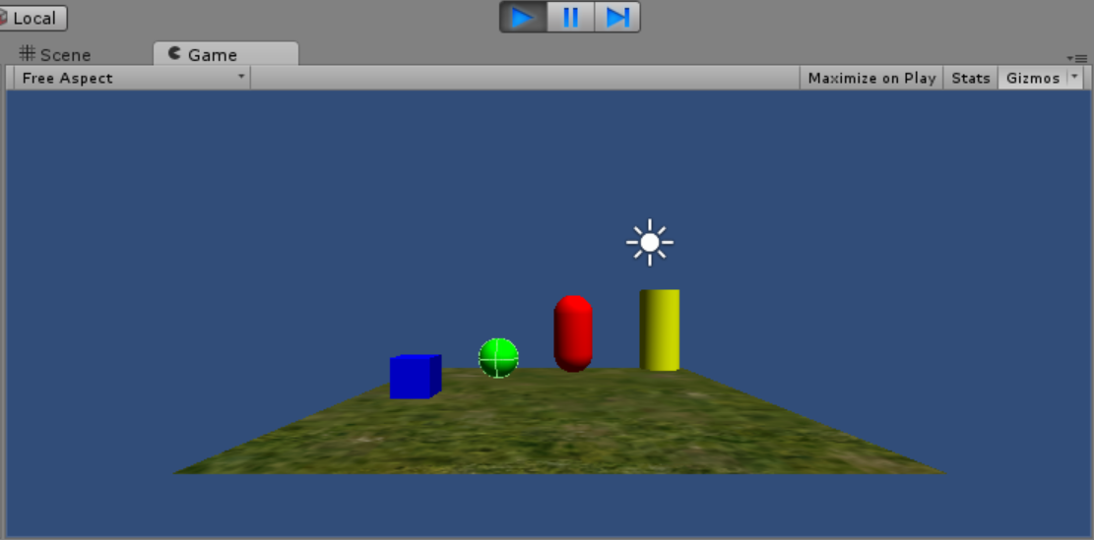
Notes:
上面物體 需有rigidbody, 且use gravity
地板 不需有rigidbody
上下至少要有個gameobject 其mesh collider 的material設定bouncy

Slide 37
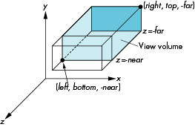
Clip Volume
glMatrixMode(GL_PROJECTION);
glLoadIdentity();
if (w <= h)
glOrtho (-nRange, nRange,
-nRange*h/w, nRange*h/w, -nRange, nRange);
else
glOrtho (-nRange*w/h, nRange*w/h, -nRange, nRange, -nRange, nRange);
Notes:
在繪製3D物體前，均需設定clip volume決定可視範圍
一般而言，目前的範例程式以視窗的長寬比例，設定一個正交投影的可視範圍
可以在glutReshapeFunc(void (*func)(int width, int height)); 指定的callback function中看到這部份的程式碼

Slide 38
GPU Fundamentals:
The Graphics Pipeline
CPU
GPU
Graphics State
Application
Transform
Rasterizer
Shade
Video
Memory
(Textures)
Vertices
(3D)
Xformed,
Lit
Vertices
(2D)
Fragments
(pre-pixels)
Final
pixels
(Color, Depth)
Render-to-texture
A simplified graphics pipeline
  Note that pipe widths vary
  Many caches, FIFOs, and so on not shown

Slide 39
Pipeline
CPU
GPU
Graphics State
Application
Vertex
Processor
Rasterizer
Pixel
Processor
Video
Memory
(Textures)
Vertices
(3D)
Xformed,
Lit
Vertices
(2D)
Fragments
(pre-pixels)
Final
pixels
(Color, Depth)
Render-to-texture
Programmable vertex processor!
Programmable pixel processor!

Slide 40
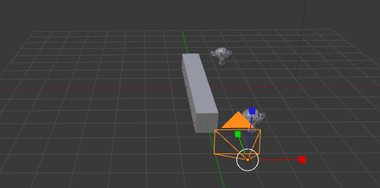
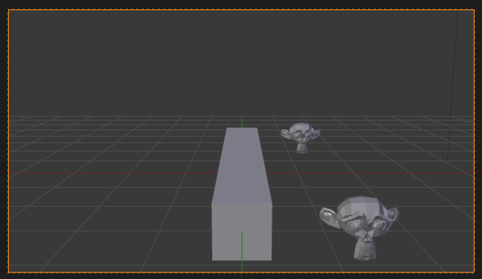
GPU Pipeline: Transform
Vertex Processor (multiple operate in parallel)
  Transform from “world space” to “image space”
  Compute per-vertex lighting
World space
Image space
Notes:
整個繪圖的流程，由物體的頂點描述之後，第一步就是將物體由世界座標投影到影像空間，
也就是要計算一個3D空間的頂點投影到影像平面的位置
這個過程也可以涵蓋各種有關於頂點的轉換，譬如說每個頂點的光影效果

Slide 41
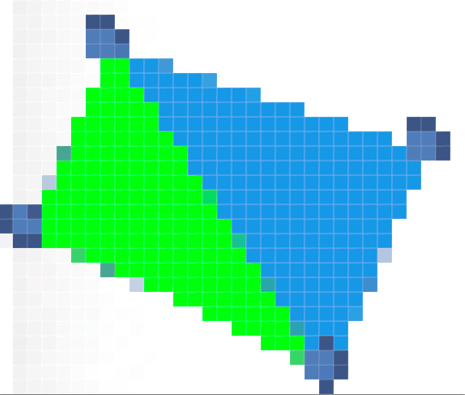
GPU Pipeline: Rasterizer
Rasterizer
  Convert geometric rep. (vertex) to image rep. (fragment)
    Fragment = image fragment
      Pixel + associated data: color, depth, stencil, etc.
  Interpolate per-vertex quantities across pixels
vertex
Geometry primitive
pixels
Notes:
Rasterizer 柵格化：主要是將幾何的描述轉換成像素的描述
一個三角形可以由三個頂點定義，當經過幾何轉換後，三個頂點在影像空間的位置就確定，配合影像空間的解析度
我們可以從這個三角形所涵蓋的像素範圍給標示出來。

Slide 42
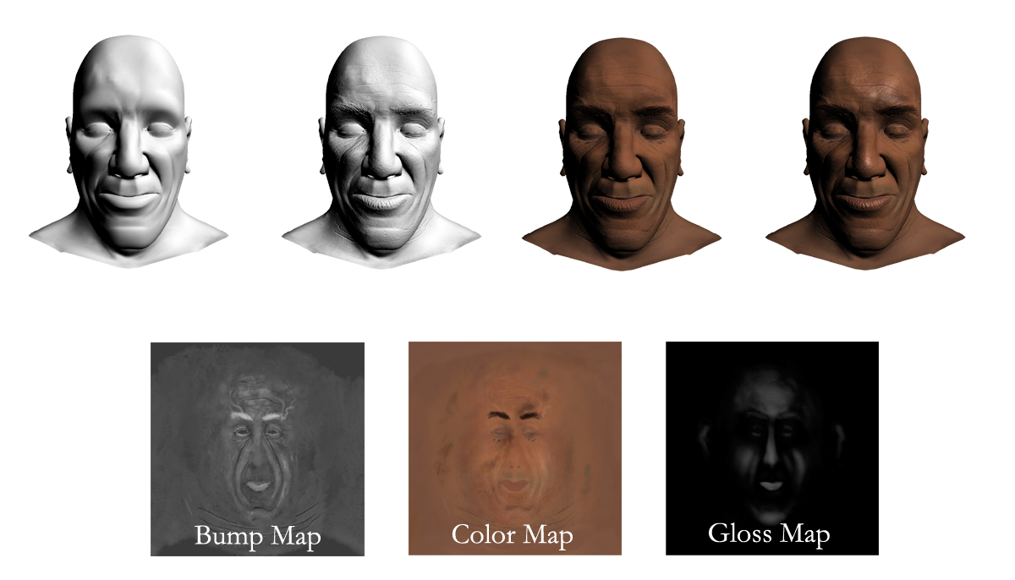
GPU Pipeline: Shade
Fragment Processors (multiple in parallel)
  Compute a color for each pixel
  Optionally read colors from textures (images)
Image from nvidia slide
Notes:
Fragment 通常指的就是在寫入至framebuffer的像素前的狀態，
在這一步前還可以經過種種不同的處理，通常包含計算像素的顏色，或更進一步經由貼圖的對應設定顏色
如下圖呈現現代遊戲常用的貼圖，透過這三種不同的貼圖，可以更正確地呈現直實的質感

Slide 43
OpenGL
做為參考資訊 上課不會講到

Slide 44
Outline
OpenGL
Primitives
  Immediate mode (4rd Ch3)
  Vertex processing and Drawing (6th ch7)
Fragment Processing and Buffers
Notes:
介紹OpenGL在繪製3D形狀的基本元素
以及各種不同buffer的功用

Slide 45
Primitives

Slide 46
OpenGL Geometric Primitives
All geometric primitives are specified by vertices
GL_LINES
GL_POINTS
GL_LINE_STRIP
GL_LINE_LOOP
GL_POLYGON
GL_TRIANGLES
GL_QUADS
GL_TRIANGLE_STRIP
GL_TRIANGLE_FAN
GL_QUAD_STRIP
Notes:
OpenGL中，3D幾何物體均以頂點做為基礎
一維的物體 點: 以一個頂點標示其位置
二維的物體 線，以兩個以上的頂點表示出線段
三維的表面，可以三個頂點決定出一個三角面，或四個頂點表示個四角面，或多邊形
另外，也可串接多個同樣幾何物體的strip表示法

Slide 47
Immediate mode
OpenGL 1.X, 2.X
glBegin(GLenum mode);
…
glVertex3f(…);
…
…
glEnd();

Slide 48
Points
glBegin(GL_POINTS);
z = -50.0f;
for(angle = 0.0f; angle <= (2.0f*GL_PI)*3.0f; angle += 0.1f)
{
x = 50.0f*sin(angle);
y = 50.0f*cos(angle);
// Specify the point and move the Z value up a little
glVertex3f(x, y, z);
z += 0.5f;
}
glEnd(); // Done drawing points
Notes:
描述下頁的螺旋形狀的點集合

Slide 49


Slide 50

PointSize
// Specify the point size before the primitive is specified
glPointSize(curSize);
// Draw the point
glBegin(GL_POINTS);
glVertex3f(x, y, z);
glEnd();
Notes:
glPointSize 可設定後續繪點指令 點的大小

Slide 51

Line
glBegin(GL_LINES);
z = 0.0f;
for(angle = 0.0f; angle <= GL_PI; angle += (GL_PI / 20.0f)) {
// Top half of the circle
x = 50.0f*sin(angle);
y = 50.0f*cos(angle);
glVertex3f(x, y, z);
// Bottom half of the circle
x = 50.0f*sin(angle+GL_PI);
y = 50.0f*cos(angle+GL_PI);
glVertex3f(x, y, z);
}
// Done drawing points
glEnd();
Notes:
藉由改變glBegin()中的primitive，會決定glBegin()和glEnd()間的頂點所構成的形狀

Slide 52

LINE_STRIP
glBegin(GL_LINE_STRIP);

Slide 53

LineWidth
glLineWidth(fCurrSize);
// Draw the line
glBegin(GL_LINES);
glVertex2f(-80.0f, y);
glVertex2f(80.0f, y);
glEnd();

Slide 54

LineStipple
GLushort pattern = 0x5555; // Stipple pattern
glLineStipple(factor,pattern);
// Draw the line
glBegin(GL_LINES);
glVertex2f(-80.0f, y);
glVertex2f(80.0f, y);
glEnd();
Notes:
可透過bitmask設定繪出直線的pattern，藉以繪製虛線

Slide 55
Triangle
float v[9][3];
glBegin(GL_TRANGLES);
glVertex3fv(v[0]);
glVertex3fv(v[1]);
glVertex3fv(v[2]);
…
glEnd();
4
5
3
0
1
2
GL_TRIANGLES
1
2
3
4
0
5
GL_TRIANGLE_FAN
0
1
2
3
4
5
6
7
GL_TRIANGLE_STRIP
Notes:
為了函式呼叫的次數(每描述一個頂點需要一次glVertex()呼叫)，有不同的繪製三角形的primitive型別
基本的GL_TRIANGLES 三個三個一數
GL_TRIANGLE_FAN 針對像傘形或圓錐的部份， (1, n+1, n+2)為一個三角形，如圖頂點(1, 2, 3)為一個三角形 (1, 3, 4)為另一個三角形，
GL_TRIANGLE_STRIP 適合長條的幾何形狀 對於奇數三角形為(n, n+1, n+2)，對於偶數三角數圖為(n+1, n, n+2)
如圖頂點(0, 1, 2)為第一個三角形 (2, 1, 3)為第二個三角形 …

Slide 56
Winding
By default, front face is defined by CCW( CounterClockwise Winding )
Winding change
  glFrontFace(GL_CW); // clockwise winding
0
1
2
Notes:
頂點的順序也決定了三角形的正反面
預設以右手座標系統，將右手四指順著頂點的順序擺放，姆指向上的方向就指出正面所在
另外，可用glFrontFace(GL_CW); or glFrontFace(GL_CCW); 改變正面和頂點順序關係

Slide 57

glBegin(GL_TRIANGLE_FAN);
// Pinnacle of cone is shared vertex for fan, moved up Z axis to produce a cone instead of a circle
glVertex3f(0.0f, 0.0f, 75.0f);
// Loop around in a circle and specify even points along the circle
// as the vertices of the triangle fan
for(angle = 0.0f; angle < (2.0f*GL_PI); angle += (GL_PI/8.0f))
{
// Calculate x and y position of the next vertex
x = 50.0f*sin(angle);
y = 50.0f*cos(angle);
// Specify the next vertex for the triangle fan
glVertex2f(x, y);
}
// Done drawing fan for cone
glEnd();

Slide 58


Hidden Surface Remove
Without hidden surface remove
glEnable(GL_DEPTH_TEST);
Notes:
箭頭處指出未打開深度測試，繪圖結果不正確處，可和右圖做比較
繪圖的結果是依據指令的先後，先畫的會被後畫的蓋住
如果沒有使用隱藏面遮蔽，就有可能在某些角度，繪製的結果就不對，如左圖顏色就對不起來，右圖顏色就對得正好

Slide 59
Polygon Construction Rules
All polygon must be planar.
The polygon’s edge must not intersect, and the polygon must be convex.
Convex polygon
Non-Convex polygon

Slide 60


Polygon
Non-Convex polygon (Concave)
  Must be composited by multi-triangle

Slide 61
Render Primitive in Modern OpenGL
Application
Client side
GPU
Server side

Slide 62
Vertex Arrays
void glVertexPointer(GLint size, GLenum type, GLsizei stride, const GLvoid * pointer);
  define an array of vertex data
void glDrawArrays(GLenum mode, GLint first, GLsizei count);
  render primitives from array data
Notes:
deprecated in opengl 3.1

Slide 63
Vertex Arrays- example
const int SMALL_STAR=100;
Glfloat vSmallStars[SMALL_STAR*2]; //(x,y)
//assign position into vSmallStars
…
glEnableClientState(GL_VERTEX_ARRAY);
glVertexPointer(2, GL_FLOAT, 0, vSmallStars);
glDrawArrays(GL_POINTS, 0, SMALL_STAR);
Notes:
接下來還有vertex buffer object

Slide 64
Vertex Array Object (VAO)
OpenGL 3.0
WebGL
OpenGL ES
In modern OpenGL, VAO with VBO is the main way to render primitive.
A VAO is an OpenGL Object that encapsulates all of the state needed to specify vertex data. Note that VAOs do not contain the arrays themselves; the arrays are stored in Buffer Objects
Notes:
http://www.opengl.org/wiki/Vertex_Array_Objects#Vertex_Array_Object
A Vertex Array Object (VAO) is an OpenGL Object that encapsulates all of the state needed to specify vertex data (with one minor exception noted below). They define the format of the vertex data as well as the sources for the vertex arrays. Note that VAOs do not contain the arrays themselves; the arrays are stored in Buffer Objects (see below). The VAOs simply reference already existing buffer objects.
Vertex buffer object (VBO) creates "buffer objects" for vertex attributes in high-performance memory on the server side and provides same access functions to reference the arrays, which are used in vertex arrays, such as glVertexPointer(), glNormalPointer(), glTexCoordPointer(), etc.

Slide 65
VAO – triangle example
// An array of 3 vectors which represents 3 vertices
static const GLfloat g_vertex_buffer_data[] = {
-1.0f, -1.0f, 0.0f,
1.0f, -1.0f, 0.0f,
0.0f, 1.0f, 0.0f,
};
ShaderInfo shaders[] = {
{ GL_VERTEX_SHADER, "triangles.vert" },
{ GL_FRAGMENT_SHADER, "triangles.frag" },
{ GL_NONE, NULL } };
GLuint program = LoadShaders(shaders);
glUseProgram(program);

Slide 66
// Generate and Bind VAO
GLuint VertexArrayID;
glGenVertexArrays(1, &VertexArrayID);
glBindVertexArray(VertexArrayID);
// This will identify our vertex buffer
GLuint vertexbuffer;
// Generate 1 buffer, put the resulting identifier in vertexbuffer
glGenBuffers(1, &vertexbuffer);
// The following commands will talk about our 'vertexbuffer' buffer
glBindBuffer(GL_ARRAY_BUFFER, vertexbuffer);
// Give our vertices to OpenGL.
glBufferData(GL_ARRAY_BUFFER, sizeof(g_vertex_buffer_data), g_vertex_buffer_data, GL_STATIC_DRAW);
Application
Client side
GPU
Server side
Glfloat []
VAO
VBO

Slide 67
VAO in display()
GPU - Server side
VAO
program
glUseProgram(program);
// 1st attribute buffer : vertices
glBindBuffer(GL_ARRAY_BUFFER, vertexbuffer);
glVertexAttribPointer(
0, // attribute 0. No particular reason for 0, but must match the layout in the shader.
3, // size
GL_FLOAT, // type
GL_FALSE, // normalized?
0, // stride
(void*)0 // array buffer offset
);
glEnableVertexAttribArray(0);
// Draw the triangle ! Starting from vertex 0; 3 vertices total -> 1 triangle
glDrawArrays(GL_TRIANGLES, 0, 3);
glDisableVertexAttribArray(0);
VBO
001010101010101010…
Vertex shader
in vec3 position
in vec3 color
Notes:
Omit some detail about program and shader

Slide 68
Reference
OpenGL Coursenote in SIGGRAPH2013
  http://www.cs.unm.edu/~angel/SIGGRAPH13/An%20Introduction%20to%20OpenGL%20Programming.pptx
Notes:
http://www.cs.unm.edu/~angel/SIGGRAPH13/An%20Introduction%20to%20OpenGL%20Programming.pptx

Slide 69
FrameBuffers

Slide 70
Single Buffer
Init()
  glutInitDisplayMode(GLUT_RGB);
Display()
  Call glFlush(); or glFinish(); when you want to see the rendering result.
Notes:
Single buffer的設定
由於只有單一buffer，在display()中繪製完物體時，是呼叫glFlush() 或是glFinish()，去確保之前呼叫的相關繪圖函式都已被執行完成
主因是opengl繪圖過程中，cpu和gpu兩側是平行進行，未必同步
glFlush ensures that previous OpenGL commands must complete in finite time
glFinish does not return until all effects from prviously issued commands [...] are fully realized

Slide 71


glScissor(x, y, width, height)
// Clear blue window
glClearColor(0.0f, 0.0f, 1.0f, 0.0f);
glClear(GL_COLOR_BUFFER_BIT);
// Now set scissor to smaller red sub region
glClearColor(1.0f, 0.0f, 0.0f, 0.0f);
glScissor(100, 100, 600, 400);
glEnable(GL_SCISSOR_TEST);
glClear(GL_COLOR_BUFFER_BIT);
Notes:
glScissor() 會在視窗座標系統定義出一塊方形區域，當glEnable(GL_SCISSOR_TEST);後
只有落在此區域的像素才會被繪圖指令更新

Slide 72

// Finally, an even smaller green rectangle
glClearColor(0.0f, 1.0f, 0.0f, 0.0f);
glScissor(200, 200, 400, 200);
glClear(GL_COLOR_BUFFER_BIT);
// Turn scissor back off for next render
glDisable(GL_SCISSOR_TEST);

Slide 73
Stencil
Init()
  glutInitDisplayMode(GLUT_RGB | GLUT_DOUBLE | GLUT_STENCIL);
Display()
  // Use 0 for clear stencil, enable stencil test
  glClearStencil(0.0f);
  glEnable(GL_STENCIL_TEST);
  // Clear color and stencil buffer
  glClear(GL_COLOR_BUFFER_BIT | GL_STENCIL_BUFFER_BIT);
Notes:
Stencil 可以想做蠟板，透過在stencil buffer的某些像素寫入值，之後要畫的圖，會先檢查stencil buffer的值，再決定要不要寫入framebuffer

Slide 74
Creating Stencil Pattern
// All drawing commands fail the stencil test, and are not
// drawn, but increment the value in the stencil buffer.
glStencilFunc(GL_NEVER, 0x0, 0x0);
glStencilOp(GL_INCR, GL_INCR, GL_INCR);
//Draw something
….
Notes:
glStencilFunc(GL_NEVER, 0x0, 0x0);
glStencilOp(fail, zpass, zfail);

Slide 75

// Now, allow drawing, except where the stencil pattern is 0x1
// and do not make any further changes to the stencil buffer
glStencilFunc(GL_NOTEQUAL, 0x1, 0x1);
glStencilOp(GL_KEEP, GL_KEEP, GL_KEEP);
// Now draw red bouncing square
// (x and y) are modified by a timer function
glColor3f(1.0f, 0.0f, 0.0f);
glRectf(x, y, x + rsize, y - rsize);
Notes:
先在stencil buffer設定如同心圓的形狀，接下來畫入紅色矩形時，在同心圓的部份就會寫不進紅色

Slide 76
deprecated

Slide 77
Display lists
Preprocess
Gluint mylist;
glNewList(mylist, GL_COMPILE);
some glcode
glEndList();
Display
glCallList(mylist);
Notes:
deprecated in opengl 3.1

