Slide 1
3D Game Programming Programmable Pipelines
Ming-Te Chi
Department of Computer Science,
National Chengchi University
Notes:
2017

Slide 2
Outline
Programmable Pipelines
Vertex shaders
Fragment shaders
Introduction to shading languages
Notes:
a shader is a computer program that is used primarily to calculate rendering effects on graphics hardware with a high degree of flexibility. (From wiki)

Slide 3
Introduction
Recent major advance in real time graphics is programmable pipeline
First introduced by NVIDIA GForce 3
Software Support
Direct X 8, 9, 10
OpenGL Extensions
OpenGL Shading Language (GLSL)
Cg

Slide 4
Background
Two main components
Vertex programs (shaders)
Fragment programs (shaders)
Requires detailed understanding of two seemingly contradictory approaches
OpenGL pipeline
Real time
RenderMan ideas
offline

Slide 5
Black Box View
vertices
vertices
fragments
fragments
CPU
Geometry
Processor
Rasterizer
Fragment
Processor
Frame
Buffer

Slide 6
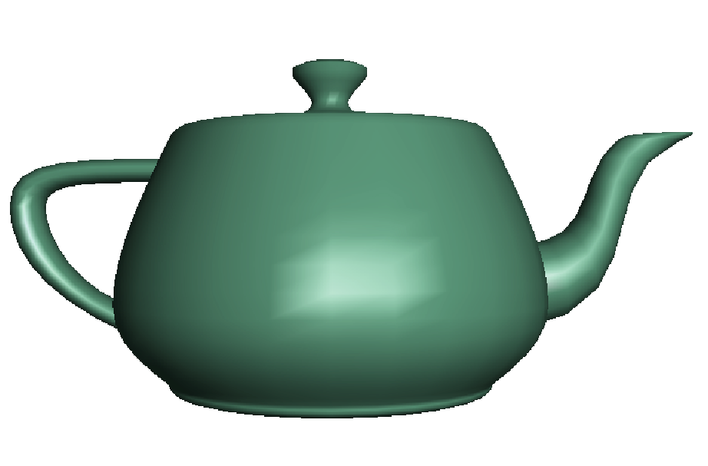
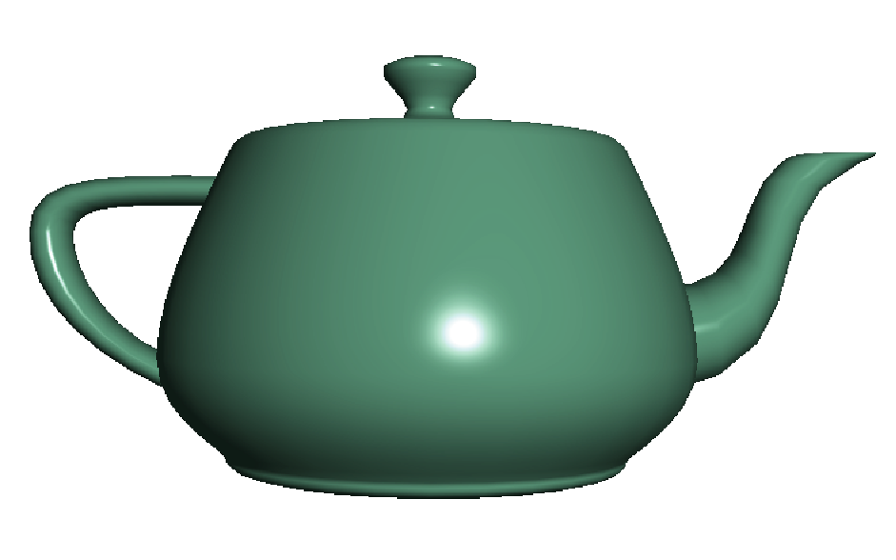
Fragment Shader Applications
Per fragment lighting calculations
per vertex lighting
per fragment lighting

Slide 7
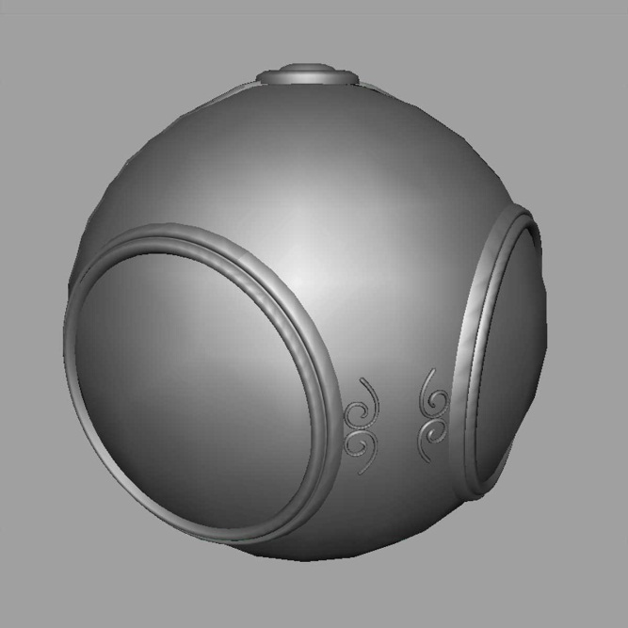
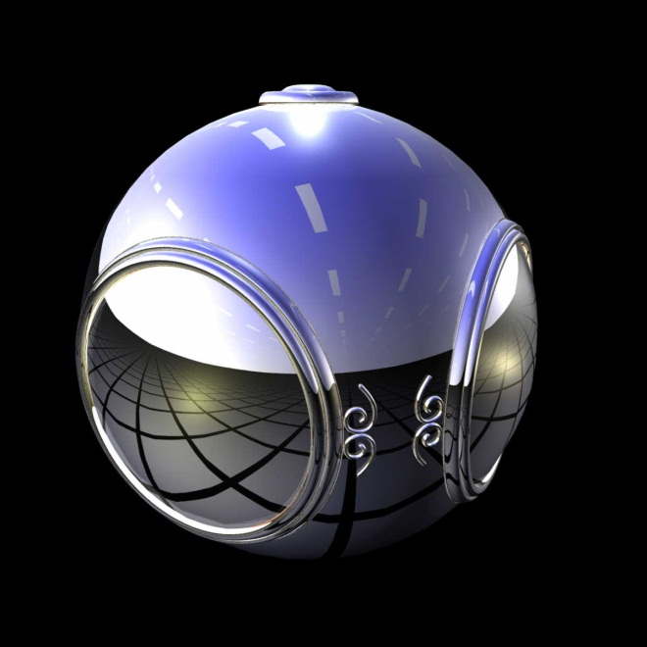
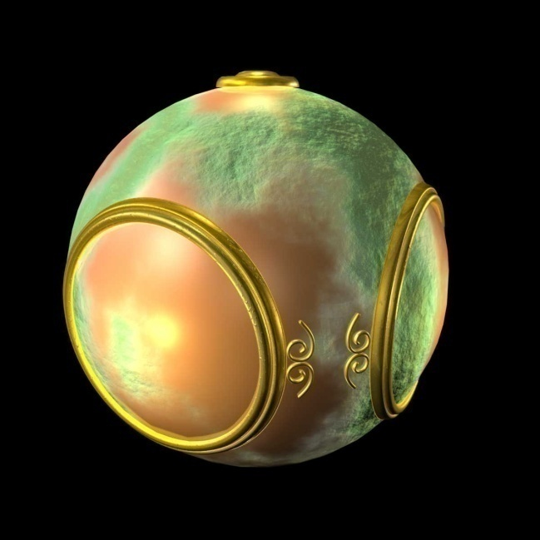
Fragment Shader Applications
Texture mapping
smooth shading
environment
mapping
bump mapping

Slide 8
GLSL 1
Simple shader

Slide 9
Objectives
Shader applications
Vertex shaders
Fragment shaders
Programming shaders
GLSL

Slide 10
Vertex Shader Applications
Moving vertices
Morphing
Wave motion
Fractals
Lighting
More realistic models
Cartoon shaders

Slide 11
Writing Shaders
First programmable shaders were programmed in an assembly-like manner
OpenGL extensions added for vertex and fragment shaders
Cg (C for graphics) C-like language for programming shaders
Works with both OpenGL and DirectX
Interface to OpenGL complex
OpenGL Shading Language (GLSL)

Slide 12
GLSL
OpenGL Shading Language
Part of OpenGL 2.0
High level C-like language
New data types
Matrices
Vectors
Samplers
OpenGL state available through built-in variables

Slide 13
Simple Vertex Shader
const vec4 red = vec4(1.0, 0.0, 0.0, 1.0);
void main(void)
{
gl_Position = gl_ProjectionMatrix
*gl_ModelViewMatrix*gl_Vertex;
gl_FrontColor = red;
}

Slide 14
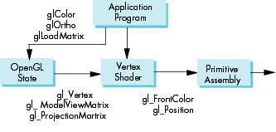
Execution Model

Slide 15
Simple Fragment Program
void main(void)
{
gl_FragColor = gl_Color;
}

Slide 16
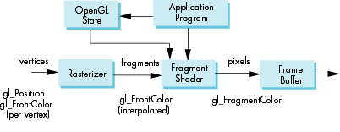
Execution Model

Slide 17
Data Types
C types: int, float, bool
Vectors:
float, vec2, vec 3, vec4
Also int (ivec) and boolean (bvec)
Matrices: mat2, mat3, mat4
Stored by columns
Standard referencing m[row][column]
C++ style constructors
vec3 a =vec3(1.0, 2.0, 3.0)
vec2 b = vec2(a)

Slide 18
Pointers
There are no pointers in GLSL
We can use C structs which
can be copied back from functions
Because matrices and vectors are basic types they can be passed into and output from GLSL functions, e.g.
matrix3 func(matrix3 a)

Slide 19
Qualifiers
GLSL has many of the same qualifiers such as const as C/C++
Need others due to the nature of the execution model
Variables can change
Once per primitive
Once per vertex
Once per fragment
At any time in the application
Vertex attributes are interpolated by the rasterizer into fragment attributes

Slide 20
Attribute Qualifier
attribute-qualified variables can change at most once per vertex
Cannot be used in fragment shaders
Built in (OpenGL state variables)
gl_Color
gl_ModelViewMatrix
User defined (in application program)
attribute float temperature
attribute vec3 velocity

Slide 21
Uniform Qualified
Variables that are constant for an entire primitive
Can be changed in application outside scope of glBegin and glEnd
Cannot be changed in shader
Used to pass information to shader such as the bounding box of a primitive

Slide 22
Varying Qualified
Variables that are passed from vertex shader to fragment shader
Automatically interpolated by the rasterizer
Built in
Vertex colors
Texture coordinates
User defined
Requires a user defined fragment shader

Slide 23
Example: Vertex Shader
const vec4 red = vec4(1.0, 0.0, 0.0, 1.0);
varying vec3 color_out;
void main(void)
{
gl_Position =
gl_ModelViewProjectionMatrix*gl_Vertex;
color_out = red;
}

Slide 24
Required Fragment Shader
varying vec3 color_out;
void main(void)
{
gl_FragColor = color_out;
}
Vertex Shader
Fragment Shader

Slide 25
Passing values
call by value-return
Variables are copied in
Returned values are copied back
Three possibilities
in
out
inout

Slide 26
Operators and Functions
Standard C functions
Trigonometric
Arithmetic
Normalize, reflect, length
Overloading of vector and matrix types
mat4 a;
vec4 b, c, d;
c = b*a; // a column vector stored as a 1d array
d = a*b; // a row vector stored as a 1d array

Slide 27
Swizzling and Selection
Can refer to array elements by element using [] or selection (.) operator with
x, y, z, w
r, g, b, a
s, t, p, q
a[2], a.b, a.z, a.p are the same
Swizzling operator lets us manipulate components
vec4 a;
a.yz = vec2(1.0, 2.0);

Slide 28
Uniform
// Find out where the flicker constant lives
flickerLocation = glGetUniformLocation(progObj, "flickerFactor");
// Pick a random flicker factor
flickerFactor += ((((GLfloat)rand())/((GLfloat)RAND_MAX)) - 0.5f) * 0.1f;
if (flickerFactor > 1.0f) flickerFactor = 1.0f;
if (flickerFactor < 0.0f) flickerFactor = 0.0f;
glUniform1f(flickerLocation, flickerFactor);

Slide 29
GLSL 2
Phong shading model

Slide 30
Objectives
Coupling GLSL to Applications
Example applications

Slide 31
Linking Shaders to OpenGL
OpenGL Extensions
ARB_shader_objects
ARB_vertex_shader
ARB_fragment_shader
OpenGL 2.0
Almost identical to using extensions
Avoids extension suffixes on function names

Slide 32
Reading a Shader
Shader are added to the program object and compiled
Usual method of passing a shader is as a null-terminated string using the function glShaderSource
If the shader is in a file, we can write a reader to convert the file to a string

Slide 33
Shader Reader
#include <stdio.h>
char* readShaderSource(const char* shaderFile)
{
FILE* fp = fopen(shaderFile, "r");
char* buf;
long size;
if(fp == NULL) return(NULL);
fseek(fp, 0L, SEEK_END); /* end of file */
size = ftell(fp);
fseek(fp, )L, SEEK_SET); /* start of file */

Slide 34
Shader Reader (cont)
buf = (char*) malloc(statBuf.st_size + 1 * sizeof(char));
fread(buf, 1, size, fp);
buf[size] = '\0'; /null termination */
fclose(fp);
return buf;
}

Slide 35
Adding a Vertex Shader
GLint vShader;
GLunit myVertexObj;
GLchar vShaderfile[] = “my_vertex_shader”;
GLchar* vSource = readShaderSource(vShaderFile);
myVertexObj = glCreateShader(GL_VERTEX_SHADER);
glShaderSource(myVertexObj, 1, & vSource, NULL);
glCompileShader(myVertexObj);

Slide 36
Program Object
Container for shaders
Can contain multiple shaders
Other GLSL functions
GLuint myProgObj;
myProgObj = glCreateProgram();
/* define shader objects here */
glUseProgram(myProgObj);
glAttachShader(myProgObj, vertexShader );
glAttachShader(myProgObj, fragmentShader );
glLinkProgram(myProgObj);

Slide 37
Vertex Attributes
Vertex attributes are named in the shaders
Linker forms a table
Application can get index from table and tie it to an application variable
Similar process for uniform variables

Slide 38
Vertex Attribute Example
// myColor is name in shader
GLint colorAttr;
colorAttr = glGetAttribLocation(myProgObj,
"myColor");
// color is variable in application
GLfloat color[4];
glVertexAttrib4fv(colorAttrib, color);

Slide 39
Uniform Variable Example
// angle defined in shader
GLint angleParam;
angleParam = glGetUniformLocation(myProgObj,
"angle");
// my_angle set in application
GLfloat my_angle;
my_angle = 5.0 /* or some other value */
glUniform1f(angleParam, my_angle);

Slide 40
Glsl.h
#include "glsl.h"
glShaderManager SM;
shader = SM.loadfromFile("brick.vert", "brick.frag");
shader->begin();
shader->setUniform3f("LightPosition", 1, 1, 1);
DrawSomething();
shader->end();
Notes:
http://www.clockworkcoders.com/oglsl/

Slide 41
Vertex Shader Applications
Moving vertices
Morphing
Wave motion
Fractals
Lighting
More realistic models
Cartoon shaders

Slide 42
Wave Motion Vertex Shader
uniform float time;
uniform float xs, zs, // frequencies
uniform float h; // height scale
void main()
{
vec4 t =gl_Vertex;
t.y = gl_Vertex.y
+ h*sin(time + xs*gl_Vertex.x)
+ h*sin(time + zs*gl_Vertex.z);
gl_Position = gl_ModelViewProjectionMatrix*t;
}

Slide 43
Particle System
uniform vec3 init_vel;
uniform float g, m, t;
void main()
{
vec3 object_pos;
object_pos.x = gl_Vertex.x + vel.x*t;
object_pos.y = gl_Vertex.y + vel.y*t
+ g/(2.0*m)*t*t;
object_pos.z = gl_Vertex.z + vel.z*t;
gl_Position =
gl_ModelViewProjectionMatrix*
vec4(object_pos,1);
}

Slide 44
Phong shading
I = k_{d} I_{d} l · n + k_{s} I_{s} (v · r )^{α} + k_{a} I_{a}
diffuse
specular
ambient

Slide 45
Modified Phong Vertex Shader I
void main(void)
/* modified Phong vertex shader (without distance term) */
{
gl_Position = gl_ModelViewProjectionMatrix * gl_Vertex;
vec4 ambient, diffuse, specular;
vec4 eyePosition = gl_ModelViewMatrix * gl_Vertex;
vec4 eyeLightPos = gl_LightSource[0].position;
vec3 N = normalize(gl_NormalMatrix * gl_Normal);
vec3 L = normalize(eyeLightPos.xyz - eyePosition.xyz);
vec3 E = -normalize(eyePosition.xyz);
vec3 H = normalize(L + E);
}
Notes:
camera在eye space是(0, 0, 0)
(0, 0, 0) - eye space poistion = view vector

Slide 46
Modified Phong Vertex Shader II
/* compute diffuse, ambient, and specular contributions */
float Kd = max(dot(L, N), 0.0);
float Ks = pow(max(dot(N, H), 0.0), gl_FrontMaterial.shininess);
float Ka = 0.0;
ambient = Ka*gl_FrontLightProduct[0].ambient;
diffuse = Kd*gl_FrontLightProduct[0].diffuse;
specular = Ks*gl_FrontLightProduct[0].specular;
gl_FrontColor = ambient+diffuse+specular;
}

Slide 47
Pass Through Fragment Shader
/* pass-through fragment shader */
void main(void)
{
gl_FragColor = gl_Color;
}

Slide 48
per vertex lighting
per fragment lighting

Slide 49
Vertex Shader for per Fragment Lighting
varying vec3 N, L, E, H;
void main()
{
gl_Position = gl_ModelViewProjectionMatrix * gl_Vertex;
vec4 eyePosition = gl_ModelViewMatrix * gl_Vertex;
vec4 eyeLightPos = gl_LightSource[0].position;
N = normalize(gl_NormalMatrix * gl_Normal);
L = normalize(eyeLightPos.xyz - eyePosition.xyz);
E = -normalize(eyePosition.xyz);
H = normalize(L + E);
}
Notes:
camera在eye space是(0, 0, 0)
(0, 0, 0) - eye space poistion = view vector

Slide 50
Fragment Shader for Modified Phong Lighting I
varying vec3 N;
varying vec3 L;
varying vec3 E;
varying vec3 H;
void main()
{
vec3 Normal = normalize(N);
vec3 Light = normalize(L);
vec3 Eye = normalize(E);
vec3 Half = normalize(H);

Slide 51
Fragment Shader for Modified Phong Lighting II
float Kd = max(dot(Normal, Light), 0.0);
float Ks = pow(max(dot(Half, Normal), 0.0),
gl_FrontMaterial.shininess);
float Ka = 0.0;
vec4 diffuse = Kd * gl_FrontLightProduct[0].diffuse;
vec4 specular = Ks * gl_FrontLightProduct[0].specular;
vec4 ambient = Ka * gl_FrontLightProduct[0].ambient;
gl_FragColor = ambient + diffuse + specular;
}

Slide 52
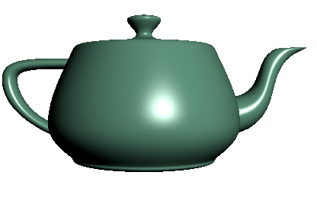
Vertex vs Fragment Lighting
per vertex lighting
per fragment lighting

Slide 53
Samplers
Provides access to a texture object
Defined for 1, 2, and 3 dimensional textures and for cube maps
In shader:
uniform sampler2D myTexture;
Vec2 texcoord;
Vec4 texcolor = texture2D(mytexture, texcoord);
In application:
texMapLocation = glGetUniformLocation(myProg,“myTexture”);
glUniform1i(texMapLocation, 0);
/* assigns to texture unit 0 */

Slide 54
Fragment Shader Applications
Texture mapping
smooth shading
environment
mapping
bump mapping

Slide 55
Cube Maps
We can form a cube map texture by defining six 2D texture maps that correspond to the sides of a box
Supported by OpenGL
Also supported in GLSL through cubemap sampler
vec4 texColor = textureCube(mycube, texcoord);
Texture coordinates must be 3D

Slide 56
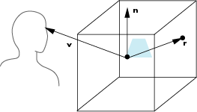
Environment Map
Use reflection vector to locate texture in cube map

Slide 57
Environment Maps with Shaders
Environment map usually computed in world coordinates which can differ from object coordinates because of modeling matrix
May have to keep track of modeling matrix and pass it shader as a uniform variable
Can also use reflection map or refraction map (for example to simulate water)

Slide 58
Reflection Map Vertex Shader
varying vec3 R;
void main(void)
{
gl_Position = gl_ModelViewProjectionMatrix*gl_Vertex;
vec3 N = normalize(gl_NormalMatrix*gl_Normal);
vec4 eyePos = gl_ModelViewMatrix*gl_Vertex;
R = reflect(-eyePos.xyz, N);
}

Slide 59
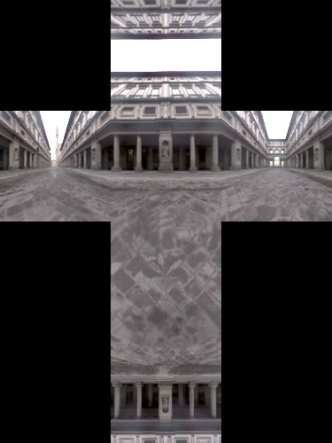
Reflection Map Fragment Shader
varying vec3 R;
uniform samplerCube texMap;
void main(void)
{
gl_FragColor = textureCube(texMap, R);
}
Cube map
Image from HDRshop

Slide 60
Bump Mapping
Perturb normal for each fragment
Store perturbation as textures

