Slide 1
3D Game Programming
Geometric Transformations
Ming-Te Chi
Department of Computer Science,
National Chengchi University
Notes:
2017

Slide 2
Outline
Geometric Transformations
Basic transformation
  The coordinates
  Hierarchy transformation

Slide 3
Transformation Terminology
Viewing
Modeling
Modelview
Projection
Viewport

Slide 4
Transformations
Translation
Rotation
Scaling

Slide 5
The Modelview Duality
+y
+y
+x
+x
+z
+z
View moving
Model moving
Notes:
Model space: 為物體相對世界座標的幾何轉換
View space: 為相機相對於世界座標的幾何轉換
兩者互為相對移動的關係，也就是移動相機等同於反方相移動所有的物體，是故會整合成modelview space，減少矩陣的變數

Slide 6
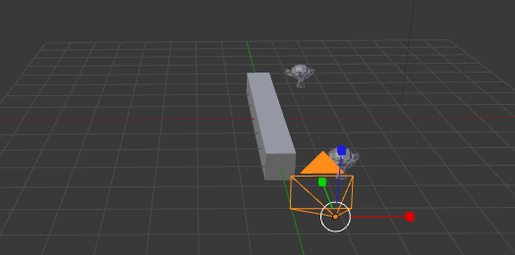
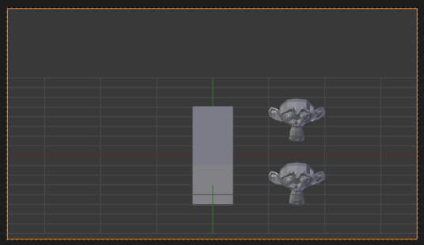
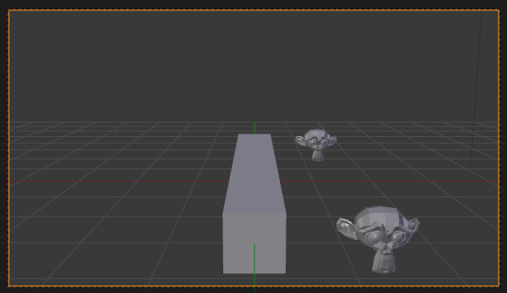
Projection
World space
Orthographic
Perspective
Notes:
在此列舉常見的兩種投影法 上圖是世界座標的觀點，同樣的場景
但在不同的投影法中，成像的結果也不一樣
左下為正交投影，右下為透視投影

Slide 7
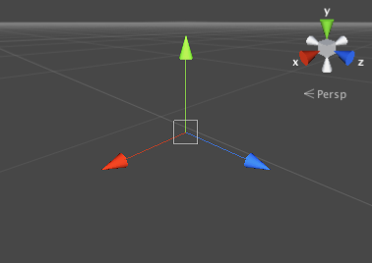
Coordinate System
Unity is a Left-Handed Coordinate System

Slide 8
Transform

Slide 9
Matrix/vector
Notes:
在繪圖中常需要利用矩陣和向量處理
各式的affine transformation可以4x4的矩陣表示
向量可表示位置(x, y, z, w)

Slide 10
Transform
Translate(tx, ty, tz);
Rotate(…);
Scale(sx, sy, sz);
glLoadIdentity();
Notes:
本頁列出基本幾何轉換的函式呼叫和對應的矩陣
由於旋轉矩陣是支援任意軸旋轉，也就是以給定(x, y, z)為旋轉軸，依右手定則的方向，旋轉angle角度
他對應的矩陣相對複雜，因此不列出。有興趣可參考 http://www.opengl.org/sdk/docs/man/xhtml/glRotate.xml

Slide 11
Rotate
public void Rotate(Vector3 eulerAngles, Space relativeTo = Space.Self);
public void Rotate(Vector3 axis, float angle, Space relativeTo = Space.Self);
public void RotateAround(Vector3 point, Vector3 axis, float angle);

Slide 12
Rotation/Translation from world to object
+y
+y
+y
Translate()
Rotate()
Rect()
+x
+x
+x
+y
+y
+y
Rotate()
Translate()
Rect()
+x
+x
+x
Notes:
反之，由C/C++指令由上至下閱讀的順序
表示從world space往object space的變化

Slide 13
Transformation
Pipeline
Poly.
Per
Vertex
CPU
DL
Raster
Frag
FB
Texture
Pixel
object
eye
clip
normalized
device
window
v
e
r
t
e
x
Modelview
Matrix
Projection
Matrix
Perspective
Division
Viewport
Transform
Modelview
Projection
other calculations here
  material è color
  shade model (flat)
  polygon rendering mode
  polygon culling
  clipping
Modelview
l
l
l
Notes:
Modelview matrix是記錄從object space到eye space間的頂點轉換
Projection matrix是記錄從eye space到clip space間的頂點投影轉換
一般來說以stack的方式存在，以便儲存和回覆特定時間的矩陣狀態，stack的深度主要是看硬體實作而定，Modelview matrix一般至少有32，Projection matrix一般至少有2
另外material-to-color, flat-shading, and clipping calculations 會發生在Modelview matrix和Projection matrix之間
The polygon culling and rendering mode operations 發生在Viewport operations之後
此外，還有texture matrix stack，用來計算貼圖座標的自動投影

Slide 14
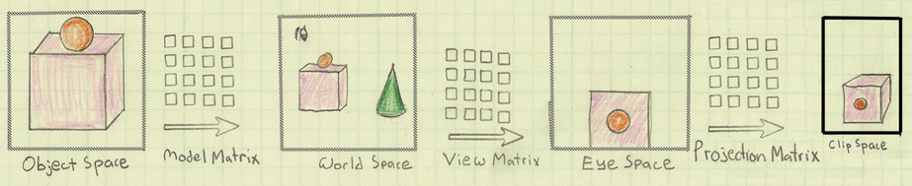
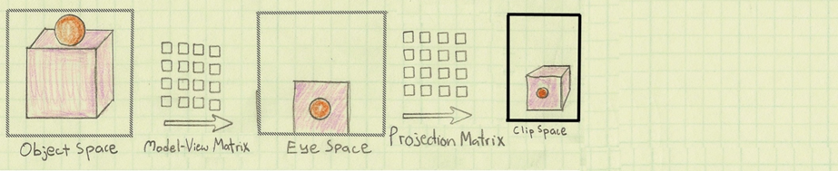
The Life of a vertex
Image by Philp Rideout
Notes:
這兩頁的圖片生動地呈現各種不同轉換發生的順序和對應的畫面變化
上下兩列可達到同樣的目的，主要是呈現model和view兩個矩陣轉換，兩者互為相對移動的關係，也就是移動相機等同於反方相移動所有的物體，
是故會整合成modelview space，減少矩陣的變數

Slide 15
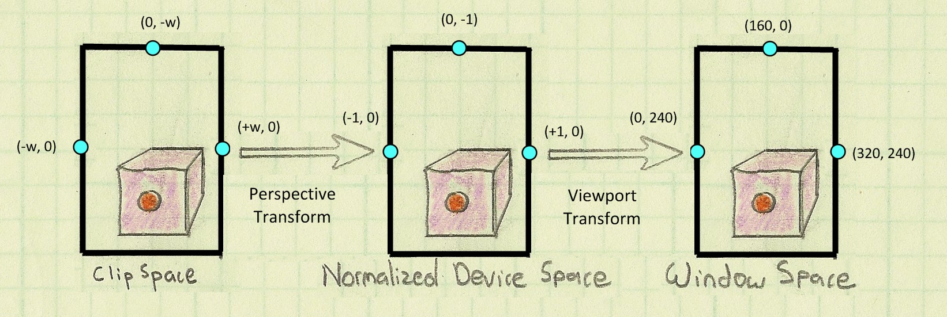
Image by Philp Rideout

Slide 16
Geometric Objects in glut
glutWireCube(10.0f);
glutSolidCube(10.0f);
Sphere, Cube, Cone, Torus, Dodecahedron, Octahedron, Tetrahedron, Icosahedron and Teapot
Notes:
http://www.opengl.org/documentation/specs/glut/spec3/node80.html#SECTION000120000000000000000
GLUT提供多種幾何物體的function，詳細功能可參考網頁的說明

Slide 17
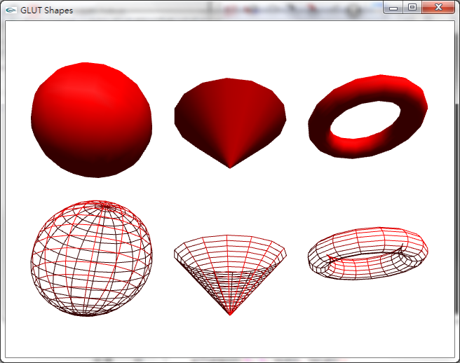
glutSolidCone(GLdouble base, GLdouble height, GLint slices, GLint stacks);
Solid
Wire
glutWireSphere(
GLdouble radius, GLint slices, GLint stacks);
glutWireTorus(
GLdouble innerRadius, GLdouble outerRadius,
GLint nsides, GLint rings);
Notes:
各種物體有不同的參數，
如球體需設定半徑radius，另由於這些幾何物體多是先用二次曲面方程式表示，opengl繪圖是以三角面或四角面為主
故需再經過tesslization進行分割，也就是指定slices和stacks的數字，可以想做橫向和縱向的切割
數字越大，形狀會越平滑，但也會帶來比較大的計算負擔

Slide 18
glPolygonMode
Select a polygon rasterization mode
void glPolygonMode(GLenum face,
GLenum mode);
face:
  GL_FRONT, GL_BACK, GL_FRONT_AND_BACK
mode:
  GL_POINT, GL_LINE, and GL_FILL

Slide 19
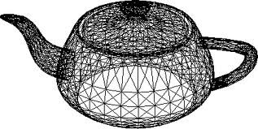
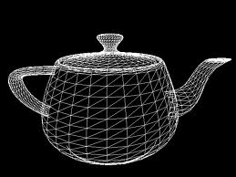
Wireframe with hidden-line removal
glEnable(GL_POLYGON_OFFSET_FILL);
glPolygonOffset( param1, param2 );
glPolygonMode(GL_FRONT , GL_FILL);
draw();
glDisable(GL_POLYGON_OFFSET_FILL);
glPolygonMode(GL_FRONT, GL_LINE );
draw();

Slide 20
Identity Matrix
glTranslatef(0, 1, 0);
glutSolidSphere(1, 15, 15);
glTranslatef(1, 0, 0);
glutSolidSphere(1, 15, 15);
glTranslatef(0, 1, 0);
glutSolidSphere(1, 15, 15);
glLoadIdentity();
glTranslatef(1, 0, 0);
glutSolidSphere(1, 15, 15);
Notes:
glLoadIdentity(); 的作用是將current transformation matrix設成單位矩陣
也等於是歸零之前的幾何轉換的作用，因此右下角的glutSolidSphere(1, 15, 15); 只受glTranslatef(1, 0, 0); 的影響

Slide 21
The Matrix Stacks
Current Matrix(modelview/projection)
glPushMatrix()
glPopMatrix()
Matrix Stack
glGet(GL_MAX_MODELVIEW_STACK_DEPTH, &size)
Notes:
OpenGL維護了一個matrix stack(通常長度為32，可用glGet()查詢 )
利用glPushMatrix() 可儲存目前的幾何轉換狀態
反之用glPopMatrix() 可還原之前儲存的狀態

Slide 22
Atom example
// First Electron Orbit
// Save viewing transformation
glPushMatrix();
// Rotate by angle of revolution
glRotatef(fElect1, 0.0f, 1.0f, 0.0f);
// Translate out from origin to orbit distance
glTranslatef(90.0f, 0.0f, 0.0f);
// Draw the electron
glutSolidSphere(6.0f, 15, 15);
// Restore the viewing transformation
glPopMatrix();
….
//(2) Second Electron Orbit
Notes:
這個範例以原子和三個電子提供了push/pop機制的使用，以及rotation和translation的組合
每個電子glutSolidSphere()，相對原子做公轉，公轉可透過隨時間增加的變數fElect1，產生旋轉，再以原子和電子的距離進行位移
另外為了避免三個電子各自的公轉影響到對方，會使用push/pop隔離公轉的位移

Slide 23
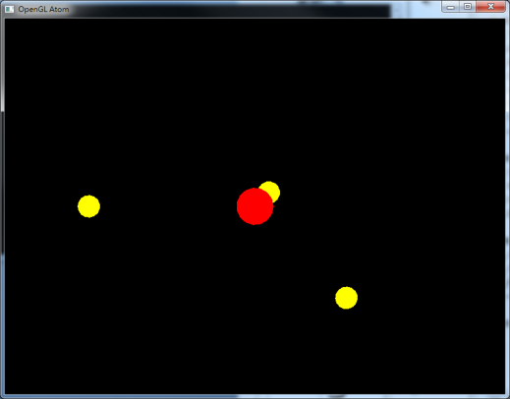
…
// (2) Second Electron Orbit
glPushMatrix();
glRotatef(45.0f, 0.0f, 0.0f, 1.0f);
glRotatef(fElect1, 0.0f, 1.0f, 0.0f);
glTranslatef(-70.0f, 0.0f, 0.0f);
glutSolidSphere(6.0f, 15, 15);
glPopMatrix();
// Third Electron Orbit
glPushMatrix();
glRotatef(360-45.0f, 0.0f, 0.0f, 1.0f);
glRotatef(fElect1, 0.0f, 1.0f, 0.0f);
glTranslatef(0.0f, 0.0f, 60.0f);
glutSolidSphere(6.0f, 15, 15);
glPopMatrix();

Slide 24
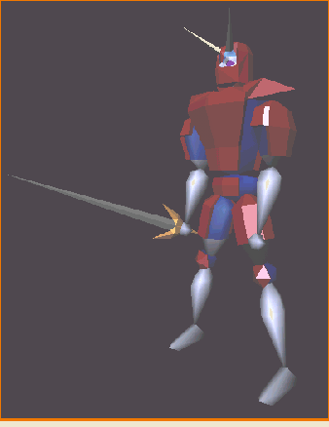
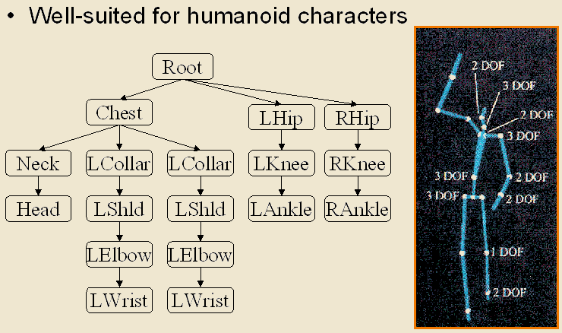
Transformation Example 1

Slide 25
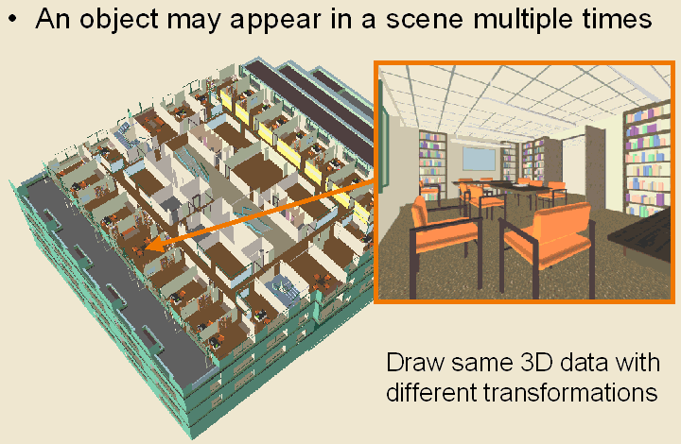
Transformation Example 2
Notes:
複雜的場景也可以利用同樣的機制，決定物體的相對位置

Slide 26
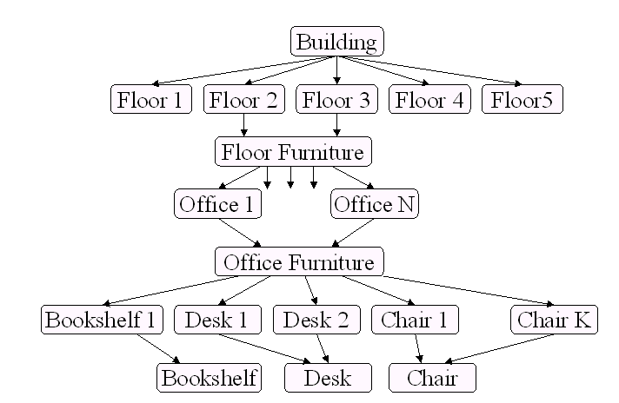
Transformation Example 2

Slide 27
Matrix in Modern OpenGL
OpenGL Mathematics
  A C++ mathematics library for graphics programming
  http://glm.g-truc.net/

Slide 28
#include <glm/vec3.hpp> // glm::vec3
#include <glm/vec4.hpp> // glm::vec4
#include <glm/mat4x4.hpp> // glm::mat4
#include <glm/gtc/matrix_transform.hpp> // glm::translate, glm::rotate, glm::scale, glm::perspective
glm::mat4 camera(float Translate, glm::vec2 const & Rotate)
{
glm::mat4 Projection = glm::perspective(45.0f, 4.0f / 3.0f, 0.1f, 100.f);
glm::mat4 View = glm::translate(glm::mat4(1.0f), glm::vec3(0.0f, 0.0f, -Translate));
View = glm::rotate(View, Rotate.y, glm::vec3(-1.0f, 0.0f, 0.0f));
View = glm::rotate(View, Rotate.x, glm::vec3(0.0f, 1.0f, 0.0f));
glm::mat4 Model = glm::scale(glm::mat4(1.0f), glm::vec3(0.5f));
return Projection * View * Model;
}

Slide 29
Mesh Format

Slide 30
Representing a Mesh
e₂
v₅
Consider a mesh
There are 8 nodes and 12 edges
  5 interior polygons
  6 interior (shared) edges
Each vertex has a location v_{i} = (x_{i} y_{i} z_{i})
v₆
e₉
e₃
e₈
v₈
v₄
e₁
e₁₁
e₁₀
e₇
v₇
e₄
v₁
e₁₂
e₆
v₂
v₃
e₅

Slide 31
3D model format
SIMPLE
Triangle
vertex1_X vertex1_Y vertex1_Z normal1_X normal1_Y normal1_Z
vertex2_X vertex2_Y vertex2_Z normal2_X normal2_Y normal2_Z
vertex3_X vertex3_Y vertex3_Z normal3_X normal3_Y normal3_Z
COLOR
Triangle
frontcolor_R frontcolor_G frontcolor_B backcolor_R backcolor_G backcolor_B
vertex1_X vertex1_Y vertex1_Z normal1_X normal1_Y normal1_Z
vertex2_X vertex2_Y vertex2_Z normal2_X normal2_Y normal2_Z
vertex3_X vertex3_Y vertex3_Z normal3_X normal3_Y normal3_Z
Notes:
http://graphics.csie.ntu.edu.tw/~ming/courses/icg/models.html

Slide 32
Simple Representation
Define each polygon by the geometric locations of its vertices
Leads to OpenGL code such as
Inefficient and unstructured
  Consider moving a vertex to a new location
  Must search for all occurrences
glBegin(GL_POLYGON);
glVertex3f(x1, x1, x1);
glVertex3f(x6, x6, x6);
glVertex3f(x7, x7, x7);
glEnd();

Slide 33
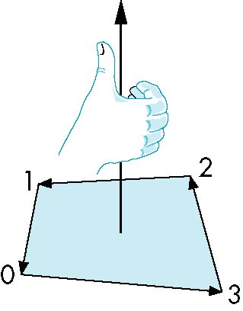
Inward and Outward Facing Polygons
The order {v₁, v₆, v₇} and {v₆, v₇, v₁} are equivalent in that the same polygon will be rendered by OpenGL but the order {v₁, v₇, v₆} is different
The first two describe outwardly
facing polygons
Use the right-hand rule =
counter-clockwise encirclement
of outward-pointing normal
OpenGL can treat inward and
outward facing polygons differently

Slide 34
Wavefront obj format
#example obj file
v -1.63326156 -3.04798102 -8.81131839
….
vn 0.00379090 0.40057179 0.01256634
…
vt 0.22390614 0.97395277 (texture)
…
f 4/2/4 3/1/3 2/2/2 (index to v/t/n)

Slide 35
Reference
Obj format http://www.martinreddy.net/gfx/3d/OBJ.spec
Ply format
STL format - http://en.wikipedia.org/wiki/STL_(file_format)

Slide 36
Scene Graph
COLLADA
FBX
Alembic

Slide 38
Rotation/Translation from object to world
Rotate()
Translate()
Rect()
+y
+y
+y
+x
+x
+x
+y
+y
+y
Translate()
Rotate()
Rect()
+x
+x
+x
Notes:
每增加一個幾何轉換指令，可視為該指令前後座標系統的相對改變
本頁投影片示範，由最下方指令往上，依序產生的座標軸變化，也就是從object space往world space的座標轉換動作

