Slide 1
Hyperledger Indy
Kyle

Slide 2
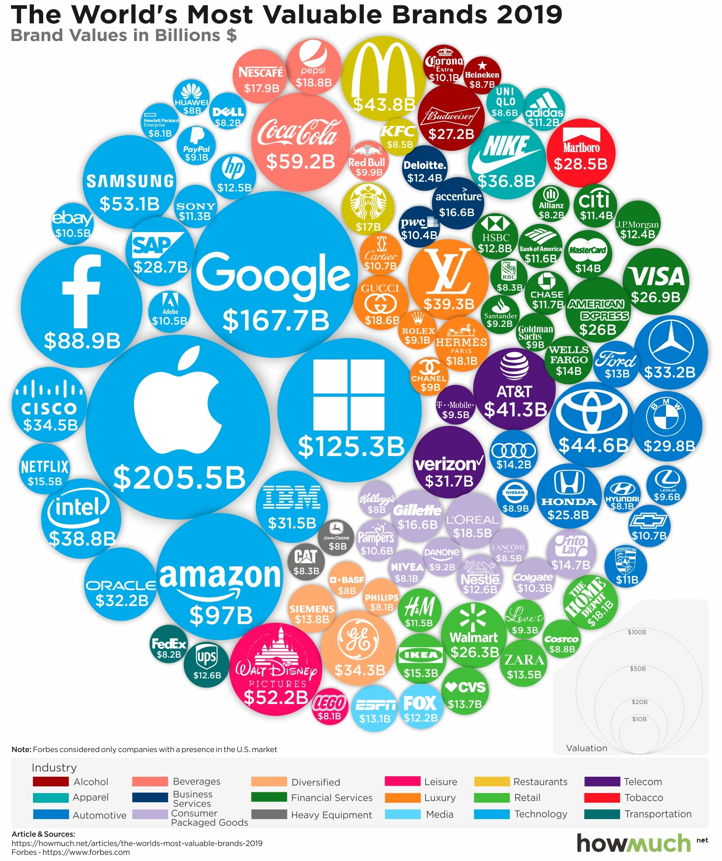
Identity
Most services start from identification
Who you are:
Biometric patterns
What you have:
Smart cards, mobile phones, devices, ip addresses, hardware keys ...
What you know:
Passwords, Q&A

Slide 3
Digital identity

Slide 4
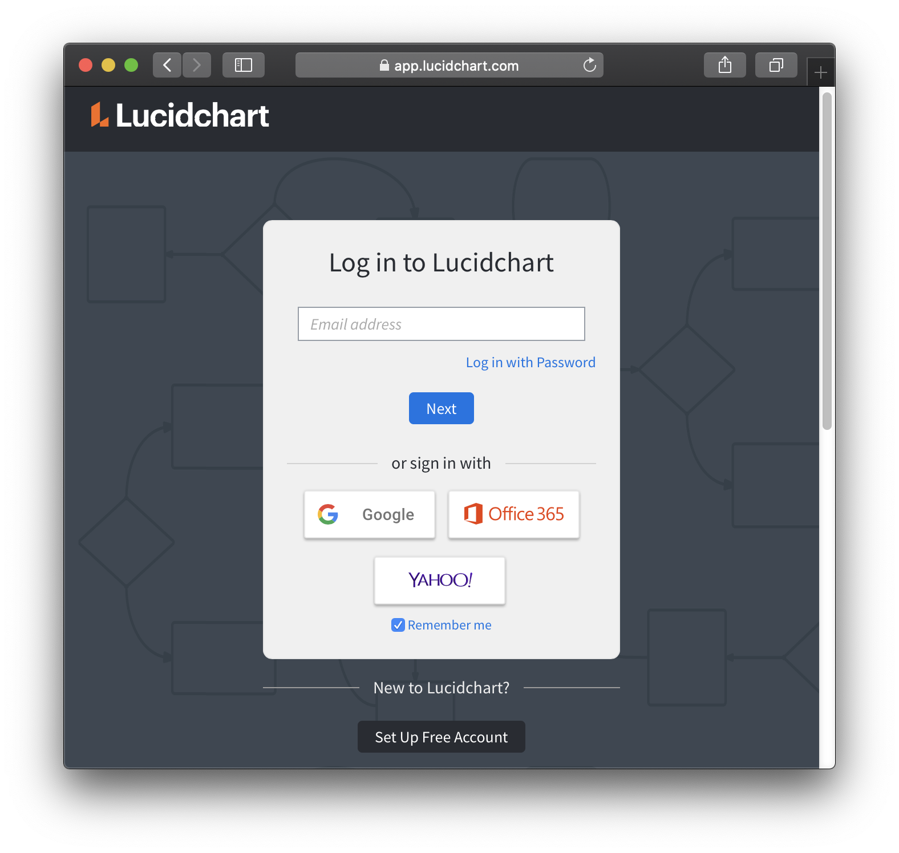
3. PKI certificate
1. ID, password
2. Single sign on

Slide 5
Models - id, password
Prover
Verifier

Slide 6
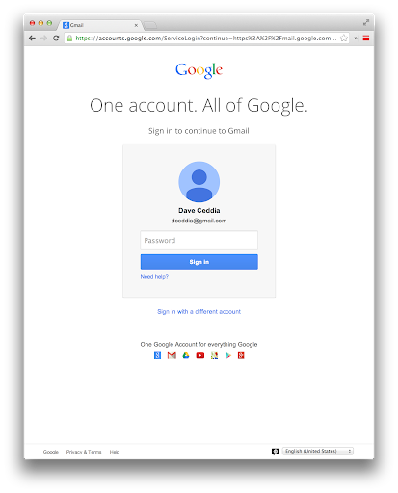
Models - single sign on
Prover
Issuer
Verifier

Slide 7
Models - id, password
Prover
Verifier, Issuer

Slide 8
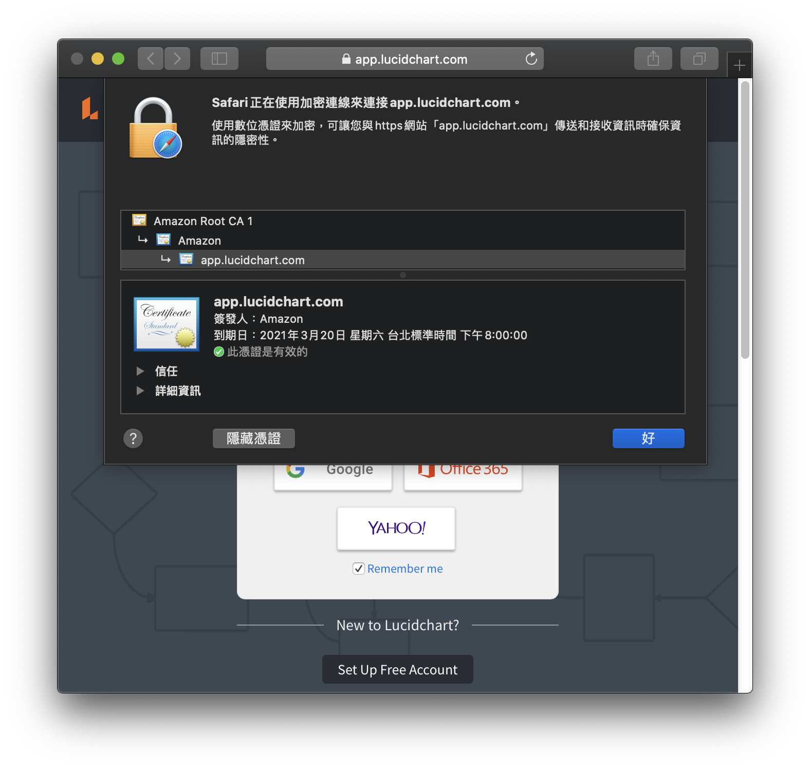

Slide 9
Model - PKI certificate
Prover
Verifier
Issuer

Slide 10
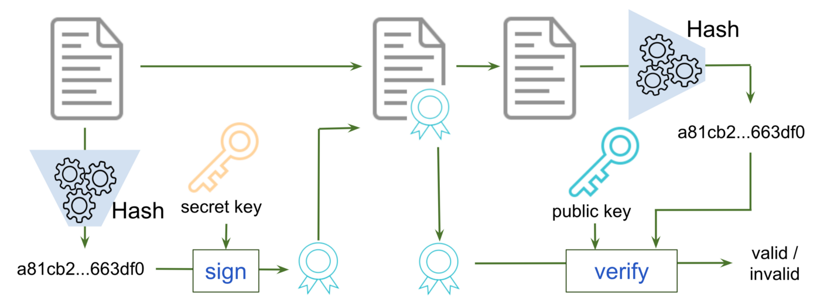
Digital signature
1. Document is not tampered; 2. signature is signed by the signer.

Slide 11
With digital signature, one can ...
Proof itself over some targets.
“ I have a dream … ” - Martin Luther King
pk_MLK

Slide 12
CA issues certificates to provers, to claim a user use a public key which is valid before a time.
This is Government, I know Bob, he is using public key pk_bob.
Certificate Authority
This is Bob, I’m using public key pk_evil.
I’m real Bob, I’m using public key pk_bob.
Evil
Bob

Slide 13
Model - PKI certificate
Prover
Verifier
Issuer
Lucidchart proves itself by signing some signature
Amazon as a CA ceritifies Lucidchart and garuantees its public key.

Slide 14
Public key infrastructure
All non-leaf nodes are call CA.
The first layer CAs are called root CAs; where root CAs are trusted by all entities.
CA issues certificats and CRLs (certificate revocation lists).
Amazon
Lucidchart

Slide 15
Vulnerabilities of PKI system
The root certificates are stored on computers. What if the root certificates are tampered?
2. What if the CRLs are tampered?

Slide 16
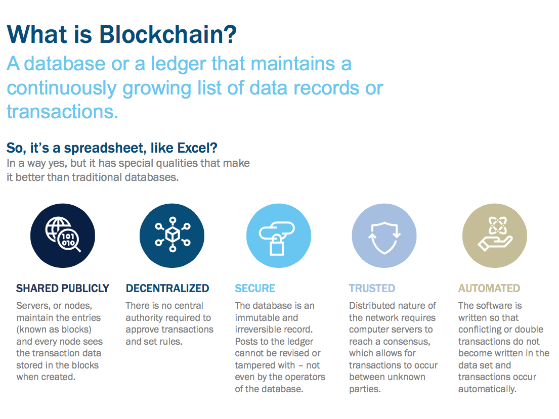

Slide 18
Blockchain solves vulnerabilities of PKI system
The root certificates are stored on computers. What if the root certificates are tampered?
2. What if the CRLs are tampered?
In Hyperledger Indy, data on blockchain is immutable.

Slide 19
Besides
PKI provides certificates which proof through digital signatues.
All attributes has to be revealed for verification.
Hyperledger Indy provides credentials which prove through zero-knowledge proof.
Attributes in credentials could be published, hidden, or challenged.

Slide 20
Zero-knowledge proof
Magic !!
Too complex to be clarified in hours. So we do not dive deeply.
I can proof “a statement” without telling the statement to verifiers.
Without leaking a secret x, I can:
Prove I know.
Prove x in the signature, make that signature verified valid.
Given a challenge y, prove x > y, x = y or x < y.

Slide 21
Take ID card for example
Digital signature
Zero-knowledge proof
Name: Bob
Nationality: Taiwan
Age: 29
Spouse: Alice
Parents: William & Mary
Gender: Male
Published: Bob
Published: Taiwan
Challenged: > 18 ? yes
Hidden
Hidden
Hidden
All published

Slide 22
Sumarization
Hyperledgr Indy is a decentralize identity system, it
follows the VIP model (verifier, issuer and prover); every entities in Indy can play all three roles.
solves the risk of single point failure in PKI architecture.
increases the flexibility and privacy by replacing digital signature using zero-knowledge proofs.
Detial Github

Slide 23
Thank you for your attension!
References
Visualizing The World’s 100 Most Valuable Brands in 2019
《動物森友會》大頭菜禮拜幾賣最好？「大頭菜走勢一鍵診斷器」告訴你
Digital signature
File:Evil lilyu.svg
Applications of Blockchain Technology in Fintech
Hyperledger Summer Internship, 2018 edition: Hyperledger Indy (part 2)

