Slide 1
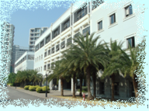
Key Management in Cryptography : Issues and Progress
Presenter: Dr. Chien-Ming Chen
1

Slide 2
Personal Introduction
Chien-Ming Chen, Ph.D.
(Associate Professor)
Network Security
Cryptography
IoT, Cloud computing, Mobile Internet, blockchain etc….
Published more than 140 papers
(80 journal papers including 60 SCI papers)
Executive Editor
International Journal of Information and Computing Security
Associate Editor
IEEE ACCESS
2012.10--2018.08, Harbin Institute of Technology (Shenzhen)
2018.09—now, Shandong University of Science and Technology
2

Slide 3
Outline
Cryptography
Authenticated Key Exchange Schemes
My Related Research

Slide 4
Introduction of Cryptography
1
规格严格 功夫到家
4

Slide 5
Outline
Data Hiding
  Steganography (藏匿學)
  Cryptography（密碼學）

Slide 6
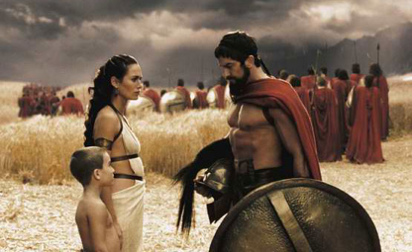
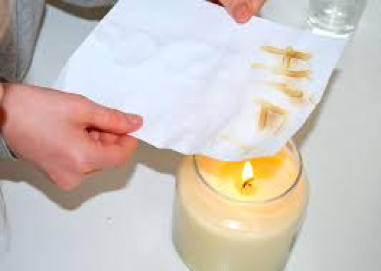
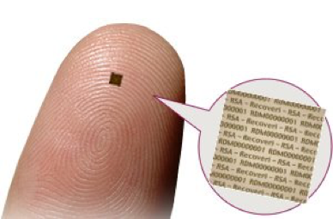
Steganography
Physical
  wax tablet
  messenger’s body
  invisible ink
  microdots

Slide 7
「我聞西方大士，為人了卻凡心。秋來明月照蓬門，香滿禪房出徑。屈指靈山會後，居然紫竹成林。童男童女拜觀音，僕僕何嫌榮頓。」
-西江月 唐伯虎

Slide 8

各待陸渾求一尉
位高方稱白髭須
同是先朝揀拔人
學易假年天若許
大兒結束隨商旅
家居瓊館海山隅
好伴寒松澗壑聲
-藏頭詩產生器

Slide 9
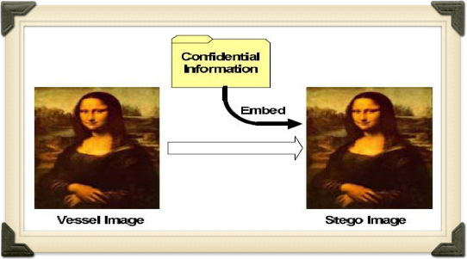
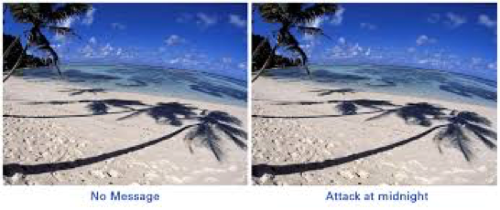
Steganography
Digital
  photo, video, audio etc

Slide 10
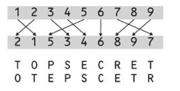
Cryptography
Covert ordinary information into unintelligible gibberish
  transposition
  substitution
A B C D E … X Y Z
r z k a t … b n s
Plaintext: C A D E
Ciphertext: k r a t

Slide 11
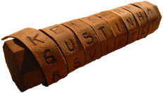
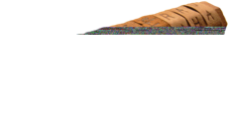
Cryptography
Scytale
  First mentioned in the 7th century BC

Slide 12

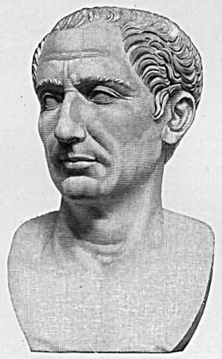
Cryptography
Caesar Cipher
58 BC

Slide 13
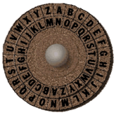
Caesar Cipher
Substitution
  Each letter is translated to the letter a fixed number of letters after it in the alphabet
  Julius Caesar only used a shift of 3 (Primitive Caesar Cipher)
Plaintext Cipher
  A E
  B F
C G
D H
E I
F J
. .
. .
. .
U Y
V Z
W A
X B
Y C
Z D
c=(m+4) mod 26

Slide 14
Brute-Force Cryptanalysis

Slide 15
Monoalphabetic Cipher
rather than just shifting the alphabet
could shuffle the letters arbitrarily
each plaintext letter maps to a different random ciphertext letter
Plain: abcdefghijklmnopqrstuvwxyz
Cipher: DKVQFIBJWPESCXHTMYAUOLRGZN
Plaintext: ifwewishtoreplaceletters
Ciphertext: WIRFRWAJUHYFTSDVFSFUUFYA

Slide 16
Monoalphabetic Cipher
now we have a total of 26!=4 x 10²⁶ possibilities
might think it is secure
but would be !!!WRONG!!!
problem is language characteristics

Slide 17
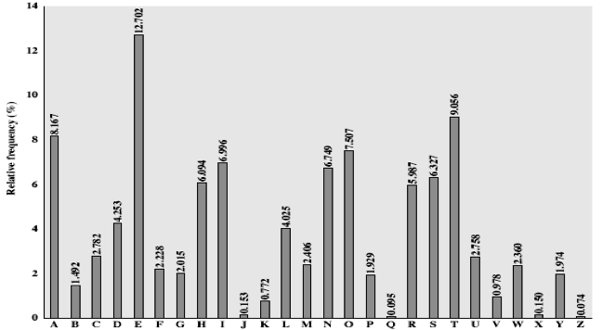
English Letter Frequencies

Slide 18
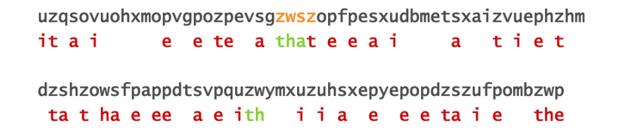
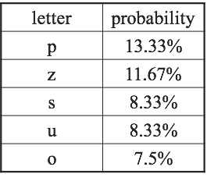
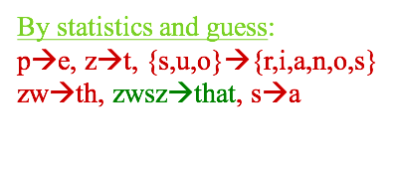
Monoalphabetic Cipher: Attack

Slide 19
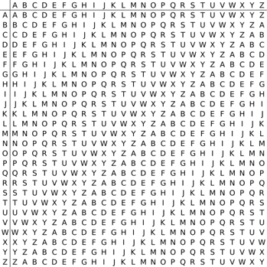
Vigenere Cipher (1585)

Slide 20
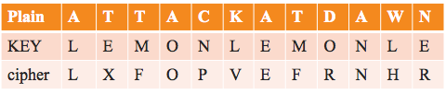
Vigenere Cipher
An example
  plaintext: ATTACKATDAWN
  key: lemon

Slide 21
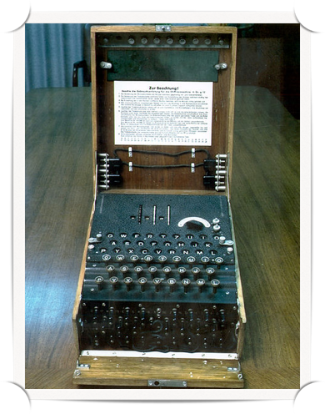
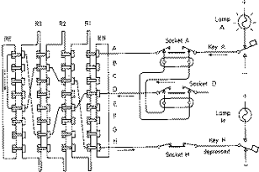
Enigma Rotor Machine
The computer era
  Enigma Rotor Machine
  adopted by Germany military and government during World War II.

Slide 22
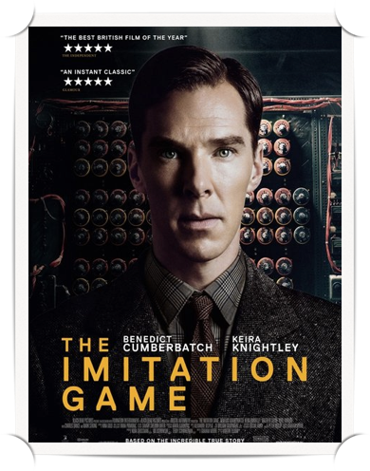
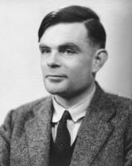
Enigma Rotor Machine
Enigma is broken by Alan Turing!!

Slide 23
DES
DES(Data Encryption Standard)
  Designed by IBM
  selected by the NIST (National Institute of Standards and Technology) as an official FIPS (Federal Information Processing Standards) standard in 1976
  Since the early 90’s, theoretical attacks on the DES have been developed.

Slide 24
AES
AES (Advanced Encryption Standard)
  NIST issued a request for possible candidates in Sept. 1997
  Submissions are due by June 15, 1998.
  1999/04/05 (5 candidate algorithms)
    Mars—IBM (USA)
    RC6 — RSADSI(USA)
    Rijndael—V. Rijmen and J. Daemen (Belgium)
    Serpent— R. Anderson et al. (UK, Israel, Norway)
    Twofish—B. Schneier et al. (USA)
  2012/10/02: Rijndael was selected as AES

Slide 25
Authenticated Key Exchange Schemes
2
规格严格 功夫到家
25

Slide 26
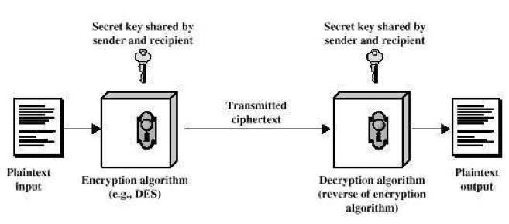
The KEY Crisis!!!!!!!!!!

Slide 27
Key Crisis
Two ways to solve this problem
  asymmetric cryptosystem
  key exchange

Slide 28
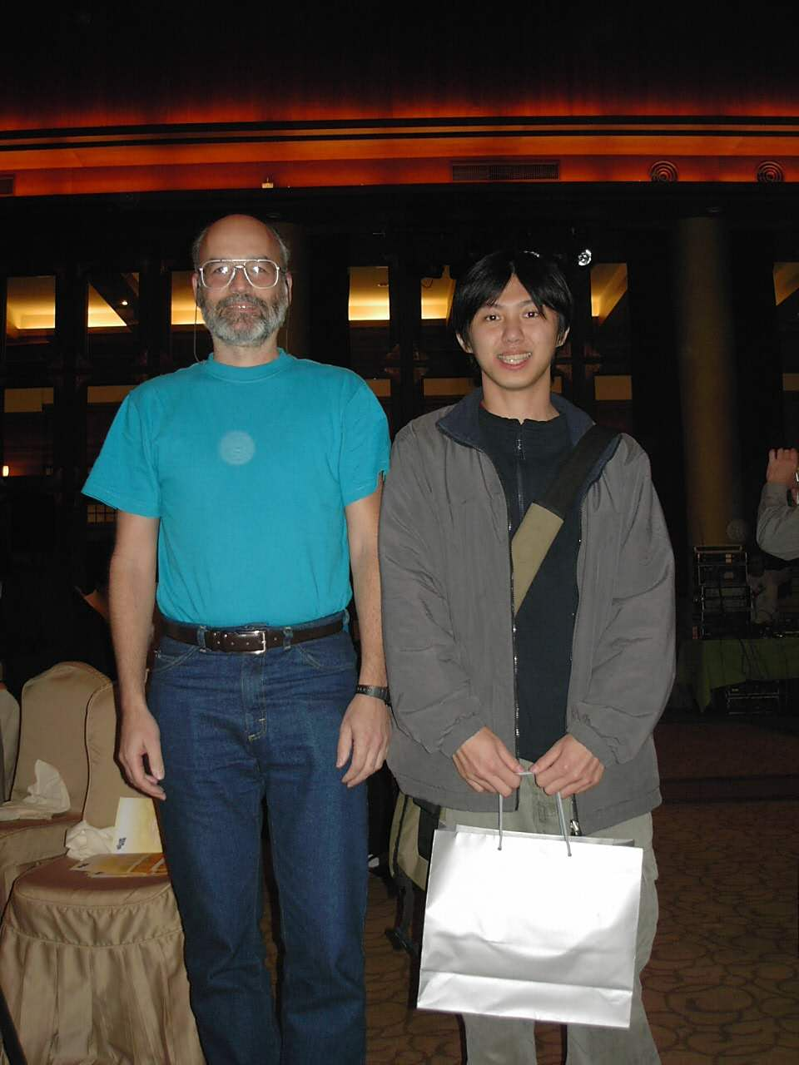
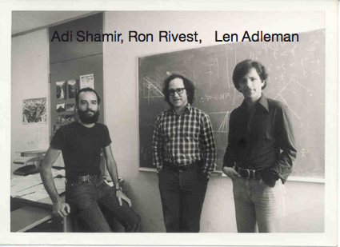
Asymmetric Cryptosystem
RSA
  Ron Rivest, Adi Shamir and Leonard Adleman
  proposed in 1977
  win 2002 Turing Award

Slide 29
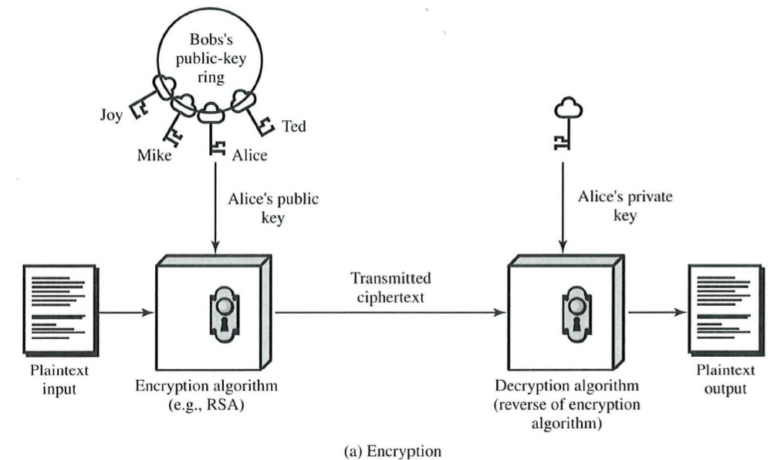
Asymmetric Cryptosystem

Slide 30
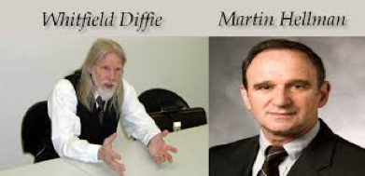
Key Exchange
Diffie-Hellman Key Exchange
  published by Whitfield Diffie and Martin Hellman in 1976.
  win 2015 Turing Award

Slide 31
One-Way Function
example of two-way fiction
  f(x)=x+2
one-way function
  easy to compute on every input
  hard to invert given the image of a random input

Slide 32
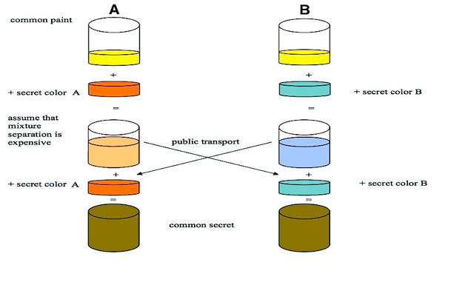
Diffie-Hellman Key Exchange

Slide 33
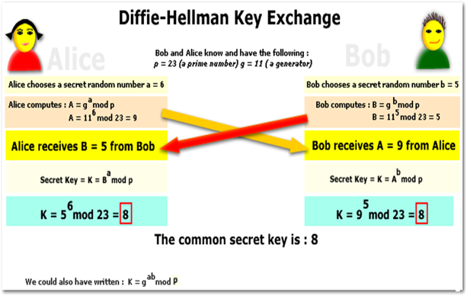
Man-in-the-Middle Attack

Slide 34
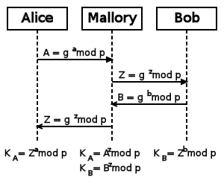

Slide 35
  Authenticated key exchange schemes
Various Authenticated Key Exchange (AKE) Schemes have been proposed.
A AKE scheme contains
  User registration phase (need a secure channel)
  Authentication and key exchange phase
    mutual authentication
    key exchange

Slide 36
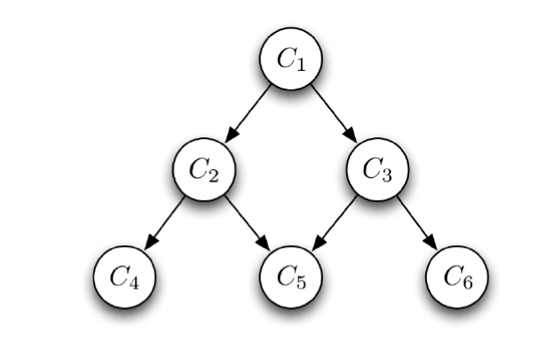
AKE Schemes
Two Party
Three Party
Group Key
Access Control
  Time-Bound
  Hierarchical
  Time-Bound Hierarchical

Slide 37
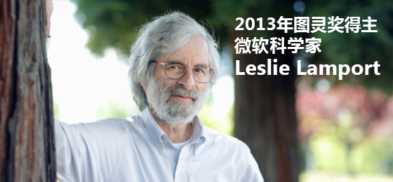
Lamport Protocol
Proposed by Leslie Lamport (1981)
  win 2013 Turing Award

Slide 38
Lamport Protocol
This protocol consists of two phases
  The Registration Phase
    The registration phase is performed only once
  The Authentication Phase
    The authentication phase is executed every time the user log in to the system.

Slide 39
Lamport Protocol
Registration Phase

Slide 40
Lamport Protocol
i^{th} authentication phase

Slide 41
Lamport Protocol
Two Practical Difficulties
  High hash overhead
  Requirement of resetting the verifier (password)

Slide 42
SAS (Simple and Secure) Protocol
Proposed in 2000
This protocol consists of two phases
  The Registration Phase
    The registration phase is performed only once
  The Authentication Phase
    The authentication phase is executed every time the user log in to the system.

Slide 43
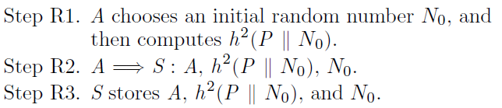
SAS Protocol
Registration Phase

Slide 44
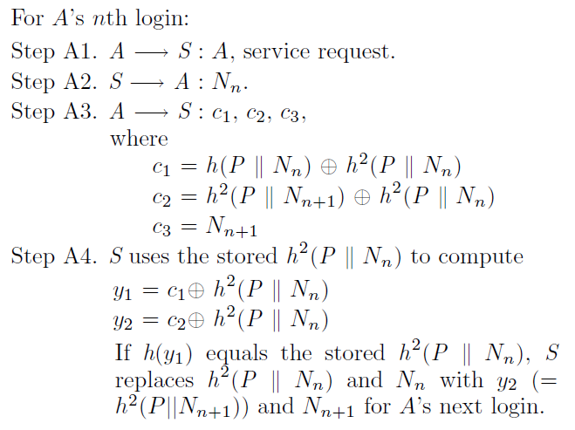
SAS Protocol

Slide 45
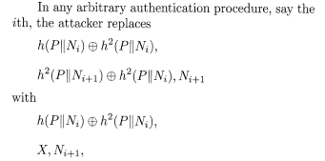
Attacks on SAS Protocol
Denial of Service Attack on SAS

Slide 46
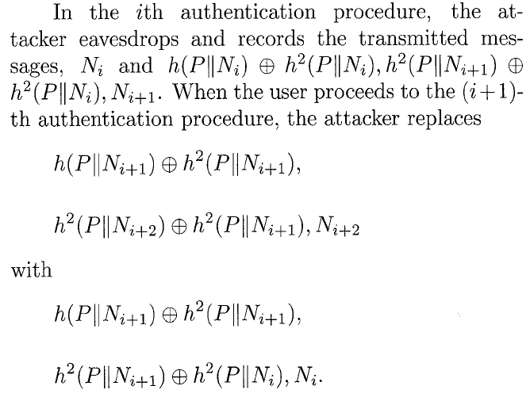
Attacks on SAS Protocol
Replay Attack on SAS

Slide 47
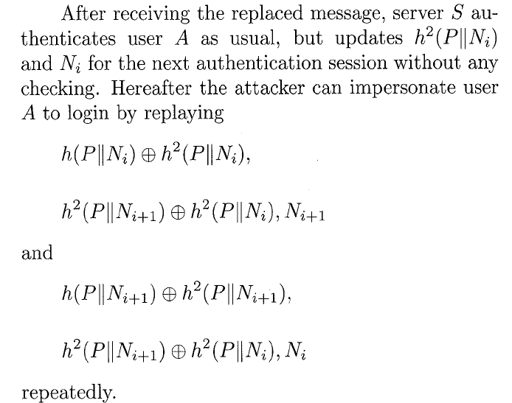

Slide 48
My Related Research
3
规格严格 功夫到家
48

Slide 49
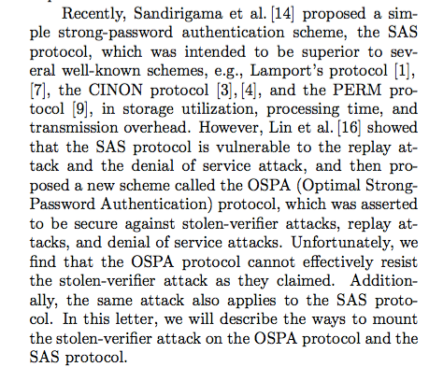
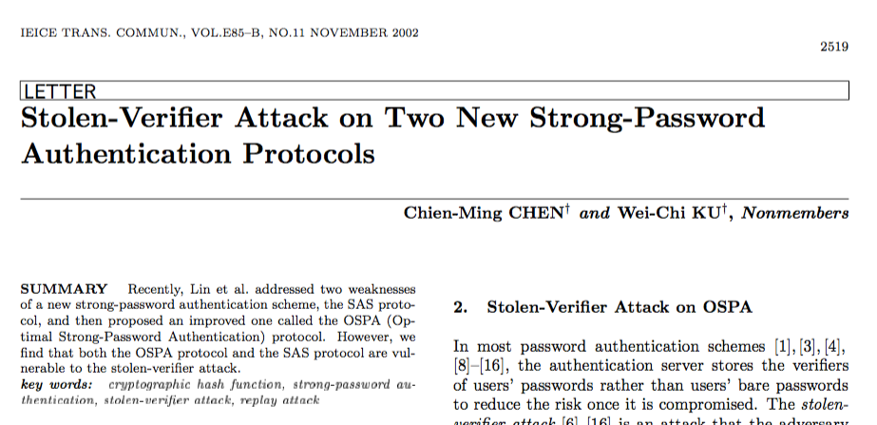
My First AKE Paper

Slide 50
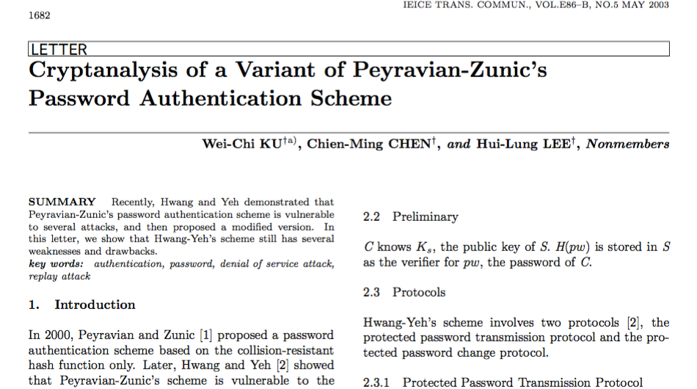
My Second AKE Paper

Slide 51
Evolution of Research of Key Management
Formal Proof
AKE for different kinds of applications and environments

Slide 52
AKE for Pay-TV Broadcasting Systems
In the past, two models for content access control in Pay-TV broadcasting systems have been proposed.
  Pay-per-channel, PPC
  Pay-per-view, PPC

Slide 53
AKE for Pay-TV Broadcasting Systems
We first define a new model, Flexible-PPC (F-PPC)
  Combines the properties and the advantages of PPC and PPV
  Propose a new conditional access system with a four-level key hierarchy.
“Flexible-Pay-Per-Channel: A New Model for Content Access Control in Pay-TV Broadcasting Systems,” IEEE Transactions on Multimedia, vol. 10, issue. 6, Page(s): 1109–1120, Oct. 2008.

Slide 54
Abstract Model of the Proposed Scheme

Slide 55
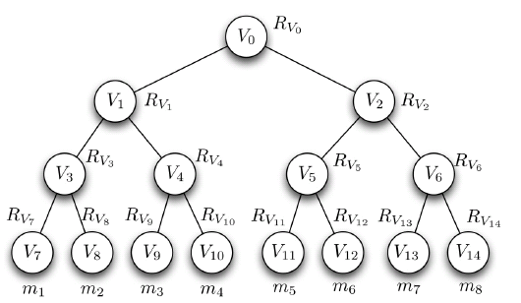
Key refreshment scheme
Our key refreshment scheme
  Members will obtain their secret number set
  Secret number set I_{mi}
    Contain several secret numbers of other leaf nodes
Notes:
In our design, each member will obtain their secret number set.
The secret number set contains several secret number of other leaf nodes.
For example, a member, m6, will obtain rv7………………

Slide 56
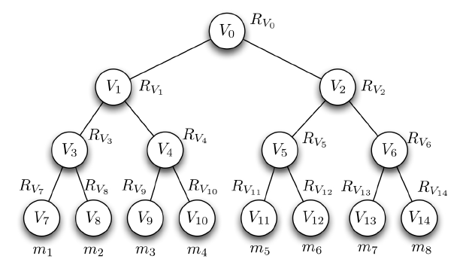

Key refreshment scheme
Member leaves
  Assume m₃ assigned to v₉ leaves the group
    Server broadcasts {leave, m₃} to all members
    All members but m₃ can calculate new group key
Notes:
If a member leaves this group, of course, the common group key must be updated.
Let’s use a simple example to explain how to do it.
If a member, m3 leaves the group, server broadcasts xxxxxx.
All members but m3 can calculate new group key……….
Since m3 does not know the secret number of rv9, he cannot calculate new key since he does not have rv9

Slide 57
Key refreshment scheme

Slide 58
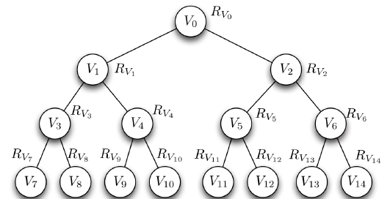
Key refreshment scheme
Member re-joins:
  When m₃ re-joins the group
m₃
m₃
Notes:
Here we consider the case that a member left the group and join the group again. He may be assign to the different leaf.
It will cause a security problem.
Let’s use this figure as example. M3 who is assigned to v9 knows the value rv1, rv2, and rv10. One day, he left the group and join the group again. This time m3 is assigned to v11. Thus, server will only transmit rv1, rv6 and rv11 to m3.
However, m3 has already obtained rv2 which he should not obtain.
Fortunately, this problem can be solved if the server assign m3 to v9 where he was originally assigned.

Slide 59
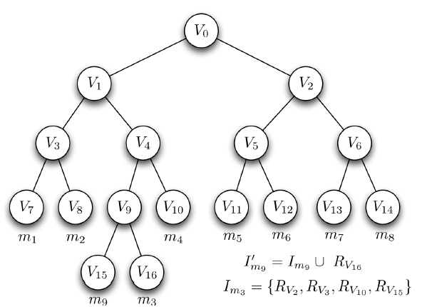
Key refreshment scheme
Member re-joins:
  When m₃ re-joins the group
Notes:
However, v9 man have been assigned to another member.
Here we use this figure to illustrate how to overcome this situation.
If v9 has assigned to another member, m9, the server can append two child nodes to v9.
The server then moves m9 to the left child and assign m3 to the right child.
Of course, server needs to transmit new secret number set to m9 and m3.
The new secret number set for m9 is original set union rv16 and new secret number set for m3 contains 4 elements.

Slide 60
AKE for Mobile Devices
We present a bipartite and a tripartite authentication protocol using a temporary confidential channel.
"A Scalable Transitive Human-Verifiable Authentication Protocol for Mobile Devices," IEEE Transactions on Information Forensics and Security, Vol.8, Issue 8, page(s): 1318-1330, August, 2013.

Slide 61
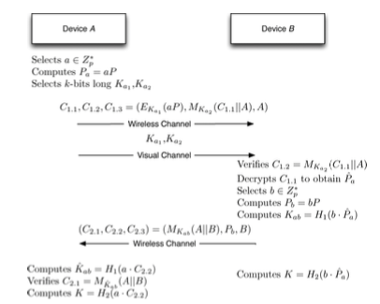
AKE for Mobile Devices

Slide 62
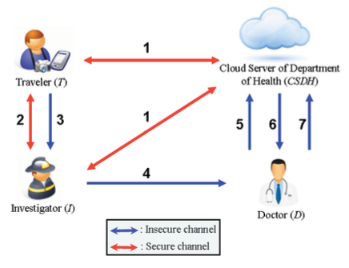
AKE for Mountaineering Events in Emergency System
In 2014, Chen et al. proposed a cloud-based emergency response and SOS system for mountaineering travelers when they encounter dangers.

Slide 63
AKE for mountaineering events in emergency system
We found Chen et al.’s scheme has the following drawbacks.
  fails to protect traveler privacy.
  unfriendly design in registration phase.
  attacker may derive the password of the traveler if the attacker obtains this traveler’s mobile phone.
“A Provable Secure Private Data Delegation Scheme for Mountaineering Events in Emergency System,” IEEE Access, pp. 3410-3422, Feb. 2017

Slide 64
AKE for RFID
In 2016, Tewari and Gupta proposed a ultra-lightweight mutual authentication protocol for IoT devices using RFID.

Slide 66
AKE for RFID
We found their protocol is still vulnerable to a key disclosure attack.
At the end of this paper, we patched their protocol with a simple fix.
"On the security of a new ultra-lightweight authentication protocol in IoT environment for RFID tags", in Journal of Supercomputing, Volume 74, Issue 1, pp 65–70, Jan. 2018

Slide 67
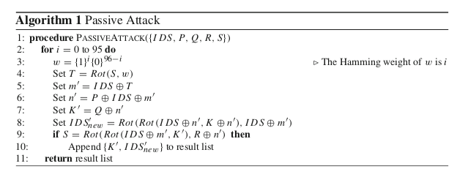

Slide 68
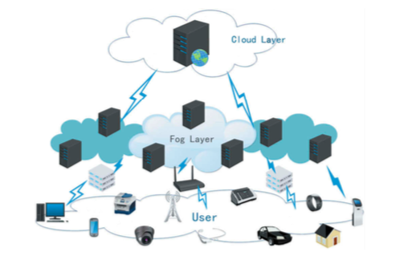
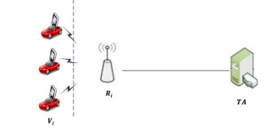
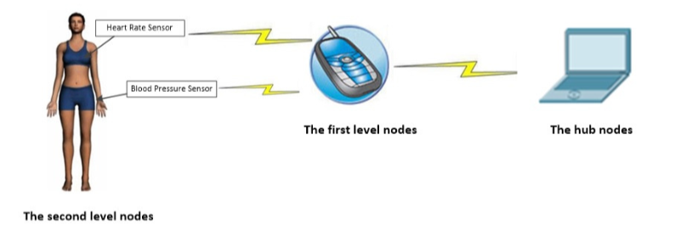
Current Works
Fog computing
VANET
Wireless Body Area Network
AKE + blockchain
Other applications?

Slide 69
Thank You !

