Slide 1
Information Visualization introduction
Ming-Te Chi
https://goo.gl/eSyajC
Notes:
2018

Slide 2
outline
Vis Examples
News Vis
Common pitfalls

Slide 3
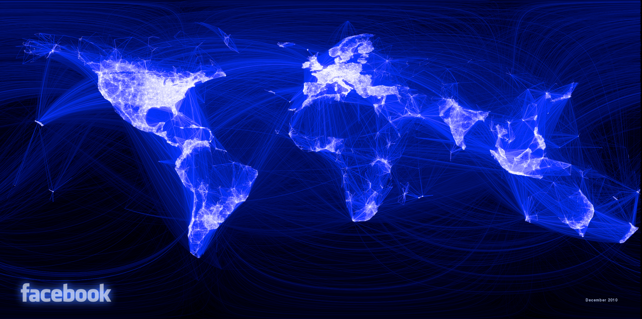
Facebook Friendship in 2010
Notes:
https://www.facebook.com/notes/facebook-engineering/visualizing-friendships/469716398919 500 million people, and a sample of about ten million pairs of friends, 2010

Slide 4
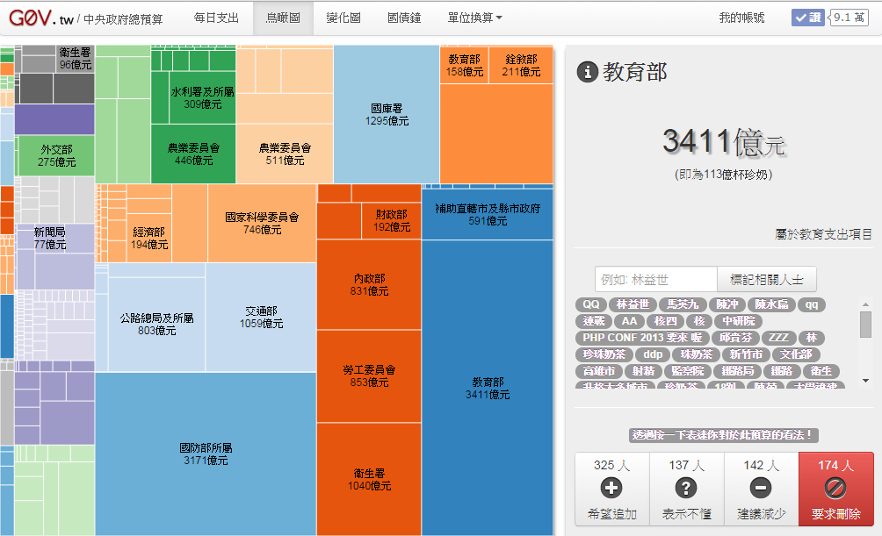
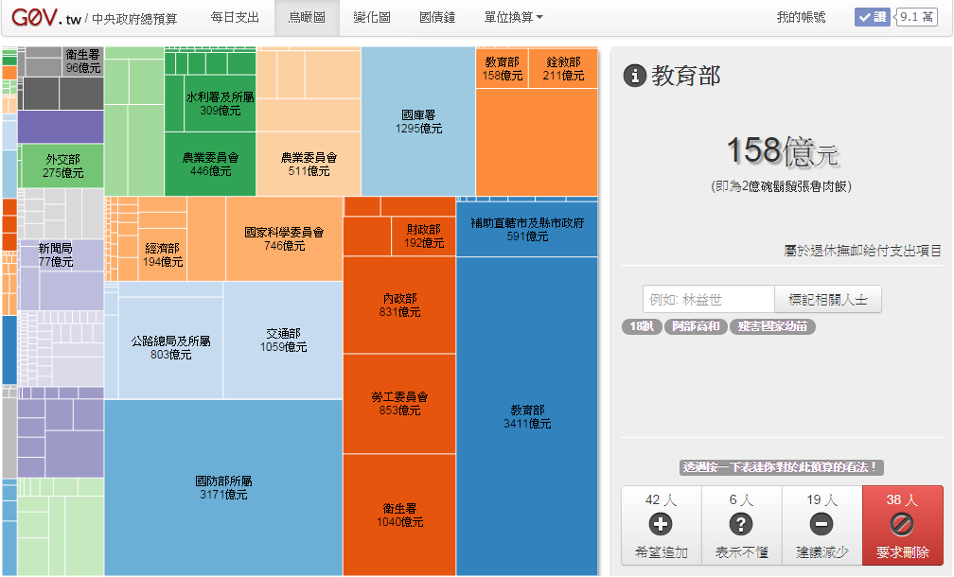
g0v 中央政府總預算
Notes:
http://budget.g0v.tw/view3

Slide 5
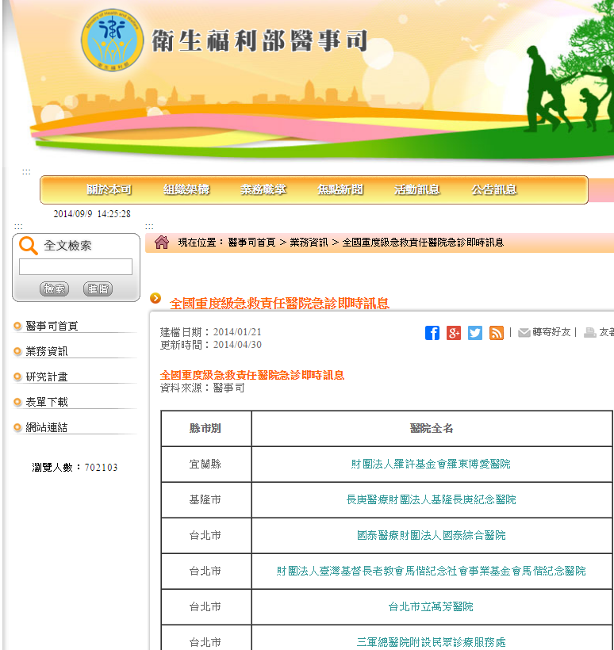

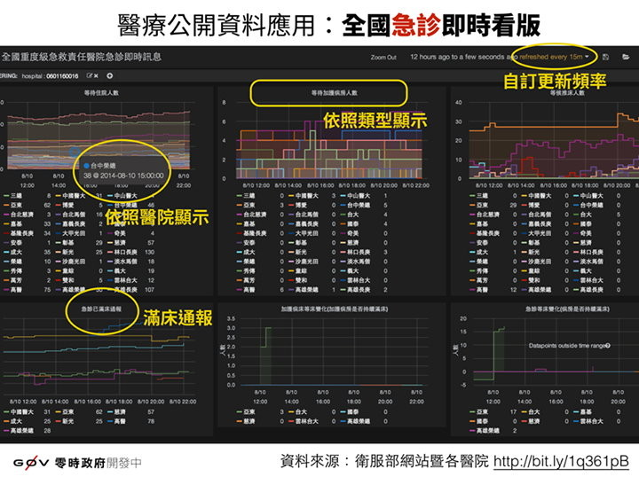
g0v全國重度級急救責任醫院急診即時訊息
Notes:
http://er.mohw.g0v.tw/#/dashboard/file/default.json 產出預期成效:
讓民眾得知目前各重症醫院 "擁塞" 程度
重大疾病爆發時間時, 各重症醫院承受程度 https://g0v.hackpad.com/vtLwiUfYgcc

Slide 6
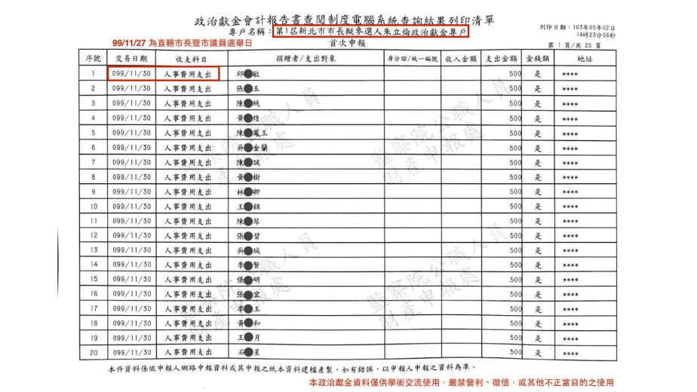
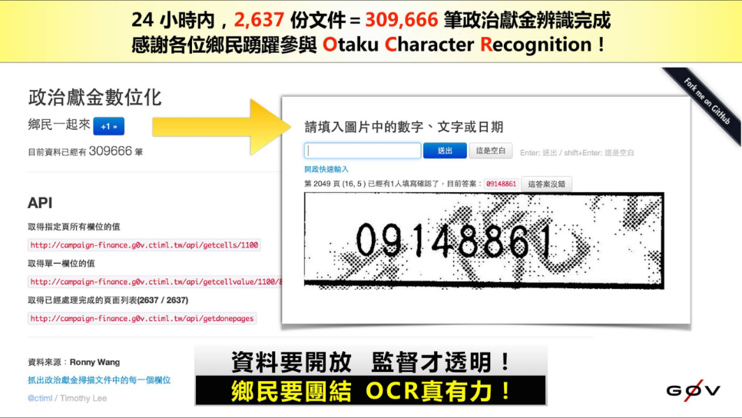
g0v 政治獻金
Notes:
https://www.facebook.com/cy.sunshine 群眾外包(Crowdsourcing) 一詞是由Jeff Howe 於2006 年提出，它的概念是將一些需要仰賴人力完成的工作透過特定的平台，外包給網路上不特定的一群自願者，處理的內容通常是較瑣碎、需要大量人力且電腦程式難以取代的工作。

Slide 7
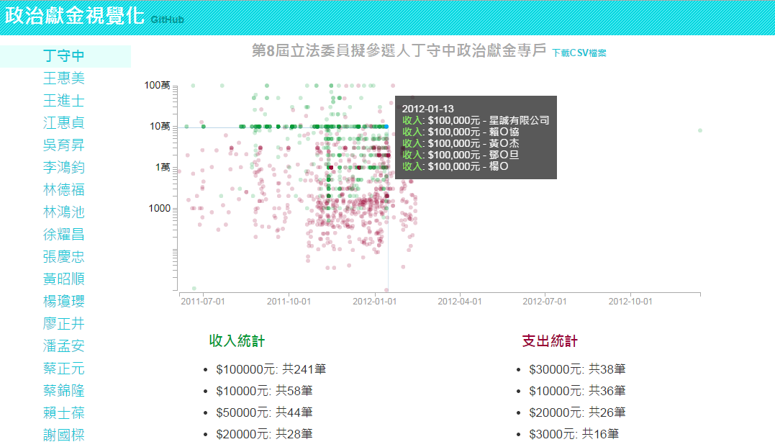
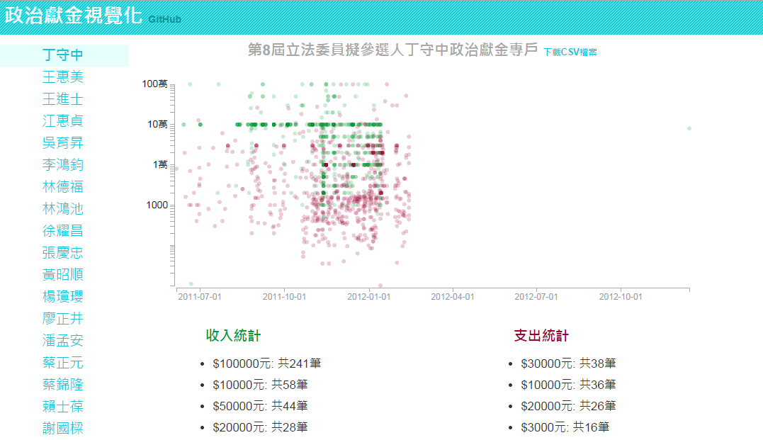
g0v 政治獻金視覺化
Notes:
http://fuyei.github.io/cf-viz/viz.htm

Slide 8
開放資料
社會議題
群眾參與
視覺化

Slide 9

Trend
Big data and open data
html5 web platform for interactive display
開放資料與資訊科技的群眾參與

Slide 10
Definition
The use of computer-generated, interactive, visual representations of data to amplify cognition.
[Card, Mackinlay, & Shneiderman 1999]
Computer-based visualization systems provide visual representations of datasets designed to help people carry out tasks more effectively.
Tamara Munzner

Slide 11

Text book
Visualization Analysis and Design. Munzner.
A K Peters Visualization Series, CRC Press, Visualization Series,
2014.

Slide 12
Outline
Visualization Analysis Framework
Analysis: What, Why, How
Spatial Layout
Color & Interaction
Guidelines and Examples

Slide 13
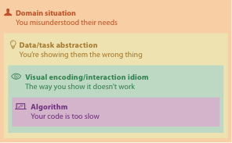
Why is validation difficult?
different ways to get it wrong at each level

Slide 14
Grading
Homework (40%)
Paper Presentation (15%)
Final Projects (45%)

Slide 15
Homework (40%)
Basic visualization using D3.js
Advance visualization using D3.js
News visualization (team work)
Cooperate with 新聞媒體實驗(大學報)
A組(1，2，3，4)，B組(6，7，8)

Slide 16
數據看台灣
Notes:
https://www.taiwanstat.com/realtime/
莊坤達

Slide 17
Paper Presentation (15%)
6/07, 6/14
before one of the classes: you each read paper on topic of your choice
during that class: you present it to everybody else (~10 min)

Slide 18
Final Projects (45%)
group of 2 ~ 3
Stages
pitches (oral, in class): 3/12
proposals (written): 4/02
Progress Presentations: 4/23
Final presentation(oral and report): 6/21

Slide 19
Final Projects
Programming
common case
three types
problem-driven design studies (target specific task/data)
technique-driven (explore design choice space for encoding or interaction idiom)
algorithm implementation (as described in previous paper)
ANALYSIS
analyze a dataset/problem using a variety of existing visualization tools of your choosing, as well as analyze the strengths and weaknesses of those tools and discuss in detail
this option is suitable for non-CS students

Slide 20
News Visualization

Slide 21
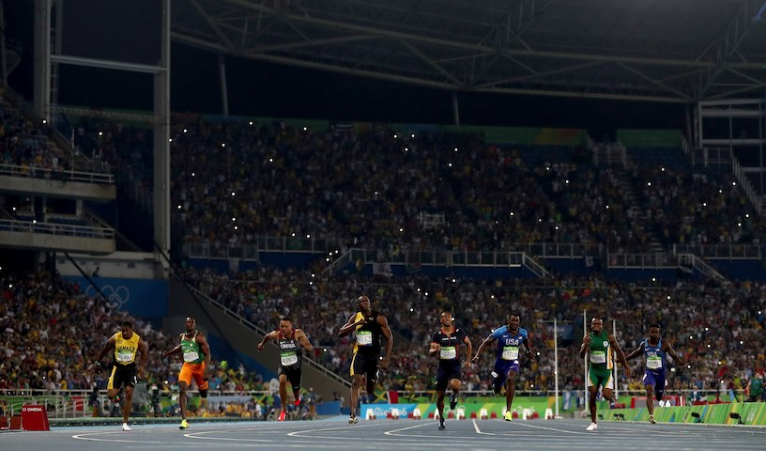
NY Times - Men’s 100-Meter Sprint
 | Gold | Silver | Bronze
2012 | 9.63 | 9.75 | 9.79
2008 | 9.69 | 9.89 | 9.91
2004 | 9.85 | 9.86 | 9.87
…
Olympic 2012

Slide 23


Slide 24
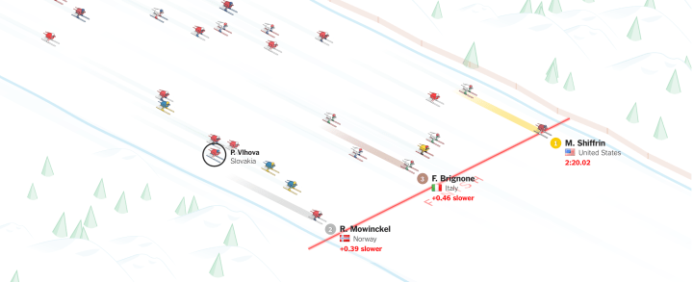
Mikaela Shiffrin pulling away for gold

Slide 25
數位敘事
互動
動畫

Slide 26
How Uber Uses Psychological Tricks to Push Its Drivers’ Buttons

Slide 27
互動
模擬
遊戲

Slide 28
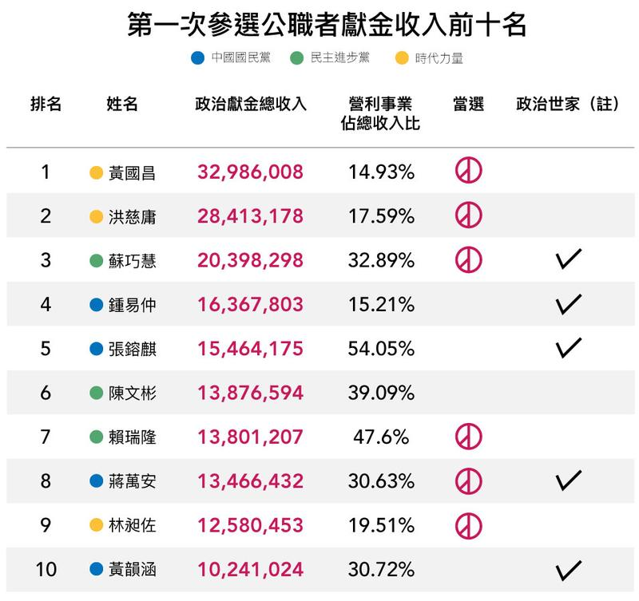
鏡周刊-數讀政治獻金

Slide 29
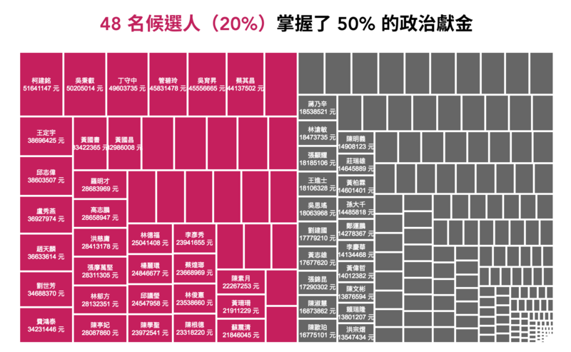

Slide 30
關鍵評論-中南部人口減少有多嚴重？

Slide 31
Resource
NY Times - Flowingata
Information is beautiful awards
D3.js - gallery

Slide 32
Resource

Slide 33

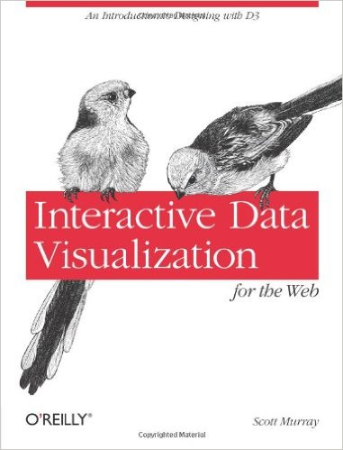
Reference book
視覺化資料 ─100% 全腦吸收大數據，直入神經元。
陳為、沈則潛、陶煜波。
佳魁資訊。2014
Interactive Data Visualization for the Web: An Introduction to Designing with D3
Scott Murray
O'Reilly Media; 1 edition (April 5, 2013) (2ed Oct, 2017)

Slide 34
Reference conference
IEEE VIS conference
VAST, InfoVis, SciVIs
IEEE PacificVis
ACM Siggraph
Notes:
VAST: Visual Analytics Science and Technology

Slide 35
SciVis
InfoVis
continuous data
inherent spatial position
from computer graphics
algorithmic focus
discrete data
abstract
from HCI
usability focus
Notes:
From miriah2012 L02-design

Slide 36
Reference
Stanford Vis Group
http://vis.stanford.edu/papers/
UCDavis center for visualization
http://vis.ucdavis.edu/
PKU Visualization and Visual Analytics Group
浙江大学可视分析小组

Slide 37
Introduction

Slide 38
Definition
Computer-based visualization systems provide visual representations of datasets designed to help people carry out tasks more effectively.
Tamara Munzner
Why?
Trade-off

Slide 39
Why have a human in the loop?
Computer-based visualization systems provide visual representations of datasets designed to help people carry out tasks more effectively.
Visualization is suitable when there is a need to augment human capabilities rather than replace people with computational decision-making methods.
don’t need vis when fully automatic solution exists and is trusted
many analysis problems ill-specified
don’t know exactly what questions to ask in advance
possibilities
long-term use for end users (e.g. exploratory analysis of scientific data)
presentation of known results
stepping stone to better understanding of requirements before developing models
help developers of automatic solution refine/debug, determine parameters
help end users of automatic solutions verify, build trust

Slide 40
Why have a Computer in the loop?

Slide 41

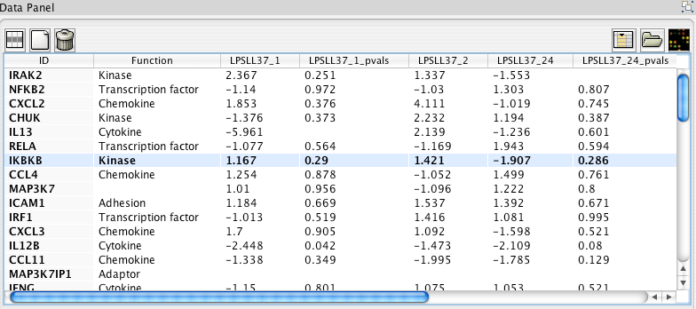
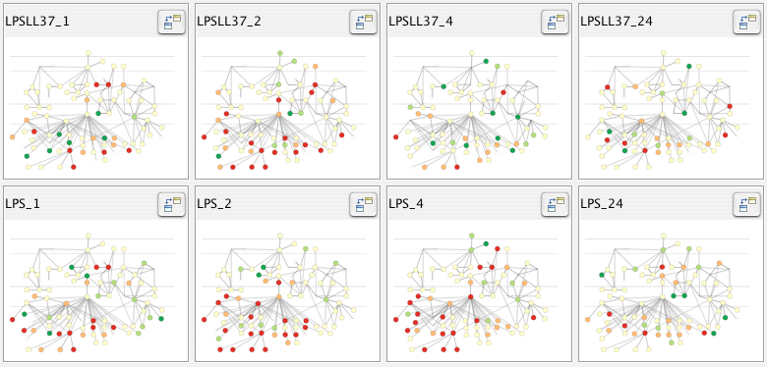
Why use an external representation?
Computer-based visualization systems provide visual representations of datasets designed to help people carry out tasks more effectively.
external representation: replace cognition with perception
[Cerebral: Visualizing Multiple Experimental Conditions on a Graph with Biological Context. Barsky, Munzner, Gardy, and Kincaid. IEEE TVCG (Proc. InfoVis) 14(6):1253-1260, 2008.]

Slide 42
Why depend on vision?
Computer-based visualization systems provide visual representations of datasets designed to help people carry out tasks more effectively.
human visual system is high-bandwidth channel to brain
overview possible due to background processing
subjective experience of seeing everything simultaneously
significant processing occurs in parallel and pre-attentively
sound: lower bandwidth and different semantics
overview not supported
subjective experience of sequential stream
touch/haptics: impoverished record/replay capacity
only very low-bandwidth communication thus far
taste, smell: no viable record/replay devices

Slide 43
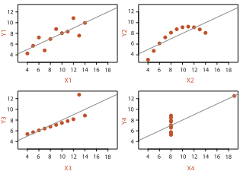
Why represent all the data?
Computer-based visualization systems provide visual representations of datasets designed to help people carry out tasks more effectively.
summaries lose information, details matter
confirm expected and find unexpected patterns
assess validity of statistical model
Anscombe's Quartet
Identical statistics
x mean | 9
x variance | 10
y mean | 7.5
y variance | 3.75
x/y correlation | 0.816

Slide 44
Why focus on tasks and effectiveness?
Computer-based visualization systems provide visual representations of datasets designed to help people carry out tasks more effectively.
tasks serve as constraint on design (as does data)
idioms do not serve all tasks equally!
challenge: recast tasks from domain-specific vocabulary to abstract forms
most possibilities ineffective
validation is necessary, but tricky
increases chance of finding good solutions if you understand full space of possibilities
what counts as effective?
novel: enable entirely new kinds of analysis
faster: speed up existing workflows

Slide 45
What resource limitations are we faced with?
Vis designers must take into account three very different kinds of resource limitations: those of computers, of humans, and of displays.
Computational limits
processing time
system memory
Human limits
human attention and memory
Display limits
pixels are precious resource, the most constrained resource
information density: ratio of space used to encode info vs unused whitespace
tradeoff between clutter and wasting space, find sweet spot between dense and sparse

Slide 46
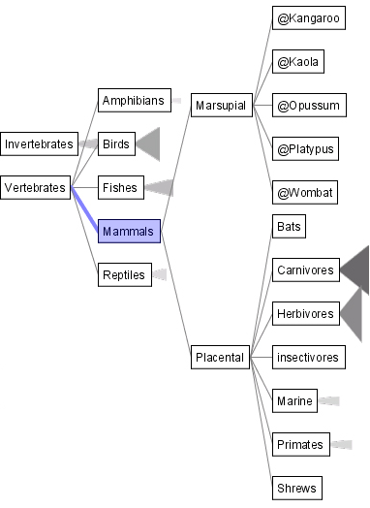
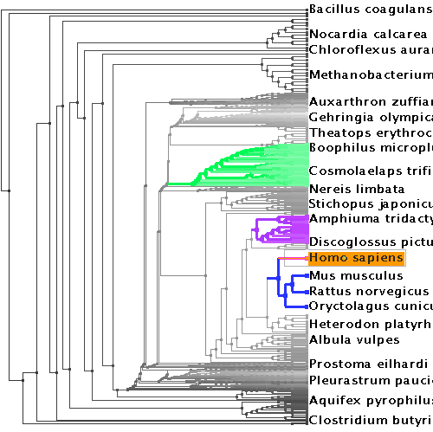
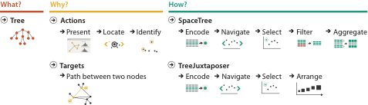

Why analyze?
SpaceTree
TreeJuxtaposer
imposes structure on huge design space
scaffold to help you think systematically about choices
analyzing existing as stepping stone to designing new
most possibilities ineffective for particular task/data combination
[SpaceTree: Supporting Exploration in Large Node Link Tree, Design Evolution and Empirical Evaluation. Grosjean, Plaisant, and Bederson. Proc. InfoVis 2002, p 57–64.]
[TreeJuxtaposer: Scalable Tree Comparison Using Focus+Context With Guaranteed Visibility. ACM Trans. on Graphics (Proc. SIGGRAPH) 22:453– 462, 2003.]

Slide 47
Further reading
Visualization Analysis and Design. Munzner. AK Peters Visualization Series, CRC Press, 2014.
Chap 1: What’s Vis, and Why Do It?

