Slide 1

Data Visualization use D3 . js
Speaker: 徐瑄甫

Slide 2
Browser-Based UI
Browser
HTML -> Structure
CSS -> Appearance
  Font
  Background
  Image
  Color, Size, Position
javascript (JS) -> Logic
  Control Everything
  in the Browser
  Library, Ex:

Slide 3
Example

Slide 4
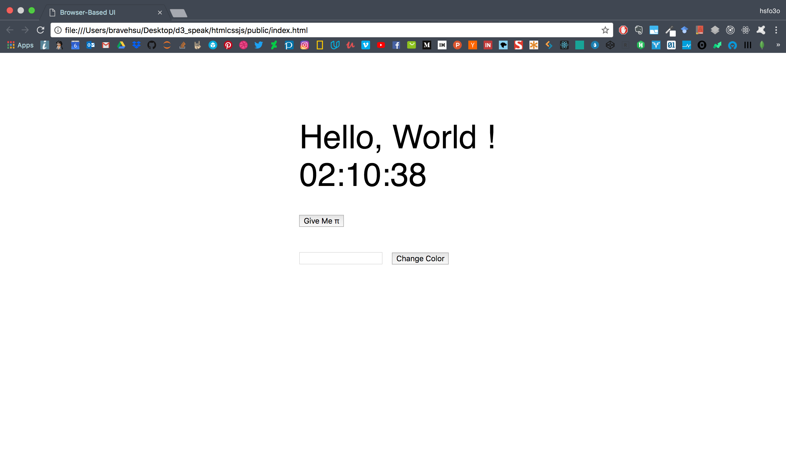

Slide 5
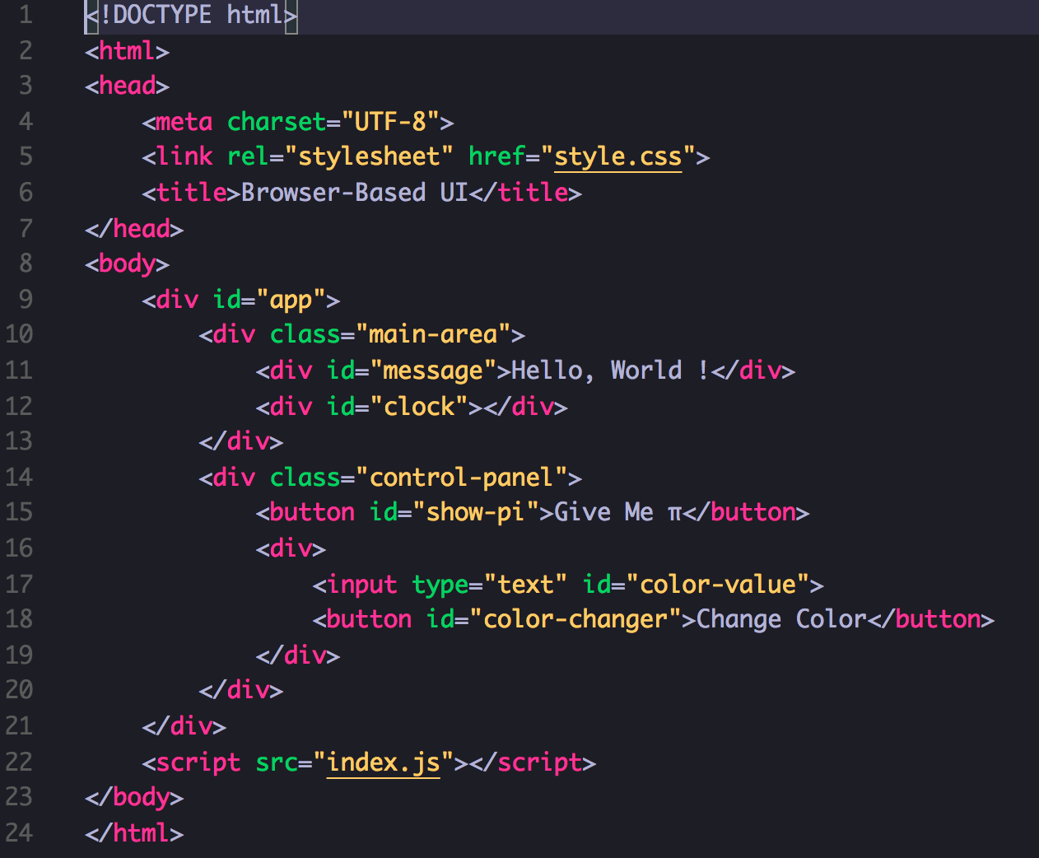
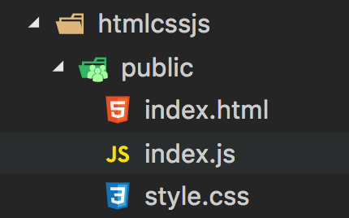
Example

Slide 6
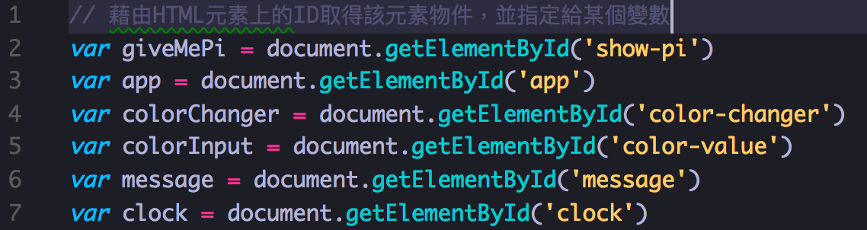
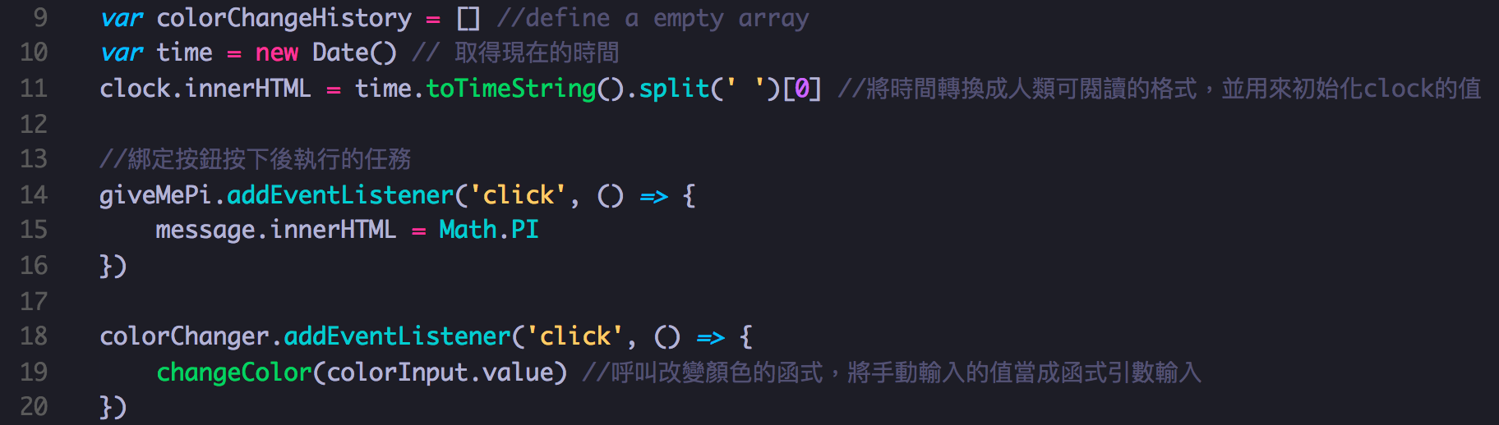
Example - index.js

Slide 7
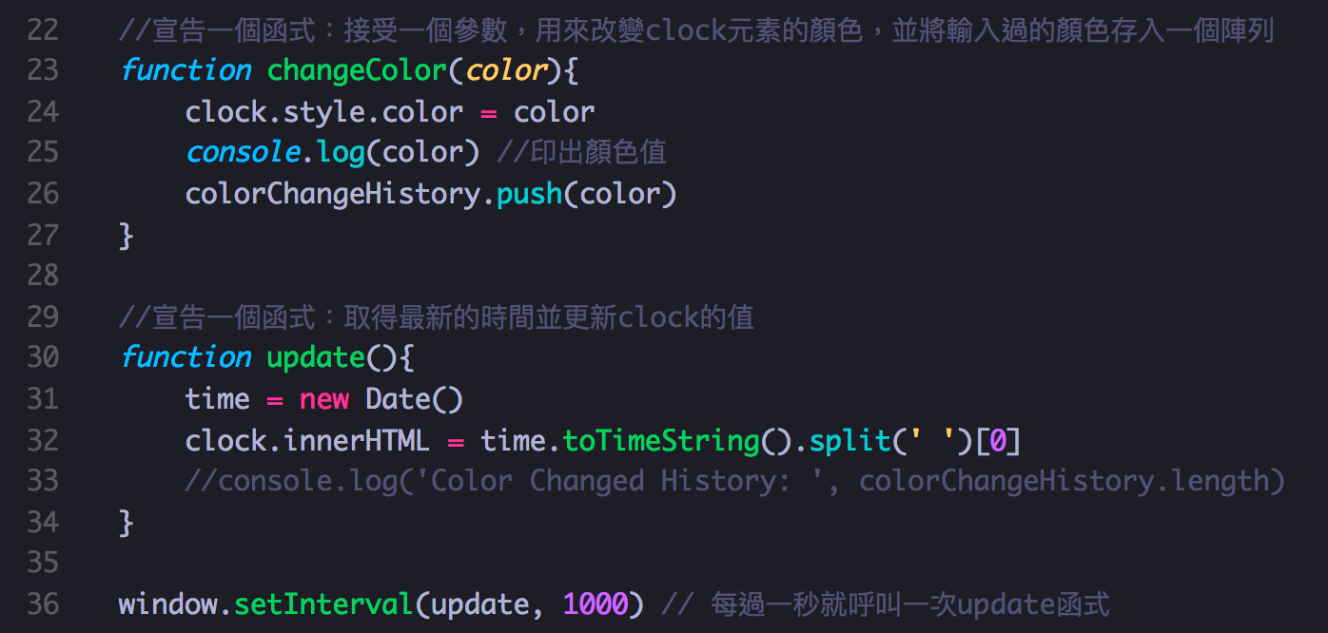
Example - index.js

Slide 8
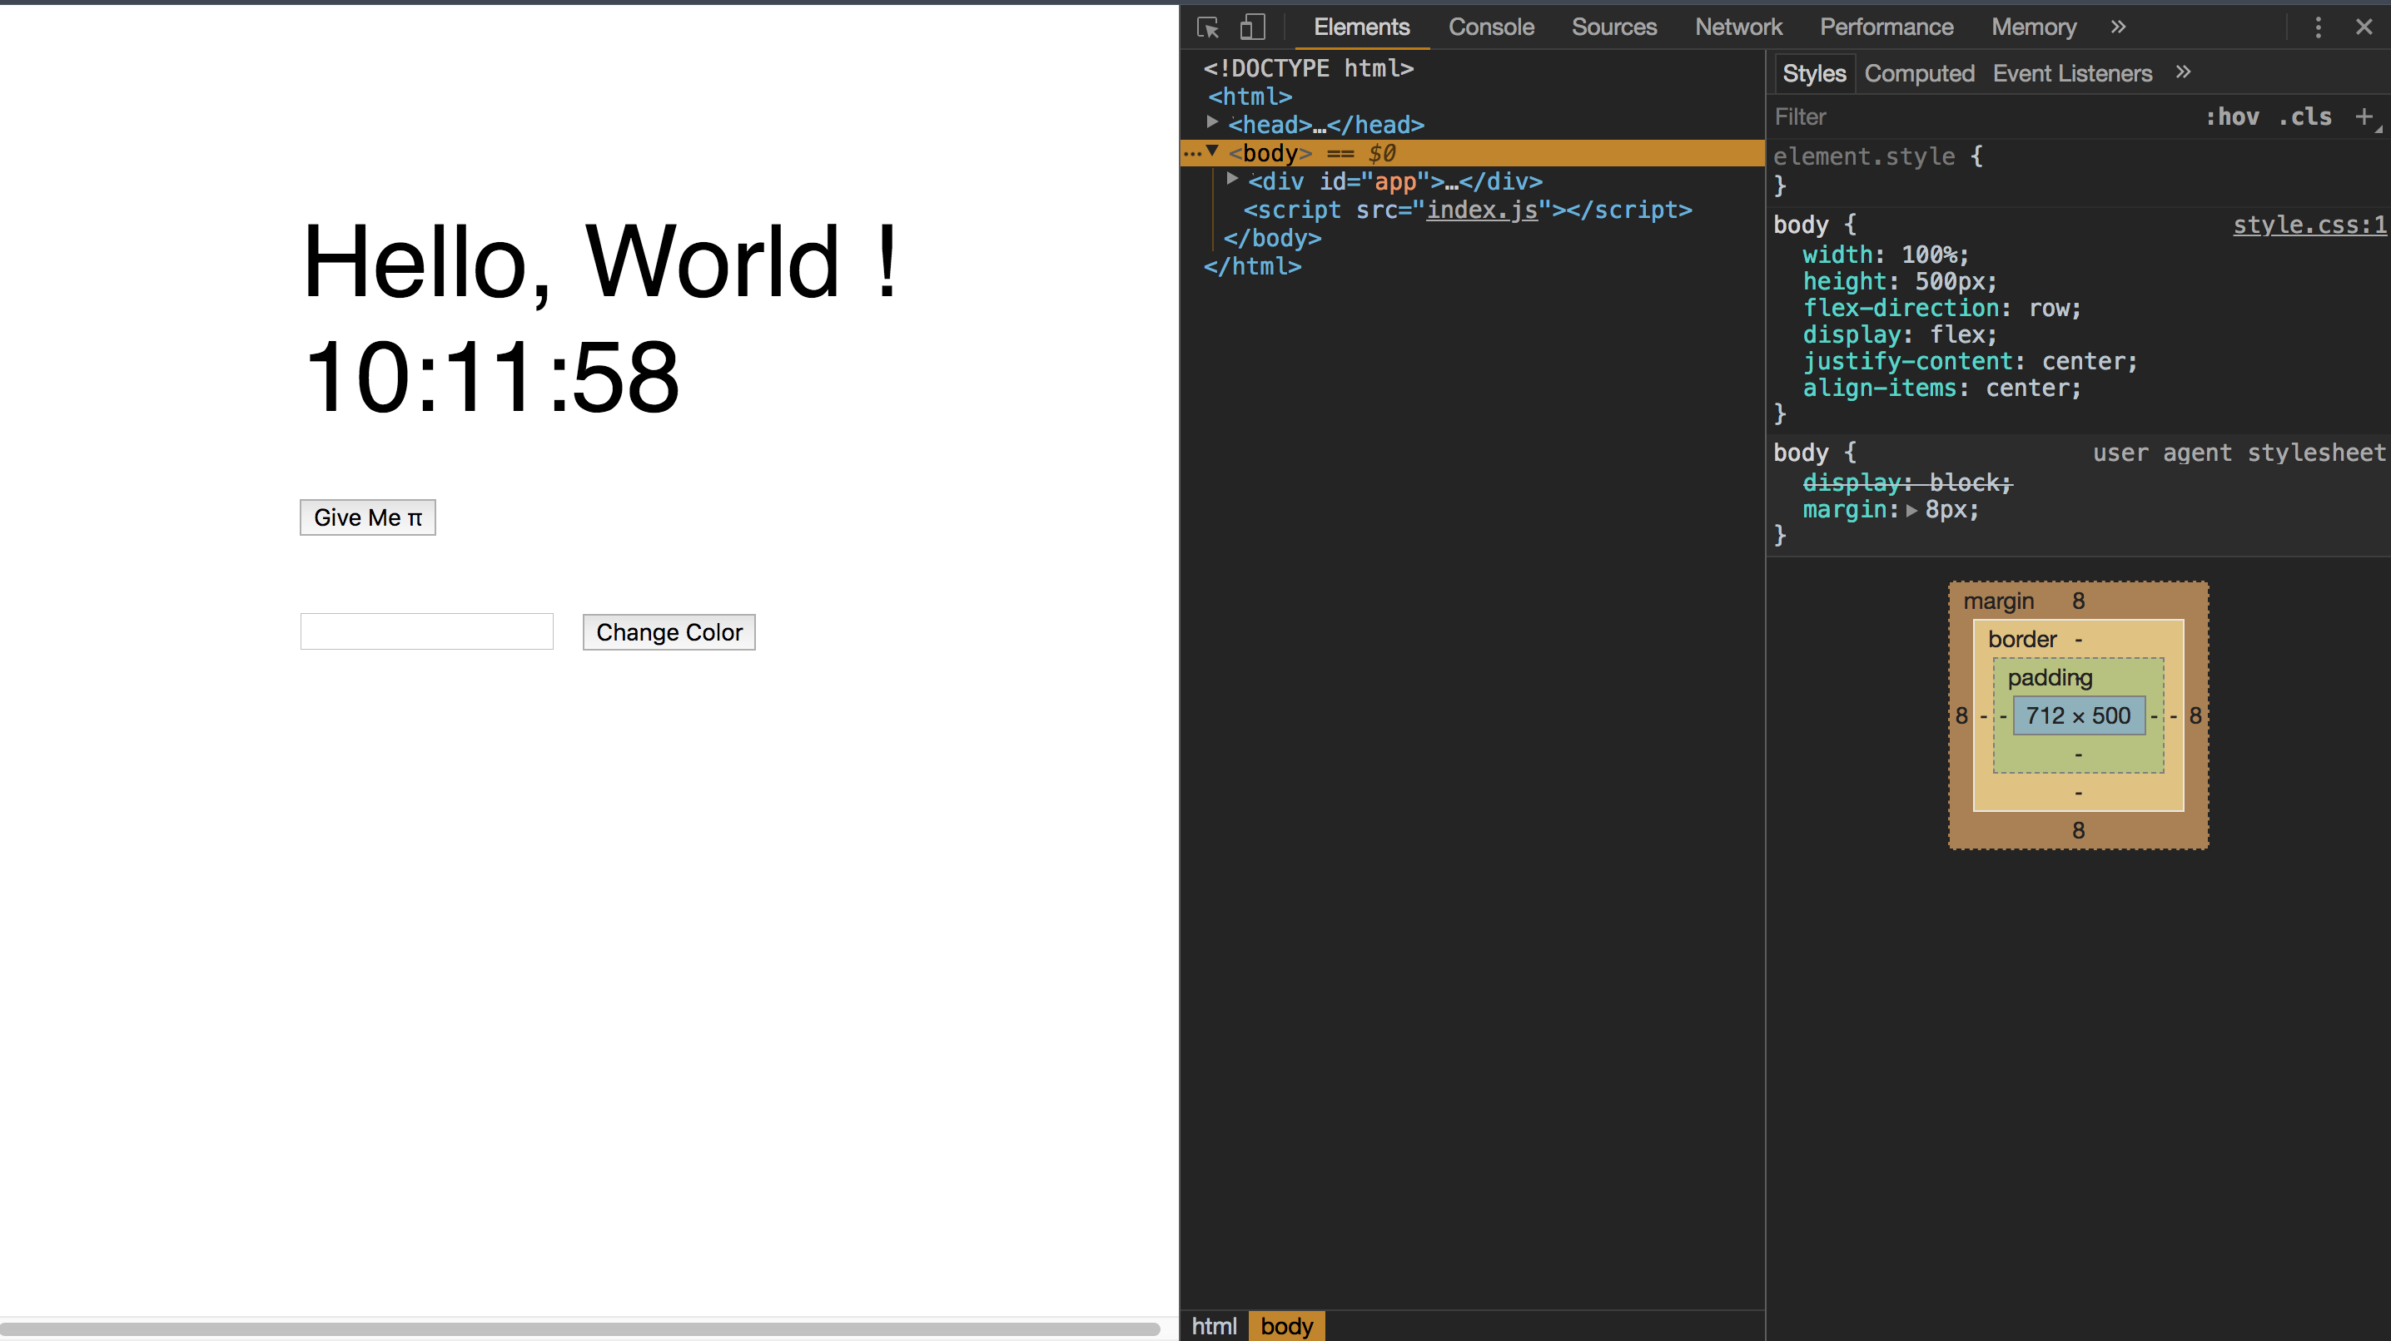
Example - Debug

Slide 9
Example
https://codepen.io/hsfo3o/pen/BrNoOg
Some Resources:
  Codecademy: https://www.codecademy.com/catalog/subject/web-development
  MDN : https://developer.mozilla.org/zh-TW/

Slide 10
What is D3.js
A Javascript Library
Help you Making Data-Driven Document
-> Control your Document(HTML+CSS) by Data

Slide 11
D3.js
Selection + modifier function
Dealing with Data
Many Useful Function
SVG (To Be Continue …)
Interaction (To Be Continue …)

Slide 12
D3.js – Selection
Selecting a single element
Selecting multiple elements
Function chaining
Modifier Function

Slide 13
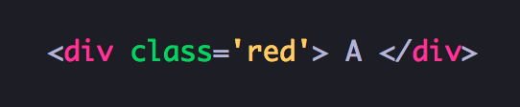
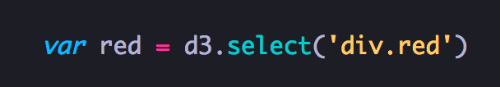
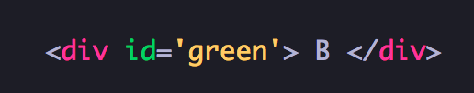

D3.js - Selecting a single element
Keyword: css selector

Slide 14
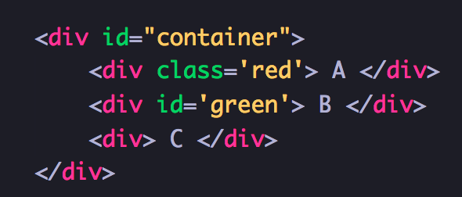

D3.js - Selecting multiple elements

Slide 15
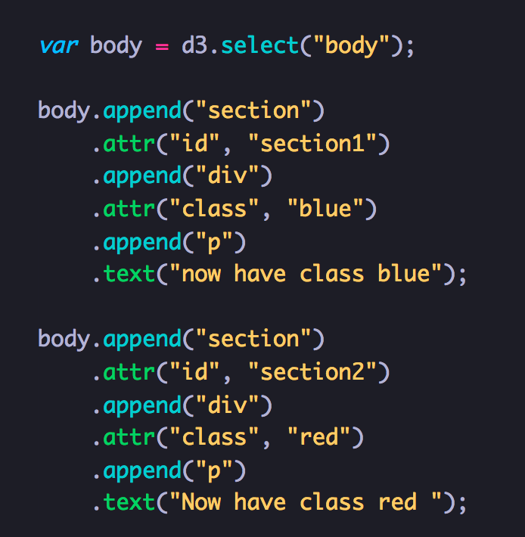
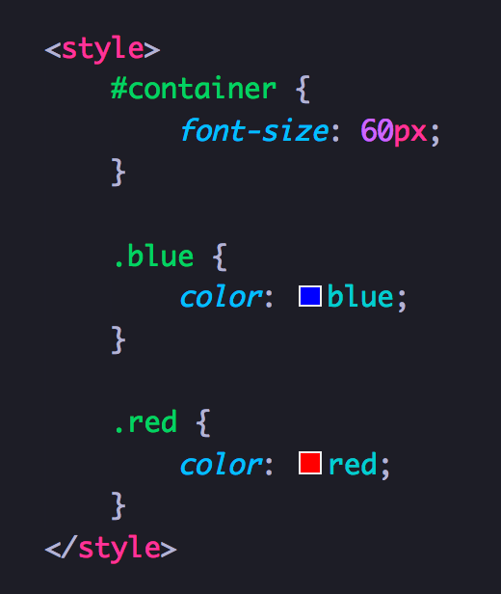
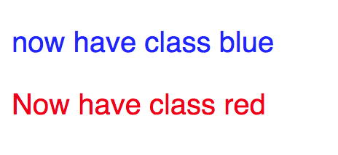
D3.js - Function chaining
CSS

Slide 16
D3.js – Modifier Function
Selection.style() / Selection.text() / Selection.html() / Selection.classed() / Selection.attr()

Slide 17
D3.js – Dealing with Data
enter()
data()
exit()
merge()

Slide 18
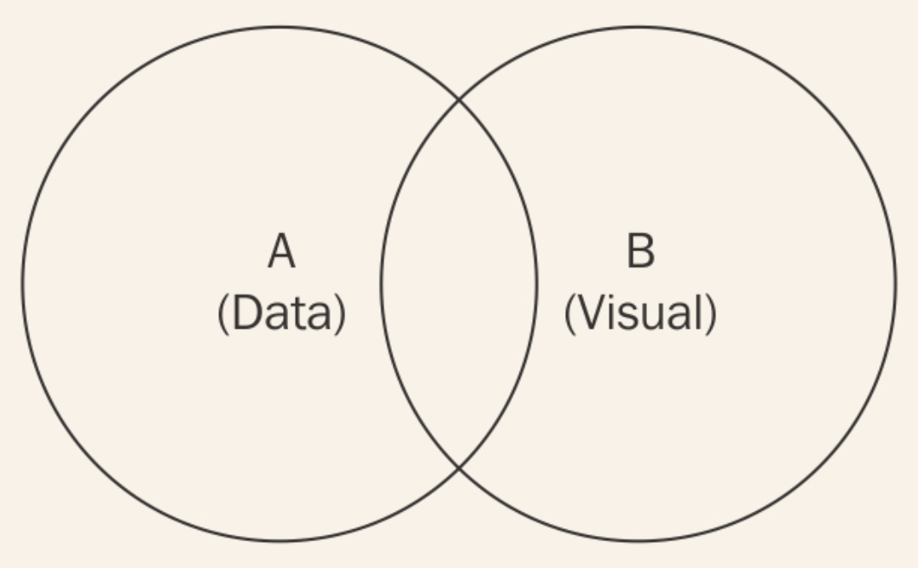
D3.js – Dealing with Data

Slide 19
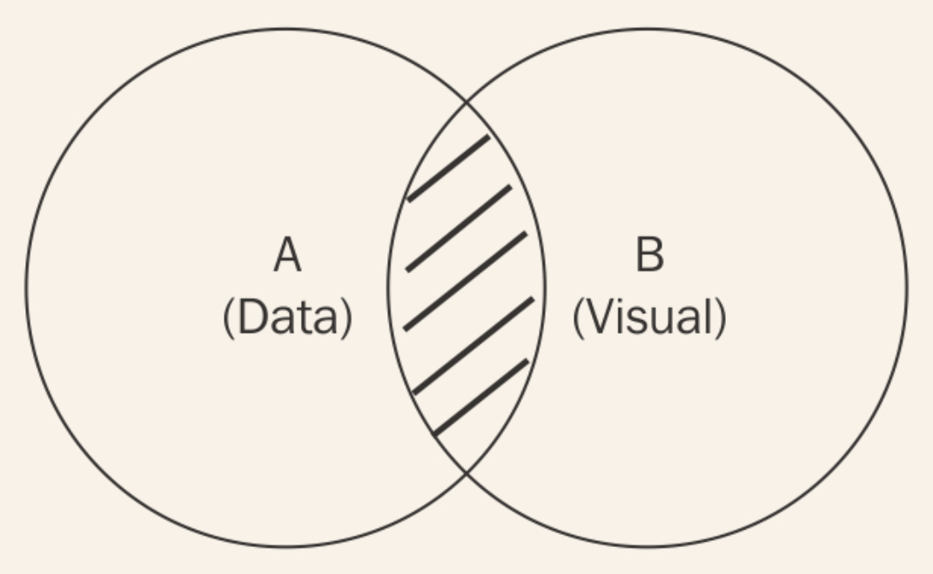
D3.js – data()
How can I find all visual elements that currently represent their corresponding data point?
-> selection.data(data)
Return new selection contains all data-bound element

Slide 20
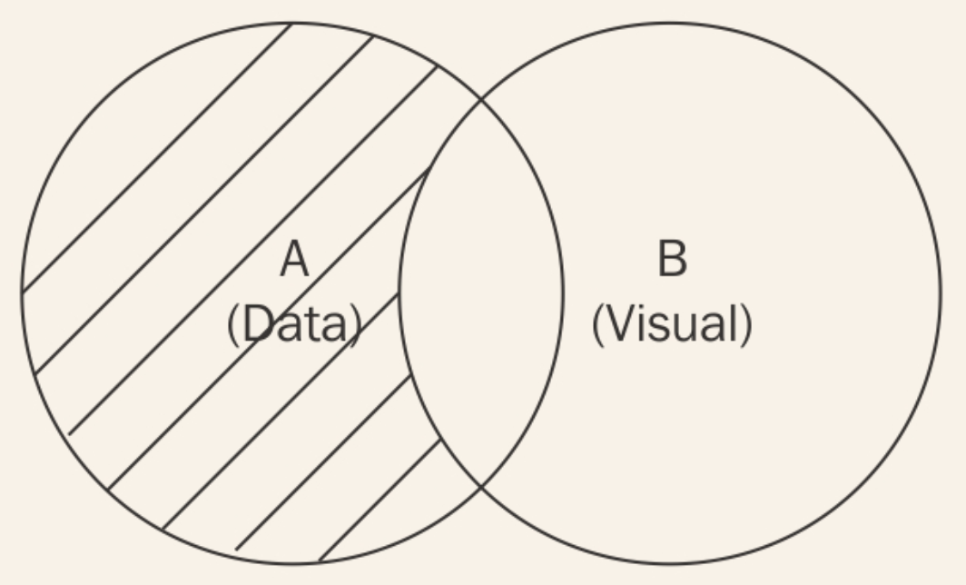
D3.js – enter()
How can I target data points that have not yet been visualized?
-> selection.data(data).enter()
Return new selection of all data that has not represented

Slide 21
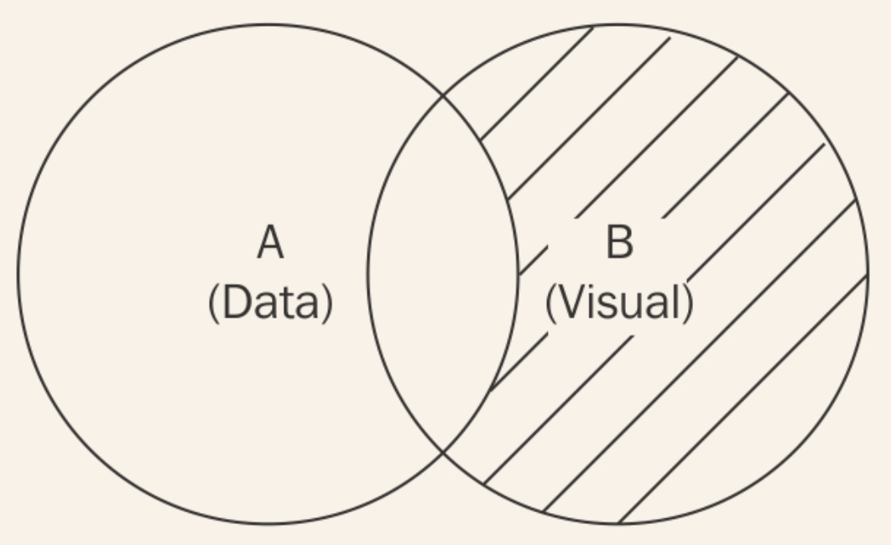
D3.js – exit()
When you remove some data, their will be some data-bound element need to be removed too.
-> selection.data(data).exit()
Return new selection contains all visual element that are no longer bound by valid data.

Slide 22
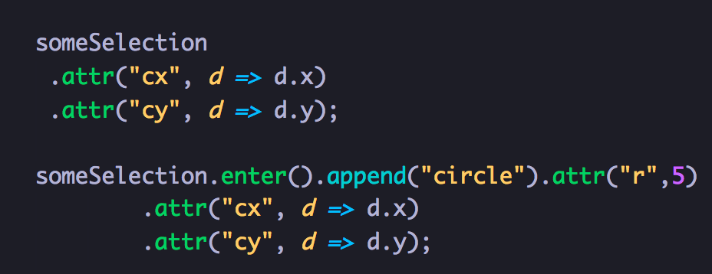
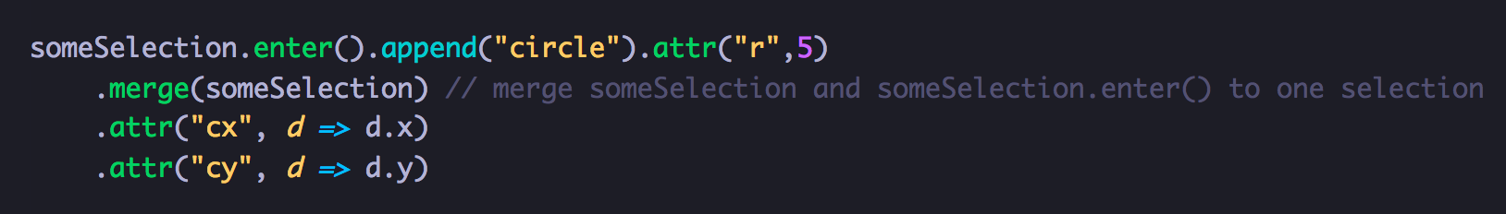
D3.js – merge()

Slide 23
D3.js – Useful Function
Working with Array
Scale
Interpolater
And More … https://github.com/d3/d3/blob/master/API.md

Slide 24
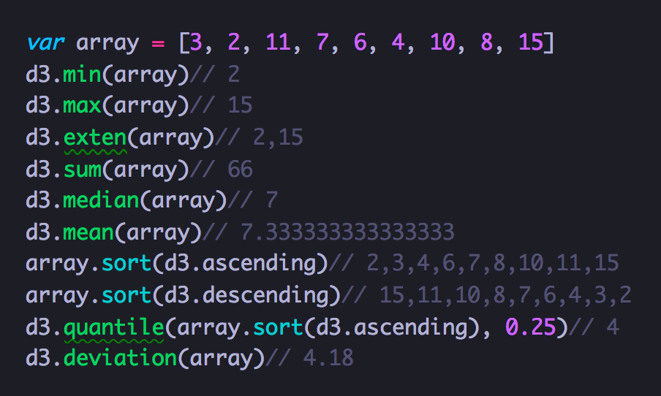
D3.js – Working with Array

Slide 25
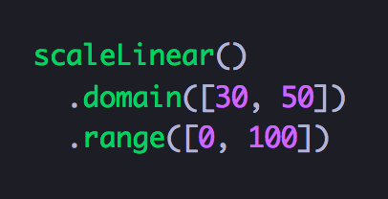
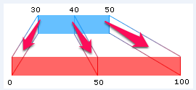
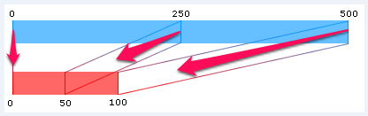
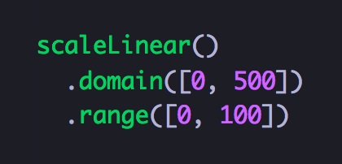
D3.js – Scale

Slide 26
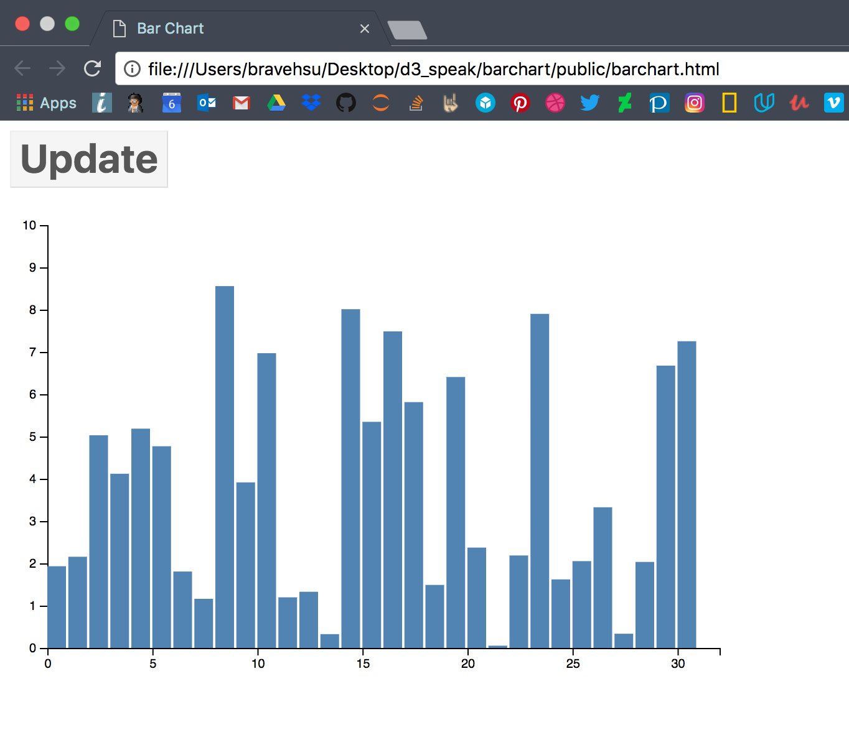
D3.js – Example

Slide 27
D3.js – More Example
Codepen search d3: https://codepen.io/search/pens?q=d3&limit=all&type=type-pens
D3js.org: https://github.com/d3/d3/wiki/Gallery
Observable: https://beta.observablehq.com/collection/visualization

