Slide 1
D3.JS Guide
2017/04/02
廖春閔

Slide 2
Outline
d3-fetch / d3-request
d3-selection
  Enter, Merge, Exit
d3-scale
d3-transition
  Transition(), duration(),delay()
Resource&Reference

Slide 3
d3-fetch / d3-request
d3-fetch(v5)是d3-request(v4)的更新 用法大同小異
以csv為例 使用d3.csv()讀csv檔
d3.csv(“file.csv”, row).then(function(data) { console.log(data); }); //fetch
d3.csv("file.csv”, row, function(data) { console.log(data); }); //request

Slide 4
function row(d) {
return {
year: new Date(+d.Year, 0, 1), // convert "Year" column to Date make: d.Make,
model: d.Model,
length: +d.Length // convert "Length" column to number
};

Slide 5
d3-selection
selectAll(element tag) : 選取所有 設定的 tag或是 id
select(element tag) : 選取一個 tag或是 id

Slide 6
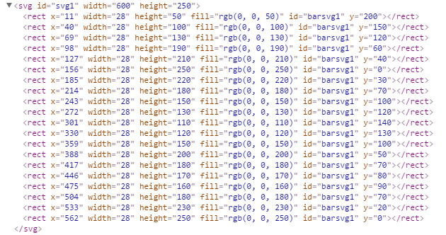
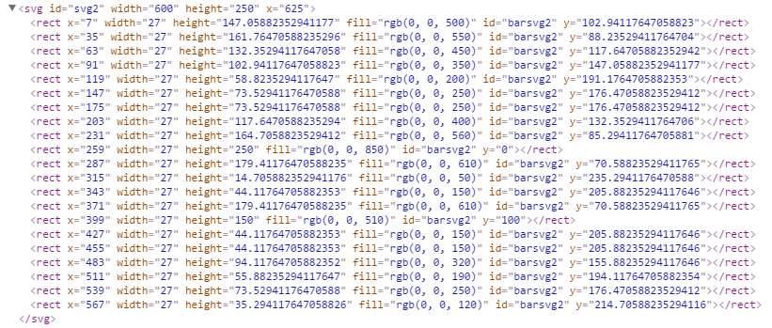
Select
只選擇在svg1裡的所有方形(rect)

Slide 7
Select
d3.selectAll(“#barsvg1”)
d3.select(“#svg1”)
.selectAll(“rect”)
Example : two_svg.html

Slide 8
Enter, Merge, Exit
selectAll(‘’).data(data) //新資料update入舊elements
enter().append()
//將沒有bind入舊elements的data創造新elements
Merge() //將舊elements和新創的elements合併處理
exit() 是列出多餘的舊elements
remove() 是將多餘的 element移除

Slide 9
Enter, Merge, Exit
selectAll(“rect”)
只找到三個方形
可是data有五個
data
element
data
element
data
element
data
?
data

Slide 10
Enter, Merge, Exit
data
element
Merge()會將舊的element和新創的element一起選取以利後續共同處理
enter()會產生相等於沒bind的data數量的element
data
element
data
element
data
New element
data
New element

Slide 11
Enter, Merge, Exit
data
element
data
element
透過remove()移除多餘的elements
exit()會列出多餘的elements
data
element
data
element
data
element
element
element

Slide 12
d3-scale
a to b -> x to y 有線性和非線性的映射方式
常用於映射數值和顏色
Let x = d3.scaleLinear()
.domain([a, b])
.range([x, y])
let color = d3.scaleLinear()
.domain([10, 100])
.range([‘red’, ‘blue’])
x.clamp(true)

Slide 13
d3-transition
transition() :
Makes it easy to animate transitions when changing the DOM.
duration() : animation time
delay() : delay start time

Slide 14
Example
General Update Pattern, III
https://bl.ocks.org/mbostock/3808234

Slide 15
Simple http server
安裝nodejs
  https://nodejs.org/en/
安裝express套件
  $ npm install express
啟動http server
  $ node server.js
進入第一個範例
  http://localhost:3000/token.html

Slide 16
Resource & Reference
http://devdocs.io/
http://blockbuilder.org/search
https://medium.com/@enjalot/the-hitchhikers-guide-to-d3-js-a8552174733a

Slide 17
END

