Slide 1
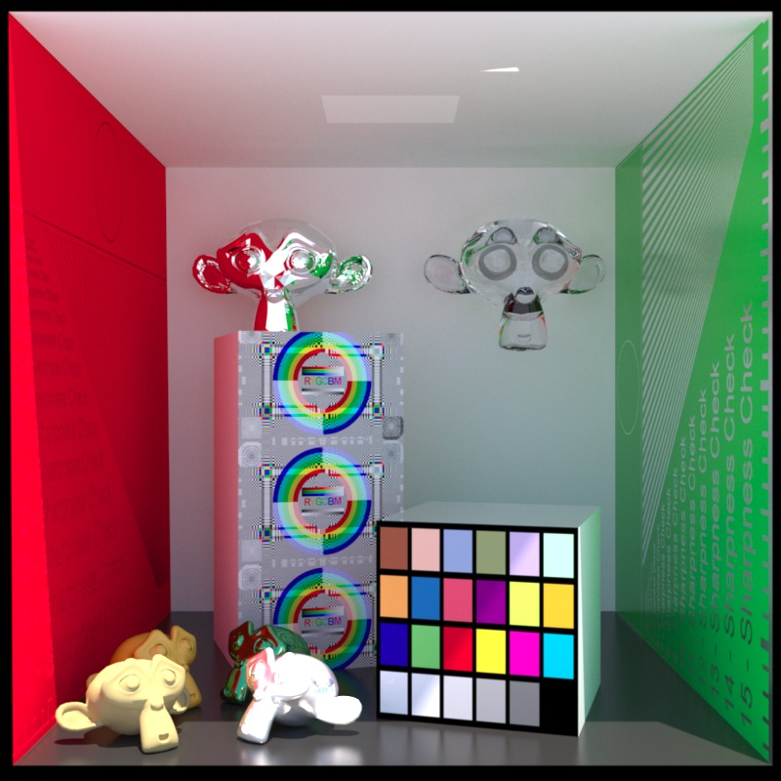
Computer Graphics
Texture Mapping
紀明德 mtchi@cs.nccu.edu.tw
Department of Computer Science,
National Chengchi University
Notes:
2019

Slide 2
Objectives
Introduce Mapping Methods
Texture Mapping
Environment Mapping
Bump Mapping
Consider basic strategies
Forward vs backward mapping
Point sampling vs area averaging

Slide 3
The Limits of Geometric Modeling
Although graphics cards can render over 10 million polygons per second, that number is insufficient for many phenomena
Clouds
Grass
Terrain
Skin

Slide 4
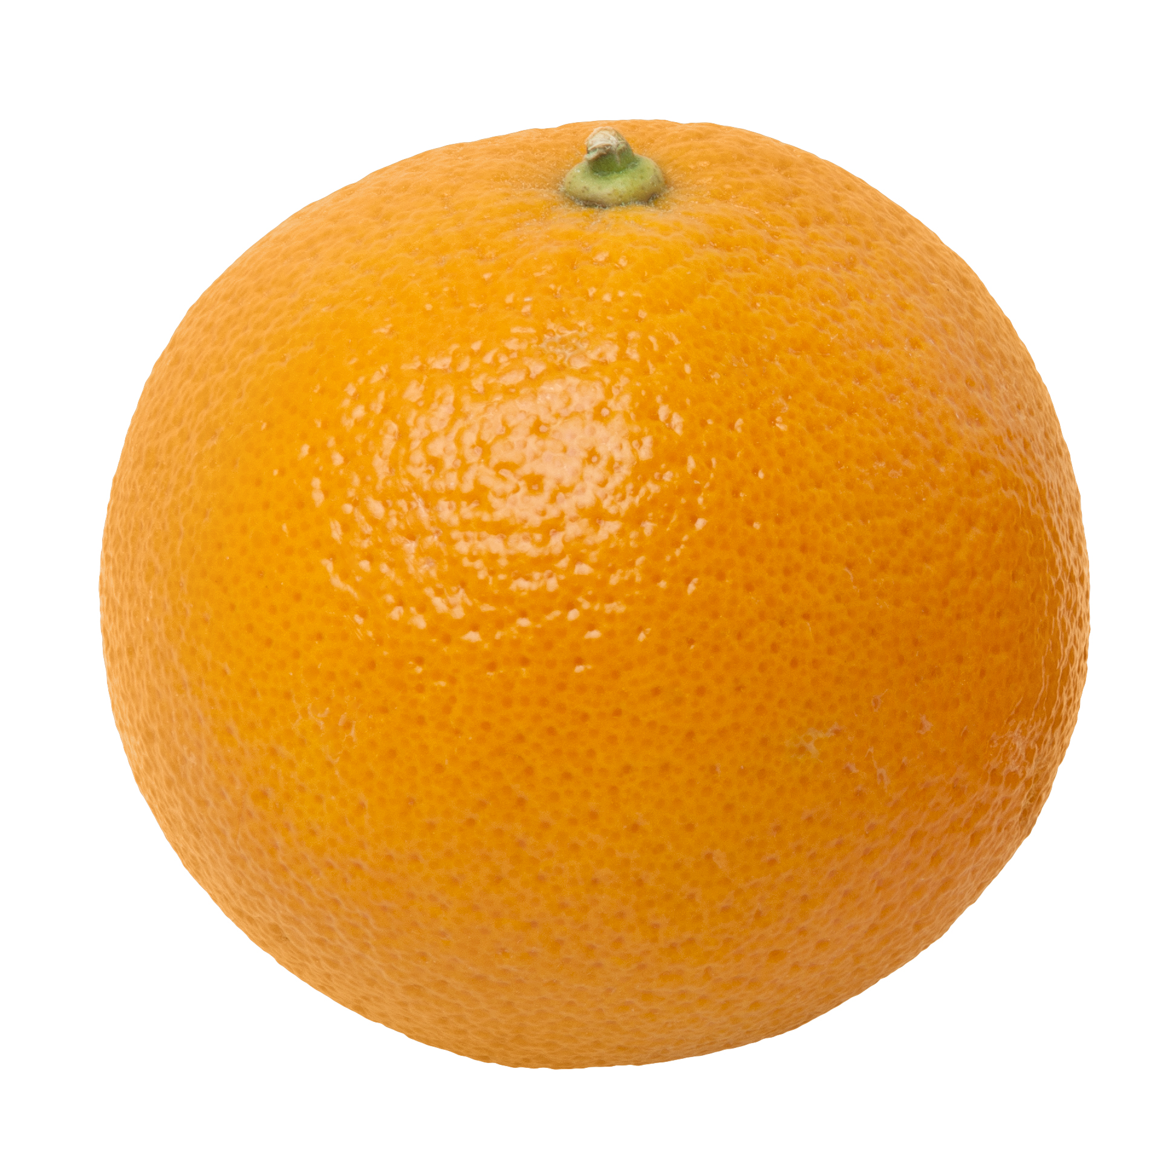
Modeling an Orange
Consider the problem of modeling an orange (the fruit)
Notes:
https://zh-yue.wikipedia.org/wiki/File:Orange-Whole-%26-Split.jpg

Slide 5
Modeling an Orange
Start with an orange-colored sphere
Too simple
Replace sphere with a more complex shape
Does not capture surface characteristics (small dimples)
Takes too many polygons to model all the dimples

Slide 6
Modeling an Orange (2)
Take a picture of a real orange, scan it, and “paste” onto simple geometric model
This process is known as texture mapping
Still might not be sufficient because resulting surface will be smooth
Need to change local shape
Bump mapping

Slide 7
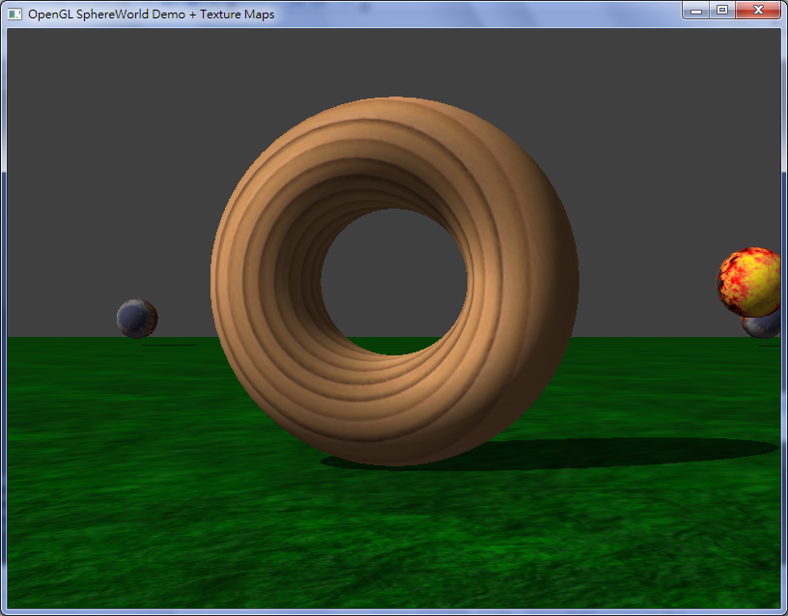
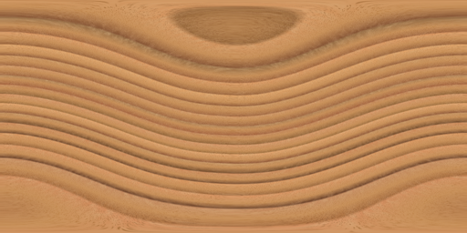
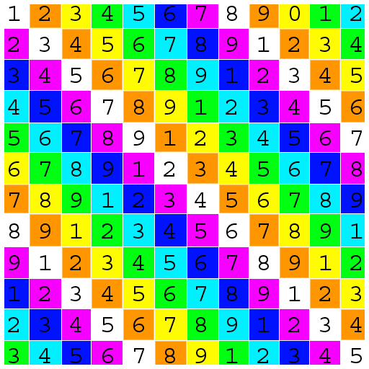
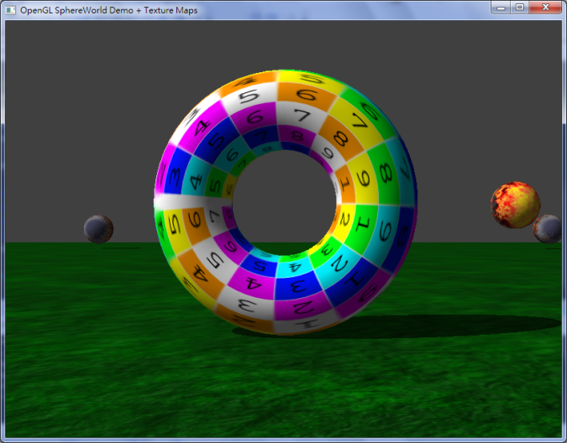
UV mapping

Slide 8
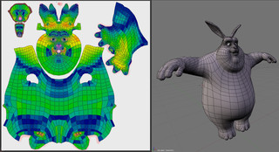
Complex model
Blender uv mapping

Slide 9
Three Basic Types of Mapping
Texture Mapping
Uses images to fill inside of polygons
Environment (reflection mapping)
Uses a picture of the environment for texture maps
Allows simulation of highly specular surfaces
Bump mapping
Emulates altering normal vectors during the rendering process

Slide 10
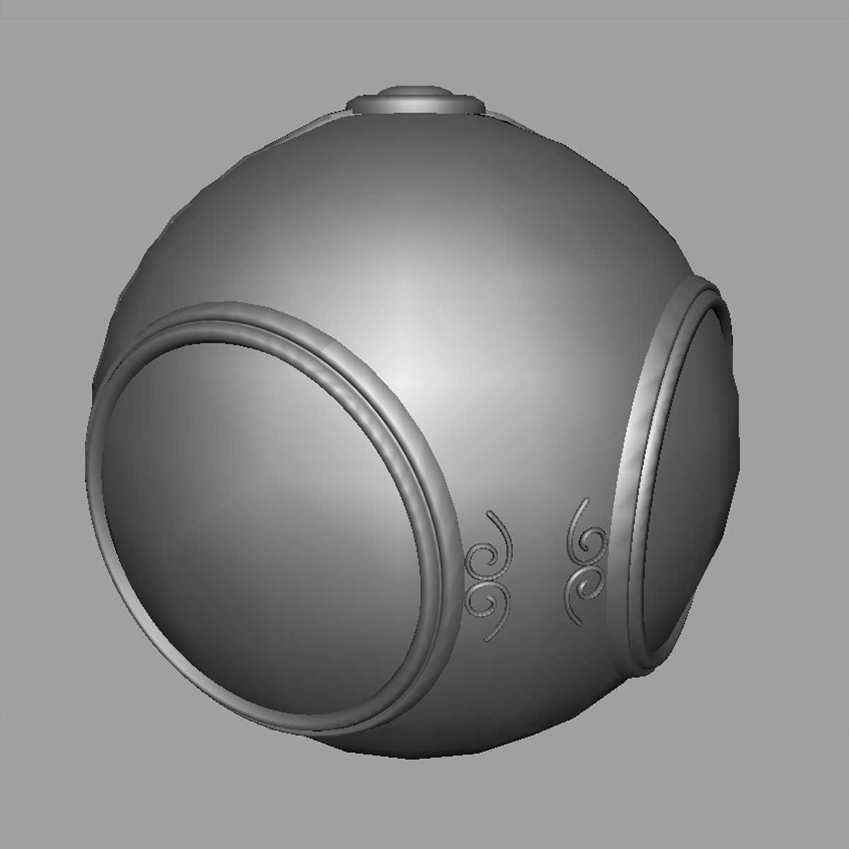
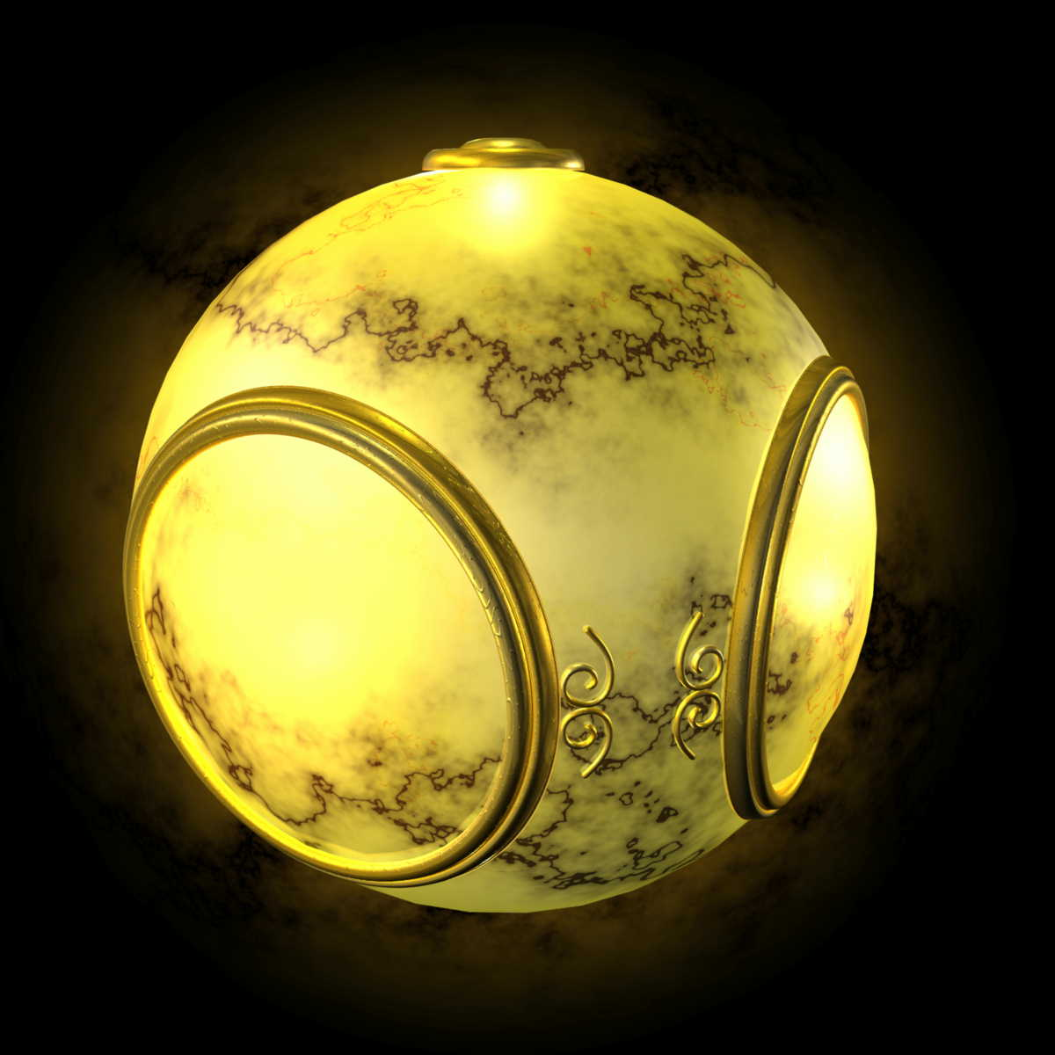
Texture Mapping
geometric model
texture mapped

Slide 11
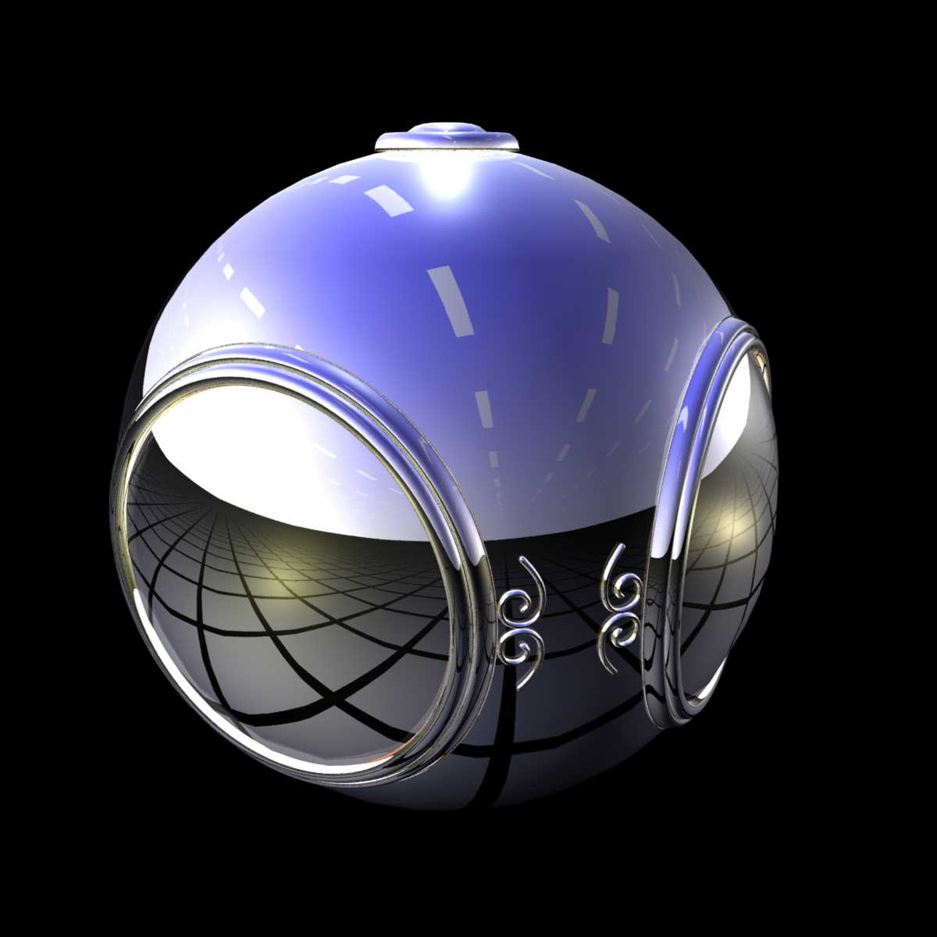
Environment Mapping

Slide 12
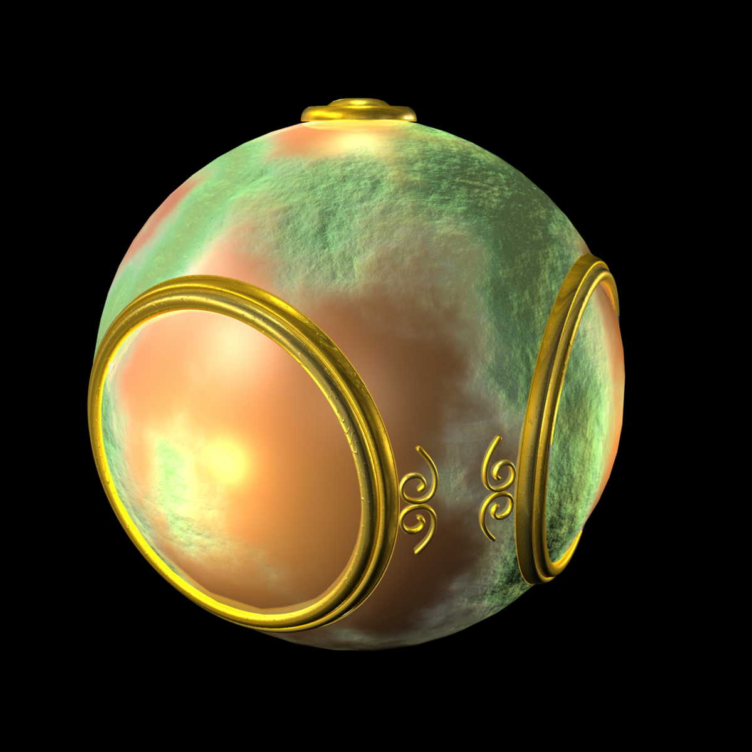
Bump Mapping

Slide 13
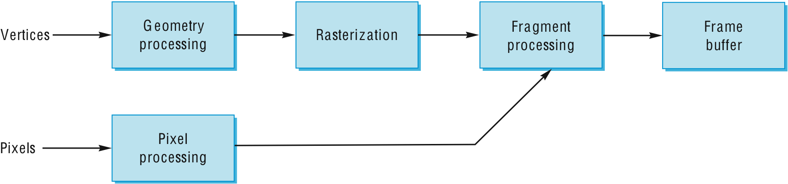
Where does mapping take place?
Mapping techniques are implemented at the end of the rendering pipeline
Very efficient because few polygons make it past the clipper

Slide 14
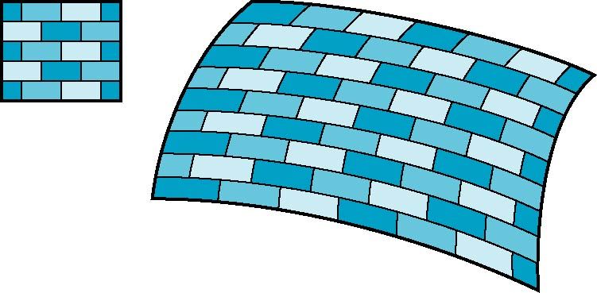
Is it simple?
Although the idea is simple---map an image to a surface---there are 3 or 4 coordinate systems involved
2D image
3D surface

Slide 15
Coordinate Systems
Parametric coordinates
May be used to model curves and surfaces
Texture coordinates
Used to identify points in the image to be mapped
Object or World Coordinates
Conceptually, where the mapping takes place
Window Coordinates
Where the final image is really produced

Slide 16
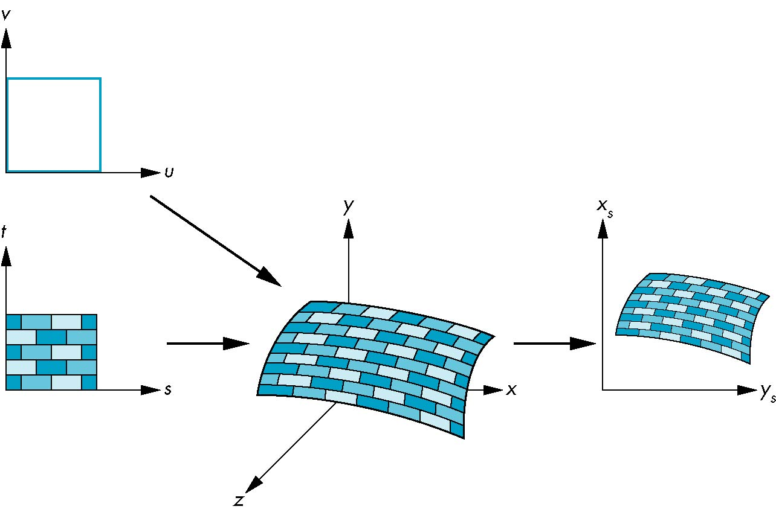
Texture Mapping
parametric coordinates
texture coordinates
window coordinates
world coordinates

Slide 17
Mapping Functions
Basic problem is how to find the maps
Consider mapping from texture coordinates to a point a surface
Appear to need three functions
x = x(s,t)
y = y(s,t)
z = z(s,t)
But we really want
to go the other way
(x,y,z)
t
s

Slide 18
Backward Mapping
We really want to go backwards
Given a pixel, we want to know to which point on an object it corresponds
Given a point on an object, we want to know to which point in the texture it corresponds
Need a map of the form
s = s(x,y,z)
t = t(x,y,z)
Such functions are difficult to find in general

Slide 19
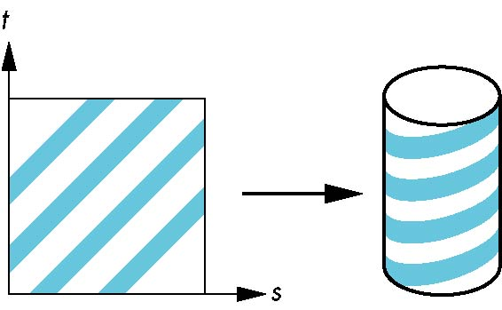
Two-part mapping
One solution to the mapping problem is to first map the texture to a simple intermediate surface
Example: map to cylinder

Slide 20
Cylindrical Mapping
parametric cylinder
x = r cos 2π u
y = r sin 2πu
z = v/h
maps rectangle in u,v space to cylinder
of radius r and height h in world coordinates
s = u
t = v
maps from texture space

Slide 21
Spherical Map
We can use a parametric sphere
x = r cos 2πu
y = r sin 2πu cos 2πv
z = r sin 2πu sin 2πv
in a similar manner to the cylinder
but have to decide where to put
the distortion
Spheres are used in environmental maps

Slide 22
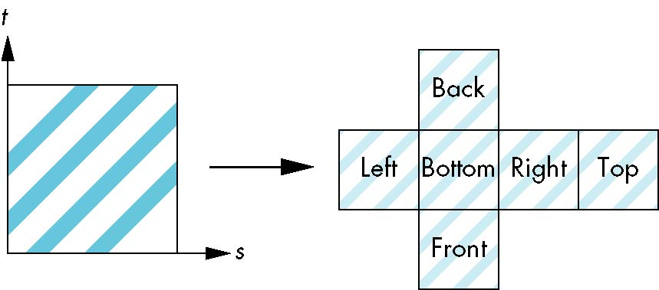
Box Mapping
Easy to use with simple orthographic projection
Also used in environment maps

Slide 23
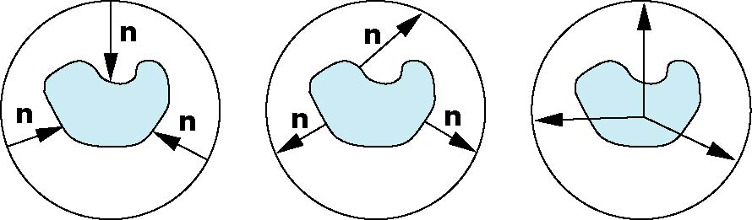
Second Mapping
Map from intermediate object to actual object
Normals from intermediate to actual
Normals from actual to intermediate
Vectors from center of intermediate
actual
intermediate

Slide 24
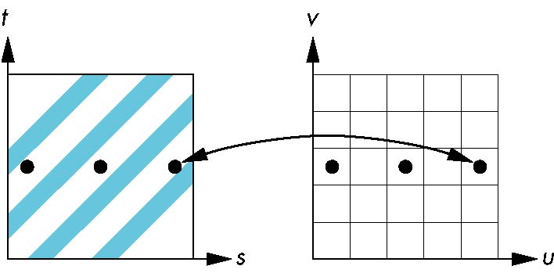
Aliasing
Point sampling of the texture can lead to aliasing errors
miss blue stripes
point samples in u,v
(or x,y,z) space
point samples in texture space

Slide 25
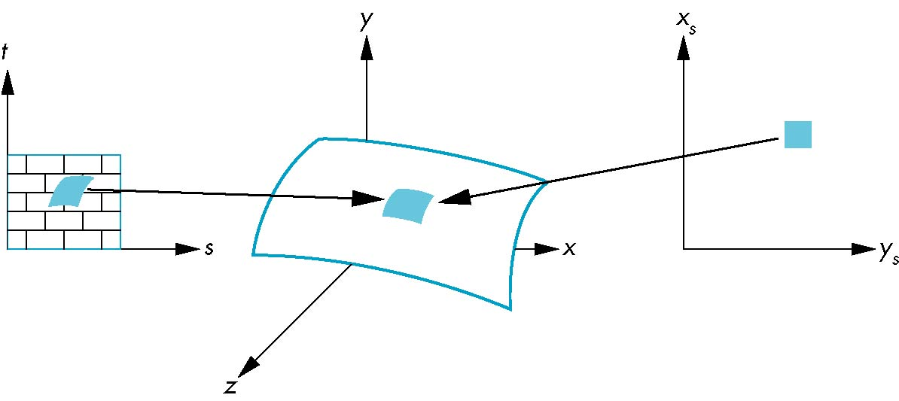
Area Averaging
A better but slower option is to use area averaging
pixel
preimage
Note that preimage of pixel is curved

Slide 26

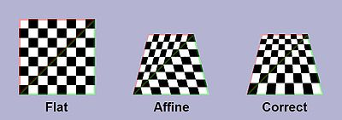
Perspective correctness
Perspective correct mapping interpolates after dividing by depth , then uses its interpolated reciprocal to recover the correct coordinate:

Slide 27
OpenGL Texture Mapping

Slide 28
Objectives
Introduce the OpenGL texture functions and options

Slide 29
Basic Stragegy
Three steps to applying a texture
specify the texture
read or generate image
assign to texture
enable texturing
assign texture coordinates to vertices
Proper mapping function is left to application
specify texture parameters
wrapping, filtering

Slide 30
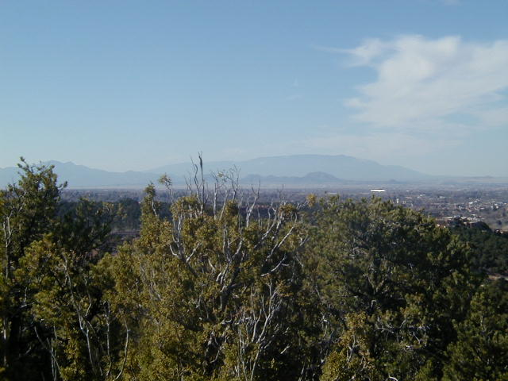
Texture Mapping
y
z
x
geometry
display
t
image
s

Slide 31
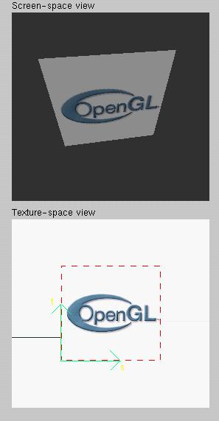
Texture Example
The texture (below) is a 256 x 256 image that has been mapped to a rectangular polygon which is viewed in perspective

Slide 32
Texture Mapping and the OpenGL Pipeline
Images and geometry flow through separate pipelines that join during fragment processing
“complex” textures do not affect geometric complexity
vertices
geometry pipeline
fragmentprocessor
image
pixel pipeline

Slide 33
Specifying a Texture Image
Define a texture image from an array of texels (texture elements) in CPU memory
Glubyte my_texels[512][512][3];//rgb
Define as any other pixel map
Scanned image
Generate by application code
Enable texture mapping
glEnable(GL_TEXTURE_2D)
OpenGL supports 1-4 dimensional texture maps

Slide 34
Define Image as a Texture
glTexImage2D( target, level, components, w, h, border, format, type, texels );
target: type of texture, e.g. GL_TEXTURE_2D
level: used for mipmapping (discussed later)
components: elements per texel
w, h: width and height of texels in pixels
border: used for smoothing (discussed later)
format and type: describe texels
texels: pointer to texel array
glTexImage2D(GL_TEXTURE_2D, 0, 3, 512, 512, 0, GL_RGB, GL_UNSIGNED_BYTE, my_texels);

Slide 35
Converting A Texture Image
OpenGL requires texture dimensions to be powers of 2
If dimensions of image are not powers of 2
gluScaleImage( format, w_in, h_in, type_in, *data_in, w_out, h_out, type_out, *data_out );
data_in is source image
data_out is for destination image
Image interpolated and filtered during scaling
Notes:
If

Slide 36
Mapping a Texture
Based on parametric texture coordinates
glTexCoord*() specified at each vertex
Texture Space
Object Space
t
1, 1
(s, t) = (0.2, 0.8)
0, 1
A
a
c
(0.4, 0.2)
b
B
C
0, 0
1, 0
s
(0.8, 0.4)

Slide 37
Typical Code
glBegin(GL_POLYGON);
glColor3f(r0, g0, b0); //if no shading used
glNormal3f(u0, v0, w0); // if shading used
glTexCoord2f(s0, t0);
glVertex3f(x0, y0, z0);
glColor3f(r1, g1, b1);
glNormal3f(u1, v1, w1);
glTexCoord2f(s1, t1);
glVertex3f(x1, y1, z1);
.
.
glEnd();
Note that we can use vertex arrays to increase efficiency

Slide 38
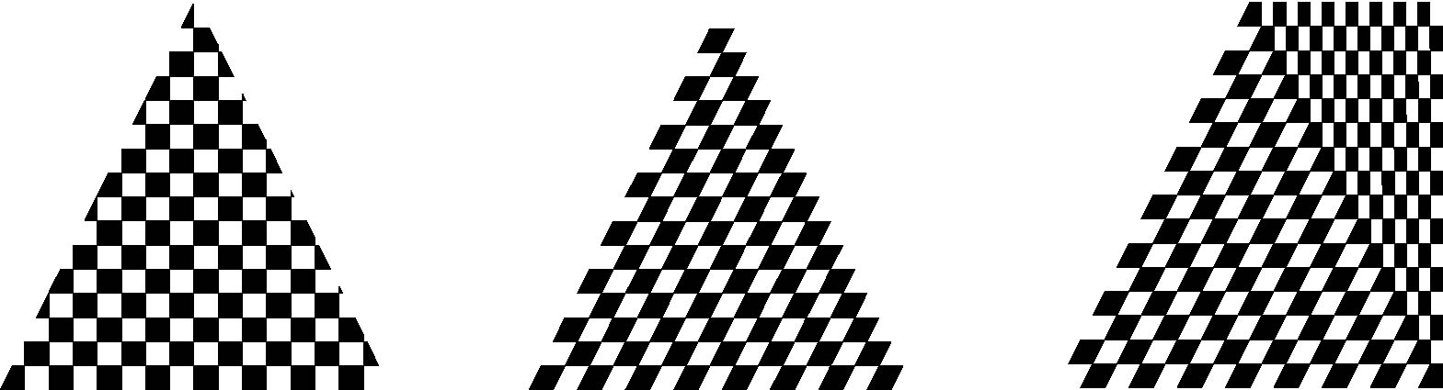
Interpolation
OpenGL uses interpolation to find proper texels from specified texture coordinates
Distortion problem
texture stretched
over trapezoid
showing effects of
bilinear interpolation
good selection
of tex coordinates
poor selection
of tex coordinates

Slide 39
Texture Parameters
OpenGL has a variety of parameters that determine how texture is applied
Wrapping parameters determine what happens if s and t are outside the (0,1) range
Filter modes allow us to use area averaging instead of point samples
Mipmapping allows us to use textures at multiple resolutions
Environment parameters determine how texture mapping interacts with shading

Slide 40
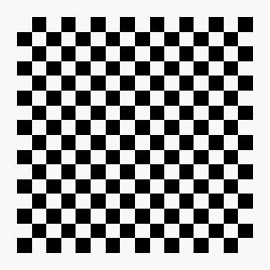
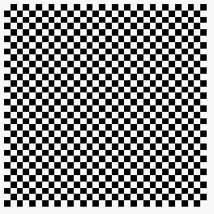

Wrapping Mode
Clamping: if s,t > 1 use 1, if s,t <0 use 0
Wrapping: use s,t modulo 1
glTexParameteri( GL_TEXTURE_2D, GL_TEXTURE_WRAP_S, GL_CLAMP )
glTexParameteri( GL_TEXTURE_2D, GL_TEXTURE_WRAP_T, GL_REPEAT )
t
s
GL_REPEAT
wrapping
GL_CLAMP
wrapping
texture

Slide 41
Magnification and Minification
More than one texel can cover a pixel (minification) or
more than one pixel can cover a texel (magnification)
Can use point sampling (nearest texel) or linear filtering
( 2 x 2 filter) to obtain texture values
Texture
Polygon
Texture
Polygon
Magnification
Minification

Slide 42
Filter Modes
Modes determined by
glTexParameteri( target, type, mode )
glTexParameteri(GL_TEXTURE_2D, GL_TEXURE_MAG_FILTER,
GL_NEAREST);
glTexParameteri(GL_TEXTURE_2D, GL_TEXURE_MIN_FILTER,
GL_LINEAR);
Note that linear filtering requires a border of an
extra texel for filtering at edges (border = 1)

Slide 43
Mipmapped Textures
Mipmapping allows for prefiltered texture maps of decreasing resolutions
Lessens interpolation errors for smaller textured objects
Declare mipmap level during texture definition
glTexImage2D( GL_TEXTURE_2D, level, … )
GLU mipmap builder routines will build all the textures from a given image
gluBuild*DMipmaps( … )

Slide 44
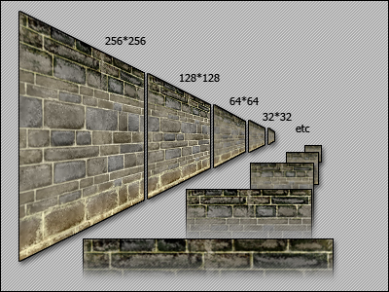
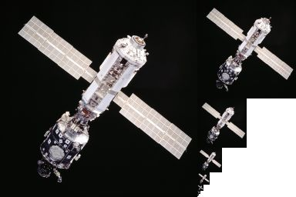
Mipmap example
http://game-art.co.uk/agtec/html/mipmaps.html

Slide 45
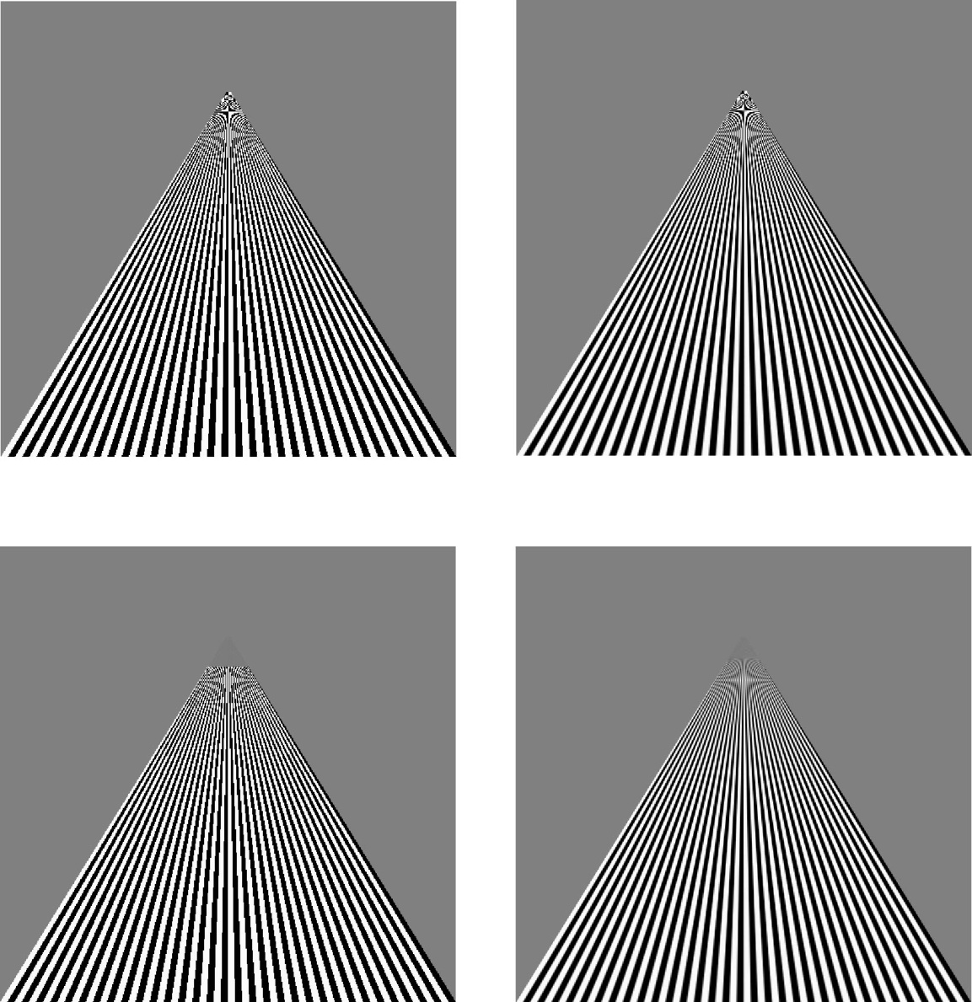
Example
point
sampling
linear
filtering
mipmapped
point
sampling
mipmapped
linear
filtering

Slide 46
Texture Functions
Controls how texture is applied
glTexEnv{fi}[v]( GL_TEXTURE_ENV, prop, param )
GL_TEXTURE_ENV_MODE modes
GL_MODULATE: modulates with computed shade
GL_BLEND: blends with an environmental color
GL_REPLACE: use only texture color
GL(GL_TEXTURE_ENV, GL_TEXTURE_ENV_MODE, GL_MODULATE);
Set blend color with GL_TEXTURE_ENV_COLOR

Slide 47
Perspective Correction Hint
Texture coordinate and color interpolation
either linearly in screen space
or using depth/perspective values (slower)
Noticeable for polygons “on edge”
glHint( GL_PERSPECTIVE_CORRECTION_HINT, hint )
where hint is one of
GL_DONT_CARE
GL_NICEST
GL_FASTEST

Slide 48
Generating Texture Coordinates
OpenGL can generate texture coordinates automatically
glTexGen{ifd}[v]()
specify a plane
generate texture coordinates based upon distance from the plane
generation modes
GL_OBJECT_LINEAR
GL_EYE_LINEAR
GL_SPHERE_MAP (used for environmental maps)

Slide 49
Texture Objects
Texture is part of the OpenGL state
If we have different textures for different objects, OpenGL will be moving large amounts data from processor memory to texture memory
Recent versions of OpenGL have texture objects
one image per texture object
Texture memory can hold multiple texture objects

Slide 50
Applying Textures II
specify textures in texture objects
set texture filter
set texture function
set texture wrap mode
set optional perspective correction hint
bind texture object
enable texturing
supply texture coordinates for vertex
coordinates can also be generated

Slide 51
Other Texture Features
Environment Maps
Start with image of environment through a wide angle lens
Can be either a real scanned image or an image created in OpenGL
Use this texture to generate a spherical map
Use automatic texture coordinate generation

Slide 52
Multitexturing
Apply a sequence of textures through cascaded texture units
void glMultiTexCoord2f(GLenum target, GLfloat s, GLfloat t);
Target: GL_TEXTUREi
Ex:
glTexCoord2f(0, 1);
glMultiTexCoord2f(GL_TEXTURE1, 0.3, 0.6);
glVertex3f(20, 20, 0);

Slide 53
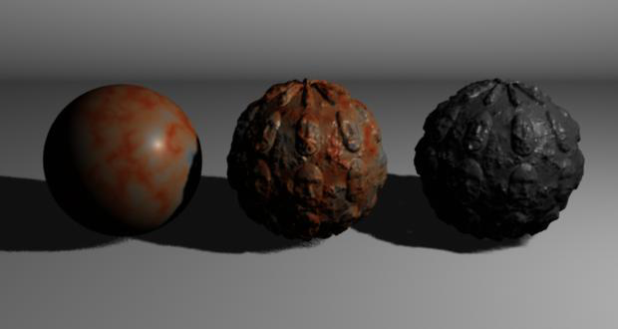
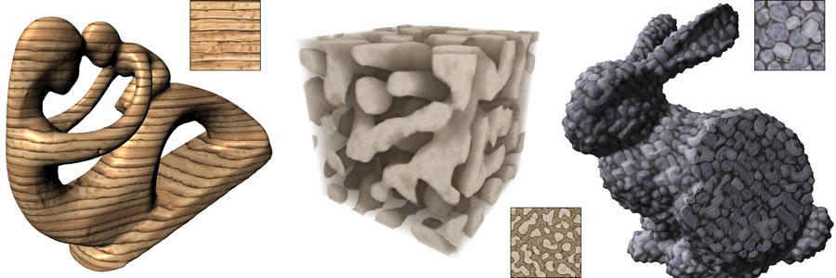
Solid texture
Solid Texture Synthesis from 2D Exemplars 2007
Notes:
http://johanneskopf.de/publications/solid/index.html

Slide 54
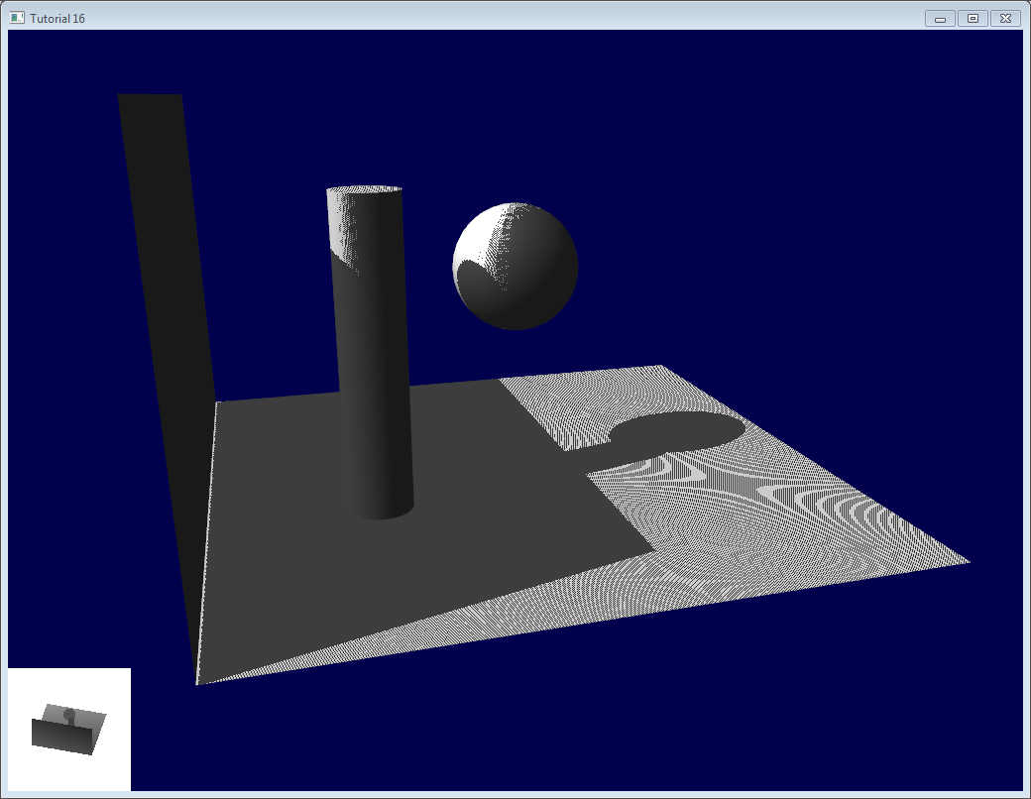

Shadow mapping 1978
Depth image
from the view of light source
image
from the view of eye
Notes:
http://www.opengl-tutorial.org/intermediate-tutorials/tutorial-16-shadow-mapping/

Slide 55
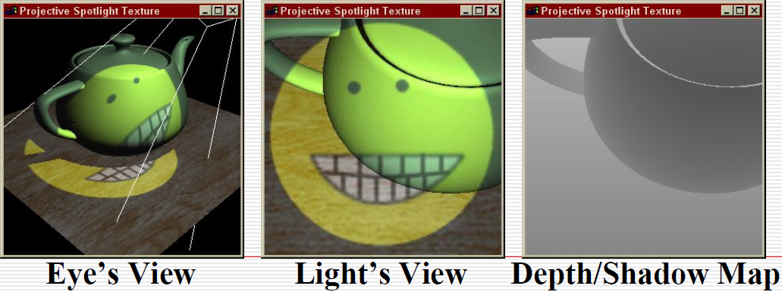
Basic Steps of Shadow Maps
Render the scene from the light’s point of view, Use the light’s depth buffer as a texture (shadow map),
Projectively texture the shadow map onto the scene,
Use “texture color”(comparison result) in fragment shading.

Slide 56
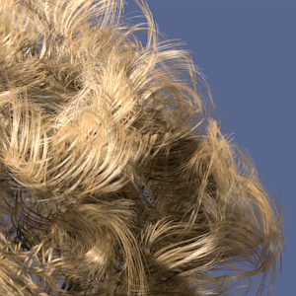
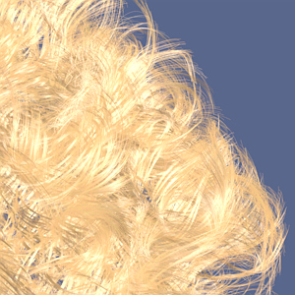
Hair rendering
shadow
Without shadow
Notes:
http://www.cs.berkeley.edu/~ravir/6160-fall04/papers/p385-lokovic.pdf

Slide 57
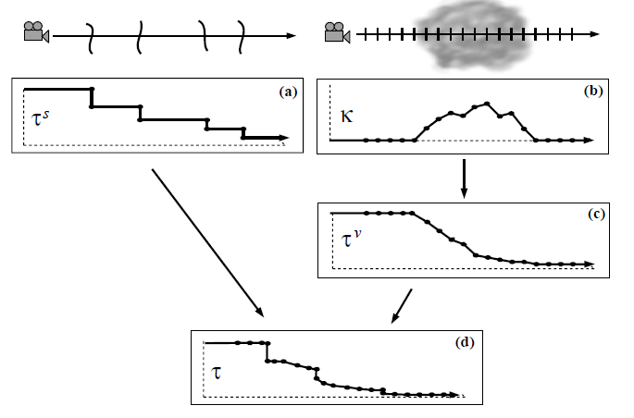

Deep shadow map
A two dimensional visibility function.

Slide 58
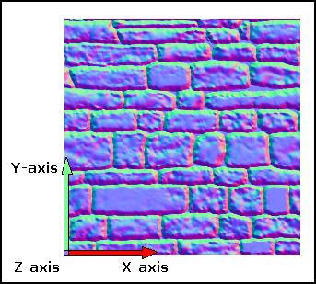
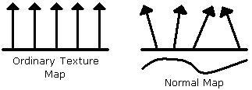
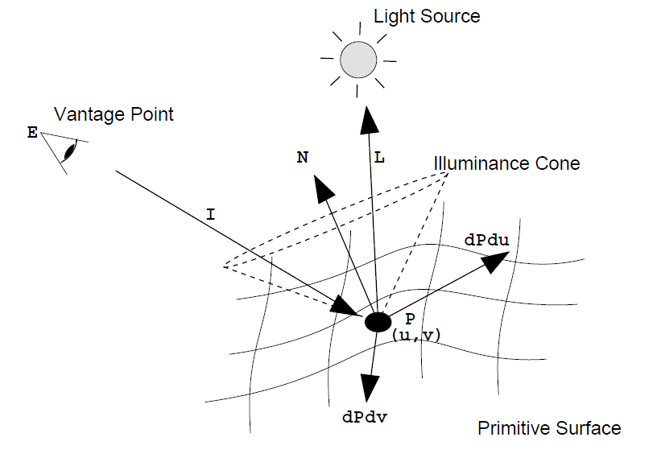
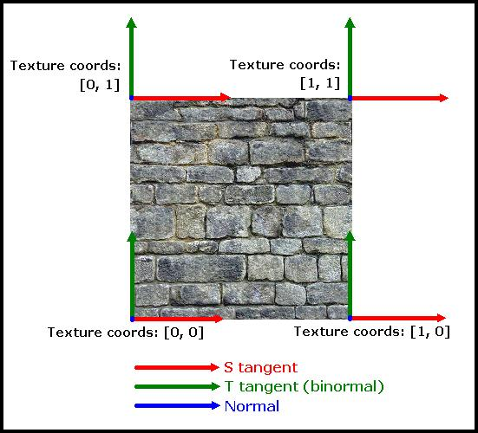
Tangent space
Notes:
http://www.blacksmith-studios.dk/projects/downloads/tangent_matrix_derivation.php

Slide 59
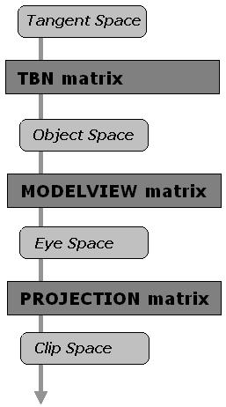
TBN matrix (Tangent, Binormal, Normal)
T = normalize(dx/du, dy/du, dz/du)
N = T × normalize(dx/dv, dy/dv, dz/dv)
B = N × T
Notes:
http://www.blacksmith-studios.dk/projects/downloads/bumpmapping_using_cg.php

Slide 60
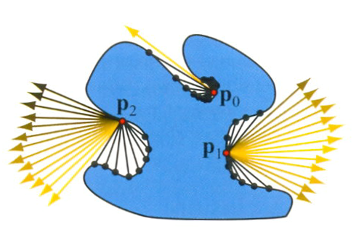
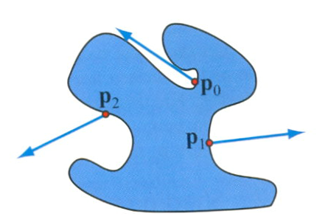
Ambient Occlusion "Production-Ready Global Illumination", SIGGRAPH 2002
On Lambertian surface
Define ambient occlusion value
bent normal

Slide 61
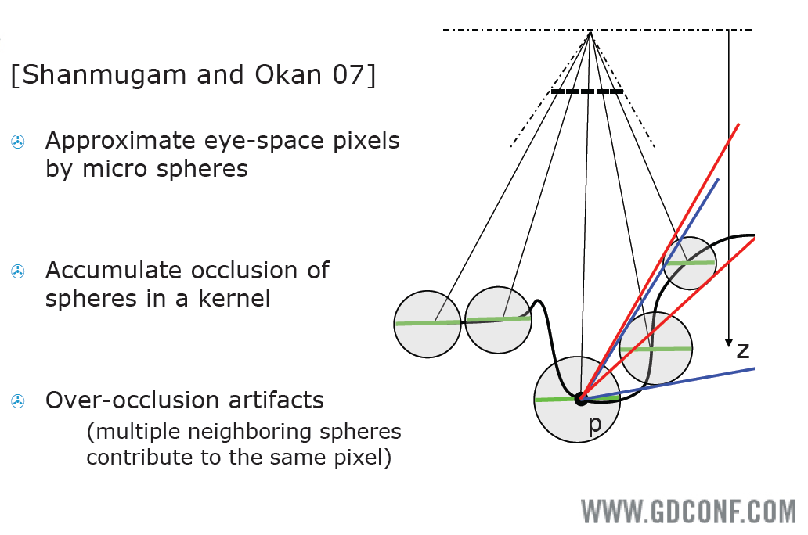
Screen space
Notes:
http://developer.download.nvidia.com/presentations/2008/GDC/GDC08_Ambient_Occlusion.pdf

Slide 62

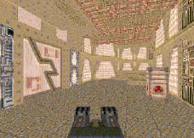
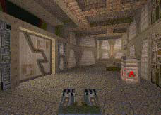
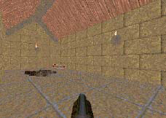
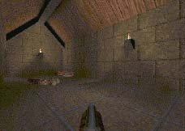
Texture Mapping in Quake
Light Map
Texture Only
Texture & Light Maps

Slide 63
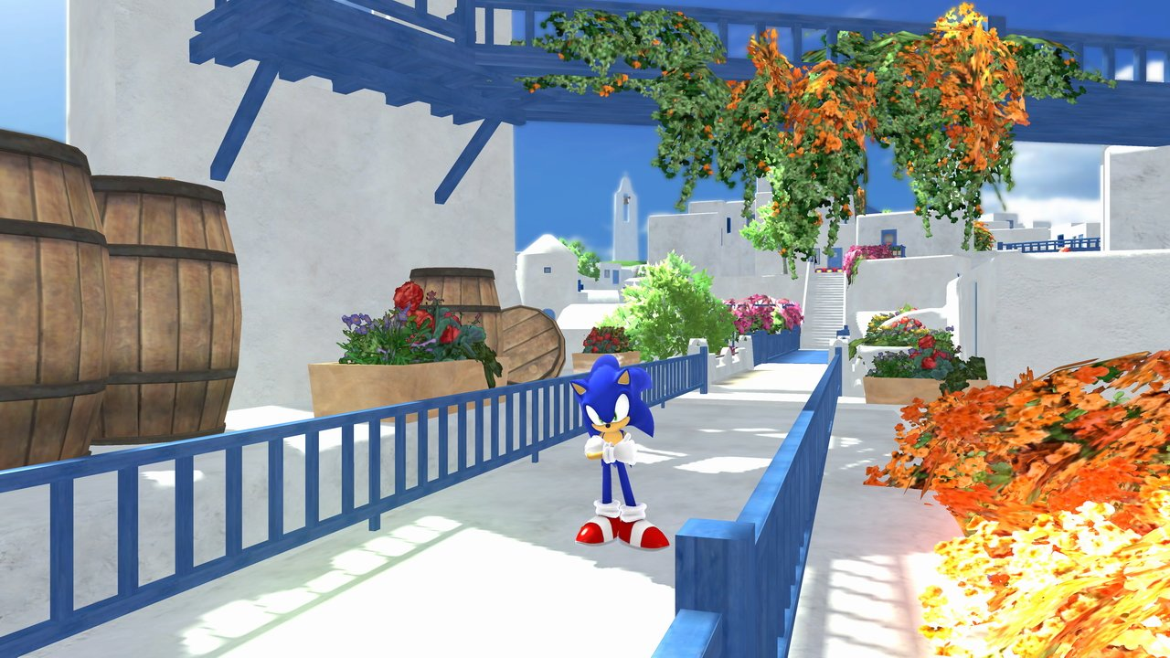
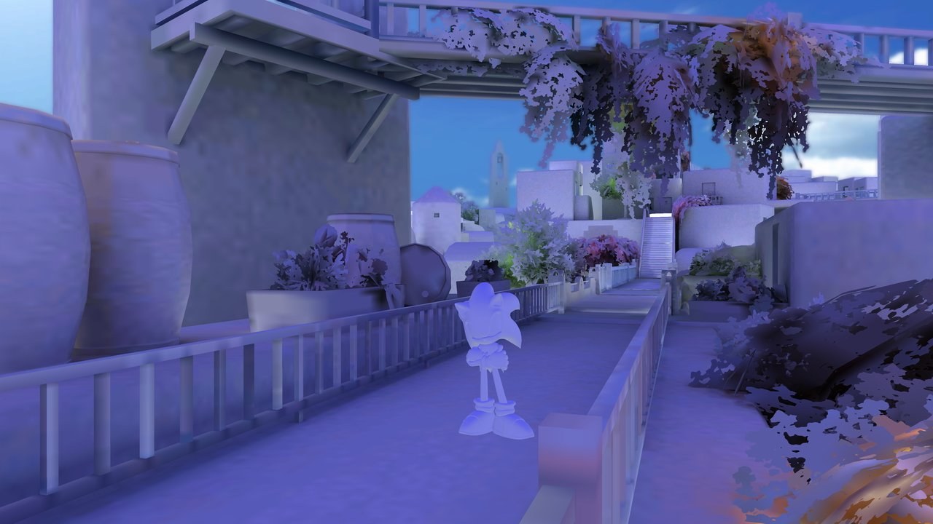
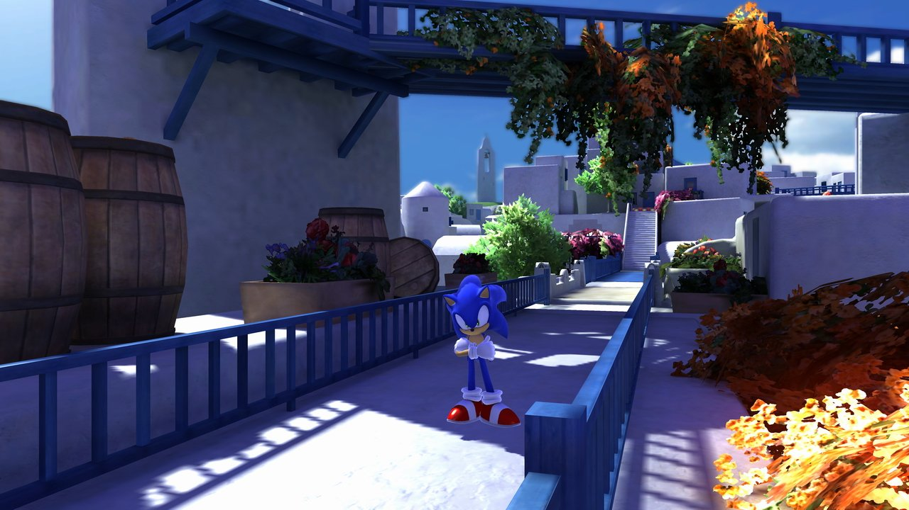
GI texture using radiosity
Notes:
http://game.watch.impress.co.jp/docs/series/3dcg/20090410_110682.html

