Slide 1
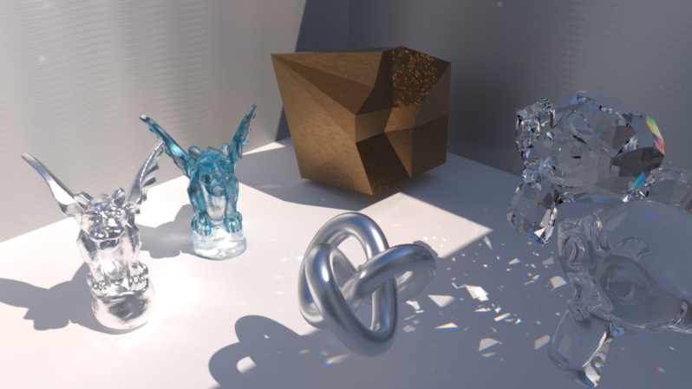
Computer Graphics
Shading
紀明德 mtchi@cs.nccu.edu.tw
Department of Computer Science,
National Chengchi University
Notes:
2019
Shading: which computers the pixel color based on the results of ray intersection
Shading refers to depicting depth perception in 3D models or illustrations by varying levels of darkness. (from wiki)
The operation of determining the effect of a light on a material is known as shading (realtime rendering 3rd)
“paint” with light (Fundmentals of CG )

Slide 2
Illumination
Local Illumination
Phong shading model
  ambient,
  diffuse,
  Specular
Lighting Type
BRDF

Slide 3
Objectives
Learn to shade objects so their images appear three-dimensional
Introduce the types of light-material interactions
Build a simple reflection model---the Phong model--- that can be used with real time graphics hardware

Slide 4

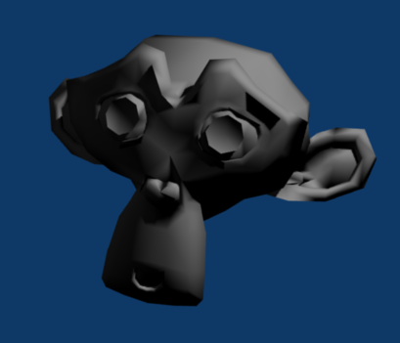
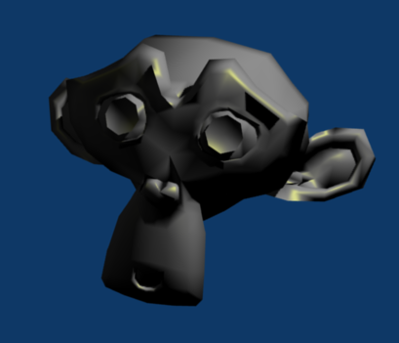
Why we need shading
Suppose we build a model using many polygons and color it with glColor. We get something like
But we want
Notes:
Before:
glColor()
After:
glEnable(GL_LIGHTING); ... Related lighting setup (glLightfv(); glMaterial();)
glNormal();

Slide 5
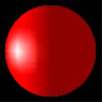
Shading
Why does the image of a real sphere look like
Light-material interactions cause each point to have a different color or shade
Need to consider
  Light sources
  Material properties
  Location of viewer
  Surface orientation

Slide 6
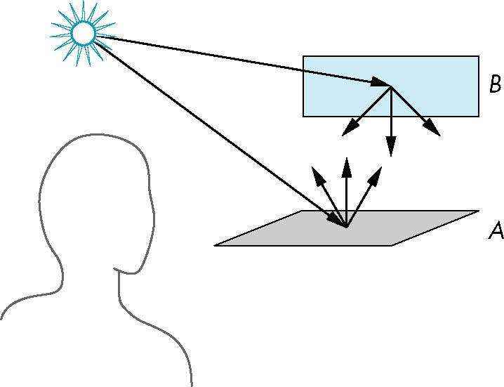
Scattering
Light strikes A
  Some scattered
  Some absorbed
Some of scattered light strikes B
  Some scattered
  Some absorbed
Some of this scattered
light strikes A
and so on

Slide 7
Rendering Equation (Kajiya 1986)
Consider a point on a surface
N
I_{in}(Φ_{in})
I_{out}(Φ_{out})

Slide 8
Rendering Equation
emission
angle between Normal and Φin
bidirectional reflection coefficient
Note that angle is really two angles in 3D and wavelength is fixed

Slide 9
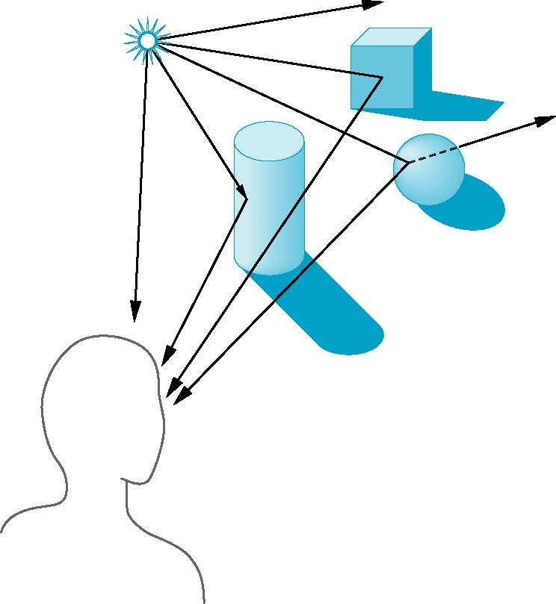
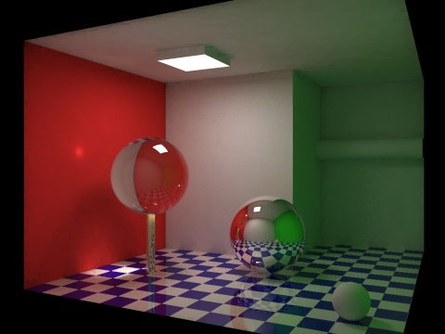
Global Effects
shadow
multiple reflection
translucent surface

Slide 10
Rendering Equation
The infinite scattering and absorption of light can be described by the rendering equation
  Cannot be solved in general
  Ray tracing is a special case for perfectly reflecting surfaces
Rendering equation is global and includes
  Shadows
  Multiple scattering from object to object

Slide 11
Local vs Global Rendering
Correct shading requires a global calculation involving all objects and light sources
  Incompatible with pipeline model which shades each polygon independently (local rendering)
However, in computer graphics, especially real time graphics, we are happy if things “look right”
  Exist many techniques for approximating global effects

Slide 12
Light-Material Interaction
Light that strikes an object is partially absorbed and partially scattered (reflected)
The amount reflected determines the color and brightness of the object
  A surface appears red under white light because the red component of the light is reflected and the rest is absorbed
The reflected light is scattered in a manner that depends on the smoothness and orientation of the surface

Slide 13
Material in the world
Material Properties
.6
Intensity
( 1, 0.5, 1 )
Intensity
( 1, 0.5, 1 ) X ( 0.8, 0.8, 0.8)
= ( 0.8, 0.4, 0.8 )
.6 X .5 =.3
.5
Material
( 0.8, 0.8, 0.8 ) Material
Notes:
Shading的效果，也就是觀察者接受到的亮度
是由光源發出的亮度(左圖0.6)，照射到材質表面，根據材質不同反射係數(左圖0.5)，兩者相乘的結果(.6 X .5 =.35
)
右圖呈現以(r, g, b)三原色

Slide 14
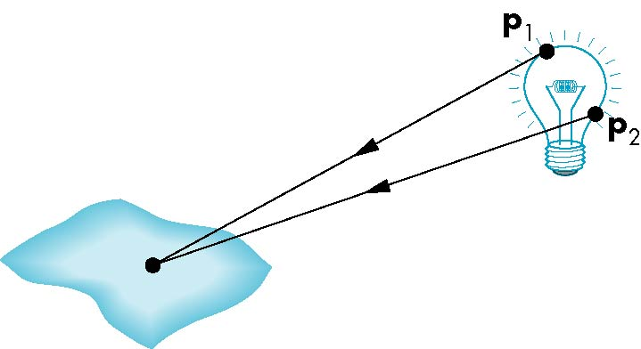
Light Sources
General light sources are difficult to work with because we must integrate light coming from all points on the source

Slide 15
Simple Light Sources
Point source
  Model with position and color
  Distant source = infinite distance away (parallel)
Spotlight
  Restrict light from ideal point source
Ambient light
  Same amount of light everywhere in scene
  Can model contribution of many sources and reflecting surfaces

Slide 16
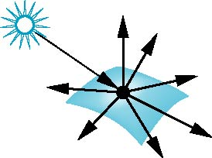
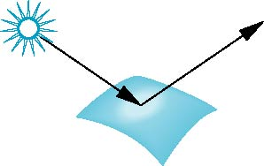
Surface Types
The smoother a surface, the more reflected light is concentrated in the direction a perfect mirror would reflected the light
A very rough surface scatters light in all directions
smooth surface
rough surface

Slide 17
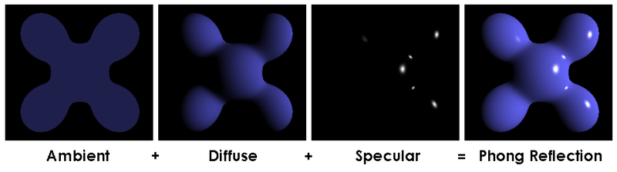
Shading Model
A simple model that can be computed rapidly
Has three components
  Diffuse
  Specular
  Ambient

Slide 18
Lambertian Shading (1971)
Perfectly diffuse reflector
Light scattered equally in all directions
Amount of light reflected is proportional to the vertical component of incoming light
  reflected light ~cos θ_{i}
  cos θ_{i} = l · n if vectors normalized
  There are also three coefficients, k_{r}, k_{b}, k_{g} that show how much of each color component is reflected

Slide 19
Lambertian Surface
d
d
θ
length
d
d/cosθ
intensity
1/d
cosθ / d
  Reflected light ~cos θ

Slide 20
Ambient Light
Ambient light is the result of multiple interactions between (large) light sources and the objects in the environment
Amount and color depend on both the color of the light(s) and the material properties of the object
Add k_{a} I_{a} to diffuse and specular terms
reflection coef.
intensity of ambient light
Notes:
[Gouraud, 1971]

Slide 21
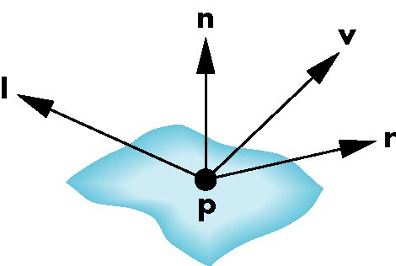
Phong shading (1973)
Uses four vectors
  To source
  To viewer
  Normal
  Perfect reflector
Notes:
^ B. T. Phong, Illumination for computer generated pictures, Communications of ACM 18 (1975), no. 6, 311–317.
^ University of Utah School of Computing, http://www.cs.utah.edu/school/history/#phong-ref

Slide 22
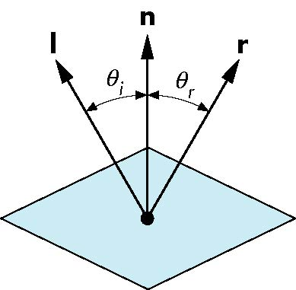
Ideal Reflector
Normal is determined by local orientation
Angle of incidence = angle of relection
The three vectors must be coplanar
r = 2 (l · n ) n - l

Slide 23
Specular Surfaces
Most surfaces are neither ideal diffusers nor perfectly specular (ideal reflectors)
Smooth surfaces show specular highlights due to incoming light being reflected in directions concentrated close to the direction of a perfect reflection
specular
highlight

Slide 24
Modeling Specular Relections
Phong proposed using a term that dropped off as the angle between the viewer and the ideal reflection increased
I_{r} ~ k_{s} I cos^{α}φ
φ
reflected
intensity
shininess coef
incoming intensity
absorption coef

Slide 25
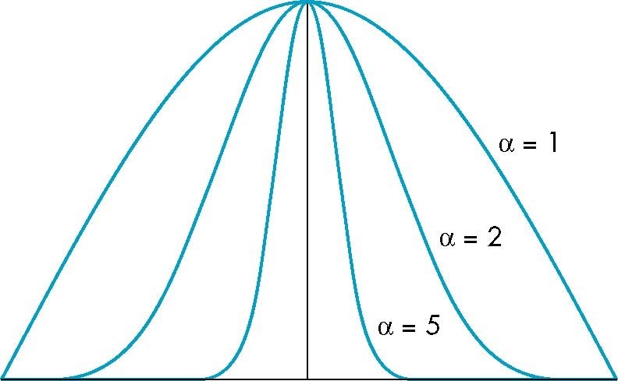
The Shininess Coefficient
Values of α between 100 and 200 correspond to metals
Values between 5 and 10 give surface that look like plastic
cos^{α} φ
-90
φ
90

Slide 26
Distance Terms
The light from a point source that reaches a surface is inversely proportional to the square of the distance between them
We can add a factor of the
form 1/(a + bd +cd²) to
the diffuse and specular
terms
The constant and linear terms soften the effect of the point source

Slide 27
Light Sources
In the Phong Model, we add the results from each light source
Each light source has separate diffuse, specular, and ambient terms to allow for maximum flexibility even though this form does not have a physical justification
Separate red, green and blue components
Hence, 9 coefficients for each point source
  I_{dr}, I_{dg}, I_{db}, I_{sr}, I_{sg}, I_{sb}, I_{ar}, I_{ag}, I_{ab}

Slide 28
Material Properties
Material properties match light source properties
  Nine absorption coefficients
    Diffuse: k_{dr}, k_{dg}, k_{db},
    Speculr: k_{sr}, k_{sg}, k_{sb},
    Ambient: k_{ar}, k_{ag}, k_{ab}
  Shininess coefficient α

Slide 29
Adding up the Components
For each light source and each color component, the Phong model can be written (without the distance terms) as
I = k_{d} I_{d} l · n + k_{s} I_{s} (v · r )^{α} + k_{a} I_{a}
For each color component
we add contributions from
all sources
ambient
diffuse
specular
Notes:
Distance ( 1/(a+bd+cd^2) )

Slide 30
Modified Phong Model (Blinn-Phong)
The specular term in the Phong model is problematic because it requires the calculation of a new reflection vector and view vector for each vertex
Blinn suggested an approximation using the halfway vector that is more efficient

Slide 31
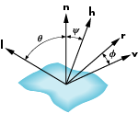
The Halfway Vector
h is normalized vector halfway between l and v
h = ( l + v )/ | l + v |

Slide 32
Using the halfway vector
Replace (v · r )^{α} by (n · h )^{β}
β is chosen to match shineness
Note that halway angle is half of angle between r and v if vectors are coplanar
Resulting model is known as the modified Phong or Blinn lighting model
  Specified in OpenGL standard

Slide 33
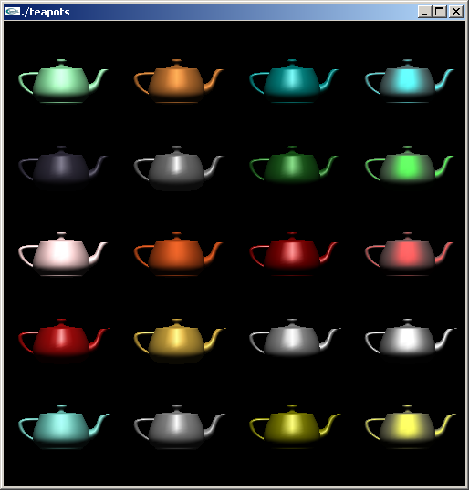
Example
Only differences in
these teapots are
the parameters
in the modified
Phong model

Slide 34
Computation of Vectors
l and v are specified by the application
Can computer r from l and n
Problem is determining n
For simple surfaces is can be determined but how we determine n differs depending on underlying representation of surface
OpenGL leaves determination of normal to application
  Exception for GLU quadrics and Bezier surfaces (Chapter 11)

Slide 35
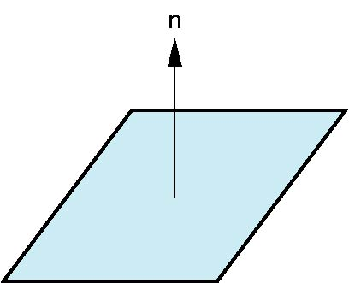
Plane Normals
Equation of plane: ax+by+cz+d = 0
From Chapter 4 we know that plane is determined by three points p₀, p₂, p₃ or normal n and p₀
Normal can be obtained by
n = (p₂-p₀) × (p₁-p₀)

Slide 36

Normal to Sphere
Implicit function f(x, y, z)=0
Normal given by gradient
Sphere f(p)=p·p-1
n = [∂f/∂x, ∂f/∂y, ∂f/∂z]^{T}=p

Slide 37
Parametric Form
For sphere
Tangent plane determined by vectors
Normal given by cross product
x=x(u,v)=cos u sin v
y=y(u,v)=cos u cos v
z= z(u,v)=sin u
∂p/∂u = [∂x/∂u, ∂y/∂u, ∂z/∂u]T
∂p/∂v = [∂x/∂v, ∂y/∂v, ∂z/∂v]T
n = ∂p/∂u × ∂p/∂v

Slide 38
General Case
We can compute parametric normals for other simple cases
  Quadrics
  Parameteric polynomial surfaces

Slide 39
Local Illumination options
Discuss polygonal shading
  Flat
  Smooth
  Gouraud
  Phong
Lighting

Slide 40
Normal for Triangle
n
plane n ·(p - p₀ ) = 0
p₂
n = (p₂ - p₀ ) ×(p₁ - p₀ )
p
p₁
normalize n ← n/ |n|
p₀
Note that right-hand rule determines outward face

Slide 41
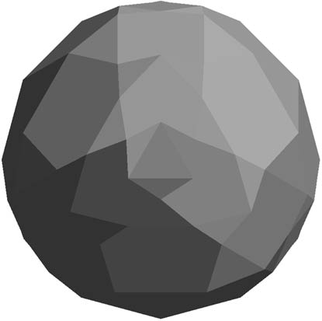
Polygon Normals
Polygons have a single normal
  Shades at the vertices as computed by the Phong model can be almost same
  Identical for a distant viewer (default) or if there is no specular component
Consider model of sphere
Want different normals at
each vertex even though
this concept is not quite
correct mathematically

Slide 42
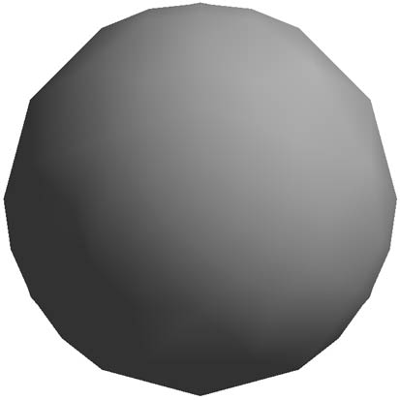
Smooth Shading
We can set a new normal at each vertex
Easy for sphere model
  If centered at origin n = p
Now smooth shading works
Note silhouette edge

Slide 43
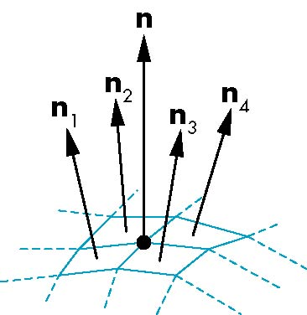
Mesh Shading
The previous example is not general because we knew the normal at each vertex analytically
For polygonal models, Gouraud proposed we use the average of the normals around a mesh vertex
n = (n₁+n₂+n₃+n₄)/ |n₁+n₂+n₃+n₄|

Slide 44
Gouraud and Phong Shading
Gouraud Shading
  Find average normal at each vertex (vertex normals)
  Apply modified Phong model at each vertex
  Interpolate vertex shades across each polygon
Phong shading
  Find vertex normals
  Interpolate vertex normals across edges
  Interpolate edge normals across polygon
  Apply modified Phong model at each fragment

Slide 45
Comparison
If the polygon mesh approximates surfaces with a high curvatures, Phong shading may look smooth while Gouraud shading may show edges
Phong shading requires much more work than Gouraud shading
  Until recently not available in real time systems
  Now can be done using fragment shaders (see Chapter 9)
Both need data structures to represent meshes so we can obtain vertex normals

Slide 46
Objectives
Introduce the OpenGL shading functions
Discuss polygonal shading
  Flat
  Smooth
  Gouraud

Slide 47
Steps in OpenGL shading
Enable shading and select model
Specify normals
Specify material properties
Specify lights

Slide 48
Normals
In OpenGL the normal vector is part of the state
Set by glNormal*()
  glNormal3f(x, y, z);
  glNormal3fv(p);
Usually we want to set the normal to have unit length so cosine calculations are correct
  Length can be affected by transformations
  Note that scaling does not preserved length
  glEnable(GL_NORMALIZE) allows for autonormalization at a performance penalty

Slide 49
Normal for Triangle
n
plane n ·(p - p₀ ) = 0
p₂
n = (p₂ - p₀ ) ×(p₁ - p₀ )
p
p₁
normalize n ← n/ |n|
p₀
Note that right-hand rule determines outward face

Slide 50
Enabling Shading
Shading calculations are enabled by
  glEnable(GL_LIGHTING)
  Once lighting is enabled, glColor() ignored
Must enable each light source individually
  glEnable(GL_LIGHTi) i=0,1…..
Can choose light model parameters
  glLightModeli(parameter, GL_TRUE)
    GL_LIGHT_MODEL_LOCAL_VIEWER do not use simplifying distant viewer assumption in calculation
    GL_LIGHT_MODEL_TWO_SIDED shades both sides of polygons independently

Slide 51
Defining a Point Light Source
For each light source, we can set an RGBA for the diffuse, specular, and ambient components, and for the position
GLfloat diffuse0[]={1.0, 0.0, 0.0, 1.0};
GLfloat ambient0[]={1.0, 0.0, 0.0, 1.0};
GLfloat specular0[]={1.0, 0.0, 0.0, 1.0};
Glfloat light0_pos[]={1.0, 2.0, 3,0, 1.0};
glEnable(GL_LIGHTING);
glEnable(GL_LIGHT0);
glLightv(GL_LIGHT0, GL_POSITION, light0_pos);
glLightv(GL_LIGHT0, GL_AMBIENT, ambient0);
glLightv(GL_LIGHT0, GL_DIFFUSE, diffuse0);
glLightv(GL_LIGHT0, GL_SPECULAR, specular0);

Slide 52
Distance
The coefficients in the distance terms are by default a=1.0 (constant terms), b=c=0.0 (linear and quadratic terms). Change by
a= 0.80;
glLightf(GL_LIGHT0, GLCONSTANT_ATTENUATION, a);

Slide 53
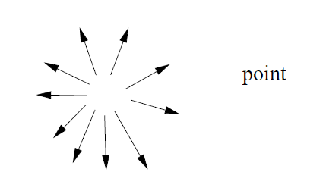
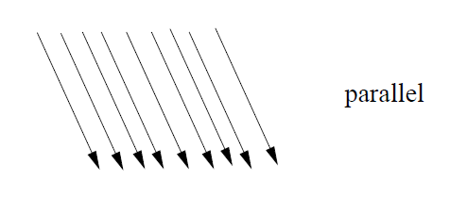
Direction
The source colors are specified in RGBA
The position is given in homogeneous coordinates
  If w =1.0, we are specifying a finite location
  If w =0.0, we are specifying a parallel source with the given direction vector

Slide 54
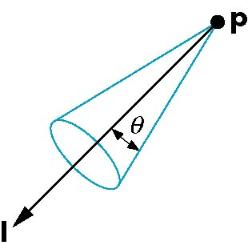
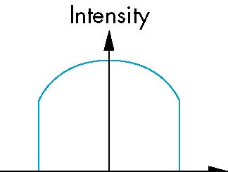
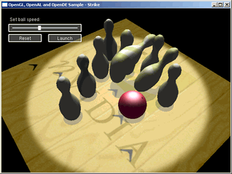
Spotlights
Use glLightv to set
  Direction GL_SPOT_DIRECTION
  Cutoff GL_SPOT_CUTOFF
  Attenuation GL_SPOT_EXPONENT
    Proportional to cos^{α}φ
−θ
φ
θ

Slide 55
Global Ambient Light
Ambient light depends on color of light sources
  A red light in a white room will cause a red ambient term that disappears when the light is turned off
OpenGL also allows a global ambient term that is often helpful for testing
  glLightModelfv(GL_LIGHT_MODEL_AMBIENT, global_ambient)

Slide 56
Moving Light Sources
Light sources are geometric objects whose positions or directions are affected by the model-view matrix
Depending on where we place the position (direction) setting function, we can
  Move the light source(s) with the object(s)
  Fix the object(s) and move the light source(s)
  Fix the light source(s) and move the object(s)
  Move the light source(s) and object(s) independently

Slide 57
Material Properties
Material properties are also part of the OpenGL state and match the terms in the modified Phong model
Set by glMaterialv()
GLfloat ambient[] = {0.2, 0.2, 0.2, 1.0};
GLfloat diffuse[] = {1.0, 0.8, 0.0, 1.0};
GLfloat specular[] = {1.0, 1.0, 1.0, 1.0};
GLfloat shine = 100.0
glMaterialf(GL_FRONT, GL_AMBIENT, ambient);
glMaterialf(GL_FRONT, GL_DIFFUSE, diffuse);
glMaterialf(GL_FRONT, GL_SPECULAR, specular);
glMaterialf(GL_FRONT, GL_SHININESS, shine);

Slide 58
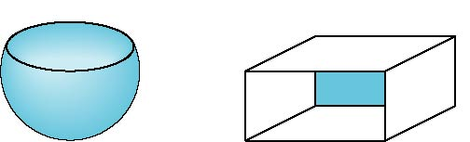
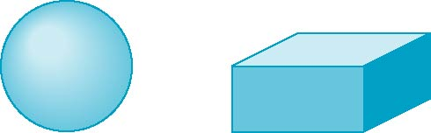
Front and Back Faces
The default is shade only front faces which works correctly for convex objects
back faces not visible
back faces visible

Slide 59
Emissive Term
We can simulate a light source in OpenGL by giving a material an emissive component
This component is unaffected by any sources or transformations
GLfloat emission[] = 0.0, 0.3, 0.3, 1.0);
glMaterialf(GL_FRONT, GL_EMISSION, emission);

Slide 60
Transparency
Material properties are specified as RGBA values
The A value can be used to make the surface translucent
The default is that all surfaces are opaque regardless of A
Later we will enable blending and use this feature

Slide 61
Polygonal Shading
Shading calculations are done for each vertex
  Vertex colors become vertex shades
By default, vertex shades are interpolated across the polygon
  glShadeModel(GL_SMOOTH);
If we use glShadeModel(GL_FLAT); the color at the first vertex will determine the shade of the whole polygon

Slide 62
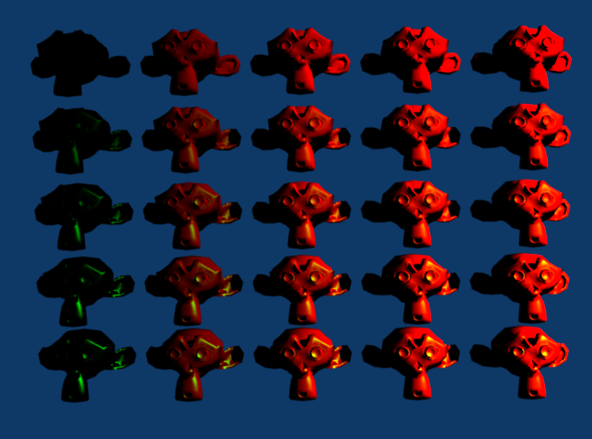
large
small
diffuse
specular
large

Slide 63
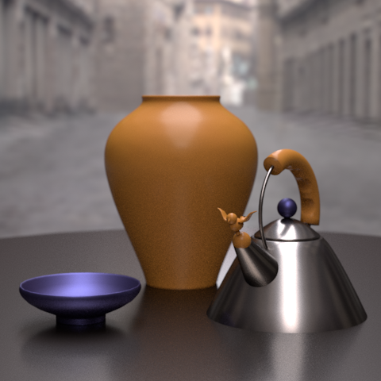
BRDF
Notes:
http://www.siggraph.org/publications/newsletter/volume-43-number-2/a-survey-of-brdf-models-for-computer-graphics

Slide 64
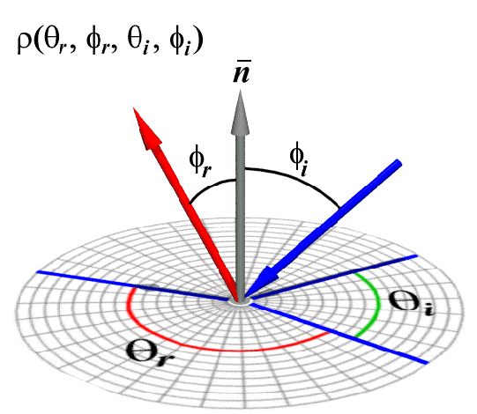
Bidirectional reflectance distribution function
Notes:
http://groups.csail.mit.edu/graphics/classes/6.837/F98/Lecture19/Slide20.html

Slide 65
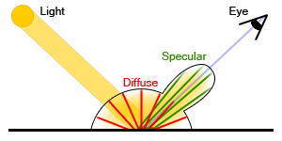
Diffuse + Specular in

Slide 66
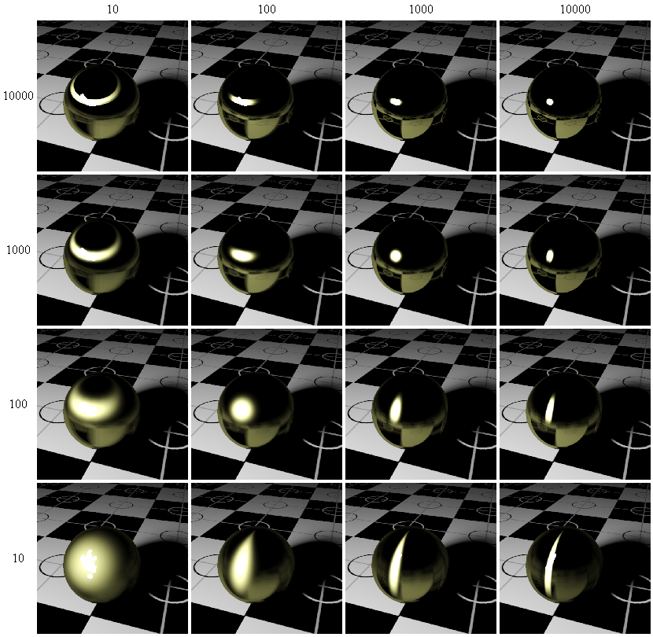
An Anisotropic Phong BRDF Model
Notes:
http://voxelizator3d.wordpress.com/2007/01/03/i-put-my-blood-into-this/

Slide 67
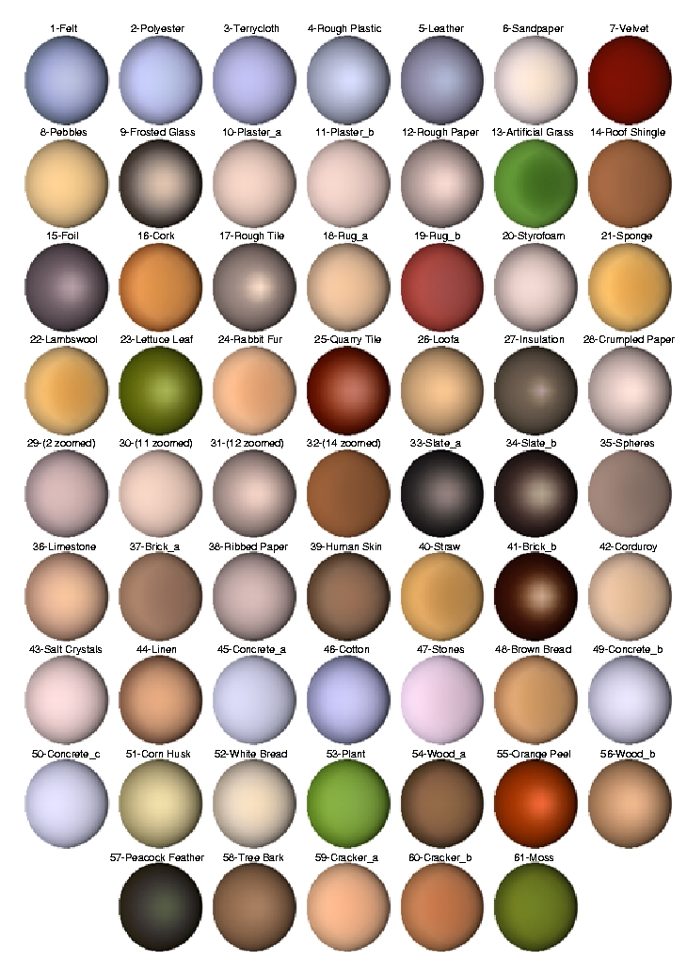
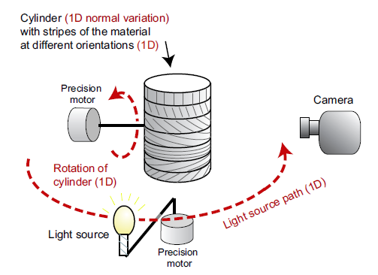
Notes:
http://people.csail.mit.edu/addy/research/ngan05_brdf_eval.pdf

Slide 68
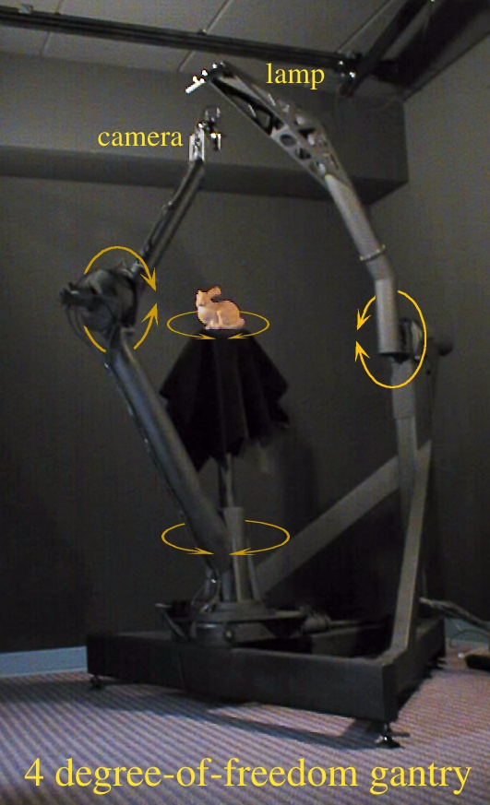
Gonioreflectometers
Can add fourth degree of freedom to measure anisotropic BRDFs
Notes:
https://en.wikipedia.org/wiki/Gonioreflectometer

Slide 69
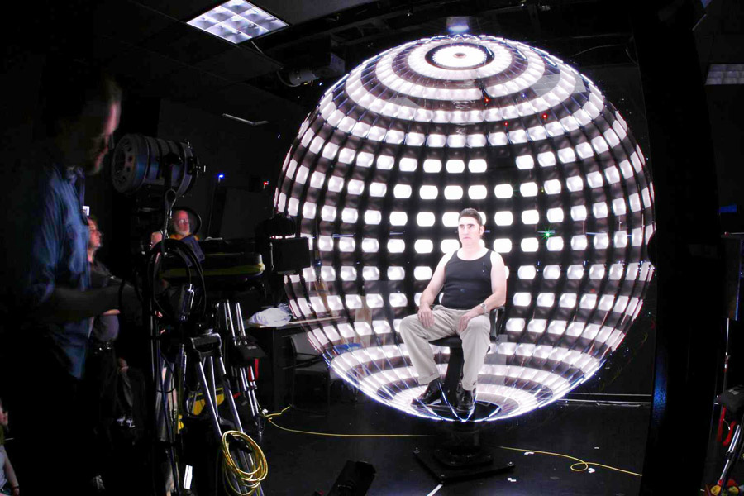
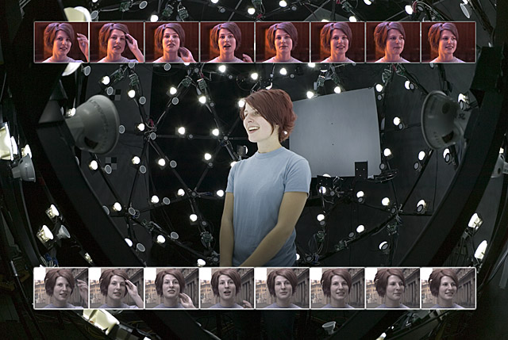
lightstage
Notes:
http://gl.ict.usc.edu/lightstages/

Slide 70
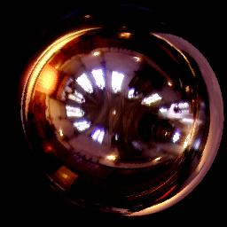
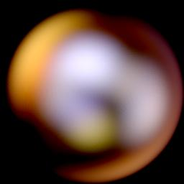
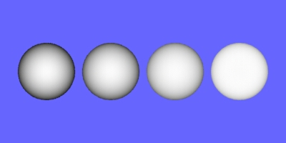
Summary of Surfaces and BRDFs
Smooth
Rough
Mirror BRDF
Torrance-Sparrow BRDF
Specular
Delta Function
Speck of reflection
Broader Highlights
Off-specular lobe
Lambertian BRDF
Oren-Nayar BRDF
Diffuse
No view dependence
Models view dependence
Many surfaces may be rough and show
both diffuse and surface reflection.

Slide 71
Spherical Coordinates
Cartesian coordinates (v_{x},v_{y},v_{z})
Spherical coordinates (θ, φ)
z
1.0
v
θ
y
φ
x

