Slide 1
Computer Graphics
Programmable Pipelines
Notes:
2019

Slide 2
Objectives
Introduce programmable pipelines
Vertex shaders
Fragment shaders
Introduce shading languages
Shaders
RenderMan

Slide 3
Introduction
Recent major advance in real time graphics is programmable pipeline
First introduced by NVIDIA GeForce 3 (2001)
Supported by high-end commodity cards
NVIDIA, ATI AMD, 3D Labs
Software Support
Direct X 8 , 9, 10
OpenGL Extensions
OpenGL Shading Language (GLSL)
Nvidia Cg

Slide 4
Background
Two components
Vertex programs (shaders)
Fragment programs (shaders)
Requires detailed understanding of two seemingly contradictory apporachs
OpenGL pipeline
Real time
RenderMan ideas
offline

Slide 5
Black Box View
vertices
vertices
fragments
fragments
CPU
Geometry
Processor
Rasterizer
Fragment
Processor
Frame
Buffer
Hw-swgl1
Hw-swgl2
Hw-swgl3

Slide 6
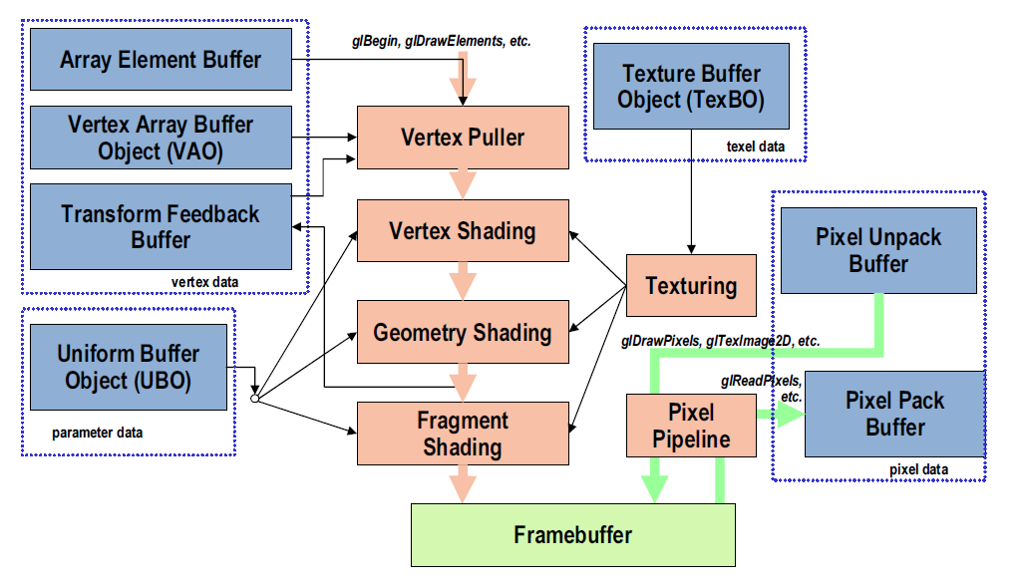
OpenGL 3 Modern Buffer-centric Processing model

Slide 7
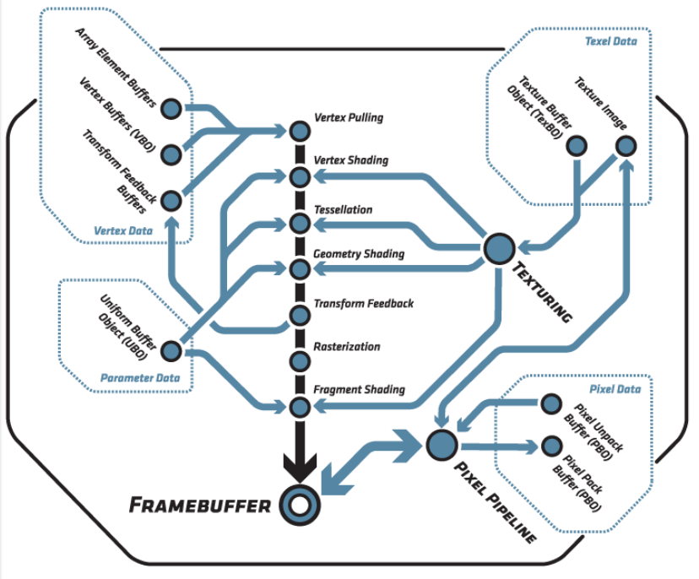
OpenGL 4.2
Khronos
Notes:
http://www.khronos.org/assets/uploads/developers/library/2011-siggraph-asia/OpenGL-4.2-SIGGRAPH-Asia_Dec-11.pdf

Slide 8
Geometric Calculations
Geometric data: set of vertices + type
Can come from program, evaluator, display list
type: point, line, polygon
Vertex data can be
(x,y,z,w) coordinates of a vertex (glVertex)
Normal vector
Texture Coordinates
RGBA color
Other data: color indices, edge flags
Additional user-defined data in GLSL

Slide 9
Per-Vertex Operations
Vertex locations are transformed by the model-view matrix into eye coordinates
Normals must be transformed with the inverse transpose of the model-view matrix so that v·n=v’ ·n’ in both spaces
Assumes there is no scaling
May have to use autonormalization
Textures coordinates are generated if autotexture enabled and the texture matrix is applied

Slide 10
Lighting Calculations
Consider a per-vertex basis Phong model
I = k_{d} I_{d} l · n + k_{s} I_{s} (v · r )^{α} + k_{a} I_{a}
Phong model requires computation of r and v at every vertex
diffuse
specular
ambient

Slide 11
Primitive Assembly
Vertices are next assembled into objects
Polygons
Line Segements
Points
Transformation by projection matrix
Clipping
Against user defined planes
View volume, x=±w, y=±w, z=±w
Polygon clipping can create new vertices
Perspective Division
Viewport mapping

Slide 12
Rasterization
Geometric entities are rasterized into fragments
Each fragment corresponds to a point on an integer grid: a displayed pixel
Hence each fragment is a potential pixel
Each fragment has
A color
Possibly a depth value
Texture coordinates

Slide 13
Fragment Operations
Texture generation
Fog
Antialiasing
Scissoring
Alpha test
Blending
Dithering
Logical Operation
Masking

Slide 14
Vertex Processor
Takes in vertices
Position attribute
Possibly color
OpenGL state
Produces
Position in clip coordinates
Vertex color

Slide 15
Fragment Processor
Takes in output of rasterizer (fragments)
Vertex values have been interpolated over primitive by rasterizer
Outputs a fragment
Color
Texture
Fragments still go through fragment tests
Hidden-surface removal
alpha

Slide 16
Programmable Shaders
Replace fixed function vertex and fragment processing by programmable processors called shaders
Can replace either or both
If we use a programmable shader we must do all required functions of the fixed function processor

Slide 17
Development
RenderMan Shading Language
Offline rendering
Hardware Shading Languages
UNC, Stanford
NVIDIA
OpenGL Vertex Program Extension
OpenGL Shading Language
Cg
OpenGL
Microsoft HLSL

Slide 18

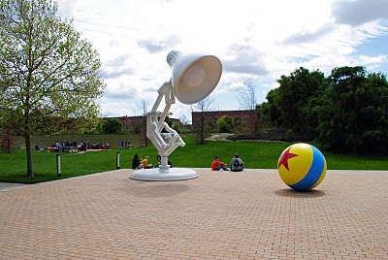
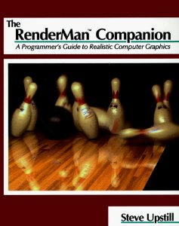
RenderMan
Developed by Pixar
S. Upstill, The RenderMan Companion, Addison-Wesley, 1989.
interface file (RIB)
Modeler
Renderer

Slide 19
Modeling vs Rendering
Modeler outputs geometric model plus information for the renderer
Specifications of camera
Materials
Lights
May have different kinds of renderers
Ray tracer
Radiosity
How do we specify a shader?

Slide 20
GLSL I
OpenGL 2.X

Slide 21
Objectives
Shader applications
Vertex shaders
Fragment shaders
Programming shaders
GLSL

Slide 22
Vertex Shader Applications
General Vertex Lighting
More realistic models
Cartoon shaders
Off loading CPU
Dynamic Meshes
Morphing

Slide 23
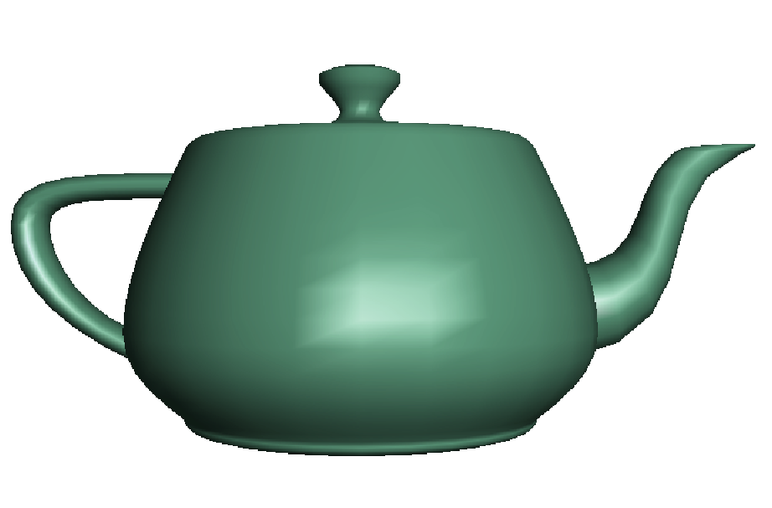
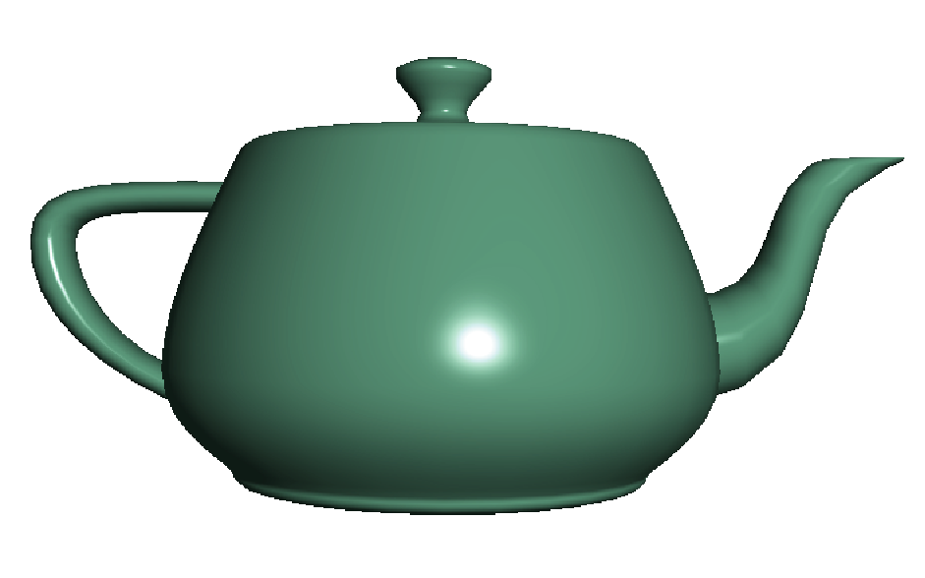
Fragment Shader Applications
Per fragment lighting calculations
per vertex lighting
per fragment lighting
Notes:
http://www.cs.toronto.edu/%7Ejacobson/phong-demo/

Slide 24
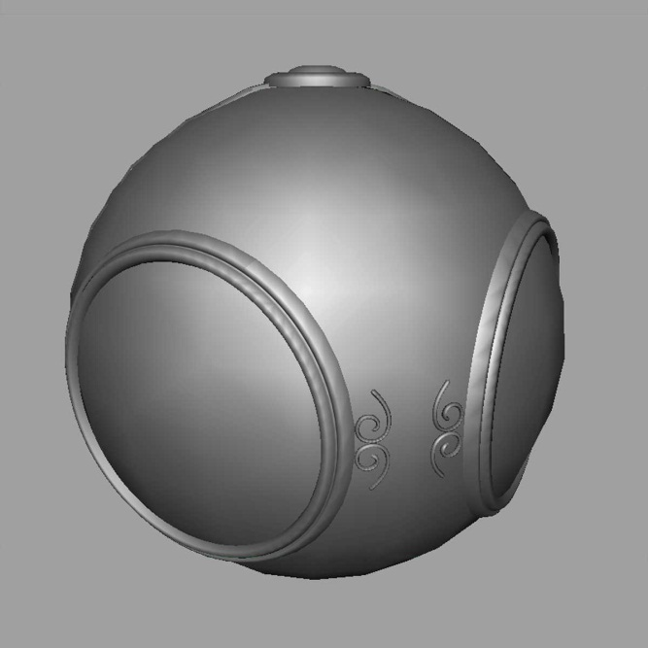
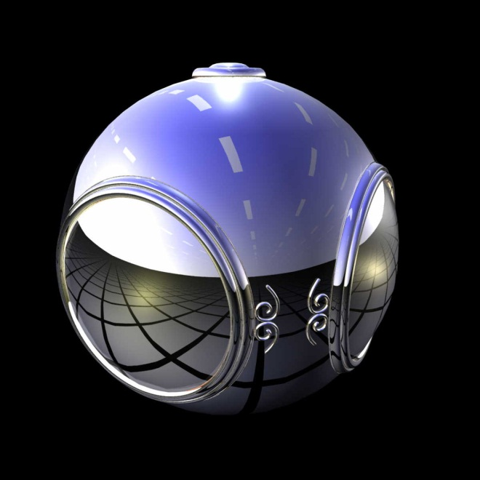
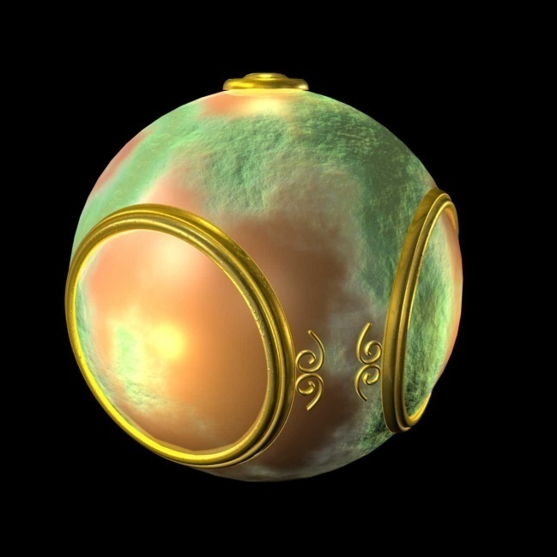
Fragment Shader Applications
Texture mapping
smooth shading
environment
mapping
bump mapping

Slide 25
Writing Shaders
First programmable shaders were programmed in an assembly-like manner
OpenGL extensions added for vertex and fragment shaders
Cg (C for graphics) C-like language for programming shaders
Works with both OpenGL and DirectX
Interface to OpenGL complex
OpenGL Shading Language (GLSL)

Slide 26
GLSL
OpenGL Shading Language
Part of OpenGL 2.0
High level C-like language
New data types
Matrices
Vectors
Samplers
OpenGL state available through built-in variables

Slide 27
Simple Vertex Shader
const vec4 red = vec4(1.0, 0.0, 0.0, 1.0);
void main(void)
{
gl_Position = gl_ProjectionMatrix
*gl_ModelViewMatrix*gl_Vertex;
gl_FrontColor = red;
}

Slide 28
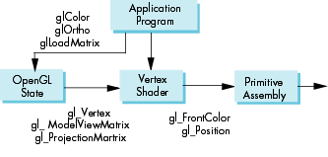
Execution Model

Slide 29
Simple Fragment Program
void main(void)
{
gl_FragColor = gl_Color;
}

Slide 30
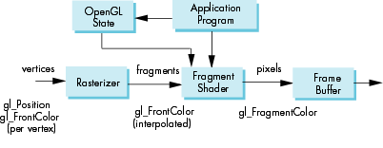
Execution Model

Slide 31
Data Types
C types: int, float, bool
Vectors:
float vec2, vec 3, vec4
Also int (ivec) and boolean (bvec)
Matrices: mat2, mat3, mat4
Stored by columns
Standard referencing m[row][column]
C++ style constructors
vec3 a =vec3(1.0, 2.0, 3.0)
vec2 b = vec2(a)

Slide 32
Pointers
There are no pointers in GLSL
We can use C structs which can be copied back from functions
Because matrices and vectors are basic types they can be passed into and output from GLSL functions, e.g.
mat3 func(mat3 a)

Slide 33
Qualifiers
GLSL has many of the same qualifiers such as const as C/C++
Need others due to the nature of the execution model
Variables can change
Once per primitive (uniform)
Once per vertex (attribute)
Once per fragment
At any time in the application
Vertex attributes are interpolated by the rasterizer into fragment attributes (varying)
Notes:
限定詞

Slide 34
Attribute Qualifier
Attribute-qualified variables can change at most once per vertex
Cannot be used in fragment shaders
Built in (OpenGL state variables)
gl_Color
gl_ModelViewMatrix
User defined (in application program)
attribute float temperature
attribute vec3 velocity

Slide 35
Uniform Qualified
Variables that are constant for an entire primitive
Can be changed in application outside scope of glBegin and glEnd
Cannot be changed in shader
Used to pass information to shader such as the bounding box of a primitive
glUniform( , )
glBegin();
glVertex()
glEnd();

Slide 36
Varying Qualified
Variables that are passed from vertex shader to fragment shader
Automatically interpolated by the rasterizer
Built in
Vertex colors
Texture coordinates
User defined
Requires a user defined fragment shader

Slide 37
Example: Vertex Shader
const vec4 red = vec4(1.0, 0.0, 0.0, 1.0);
varying vec3 color_out;
void main(void)
{
gl_Position = gl_ModelViewProjectionMatrix*gl_Vertex;
color_out = red;
}

Slide 38
Required Fragment Shader
varying vec3 color_out;
void main(void)
{
gl_FragColor = color_out;
}
Vertex Shader
Fragment Shader

Slide 39
Passing values
call by value-return
Variables are copied in
Returned values are copied back
Three possibilities
in
out
inout

Slide 40
Operators and Functions
Standard C functions
Trigonometric
Arithmetic
Normalize, reflect, length
Overloading of vector and matrix types
mat4 a;
vec4 b, c, d;
c = b*a; // a column vector stored as a 1d array
d = a*b; // a row vector stored as a 1d array

Slide 41
Swizzling and Selection
Can refer to array elements by element using [] or selection (.) operator with
x, y, z, w
r, g, b, a
s, t, p, q
a[2], a.b, a.z, a.p are the same
Swizzling operator lets us manipulate components
vec4 a;
a.yz = vec2(1.0, 2.0);

Slide 42
Shading language changes after OpenGL 3.X

Slide 43
Qualifiers
in, out
Copy vertex attributes and other variable to/ from shaders
in vec2 tex_coord;
out vec4 color;
uniform: variable from application
uniform float time;
uniform vec4 rotation;
Notes:
In addition to types, GLSL has numerous qualifiers to describe a variable usage. The most common of those are:
in qualifiers that indicate the shader variable will receive data flowing into the shader, either from the application, or the previous shader stage.
out qualifier which tag a variable as data output where data will flow to the next shader stage, or to the framebuffer
uniform qualifiers for accessing data that doesn’t change across a draw operation

Slide 44
Built-in Variables
gl_Position: output position from vertex shader
gl_FragColor: output color from fragment shader
Only for ES, WebGL and older versions of GLSL
Present version use an out variable
Notes:
Fundamental to shader processing are a couple of built-in GLSL variable which are the terminus for operations. In particular, vertex data, which can be processed by up to for shader stages in OpenGL are all ended by setting a positional value into the built-in variable, gl_Position. Similarly, the output of a fragment shader (in version 3.1 of OpenGL) is set by writing values into the built-in variable gl_FragColor. Later versions of OpenGL allow fragment shaders to output to other variables of the user’s designation as well.

Slide 45
Simple Vertex Shader for Cube Example
// in CPU side
GLuint vPosition = glGetAttribLocation( program, "vPosition" );
glEnableVertexAttribArray( vPosition );
glVertexAttribPointer( vPosition, 4, GL_FLOAT, GL_FALSE, 0, BUFFER_OFFSET(0) );
GLuint vColor = glGetAttribLocation( program, "vColor" );
glEnableVertexAttribArray( vColor );
glVertexAttribPointer( vColor, 4, GL_FLOAT, GL_FALSE, 0,
BUFFER_OFFSET(sizeof(points)) );
#version 330 core
in vec4 vPosition;
in vec4 vColor;
out vec4 color;
void main()
{
color=vColor;
gl_Position=vPosition;
}
Notes:
Here’s the simple vertex shader we use in our cube rendering example. It accepts two vertex attributes as input: the vertex’s position and color, and does very little processing on them; in fact, it merely copies the input into some output variables (with gl_Position being implicitly declared). The results of each vertex shader execution are passed further down the OpenGL pipeline, and ultimately end their processing in the fragment shader.

Slide 46
The Simplest Fragment Shader
in vec4 color;
out vec4 FragColor;
void main()
{
FragColor = color;
}
Notes:
Here’s the associated fragment shader that we use in our cube example. While this shader is as simple as they come – merely setting the fragment’s color to the input color passed in, there’s been a lot of processing to this point. In particular, every fragment that’s shaded was generated by the rasterizer, which is a built-in, non-programmable (i.e., you don’t write a shader to control its operation). What’s magical about this process is that if the colors across the geometric primitive (for multi-vertex primitives: lines and triangles) is not the same, the rasterizer will interpolate those colors across the primitive, passing each iterated value into our color variable.

Slide 47
GLSL II

Slide 48
Objectives
Coupling GLSL to Applications
Example applications

Slide 49
Linking with Application
In OpenGL application, we must:
Read shaders
Compile shaders
Define variables
Link everything together

Slide 50
Reading a Shader
Shader are added to the program object and compiled
Usual method of passing a shader is as a null-terminated string using the function glShaderSource
If the shader is in a file, we can write a reader to convert the file to a string

Slide 51
Shader Reader
#include <stdio.h>
char* readShaderSource(const char* shaderFile)
{
FILE* fp = fopen(shaderFile, "r");
char* buf;
long size;
if(fp == NULL) return(NULL);
fseek(fp, 0L, SEEK_END); /* end of file */
size = ftell(fp);
fseek(fp, )L, SEEK_SET); /* start of file */

Slide 52
Shader Reader (cont)
buf = (char*) malloc(statBuf.st_size + 1 * sizeof(char));
fread(buf, 1, size, fp);
buf[size] = '\0'; /null termination */
fclose(fp);
return buf;
}

Slide 53
Adding a Vertex Shader
GLint vShader;
GLunit myVertexObj;
GLchar vShaderfile[] = “my_vertex_shader”;
GLchar* vSource = readShaderSource(vShaderFile);
myVertexObj = glCreateShader(GL_VERTEX_SHADER);
glShaderSource(myVertexObj, 1, & vSource, NULL);
glCompileShader(myVertexObj);

Slide 54
Program Object
Container for shaders
Can contain multiple shaders
Other GLSL functions
GLuint myProgObj;
myProgObj = glCreateProgram();
/* define shader objects here */
glUseProgram(myProgObj);
glAttachShader(myProgObj, vertexShader );
glAttachShader(myProgObj, fragmentShader );
glLinkProgram(myProgObj);

Slide 55
Vertex Attributes
Vertex attributes are named in the shaders
Linker forms a table
Application can get index from table and tie it to an application variable
Similar process for uniform variables

Slide 56
Vertex Attribute Example
GLint colorAttr;
colorAttr = glGetAttribLocation(myProgObj,
"myColor");
/* myColor is name in shader */
------------------------------------------
GLfloat color[4];
glVertexAttrib4fv(colorAttrib, color);
/* color is variable in application */

Slide 57
Uniform Variable Example
GLint angleParam;
angleParam = glGetUniformLocation(myProgObj,
"angle");
/* angle defined in shader */
/* my_angle set in application */
GLfloat my_angle;
my_angle = 5.0 /* or some other value */
glUniform1f(angleParam, my_angle);

Slide 58
Glsl.h
#include "glsl.h“
cwc::glShaderManager SM;
cwc::glShader *shader;
shader = SM.loadfromFile("brick.vert", "brick.frag");
shader->begin();
shader->setUniform3f(“ucolor", 1, 0, 0);
DrawSomething();
shader->end();
Notes:
https://www.opengl.org/sdk/docs/tutorials/ClockworkCoders/loading.php
http://www.clockworkcoders.com/oglsl/ 已無效

Slide 59
Vertex Shader with uniform
uniform vec4 ucolor;
void main(void)
{
gl_Position = gl_ProjectionMatrix
*gl_ModelViewMatrix*gl_Vertex;
gl_FrontColor = ucolor;
}

Slide 60
Vertex Shader Applications
Moving vertices
Morphing
Wave motion
Fractals
Lighting
More realistic models
Cartoon shaders

Slide 61
Wave Motion Vertex Shader
uniform float time;
uniform float xs, zs, // frequencies
uniform float h; // height scale
void main()
{
vec4 t =gl_Vertex;
t.y = gl_Vertex.y
+ h*sin(time + xs*gl_Vertex.x)
+ h*sin(time + zs*gl_Vertex.z);
gl_Position =
gl_ModelViewProjectionMatrix*t;
}

Slide 62
Particle System
uniform vec3 init_vel;
uniform float g, m, t;
void main()
{
vec3 object_pos;
object_pos.x = gl_Vertex.x + vel.x*t;
object_pos.y = gl_Vertex.y + vel.y*t
+ g/(2.0*m)*t*t;
object_pos.z = gl_Vertex.z + vel.z*t;
gl_Position =
gl_ModelViewProjectionMatrix *
vec4(object_pos,1);
}

Slide 63
Modified Phong Vertex Shader I
void main(void)
/* modified Phong vertex shader (without distance term) */
{
gl_Position = gl_ModelViewProjectionMatrix * gl_Vertex;
vec4 ambient, diffuse, specular;
vec4 eyePosition = gl_ModelViewMatrix * gl_Vertex;
vec4 eyeLightPos = gl_LightSource[0].position;
vec3 N = normalize(gl_NormalMatrix * gl_Normal);
vec3 L = normalize(eyeLightPos.xyz - eyePosition.xyz);
vec3 E = -normalize(eyePosition.xyz);
vec3 H = normalize(L + E);
Notes:
camera在eye space是(0, 0, 0)
(0, 0, 0) - eye space poistion = view vector

Slide 64
Modified Phong Vertex Shader II
/* compute diffuse, ambient, and specular contributions */
float Kd = max(dot(L, N), 0.0);
float Ks = pow(max(dot(N, H), 0.0), gl_FrontMaterial.shininess);
float Ka = 0.0;
ambient = Ka*gl_FrontLightProduct[0].ambient;
diffuse = Kd*gl_FrontLightProduct[0].diffuse;
specular = Ks*gl_FrontLightProduct[0].specular;
gl_FrontColor = ambient+diffuse+specular;
}

Slide 65
Pass Through Fragment Shader
/* pass-through fragment shader */
void main(void)
{
gl_FragColor = gl_Color;
}

Slide 66
Vertex Shader for per Fragment Lighting
varying vec3 N, L, E, H;
void main()
{
gl_Position = gl_ModelViewProjectionMatrix * gl_Vertex;
vec4 eyePosition = gl_ModelViewMatrix * gl_Vertex;
vec4 eyeLightPos = gl_LightSource[0].position;
N = normalize(gl_NormalMatrix * gl_Normal);
L = normalize(eyeLightPos.xyz - eyePosition.xyz);
E = -normalize(eyePosition.xyz);
H = normalize(L + E);
}

Slide 67
Fragment Shader for Modified Phong Lighting I
varying vec3 N;
varying vec3 L;
varying vec3 E;
varying vec3 H;
void main()
{
vec3 Normal = normalize(N);
vec3 Light = normalize(L);
vec3 Eye = normalize(E);
vec3 Half = normalize(H);

Slide 68
Fragment Shader for Modified Phong Lighting II
float Kd = max(dot(Normal, Light), 0.0);
float Ks = pow(max(dot(Half, Normal), 0.0),
gl_FrontMaterial.shininess);
float Ka = 0.0;
vec4 diffuse = Kd * gl_FrontLightProduct[0].diffuse;
vec4 specular = Ks * gl_FrontLightProduct[0].specular;
vec4 ambient = Ka * gl_FrontLightProduct[0].ambient;
gl_FragColor = ambient + diffuse + specular;
}

Slide 69
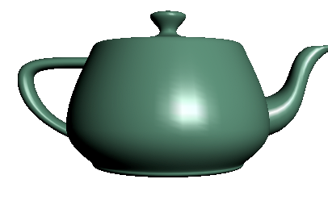
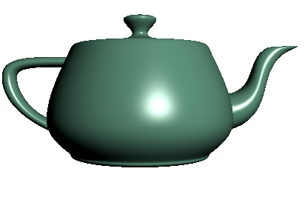
Vertex vs Fragment Lighting
per vertex lighting
per fragment lighting

Slide 70
Samplers
Provides access to a texture object
Defined for 1, 2, and 3 dimensional textures and for cube maps
In shader:
uniform sampler2D myTexture;
Vec2 texcoord;
Vec4 texcolor = texture2D(mytexture, texcoord);
In application:
texMapLocation = glGetUniformLocation(myProg,“myTexture”);
glUniform1i(texMapLocation, 0);
/* assigns to texture unit 0 */

Slide 71
Fragment Shader Applications
Texture mapping
smooth shading
environment
mapping
bump mapping

Slide 72
Cube Maps
We can form a cube map texture by defining six 2D texture maps that correspond to the sides of a box
Supported by OpenGL
Also supported in GLSL through cubemap sampler
vec4 texColor = textureCube(mycube, texcoord);
Texture coordinates must be 3D

Slide 73
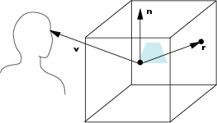
Environment Map
Use reflection vector to locate texture in cube map

Slide 74
Environment Maps with Shaders
Environment map usually computed in world coordinates which can differ from object coordinates because of modeling matrix
May have to keep track of modeling matrix and pass it shader as a uniform variable
Can also use reflection map or refraction map (for example to simulate water)

Slide 75
Reflection Map Vertex Shader
varying vec3 R;
void main(void)
{
gl_Position = gl_ModelViewProjectionMatrix*gl_Vertex;
vec3 N = normalize(gl_NormalMatrix*gl_Normal);
vec4 eyePos = gl_ModelViewMatrix*gl_Vertex;
R = reflect(-eyePos.xyz, N);
}

Slide 76
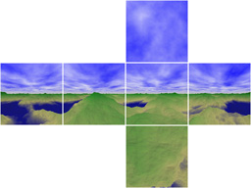
Refelction Map Fragment Shader
varying vec3 R;
uniform samplerCube texMap;
void main(void)
{
gl_FragColor = textureCube(texMap, R);
}

Slide 77
Bump Mapping
Perturb normal for each fragment
Store perturbation as textures

