Slide 1
Computer Graphics
OpenGL Programming
Ming-Te Chi
Department of Computer Science,
National Chengchi University
Notes:
2019
Part of slide comes from Introduction to Modern OpenGL Programming 2002 coursenote

Slide 2
Outline
Basic Concept
OpenGL and GLUT Overview
Elementary Rendering
Animation and Depth Buffering
Imaging and Raster Primitives
Gasket Triangle

Slide 3
Cartesian Plane
+y
(4, 3)
(0, 0)
+x
(-3, -2)
+z
Notes:
對於物體位置，採用迪卡爾座標系統描述，以垂直正交的座標軸定義出每個頂點所在的座標位置(x, y)

Slide 4
Coordinate Clipping
+y
(150, 100)
(75, 50)
(0, 0)
+x
(-75, -50)
Notes:
對於3D空間的可視範圍，我們可以定義出所謂的Clipping空間，如紅色虛線框出的立方體
繪圖硬體可根據clipping空間，略過空間外的不可見的物件，用來加速

Slide 5
Viewport
Mapping drawing coordinates to windows coordinates
+y
(0, 0)
+x
clipping space
Window space
Notes:
Viewport則是在螢幕(或視窗的顯示範圍)，設定一塊區域，與clipping space做對應
OpenGL中可以指定多個viewport轉換，使同一個視窗畫面呈現不同角度或不同場景的畫面

Slide 6
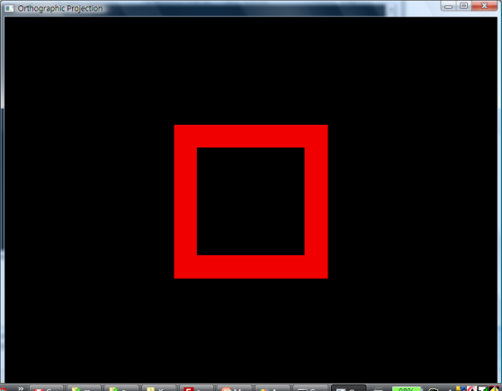
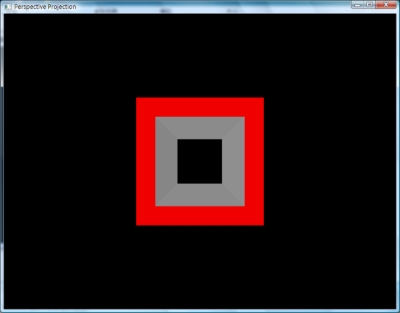
Projection
Getting 3D to 2D
  Orthographic projections
  Perspective projections
Notes:
投影則是將3D物體從world space投影轉換到image space的過程，常用的有正交投影和透視投影
這幾個名詞，還會在05-Transformation和06-Projection做詳細的介紹

Slide 7
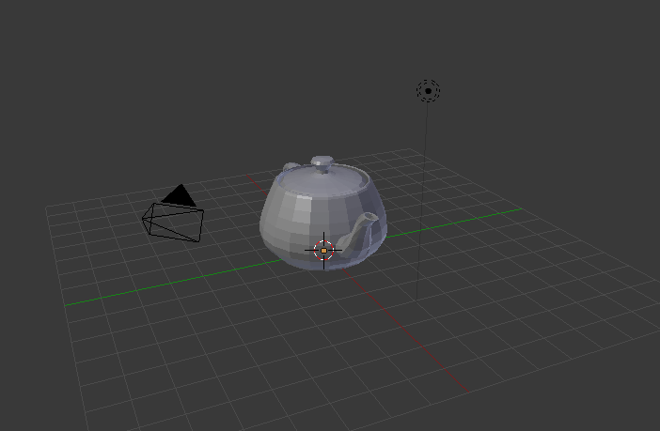

Representing Visuals
Scene
  3D objects
    Mesh: geometry
    Material: Shader
    Texture: texture image
  Lighting
  Camera

Slide 8
OpenGL and GLUT Overview
What is OpenGL & what can it do for me?
OpenGL in windowing systems
Why GLUT
A GLUT program template
Notes:
In this section, we discuss what the OpenGL API (Application Programming Interface) is, and some of its capabilities.
As OpenGL is platform independent, we need some way to integrate OpenGL into each windowing system. Every windowing system where OpenGL is supported has additional API calls for managing OpenGL windows, colormaps, and other features. These additional APIs are platform dependent.
For the sake of simplicity, we’ll use an additional freeware library for simplifying interacting with windowing systems, GLUT. GLUT, the OpenGL Utility Toolkit is a library to make writing OpenGL programs regardless of windowing systems much easier. It’ll be the base of all of our examples in the class.
We conclude the section with a basic program template for an OpenGL program using GLUT.

Slide 9
What Is OpenGL?
OpenGL is a computer graphics rendering API
  With it, you can generate high-quality color images by rendering with geometric and image primitives
  It forms the basis of many interactive applications that include 3D graphics
  By using OpenGL, the graphics part of your application can be
    operating system independent
    window system independent
Notes:
OpenGL is a library of function calls for doing computer graphics. With it, you can create interactive applications that render high-quality color images composed of 3D geometric objects and images.
Additionally, the OpenGL API is window and operating system independent. That means that the part of your application that draws can be platform independent. However, in order for OpenGL to be able to render, it needs a window to draw into. Generally, this is controlled by the windowing system on whatever platform you are working on.

Slide 10
The Evolution of the OpenGL Pipeline

Slide 11

In the Beginning …
OpenGL 1.0 was released on July 1st, 1994
Its pipeline was entirely fixed-function
  the only operations available were fixed by the implementation
The pipeline evolved, but remained fixed-function through OpenGL versions 1.1 through 2.0 (Sept. 2004)
Vertex
Data
Vertex Transform and Lighting
Primitive
Setup and Rasterization
Fragment Coloring and Texturing
Blending
Pixel
Data
Texture
Store
Notes:
The initial version of OpenGL was announced in July of 1994. That version of OpenGL implemented what’s called a fixed-function pipeline, which means that all of the operations that OpenGL supported were fully-defined, and an application could only modify their operation by changing a set of input values (like colors or positions). The other point of a fixed-function pipeline is that the order of operations was always the same – that is, you can’t reorder the sequence operations occur.
This pipeline was the basis of many versions of OpenGL and expanded in many ways, and is still available for use. However, modern GPUs and their features have diverged from this pipeline, and support of these previous versions of OpenGL are for supporting current applications. If you’re developing a new application, we strongly recommend using the techniques that we’ll discuss. Those techniques can be more flexible, and will likely preform better than using one of these early versions of OpenGL since they can take advantage of the capabilities of recent Graphics Processing Units (GPUs).

Slide 12
The Start of the Programmable Pipeline
OpenGL 2.0 (officially) added programmable shaders
  vertex shading augmented the fixed-function transform and lighting stage
  fragment shading augmented the fragment coloring stage
However, the fixed-function pipeline was still available
Vertex
Data
Vertex Transform and Lighting
Primitive
Setup and Rasterization
Fragment Coloring and Texturing
Blending
Pixel
Data
Texture
Store
Notes:
While many features and improvements were added into the fixed-function OpenGL pipeline, designs of GPUs were exposing more features than could be added into OpenGL. To allow applications to gain access to these new GPU features, OpenGL version 2.0 officially added programmable shaders into the graphics pipeline. This version of the pipeline allowed an application to create small programs, called shaders, that were responsible for implementing the features required by the application. In the 2.0 version of the pipeline, two programmable stages were made available:
vertex shading enabled the application full control over manipulation of the 3D geometry provided by the application
fragment shading provided the application capabilities for shading pixels (the terms classically used for determining a pixel’s color).
OpenGL 2.0 also fully supported OpenGL 1.X’s pipeline, allowing the application to use both version of the pipeline: fixed-function, and programmable.

Slide 13
An Evolutionary Change
OpenGL 3.0 introduced the deprecation model
  the method used to remove features from OpenGL
The pipeline remained the same until OpenGL 3.1 (released March 24th, 2009)
Introduced a change in how OpenGL contexts are used
Context Type | Description
Full | Includes all features (including those marked deprecated) available in the current version of OpenGL
Forward Compatible | Includes all non-deprecated features (i.e., creates a context that would be similar to the next version of OpenGL)
Notes:
Until OpenGL 3.0, features have only been added (but never removed) from OpenGL, providing a lot of application backwards compatibility (up to the use of extensions). OpenGL version 3.0 introduced the mechanisms for removing features from OpenGL, called the deprecation model. It defines how the OpenGL design committee (the OpenGL Architecture Review Board (ARB) of the Khronos Group) will advertise of which and how functionality is removed from OpenGL.
You might ask: why remove features from OpenGL? Over the 15 years to OpenGL 3.0, GPU features and capabilities expanded and some of the methods used in older versions of OpenGL were not as efficient as modern methods. While removing them could break support for older applications, it also simplified and optimized the GPUs allowing better performance.
Within an OpenGL application, OpenGL uses an opaque data structure called a context, which OpenGL uses to store shaders and other data. Contexts come in two flavors:
full contexts expose all the features of the current version of OpenGL, including features that are marked deprecated.
forward-compatible contexts enable only the features that will be available in the next version of OpenGL (i.e., deprecated features pretend to be removed), which can help developers make sure their applications work with future version of OpenGL.
Forward-compatible contexts are available in OpenGL versions from 3.1 onwards.

Slide 14
The Exclusively Programmable Pipeline
OpenGL 3.1 removed the fixed-function pipeline
  programs were required to use only shaders
Additionally, almost all data is GPU-resident
  all vertex data sent using buffer objects
Vertex
Data
Vertex
Shader
Primitive
Setup and Rasterization
Fragment
Shader
Blending
Pixel
Data
Texture
Store
Notes:
OpenGL version 3.1 was the first version to remove deprecated features, and break backwards compatibility with previous versions of OpenGL. The features removed from included the old-style fixed-function pipeline, among other lesser features.
One major refinement introduced in 3.1 was requiring all data to be placed in GPU-resident buffer objects, which help reduce the impacts of various computer system architecture limitations related to GPUs.
While many features were removed from OpenGL 3.1, the OpenGL ARB realized that to make it easy for application developers to transition their products, they introduced an OpenGL extensions, GL_ARB_compatibility, that allowed access to the removed features.

Slide 15
More Programability
OpenGL 3.2 (released August 3rd, 2009) added an additional shading stage – geometry shaders
Vertex
Data
Vertex
Shader
Primitive
Setup and Rasterization
Fragment
Shader
Blending
Geometry
Shader
Pixel
Data
Texture
Store
Notes:
Until OpenGL 3.2, the number of shader stages in the OpenGL pipeline remained the same, with only vertex and fragment shaders being supported. OpenGL version 3.2 added a new shader stage called geometry shading which allows the modification (and generation) of geometry within the OpenGL pipeline.

Slide 16
More Evolution – Context Profiles
OpenGL 3.2 also introduced context profiles
  profiles control which features are exposed
    it’s like GL_ARB_compatibility, only not insane ☺
  currently two types of profiles: core and compatible
Context Type | Profile | Description
Full | core | All features of the current release
 | compatible | All features ever in OpenGL
Forward Compatible | core | All non-deprecated features
 | compatible | Not supported
Notes:
In order to make it easier for developers to choose the set of features they want to use in their application, OpenGL 3.2 also introduced profiles which allow further selection of OpenGL contexts.
The core profile is the modern, trimmed-down version of OpenGL that includes the latest features. You can request a core profile for a Full or Forward-compatible profile. Conversely, you could request a compatible profile, which includes all functionality (supported by the OpenGL driver on your system) in all versions of OpenGL up to, and including, the version you’ve requested.

Slide 17
The Latest Pipelines
OpenGL 4.1 (released July 25th, 2010) included additional shading stages – tessellation-control and tessellation-evaluation shaders
Latest version is 4.3
Vertex
Data
Vertex
Shader
Primitive
Setup and Rasterization
Fragment
Shader
Blending
Tessellation
Control
Shader
Tessellation
Evaluation
Shader
Geometry
Shader
Pixel
Data
Texture
Store
Notes:
The OpenGL 4.X pipeline added another pair of shaders (which work in tandem, so we consider it a single stage) for supporting dynamic tessellation in the GPU. Tessellation control and tessellation evaluation shaders were added to OpenGL version 4.0.
The current version of OpenGL is 4.3, which includes some additional features over the 4.0 pipeline, but no new shading stages.

Slide 18
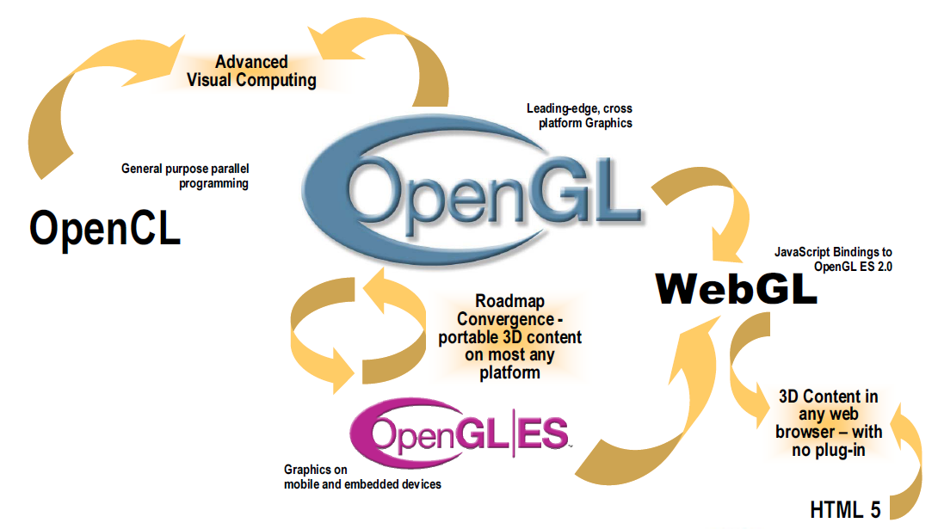
OpenGL-related Ecosystem

Slide 19
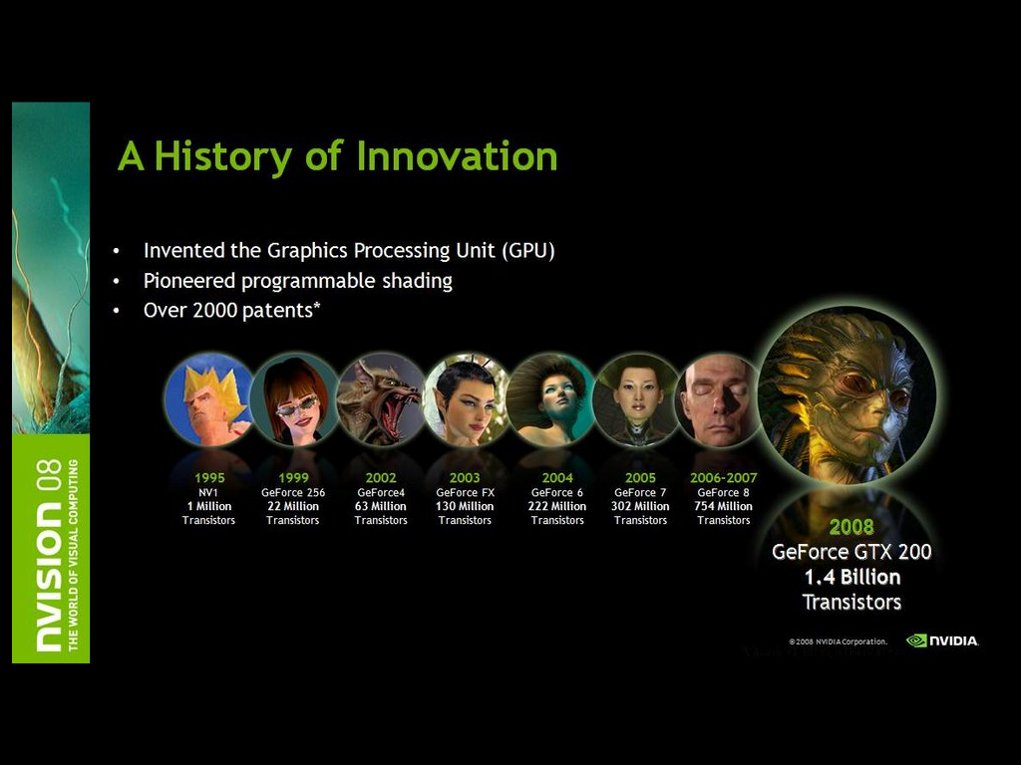

Slide 20
Related APIs
AGL, GLX, WGL
  glue between OpenGL and windowing systems
GLU (OpenGL Utility Library)
  part of OpenGL
  NURBS, tessellators, quadric shapes, etc.
GLUT (OpenGL Utility Toolkit)
  portable windowing API
  not officially part of OpenGL
Notes:
As mentioned, OpenGL is window and operating system independent. To integrate it into various window systems, additional libraries are used to modify a native window into an OpenGL capable window. Every window system has its own unique library and functions to do this. Some examples are:
GLX for the X Windows system, common on Unix platforms
AGL for the Apple Macintosh
WGL for Microsoft Windows
OpenGL also includes a utility library, GLU, to simplify common tasks such as: rendering quadric surfaces (i.e. spheres, cones, cylinders, etc. ), working with NURBS and curves, and concave polygon tessellation.
Finally to simplify programming and window system dependence, we’ll be using the freeware library, GLUT. GLUT, written by Mark Kilgard, is a public domain window system independent toolkit for making simple OpenGL applications. It simplifies the process of creating windows, working with events in the window system and handling animation.

Slide 21
OpenGL and Related APIs
application program
OpenGL Motif
widget or similar
GLUT
GLX, AGL
or WGL
GLU
X, Win32, Mac O/S
GL
software and/or hardware
Notes:
The above diagram illustrates the relationships of the various libraries and window system components.
Generally, applications which require more user interface support will use a library designed to support those types of features (i.e. buttons, menu and scroll bars, etc.) such as Motif or the Win32 API.
Prototype applications, or one which don’t require all the bells and whistles of a full GUI, may choose to use GLUT instead because of its simplified programming model and window system independence.

Slide 22
Preliminaries
Headers Files
#ifdef WIN32
  #include <windows.h> // Must have for Windows platform builds
  #include "glee.h" // OpenGL Extension "autoloader"
  #include <gl\gl.h> // Microsoft OpenGL headers (version 1.1 by themselves)
  #include <gl\glu.h> // OpenGL Utilities
  #include <gl\glut.h> // Glut (Free-Glut on Windows)
#endif
Libraries
Enumerated Types
  OpenGL defines numerous types for compatibility
      GLfloat, GLint, GLenum, etc.
Notes:
All of our discussions today will be presented in the C computer language.
For C, there are a few required elements which an application must do:
Header files describe all of the function calls, their parameters and defined constant values to the compiler. OpenGL has header files for GL (the core library), GLU (the utility library), and GLUT (freeware windowing toolkit).
Note: glut.h includes gl.h and glu.h. On Microsoft Windows, including only glut.h is recommended to avoid warnings about redefining Windows macros.
Libraries are the operating system dependent implementation of OpenGL on the system you’re using. Each operating system has its own set of libraries. For Unix systems, the OpenGL library is commonly named libGL.so and for Microsoft Windows, it’s named opengl32.lib.
Finally, enumerated types are definitions for the basic types (i.e. float, double, int, etc.) which your program uses to store variables. To simplify platform independence for OpenGL programs, a complete set of enumerated types are defined. Use them to simplify transferring your programs to other operating systems.

Slide 23
Notes on compilation
See website and ftp for examples
Unix/linux
  Include files usually in …/include/GL
  Compile with –lglut –lglu –lgl loader flags
  May have to add –L flag for X libraries
  Mesa implementation included with most linux distributions
  Check web for latest versions of Mesa and glut

Slide 24
Compilation on Windows
Visual C++
  Get glut.h, glut32.lib and glut32.dll from web
  Create a console application
  Add opengl32.lib, glu32.lib, glut32.lib to project settings (under link tab)
Borland C similar
Cygwin (linux under Windows)
  Can use gcc and similar makefile to linux
  Use –lopengl32 –lglu32 –lglut32 flags

Slide 25
GLUT Basics
Application Structure
  Configure and open window
  Initialize OpenGL state
  Register input callback functions
    render
    resize
    input: keyboard, mouse, etc.
  Enter event processing loop
Notes:
Here’s the basic structure that we’ll be using in our applications. This is generally what you’d do in your own OpenGL applications.
The steps are:
1) Choose the type of window that you need for your application and initialize it.
2) Initialize any OpenGL state that you don’t need to change every frame of your program. This might include things like the background color, light positions and texture maps.
3) Register the callback functions that you’ll need. Callbacks are routines you write that GLUT calls when a certain sequence of events occurs, like the window needing to be refreshed, or the user moving the mouse. The most important callback function is the one to render your scene, which we’ll discuss in a few slides.
4) Enter the main event processing loop. This is where your application receives events, and schedules when callback functions are called.

Slide 26
GLUT Sample – event loop
OpenGL and Windows
Initialization
int main( int argc, char** argv )
{
int mode = GLUT_RGB|GLUT_DOUBLE;
glutInitDisplayMode( mode );
glutCreateWindow( argv[0] );
init();
glutDisplayFunc( display );
glutReshapeFunc( resize );
glutKeyboardFunc( key );
glutIdleFunc( idle );
glutMainLoop();
return 0;
}
Callback function Registration
Event Loop
Get Event
Process Event
Idle
Notes:
這裡呈現出glut程式中main()的主要架構
首先呼叫The glutInitDisplayMode() and glutCreateWindow() functions 去設定視窗
並利用自訂的init() 設定OpenGL的狀態
接下來註冊不同事件的對應處理函式
最後呼叫glutMainLoop(); 進入一個無窮的事件
對應不同的事件(如滑鼠或鍵盤的輸入)
依註冊的callback函式進行處理
這樣就是一個glut互動程式的基本架構

Slide 27
OpenGL Initialization
Set up whatever state you’re going to use
  void init( void )
  {
  glClearColor( 0.0, 0.0, 0.0, 1.0 );
  glClearDepth( 1.0 );
  glEnable( GL_LIGHT0 );
  glEnable( GL_LIGHTING );
  glEnable( GL_DEPTH_TEST );
  }
Notes:
Here’s the internals of our initialization routine, init(). Over the course of the day, you’ll learn what each of the above OpenGL calls do.

Slide 28
GLUT Callback Functions
Routine to call when something happens
  window resize or redraw
  user input
  animation
“Register” callbacks with GLUT
    glutDisplayFunc( display );
    glutIdleFunc( idle );
    glutKeyboardFunc( keyboard );
Notes:
GLUT uses a callback mechanism to do its event processing. Callbacks simplify event processing for the application developer. As compared to more traditional event driven programming, where the author must receive and process each event, and call whatever actions are necessary, callbacks simplify the process by defining what actions are supported, and automatically handling the user events. All the author must do is fill in what should happen when.
GLUT supports many different callback actions, including:
glutDisplayFunc() - called when pixels in the window need to be refreshed.
glutReshapeFunc() - called when the window changes size
glutKeyboardFunc() - called when a key is struck on the keyboard
glutMouseFunc() - called when the user presses a mouse button on the mouse
glutMotionFunc() - called when the user moves the mouse while a mouse button is pressed
glutPassiveMouseFunc() - called when the mouse is moved regardless of mouse button state
glutIdleFunc() - a callback function called when nothing else is going on. Very useful for animations.

Slide 29
Rendering Callback
Do all of your drawing here
glutDisplayFunc( display );
  void display( void )
  {
  glClear( GL_COLOR_BUFFER_BIT );
  glBegin( GL_TRIANGLES );
  glVertex3f( x1, y1, z1 );
  glVertex3f( x2, y2, z2 );
  glVertex3f( x3, y3, z3 );
  glEnd();
  glutSwapBuffers();
  }
Notes:
One of the most important callbacks is the glutDisplayFunc() callback. This callback is called when the window needs to be refreshed. It’s here that you’d do all of your OpenGL rendering.
The above routine merely clears the window, and renders a triangle strip and then swaps the buffers for smooth animation transition. You’ll learn more about what each of these calls do during the day.

Slide 30
Idle Callbacks
Use for animation and continuous update
glutIdleFunc( idle );
void idle( void )
{
t += dt;
glutPostRedisplay();
}
Notes:
Animation requires the ability to draw a sequence of images. The glutIdleFunc()is the mechanism for doing animation. You register a routine which updates your motion variables (usually global variables in your program which control how things move) and then requests that the scene be updated.
glutPostRedisplay() requests that the callback registered with glutDisplayFunc() be called as soon as possible. This is preferred over calling your rendering routine directly, since the user may have interacted with your application and user input events need to be processed.

Slide 31
Elementary Rendering

Slide 32
Elementary Rendering
Geometric Primitives
Managing OpenGL State
OpenGL Buffers
Notes:
In this section, we’ll be discussing the basic geometric primitives that OpenGL uses for rendering, as well as how to manage the OpenGL state which controls the appearance of those primitives.
OpenGL also supports the rendering of bitmaps and images, which is discussed in a later section.
Additionally, we’ll discuss the different types of OpenGL buffers, and what each can be used for.

Slide 33
OpenGL Geometric Primitives
All geometric primitives are specified by vertices
GL_LINES
GL_POINTS
GL_POLYGON
GL_LINE_STRIP
GL_LINE_LOOP
GL_TRIANGLES
GL_TRIANGLE_STRIP
GL_QUADS
GL_QUAD_STRIP
GL_TRIANGLE_FAN
Notes:
Every OpenGL geometric primitive is specified by its vertices, which are homogenous coordinates. Homogenous coordinates are of the form
( x, y, z, w ). Depending on how vertices are organized, OpenGL can render any of the shown primitives.

Slide 34
Simple Example
void drawRhombus( GLfloat color[] )
{
  glBegin( GL_QUADS );
    glColor3fv( color );
    glVertex2f( 0.0, 0.0 );
    glVertex2f( 1.0, 0.0 );
    glVertex2f( 1.5, 1.118 );
    glVertex2f( 0.5, 1.118 );
  glEnd();
}
Notes:
The drawRhombus() routine causes OpenGL to render a single quadrilateral in a single color. The rhombus is planar, since the z value is automatically set to 0.0 by glVertex2f().

Slide 35
OpenGL Command Formats
glVertex3fv( v )
Number of
components
Data Type
Vector
b - byte
ub - unsigned byte
s - short
us - unsigned short
i - int
ui - unsigned int
f - float
d - double
omit “v” for
scalar form
glVertex2f( x, y )
2 - (x,y)
3 - (x,y,z)
4 - (x,y,z,w)
Notes:
The OpenGL API calls are designed to accept almost any basic data type, which is reflected in the calls name. Knowing how the calls are structured makes it easy to determine which call should be used for a particular data format and size.
For instance, vertices from most commercial models are stored as three component floating point vectors. As such, the appropriate OpenGL command to use is glVertex3fv( coords ).
As mentioned before, OpenGL uses homogenous coordinates to specify vertices. For glVertex*() calls which don’t specify all the coordinates
( i.e. glVertex2f()), OpenGL will default z = 0.0, and w = 1.0 .

Slide 36
Specifying Geometric Primitives
Primitives are specified using
      glBegin( primType );
      glEnd();
  primType determines how vertices are combined
  GLfloat red, green, blue;
  Glfloat coords[3];
  glBegin( primType );
  for ( i = 0; i < nVerts; ++i ) {
  glColor3f( red, green, blue );
  glVertex3fv( coords );
  }
  glEnd();
Notes:
OpenGL organizes vertices into primitives based upon which type is passed into glBegin(). The possible types are:
GL_POINTS GL_LINE_STRIP
GL_LINES GL_LINE_LOOP
GL_POLYGON GL_TRIANGLE_STRIP
GL_TRIANGLES GL_TRIANGLE_FAN
GL_QUADS GL_QUAD_STRIP

Slide 37
OpenGL Color
Models
Per
Vertex
Poly.
CPU
DL
Raster
Frag
FB
Texture
Pixel
RGBA or Color Index
color index mode
Red
Green
Blue
0
1
1
Display
2
2
4
8
3
ww
16
www
ww
24
123
219
74
25
26
www
RGBA mode
Notes:
Every OpenGL implementation must support rendering in both RGBA mode,
( sometimes described as TrueColor mode ) and color index ( or colormap ) mode.
For RGBA rendering, vertex colors are specified using the glColor*() call.
For color index rendering, the vertex’s index is specified with glIndex*().
The type of window color model is requested from the windowing system. Using GLUT, the glutInitDisplayMode() call is used to specify either an RGBA window ( using GLUT_RGBA ), or a color indexed window ( using GLUT_INDEX ).

Slide 38
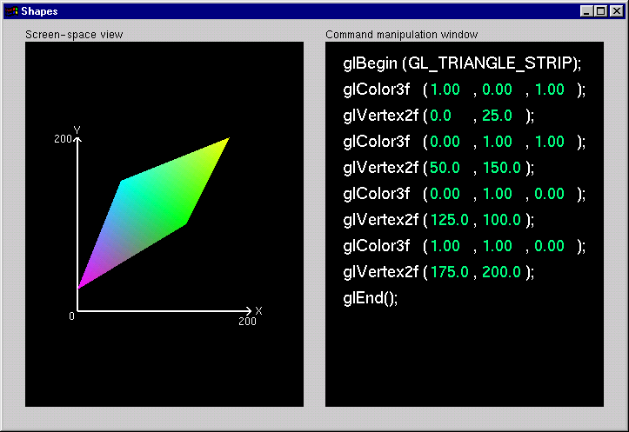
Shapes Tutorial
Notes:
This is the first of the series of Nate Robins’ tutorials. This tutorial illustrates the principles of rendering geometry, specifying both colors and vertices.
The shapes tutorial has two views: a screen-space window and a command manipulation window.
In the command manipulation window, pressing the LEFT mouse while the pointer is over the green parameter numbers allows you to move the mouse in the y-direction (up and down) and change their values. With this action, you can change the appearance of the geometric primitive in the other window. With the RIGHT mouse button, you can bring up a pop-up menu to change the primitive you are rendering. (Note that the parameters have minimum and maximum values in the tutorials, sometimes to prevent you from wandering too far. In an application, you probably don’t want to have floating-point color values less than 0.0 or greater than 1.0, but you are likely to want to position vertices at coordinates outside the boundaries of this tutorial.)
In the screen-space window, the RIGHT mouse button brings up a different pop-up menu, which has menu choices to change the appearance of the geometry in different ways.
The left and right mouse buttons will do similar operations in the other tutorials.

Slide 39
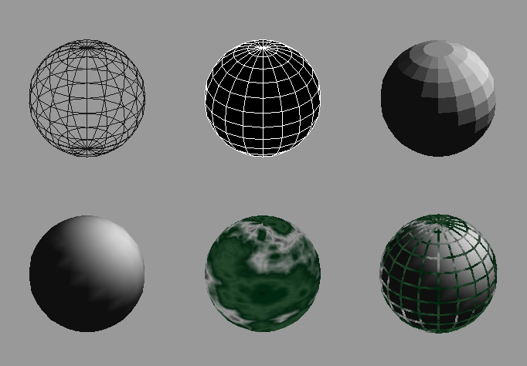
Controlling Rendering Appearance
From
Wireframe
to Texture
Mapped
Notes:
OpenGL can render from a simple line-based wireframe to complex multi-pass texturing algorithms to simulate bump mapping or Phong lighting.

Slide 40
OpenGL’s State Machine
All rendering attributes are encapsulated in the OpenGL State
  rendering styles
  shading
  lighting
  texture mapping
Notes:
Each time OpenGL processes a vertex, it uses data stored in its internal state tables to determine how the vertex should be transformed, lit, textured or any of OpenGL’s other modes.

Slide 41
Manipulating OpenGL State
Appearance is controlled by current state
  for each ( primitive to render ) {
    update OpenGL state
    render primitive
  }
Manipulating vertex attributes is most
common way to manipulate state
    glColor*() / glIndex*()
    glNormal*()
    glTexCoord*()
Notes:
The general flow of any OpenGL rendering is to set up the required state, then pass the primitive to be rendered, and repeat for the next primitive.
In general, the most common way to manipulate OpenGL state is by setting vertex attributes, which include color, lighting normals, and texturing coordinates.

Slide 42
Controlling current state
Setting State
    glPointSize( size );
    glLineStipple( repeat, pattern );
    glShadeModel( GL_SMOOTH );
Enabling Features
    glEnable( GL_LIGHTING );
    glDisable( GL_TEXTURE_2D );
Notes:
Setting OpenGL state usually includes modifying the rendering attribute, such as loading a texture map, or setting the line width. Also for some state changes, setting the OpenGL state also enables that feature ( like setting the point size or line width ).
Other features need to be turned on. This is done using glEnable(), and passing the token for the feature, like GL_LIGHT0 or GL_POLYGON_STIPPLE.

Slide 43
The mouse callback
glutMouseFunc(mymouse)
void mymouse(GLint button, GLint state, GLint x, GLint y)
Returns
  which button (GLUT_LEFT_BUTTON, GLUT_MIDDLE_BUTTON, GLUT_RIGHT_BUTTON) caused event
  state of that button (GLUT_UP, GLUT_DOWN)
  Position in window

Slide 44
Positioning
The position in the screen window is usually measured in pixels with the origin at the top-left corner
  Consequence of refresh done from top to bottom
OpenGL uses a world coordinate system with origin at the bottom left
  Must invert y coordinate returned by callback by height of window
  y = h – y;
(0,0)
h
w

Slide 45
Obtaining the window size
To invert the y position we need the window height
  Height can change during program execution
  Track with a global variable
  New height returned to reshape callback that we will look at in detail soon
  Can also use query functions
    glGetIntv
    glGetFloatv
  to obtain any value that is part of the state

Slide 46
Immediate
Recall that in a standard OpenGL program, once an object is rendered there is no memory of it and to redisplay it, we must re-execute the code for it
  Known as immediate mode graphics
  Can be especially slow if the objects are complex and must be sent over a network

Slide 47
Compatibility profile
Some features (Immediate…) were deprecated in 3.0, and actually removed in 3.1 (but still provided compatibility via an ARB extension).
In OpenGL 3.2, they moved these features into a 'compatibility' profile that is optional for driver writers to implement.
Notes:
these features were deprecated in 3.0, and actually removed in 3.1 (but still provided compatibility via an ARB extension). In OpenGL 3.2, they moved these features into a 'compatibility' profile that is optional for driver writers to implement.
So what does this mean? NVidia, at least, has vowed to continue support for the old-school compatibility mode for the forseeable future - there is a large wealth of legacy code out there that they need to support. You can find the discussion of their support in a slideshow at:
http://www.slideshare.net/Mark_Kilgard/opengl-32-and-more

Slide 48
Animation and
Depth Buffering

Slide 49
Animation and Depth Buffering
Discuss double buffering and animation
Discuss hidden surface removal using the depth buffer
Notes:
In this section we talk about adding the necessary steps for producing smooth interactive animations with OpenGL using double buffering. Additionally, we discuss hidden surface removal using depth buffering.

Slide 50
Double
Buffering
Poly.
Per
Vertex
CPU
DL
Raster
Frag
FB
Texture
Pixel
1
2
1
2
Front
Buffer
4
4
Back
Buffer
8
8
16
16
Display
Notes:
Double buffer is a technique for tricking the eye into seeing smooth animation of rendered scenes. The color buffer is usually divided into two equal halves, called the front buffer and the back buffer.
The front buffer is displayed while the application renders into the back buffer. When the application completes rendering to the back buffer, it requests the graphics display hardware to swap the roles of the buffers, causing the back buffer to now be displayed, and the previous front buffer to become the new back buffer.

Slide 51
Animation Using Double Buffering
Request a double buffered color buffer
    glutInitDisplayMode( GLUT_RGB | GLUT_DOUBLE );
Clear color buffer
    glClear( GL_COLOR_BUFFER_BIT );
Render scene
Request swap of front and back buffers
    glutSwapBuffers();
Repeat steps 2 - 4 for animation
Notes:
Requesting double buffering in GLUT is simple. Adding GLUT_DOUBLE to your glutInitDisplayMode() call will cause your window to be double buffered.
When your application is finished rendering its current frame, and wants to swap the front and back buffers, the glutSwapBuffers() call will request the windowing system to update the window’s color buffers.

Slide 52
Depth Buffering and
Hidden Surface Removal
1
2
1
2
Color
Buffer
4
4
Depth
Buffer
8
8
16
16
Display
Notes:
Depth buffering is a technique to determine which primitives in your scene are occluded by other primitives. As each pixel in a primitive is rasterized, its distance from the eyepoint (depth value), is compared with the values stored in the depth buffer. If the pixel’s depth value is less than the stored value, the pixel’s depth value is written to the depth buffer, and its color is written to the color buffer.
The depth buffer algorithm is:
if ( pixel->z < depthBuffer(x,y)->z ) {
depthBuffer(x,y)->z = pixel->z;
colorBuffer(x,y)->color = pixel->color;
}
OpenGL depth values range from [0, 1], with one being essentially infinitely far from the eyepoint. Generally, the depth buffer is cleared to one at the start of a frame.

Slide 53
Depth Buffering Using OpenGL
Request a depth buffer
    glutInitDisplayMode( GLUT_RGB | GLUT_DOUBLE | GLUT_DEPTH );
Enable depth buffering
    glEnable( GL_DEPTH_TEST );
Clear color and depth buffers
    glClear( GL_COLOR_BUFFER_BIT | GL_DEPTH_BUFFER_BIT );
Render scene
Swap color buffers
Notes:
Enabling depth testing in OpenGL is very straightforward.
A depth buffer must be requested for your window, once again using the glutInitDisplayMode(), and the GLUT_DEPTH bit.
Once the window is created, the depth test is enabled using
glEnable( GL_DEPTH_TEST ).

Slide 54
An Updated Program Template
void main( int argc, char** argv )
{
  glutInit( &argc, argv );
  glutInitDisplayMode( GLUT_RGB |
  GLUT_DOUBLE | GLUT_DEPTH );
  glutCreateWindow( “Tetrahedron” );
  init();
  glutIdleFunc( idle );
  glutDisplayFunc( display );
  glutMainLoop();
}
Notes:
In main(),
1) GLUT initializes and creates a window named “Tetrahedron”
2) set OpenGL state which is enabled through the entire life of the program
in init()
3) set GLUT’s idle function, which is called when there are no user events
to process.
4) enter the main event processing loop of the program.

Slide 55
An Updated Program Template (cont.)
void init( void )
{
glClearColor( 0.0, 0.0, 1.0, 1.0 );
}
void idle( void )
{
glutPostRedisplay();
}
Notes:
In init() the basic OpenGL state to be used throughout the program is initialized. For this simple program, all we do is set the background (clear color) for the color buffer. In this case, we’ve decided that instead of the default black background, we want a blue background.
Additionally, our glutIdleFunc(), which we’ve set to the function idle() above, requests that GLUT re-render our scene again. The function glutPostRedisplay() requests that GLUT call our display function (this was set with glutDisplayFunc()) at the next convenient time. This method provides better event processing response from the application.

Slide 56
An Updated Program Template (cont.)
void drawScene( void )
{
  GLfloat vertices[] = { … };
  GLfloat colors[] = { … };
  glClear( GL_COLOR_BUFFER_BIT | GL_DEPTH_BUFFER_BIT );
  glBegin( GL_TRIANGLE_STRIP );
  /* calls to glColor*() and glVertex*() */
  glEnd();
  glutSwapBuffers();
}
Notes:
In drawScene(),
1) the color buffer is cleared to the background color
2) a triangle strip is rendered to create a tetrahedron (use your imagination for the details!)
3) the front and back buffers are swapped.

Slide 57
Imaging and Raster Primitives

Slide 58
Imaging and Raster Primitives
Describe OpenGL’s raster primitives: bitmaps and image rectangles
Demonstrate how to get OpenGL to read and render pixel rectangles
Notes:
OpenGL is not only a complete interface for 3D rendering, it’s also a very capable image processing engine. In this section we discuss some of the basic functions of OpenGL for rendering color-pixel rectangles and single-bit bitmaps, as well as how to read color information from the framebuffer.
OpenGL doesn’t render images, per se, since images usually are stored in some file with an image format associated with it (for example, JPEG images). OpenGL only knows how to render rectangles of pixels, not decode image files.

Slide 59
Pixel-based primitives
Bitmaps
  2D array of bit masks for pixels
    update pixel color based on current color
Images
  2D array of pixel color information
    complete color information for each pixel
OpenGL doesn’t understand image formats
Notes:
In addition to geometric primitives, OpenGL also supports pixel-based primitives. These primitives contain explicit color information for each pixel that they contain. They come in two types:
Bitmaps are single bit images, which are used as a mask to determine which pixels to update. The current color, set with glColor()is used to determine the new pixel color.
Images are blocks of pixels with complete color information for each pixel.
OpenGL, however, doesn’t understand image formats, like JPEG, PNG or GIFs. In order for OpenGL to use the information contained in those file formats, the file must be read and decoded to obtain the color information, at which point, OpenGL can rasterize the color values.

Slide 60
Pixel Pipeline
Poly.
Per
Vertex
CPU
DL
Raster
Frag
FB
Texture
Pixel
Programmable pixel storage
and transfer operations
glBitmap(), glDrawPixels()
Pixel
Storage
Modes
Pixel-Transfer
Operations
(and Pixel Map)
Rasterization
(including
Pixel Zoom)
Per Fragment
Operations
Frame
Buffer
CPU
TextureMemory
glCopyTex*Image();
glReadPixels(), glCopyPixels()
Notes:
Just as there’s a pipeline that geometric primitives go through when they are processed, so do pixels. The pixels are read from main storage, processed to obtain the internal format which OpenGL uses, which may include color translations or byte-swapping. After this, each pixel from the image is processed by the fragment operations discussed in the last section, and finally rasterized into the framebuffer.
In addition to rendering into the framebuffer, pixels can be copied from the framebuffer back into host memory, or transferred into texture mapping memory.
For best performance, the internal representation of a pixel array should match the hardware. For example, for a 24 bit frame buffer, 8-8-8 RGB would probably be a good match, but 10-10-10 RGB could be bad. Warning: non-default values for pixel storage and transfer can be very slow.

Slide 61
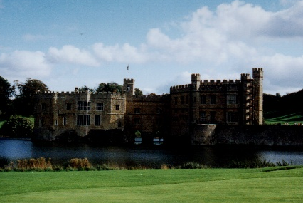
Positioning Image Primitives
glRasterPos3f( x, y, z )
  raster position transformed like geometry
  discarded if raster position
  is outside of viewport
    may need to fine tune
    viewport for desired
    results
Raster Position
Notes:
Images are positioned by specifying the raster position, which maps the lower left corner of an image primitive to a point in space. Raster positions are transformed and clipped the same as vertices. If a raster position fails the clip check, no fragments are rasterized.

Slide 62
  glWindowPos2f( x, y)
Specify the raster position in window coordinates for pixel operations

Slide 63
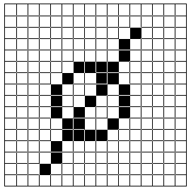
Rendering Bitmaps
glBitmap( width, height, xorig, yorig, xmove, ymove, bitmap )
  render bitmap in current color
  at
  advance raster position by
  after
  rendering
height
yorig
width
xorig
xmove
Notes:
Bitmaps are used as a mask to determine which pixels to update. A bitmap is specified as a packed array of bits in a byte array. For each value of one in the bitmap, a fragment is generated in the currently set color and processed by the fragment operations.
Bitmaps can have their own origin, which provides a relative position to the current raster position. Additionally, after the bitmap is rendered, the raster position is automatically updated by the offset provided in (xmove, ymove).
Bitmaps are particularly useful for rendering bitmapped text, which we’ll discuss in a moment.

Slide 64
Rendering Fonts using Bitmaps
OpenGL uses bitmaps for font rendering
  each character is stored in a display list containing a bitmap
  window system specific routines to access system fonts
    glXUseXFont()
    wglUseFontBitmaps()
Notes:
OpenGL uses bitmaps to do font rendering. The window system specific routines process system native font files, and create bitmaps for the different glyphs in the font. Each character is stored in a display list that is part of a set that is created when the font is processed.

Slide 65

Rendering Images
glDrawPixels( width, height, format, type, pixels )
  render pixels with lower left of
  image at current raster position
  numerous formats and data types
  for specifying storage in memory
    best performance by using format and type that matches hardware
RasterPosition/WindowsPosition
Notes:
Rendering images is done with the glDrawPixels()command. A block of pixels from host CPU memory is passed into OpenGL with a format and data type specified. For each pixel in the image, a fragment is generated using the color retrieved from the image, and further processed.
OpenGL supports many different formats for images including:
RGB images with an RGB triplet for every pixel
intensity images which contain only intensity for each pixel. These images are converted into greyscale RGB images internally.
depth images which are depth values written to the depth buffer, as compared to the color framebuffer. This is useful in loading the depth buffer with values and then rendering a matching color images with depth testing enabled.
stencil images which copy stencil masks in the stencil buffer. This provides an easy way to load a complicated per pixel mask.
The type of the image describes the format that the pixels stored in host memory. This could be primitive types like GL_FLOAT or GL_INT, or pixels with all color components packed into a primitive type, like GL_UNSIGNED_SHORT_5_6_5.

Slide 66
Reading Pixels
glReadPixels( x, y, width, height, format, type, pixels )
  read pixels from specified (x,y) position in framebuffer
  pixels automatically converted from framebuffer format into requested format and type
Framebuffer pixel copy
glCopyPixels( x, y, width, height, type )
Notes:
Just as you can send pixels to the framebuffer, you can read the pixel values back from the framebuffer to host memory for doing storage or image processing.
Pixels read from the framebuffer are processed by the pixel storage and transfer modes, as well as converting them into the format and type requested, and placing them in host memory.
Additionally, pixels can be copied from the framebuffer from one location to another using glCopyPixels(). Pixels are processed by the pixel storage and transfer modes before being returned to the framebuffer.

Slide 67

Pixel Zoom
glPixelZoom( x, y )
  expand, shrink or reflect pixels
  around current raster position
  fractional zoom supported
Raster
Position
glPixelZoom(1.0, -1.0);
Notes:
OpenGL can also scale pixels as they are being rendered. glPixelZoom()will scale or shrink pixels as well as reflect them around the current raster position.

Slide 68
Storage and Transfer Modes
Storage modes control accessing memory
  byte alignment in host memory
  extracting a subimage
Transfer modes allow modify pixel values
  scale and bias pixel component values
  replace colors using pixel maps
Notes:
When pixels are read from or written to host memory, pixels can be modified by storage and transfer modes.
Storage modes control how host memory is accessed and written to, including byte swapping and addressing, and modifying how memory is accessed to read only a small subset of the original image.
Transfer modes allow pixel modifications as they are processed. This includes scaling and biasing the color component values, as well as replacing color values using color lookup tables.

Slide 69
Pixel Packing
void glPixelstorei(GLenum pname, GLint param);
Pname | Param
GL_UNPACK_ALIGNMENT | 1, 2, 4, or 8
GL_PACK_ALIGNMENT | 1, 2, 4, or 8
unpack
Memory
FrameBuffer
pack

Slide 70
Gasket Triangle

Slide 71
Objectives
Develop a more sophisticated three-dimensional example
  Sierpinski gasket: a fractal
Introduce hidden-surface removal

Slide 72
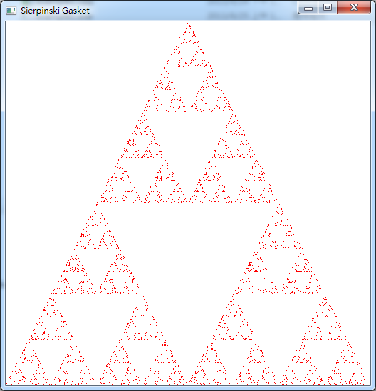
Sierpinski gasket
5000 points

Slide 73
Three-dimensional Applications
In OpenGL, two-dimensional applications are a special case of three-dimensional graphics
Going to 3D
  Not much changes
  Use glVertex3*( )
  Have to worry about the order in which polygons are drawn or use hidden-surface removal
  Polygons should be simple, convex, flat

Slide 74
Sierpinski Gasket (2D)
Start with a triangle
Connect bisectors of sides and remove central triangle
Repeat

Slide 75
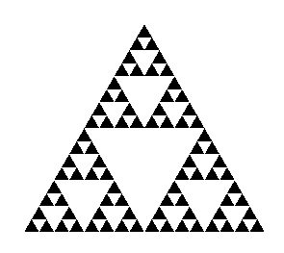
Example
Five subdivisions

Slide 76
The gasket as a fractal
Consider the filled area (black) and the perimeter (the length of all the lines around the filled triangles)
As we continue subdividing
  the area goes to zero
  but the perimeter goes to infinity
This is not an ordinary geometric object
  It is neither two- nor three-dimensional
It is a fractal (fractional dimension) object

Slide 77
Gasket Program
#include <GL/glut.h>
/* initial triangle */
GLfloat v[3][2]={
{-1.0, -0.58},
{1.0, -0.58},
{0.0, 1.15}
};
int n; /* number of recursive steps */

Slide 78
Draw one triangle
/* display one triangle */
void triangle( GLfloat *a, GLfloat *b, GLfloat *c)
{
glVertex2fv(a);
glVertex2fv(b);
glVertex2fv(c);
}

Slide 79
Triangle Subdivision
/* triangle subdivision using vertex numbers */
void divide_triangle(GLfloat *a, GLfloat *b, GLfloat *c, int m)
{
GLfloat v0[2], v1[2], v2[2];
int j;
if(m>0) {
for(j=0; j<2; j++) v0[j]=(a[j]+b[j])/2;
for(j=0; j<2; j++) v1[j]=(a[j]+c[j])/2;
for(j=0; j<2; j++) v2[j]=(b[j]+c[j])/2;
divide_triangle(a, v0, v1, m-1);
divide_triangle(c, v1, v2, m-1);
divide_triangle(b, v2, v0, m-1);
} else {
triangle(a,b,c);
}
/* draw triangle at end of recursion */
}

Slide 80
display and init Functions
void display()
{
glClear(GL_COLOR_BUFFER_BIT);
glBegin(GL_TRIANGLES);
divide_triangle(v[0], v[1], v[2], n);
glEnd();
glFlush();
}
void myinit()
{
glMatrixMode(GL_PROJECTION);
glLoadIdentity();
gluOrtho2D(-2.0, 2.0, -2.0, 2.0);
glMatrixMode(GL_MODELVIEW);
glClearColor (1.0, 1.0, 1.0,1.0);
glColor3f(0.0,0.0,0.0);
}

Slide 81
main Function
int main(int argc, char **argv)
{
n = 4;
glutInit(&argc, argv);
glutInitDisplayMode(GLUT_SINGLE|GLUT_RGB);
glutInitWindowSize(500, 500);
glutCreateWindow("2D Gasket");
glutDisplayFunc(display);
myinit();
glutMainLoop();
}

Slide 82
Efficiency Note
By having the glBegin and glEnd in the display callback rather than in the function triangle and using GL_TRIANGLES rather than GL_POLYGON in glBegin, we call glBegin and glEnd only once for the entire gasket rather than once for each triangle

Slide 83
Moving to 3D
We can easily make the program three-dimensional by using
  GLfloat v[3][3]
  glVertex3f
  glOrtho
But that would not be very interesting
Instead, we can start with a tetrahedron

Slide 84
3D Gasket
We can subdivide each of the four faces
Appears as if we remove a solid tetrahedron from the center leaving four smaller tetrahedra

Slide 85
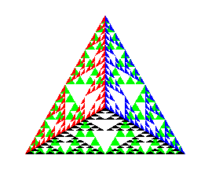
Example
after 5 iterations

Slide 86
Gasket Program
/* initial triangle */
GLfloat v[4][3]={
{-1.0, -0.58, 0.0},
{1.0, -0.58, 0.0},
{0.0, 1.15, 0.0},
{0.0, 0.0, 0.0}
};
int n; /* number of recursive steps */

Slide 87
triangle code
void triangle( GLfloat *a, GLfloat *b, GLfloat *c)
{
glVertex3fv(a);
glVertex3fv(b);
glVertex3fv(c);
}

Slide 88
subdivision code
void divide_triangle(GLfloat *a, GLfloat *b, GLfloat *c, int m)
{
GLfloat v1[3], v2[3], v3[3];
int j;
if(m>0) {
for(j=0; j<3; j++) v1[j]=(a[j]+b[j])/2;
for(j=0; j<3; j++) v2[j]=(a[j]+c[j])/2;
for(j=0; j<3; j++) v3[j]=(b[j]+c[j])/2;
divide_triangle(a, v1, v2, m-1);
divide_triangle(c, v2, v3, m-1);
divide_triangle(b, v3, v1, m-1);
} else {
triangle(a,b,c);
}
}

Slide 89
tetrahedron code
void tetrahedron( int m )
{
glColor3f(0.0,1.0,0.0);
divide_triangle(v[0], v[1], v[2], m);
glColor3f(0.0,0.0,1.0);
divide_triangle(v[3], v[2], v[1], m);
glColor3f(0.0,0.0,0.0);
divide_triangle(v[0], v[3], v[1], m);
glColor3f(1.0,0.0,0.0);
divide_triangle(v[0], v[2], v[3], m);}

Slide 90
display Functions
void display()
{
glClear(GL_COLOR_BUFFER_BIT);
glBegin(GL_TRIANGLES);
tetrahedron(n);
glEnd();
glFlush();
}

Slide 91
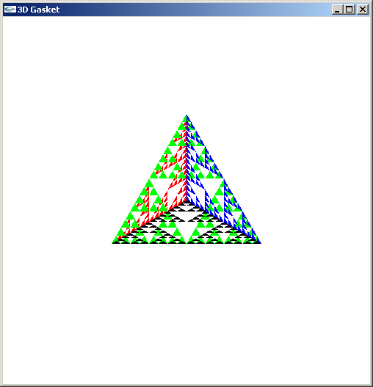
Almost Correct
Because the triangles are drawn in the order they are defined in the program, the front triangles are not always rendered in front of triangles behind them
get this
want this

Slide 92
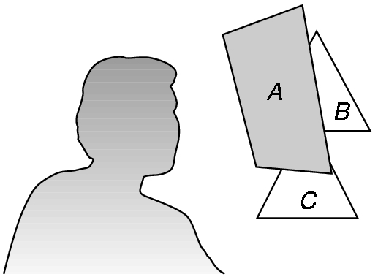
Hidden-Surface Removal
We want to see only those surfaces in front of other surfaces
OpenGL uses a hidden-surface method called the z-buffer algorithm that saves depth information as objects are rendered so that only the front objects appear in the image

Slide 93
Using the z-buffer algorithm
The algorithm uses an extra buffer, the z-buffer, to store depth information as geometry travels down the pipeline
It must be
  Requested in main.c
    glutInitDisplayMode
    (GLUT_SINGLE | GLUT_RGB | GLUT_DEPTH)
  Enabled in init.c
    glEnable(GL_DEPTH_TEST)
  Cleared in the display callback
    glClear(GL_COLOR_BUFFER_BIT |
    GL_DEPTH_BUFFER_BIT)

Slide 94
Surface vs Volume Subdvision
In our example, we divided the surface of each face
We could also divide the volume using the same midpoints
The midpoints define four smaller tetrahedrons, one for each vertex
Keeping only these tetrahedrons removes a volume in the middle
See text for code

Slide 95
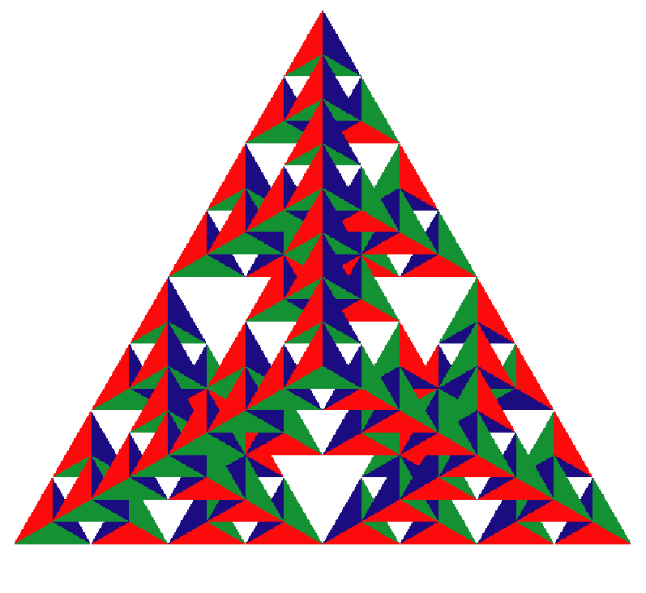
Volume Subdivision

Slide 96
Bounce

Slide 97
Positioning
The position in the screen window is usually measured in pixels with the origin at the top-left corner
  Consequence of refresh done from top to bottom
OpenGL uses a world coordinate system with origin at the bottom left
  Must invert y coordinate returned by callback by height of window
  y = h – y;
h
(0,0)
w

Slide 98
Rect
void RenderScene(void)
{
// Clear the window with current clearing color
glClear(GL_COLOR_BUFFER_BIT);
// Set current drawing color to red
// R G B
glColor3f(1.0f, 0.0f, 0.0f);
// Draw a filled rectangle with current color
glRectf(x, y, x + rsize, y - rsize);
// Flush drawing commands and swap
glutSwapBuffers();
}

Slide 99
Time function
glutTimerFunc(unsigned int millis, void (GLUTCALLBACK *func)(int value), int value);
Registers a timer callback to be triggered in a specified number of milliseconds.

Slide 100
Bounce
void TimerFunction(int value)
{
// Reverse direction when you reach left or right edge
if(x > windowWidth-rsize || x < -windowWidth)
xstep = -xstep;
// Reverse direction when you reach top or bottom edge
if(y > windowHeight || y < -windowHeight + rsize)
ystep = -ystep;
// Actually move the square
x += xstep;
y += ystep;

Slide 101
// Check bounds. This is in case the window is made
// smaller while the rectangle is bouncing and the
// rectangle suddenly finds itself outside the new
// clipping volume
if(x > (windowWidth-rsize + xstep))
x = windowWidth-rsize-1;
else if(x < -(windowWidth + xstep))
x = -windowWidth -1;
if(y > (windowHeight + ystep))
y = windowHeight-1;
else if(y < -(windowHeight - rsize + ystep))
y = -windowHeight + rsize - 1;
// Redraw the scene with new coordinates
glutPostRedisplay();
glutTimerFunc(33, TimerFunction, 1);
}

