Slide 1
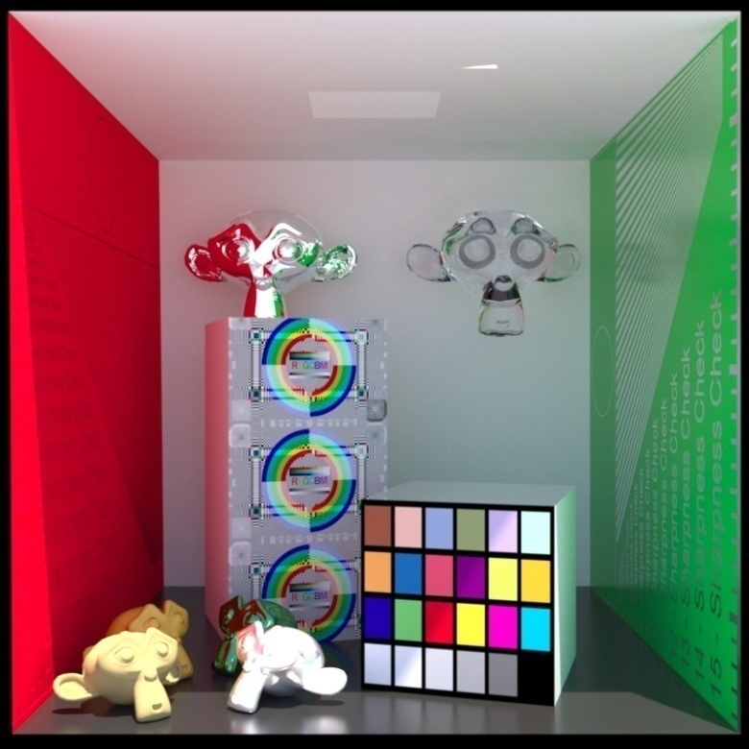
Computer Graphics
Ray tracing
Ming-Te Chi
Department of Computer Science,
National Chengchi University
Notes:
2016
The image is made by LuxRender. http://www.luxrender.net/

Slide 2
Global Illumination
Ray tracing
Rendering equation

Slide 3
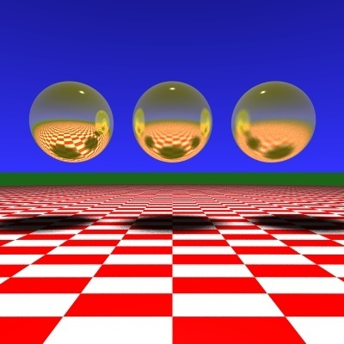
Ray Tracing
Slide Courtesy of Roger Crawfis, Ohio State

Slide 4
Ray Tracing
Follow rays of light from a point source
Can account for reflection and transmission

Slide 5
Computation
Should be able to handle all physical interactions
Ray tracing paradigm is not computational
Most rays do not affect what we see
Scattering produces many (infinite) additional rays
Alternative: ray casting

Slide 6
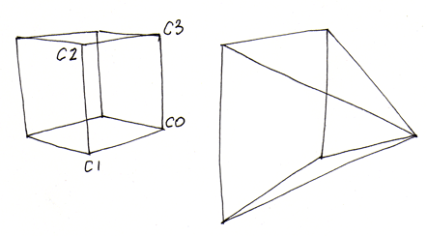
Ray Casting
Only rays that reach the eye matter
Reverse direction and cast rays
Need at least one ray per pixel

Slide 7
Ray Casting a Sphere
Ray is parametric
Sphere is quadric
Resulting equation is a scalar quadratic equation which gives entry and exit points of ray (or no solution if ray misses)

Slide 8
Shadow Rays
Even if a point is visible, it will not be lit unless we can see a light source from that point
Cast shadow or feeler rays

Slide 9
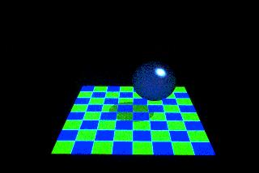
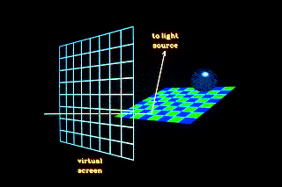
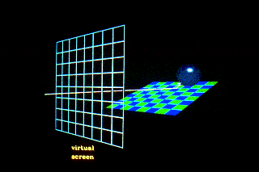
Shadow Rays
Notes:
http://www.siggraph.org/education/materials/HyperGraph/raytrace/rtrace1.htm

Slide 10
Reflection
Must follow shadow rays off reflecting or transmitting surfaces
Process is recursive

Slide 11
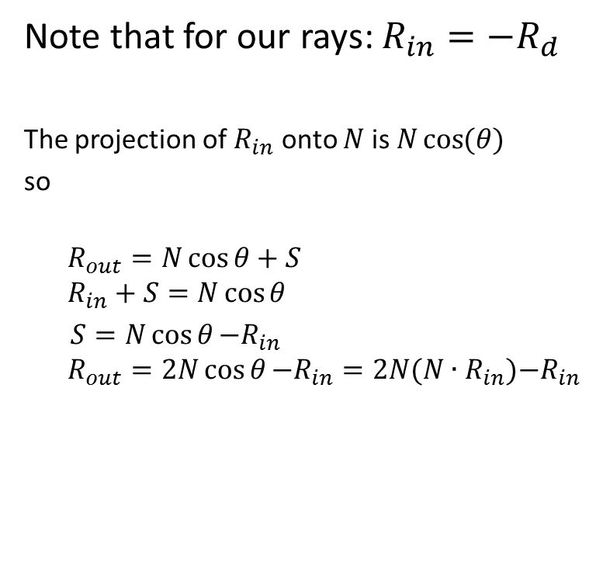
Computing a Reflected Ray
N
S
S
Rin
Rout
Ɵ
Ɵ
Notes:
http://www.opengl.org/sdk/docs/manglsl/xhtml/reflect.xml

Slide 12
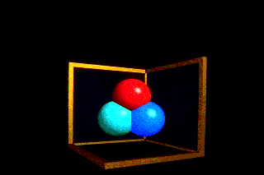
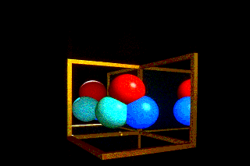
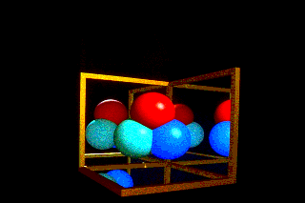
Scene with no reflection rays
Scene with one layer of reflection
Scene with two layer of reflection

Slide 13
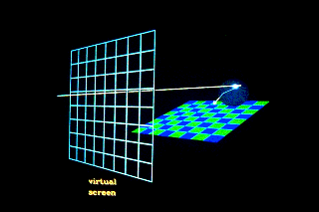
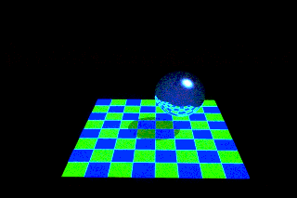
Transmission
Notes:
http://www.opengl.org/sdk/docs/manglsl/xhtml/refract.xml

Slide 14
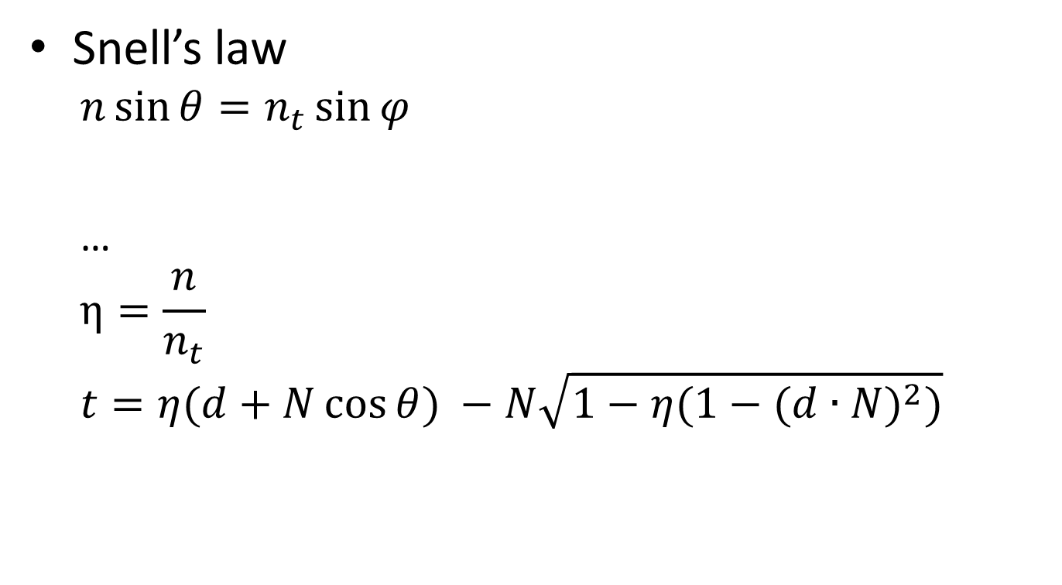

Transformed ray
d
θ
N
θ
r
t
Notes:
http://www.opengl.org/sdk/docs/manglsl/xhtml/refract.xml

Slide 15
Ray Trees

Slide 16
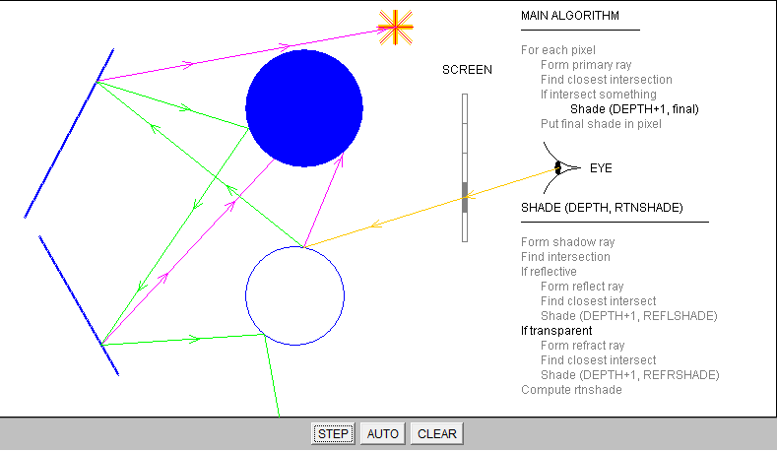
A Ray Tracing demonstration program
Notes:
http://www.siggraph.org/education/materials/HyperGraph/raytrace/rt_java/raytrace.html

Slide 17
Diffuse Surfaces
Theoretically the scattering at each point of intersection generates an infinite number of new rays that should be traced
In practice, we only trace the transmitted and reflected rays, but use the Phong model to compute shade at point of intersection
Radiosity works best for perfectly diffuse (Lambertian) surfaces

Slide 18
Building a Ray Tracer
Best expressed recursively
Can remove recursion later
Image based approach
For each ray …….
Find intersection with closest surface
Need whole object database available
Complexity of calculation limits object types
Compute lighting at surface
Trace reflected and transmitted rays

Slide 19
When to stop
Some light will be absorbed at each intersection
Track amount left
Ignore rays that go off to infinity
Put large sphere around problem
Count steps

Slide 20
Recursive Ray Tracer(1/3)
color c = trace(point p, vector d, int step)
{
color local, reflected, transmitted;
point q;
normal n;
if(step > max) return(background_color);
p
d

Slide 21
Recursive Ray Tracer (2/3)
N
p
r
q = intersect(p, d, status);
if(status==light_source) return(light_source_color);
if(status==no_intersection) return(background_color);
n = normal(q);
r = reflect(q, n);
t = transmit(q,n);
d
q
t

Slide 22
Recursive Ray Tracer (3/3)
local = phong(q, n, r);
reflected = trace(q, r, step+1);
transmitted = trace(q,t, step+1);
return(local + reflected + transmitted);
}
N
p
r
d
q
t

Slide 23
Intersections

Slide 24
Computing Intersections
Implicit Objects
Quadrics
Planes
Polyhedra
Parametric Surfaces

Slide 25
Implicit Surfaces
Ray from p₀ in direction d
p(t) = p₀ +t d
General implicit surface
f(p) = 0
Solve scalar equation
f(p(t)) = 0
General case requires numerical methods

Slide 26



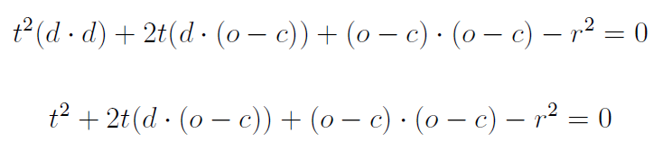

Sphere

Slide 27
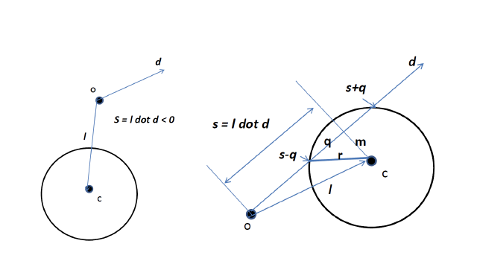

Slide 28
Planes
p • n + c = 0
p(t) = p₀ +t d
t = -(p₀ • n + c)/ d • n

Slide 29
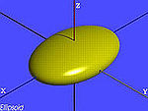
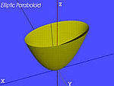
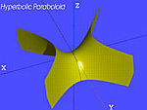
Quadrics
General quadric can be written as
p^{T}Ap + b^{T}p +c = 0
Substitute equation of ray
p(t) = p₀ +t d
to get quadratic equation
Ellipsoid
Elliptic paraboloid
Hyperbolic paraboloid
…..
Notes:
http://en.wikipedia.org/wiki/Quadric

Slide 30
Ray Casting Quadrics
Ray casting has become the standard way to visualize quadrics which are implicit surfaces in CSG systems
Constructive Solid Geometry
Primitives are solids
Build objects with set operations
Union, intersection, set difference

Slide 31
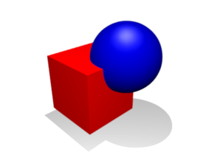
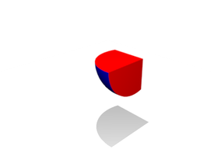
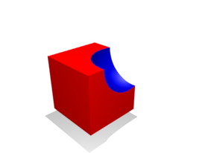
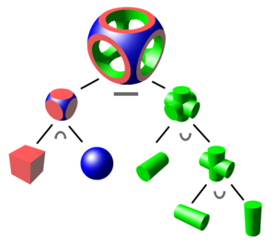
Constructive solid geometry (CSG)
union
intersection
difference
Notes:
Ricci 1973

Slide 32
Polyhedra
Generally we want to intersect with closed objects such as polygons and polyhedra rather than planes
Hence we have to worry about inside/outside testing
For convex objects such as polyhedra there are some fast tests

Slide 33
Ray Tracing Polyhedra
If ray enters an object, it must enter a front facing polygon and leave a back facing polygon
Polyhedron is formed by intersection of planes
Ray enters at furthest intersection with front facing planes
Ray leaves at closest intersection with back facing planes
If entry is further away than exit, ray must miss the polyhedron

Slide 34
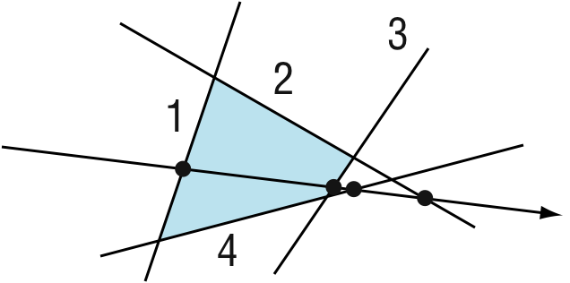
Ray Tracing a Polygon

Slide 35
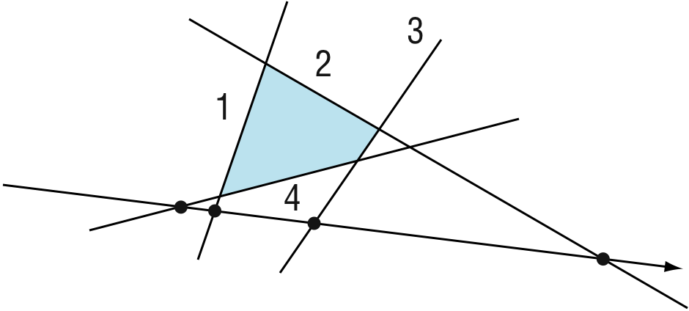
Ray Tracing a Polygon

Slide 36
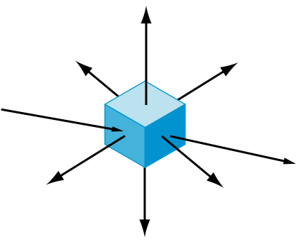
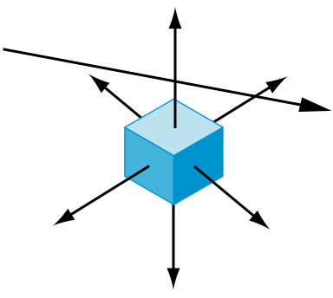
Ray Tracing Polyhedra

Slide 37
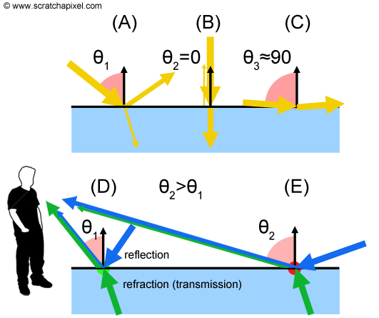
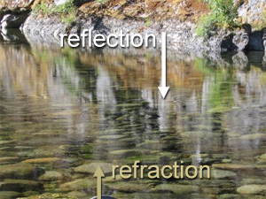
Notes:
http://www.scratchapixel.com/old/lessons/3d-basic-lessons/lesson-14-interaction-light-matter/optics-reflection-and-refraction/

Slide 38
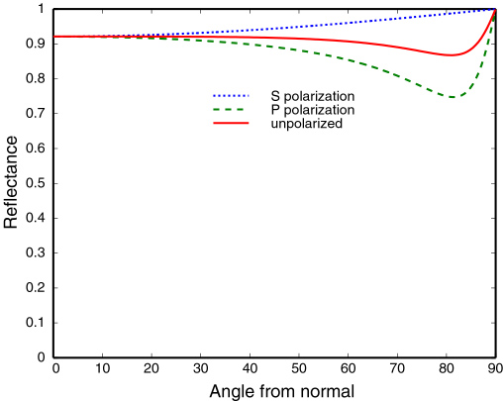
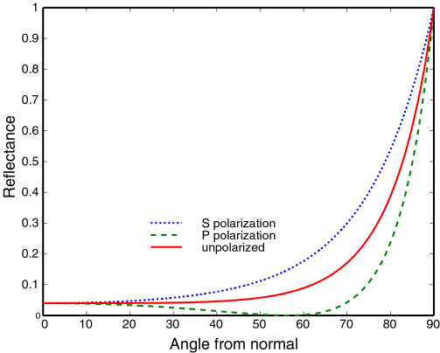
Fresnel Reflectance
Fresnel equation describe the behaviour of light when moving between media of differing refractive indices.
conductive materials
aluminum
dielectric
glasses
Notes:
http://www.graphics.cornell.edu/~westin/misc/fresnel.html

Slide 39
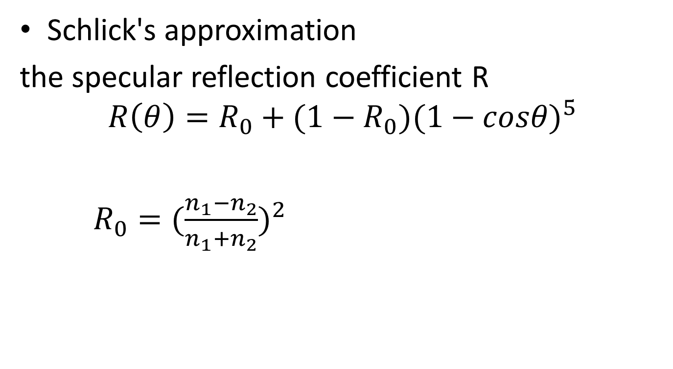
Schlick's approximation
the specular reflection coefficient R
$$R\left(θ\right)=R_{0}+(1−R_{0}){(1−cosθ)}^{5}$$
$R_{0}={(\frac{n_{1}−n_{2}}{n_{1}+n_{2}})}^{2}$
Notes:
Schlick, C. (1994). "An Inexpensive BRDF Model for Physically-based Rendering". Computer Graphics Forum 13 (3): 233

Slide 40
Distributed Ray Tracing
Robert L. Cook, Thomas Porter, Loren Carpenter
1984

Slide 41
Shadows
Ray tracing casts shadow feelers to a point light source.
Many light sources are illuminated over a finite area.
The shadows between these are substantially different.
Area light sources cast soft shadows
Penumbra
Umbra

Slide 42
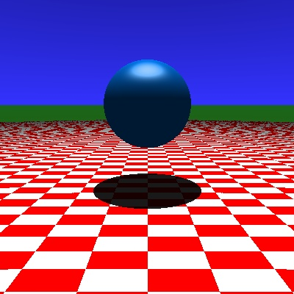

Soft Shadows
Slide Courtesy of Roger Crawfis, Ohio State

Slide 43
Soft Shadows
Penumbra
Umbra
Slide Courtesy of Roger Crawfis, Ohio State

Slide 44
Camera Models
Up to now, we have used a pinhole camera model.
These has everything in focus throughout the scene.
The eye and most cameras have a larger lens or aperature.
Notes:
Slide Courtesy of Roger Crawfis, Ohio State

Slide 45
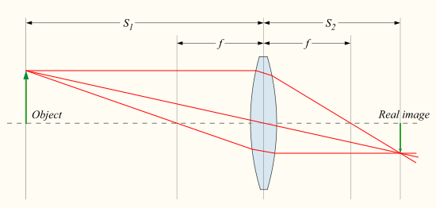

thin lens formula
$\frac{1}{S_{1}}+\frac{1}{S_{2}}=\frac{1}{f}$

Slide 46
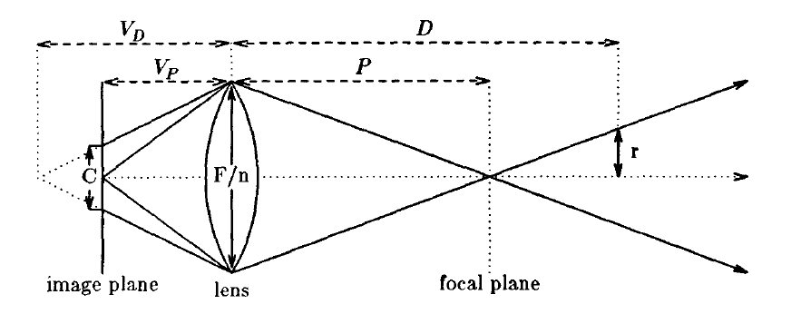

Circle of confusion
F: Focal length; n: aperture number
$V_{P}=\frac{FP}{P−F},$ for P>F, $V_{D}=\frac{FD}{D−F},$ for D>F
$C=\left|V_{D}−V_{P}\right|\frac{F}{nV_{D}}$

Slide 47
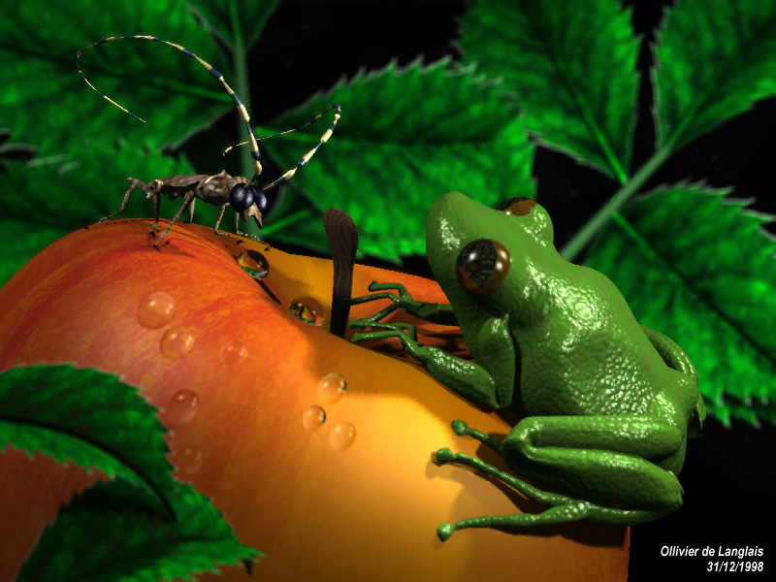
Depth-of-Field

Slide 48
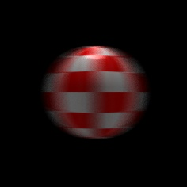
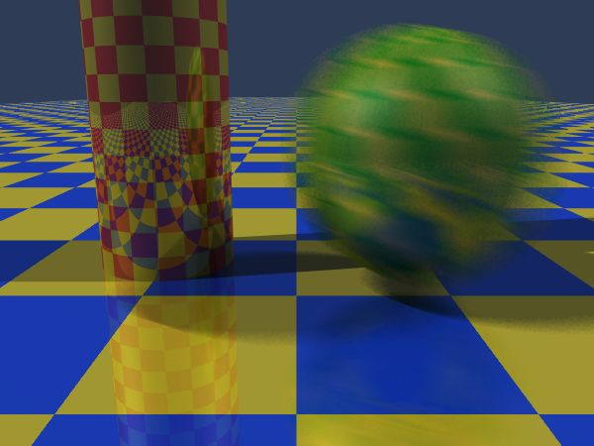
Motion Blur
Slide Courtesy of Roger Crawfis, Ohio State

Slide 49
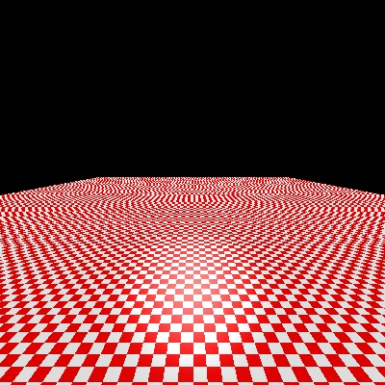
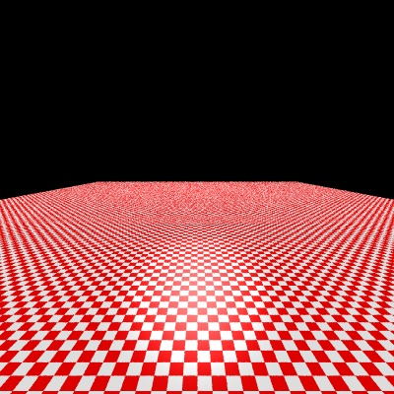
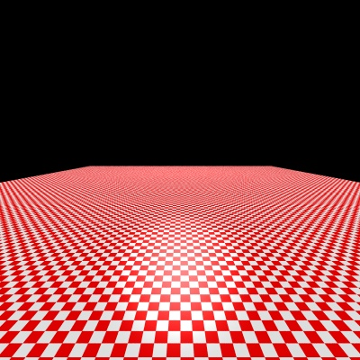
Supersampling
1 sample per pixel
16 sample per pixel
256 sample per pixel
Slide Courtesy of Roger Crawfis, Ohio State

Slide 50
More On Ray-Tracing
Already discussed recursive ray-tracing!
Improvements to ray-tracing!
Area sampling variations to address aliasing
Distributed ray-tracing!

Slide 51
Area Subdivision (Warnock) (mixed object/image space)
Clipping used to subdivide polygons that are across regions

Slide 52
Softwares
POV-ray (http://www.povray.org/)
A free rendering tool (not a modeling tool)
Uses a text based scene description language (SDL)
Blender (http://www.blender3d.org)
Modeling, Animation, rendering tool
Especially useful in 3D game creation

Slide 53
Rendering Equation

Slide 54
Rendering Equation (Kajiya 1986)
Consider a point on a surface
N
I_{in}(Φ_{in})
I_{out}(Φ_{out})

Slide 55
Rendering Equation
Outgoing light is from two sources
Emission
Reflection of incoming light
Must integrate over all incoming light
Integrate over hemisphere
Must account for foreshortening of incoming light

Slide 56
Rendering Equation
I_{out}(Φ_{out}) = E(Φ_{out}) + ∫ _{2π}R_{bd}(Φ_{out}, Φ_{in} )I_{in}(Φ_{in}) cos θ dω
emission
angle between Normal and Φin
bidirectional reflection coefficient
Note that angle is really two angles in 3D and wavelength is fixed

Slide 57
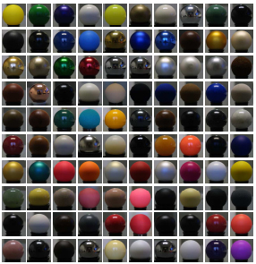
BRDF database
http://www.merl.com/brdf/
Notes:
33MB per material
#define BRDF_SAMPLING_RES_THETA_H 90
#define BRDF_SAMPLING_RES_THETA_D 90
#define BRDF_SAMPLING_RES_PHI_D 360
RGB 3 float
// Read BRDF data
bool read_brdf(const char *filename, double* &brdf)
{
FILE *f = fopen(filename, "rb");
if (!f)
return false;
int dims[3];
fread(dims, sizeof(int), 3, f);
int n = dims[0] * dims[1] * dims[2];
if (n != BRDF_SAMPLING_RES_THETA_H *
BRDF_SAMPLING_RES_THETA_D *
BRDF_SAMPLING_RES_PHI_D / 2)
{
fprintf(stderr, "Dimensions don't match\n");
fclose(f);
return false;
}
brdf = (double*) malloc (sizeof(double)*3*n);
fread(brdf, sizeof(double), 3*n, f);
fclose(f);
return true;
}

Slide 58
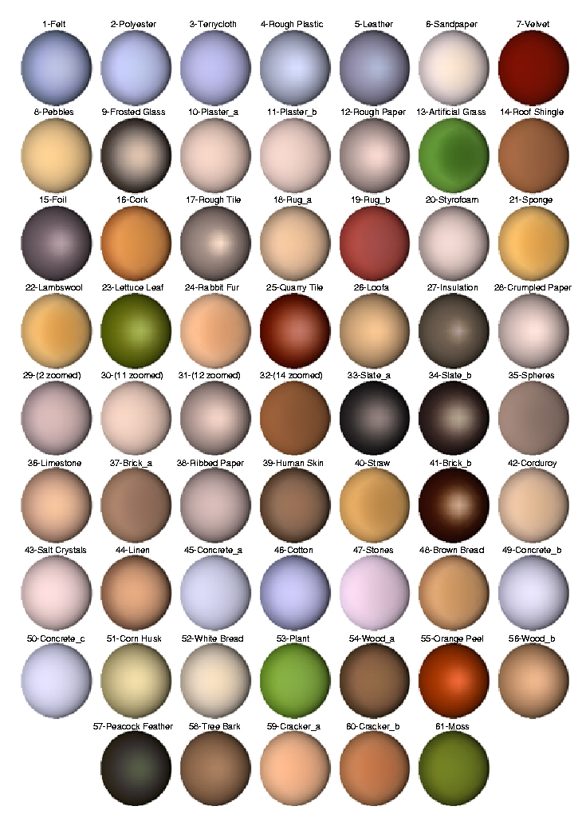
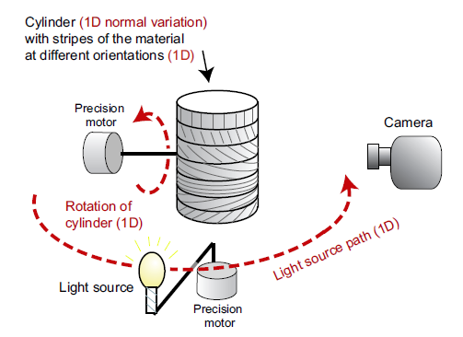
Notes:
http://people.csail.mit.edu/addy/research/ngan05_brdf_eval.pdf

Slide 59
Rendering Equation
Rendering equation is an energy balance
Energy in = energy out
Integrate over hemisphere
Fredholm integral equation
Cannot be solved analytically in general
Various approximations of R_{bd} give standard rendering models
Should also add an occlusion term in front of right side to account for other objects blocking light from reaching surface

Slide 60
Another version
Consider light at a point p arriving from p’
i(p, p’) = υ(p, p’)(ε(p,p’)+ ∫ ρ(p, p’, p’’)i(p’, p’’)dp’’)
emission from p’ to p
occlusion = 0
or
attenuation =1/d²
light reflected at p’ from all
points p’’ towards p

