Slide 1
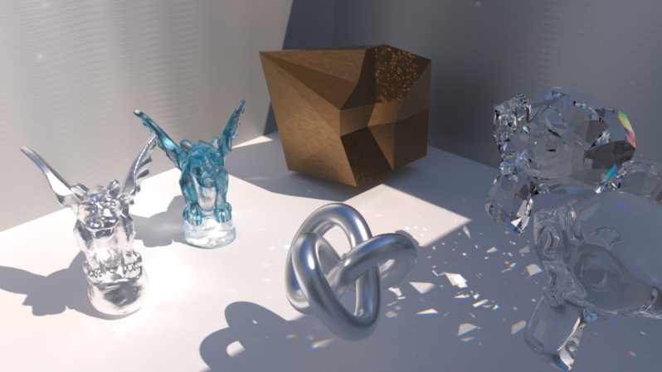
Computer Graphics
Shading
紀明德 mtchi@cs.nccu.edu.tw
Department of Computer Science,
National Chengchi University
Notes:
2016
Shading: which computers the pixel color based on the results of ray intersection
Shading refers to depicting depth perception in 3D models or illustrations by varying levels of darkness. (from wiki)
The operation of determining the effect of a light on a material is known as shading (realtime rendering 3rd)
“paint” with light (Fundmentals of CG )

Slide 2
Illumination
Local Illumination
Phong shading model
ambient,
diffuse,
Specular
Lighting Type
BRDF

Slide 3
Objectives
Learn to shade objects so their images appear three-dimensional
Introduce the types of light-material interactions
Build a simple reflection model---the Phong model--- that can be used with real time graphics hardware

Slide 4

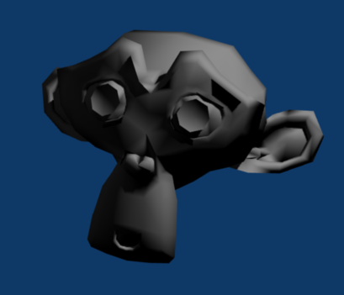
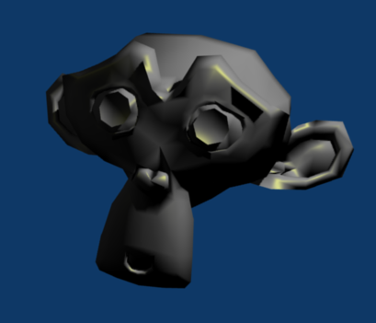
Why we need shading
Suppose we build a model using many polygons and color it with glColor. We get something like
But we want
Notes:
Before:
glColor()
After:
glEnable(GL_LIGHTING); ... Related lighting setup (glLightfv(); glMaterial();)
glNormal();

Slide 5
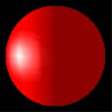
Shading
Why does the image of a real sphere look like
Light-material interactions cause each point to have a different color or shade
Need to consider
Light sources
Material properties
Location of viewer
Surface orientation

Slide 6
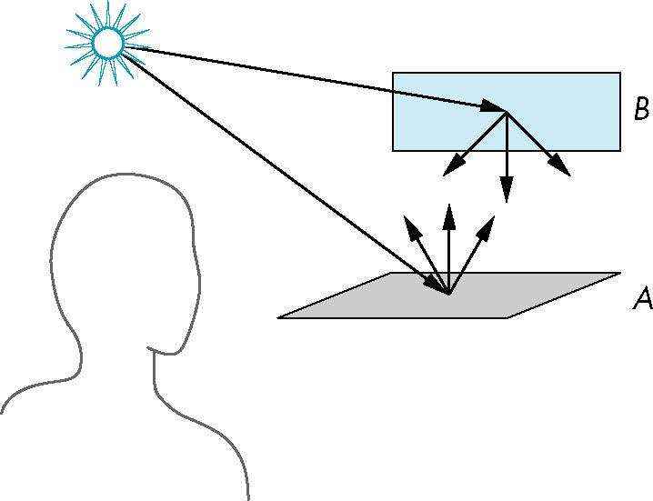
Scattering
Light strikes A
Some scattered
Some absorbed
Some of scattered light strikes B
Some scattered
Some absorbed
Some of this scattered
light strikes A
and so on

Slide 7
Rendering Equation (Kajiya 1986)
Consider a point on a surface
N
I_{in}(Φ_{in})
I_{out}(Φ_{out})

Slide 8
Rendering Equation
emission
angle between Normal and Φin
bidirectional reflection coefficient
Note that angle is really two angles in 3D and wavelength is fixed

Slide 9
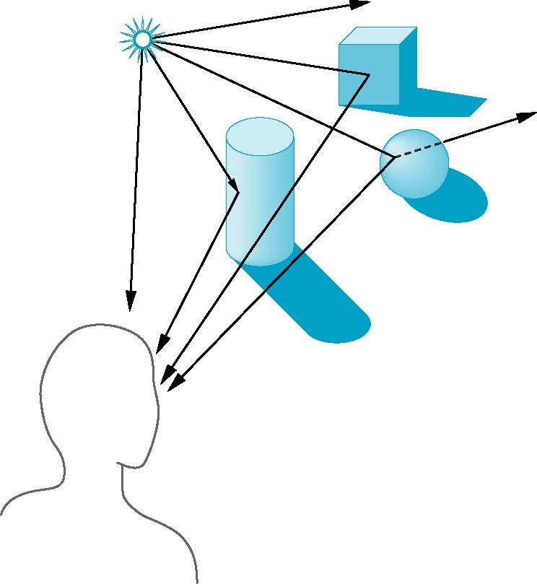
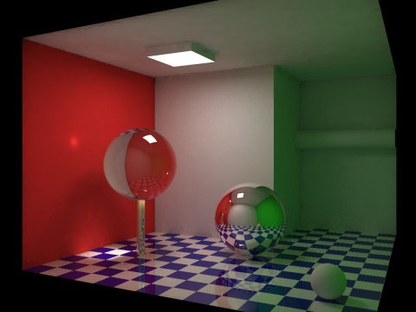
Global Effects
shadow
multiple reflection
translucent surface

Slide 10
Rendering Equation
The infinite scattering and absorption of light can be described by the rendering equation
Cannot be solved in general
Ray tracing is a special case for perfectly reflecting surfaces
Rendering equation is global and includes
Shadows
Multiple scattering from object to object

Slide 11
Local vs Global Rendering
Correct shading requires a global calculation involving all objects and light sources
Incompatible with pipeline model which shades each polygon independently (local rendering)
However, in computer graphics, especially real time graphics, we are happy if things “look right”
Exist many techniques for approximating global effects

Slide 12
Light-Material Interaction
Light that strikes an object is partially absorbed and partially scattered (reflected)
The amount reflected determines the color and brightness of the object
A surface appears red under white light because the red component of the light is reflected and the rest is absorbed
The reflected light is scattered in a manner that depends on the smoothness and orientation of the surface

Slide 13
Material in the world
Material Properties
.6
Intensity
( 1, 0.5, 1 )
Intensity
( 1, 0.5, 1 ) X ( 0.8, 0.8, 0.8)
= ( 0.8, 0.4, 0.8 )
.6 X .5 =.3
.5
Material
( 0.8, 0.8, 0.8 ) Material
Notes:
Shading的效果，也就是觀察者接受到的亮度
是由光源發出的亮度(左圖0.6)，照射到材質表面，根據材質不同反射係數(左圖0.5)，兩者相乘的結果(.6 X .5 =.35
)
右圖呈現以(r, g, b)三原色

Slide 14
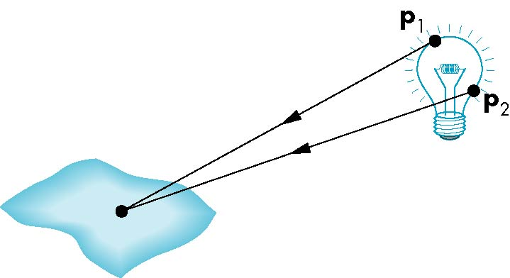
Light Sources
General light sources are difficult to work with because we must integrate light coming from all points on the source

Slide 15
Simple Light Sources
Point source
Model with position and color
Distant source = infinite distance away (parallel)
Spotlight
Restrict light from ideal point source
Ambient light
Same amount of light everywhere in scene
Can model contribution of many sources and reflecting surfaces

Slide 16
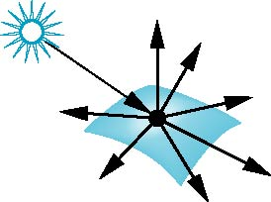
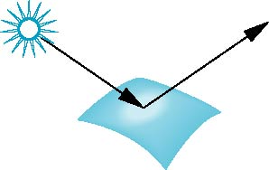
Surface Types
The smoother a surface, the more reflected light is concentrated in the direction a perfect mirror would reflected the light
A very rough surface scatters light in all directions
smooth surface
rough surface

Slide 17
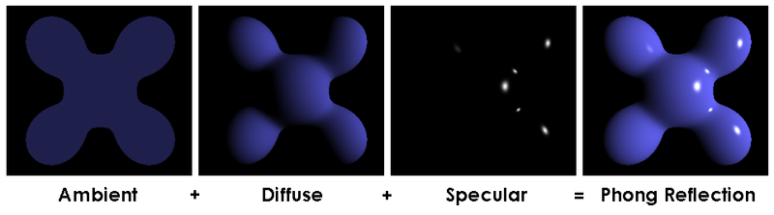
Shading Model
A simple model that can be computed rapidly
Has three components
Diffuse
Specular
Ambient

Slide 18
Lambertian Shading (1971)
Perfectly diffuse reflector
Light scattered equally in all directions
Amount of light reflected is proportional to the vertical component of incoming light
reflected light ~cos θ_{i}
cos θ_{i} = l · n if vectors normalized
There are also three coefficients, k_{r}, k_{b}, k_{g} that show how much of each color component is reflected

Slide 19
Lambertian Surface
d
d
θ
length
d
d/cosθ
intensity
1/d
cosθ / d
Reflected light ~cos θ

Slide 20
Ambient Light
Ambient light is the result of multiple interactions between (large) light sources and the objects in the environment
Amount and color depend on both the color of the light(s) and the material properties of the object
Add k_{a} I_{a} to diffuse and specular terms
reflection coef.
intensity of ambient light
Notes:
[Gouraud, 1971]

Slide 21
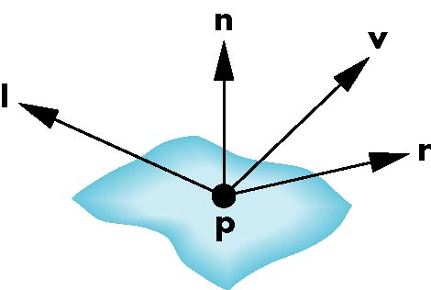
Phong shading (1973)
Uses four vectors
To source
To viewer
Normal
Perfect reflector
Notes:
^ B. T. Phong, Illumination for computer generated pictures, Communications of ACM 18 (1975), no. 6, 311–317.
^ University of Utah School of Computing, http://www.cs.utah.edu/school/history/#phong-ref

Slide 22
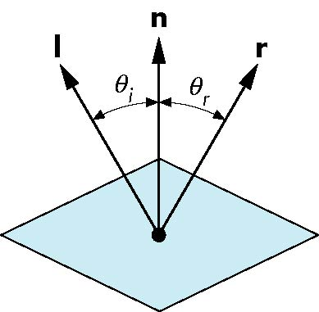
Ideal Reflector
Normal is determined by local orientation
Angle of incidence = angle of relection
The three vectors must be coplanar
r = 2 (l · n ) n - l

Slide 23
Specular Surfaces
Most surfaces are neither ideal diffusers nor perfectly specular (ideal reflectors)
Smooth surfaces show specular highlights due to incoming light being reflected in directions concentrated close to the direction of a perfect reflection
specular
highlight

Slide 24
Modeling Specular Relections
Phong proposed using a term that dropped off as the angle between the viewer and the ideal reflection increased
I_{r} ~ k_{s} I cos^{α}φ
φ
reflected
intensity
shininess coef
incoming intensity
absorption coef

Slide 25
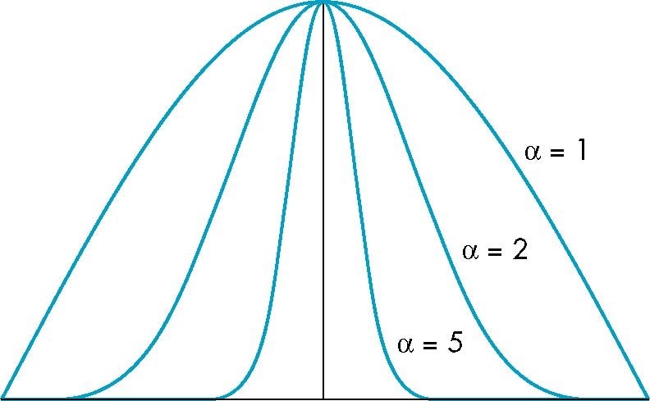
The Shininess Coefficient
Values of α between 100 and 200 correspond to metals
Values between 5 and 10 give surface that look like plastic
cos^{α} φ
-90
φ
90

Slide 26
Distance Terms
The light from a point source that reaches a surface is inversely proportional to the square of the distance between them
We can add a factor of the
form 1/(a + bd +cd²) to
the diffuse and specular
terms
The constant and linear terms soften the effect of the point source

Slide 27
Light Sources
In the Phong Model, we add the results from each light source
Each light source has separate diffuse, specular, and ambient terms to allow for maximum flexibility even though this form does not have a physical justification
Separate red, green and blue components
Hence, 9 coefficients for each point source
I_{dr}, I_{dg}, I_{db}, I_{sr}, I_{sg}, I_{sb}, I_{ar}, I_{ag}, I_{ab}

Slide 28
Material Properties
Material properties match light source properties
Nine absorption coefficients
Diffuse: k_{dr}, k_{dg}, k_{db},
Speculr: k_{sr}, k_{sg}, k_{sb},
Ambient: k_{ar}, k_{ag}, k_{ab}
Shininess coefficient α

Slide 29
Adding up the Components
For each light source and each color component, the Phong model can be written (without the distance terms) as
I = k_{d} I_{d} l · n + k_{s} I_{s} (v · r )^{α} + k_{a} I_{a}
For each color component
we add contributions from
all sources
ambient
diffuse
specular
Notes:
Distance ( 1/(a+bd+cd^2) )

Slide 30
Modified Phong Model (Blinn-Phong)
The specular term in the Phong model is problematic because it requires the calculation of a new reflection vector and view vector for each vertex
Blinn suggested an approximation using the halfway vector that is more efficient

Slide 31
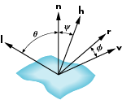
The Halfway Vector
h is normalized vector halfway between l and v
h = ( l + v )/ | l + v |

Slide 32
Using the halfway vector
Replace (v · r )^{α} by (n · h )^{β}
β is chosen to match shineness
Note that halway angle is half of angle between r and v if vectors are coplanar
Resulting model is known as the modified Phong or Blinn lighting model
Specified in OpenGL standard

Slide 33
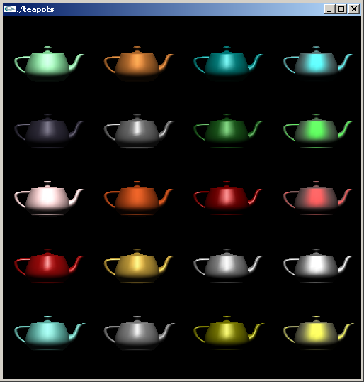
Example
Only differences in
these teapots are
the parameters
in the modified
Phong model

Slide 34
Computation of Vectors
l and v are specified by the application
Can computer r from l and n
Problem is determining n
For simple surfaces is can be determined but how we determine n differs depending on underlying representation of surface
OpenGL leaves determination of normal to application
Exception for GLU quadrics and Bezier surfaces (Chapter 11)

Slide 35
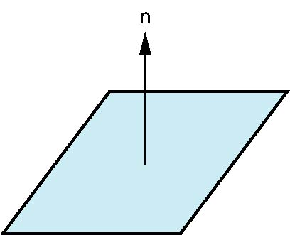
Plane Normals
Equation of plane: ax+by+cz+d = 0
From Chapter 4 we know that plane is determined by three points p₀, p₂, p₃ or normal n and p₀
Normal can be obtained by
n = (p₂-p₀) × (p₁-p₀)

Slide 36

Normal to Sphere
Implicit function f(x, y, z)=0
Normal given by gradient
Sphere f(p)=p·p-1
n = [∂f/∂x, ∂f/∂y, ∂f/∂z]^{T}=p

Slide 37
Parametric Form
For sphere
Tangent plane determined by vectors
Normal given by cross product
x=x(u,v)=cos u sin v
y=y(u,v)=cos u cos v
z= z(u,v)=sin u
∂p/∂u = [∂x/∂u, ∂y/∂u, ∂z/∂u]T
∂p/∂v = [∂x/∂v, ∂y/∂v, ∂z/∂v]T
n = ∂p/∂u × ∂p/∂v

Slide 38
General Case
We can compute parametric normals for other simple cases
Quadrics
Parameteric polynomial surfaces

Slide 39
Local Illumination options
Discuss polygonal shading
Flat
Smooth
Gouraud
Phong
Lighting

Slide 40
Normal for Triangle
n
plane n ·(p - p₀ ) = 0
p₂
n = (p₂ - p₀ ) ×(p₁ - p₀ )
p
p₁
normalize n ← n/ |n|
p₀
Note that right-hand rule determines outward face

Slide 41
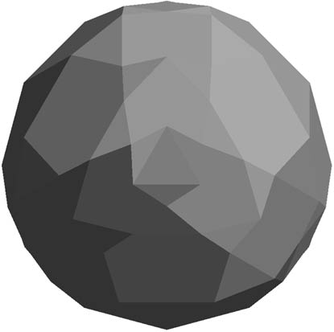
Polygon Normals
Polygons have a single normal
Shades at the vertices as computed by the Phong model can be almost same
Identical for a distant viewer (default) or if there is no specular component
Consider model of sphere
Want different normals at
each vertex even though
this concept is not quite
correct mathematically

Slide 42
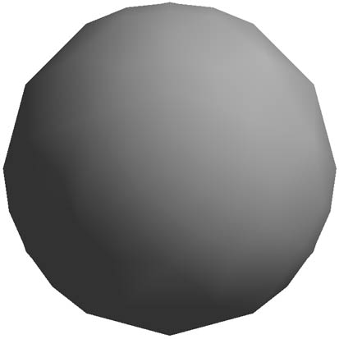
Smooth Shading
We can set a new normal at each vertex
Easy for sphere model
If centered at origin n = p
Now smooth shading works
Note silhouette edge

Slide 43
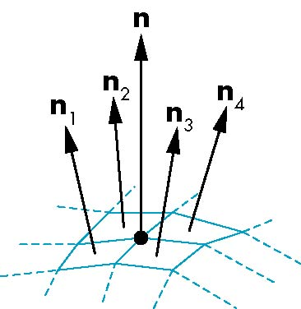
Mesh Shading
The previous example is not general because we knew the normal at each vertex analytically
For polygonal models, Gouraud proposed we use the average of the normals around a mesh vertex
n = (n₁+n₂+n₃+n₄)/ |n₁+n₂+n₃+n₄|

Slide 44
Gouraud and Phong Shading
Gouraud Shading
Find average normal at each vertex (vertex normals)
Apply modified Phong model at each vertex
Interpolate vertex shades across each polygon
Phong shading
Find vertex normals
Interpolate vertex normals across edges
Interpolate edge normals across polygon
Apply modified Phong model at each fragment

Slide 45
Comparison
If the polygon mesh approximates surfaces with a high curvatures, Phong shading may look smooth while Gouraud shading may show edges
Phong shading requires much more work than Gouraud shading
Until recently not available in real time systems
Now can be done using fragment shaders (see Chapter 9)
Both need data structures to represent meshes so we can obtain vertex normals

Slide 46
Objectives
Introduce the OpenGL shading functions
Discuss polygonal shading
Flat
Smooth
Gouraud

Slide 47
Steps in OpenGL shading
Enable shading and select model
Specify normals
Specify material properties
Specify lights

Slide 48
Normals
In OpenGL the normal vector is part of the state
Set by glNormal*()
glNormal3f(x, y, z);
glNormal3fv(p);
Usually we want to set the normal to have unit length so cosine calculations are correct
Length can be affected by transformations
Note that scaling does not preserved length
glEnable(GL_NORMALIZE) allows for autonormalization at a performance penalty

Slide 49
Normal for Triangle
n
plane n ·(p - p₀ ) = 0
p₂
n = (p₂ - p₀ ) ×(p₁ - p₀ )
p
p₁
normalize n ← n/ |n|
p₀
Note that right-hand rule determines outward face

Slide 50
Enabling Shading
Shading calculations are enabled by
glEnable(GL_LIGHTING)
Once lighting is enabled, glColor() ignored
Must enable each light source individually
glEnable(GL_LIGHTi) i=0,1…..
Can choose light model parameters
glLightModeli(parameter, GL_TRUE)
GL_LIGHT_MODEL_LOCAL_VIEWER do not use simplifying distant viewer assumption in calculation
GL_LIGHT_MODEL_TWO_SIDED shades both sides of polygons independently

Slide 51
Defining a Point Light Source
For each light source, we can set an RGBA for the diffuse, specular, and ambient components, and for the position
GLfloat diffuse0[]={1.0, 0.0, 0.0, 1.0};
GLfloat ambient0[]={1.0, 0.0, 0.0, 1.0};
GLfloat specular0[]={1.0, 0.0, 0.0, 1.0};
Glfloat light0_pos[]={1.0, 2.0, 3,0, 1.0};
glEnable(GL_LIGHTING);
glEnable(GL_LIGHT0);
glLightv(GL_LIGHT0, GL_POSITION, light0_pos);
glLightv(GL_LIGHT0, GL_AMBIENT, ambient0);
glLightv(GL_LIGHT0, GL_DIFFUSE, diffuse0);
glLightv(GL_LIGHT0, GL_SPECULAR, specular0);

Slide 52
Distance
The coefficients in the distance terms are by default a=1.0 (constant terms), b=c=0.0 (linear and quadratic terms). Change by
a= 0.80;
glLightf(GL_LIGHT0, GLCONSTANT_ATTENUATION, a);

Slide 53
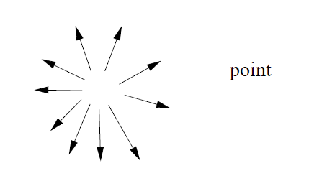
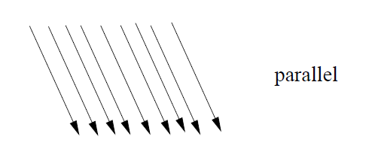
Direction
The source colors are specified in RGBA
The position is given in homogeneous coordinates
If w =1.0, we are specifying a finite location
If w =0.0, we are specifying a parallel source with the given direction vector

Slide 54
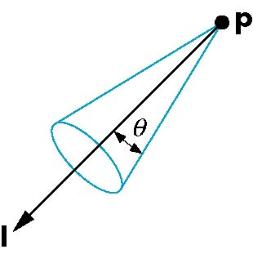
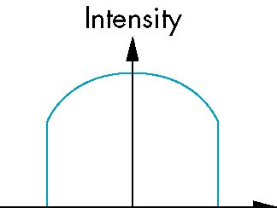
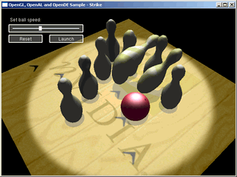
Spotlights
Use glLightv to set
Direction GL_SPOT_DIRECTION
Cutoff GL_SPOT_CUTOFF
Attenuation GL_SPOT_EXPONENT
Proportional to cos^{α}φ
−θ
φ
θ

Slide 55
Global Ambient Light
Ambient light depends on color of light sources
A red light in a white room will cause a red ambient term that disappears when the light is turned off
OpenGL also allows a global ambient term that is often helpful for testing
glLightModelfv(GL_LIGHT_MODEL_AMBIENT, global_ambient)

Slide 56
Moving Light Sources
Light sources are geometric objects whose positions or directions are affected by the model-view matrix
Depending on where we place the position (direction) setting function, we can
Move the light source(s) with the object(s)
Fix the object(s) and move the light source(s)
Fix the light source(s) and move the object(s)
Move the light source(s) and object(s) independently

Slide 57
Material Properties
Material properties are also part of the OpenGL state and match the terms in the modified Phong model
Set by glMaterialv()
GLfloat ambient[] = {0.2, 0.2, 0.2, 1.0};
GLfloat diffuse[] = {1.0, 0.8, 0.0, 1.0};
GLfloat specular[] = {1.0, 1.0, 1.0, 1.0};
GLfloat shine = 100.0
glMaterialf(GL_FRONT, GL_AMBIENT, ambient);
glMaterialf(GL_FRONT, GL_DIFFUSE, diffuse);
glMaterialf(GL_FRONT, GL_SPECULAR, specular);
glMaterialf(GL_FRONT, GL_SHININESS, shine);

Slide 58
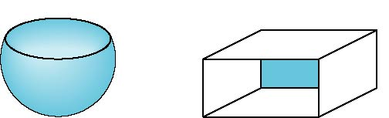
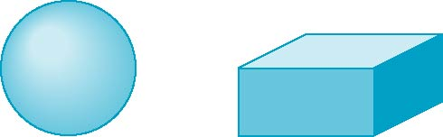
Front and Back Faces
The default is shade only front faces which works correctly for convex objects
back faces not visible
back faces visible

Slide 59
Emissive Term
We can simulate a light source in OpenGL by giving a material an emissive component
This component is unaffected by any sources or transformations
GLfloat emission[] = 0.0, 0.3, 0.3, 1.0);
glMaterialf(GL_FRONT, GL_EMISSION, emission);

Slide 60
Transparency
Material properties are specified as RGBA values
The A value can be used to make the surface translucent
The default is that all surfaces are opaque regardless of A
Later we will enable blending and use this feature

Slide 61
Polygonal Shading
Shading calculations are done for each vertex
Vertex colors become vertex shades
By default, vertex shades are interpolated across the polygon
glShadeModel(GL_SMOOTH);
If we use glShadeModel(GL_FLAT); the color at the first vertex will determine the shade of the whole polygon

Slide 62
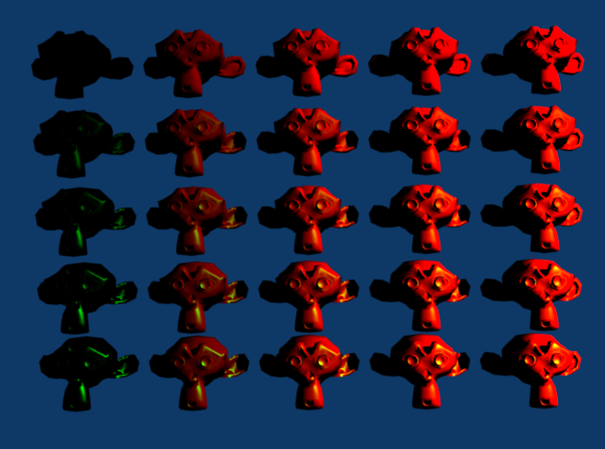
large
small
diffuse
specular
large

Slide 63
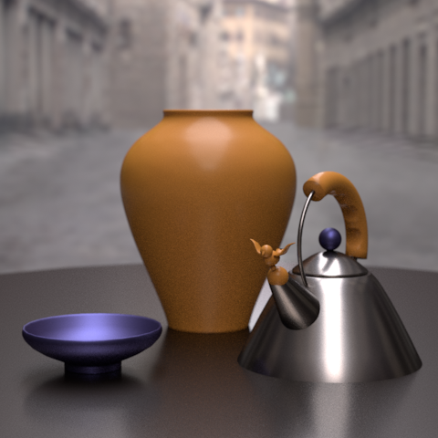
BRDF
Notes:
http://www.siggraph.org/publications/newsletter/volume-43-number-2/a-survey-of-brdf-models-for-computer-graphics

Slide 64
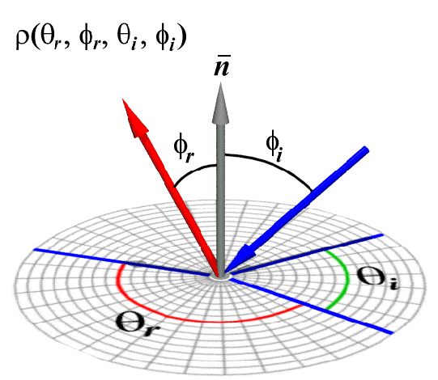
Bidirectional reflectance distribution function
Notes:
http://groups.csail.mit.edu/graphics/classes/6.837/F98/Lecture19/Slide20.html

Slide 65
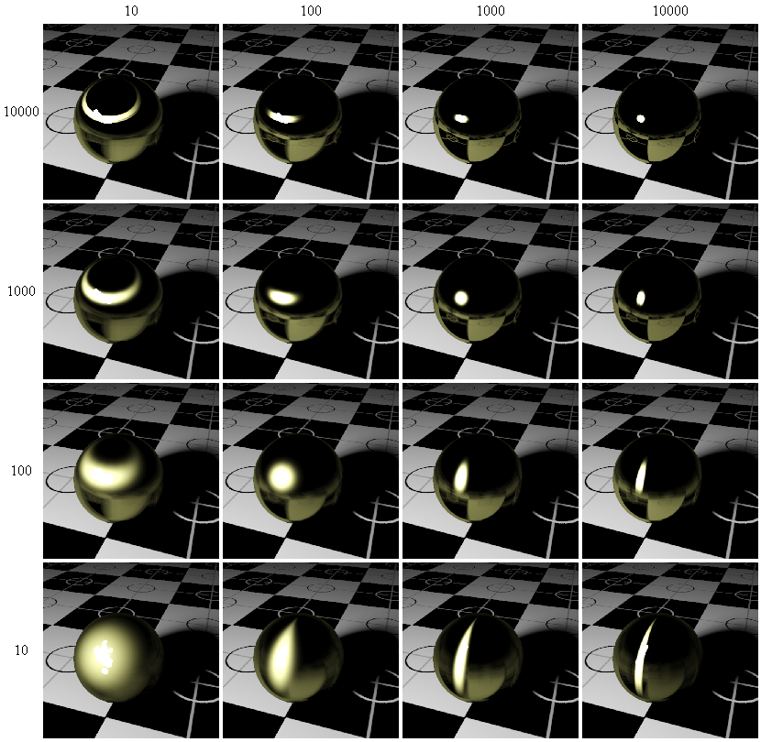
An Anisotropic Phong BRDF Model
Notes:
http://voxelizator3d.wordpress.com/2007/01/03/i-put-my-blood-into-this/

Slide 66
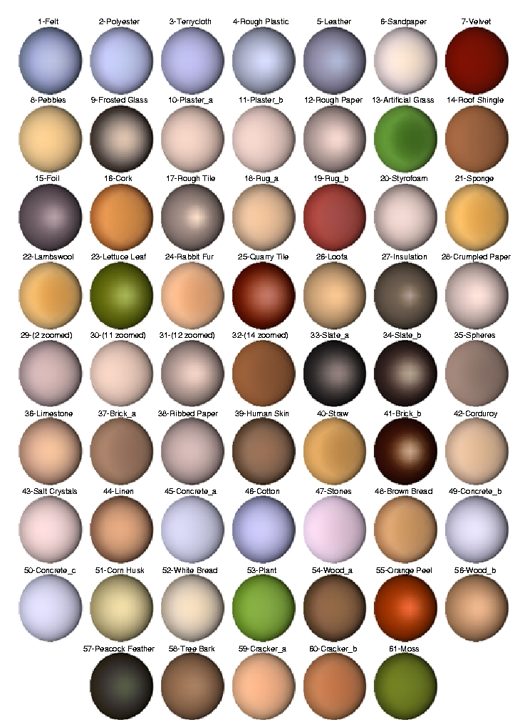
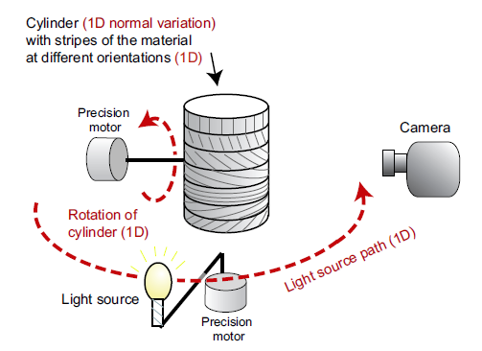
Notes:
http://people.csail.mit.edu/addy/research/ngan05_brdf_eval.pdf

Slide 67
Summary of Surfaces and BRDFs
Smooth
Rough
Mirror BRDF
Torrance-Sparrow BRDF
Specular
Delta Function
Speck of reflection
Broader Highlights
Off-specular lobe
Lambertian BRDF
Oren-Nayar BRDF
Diffuse
No view dependence
Models view dependence
Many surfaces may be rough and show
both diffuse and surface reflection.

Slide 68
Specular Reflection and Mirror BRDF - RECAP
source intensity I
specular/mirror
direction
incident
direction
normal
viewing
direction
surface
element
Very smooth surface.
All incident light energy reflected in a SINGLE direction.
(only when = )
Mirror BRDF is simply a double-delta function :
specular albedo
Surface Radiance :

Slide 69
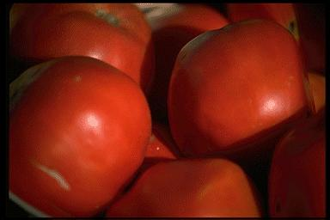
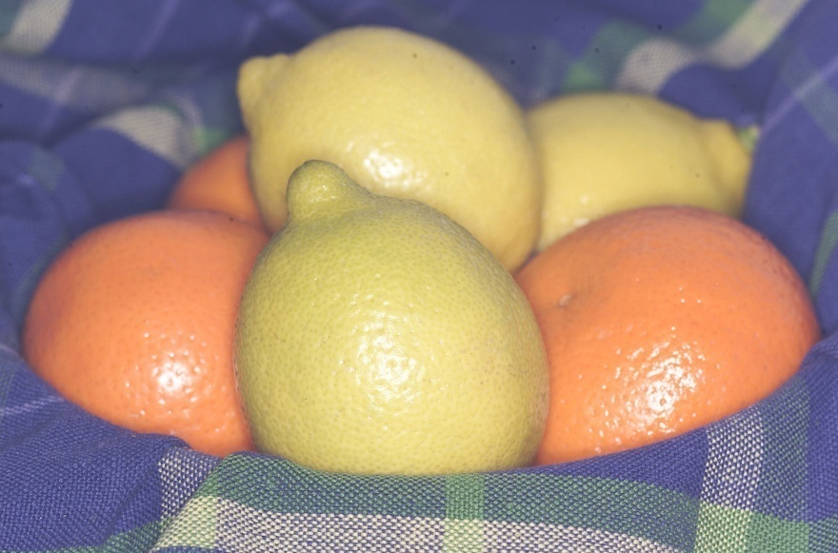
Glossy Surfaces
Delta Function too harsh a BRDF model
(valid only for highly polished mirrors and metals).
Many glossy surfaces show broader highlights in addition to mirror reflection.
Surfaces are not perfectly smooth –
they show micro-surface geometry (roughness).
Example Models : Phong model
Torrance Sparrow model

Slide 70
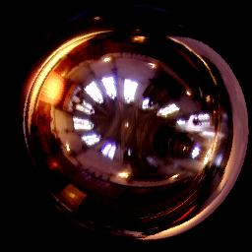
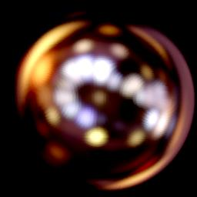
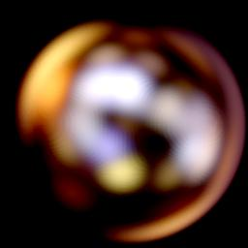
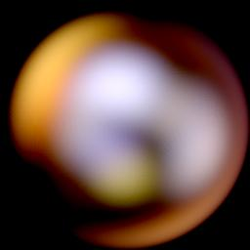
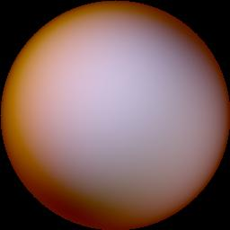
Blurred Highlights and Surface Roughness
Roughness

Slide 71
Phong Model: An Empirical Approximation
How to model the angular falloff of highlights:
Phong Model Blinn-Phong Model
Sort of works, easy to compute
But not physically based (no energy conservation and reciprocity).
Very commonly used in computer graphics.
N
N
H
R
-S
E

Slide 72
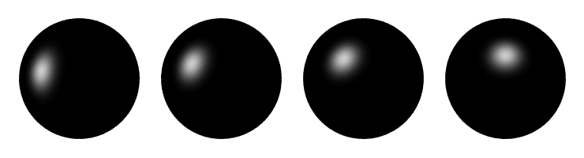
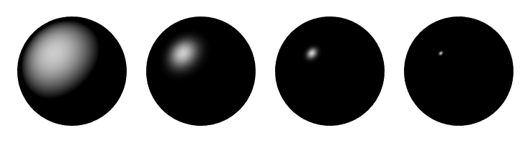
Phong Examples
These spheres illustrate the Phong model as lighting direction and n_{shiny} are varied:

Slide 73
Torrance-Sparrow Model – Main Points
Physically Based Model for Surface Reflection.
Based on Geometric Optics.
Explains off-specular lobe (wider highlights).
Works for only rough surfaces.
For very smooth surfaces, electromagnetic nature of light must be used
Beckmann-Spizzichinno model.
Beyond the scope of this course.

Slide 74
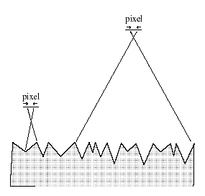
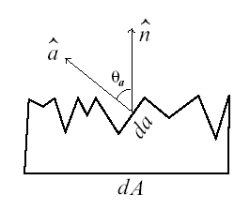
Modeling Rough Surfaces - Microfacets
Roughness simulated by Symmetric V-groves at Microscopic level.
Distribution on the slopes of the V-grove faces are modeled.
Each microfacet assumed to behave like a perfect mirror.

Slide 75
Torrance-Sparrow BRDF – Different Factors
Fresnel term:
allows for wavelength dependency
Geometric Attenuation:
reduces the output based on the amount of shadowing or masking that occurs.
Distribution:
distribution function determines what percentage of microfacets are oriented to reflect in the viewer direction.
How much of the macroscopic surface is visible to the light source
How much of the macroscopic surface is visible to the viewer

Slide 76
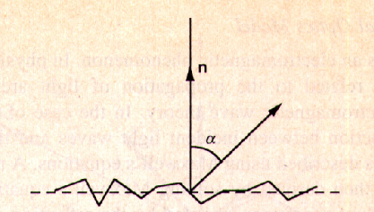
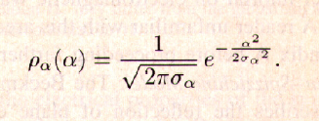
Slope Distribution Model
Model the distribution of slopes as Gaussian.
Mean is Zero, Variance represents ROUGHNESS.

Slide 77
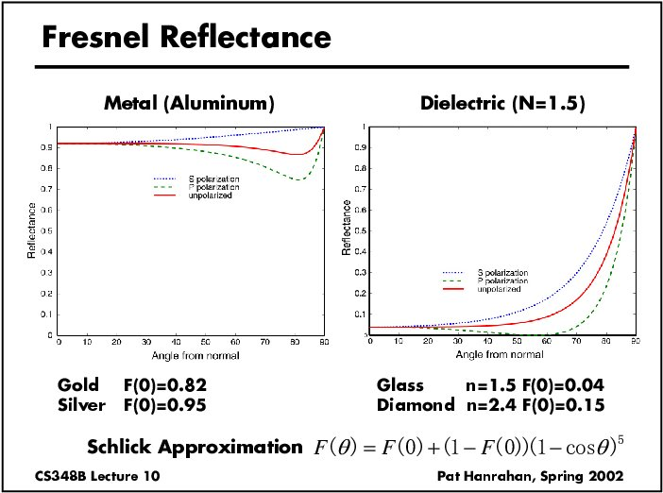

Slide 78
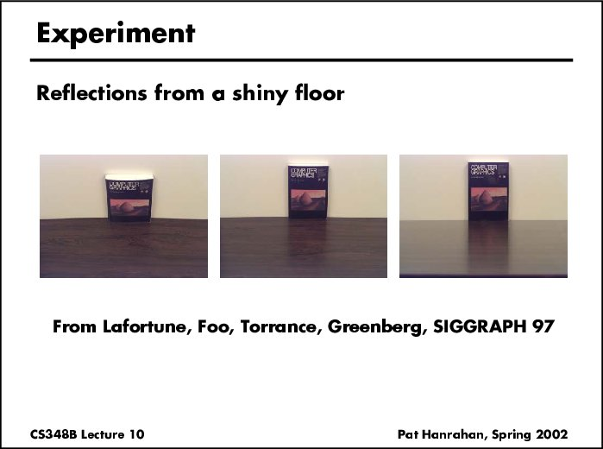

Slide 79
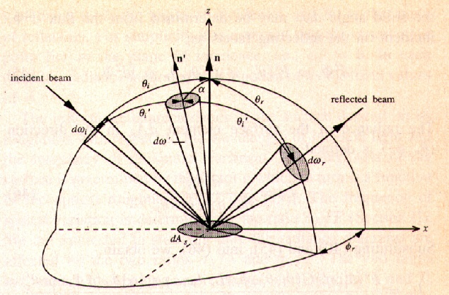
Coordinate System needed to derive T-S model

Slide 80
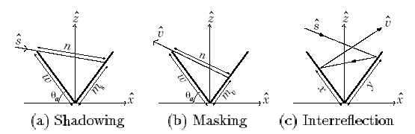

Geometric Attenuation Factor
No interreflections taken into account in above function.
Derivation found in 1967 JOSA paper (read if interested).

Slide 81

Geometric Attenuation Factor

Slide 82


Torrance Sparrow Model - Final Expression
Does the expression blow-up at grazing viewing angles?
At grazing angles F is maximum, denominator is close to zero.
Specular surfaces appear very bright at grazing angles.
At the same time, due to shadowing, the total brightness does
not explode (G term at grazing angles is close to zero).

Slide 83



Reflections on water surfaces - Glittering
Possible Midterm Assignment:
Can the glittering be modeled by Torrance-Sparrow model?
Explain the shape of the glittering as a function of viewing angle?

Slide 84

Components of Surface Reflection – Moving Light Source

Slide 85

Components of Surface Reflection – Moving Camera

Slide 86

Split off-specular Reflections in Woven Surfaces

Slide 87
Diffuse Reflection and Lambertian BRDF - Recap
source intensity I
incident
direction
normal
viewing
direction
surface
element
Surface appears equally bright from ALL directions!
(independent of )
albedo
Lambertian BRDF is simply a constant :
Surface Radiance :
source intensity
Commonly used in Vision and Graphics!

Slide 88

Diffuse Reflection and Lambertian BRDF - Recap
Radiance decreases with increase in angle between surface normal and source

Slide 89

Rendered Sphere with Lambertian BRDF
Edges are dark (N.S = 0) when lit head-on
See shading effects clearly.

Slide 90




Why does the Full Moon have a flat appearance?
The moon appears matte (or diffuse)
But still, edges of the moon look bright
(not close to zero) when illuminated by
earth’s radiance.

Slide 91




Why does the Full Moon have a flat appearance?
Lambertian Spheres and Moon Photos illuminated similarly

Slide 92

Surface Roughness Causes Flat Appearance
Actual Vase
Lambertian Vase

Slide 93
Surface Roughness Causes Flat Appearance
Increasing surface roughness
Lambertian model
Valid for only SMOOTH MATTE surfaces.
Bad for ROUGH MATTE surfaces.

Slide 94
Oren-Nayar Model – Main Points
Physically Based Model for Diffuse Reflection.
Based on Geometric Optics.
Explains view dependent appearance in Matte Surfaces
Take into account partial interreflections.
Roughness represented like in Torrance-Sparrow Model
Lambertian model is simply an extreme case with
roughness equal to zero.

Slide 95
Modeling Rough Surfaces - Microfacets
Roughness simulated by Symmetric V-groves at Microscopic level.
Distribution on the slopes of the V-grove faces are modeled.
Each microfacet assumed to behave like a perfect lambertian surface.

Slide 96

View Dependence of Matte Surfaces - Key Observation
Overall brightness increases as the angle between the source and viewing direction decreases. WHY?
Pixels have finite areas. As the viewing direction changes, different mixes between dark and bright are added up to give pixel brightness.

Slide 97
Torrance-Sparrow BRDF – Different Factors (RECAP)
Fresnel term:
allows for wavelength dependency
Geometric Attenuation:
reduces the output based on the amount of shadowing or masking that occurs.
Distribution:
distribution function determines what percentage of microfacets are oriented to reflect in the viewer direction.
How much of the macroscopic surface is visible to the light source
How much of the macroscopic surface is visible to the viewer

Slide 98
Slope Distribution Model
Model the distribution of slopes as Gaussian.
Mean is Zero, Variance represents ROUGHNESS.

Slide 99
Geometric Attenuation Factor
No interreflections taken into account in above function.
Derivation found in 1967 JOSA paper (read if interested).

Slide 100
Torrance-Sparrow BRDF – Different Factors (RECAP)
Fresnel term:
allows for wavelength dependency
Geometric Attenuation:
reduces the output based on the amount of shadowing or masking that occurs.
Distribution:
distribution function determines what percentage of microfacets are oriented to reflect in the viewer direction.
How much of the macroscopic surface is visible to the light source
How much of the macroscopic surface is visible to the viewer

Slide 101
Oren-Nayar Model – Different Factors
Fresnel term:
allows for wavelength dependency
Geometric Attenuation:
reduces the output based on the amount of shadowing or masking that occurs.
Distribution:
distribution function determines what percentage of microfacets are oriented to reflect in the viewer direction.
How much of the macroscopic surface is visible to the light source
How much of the macroscopic surface is visible to the viewer

Slide 102
Oren-Nayar Model – Different Factors
Fresnel term:
allows for wavelength dependency
Geometric Attenuation:
reduces the output based on the amount of shadowing or masking that occurs.
Distribution:
distribution function determines what fraction of the surface area do the facets of the same orientation cover?
How much of the macroscopic surface is visible to the light source
How much of the macroscopic surface is visible to the viewer

Slide 103
Oren-Nayar Model – Different Factors (contd.)
Take into account two light bounces (reflections).
Hard to solve analytically, so they find a functional approximation.

Slide 104




Oren-Nayar Model – Final Expression
Lambertian model is simply an extreme case with roughness equal to zero.

Slide 105




Comparison to Ground Truth
Real Objects
Renderings

Slide 106
Summary of Surfaces and BRDFs
Smooth
Rough
Mirror BRDF
Torrance-Sparrow BRDF
Specular
Delta Function
Speck of reflection
Broader Highlights
Off-specular lobe
Lambertian BRDF
Oren-Nayar BRDF
Diffuse
No view dependence
Models view dependence
Many surfaces may be rough and show
both diffuse and surface reflection.

Slide 107
Spherical Coordinates
Cartesian coordinates (v_{x},v_{y},v_{z})
Spherical coordinates (θ, φ)
z
1.0
v
θ
y
φ
x

Slide 108

Gonioreflectometers
Can add fourth degree of freedom to measure anisotropic BRDFs

Slide 109


lightstage

