Slide 1
Computer Graphics
Geometry Objects and Transformation
Notes:
2016

Slide 2
Outline
Geometry
Representation
Transformations
OpenGL Transformations

Slide 3
Geometry

Slide 4
Objectives
Introduce the elements of geometry
  Scalars
  Vectors
  Points
Develop mathematical operations among them in a coordinate-free manner
Define basic primitives
  Line segments
  Polygons

Slide 5
Basic Elements
Geometry is the study of the relationships among objects in an n-dimensional space
  In computer graphics, we are interested in objects that exist in three dimensions
Want a minimum set of primitives from which we can build more sophisticated objects
We will need three basic elements
  Scalars
  Vectors
  Points

Slide 6
Coordinate-Free Geometry
When we learned simple geometry, most of us started with a Cartesian approach
  Points were at locations in space p=(x,y,z)
  We derived results by algebraic manipulations involving these coordinates
This approach was nonphysical
  Physically, points exist regardless of the location of an arbitrary coordinate system
  Most geometric results are independent of the coordinate system
  Example Euclidean geometry: two triangles are identical if two corresponding sides and the angle between them are identical

Slide 7
Scalars
Need three basic elements in geometry
  Scalars, Vectors, Points
Scalars can be defined as members of sets which can be combined by two operations (addition and multiplication) obeying some fundamental axioms (associativity, commutivity, inverses)
Examples include the real and complex number systems under the ordinary rules with which we are familiar
Scalars alone have no geometric properties

Slide 8
Vectors
Physical definition: a vector is a quantity with two attributes
  Direction
  Magnitude
Examples include
  Force
  Velocity
  Directed line segments
    Most important example for graphics
    Can map to other types
v

Slide 9
Vector Operations
Every vector has an inverse
  Same magnitude but points in opposite direction
Every vector can be multiplied by a scalar
There is a zero vector
  Zero magnitude, undefined orientation
The sum of any two vectors is a vector
  Use head-to-tail axiom
v
w
v
-v
αv
u

Slide 10
Linear Vector Spaces
Mathematical system for manipulating vectors
Operations
  Scalar-vector multiplication u = α v
  Vector-vector addition: w = u + v
Expressions such as
  v=u+2w-3r
Make sense in a vector space

Slide 11
Addition of Vectors
Parallelogram rule
+
=
+y
+x

Slide 12
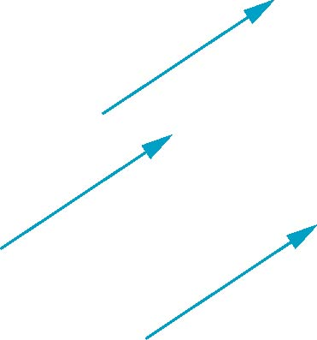
Vectors Lack Position
These vectors are identical
  Same length and magnitude
Vectors spaces insufficient for geometry
  Need points

Slide 13
Vector Operations
Vector
  an n-tuple of real numbers (scalars)
  two operations: addition & multiplication
Commutative Laws
  a+ b= b+ a
  a•b= b•a
Identities
  a+ 0 = a
  a•1 = a
Associative Laws
  (a+ b) + c= a+ (b+ c)
  (a•b) •c= a•(b•c)
Distributive Laws
  a•(b+ c) = a•b+ a•c
  (a+ b) •c= a•c+ b•c
Inverse
  a+ b= 0 -> b= -a

Slide 14
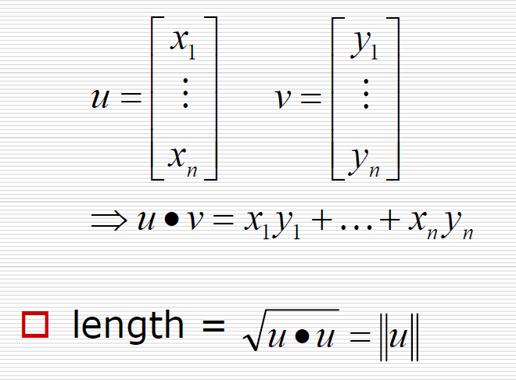
The Vector Dot Product
Euclidean norm
Or L2 norm

Slide 15
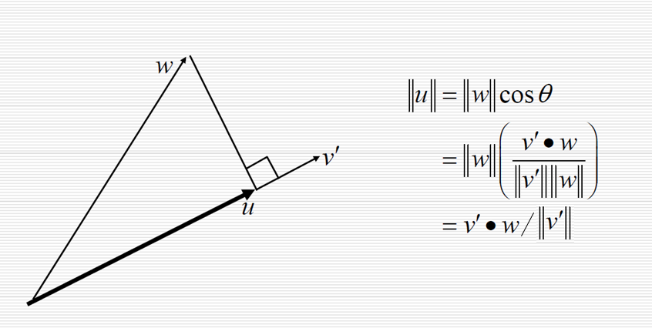
Projection

Slide 16
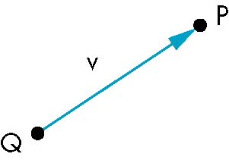
Points
Location in space
Operations allowed between points and vectors
  Point-point subtraction yields a vector
  Equivalent to point-vector addition
v=P-Q
P=v+Q

Slide 17
Affine Spaces
Point + a vector space
Operations
  Vector-vector addition
  Scalar-vector multiplication
  Point-vector addition
  Scalar-scalar operations
For any point define
  1 • P = P
  0 • P = 0 (zero vector)

Slide 18
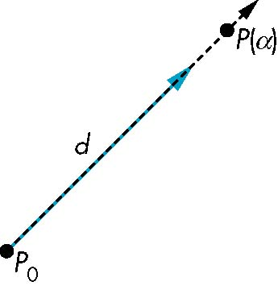
Lines
Consider all points of the form
  P(α)=P₀ + α d
  Set of all points that pass through P₀ in the direction of the vector d

Slide 19
Parametric Form
This form is known as the parametric form of the line
  More robust and general than other forms
  Extends to curves and surfaces
Two-dimensional forms
  Explicit: y = mx +h
  Implicit: ax + by +c =0
  Parametric:
  x(α) = αx₀ + (1-α)x₁
  y(α) = αy₀ + (1-α)y₁

Slide 20
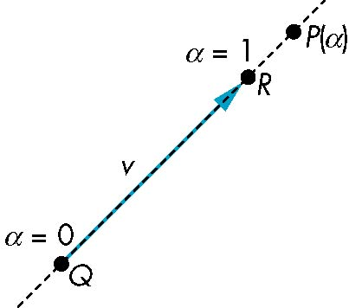
Rays and Line Segments
If α >= 0, then P(α) is the ray leaving P₀ in the direction d
If we use two points to define v, then
P( α) = Q + α (R-Q)=Q+αv
=αR + (1-α)Q
For 0<=α<=1 we get all the
points on the line segment
joining R and Q

Slide 21
Convexity
An object is convex iff for any two points in the object, all points on the line segment between these points are also in the object.
P
P
Q
Q
not convex
convex

Slide 22
Affine Sums
Consider the “sum”
P=α₁P₁+α₂P₂+…..+α_{n}P_{n}
Can show by induction that this sum makes sense iff
α₁+α₂+…..α_{n}=1
in which case we have the affine sum of the points P₁,P₂,…..P_{n}
If, in addition, α_{i}>=0, we have the convex hull of P₁,P₂,…..P_{n}

Slide 23
Convex Hull
Smallest convex object containing P₁,P₂,…..P_{n}
Formed by “shrink wrapping” points

Slide 24
Curves and Surfaces
Curves are one parameter entities of the form P(α) where the function is nonlinear
Surfaces are formed from two-parameter functions P(α, β)
  Linear functions give planes and polygons
P(α)
P(α, β)

Slide 25
Planes
A plane can be defined by a point and two vectors or by three points
P
v
Q
R
u
R
P(α,β)=R+αu+βv
P(α,β)=R+α(Q-R)+β(P-R)
Notes:
Planes: alpha and beta are arbitrary scalar

Slide 26
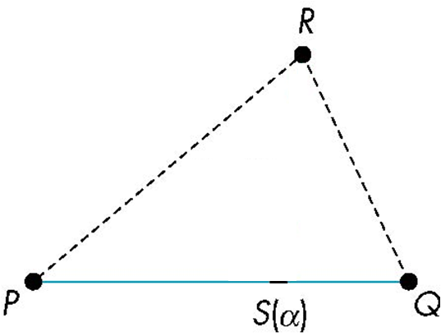
Triangles
convex sum of P and Q
for 0<=α,β<=1, we get all points in triangle

Slide 27
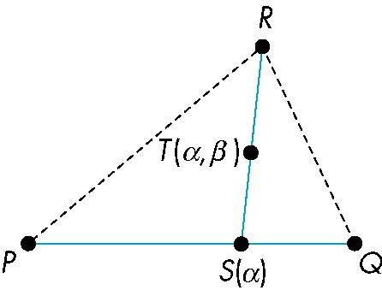
Triangles
convex sum of S(α) and R
convex sum of P and Q
for 0<=α,β<=1, we get all points in triangle

Slide 28
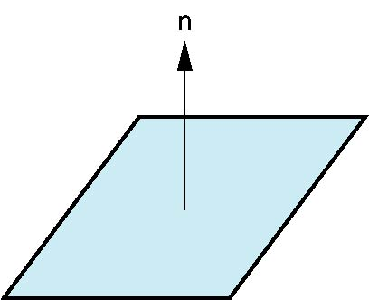
Normals
Every plane has a vector n normal (perpendicular, orthogonal) to it
From point-two vector form P(α,β)=R+αu+βv,
we know we can use the cross product to find
n = u × v and
the equivalent form
(P(α, β)-P) ⋅ n=0
v
u
P

Slide 29
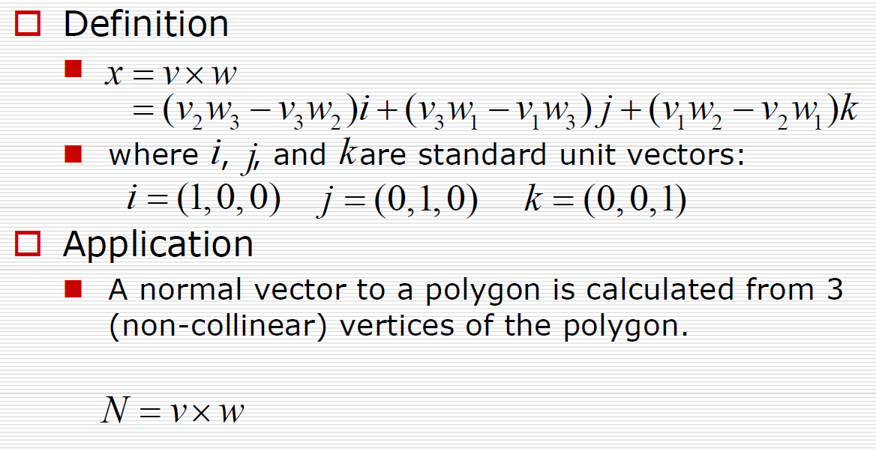
Cross Product of Vectors
N
w
v

Slide 30
Representation

Slide 31
Objectives
Introduce concepts such as dimension and basis
Introduce coordinate systems for representing vectors spaces and frames for representing affine spaces
Discuss change of frames and bases
Introduce homogeneous coordinates

Slide 32
Linear Independence
A set of vectors v₁, v₂, …, v_{n} is linearly independent if
α₁v₁+α₂v₂+.. α_{n}v_{n}=0 iff α₁=α₂=…=0
If a set of vectors is linearly independent, we cannot represent one in terms of the others
If a set of vectors is linearly dependent, as least one can be written in terms of the others

Slide 33
Dimension
In a vector space, the maximum number of linearly independent vectors is fixed and is called the dimension of the space
In an n-dimensional space, any set of n linearly independent vectors form a basis for the space
Given a basis v₁, v₂,…., v_{n}, any vector v can be written as
v=α₁v₁+ α₂v₂ +….+α_{n}v_{n}
where the {α_{i}} are unique

Slide 34
Representation
Until now we have been able to work with geometric entities without using any frame of reference, such as a coordinate system
Need a frame of reference to relate points and objects to our physical world.
  For example, where is a point? Can’t answer without a reference system
  World coordinates
  Camera coordinates

Slide 35
Coordinate Systems
Consider a basis v₁, v₂,…., v_{n}
A vector is written v=α₁v₁+ α₂v₂ +….+α_{n}v_{n}
The list of scalars {α₁, α₂, …. α_{n}}is the representation of v with respect to the given basis
We can write the representation as a row or column array of scalars
a=[α₁ α₂ …. α_{n}]^{T}=

Slide 36
Example
v=2v₁+3v₂-4v₃
a=[2 3 –4]^{T}
Note that this representation is with respect to a particular basis
For example, in OpenGL we start by representing vectors using the object basis but later the system needs a representation in terms of the camera or eye basis

Slide 37
Coordinate Systems
Which is correct?
Both are because vectors have no fixed location
v
v

Slide 38
Frames
A coordinate system is insufficient to represent points
If we work in an affine space we can add a single point, the origin, to the basis vectors to form a frame
v₂
v₁
P₀
v₃
Notes:
A frame of reference
Coordinate frame

Slide 39
Representation in a Frame
Frame determined by (P₀, v₁, v₂, v₃)
Within this frame,
  Every vector can be written as
v = α₁v₁+ α₂v₂ +….+α_{n}v_{n}
  Every point can be written as
P = P₀ + β₁v₁+ β₂v₂ +….+β_{n}v_{n}

Slide 40
Confusing Points and Vectors
Consider the point and the vector
P = P₀ + β₁v₁+ β₂v₂ +….+β_{n}v_{n}
v = α₁v₁+ α₂v₂ +….+α_{n}v_{n}
They appear to have the similar representations
p=[β₁ β₂ β₃] ^{T} v=[α₁ α₂ α₃] ^{T}
which confuses the point with the vector
A vector has no position
v
p
v
Vector can be placed anywhere
point: fixed

Slide 41
A Single Representation
If we define 0•P = 0 and 1•P =P then we can write
V =α₁v₁+ α₂v₂ +α₃v₃ = [α₁ α₂ α₃ 0 ] [v₁ v₂ v₃ P₀] ^{T}
P = P₀ + β₁v₁+ β₂v₂ +β₃v₃= [β₁ β₂ β₃ 1 ] [v₁ v₂ v₃ P₀] ^{T}
Thus we obtain the four-dimensional homogeneous coordinate representation
v = [α₁ α₂ α₃ 0 ] ^{T}
p = [β₁ β₂ β₃ 1 ] ^{T}

Slide 42
Homogeneous Coordinates
The homogeneous coordinates form for a three dimensional point [x y z] is given as
p =[x’ y’ z’ 1] ^{T} =[wx wy wz w] ^{T}
We return to a three dimensional point (for w≠0) by
x←x’/w
y←y’/w
z←z’/w
If w=0, the representation is that of a vector
Note that homogeneous coordinates replaces points in three dimensions by lines through the origin in four dimensions
For w=1, the representation of a point is [x y z 1]

Slide 43
Homogeneous Coordinates and Computer Graphics
Homogeneous coordinates are key to all computer graphics systems
  All standard transformations (rotation, translation, scaling) can be implemented with matrix multiplications using 4 x 4 matrices
  Hardware pipeline works with 4 dimensional representations
  For orthographic viewing, we can maintain w=0 for vectors and w=1 for points
  For perspective we need a perspective division

Slide 44
Change of Coordinate Systems
Consider two representations of a the same vector with respect to two different bases. The representations are
a=[α₁ α₂ α₃ ]
b=[β₁ β₂ β₃]
where
v=α₁v₁+ α₂v₂ +α₃v₃ = [α₁ α₂ α₃] [v₁ v₂ v₃] ^{T}
=β₁u₁+ β₂u₂ +β₃u₃ = [β₁ β₂ β₃] [u₁ u₂ u₃] ^{T}

Slide 45
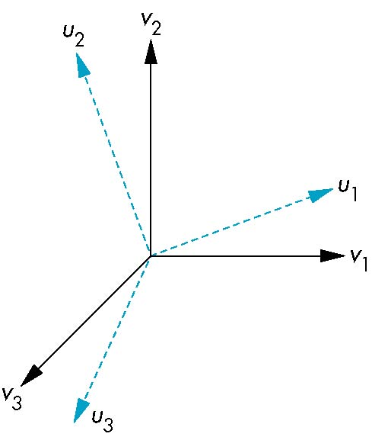
Representing second basis in terms of first
Each of the basis vectors, u1,u2, u3, are vectors that can be represented in terms of the first basis
v
u₁ = γ₁₁v₁+γ₁₂v₂+γ₁₃v₃
u₂ = γ₂₁v₁+γ₂₂v₂+γ₂₃v₃
u₃ = γ₃₁v₁+γ₃₂v₂+γ₃₃v₃

Slide 46
Matrix Form
The coefficients define a 3 x 3 matrix
and the bases can be related by
see text for numerical examples
M =
a=M^{T}b

Slide 47
Change of Frames
We can apply a similar process in homogeneous coordinates to the representations of both points and vectors
Any point or vector can be represented in either frame
We can represent Q₀, u₁, u₂, u₃ in terms of P₀, v₁, v₂, v₃
v₂
u₂
u₁
Consider two frames:
(P₀, v₁, v₂, v₃)
(Q₀, u₁, u₂, u₃)
Q₀
P₀
v₁
v₃
u₃

Slide 48
Representing One Frame in Terms of the Other
Extending what we did with change of bases
u₁ = γ₁₁v₁+γ₁₂v₂+γ₁₃v₃
u₂ = γ₂₁v₁+γ₂₂v₂+γ₂₃v₃
u₃ = γ₃₁v₁+γ₃₂v₂+γ₃₃v₃
Q₀ = γ₄₁v₁+γ₄₂v₂+γ₄₃v₃ +γ₄₄P₀
defining a 4 x 4 matrix
M =

Slide 49
Working with Representations
Within the two frames any point or vector has a representation of the same form
a=[α₁ α₂ α₃ α₄ ] in the first frame
b=[β₁ β₂ β₃ β₄ ] in the second frame
where α₄ = β₄ = 1 for points and α₄ = β₄ = 0 for vectors and
The matrix M is 4 x 4 and specifies an affine transformation in homogeneous coordinates
a=M^{T}b

Slide 50
Affine Transformations
Every linear transformation is equivalent to a change in frames
Every affine transformation preserves lines
However, an affine transformation has only 12 degrees of freedom because 4 of the elements in the matrix are fixed and are a subset of all possible 4 x 4 linear transformations

Slide 51
The World and Camera Frames
When we work with representations, we work with n-tuples or arrays of scalars
Changes in frame are then defined by 4 x 4 matrices
In OpenGL, the base frame that we start with is the world frame
Eventually we represent entities in the camera frame by changing the world representation using the model-view matrix
Initially these frames are the same (M=I)

Slide 52
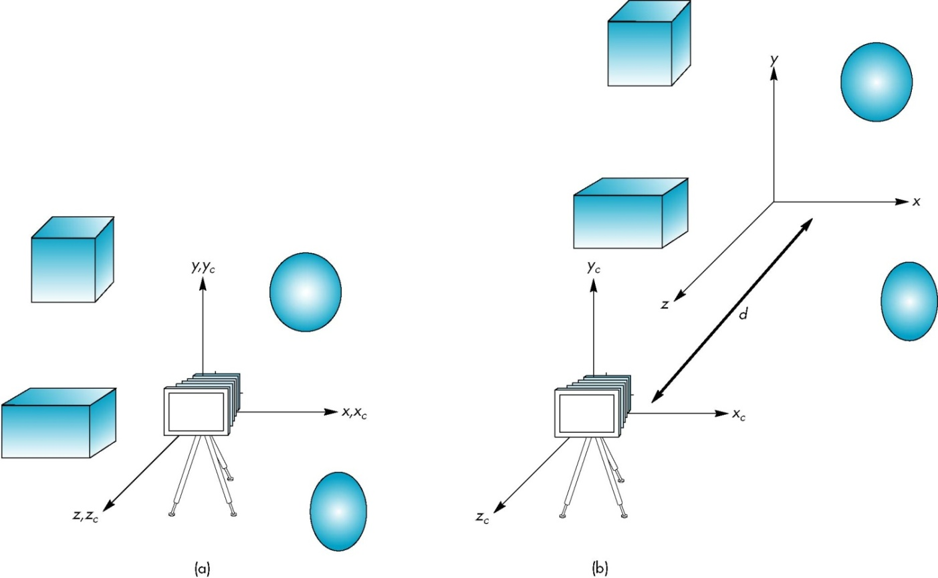
Moving the Camera
If objects are on both sides of z=0, we must move camera frame

Slide 53
Transformation

Slide 54
Objectives
Introduce standard transformations
  Rotation
  Translation
  Scaling
  Shear
Derive homogeneous coordinate transformation matrices
Learn to build arbitrary transformation matrices from simple transformations

Slide 55
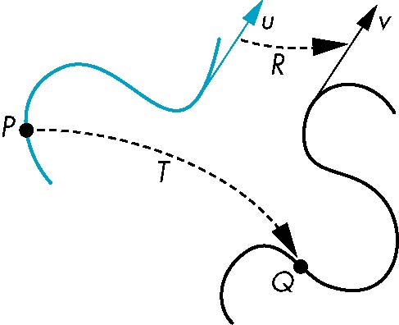
General Transformations
A transformation maps points to other points and/or vectors to other vectors
v=T(u)
Q=T(P)

Slide 56
Affine Transformations
Line preserving
Characteristic of many physically important transformations
  Rigid body transformations: rotation, translation
  Scaling, shear
Importance in graphics is that we need only transform endpoints of line segments and let implementation draw line segment between the transformed endpoints

Slide 57
Pipeline Implementation
T
(from application program)
frame
buffer
u
transformation
T(u)
rasterizer
v
T(v)
T(v)
T(v)
v
T(u)
u
T(u)
vertices
vertices
pixels

Slide 58
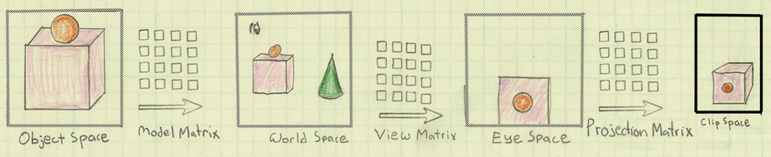
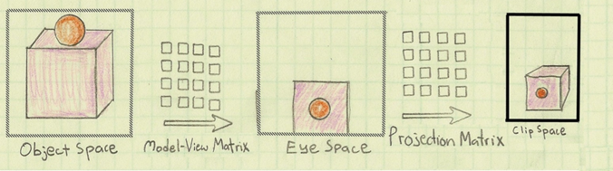
The Life of a vertex
Merge model matrix and view matrix
Image by Philp Rideout
Notes:
這兩頁的圖片生動地呈現各種不同轉換發生的順序和對應的畫面變化
上下兩列可達到同樣的目的，主要是呈現model和view兩個矩陣轉換，兩者互為相對移動的關係，也就是移動相機等同於反方相移動所有的物體，
是故會整合成modelview space，減少矩陣的變數

Slide 59
Notation
We will be working with both coordinate-free representations of transformations and representations within a particular frame
P, Q, R: points in an affine space
u, v, w: vectors in an affine space
α, β, γ: scalars
p, q, r: representations of points
-array of 4 scalars in homogeneous coordinates
u, v, w: representations of vectors
-array of 4 scalars in homogeneous coordinates

Slide 60
Translation
Move (translate, displace) a point to a new location
Displacement determined by a vector d
  Three degrees of freedom
  P’= P+d
P’
d
P

Slide 61
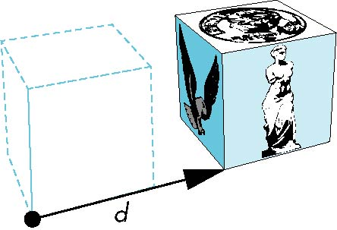

How many ways?
Although we can move a point to a new location in infinite ways, when we move many points there is usually only one way
object
translation: every point displaced
by same vector

Slide 62
Translation Using Representations
Using the homogeneous coordinate representation in some frame
p = [ x y z 1]^{T}
p’= [x’ y’ z’ 1]^{T}
d = [dx dy dz 0]^{T}
Hence p’ = p + d or
x’= x+d_{x}
y’= y+d_{y}
z’= z+d_{z}
note that this expression is in
four dimensions and expresses
point = vector + point

Slide 63
Translation Matrix
We can also express translation using a
4 x 4 matrix T in homogeneous coordinates
p’=Tp where
T = T(d_{x}, d_{y}, d_{z}) =
This form is better for implementation because all affine transformations can be expressed this way and multiple transformations can be concatenated together

Slide 64
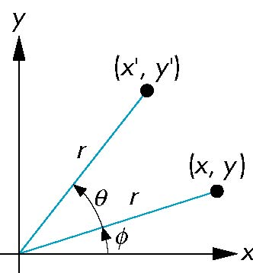
Rotation (2D)
Consider rotation about the origin by θ degrees
  radius stays the same, angle increases by θ
x’ = r cos (φ + θ)
y' = r sin (φ + θ)
x’= x cos θ –y sin θ
y’ = x sin θ + y cos θ
x = r cos φ
y = r sin φ

Slide 65
Rotation about the z axis
Rotation about z axis in three dimensions leaves all points with the same z
  Equivalent to rotation in two dimensions in planes of constant z
  or in homogeneous coordinates
  p’=R_{z}(θ)p
x’=x cos θ –y sin θ
y’ = x sin θ + y cos θ
z’ =z

Slide 66
Rotation Matrix
R = R_{z}(θ) =

Slide 67
Rotation about x and y axes
Same argument as for rotation about z axis
  For rotation about x axis, x is unchanged
  For rotation about y axis, y is unchanged
R = R_{x}(θ) =
R = R_{y}(θ) =

Slide 68
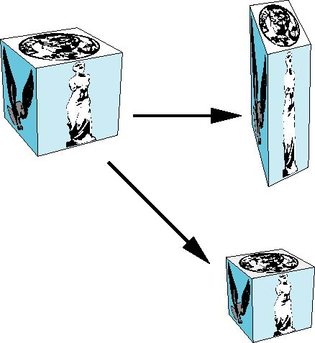
Scaling
Expand or contract along each axis (fixed point of origin)
x’=s_{x}x
y’=s_{y}y
z’=s_{z}z
p’=Sp
S = S(s_{x}, s_{y}, s_{z}) =

Slide 69
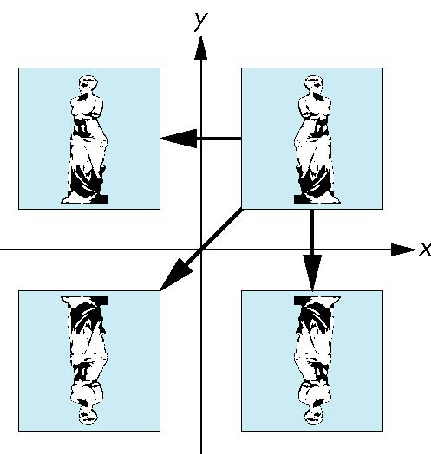
Reflection
corresponds to negative scale factors
s_{x} = -1 s_{y} = 1
original
s_{x} = -1 s_{y} = -1
s_{x} = 1 s_{y} = -1

Slide 70
Inverses
Although we could compute inverse matrices by general formulas, we can use simple geometric observations
  Translation: T⁻¹(d_{x}, d_{y}, d_{z}) = T(-d_{x}, -d_{y}, -d_{z})
  Rotation: R ⁻¹(θ) = R(-θ)
    Holds for any rotation matrix
    Note that since cos(-θ) = cos(θ) and sin(-θ)=-sin(θ)
    R ⁻¹(θ) = R ^{T}(θ)
  Scaling: S⁻¹(s_{x}, s_{y}, s_{z}) = S(1/s_{x}, 1/s_{y}, 1/s_{z})

Slide 71
Concatenation
We can form arbitrary affine transformation matrices by multiplying together rotation, translation, and scaling matrices
Because the same transformation is applied to many vertices, the cost of forming a matrix M=ABCD is not significant compared to the cost of computing Mp for many vertices p
The difficult part is how to form a desired transformation from the specifications in the application

Slide 72
Order of Transformations
Note that matrix on the right is the first applied
Mathematically, the following are equivalent
p’ = ABCp = A(B(Cp))
Note many references use column matrices to represent points. In terms of column matrices
p^{’T} = p^{T}C^{T}B^{T}A^{T}

Slide 73
General Rotation About the Origin
A rotation by θ about an arbitrary axis
can be decomposed into the concatenation
of rotations about the x, y, and z axes
R(θ) = R_{z}(θ_{z}) R_{y}(θ_{y}) R_{x}(θ_{x})
y
v
θ_{x} θ_{y} θ_{z} are called the Euler angles
θ
Note that rotations do not commute
We can use rotations in another order but
with different angles
x
z

Slide 74
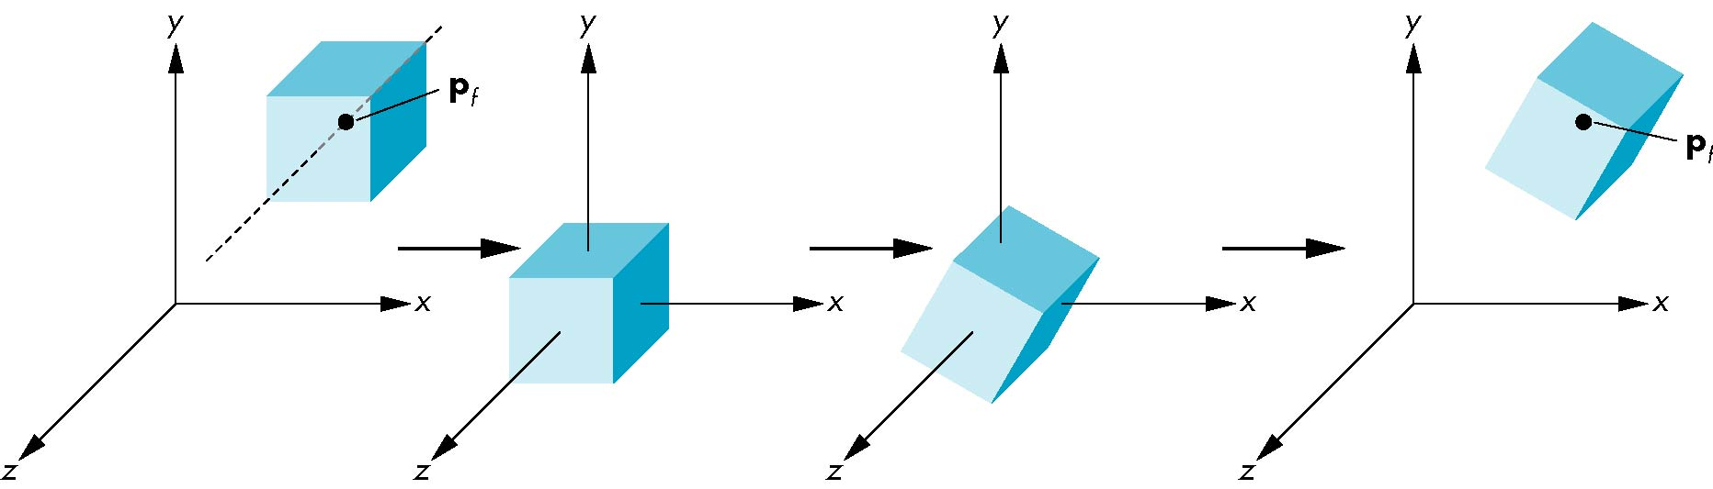
Rotation About a Fixed Point other than the Origin
Move fixed point to origin
Rotate
Move fixed point back
M = T(p_{f}) R(θ) T(-p_{f})

Slide 75
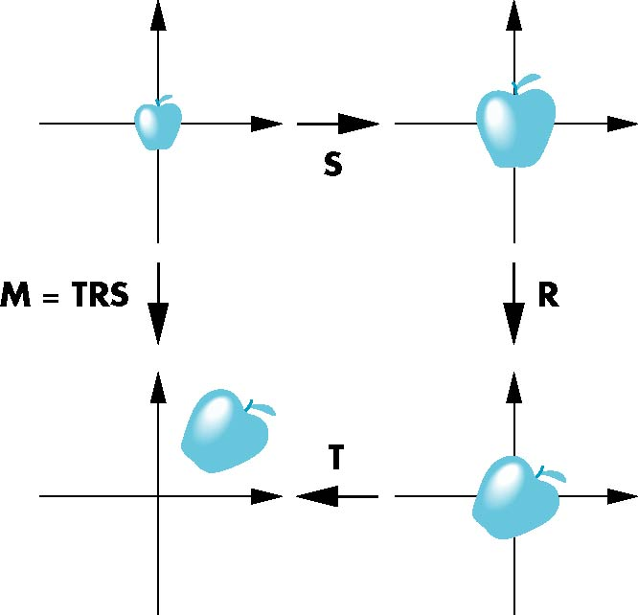
Instancing
In modeling, we often start with a simple object centered at the origin, oriented with the axis, and at a standard size
We apply an instance transformation to its vertices to
Scale
Orient
Locate

Slide 76
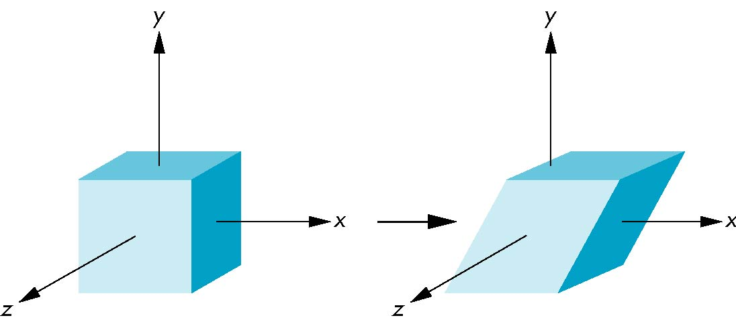
Shear
Helpful to add one more basic transformation
Equivalent to pulling faces in opposite directions

Slide 77
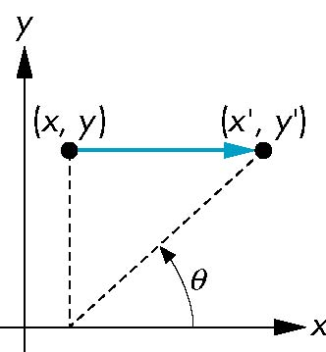
Shear Matrix
Consider simple shear along x axis
x’ = x + y cot θ
y’ = y
z’ = z
H(θ) =

Slide 78
Transformation in OpenGL

Slide 79
Objectives
Learn how to carry out transformations in OpenGL
  Rotation
  Translation
  Scaling
Introduce OpenGL matrix modes
  Model-view
  Projection

Slide 80
OpenGL Matrices
In OpenGL matrices are part of the state
Multiple types
  Model-View (GL_MODELVIEW)
  Projection (GL_PROJECTION)
  Texture (GL_TEXTURE) (ignore for now)
  Color(GL_COLOR) (ignore for now)
Single set of functions for manipulation
Select which to manipulated by
  glMatrixMode(GL_MODELVIEW);
  glMatrixMode(GL_PROJECTION);

Slide 81
Current Transformation Matrix (CTM)
Conceptually there is a 4 x 4 homogeneous coordinate matrix, the current transformation matrix (CTM) that is part of the state and is applied to all vertices that pass down the pipeline
The CTM is defined in the user program and loaded into a transformation unit
C
p
p’=Cp
vertices
CTM
vertices

Slide 82
CTM operations
The CTM can be altered either by loading a new CTM or by postmutiplication
Load an identity matrix: C ← I
Load an arbitrary matrix: C ← M
Load a translation matrix: C ← T
Load a rotation matrix: C ← R
Load a scaling matrix: C ← S
Postmultiply by an arbitrary matrix: C ← CM
Postmultiply by a translation matrix: C ← CT
Postmultiply by a rotation matrix: C ← C R
Postmultiply by a scaling matrix: C ← C S

Slide 83
Rotation about a Fixed Point
Start with identity matrix: C ← I
Move fixed point to origin: C ← CT
Rotate: C ← CR
Move fixed point back: C ← CT ⁻¹
Result: C = TR T ^{–1} which is backwards.
This result is a consequence of doing postmultiplications.
Let’s try again.

Slide 84
Reversing the Order
We want C = T ^{–1} R T
so we must do the operations in the following order
C ← I
C ← CT ⁻¹
C ← CR
C ← CT
Each operation corresponds to one function call in the program.
Note that the last operation specified is the first executed in the program

Slide 85
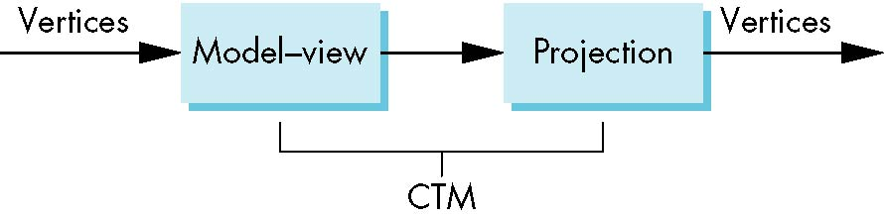
CTM in OpenGL
OpenGL has a model-view and a projection matrix in the pipeline which are concatenated together to form the CTM
Can manipulate each by first setting the correct matrix mode

Slide 86
Rotation, Translation, Scaling
Load an identity matrix:
glLoadIdentity()
Multiply on right:
glRotatef(theta, vx, vy, vz)
theta in degrees, (vx, vy, vz) define axis of rotation
glTranslatef(dx, dy, dz)
glScalef(sx, sy, sz)
Each has a float (f) and double (d) format (glScaled)

Slide 87
Example
Rotation about z axis by 30 degrees with a fixed point of (1.0, 2.0, 3.0)
Remember that last matrix specified in the program is the first applied
glMatrixMode(GL_MODELVIEW);
glLoadIdentity();
glTranslatef(1.0, 2.0, 3.0);
glRotatef(30.0, 0.0, 0.0, 1.0);
glTranslatef(-1.0, -2.0, -3.0);

Slide 88
Arbitrary Matrices
Can load and multiply by matrices defined in the application program
The matrix m is a one dimension array of 16 elements which are the components of the desired 4 x 4 matrix stored by columns
In glMultMatrixf, m multiplies the existing matrix on the right
glLoadMatrixf(m)
glMultMatrixf(m)

Slide 89
Matrix Stacks
In many situations we want to save transformation matrices for use later
  Traversing hierarchical data structures (Chapter 10)
  Avoiding state changes when executing display lists
OpenGL maintains stacks for each type of matrix
  Access present type (as set by glMatrixMode) by
glPushMatrix()
glPopMatrix()

Slide 90
Reading Back Matrices
Can also access matrices (and other parts of the state) by query functions
For matrices, we use as
glGetIntegerv
glGetFloatv
glGetBooleanv
glGetDoublev
glIsEnabled
double m[16];
glGetDoublev(GL_MODELVIEW, m);

Slide 91
Using Transformations
Example: use idle function to rotate a cube and mouse function to change direction of rotation
Start with a program that draws a cube (colorcube.c) in a standard way
  Centered at origin
  Sides aligned with axes
  Will discuss modeling in next lecture

Slide 92
main.c
int main(int argc, char **argv)
{
glutInit(&argc, argv);
glutInitDisplayMode(GLUT_DOUBLE | GLUT_RGB |
GLUT_DEPTH);
glutInitWindowSize(500, 500);
glutCreateWindow("colorcube");
glutReshapeFunc(myReshape);
glutDisplayFunc(display);
glutIdleFunc(spinCube);
glutMouseFunc(mouse);
glEnable(GL_DEPTH_TEST);
glutMainLoop();
return 0;
}

Slide 93
Idle and Mouse callbacks
void spinCube()
{
theta[axis] += 2.0;
if( theta[axis] > 360.0 ) theta[axis] -= 360.0;
glutPostRedisplay();
}
void mouse(int btn, int state, int x, int y)
{
if(btn==GLUT_LEFT_BUTTON && state == GLUT_DOWN)
axis = 0;
if(btn==GLUT_MIDDLE_BUTTON && state == GLUT_DOWN)
axis = 1;
if(btn==GLUT_RIGHT_BUTTON && state == GLUT_DOWN)
axis = 2;
}

Slide 94
Display callback
void display()
{
glClear(GL_COLOR_BUFFER_BIT | GL_DEPTH_BUFFER_BIT);
glLoadIdentity();
glRotatef(theta[0], 1.0, 0.0, 0.0);
glRotatef(theta[1], 0.0, 1.0, 0.0);
glRotatef(theta[2], 0.0, 0.0, 1.0);
colorcube();
glutSwapBuffers();
}
Note that because of fixed from of callbacks, variables
such as theta and axis must be defined as globals
Camera information is in standard reshape callback

Slide 95
Using the Model-view Matrix
In OpenGL the model-view matrix is used to
  Position the camera
    Can be done by rotations and translations but is often easier to use gluLookAt
  Build models of objects
The projection matrix is used to define the view volume and to select a camera lens

Slide 96
Model-view and Projection Matrices
Although both are manipulated by the same functions, we have to be careful because incremental changes are always made by postmultiplication
  For example, rotating model-view and projection matrices by the same matrix are not equivalent operations. Postmultiplication of the model-view matrix is equivalent to premultiplication of the projection matrix

Slide 97
Smooth Rotation
From a practical standpoint, we are often want to use transformations to move and reorient an object smoothly
  Problem: find a sequence of model-view matrices M₀,M₁,…..,M_{n} so that when they are applied successively to one or more objects we see a smooth transition
For orientating an object, we can use the fact that every rotation corresponds to part of a great circle on a sphere
  Find the axis of rotation and angle
  Virtual trackball (see text)

Slide 98
Incremental Rotation
Consider the two approaches
  For a sequence of rotation matrices R₀,R₁,…..,R_{n} , find the Euler angles for each and use R_{i}= R_{iz} R_{iy} R_{ix}
    Not very efficient
  Use the final positions to determine the axis and angle of rotation, then increment only the angle
Quaternions can be more efficient than either

Slide 99
Quaternions
Extension of imaginary numbers from two to three dimensions
Requires one real and three imaginary components i, j, k
Quaternions can express rotations on sphere smoothly and efficiently. Process:
  Model-view matrix → quaternion
  Carry out operations with quaternions
  Quaternion → Model-view matrix
q = q₀+q₁i+q₂j+q₃k

Slide 100
Interfaces
One of the major problems in interactive computer graphics is how to use two-dimensional devices such as a mouse to interface with three dimensional obejcts
Example: how to form an instance matrix?
Some alternatives
  Virtual trackball
  3D input devices such as the spaceball
  Use areas of the screen
    Distance from center controls angle, position, scale depending on mouse button depressed

Slide 101
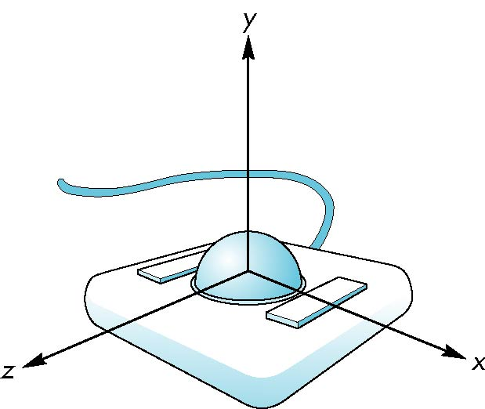
Trackball Frame
origin at center of ball

Slide 102
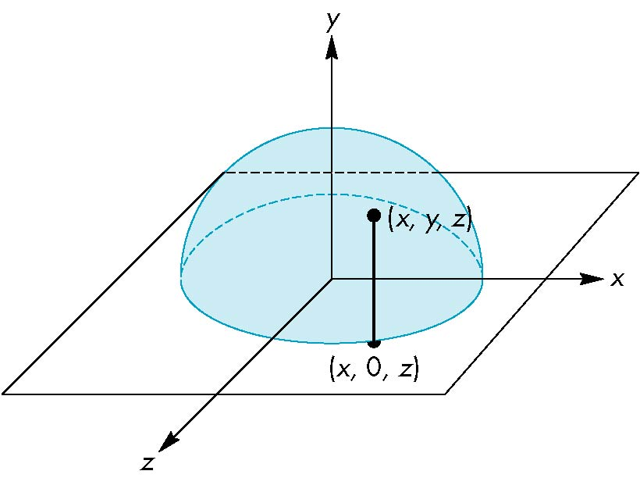
Projection of Trackball Position
We can relate position on trackball to position on a normalized mouse pad by projecting orthogonally onto pad

Slide 103
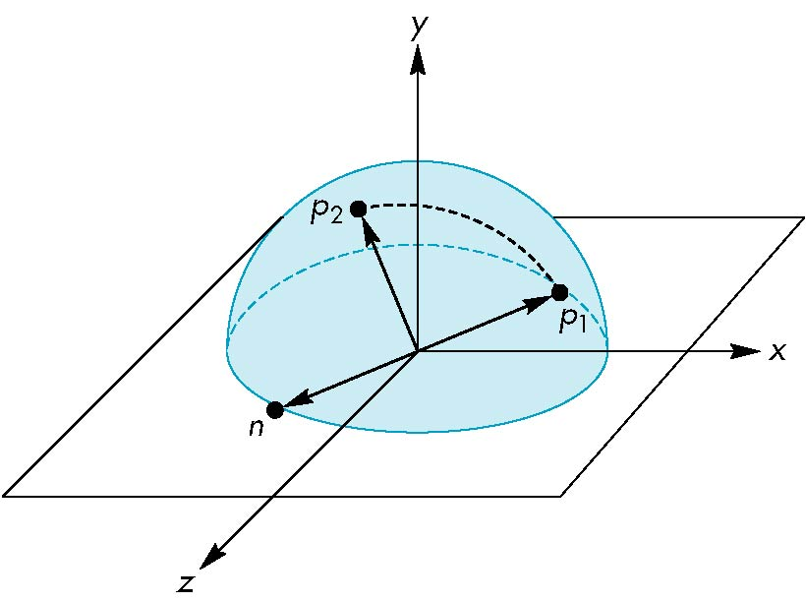
Using the cross product
The axis of rotation is given by the normal to the plane determined by the origin, p₁ , and p₂
n = p₁ × p₂

