Slide 1
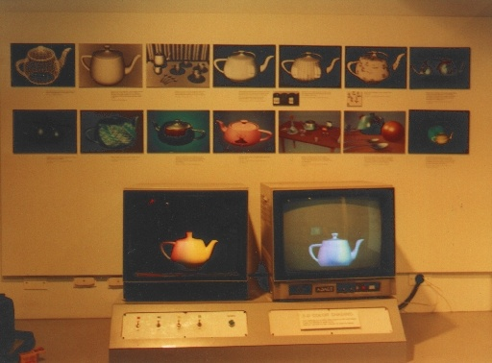
Computer Graphics 2016
Introduction
Ming-Te Chi
Department of Computer Science,
National Chengchi University
Notes:
2016

Slide 2
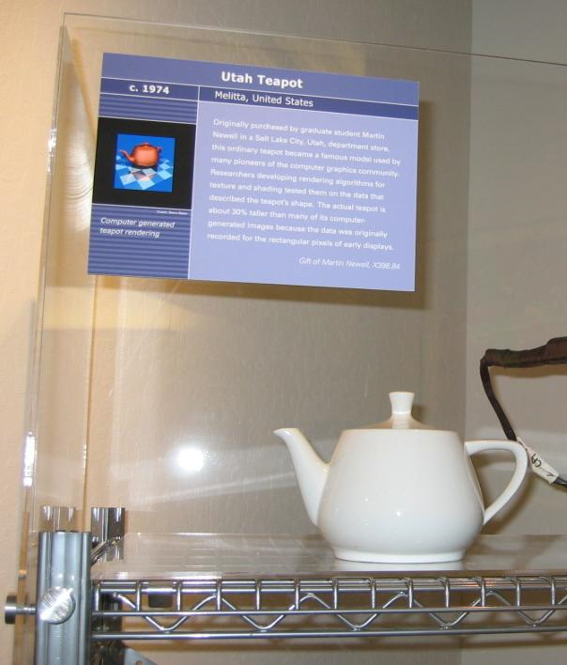
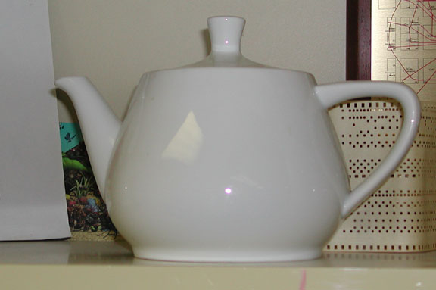
The teapot
Real teapot
Notes:
Martin Newell, The teapot model was created in 1975 by early computer graphics researcher Martin Newell, a member of the pioneering graphics program at the University of Utah.

Slide 3
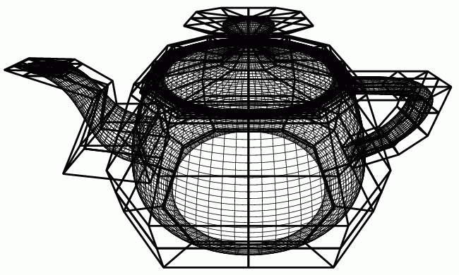
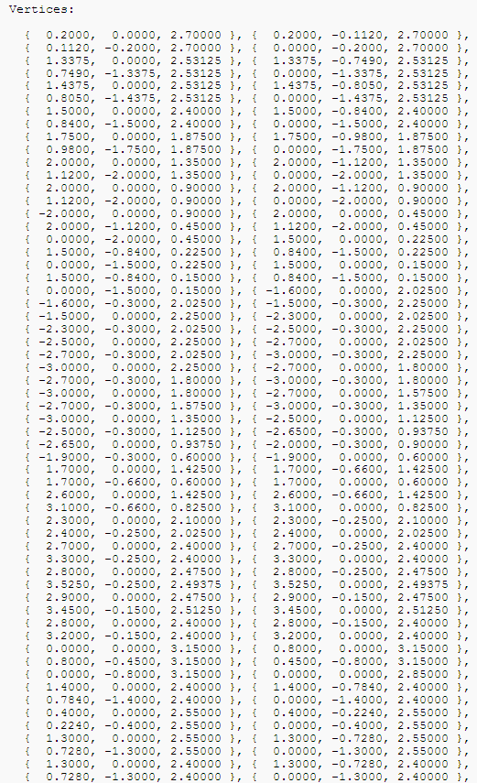
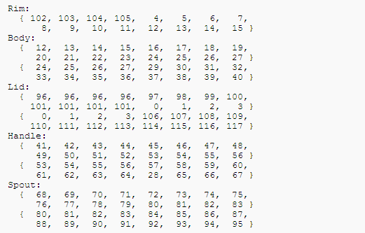
Teapot’s Data

Slide 4

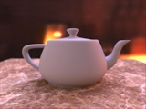
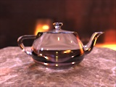

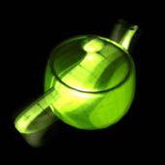
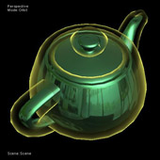
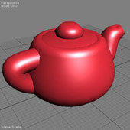
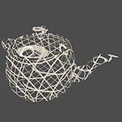
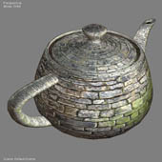
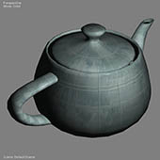
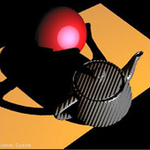
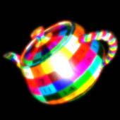
Notes:
http://graphics.stanford.edu/~henrik/images/global.html
http://developer.download.nvidia.com/shaderlibrary/webpages/shader_library.html

Slide 5
Computer Graphics

Slide 6
Computer Graphics
Computer graphics deals with all aspects of creating images with a computer
  Hardware
  Software
  Applications

Slide 7
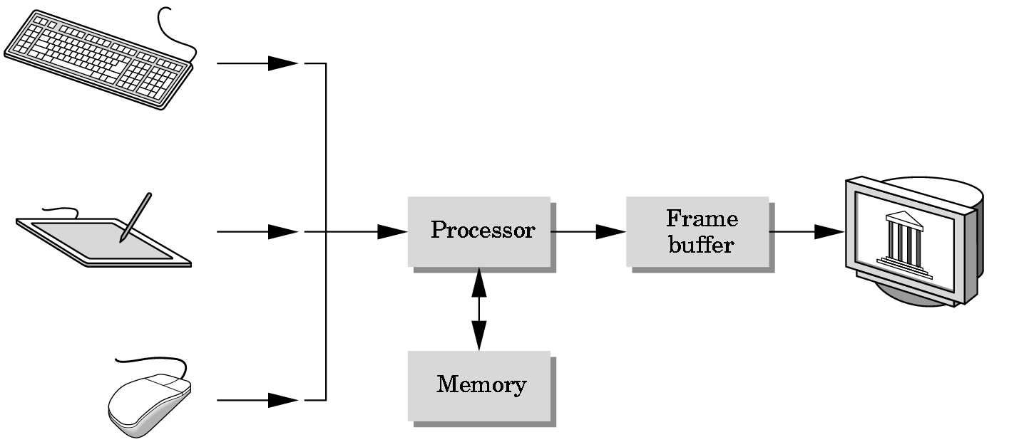
Basic Graphics System
Input devices
Image formed in FB
Output device
Notes:
In 1969, A. Michael Noll of Bell Labs implemented a scanned display with a frame buffer.

Slide 8

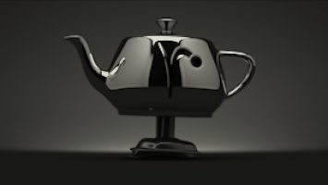
Computer Graphics Areas
User interaction
Image processing
Modeling
Virtual reality
3D scanning
Rendering
Animation
Visualization
Computational photography

Slide 9
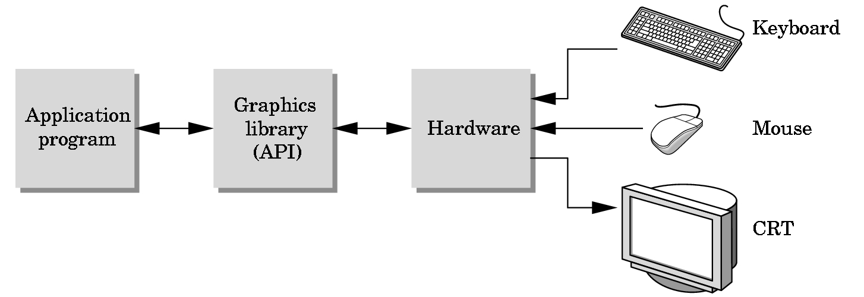
The Programmer’s Interface
Programmer sees the graphics system through an interface: the Application Programmer Interface (API)

Slide 10
Object Specification
Most APIs support a limited set of primitives including
  Points (1D objects)
  Line segments (2D objects)
  Polygons (3D objects)
  Some curves and surfaces
    Quadrics
    Parametric polynomial
All are defined through locations in space or vertices

Slide 11
Example
type of object
location of vertex
glBegin(GL_POLYGON)
glVertex3f(0.0, 0.0, 0.0);
glVertex3f(0.0, 1.0, 0.0);
glVertex3f(0.0, 0.0, 1.0);
glEnd( );
end of object definition

Slide 12
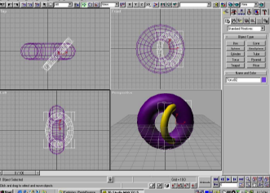
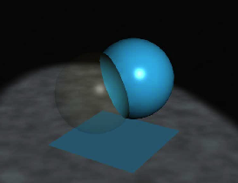
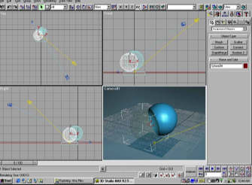
Modeling Package
Digital Content Creation

Slide 13
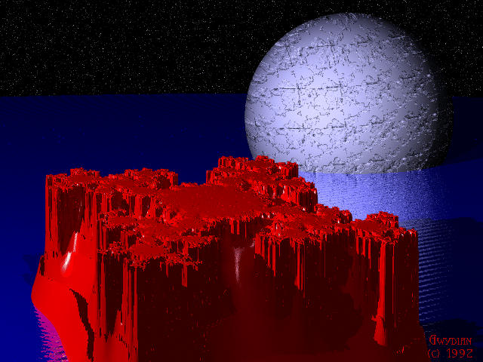
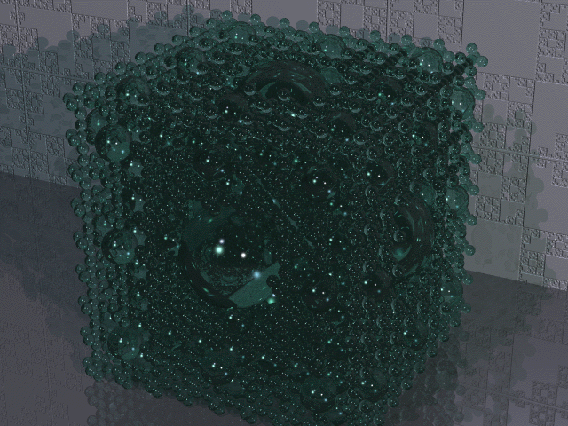
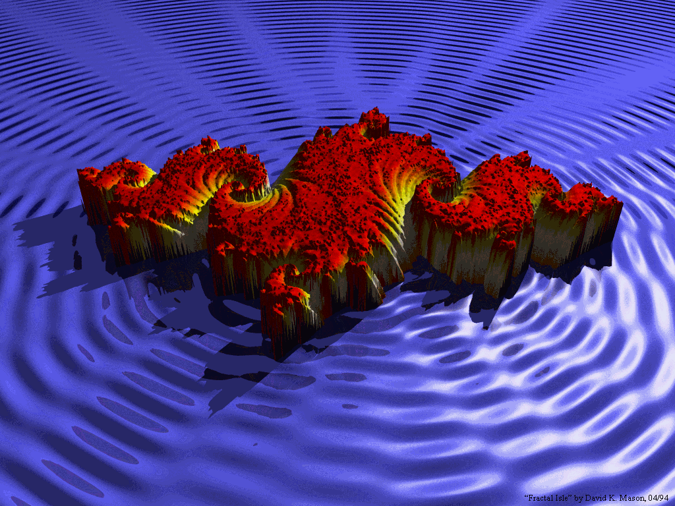
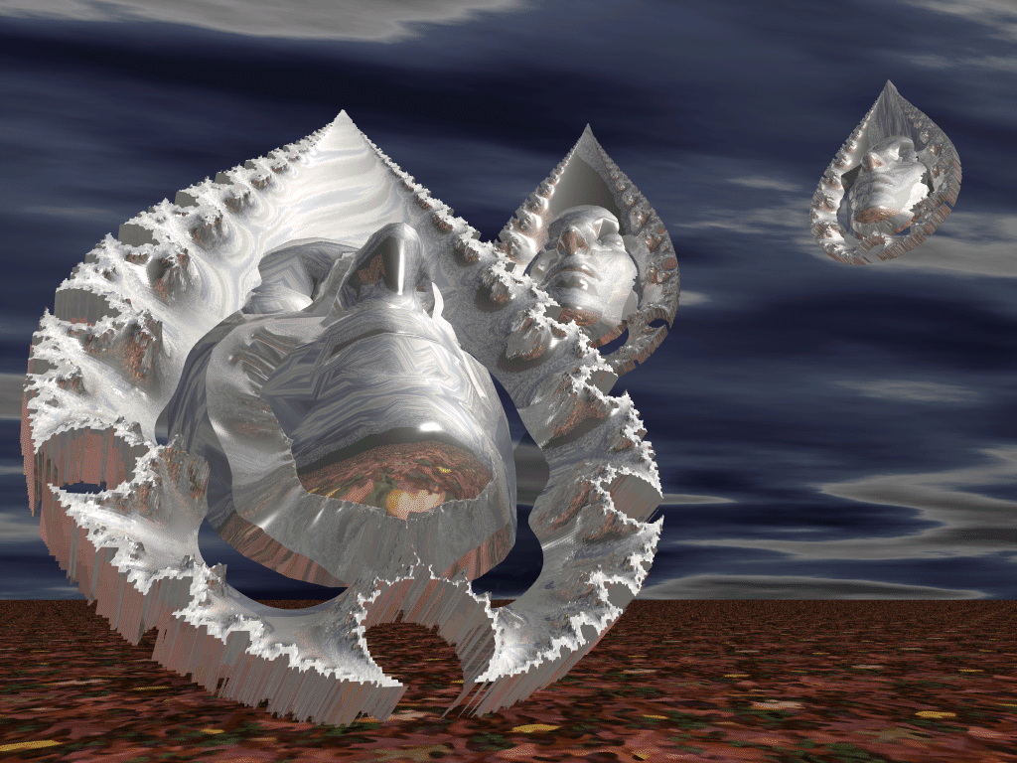
www.povray.org

Slide 14
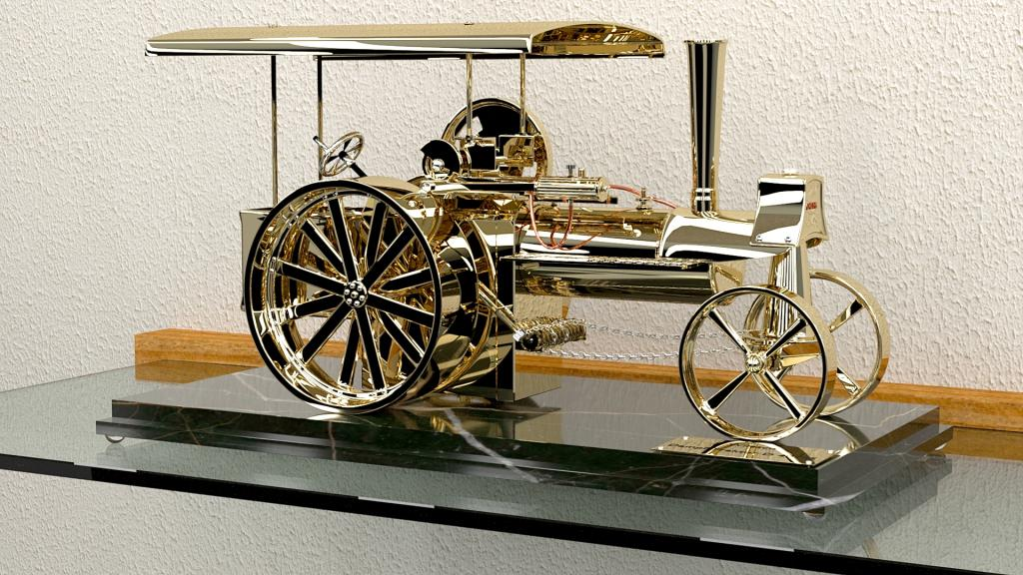
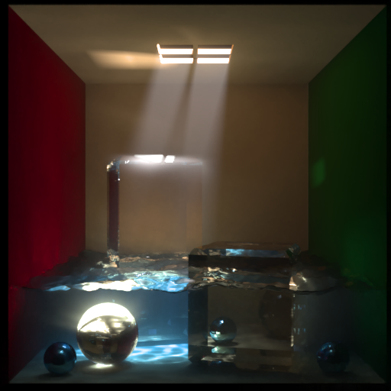
LuxRender
Dampftraktor
Wilesco Dampf Traktor D 40 MS
Cornell Box by A-man rendered to approximately 100k s/p

Slide 15
Displayer & Framebuffer

Slide 16
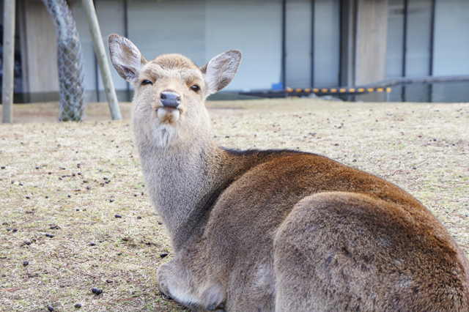
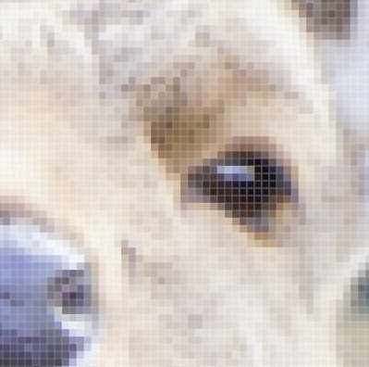
Raster Graphics
Image produced as an array (the raster) of picture elements (pixels) in the frame buffer
(179, 161, 153)
Notes:
在此簡述一下，呈像的原理
一張影像可視為由二維的像素(pixel)所組成，而每個像素則是包含了RGB (紅綠藍)三色的強度
在電腦中有一塊特別的記憶體稱之為framebuffer，它記錄了這些像素的資訊，並與顯示器的發光體有著一對一的對應
因此改變framebuffer內部的值，顯示器的畫面也隨之改變，
所以在設計遊戲的畫面，最基本的核心就是如何控制framebuffer的值

Slide 17
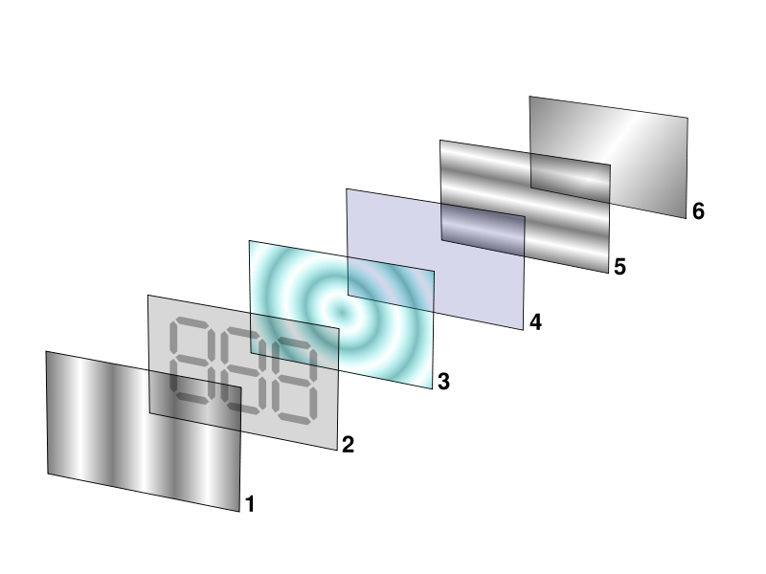
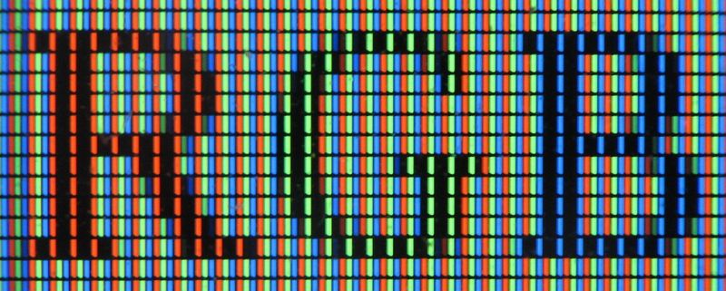
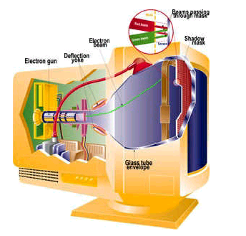
Display Technologies
CRT
LCD

Slide 18
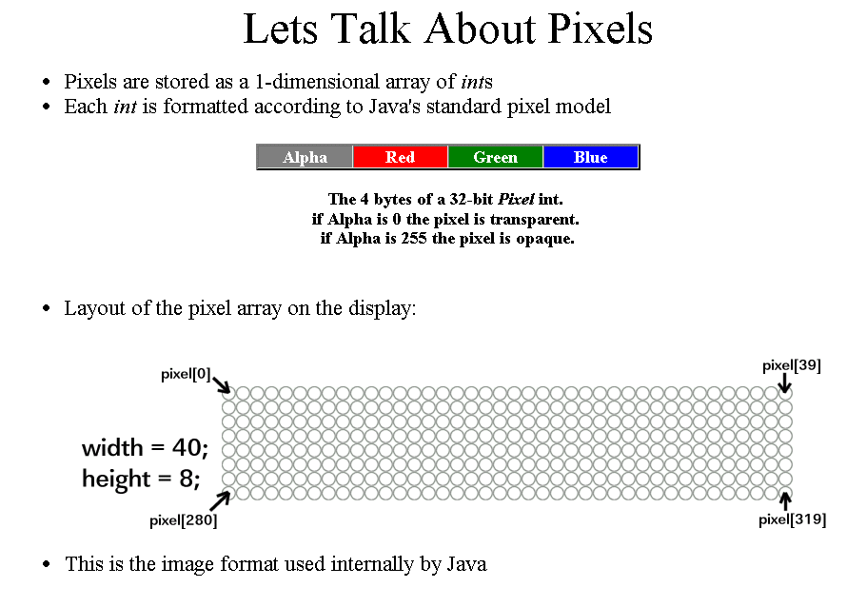

Slide 19
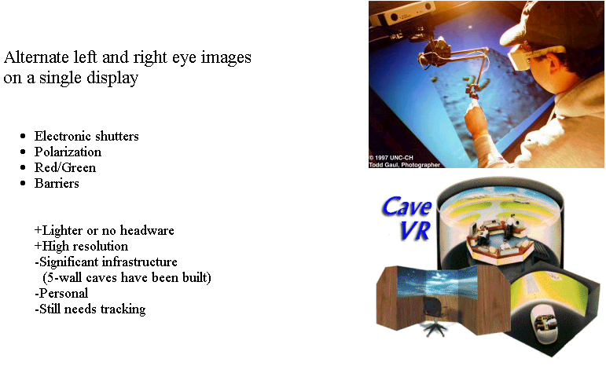
Caves and Fish Bowls

Slide 20
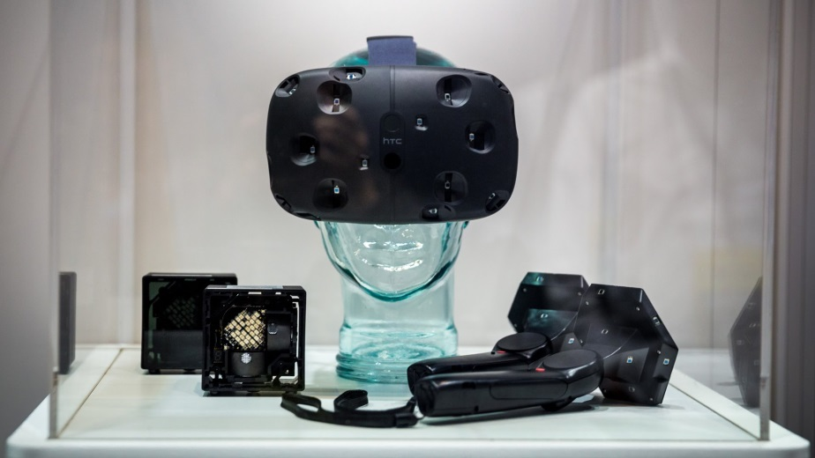
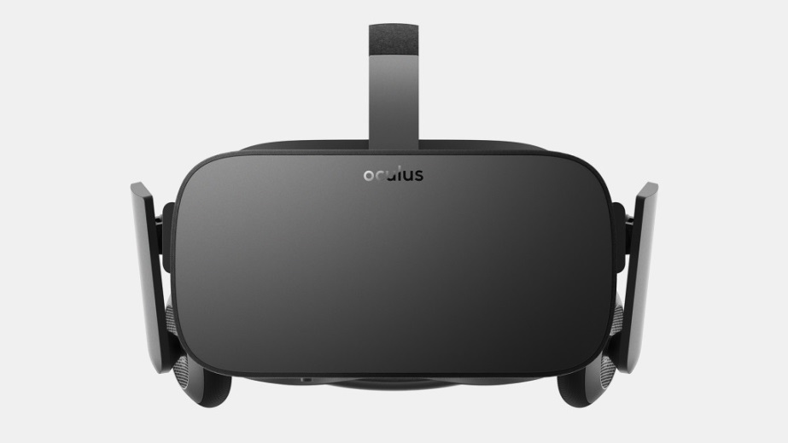
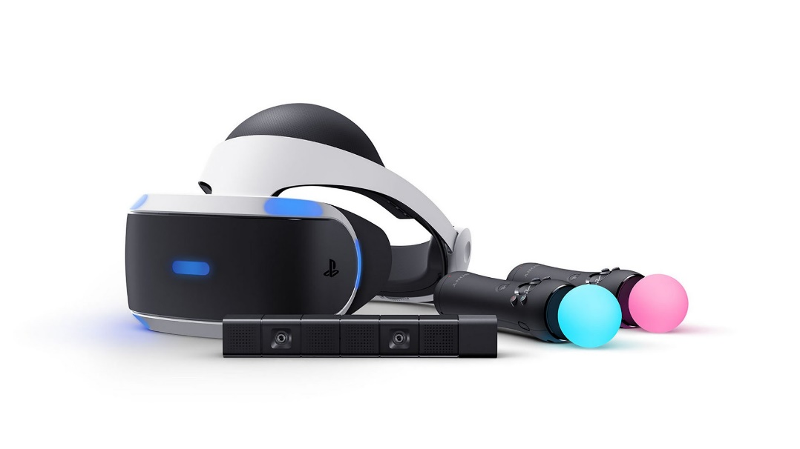
Head-Mounted Displays
Htc vive
Oculus Rift
Sony VR
Notes:
另外還有些特別的顯示裝置和顯示方法，將會在虛擬實境的單元作介紹

Slide 21
evolution

Slide 22
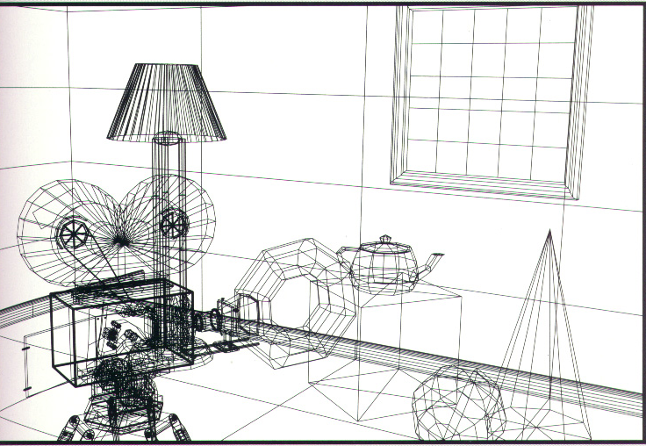
Wire-Frame
Shutterbug: Copyright 1990 Pixar - Rendered by Thomas Williams and H. B. Siegel using Pixar's RenderManTM

Slide 23
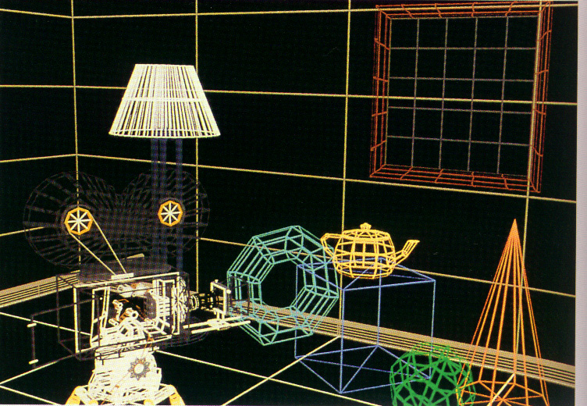
Coloring
Shutterbug: Copyright 1990 Pixar - Rendered by Thomas Williams and H. B. Siegel using Pixar's RenderManTM

Slide 24
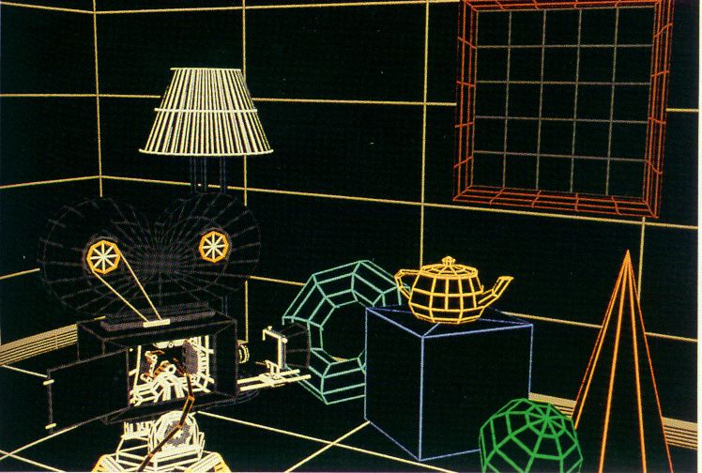
Hidden Surface Removal

Slide 25
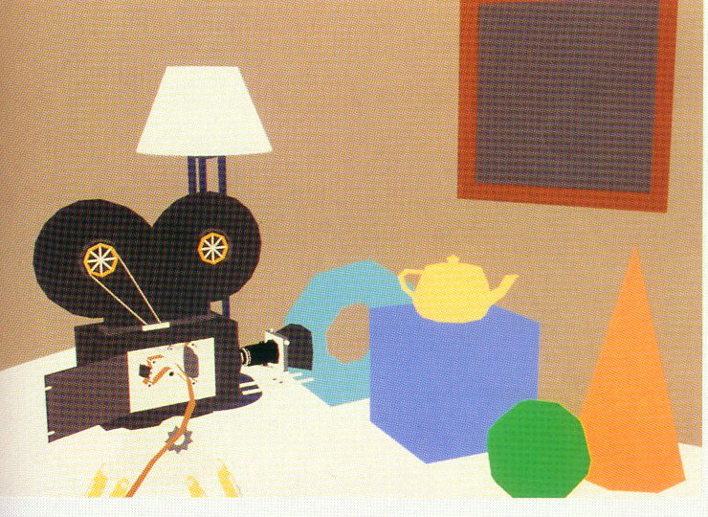
Constant Rendering
Shutterbug: Copyright 1990 Pixar - Rendered by Thomas Williams and H. B. Siegel using Pixar's RenderManTM

Slide 26
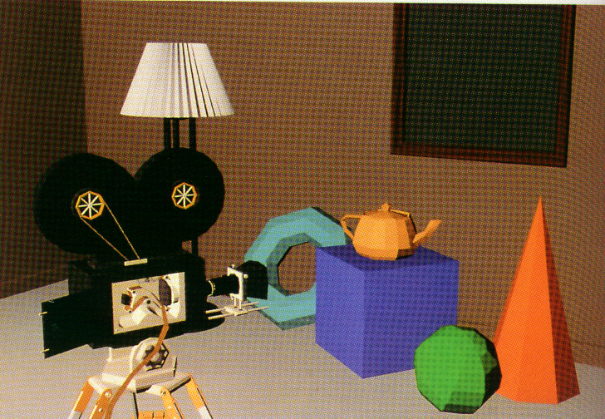
Facet Shading
Shutterbug: Copyright 1990 Pixar - Rendered by Thomas Williams and H. B. Siegel using Pixar's RenderManTM

Slide 27
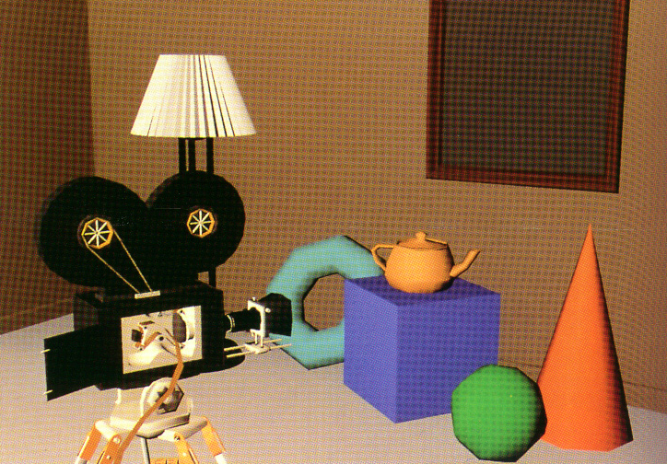
Smooth Shading
Shutterbug: Copyright 1990 Pixar - Rendered by Thomas Williams and H. B. Siegel using Pixar's RenderManTM

Slide 28
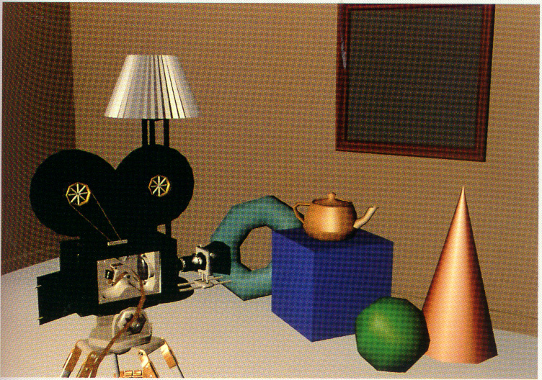
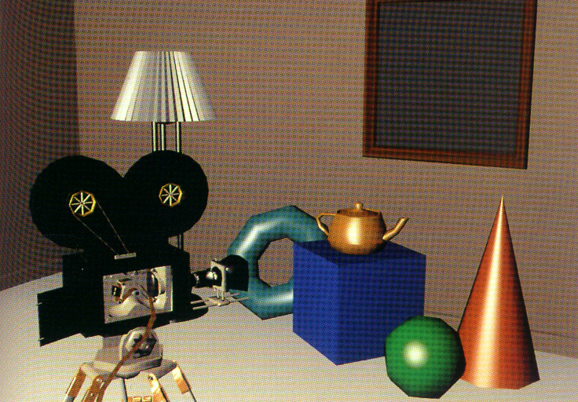
Correct Highlight
Shutterbug: Copyright 1990 Pixar - Rendered by Thomas Williams and H. B. Siegel using Pixar's RenderManTM

Slide 29
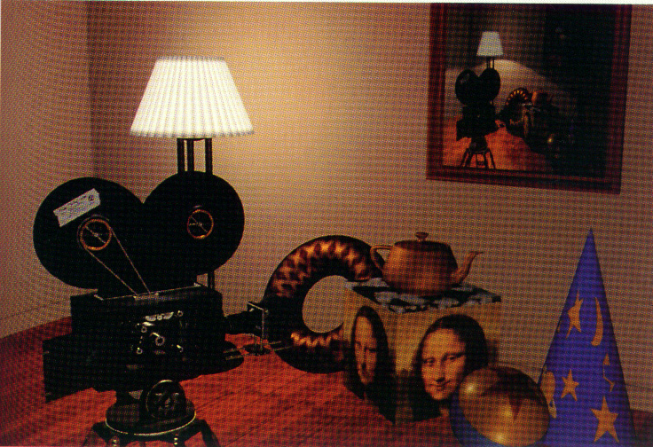
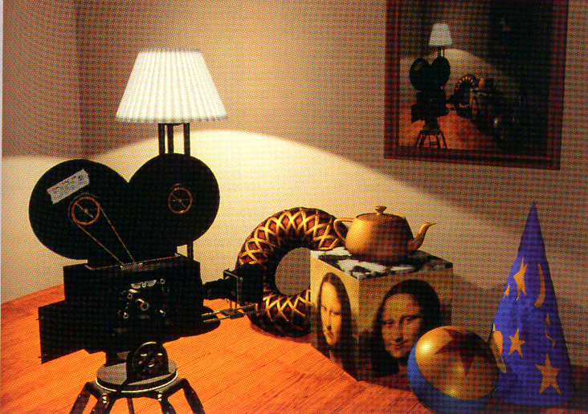
Texture & Shadow
Shutterbug: Copyright 1990 Pixar - Rendered by Thomas Williams and H. B. Siegel using Pixar's RenderManTM

Slide 30
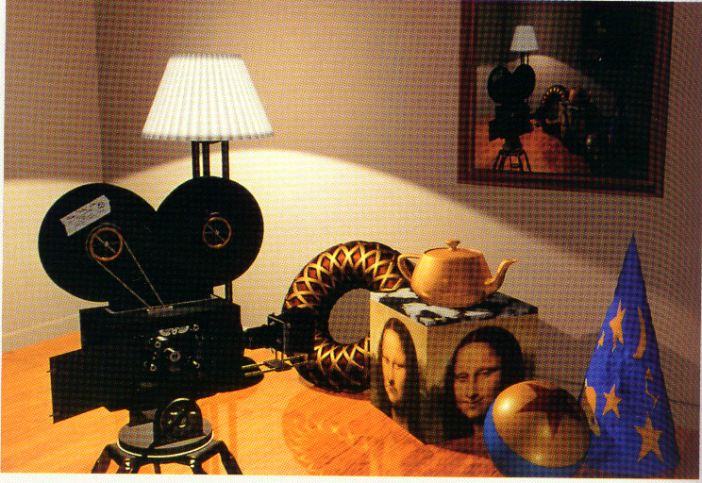
Reflection
Shutterbug: Copyright 1990 Pixar - Rendered by Thomas Williams and H. B. Siegel using Pixar's RenderManTM

Slide 31
Rendering pipeline

Slide 32
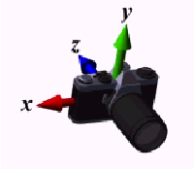

Following the Pipeline: Transformations
Much of the work in the pipeline is in converting object representations from one coordinate system to another
  World coordinates
  Camera coordinates
  Screen coordinates
Every change of coordinates is equivalent to a matrix transformation

Slide 33


Clipping
Just as a real camera cannot “see” the whole world, the virtual camera can only see part of the world space
  Objects that are not within this volume are said to be clipped out of the scene

Slide 34


Rasterization
If an object is visible in the image, the appropriate pixels in the frame buffer must be assigned colors
  Vertices assembled into objects
  Effects of lights and materials must be determined
  Polygons filled with interior colors/shades
  Must have also determine which objects are in front (hidden surface removal)

Slide 35

Shading
Shading refers to depicting depth perception in 3D models or illustrations by varying levels of darkness.

Slide 36



Global Illumination
Cornell box
Test scene by Luxrender

Slide 37





Non-photorealistic Rendering
Photo image of
the real scene

Slide 38




Color space and Filters
Notes:
http://www.mathworks.com/matlabcentral/fileexchange/7744

Slide 39
Applications

Slide 40
Major Applications
Video games
Cartoons
Visual effects
Animated films
CAD/CAM
Simulation
Medical imaging
Information visualization

Slide 41



Computer Graphics is about Movies!
Notes:
Avatar by James Cameron
Wall-E by Pixar
Transformers by Michael Bay
http://www.ilm.com/

Slide 42


Games are OK here

Slide 43


Medical Applications

Slide 44





Graphical User Interfaces (GUIs)

Slide 45

Visualization
http://d3js.org/

Slide 46
Reference

Slide 47



Textbooks

Slide 48







Reference

Slide 49
Resource
http://www.opengl.org
OpenGL software implementation
  http://www.mesa3d.org/
http://nehe.gamedev.net/
Computer Graphics Paper Collection
  http://kesen.realtimerendering.com

