Slide 1
3D Game Programming Virtual Reality
Ming-Te Chi
Department of Computer Science,
National Chengchi University
Notes:
2019

Slide 2
Goal
Stereo display
Human interface device
Notes:
這個單元將以虛擬實境為主，介紹立體顯示的原理和應用，以及各種人機介面的輸出入裝置

Slide 3
Depth perception
Depth sensation is the ability to move accurately, or to respond consistently, based on the distances of objects in an environment
binocular cues
monocular cue
Notes:
深度的識覺是用以覺察環境中物體的距離的能力，基本上由兩大線索(或說情報來源)，一是雙眼構造的特性，另一種則是單眼的線索

Slide 4
Binocular cues
Stereopsis or retinal(binocular) disparity
Convergence
Shadow Stereopsis
Left eye
Right eye
Notes:
雙眼間存在橫向的視差，大腦會根據這一對具視差的影像解讀物體的距離
另外，藉由雙眼對焦的不同，也提供了距離和立體感

Slide 5
Monocular cues
Motion parallax
Depth from motion
Perspective
Relative size
Occlusion
Notes:
就算只有單眼的情形，也能提供距離的線索
Motion parallax 就像坐火車時，較近的物體移動比較快，較遠的物體移動相對的比較慢。早期2D遊戲用多重捲軸做出立體的效果
Depth from motion 同一個物體向遠處移動，會變得相對小
Perspective 透視投影，平行往遠處延伸的鐵軌
Relative size 相同的物體，在近處比較大，在遠處比較小。
Occlusion 透過遮蔽的情況，估算物體的遠近

Slide 6

Stereoscopic
Stereoscopic technology provides a different image to the viewer's left and right eyes.
View of Boston, c. 1860
Notes:
由於雙眼視差是立體效果最明顯的線索，很早就有人嘗試不同方法讓左右兩眼各自看到有視差的影像

Slide 7
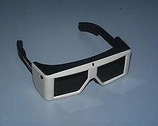
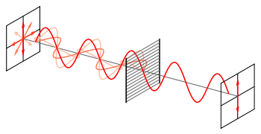
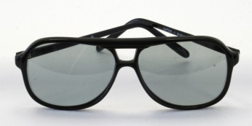
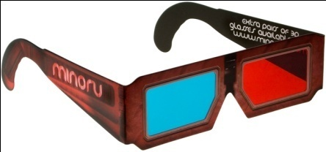
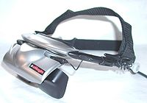
Categories of 3D viewer technology
With glasses
Active
Liquid crystal shutter glasses
Passive
polarized glasses
Complementary color anaglyphs
Others
Head-mounted display
Notes:
需要戴眼鏡的方式，可分為兩大類
-Active 眼鏡本身會做主動式的更新，配合高更新率的顯示器輪流播放左右眼的影像，輪流讓其中一隻眼看到對應影像，另外一隻眼看不見
-Passive 利用光的偏震特性濾掉特定光線或是顏色濾色片
- 或是直接在兩眼前各放一個螢幕

Slide 8
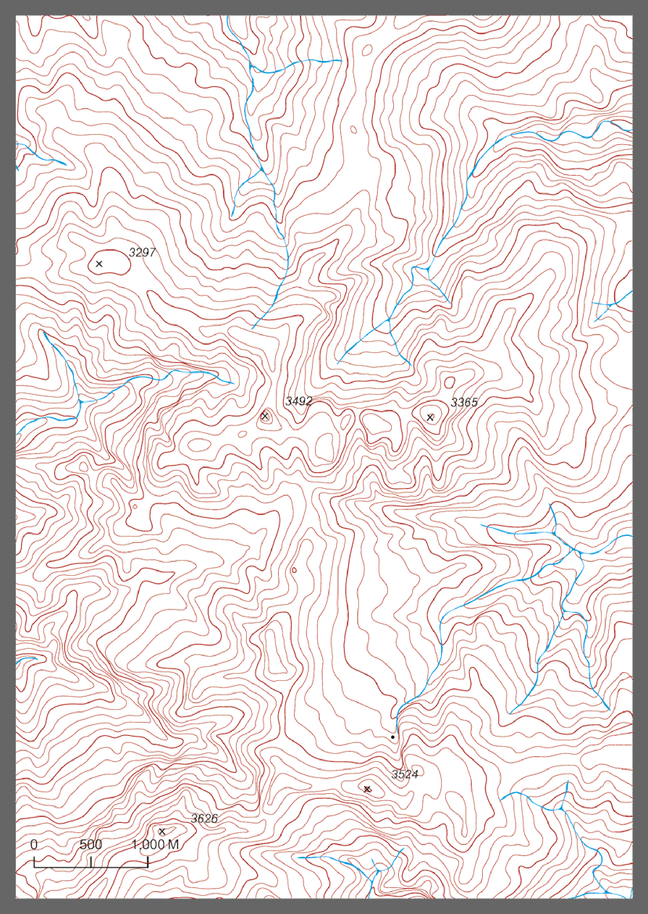
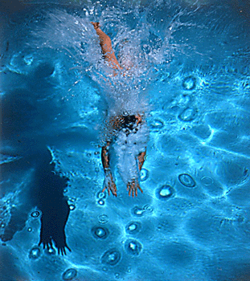
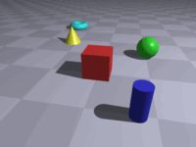
Without glasses
Wiggle stereoscopy
Notes:
不需要眼鏡的還有
Wiggle stereoscopy 利用快速更新具視差的畫面，產生立體感。但缺點是畫面很閃爍

Slide 9
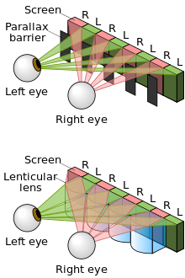
Without glasses
Autostereoscopy
Parallax barrier
Lenticular lens
Notes:
或是裸眼成像技術，在顯示器裡面動手腳，讓特定角度看進來的畫面不一樣

Slide 10
Holography
Holography is a technique that allows the light scattered from an object to be recorded and later reconstructed so that it appears as if the object is in the same position relative to the recording medium as it was when recorded.
Notes:
全像技術也已經發展很久，已廣泛應用在信用卡的雷射貼紙上

Slide 11
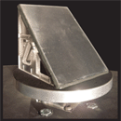
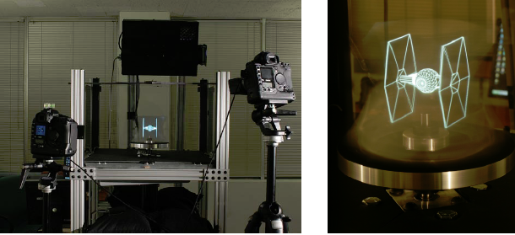
Light field display
Andrew Jones et al proposed an autostereoscopic light field display able to present interactive 3D graphics to multiple simultaneous viewers 360 degrees around the display, in 2007,
Anisotropic spinning mirror
3D display
USC Institute for Creative Technologies
Notes:
http://gl.ict.usc.edu/Research/3DDisplay/
Light field display是近年發展出的一個有趣技術，藉由高速旋轉的鏡面，反射出各角度可能的光線，即等於重現出Light field
便可從各種角度看到立體影像

Slide 12
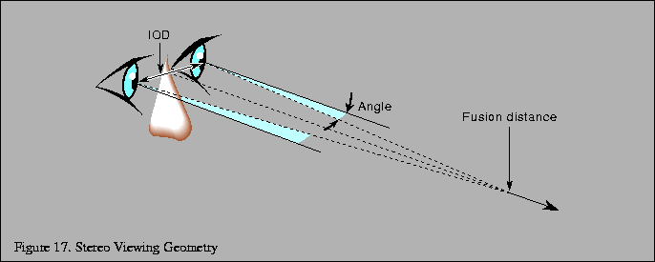
SIGGRAPH 99 coursenote

Slide 13
OpenGL Quad buffer
glClear();
glMatrixMode(GL_MODELVIEW);
glLoadIdentity(); /* the default matrix */
glPushMatrix();
glDrawBuffer(GL_BACK_LEFT);
gluLookAt(-IOD/2.0, 0.0, EYE_BACK,
0.0, 0.0, 0.0,
0.0, 1.0, 0.0);
<viewing transforms>
<modeling transforms>
draw();
glClear();
glPopMatrix();
glPushMatrix() glDrawBuffer(GL_BACK_RIGHT); gluLookAt(IOD/2.0, 0.0, EYE_BACK,
0.0, 0.0, 0.0,
0.0, 1.0, 0.0);
<viewing transforms>
<modeling transforms>
draw();
glPopMatrix();
glutSwapBuffer();

Slide 14
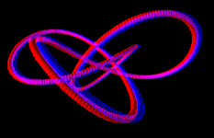
Anaglyphs Using OpenGL
glClear(GL_COLOR_BUFFER_BIT | GL_DEPTH_BUFFER_BIT);
glColorMask(GL_TRUE, GL_FALSE, GL_FALSE, GL_TRUE);
// set camera for blue eye, red will be filtered.
// draw scene
glClear(GL_DEPTH_BUFFER_BIT);
glEnable(GL_BLEND);
glBlendFunc(GL_ONE, GL_ONE);
glColorMask(GL_FALSE, GL_FALSE, GL_TRUE, GL_TRUE);
// set camera for red eye, blue will be filtered.
…
// draw scene
….

Slide 15
libgls
glsClear(ctx);
// ... clear and render left view ...
glsSubmitView(ctx, GLS_VIEW_LEFT);
// ... clear and render right view ...
glsSubmitView(ctx, GLS_VIEW_RIGHT);
glsDrawSubmittedViews(ctx, GLS_MODE_RED_CYAN_DUBOIS, GL_FALSE);
// ... swap buffers ...
Notes:
http://libgls.sourceforge.net/doc/html/index.html

Slide 16
Unity VR
VR support is enabled by visiting Edit > Project Settings> Player > Other Settings > Rendering.
Then enabling the “Virtual Reality Supported” checkbox in the Inspector.
Notes:
https://unity3d.com/learn/tutorials/topics/virtual-reality/vr-overview

Slide 17
Human Interface Device

Slide 18
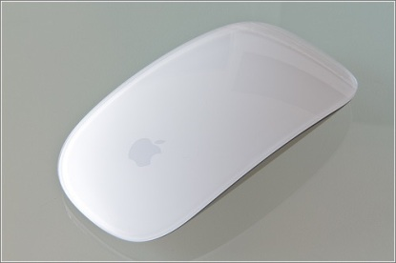
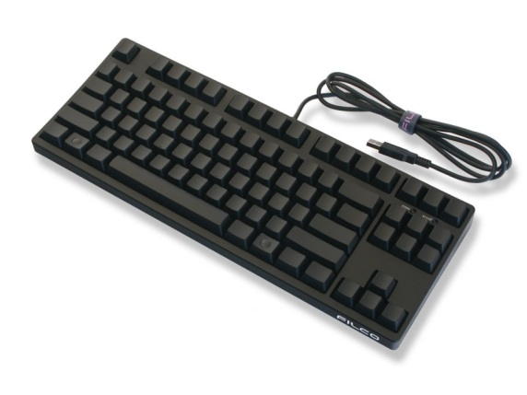
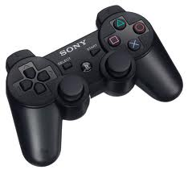
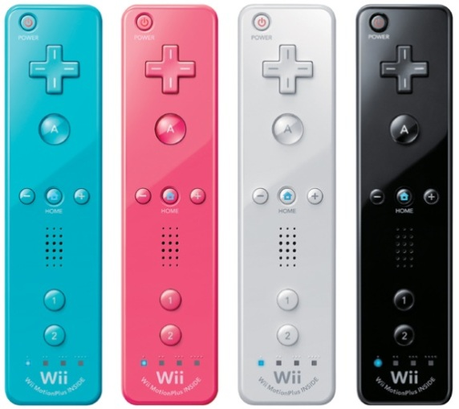
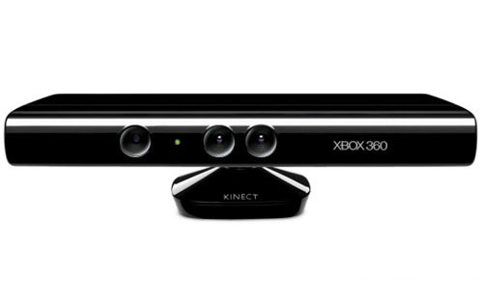
Input device
Mouse
Keyboard
Gamepad
Immersed control

Slide 19
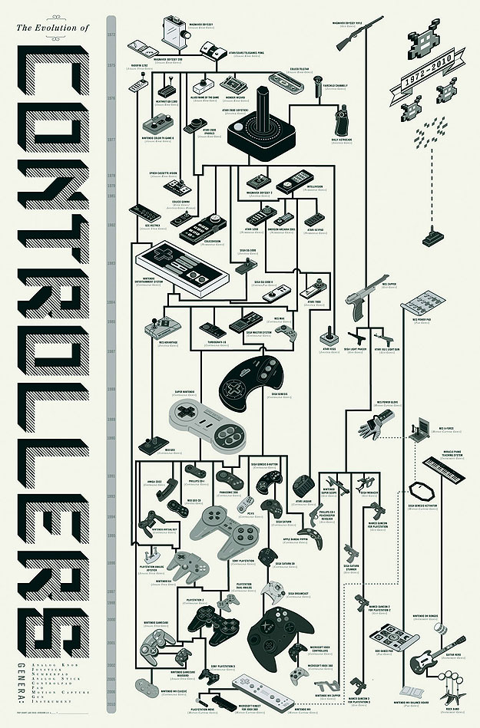
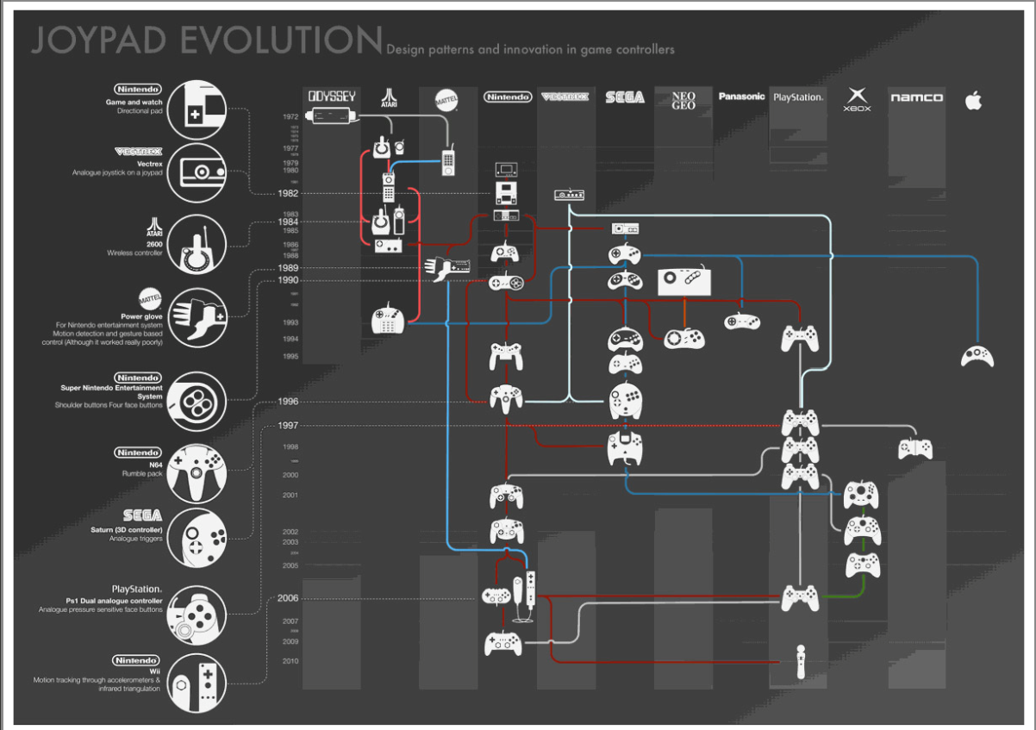
Controllers
http://www.bitrebels.com/geek/the-evolution-of-video-game-controllers-infographic/
Notes:
http://www.horriblenight.com/5866/the-history-of-control-pads-in-one-infographic

Slide 20
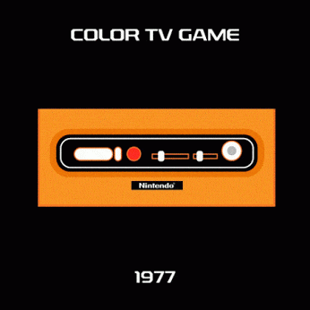
Gif made by Christian Tailor.

Slide 21
Type of inputs
Digital buttons
Analog axes and buttons
Relative Axes

Slide 22
Accelerometer (加速度儀)
An accelerometer is a device that measures proper acceleration.
Especially useful to identify the gravity force

Slide 23
Gyroscope(陀螺儀)
A gyroscope is a device for measuring or maintaining orientation, based on the principles of conservation of angular momentum.

Slide 24

Touch user interface (觸控介面)
A touch user interface (TUI) is a computer-pointing technology based upon the sense of touch (haptics).
An touch based interface example.
As-Rigid-As-Possible Shape Manipulation
Notes:
Takeo Igarashi, Tomer Moscovich, John F. Hughes, "As-Rigid-As-Possible Shape Manipulation", ACM Transactions on Computer Graphics, Vol.24, No.3, ACM SIGGRAPH 2005, Los Angels, USA, 2005. PDF
Takeo Igarashi and Yuki Igarashi. "Implementing As-Rigid-As-Possible Shape Manipulation and Surface Flattening." Journal of Graphics, GPU, and Game Tools, A.K.Peters, Volume 14, Number 1, pp.17-30, ISSN:2151-237X, June, 2009. PDF

Slide 25

Vision based interface
Get user input through the computer vision technique
Wii remote contains a IR camera
Kinect
Depth sensors
RGB camera
Notes:
Kinect Effect
http://www.youtube.com/watch?feature=player_embedded&v=T_QLguHvACs#!

Slide 26
Types of HID outputs
Rumble
Simulating the turbulences or impact
Force-Feedback
Steering wheel
Audio

Slide 27
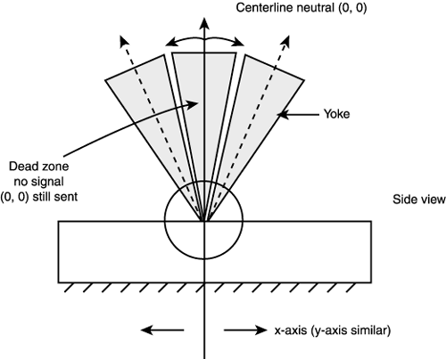
HID process
Dead zones
Analog signal filtering
Event detection
Button sequences and multiple player
Gesture detection
Controller input re-mapping
The "joystick deadzone" is the area around the center of a joystick that does not respond to movement. It is designed to cut down on accidental movement caused by "jitter".
Notes:
https://docs.unity3d.com/Manual/class-InputManager.html
Dead: Any positive or negative values that are less than this number register as zero. Useful for joysticks.

Slide 28
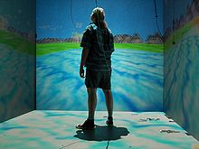
Cave
Cave Automatic Virtual Environment
Aimmersive virtual reality environment where projectors are directed to three, four, five or six of the walls of a room-sized cube.

Slide 29
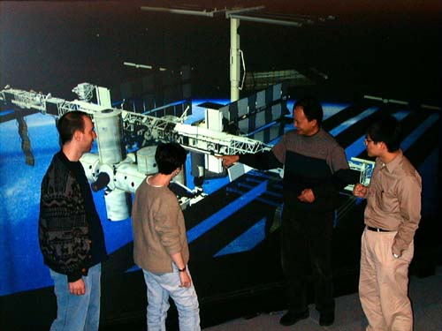
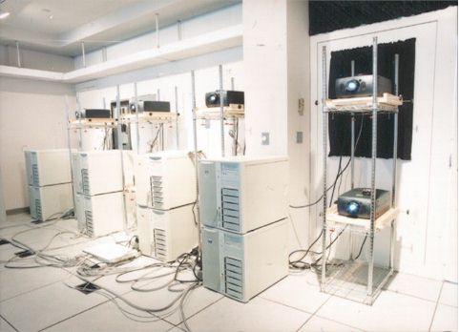


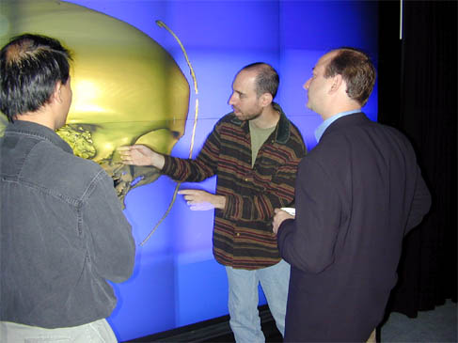
Display wall in NASA Space Station
http://www.cs.princeton.edu/~benshedd/CSDisplayWall8&24/index.html

Slide 30
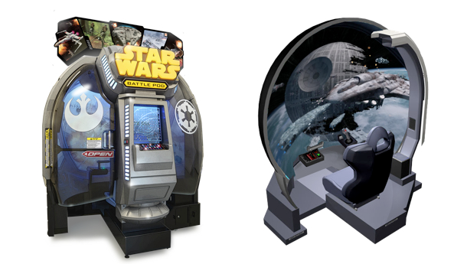
Star wars battle pod
Notes:
http://www.starwarsbattlepod.com/

Slide 31
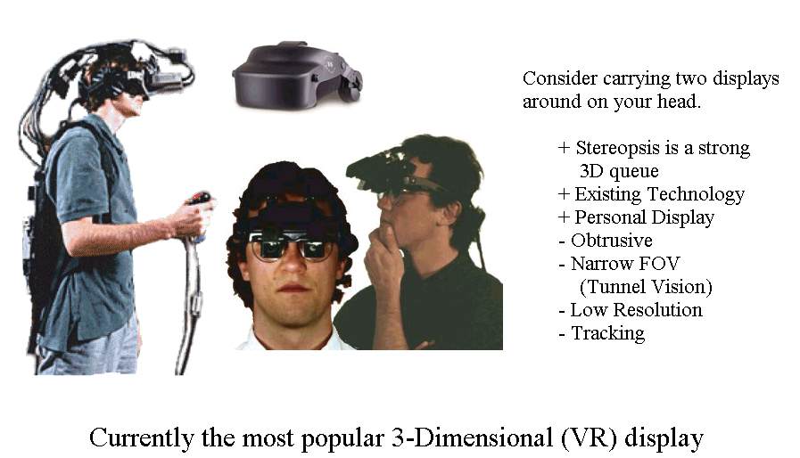
Head-Mounted Displays

Slide 32
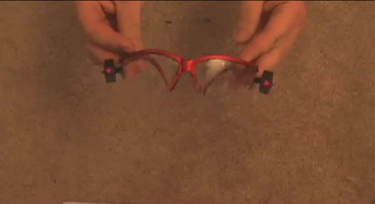
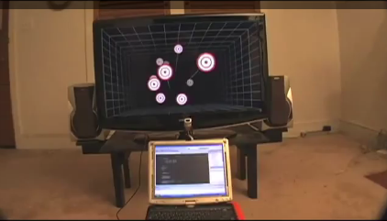
Head Tracking
Head Tracking is an important to obtain position and orientation for pose determination and recognition of simple gestures such as nodding and head shaking.
Head Tracking for Desktop VR Displays using the Wii Remote
Johnny Chung Lee
Using (left)a head mounted sensor bar (two IR LEDs) and light a wii remote .
Notes:
http://www.youtube.com/watch?v=Jd3-eiid-Uw
Head Tracking for Desktop VR Displays using the Wii Remote http://johnnylee.net/projects/wii/

Slide 33
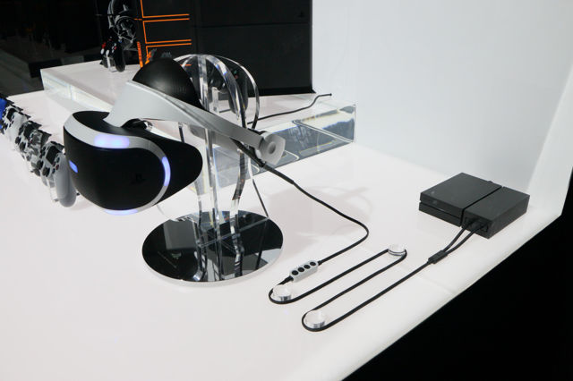
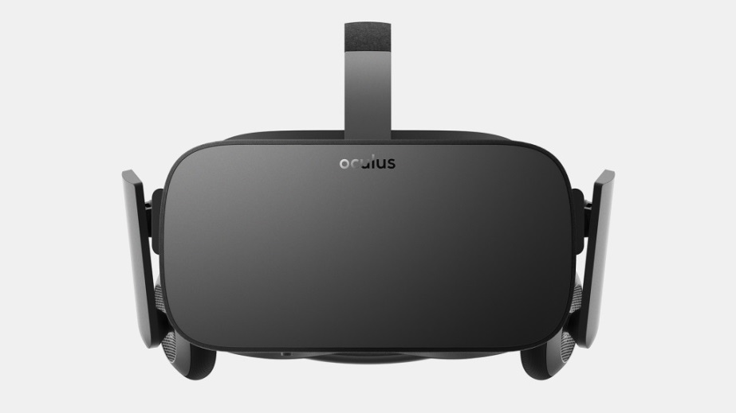
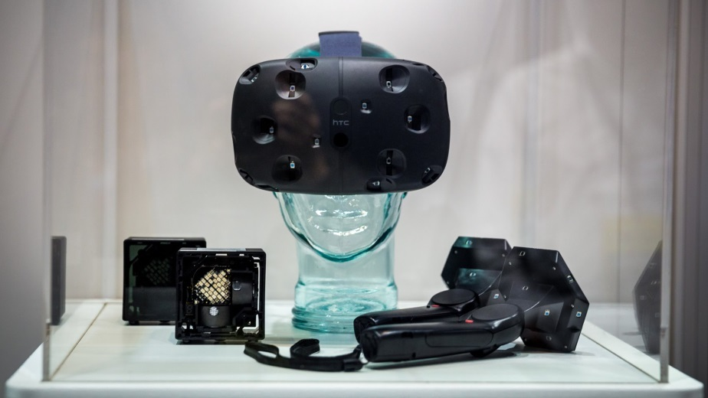
Head-Mounted Displays
Sony
PlayStation VR
Oculus Rift
Htc vive
Notes:
另外還有些特別的顯示裝置和顯示方法，將會在虛擬實境的單元作介紹

Slide 34
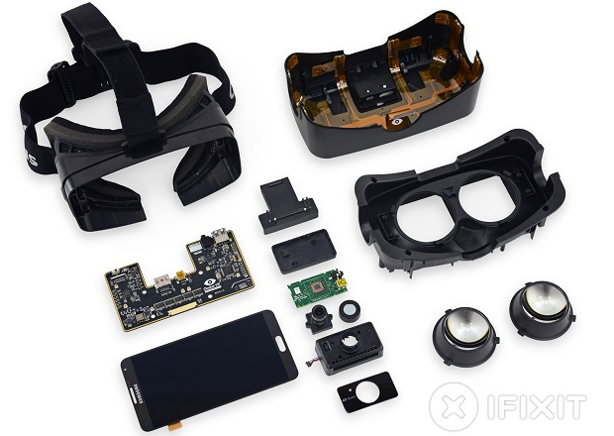
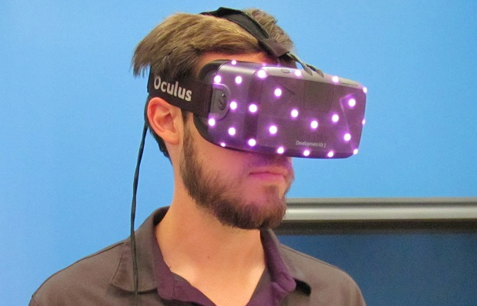
Inside oculus rift DK2
Notes:
https://developer.oculus.com/blog/open-source-release-of-rift-dk2/

Slide 35
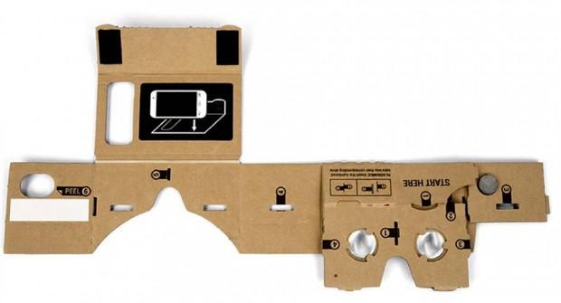
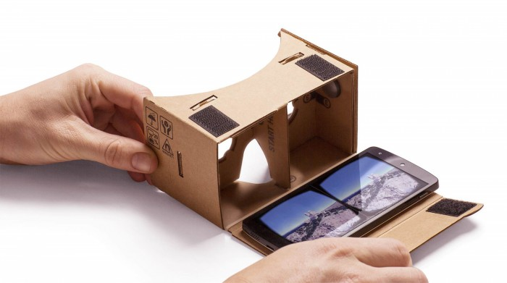
google cardboard
Notes:
平價VR

Slide 36
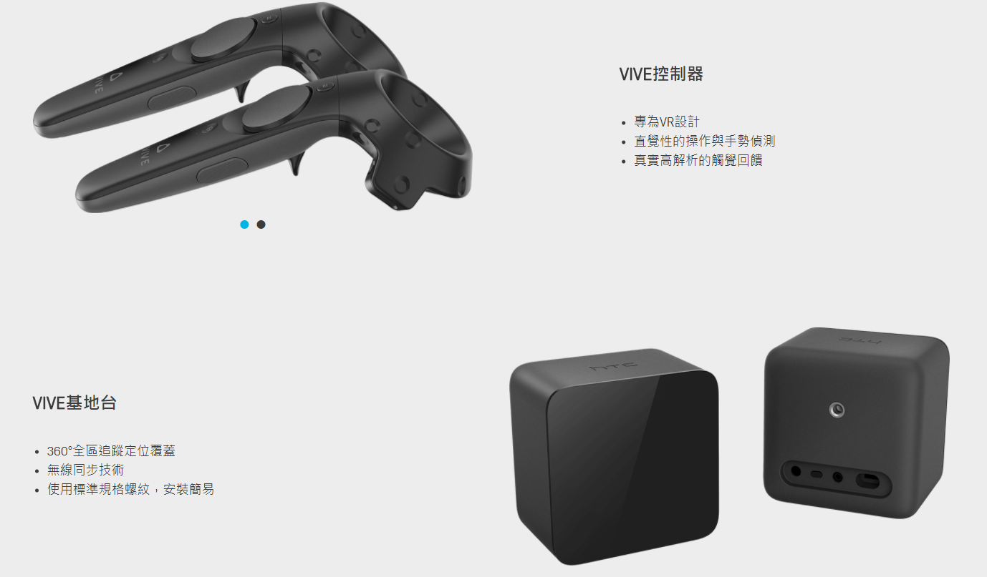
HTC vive
Notes:
http://technews.tw/2016/05/19/htc-vive-oculus-rift-dismantling/
Vive 所配備的空間位置定位系統 Lighthouse 方面，Vive 在對角的兩個基站內建了 LED 鏡頭，用於檢測頭盔和手把發射的紅外雷射，進行空間位置追蹤。

Slide 37
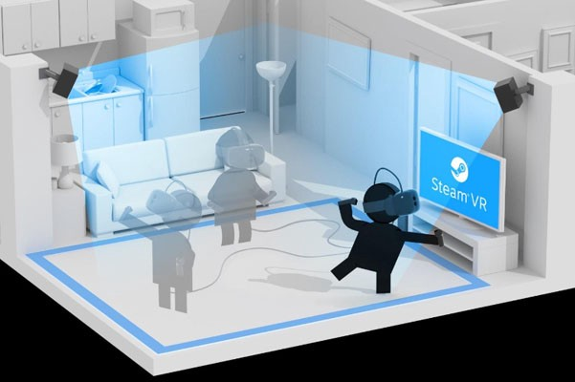
Room scale VR
Notes:
play area:
Room-scale VR requires a minimum of 2 x 1.5 meters
1 x 1 (Standing Only)
Valve Steam 發現，81.5% 的 VR 玩家皆有至少 3 平方公尺的遊戲空間 http://steamcommunity.com/app/358720/discussions/0/350532536103514259/

Slide 38
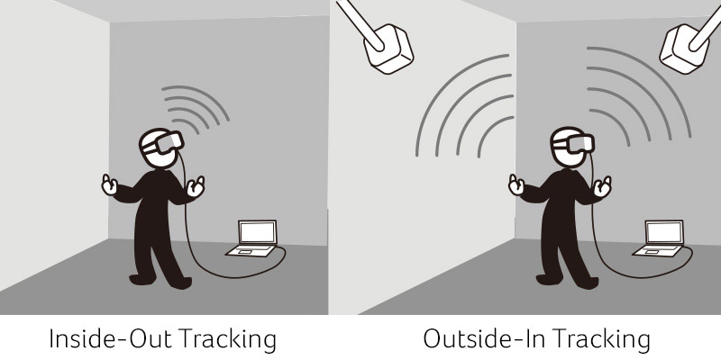
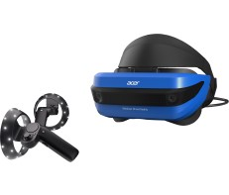
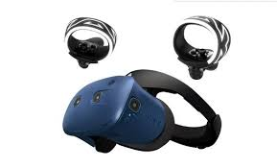
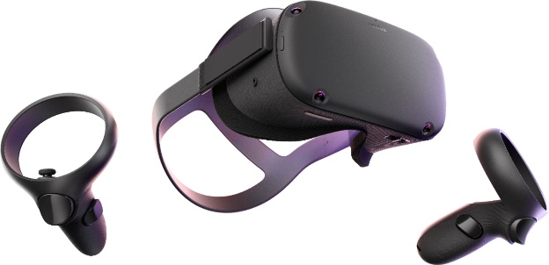
Inside-out tracking

Slide 39
Reference
立體顯示技術簡介
Creating And Viewing Anaglyphs
Head Tracking for Desktop VR Displays using the Wii Remote
http://johnnylee.net/projects/wii/

