Slide 1
3D Game Programming
Geometric Transformations
Ming-Te Chi
Department of Computer Science,
National Chengchi University
Notes:
2019

Slide 2
Outline
Geometric Transformations
Basic transformation
  The coordinates
  Hierarchy transformation
Modeling
  Mesh format / import
  Unity ProBuilder

Slide 3
Transformation Terminology
Viewing
Modeling
Modelview
Projection
Viewport

Slide 4
Transformations
Translation
Rotation
Scaling

Slide 5
The Modelview Duality
+y
+y
+x
+x
+z
+z
View moving
Model moving
Notes:
Model space: 為物體相對世界座標的幾何轉換
View space: 為相機相對於世界座標的幾何轉換
兩者互為相對移動的關係，也就是移動相機等同於反方相移動所有的物體，是故會整合成modelview space，減少矩陣的變數

Slide 6
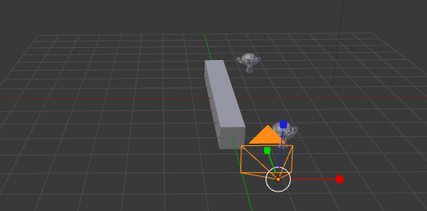
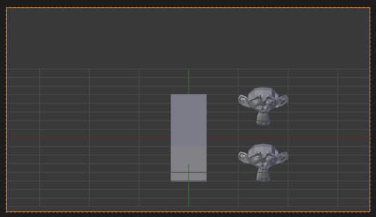
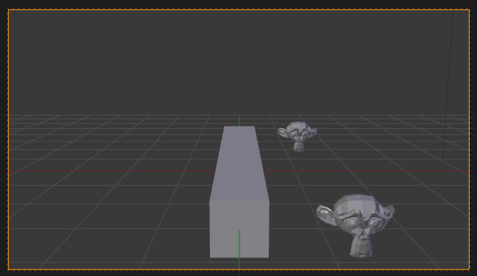
Projection
World space
Orthographic
Perspective
Notes:
在此列舉常見的兩種投影法 上圖是世界座標的觀點，同樣的場景
但在不同的投影法中，成像的結果也不一樣
左下為正交投影，右下為透視投影

Slide 7
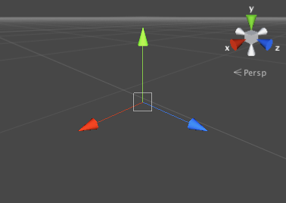
Coordinate System
Unity is a Left-Handed Coordinate System

Slide 8
Transform

Slide 9
Matrix/vector
Notes:
在繪圖中常需要利用矩陣和向量處理
各式的affine transformation可以4x4的矩陣表示
向量可表示位置(x, y, z, w)

Slide 10
Transform in Unity
Translate(Vector3 translation);
Rotate(…);
Notes:
本頁列出基本幾何轉換的函式呼叫和對應的矩陣
由於旋轉矩陣是支援任意軸旋轉，也就是以給定(x, y, z)為旋轉軸，依左手定則(Unity)的方向，旋轉angle角度
他對應的矩陣相對複雜，因此不列出。有興趣可參考 http://www.opengl.org/sdk/docs/man/xhtml/glRotate.xml

Slide 11
Scale
public Vector3 localScale;
  The scale of the transform relative to the GameObjects parent.
public float x = 0.1f;
public float y = 0.1f;
public float z = 0.1f;
void Update() {
// Widen the object by x, y, and z values
transform.localScale += new Vector3(x, y, z);
}

Slide 12
Rotate
public void Rotate(Vector3 eulerAngles, Space relativeTo = Space.Self);
public void Rotate(Vector3 axis, float angle, Space relativeTo = Space.Self);
public void RotateAround(Vector3 point, Vector3 axis, float angle);

Slide 13

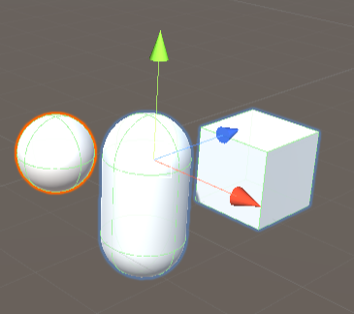
Parent/Child
// Moves all transform children 10 units upwards!
void Start()
{
foreach (Transform child in transform)
{
child.position += Vector3.up * 10.0f;
}
}

Slide 14
Reset to parent transform
transform.rotation = transform.parent.transform.rotation;
transform.localPosition = Vector3.zero;
transform.localScale = Vector3.one;

Slide 15
Rotation/Translation from world to object
+y
+y
+y
Translate()
Rotate()
Rect()
+x
+x
+x
+y
+y
+y
Rotate()
Translate()
Rect()
+x
+x
+x
Notes:
反之，由C/C++指令由上至下閱讀的順序
表示從world space往object space的變化

Slide 16
Transformation
Pipeline
Poly.
Per
Vertex
CPU
DL
Raster
Frag
FB
Texture
Pixel
object
eye
clip
normalized
device
window
v
e
r
t
e
x
Modelview
Matrix
Projection
Matrix
Perspective
Division
Viewport
Transform
Modelview
Projection
other calculations here
  material è color
  shade model (flat)
  polygon rendering mode
  polygon culling
  clipping
Modelview
l
l
l
Notes:
Modelview matrix是記錄從object space到eye space間的頂點轉換
Projection matrix是記錄從eye space到clip space間的頂點投影轉換
一般來說以stack的方式存在，以便儲存和回覆特定時間的矩陣狀態，stack的深度主要是看硬體實作而定，Modelview matrix一般至少有32，Projection matrix一般至少有2
另外material-to-color, flat-shading, and clipping calculations 會發生在Modelview matrix和Projection matrix之間
The polygon culling and rendering mode operations 發生在Viewport operations之後
此外，還有texture matrix stack，用來計算貼圖座標的自動投影

Slide 17
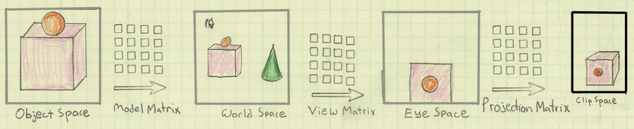
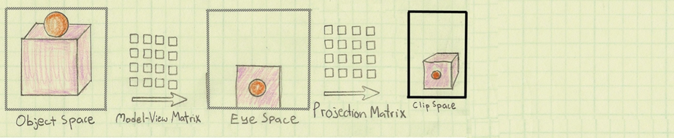
The Life of a vertex
Image by Philp Rideout
Notes:
這兩頁的圖片生動地呈現各種不同轉換發生的順序和對應的畫面變化
上下兩列可達到同樣的目的，主要是呈現model和view兩個矩陣轉換，兩者互為相對移動的關係，也就是移動相機等同於反方相移動所有的物體，
是故會整合成modelview space，減少矩陣的變數

Slide 18
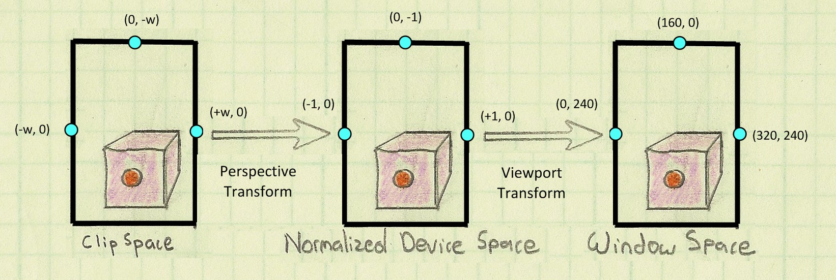
Image by Philp Rideout

Slide 19
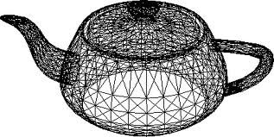
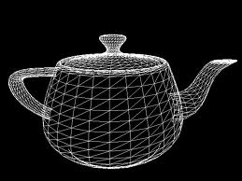
Wireframe with hidden-line removal
glEnable(GL_POLYGON_OFFSET_FILL);
glPolygonOffset( param1, param2 );
glPolygonMode(GL_FRONT , GL_FILL);
draw();
glDisable(GL_POLYGON_OFFSET_FILL);
glPolygonMode(GL_FRONT, GL_LINE );
draw();

Slide 20
Identity Matrix
glTranslatef(0, 1, 0);
glutSolidSphere(1, 15, 15);
glTranslatef(1, 0, 0);
glutSolidSphere(1, 15, 15);
glTranslatef(0, 1, 0);
glutSolidSphere(1, 15, 15);
glLoadIdentity();
glTranslatef(1, 0, 0);
glutSolidSphere(1, 15, 15);
Notes:
glLoadIdentity(); 的作用是將current transformation matrix設成單位矩陣
也等於是歸零之前的幾何轉換的作用，因此右下角的glutSolidSphere(1, 15, 15); 只受glTranslatef(1, 0, 0); 的影響

Slide 21
The Matrix Stacks
Current Matrix(modelview/projection)
glPushMatrix()
glPopMatrix()
Matrix Stack
glGet(GL_MAX_MODELVIEW_STACK_DEPTH, &size)
Notes:
OpenGL維護了一個matrix stack(通常長度為32，可用glGet()查詢 )
利用glPushMatrix() 可儲存目前的幾何轉換狀態
反之用glPopMatrix() 可還原之前儲存的狀態

Slide 22
Atom example
// First Electron Orbit
// Save viewing transformation
glPushMatrix();
// Rotate by angle of revolution
glRotatef(fElect1, 0.0f, 1.0f, 0.0f);
// Translate out from origin to orbit distance
glTranslatef(90.0f, 0.0f, 0.0f);
// Draw the electron
glutSolidSphere(6.0f, 15, 15);
// Restore the viewing transformation
glPopMatrix();
….
//(2) Second Electron Orbit
Notes:
這個範例以原子和三個電子提供了push/pop機制的使用，以及rotation和translation的組合
每個電子glutSolidSphere()，相對原子做公轉，公轉可透過隨時間增加的變數fElect1，產生旋轉，再以原子和電子的距離進行位移
另外為了避免三個電子各自的公轉影響到對方，會使用push/pop隔離公轉的位移

Slide 23
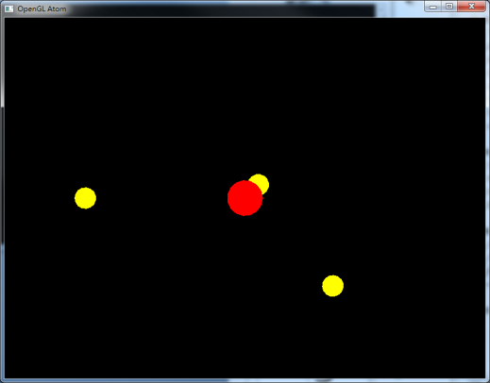
…
// (2) Second Electron Orbit
glPushMatrix();
glRotatef(45.0f, 0.0f, 0.0f, 1.0f);
glRotatef(fElect1, 0.0f, 1.0f, 0.0f);
glTranslatef(-70.0f, 0.0f, 0.0f);
glutSolidSphere(6.0f, 15, 15);
glPopMatrix();
// Third Electron Orbit
glPushMatrix();
glRotatef(360-45.0f, 0.0f, 0.0f, 1.0f);
glRotatef(fElect1, 0.0f, 1.0f, 0.0f);
glTranslatef(0.0f, 0.0f, 60.0f);
glutSolidSphere(6.0f, 15, 15);
glPopMatrix();

Slide 24
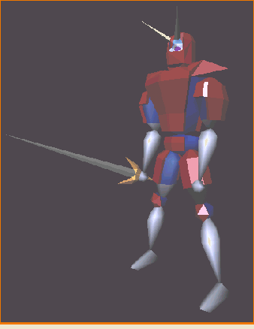
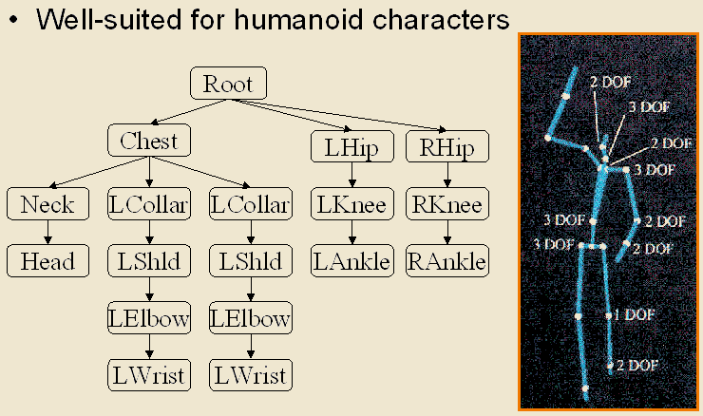
Transformation Example 1

Slide 25
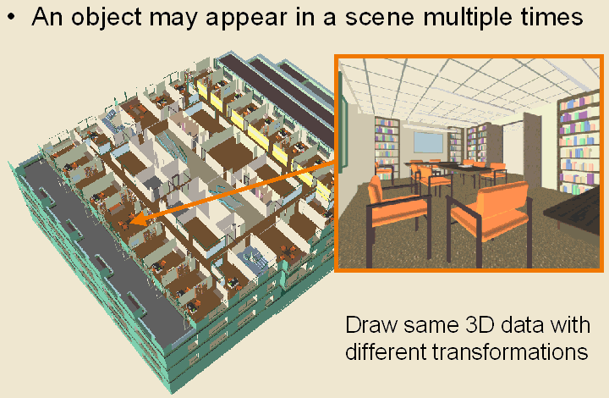
Transformation Example 2
Notes:
複雜的場景也可以利用同樣的機制，決定物體的相對位置

Slide 26
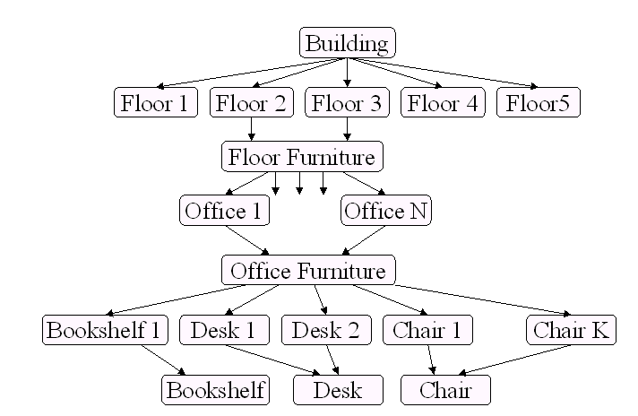
Transformation Example 2

Slide 27
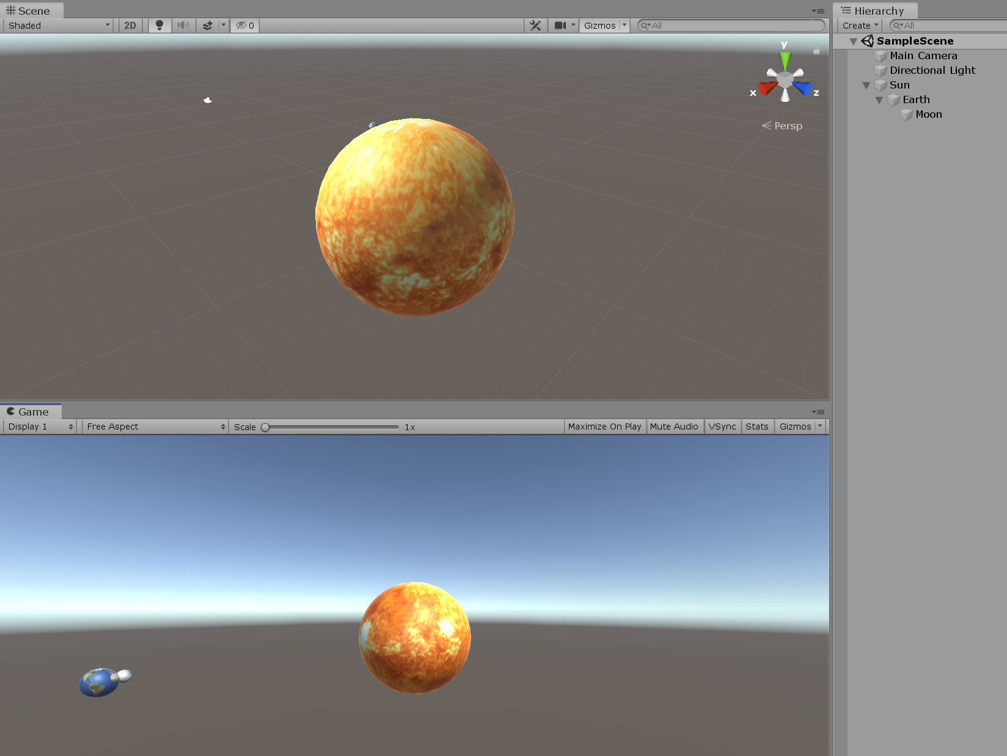
Sun Earth Moon

Slide 28
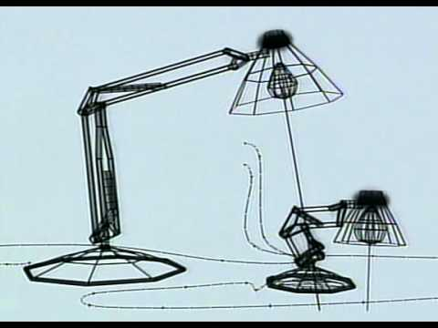
Luxo Jr [Pencil Test] [1986]
Notes:
https://www.youtube.com/watch?v=9L7wSAMPFH8

Slide 29
Matrix in Modern OpenGL
OpenGL Mathematics
  A C++ mathematics library for graphics programming
  http://glm.g-truc.net/

Slide 30
#include <glm/vec3.hpp> // glm::vec3
#include <glm/vec4.hpp> // glm::vec4
#include <glm/mat4x4.hpp> // glm::mat4
#include <glm/gtc/matrix_transform.hpp> // glm::translate, glm::rotate, glm::scale, glm::perspective
glm::mat4 camera(float Translate, glm::vec2 const & Rotate)
{
glm::mat4 Projection = glm::perspective(45.0f, 4.0f / 3.0f, 0.1f, 100.f);
glm::mat4 View = glm::translate(glm::mat4(1.0f), glm::vec3(0.0f, 0.0f, -Translate));
View = glm::rotate(View, Rotate.y, glm::vec3(-1.0f, 0.0f, 0.0f));
View = glm::rotate(View, Rotate.x, glm::vec3(0.0f, 1.0f, 0.0f));
glm::mat4 Model = glm::scale(glm::mat4(1.0f), glm::vec3(0.5f));
return Projection * View * Model;
}

Slide 31
Mesh Format

Slide 32
Representing a Mesh
e₂
v₅
Consider a mesh
There are 8 nodes and 12 edges
  5 interior polygons
  6 interior (shared) edges
Each vertex has a location v_{i} = (x_{i} y_{i} z_{i})
v₆
e₉
e₃
e₈
v₈
v₄
e₁
e₁₁
e₁₀
e₇
v₇
e₄
v₁
e₁₂
e₆
v₂
v₃
e₅

Slide 33
3D model format
SIMPLE
Triangle
vertex1_X vertex1_Y vertex1_Z normal1_X normal1_Y normal1_Z
vertex2_X vertex2_Y vertex2_Z normal2_X normal2_Y normal2_Z
vertex3_X vertex3_Y vertex3_Z normal3_X normal3_Y normal3_Z
COLOR
Triangle
frontcolor_R frontcolor_G frontcolor_B backcolor_R backcolor_G backcolor_B
vertex1_X vertex1_Y vertex1_Z normal1_X normal1_Y normal1_Z
vertex2_X vertex2_Y vertex2_Z normal2_X normal2_Y normal2_Z
vertex3_X vertex3_Y vertex3_Z normal3_X normal3_Y normal3_Z
Notes:
http://graphics.csie.ntu.edu.tw/~ming/courses/icg/models.html

Slide 34
Simple Representation
Define each polygon by the geometric locations of its vertices
Leads to OpenGL code such as
Inefficient and unstructured
  Consider moving a vertex to a new location
  Must search for all occurrences
glBegin(GL_POLYGON);
glVertex3f(x1, x1, x1);
glVertex3f(x6, x6, x6);
glVertex3f(x7, x7, x7);
glEnd();

Slide 35
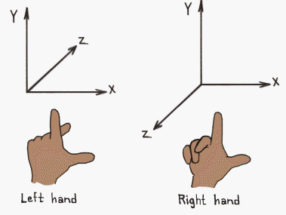
Inward and Outward Facing Polygons
V1
The order {v₁, v₆, v₇} and {v₆, v₇, v₁} are equivalent in that the same polygon will be rendered but the order {v₁, v₇, v₆} is different.
Use the left-hand rule =
clockwise encirclement
of outward-pointing normal
V7
V6

Slide 36
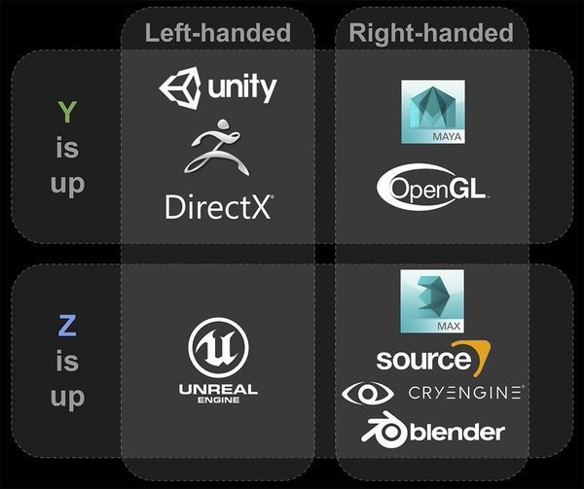

Slide 37
Wavefront obj format
#example obj file
v -1.63326156 -3.04798102 -8.81131839
….
vn 0.00379090 0.40057179 0.01256634
…
vt 0.22390614 0.97395277 (texture)
…
f 4/2/4 3/1/3 2/2/2 (index to v/t/n)
Notes:
Use Vertex pool to save storage.

Slide 38
Reference
obj format http://www.martinreddy.net/gfx/3d/OBJ.spec
ply format
STL format - http://en.wikipedia.org/wiki/STL_(file_format)

Slide 39
Scene Graph
FBX (Filmbox) by Autodesk
COLLADA
Alembic
Notes:
https://docs.unity3d.com/Manual/3D-formats.html

Slide 40
ProBuilder
Building and editing complex Meshes inside Unity

Slide 41
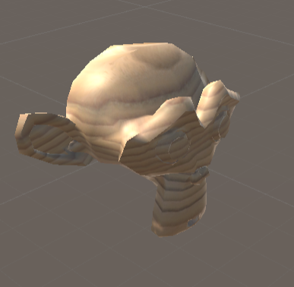

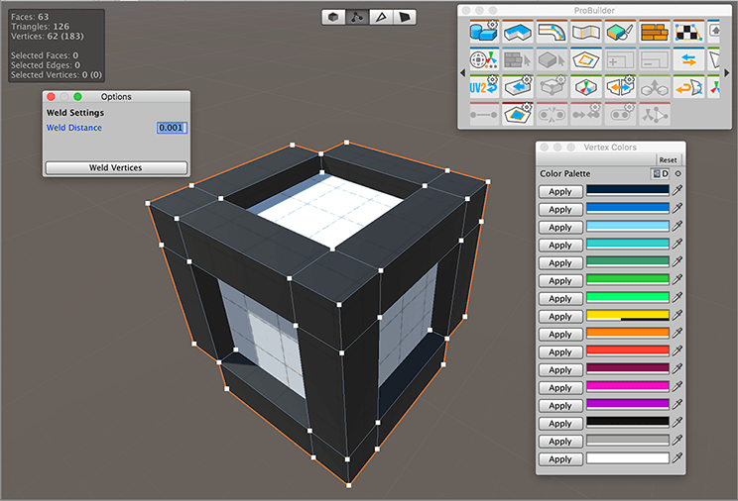

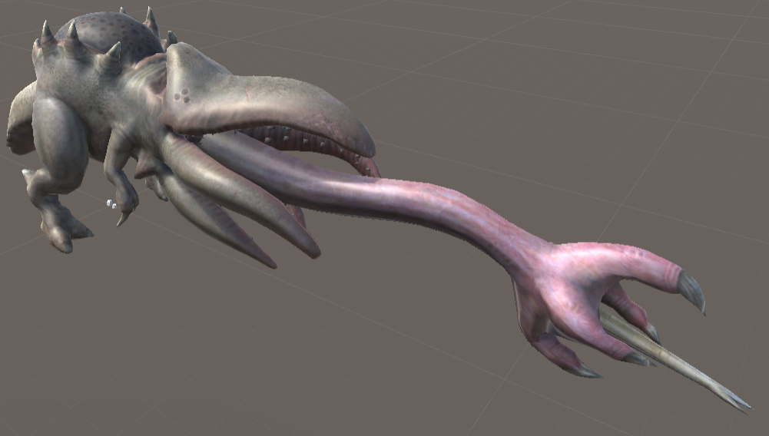
Modeling
Import
from modeling tools
Assemble
with Primitive
ProBuilder
inside Unity

Slide 42
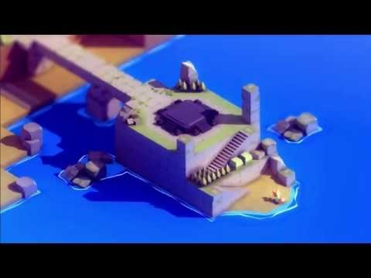
Notes:
https://www.youtube.com/watch?v=i2IT4VBqfGI

Slide 43
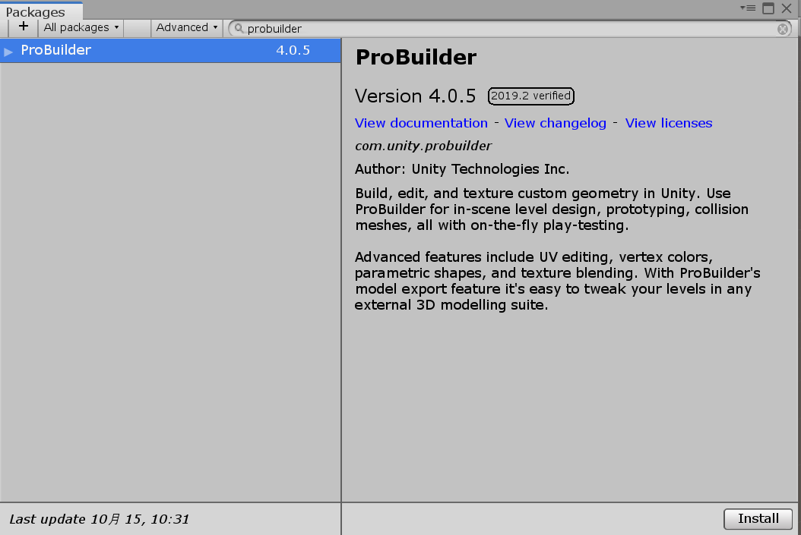
Installing ProBuilder
Open the Package Manager (in Unity's top menu: Window > Package Manager).
Enter ProBuilder in the search box.
Click ProBuilder in the package list (left side), then click the Install button in the package details (right side).
Notes:
https://docs.unity3d.com/Packages/com.unity.probuilder@4.0/manual/index.html

Slide 44
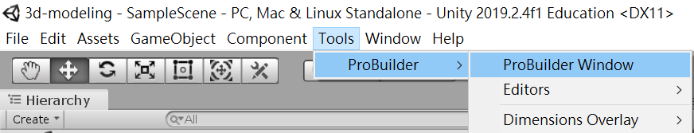
To verify that ProBuilder is correctly installed, open the ProBuilder toolbar (from Unity's top menu: Tools > ProBuilder > ProBuilder Window).
If you don't see the ProBuilder Window menu item, then ProBuilder did not install correctly.

Slide 45
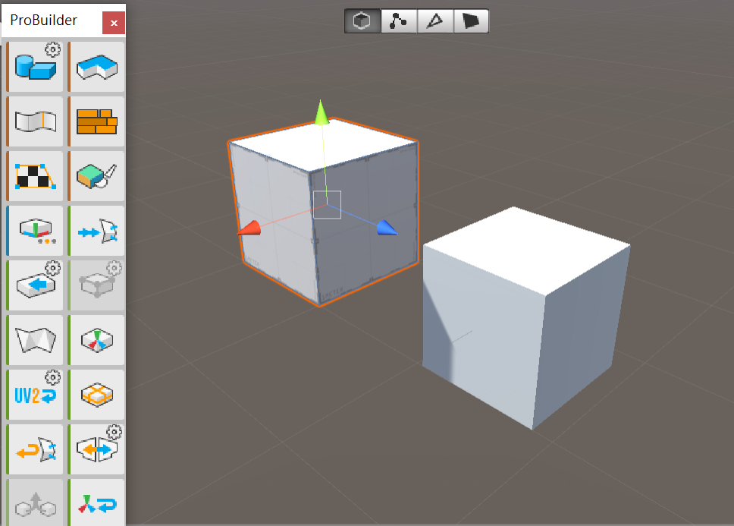
Probuilder edit mode toolbar
Box
ProBuilder
Box
Unity build-in
Probuilder toolbar

Slide 46
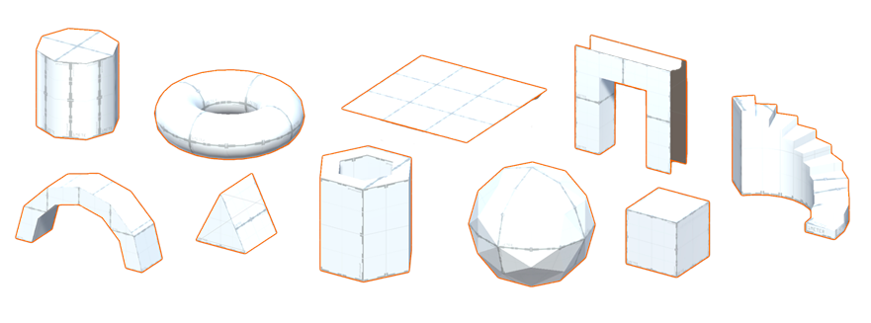
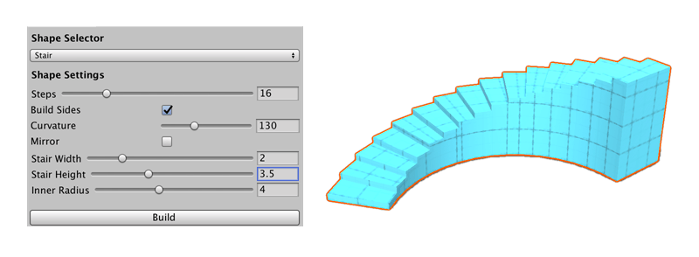
Creating Meshes

Slide 47
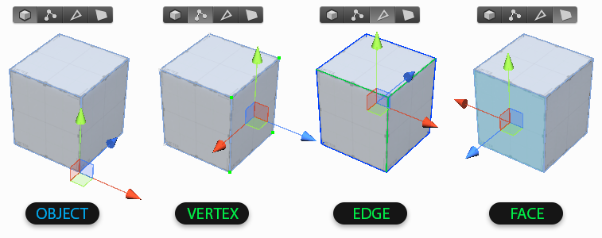
Edit modes (Object vs Element)

Slide 48
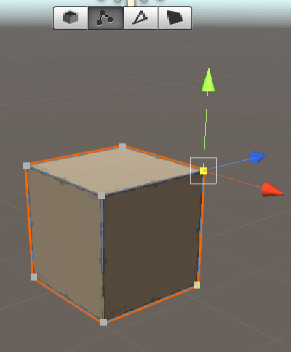
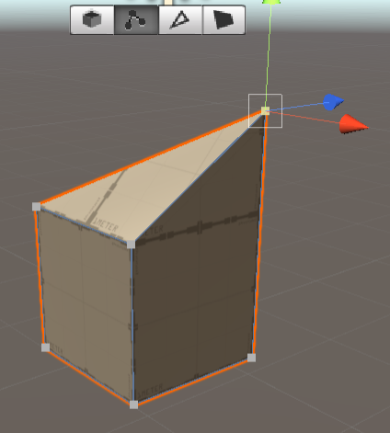
Select -> Transforming

Slide 49
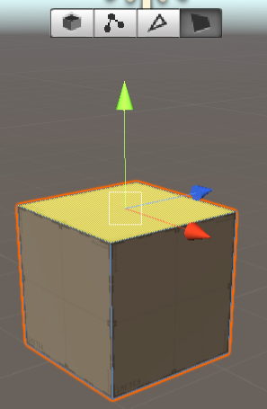
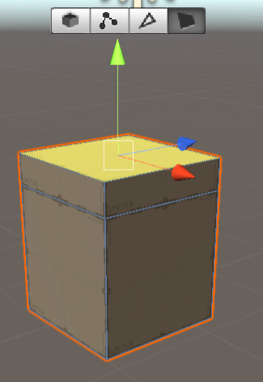
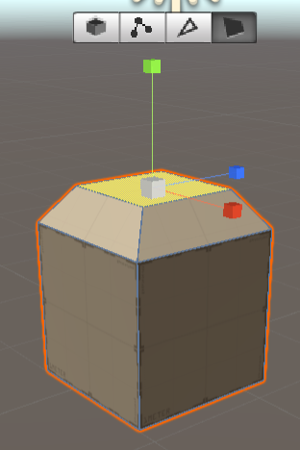
Select face -> Extruding
Select a face
Shift key +
Translate
Scale

Slide 50
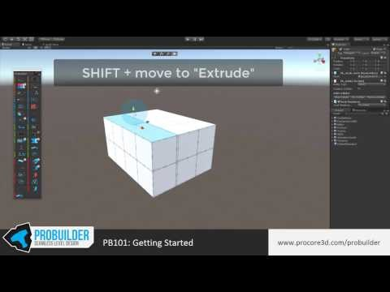
Getting Started with ProBuilder for Unity
Notes:
https://www.youtube.com/watch?v=Ta3HkV_qHTc

Slide 51
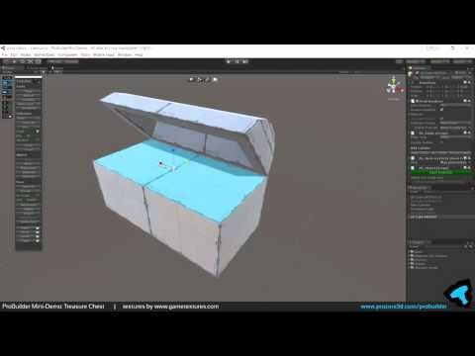
Treasure Chest

Slide 52
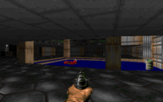
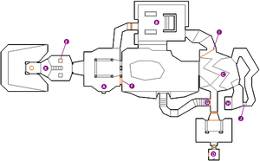
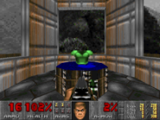
Level Editor

Slide 53
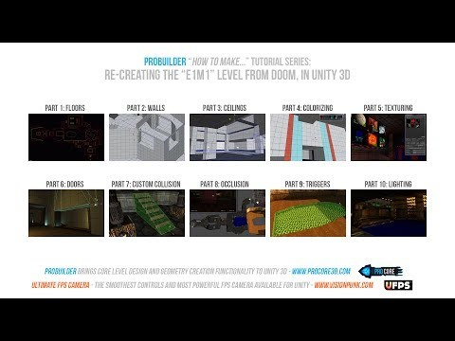
Notes:
https://www.youtube.com/watch?v=f2ia28kSiLs

