Slide 1
3D Game Programming intersection and particle
Ming-Te Chi
Department of Computer Science,
National Chengchi University
Notes:
2018

Slide 2
Outline
Intersection
Particles
Notes:
-介紹鍵盤事件處理的技巧，以及如何得知畫面中物件的位置和名稱
-碰撞的概念
-粒子系統和物理模擬

Slide 3
Intersection

Slide 4
What you need to know
Basic geometry
vectors, points, homogenous coordinates, affine transformations, dot product, cross product, vector projections, normals, planes
Math helps…
Linear algebra, calculus, differential equations
Notes:
這一小單元的內容改編至由Ryan Schmidt設計的Everything you ever wanted to know about collision detection
http://www.cpsc.ucalgary.ca/~ryansc

Slide 5
Plane Equations
(Nx, Ny, Xz)
A 3D Plane is defined by a normal and a distance along that normal
Plane Equation:
Find d:
For test point (x,y,z), if plane equation
> 0: point on ‘front’ side (in direction of normal),
< 0: on ‘back’ side
= 0: directly on plane
2D Line ‘Normal’: negate rise and run, find d using the same method
P
Notes:
利用平面方程式偵測，一點(x, y, z)落在平面的哪一側

Slide 6
So where do you start….?
First you have to detect collisions
With discrete timesteps, every frame you check to see if objects are intersecting (overlapping)
Testing if your model’s actual volume overlaps another’s is too slow
Use bounding volumes to approximate each object’s real volume
Notes:
如果逐一的偵測每一個平面和平面是否有碰撞是非常複雜且計算龐大的工作
因此最好將物體以bounding box先代表，簡化計算量

Slide 7
Bounding Volumes
Convex-ness is important.
Spheres, cylinders, boxes, polyhedra, etc.
Really you are only going to use spheres, boxes, and polyhedra (…and probably not polyhedra)
Spheres are mostly used for fast culling
For boxes and polyhedra, most intersection tests start with point inside-outside tests
That’s why convexity matters. There is no general inside-outside test for a 3D concave polyhedron.

Slide 8


2D Point Inside-Outside Tests
Convex Polygon Test
Test point has to be on same side of all edges
Concave Polygon Tests
360 degree angle summation
Compute angles between test point and each vertex, inside if they sum to 360
Slow, dot product and acos for each angle!

Slide 9
Closest point on a line
Handy for all sorts of things…
Pt
P2
Pc
P1

Slide 10
Spheres as Bounding Volumes
Simplest 3D Bounding Volume
Center point and radius
Point in/out test:
Calculate distance between test point and center point
If distance <= radius, point is inside
You can save a square root by calculating the squared distance and comparing with the squared radius !!!
(this makes things a lot faster)
It is ALWAYS worth it to do a sphere test before any more complicated test. ALWAYS. I said ALWAYS.

Slide 11
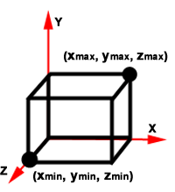
Axis-Aligned Bounding Boxes
Specified as two points:
Normals are easy to calculate
Simple point-inside test:

Slide 12
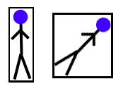
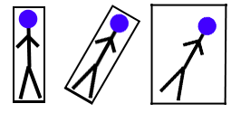
Problems With AABB’s
Not very efficient
Rotation can be complicated
Must rotate all 8 points of box
Other option is to rotate model and rebuild AABB, but this is not efficient

Slide 13
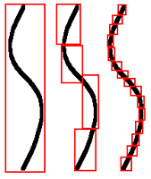
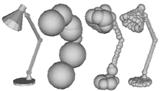
Heirarchical Bounding Volumes
Sphere Trees, AABB Trees, OBB Trees
Gran Turismo used Sphere Trees
Trees are built automagically
Usually precomputed, fitting is expensive
Accurate bounding of concave objects
Down to polygon level if necessary
Still very fast
See papers on-line
Approximating Polyhedra with Spheres for Time-Critical Collision Detection, Philip M. Hubbard

Slide 14
Reducing Collision Tests
Testing each object with all others is O(N²)
At minimum, do bounding sphere tests first
Reduce to O(N+k) with sweep-and-prune
See SIGGRAPH 97 Physically Based Modelling Course Notes
Spatial Subdivision is fast too
Updating after movement can be complicated
AABB is easiest to sort and maintain
Not necessary to subdivide all 3 dimensions

Slide 15
Particles
Notes:
接下來以粒子系統來介紹物理定律模擬的觀念

Slide 16
Dynamic Particle Simulation
Simplest type of dynamics system
Based on basic linear ODE:
Notes:
常微分方程（ordinary differential equation，簡稱ODE）
牛頓力學第二定律 f=ma 描述外力對於物體質量的加速度變化
由這個式子分解，可以用計算的方式模擬第二運動定律的物理效果

Slide 17
Particle Movement
Particle Definition:
Position x(x,y,z)
Velocity v(x,y,z)
Mass m
Notes:
在電腦數位離散的系統，要用來模擬物理的現像
可以將時間離散地切成間隔，
對於每一個時間間隔，
先根據目前的速度，更新物體的位置
再根據外力，更新新的速度

Slide 18
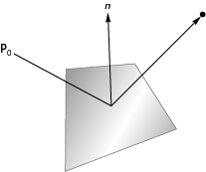
Collisions
Once we detect a collision, we can calculate new path
Use coefficient of resititution
Reflect vertical component
May have to use partial time step

Slide 19
Contact Force
A force that acts at the point of contact between two objects

Slide 20
Using Particle Dynamics
Each timestep:
Update position (add velocity)
Calculate forces on particle
Update velocity (add force over mass)
Model has no rotational velocity
You can hack this in by rotating the velocity vector each frame
Causes problems with collision response
Notes:
將以上的概念撰寫成程式
便是在每個時間間距依序更新位置、取得外力(常見的外力有重力)，更新速度
以下外力未考慮旋轉的加速度，如果同學有興趣，可以進一步思考如何整合

Slide 21
Particle Init
for(i=0; i<num_particles; i++)
{
particles[i].mass = 1.0;
particles[i].color = i%8;
for(j=0; j<3; j++)
{
particles[i].position[j] = 2.0*((float) rand()/RAND_MAX)-1.0;
particles[i].velocity[j] = speed*2.0*((float) rand()/RAND_MAX)-1.0;
}
}
glPointSize(point_size);
Notes:
先初始化每一個粒子的位置和加速度向量和大小

Slide 22
update
void myIdle()
{
int i, j, k;
float dt;
present_time = glutGet(GLUT_ELAPSED_TIME);
dt = 0.001*(present_time - last_time);
for(i=0; i<num_particles; i++)
{
for(j=0; j<3; j++)
{
particles[i].position[j] += dt*particles[i].velocity[j];
particles[i].velocity[j] += dt*forces(i,j)/particles[i].mass;
}
collision(i);
}
}
Notes:
當idle事件發生時
先取得和上一次idle的時間差
接下來
先更新位置
再更新速度向量
接下來偵測是否有碰撞

Slide 23
collision
int i;
for (i=0; i<3; i++)
{
if(particles[n].position[i]>=1.0)
{
particles[n].velocity[i] = -coef*particles[n].velocity[i];
particles[n].position[i] = 1.0-coef*(particles[n].position[i]-1.0);
}
if(particles[n].position[i]<=-1.0)
{
particles[n].velocity[i] = -coef*particles[n].velocity[i];
particles[n].position[i] = -1.0-coef*(particles[n].position[i]+1.0);
}
}
Notes:
在這個例子，所有的例子都在一個(-1, -1, -1)到(1, 1, 1)的立方體
只有當碰撞到立方體的時才需改變速度向量

Slide 24
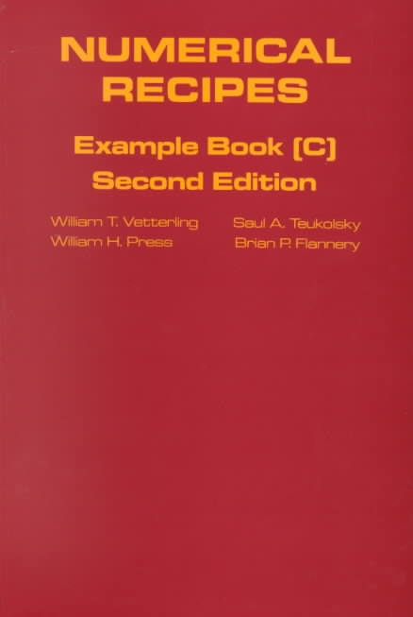
Helpful Books
Real Time Rendering
Lots of these notes derived from this book
Graphics Gems series
Lots of errors, find errata on internet
Numerical Recipes in C
The mathematical computing bible
Game Programming Gems
Not much on CD, but lots of neat tricks
Lex & Yacc (published by O’reilly)
Not about CD, but useful for reading data files

Slide 25
about PC hardware
Cache Memory
Linear memory access at all costs!
Wasting cycles and space to get linear access is often faster. It is worth it to do some profiling.
DO NOT USE LINKED LISTS. They are bad.
STL vector<T> class is great, so is STL string
vector<T> is basically a dynamically-sized array
vector.begin() returns a pointer to front of array
Conditionals are Evil
Branch prediction makes conditionals dangerous
They can trash the pipeline, minimize them if possible

Slide 26
about C/C++ compilers
Compilers only inline code in headers
The inline keyword is only a hint
If the code isn’t in a header, inlining is impossible
Inlining can be an insane speedup
Avoid the temptation to be too OO
Simple objects should have simple classes
Eg: writing your own templated, dynamically resizable vector class with a bunch of overloaded operators is probably not going to be worth it in the end.

Slide 27
Numerical Computing
Lots of algorithms have degenerate conditions
Learn to use isinf(), isnan(), finite()
Testing for X = 0 is dangerous
If X != 0, but is really small, many algorithms will still degenerate
Often better to test fabs(X) < (small number)
Avoid sqrt(), pow() – they are slow

Slide 28
Physics engine
2D
Box2D http://box2d.org/
3D
bullet3D http://bulletphysics.org
PhysX http://developer.nvidia.com/physx
Notes:
除了自己實做物理模擬
現在有物理引擎，對於物理模擬所需要的元件做有效率地設計
善用這些函式庫，可做出更有趣的遊戲

