Slide 1
Ecological Smart Home Network

Slide 2
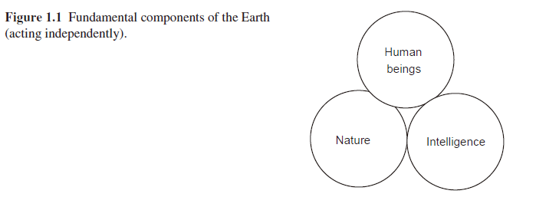
1.2 Historical transitions
工業革命後，”modern technology” invent many new mechanisms
The interrelationship among these 3 components is very vague and shallow (Fig .1), operated independently without “interaction”

Slide 3
1.2.2 Modern times
第二次世界大戰後，ICT (information and communication technology) widely used
Electronic data processors
Semiconductor
Automobile
Energy industry
ICT supports business management and organizational management (Fig 1.2)

Slide 4
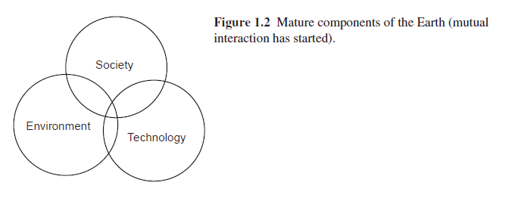
Mutual interaction started
SNS: social networking services
Technologies require much energy and materials from natural resources
Natural environment may become contaminated
Need good solutions to environmental problem

Slide 5
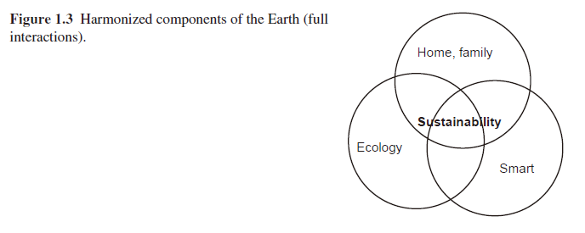
1.2.3 The future
Change our thinking to realize better solutions for human happiness in the future (happy and peaceful) (Fig. 1.3)
Energy
Communication system
Entertainment
Security system, etc
Make our life more convenient, but is not good for Earth?
“Smart” : harmonization of technology and ecology

Slide 6
跨領域新思維
又要smart又要ecological
新增一些knowledge
跨領域思維
“new” technology?
復古? But? 科技的腳色?

Slide 7
1.3 Moving toward sustainability
Fig. 3, 中間交集, “sustainability”
又要省energy, 環保, 又要舒適smart
Requires more elaborate strategy!
Sustainability means natural resources are used in such a way that the same usage is assured for future generations.
Technologies in a smart or restricted way so that sustainability can be realized.
E.g. oil and coal cannot be reproduced
Invent artificial oil or gasoline
Invent an alternative to gas-powered automobiles.

Slide 8
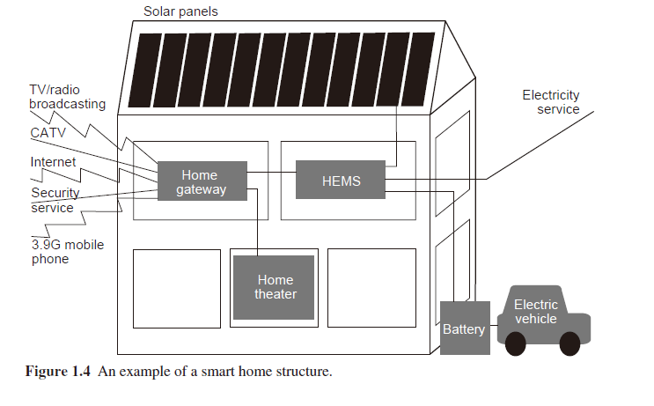
1.4 Technology elements that support smart home
Networks, and relevant environments, and equipment
Rapid exchange of information without delay is most important in an operating smart home (efficient and reliable)

Slide 9
Wireless networks and mobile telephones
LAN
IEEE 802.11, WiFi
Smartphones
Sensors and their network
Humidity, Motion direction, Sound, Biosensors
Information collected by sensors should be accessible as possible
Bluetooth, ZigBee, IrDA, NFC

Slide 10
Internet of Things
Receiver thing needs to respond to sender thing
Communication style may be different, and new behaviors and situation occur
Similar idea, M2M (machine-to-machine)
“The smart home”, itself, is a “thing” to be connected to Internet.

Slide 11
Others,
Femtocell
Home network gateway
Use services provided outside the home

Slide 12
1.4.2 Software: platform and user interface
Very important !!
Communication among components can occur seamlessly
Well-designed user interface, e.g. voice interface.
Management: Private information, security invasions

Slide 13
1.4.3 Energy management
HEMS: home energy management system
E.g. Automated control of electricity usage though a HEMS meter
Possible to group of several houses within a neighborhood. E.g. smart grid.
Remote control of home equipment

Slide 14
1.4.4 Integrated applications
Content management in a home theater
Take in media content from outside the home
Human activity recognition, personal behavior monitoring and management
Care for older people so that stay happy and safe
Health care and medical care

Slide 15
1.5 Design considerations
Define specifications
Functional requirements
Cost and schedule of construction
Ease of use and safety considerations
Aesthetics (美學) and enjoyment
Ecological considerations and sustainability
Ecological design does not have to work against the desired technology
We need to make efforts to develop technologies to support ecological design !!

Slide 16
Samsung Smart House

