Slide 1
Introduction to Network, Multimedia, Application Scenario & Design
蔡子傑

Slide 2
網路科技概論
What is “network”?
Computer network
Communication network
Why “networking”?
How “networking”?

Slide 3
Communication Network
vs.
TCP/IP Internet

Slide 4
Communication Protocols
Protocol: a standard set of rules for communicating
Standards evolve over time
International agreements make Internet possible
Internet Society makes standards and promotes researchwww.isoc.org
Protocol hierarchy/protocol stack, TCP/IP
Layers of protocols
Physical transmission to end application rules and standards

Slide 6
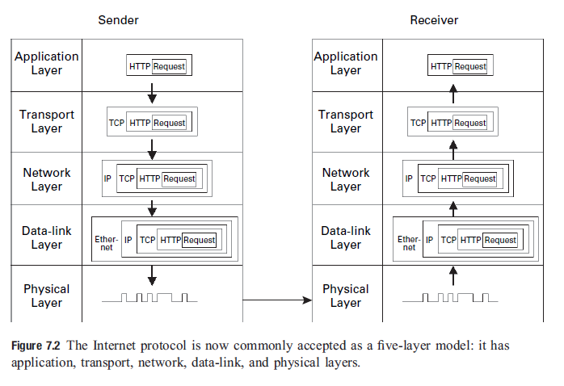

Slide 7
IP data packet
VERS: IP version number
HLEN: header length
Type of service (TOS)
Total length
Identification: a unique number assigned to a datagram fragment
Flags: fragmented or not
Frag offset
TTL: time to live
Protocol: layer-4 protocol, e.g. UDP, TCP, ICMP, IGRP
Header checksum
IP options
Padding

Slide 8
Network layer provides an unreliable service (i.e. only best-effort delivery)
No guarantees about packet loss, data corruption, out-of-order packet arrival, duplicate arrival.

Slide 9
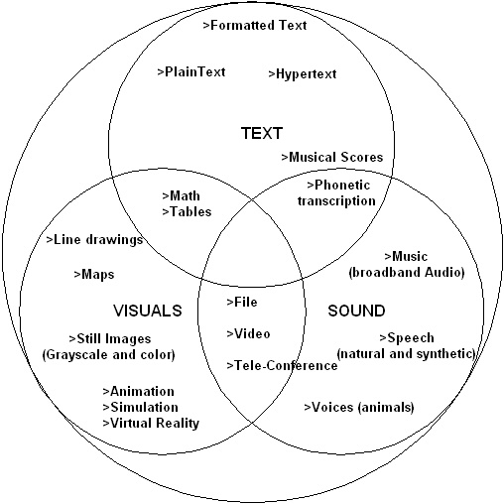
Diversity of multimedia data signals

Slide 10
Text
Unformatted plain text
Formatted text, such as mathematical expressions, hypertext
→inherently digital
Visual
Drawing, maps, images, animation, etc
→can be analog and converted into digital
Sound
Voice, audio, music, etc.
→can be analog and converted into digital

Slide 11
Multimedia classification from network perspective
Real-Time (RT)
Bounds on the end-to-end packet delay/jitter
Further classified as
Discrete media (DM): discrete quantum as a file or message, e.g.
MSN/Yahoo messengers (error-intolerant)
Instant messaging services like stock quote updates (error-tolerant)
Continuous media (CM): continuously as a stream of messages ,
Further classified as
Delay tolerant: Internet webcast
Delay intolerant: audio, video streaming in conferencing systems
Non Real-Time (NRT)
Do not have strict delay constraints
E.g. text and image files

Slide 12
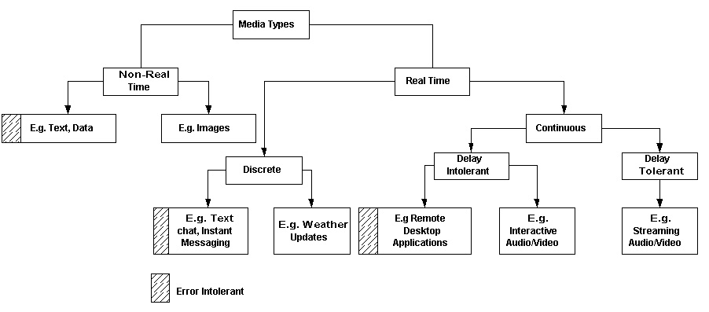
Network oriented classification of Media Types

Slide 13
Text
Most popular
Transfer protocols
ftp, http, SMTP(Simple Mail Transfer Protocol)
Represented in binary as
7-bit ASCII
8-bit ISO-8859
16-bit Unicode
32-bit ISO 10646

Slide 14
Error depend on applications
Loss/error free, use TCP for transport
E.g. File transfer
Error-tolerant, can use UDP for transport
E.g. Instant messaging
Applications that use text as primary media do not have any real-time constraints
Elastic applications
E.g. web browsing
However, applications like instant messaging do require some guarantees on experienced delay

Slide 15
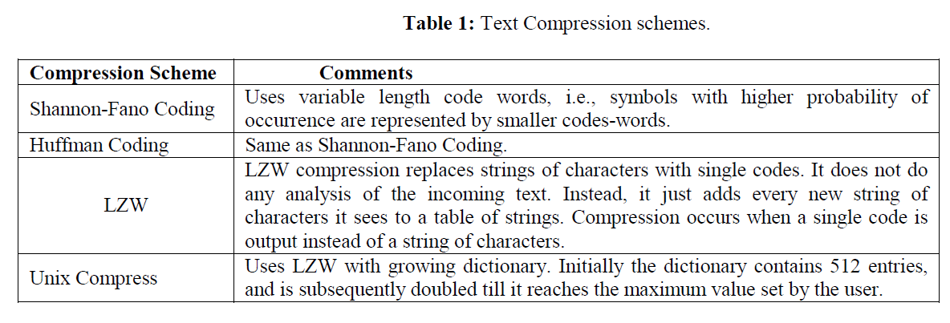
Bandwidth vs. compression scheme

Slide 16
Audio
Sound/speech converted into digital form using sampling and quantization
Digitized audio media is transmitted as a stream of discrete packets over the network

Slide 17
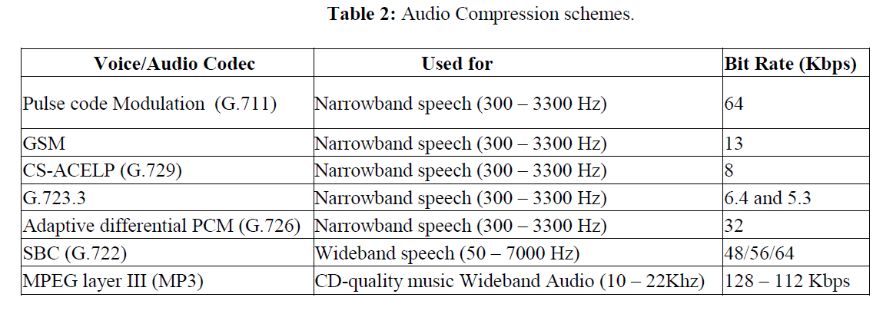
Bandwidth vs compression

Slide 18
Audio loss and delay
Loose requirement on packet loss/errors (or error-tolerant)
1 to 2% packet loss/error without much degradation
Strict real-time requirement
Highly interactive and shorter response time
Bounds on end-to-end delay/jitter to be of acceptable quality, e.g. limited to ~200ms.
Real-Time Intolerant (RTI) applications, e.g. Internet-Telephony
Weaker bounds on delay/jitter
Real-Time Tolerant (RTT) application
Involves one-way communication, relatively low interactivity, e.g. Internet webcast, streaming audio

Slide 19
Graphics and Animation
Static media like digital images, and dynamic media like flash presentations
An uncompressed, digitally encoded image consists of
Array of pixels, with each pixel encoded in bits to represent luminance and color
Tend to be large in size
E.g. 480x640 pixels and color resolution of 24 bits, requires ~1MBytes.
Compression utilizes spatial redundancy

Slide 20
Graphics and Animation
Static media like digital images, and dynamic media like flash presentations
An uncompressed, digitally encoded image consists of
Array of pixels, with each pixel encoded in bits to represent luminance and color
Tend to be large in size
E.g. 480x640 pixels and color resolution of 24 bits, requires ~1MBytes.
Compression utilizes spatial redundancy

Slide 21
Graphics and Animation
Static media like digital images, and dynamic media like flash presentations
An uncompressed, digitally encoded image consists of
Array of pixels, with each pixel encoded in bits to represent luminance and color
Tend to be large in size
E.g. 480x640 pixels and color resolution of 24 bits, requires ~1MBytes.
Compression utilizes spatial redundancy

Slide 22
Image loss and delay
Images are error-tolerant and can sustain packet loss
Provided the application used to render them knows how to handle lost packets
Like text file, Do not have any real-time constraints

Slide 23
Image loss and delay
Images are error-tolerant and can sustain packet loss
Provided the application used to render them knows how to handle lost packets
Like text file, Do not have any real-time constraints

Slide 24
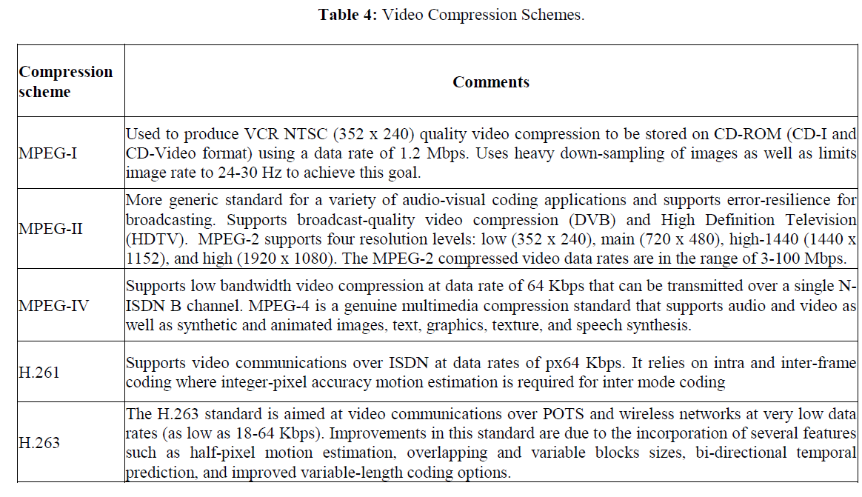
Bandwidth vs compression

Slide 25
Video loss and delay
Error- and real-time requirements are similar to audio media type.

Slide 26
Multimedia classification from network perspective
Real-Time (RT)
Bounds on the end-to-end packet delay/jitter
Further classified as
Discrete media (DM): discrete quantum as a file or message, e.g.
MSN/Yahoo messengers (error-intolerant)
Instant messaging services like stock quote updates (error-tolerant)
Continuous media (CM): continuously as a stream of messages ,
Further classified as
Delay tolerant: Internet webcast
Delay intolerant: audio, video streaming in conferencing systems
Non Real-Time (NRT)
Do not have strict delay constraints
E.g. text and image files

Slide 27
Network oriented classification of Media Types

Slide 28
Multimedia expectations from a communication network
Traffic requirement
Real-time characteristics
Audio and video must be played back continuously at the rate at which they are sampled
High bandwidth
Congestion control
See table 5, bandwidth requirement
Compressed media still requires significantly high bandwidth
Lossy (introduce distortion) and lossless compression
error

Slide 29
Error control on networking
Error detection followed by Automatic Retransmission reQuest (ARQ)
Used by TCP (Transport Control Protocol)
Provide reliable connection-oriented service
Forward Error Correction (FEC)
Provide sufficient redundancy to correct errors without retransmission
May be used by UDP (User Datagram Protocol), because UDP provides connectionless un-reliable service
Applications that exchange error-tolerant media types (both RT and NRT) typically use UDP for eliminating time lost in retransmissions.

Slide 30
Internet 與物聯網
Computer Network vs Internet
Internet of “Things”
輸入 (sensor)
計算
輸出、通訊
Applications? Data where (cloud)? Computing where (cloud)?

Slide 31
IoT Applications
Smart Home
Vehicular Network
Body Area Network

Slide 32
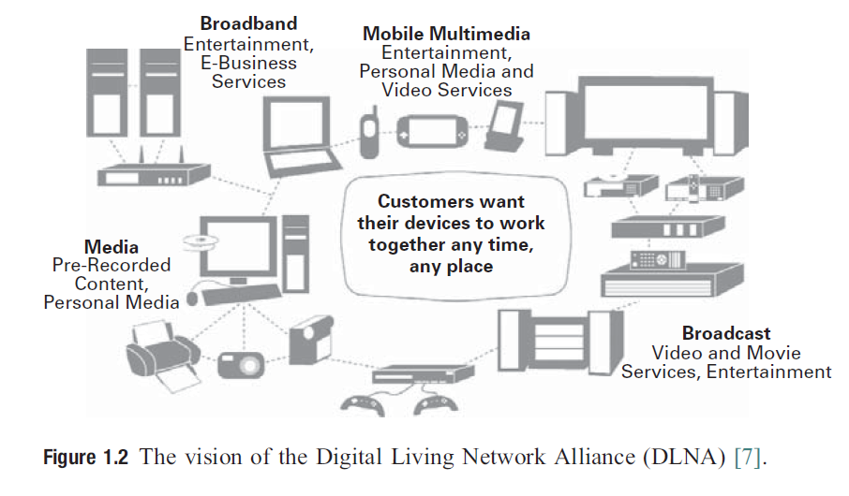
DLNA (Digital Living Network Alliance)
A digital home

Slide 33
Wire to wireless

Slide 34
Wireless technologies

Slide 35
Basic Home Use Cases

Slide 36
Basic Home Use Cases

Slide 37
Telematics: infotainment in automobiles
Information and entertainment
Navigation
Traffic status
Hand-free communcation
Location-aware services
Back-seat infotainment, multimedia entertainment and gaming
Internet browsing, email access

Slide 39
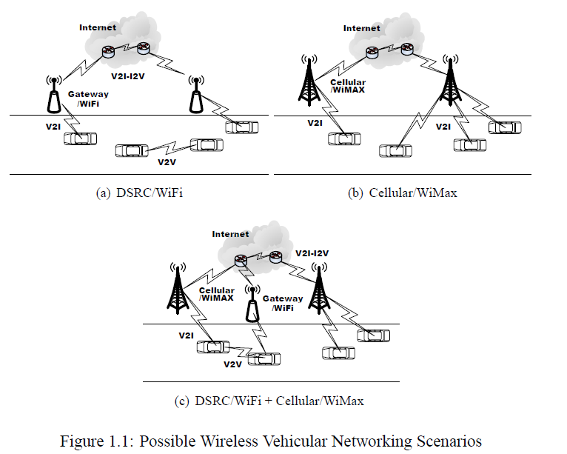
Vehicular Networking

Slide 40
Vehicular application classification
Mobile data gathering
Vehicle can sense events (image from street or presence of toxic chemicals), process sensed data (recognize license plate), and route to other vehicles
Consumer of content
Location-aware information, entertainment (movies, music, ads)
Both producers and consumers of content
Report on road conditions, traffic congestion monitoring, emergency alert

Slide 41
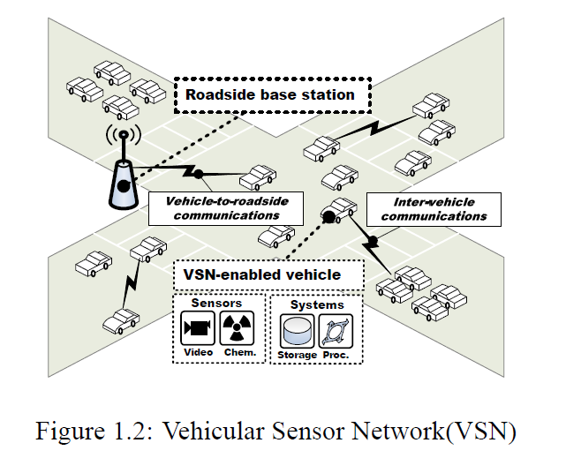
MobEyes: proactive urban monitoring services

Slide 42
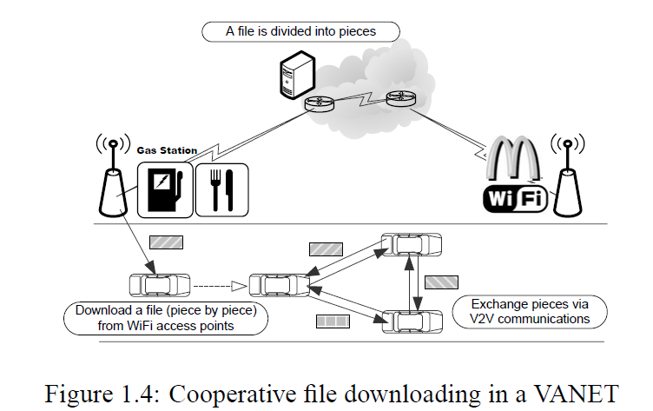
Spawn: content distribution

Slide 43
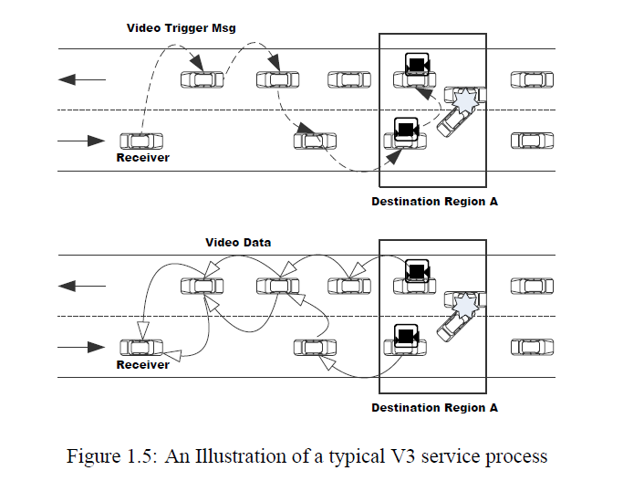
Emergency location-aware live video streaming

Slide 44
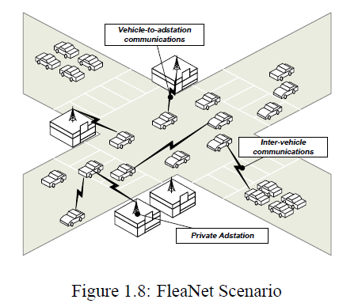
Fleanet: a virtual market place

Slide 45
Vehicular: Interactive applications
RoadSpeak: Voice Chatting in Vehicular Social Networks
Online “Passenger” Games

Slide 46
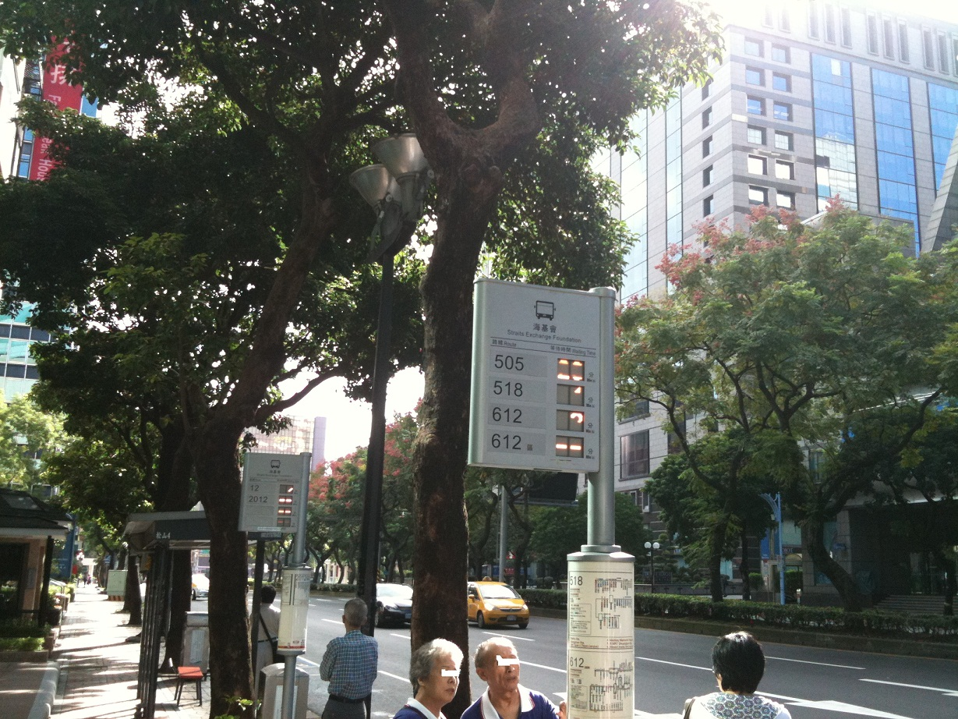
台北市公車站系統

Slide 47
遠端互動藝術
弄偶者、表演者或虛擬人─ 在無線網路空間內的感觀差異時間:
保羅‧瑟曼喜歡探索在遠端網絡的世界，並與遠端參與者在網域間互動。
他透過色彩的調和以及視訊會議技術的運用，讓兩個空間內的參與觀眾，同時被連結在一個虛擬的空間中，變成一個可以互動的視覺裝置作品。
藉由遠端視訊空間，以及觀者與表演者間親密的接觸，傳達自我反射的裝置作品。

Slide 48
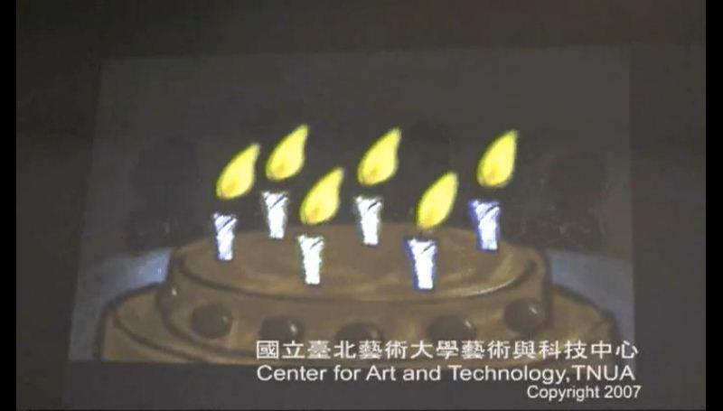
無線Ad hoc網路在群體異地互動應用
http://www.youtube.com/watch?v=Cwp5EY_AZIo

Slide 49
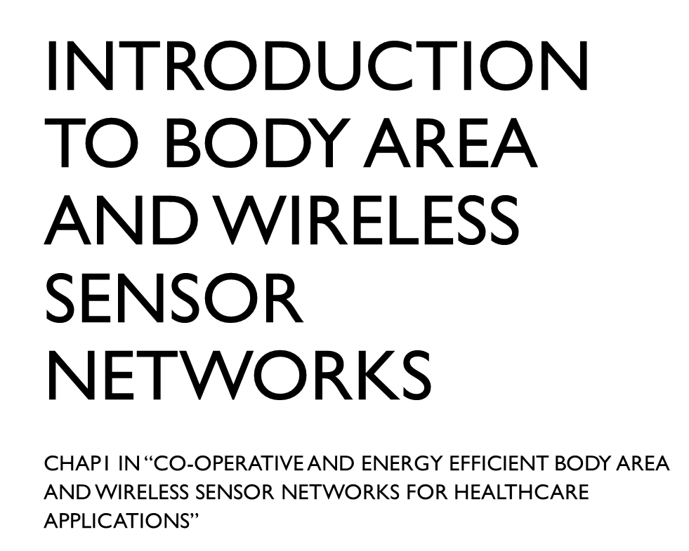

Slide 56
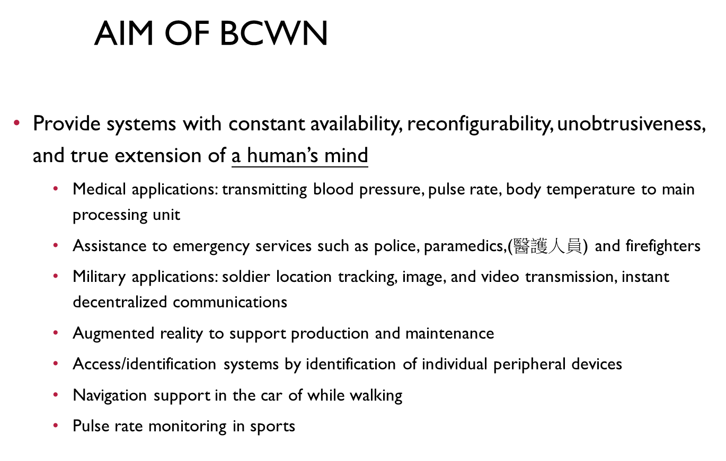

Slide 57
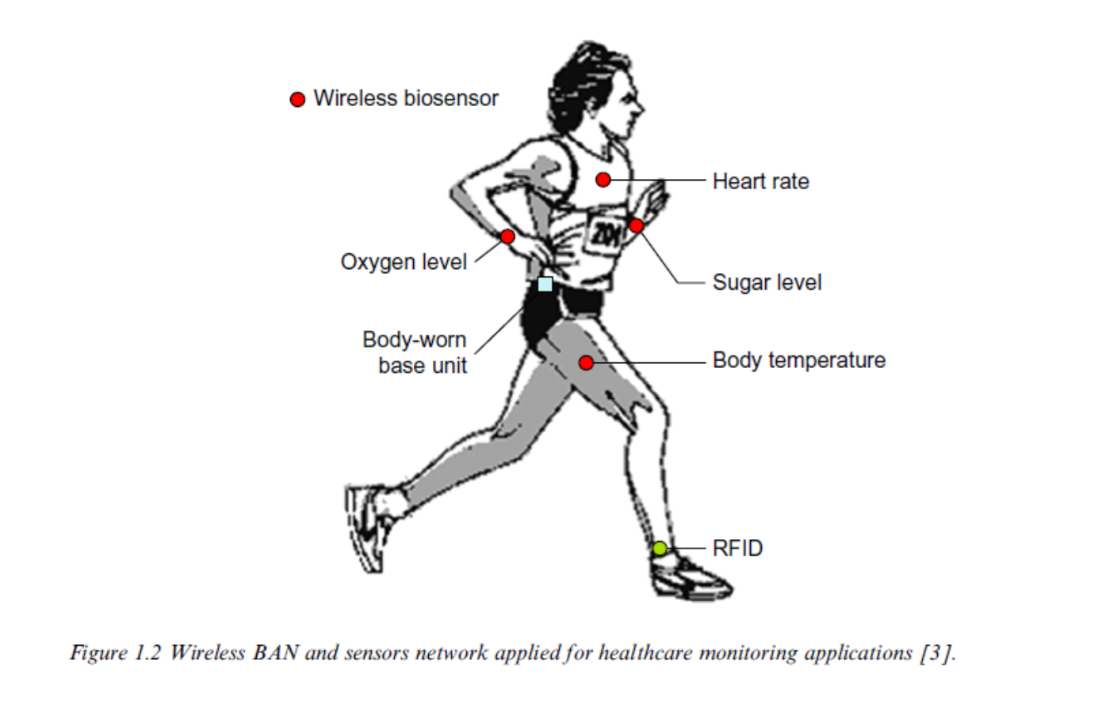

Slide 59
How to design & innovation
Design issues?

Slide 60
Design issues
Client device
Small/large, mobile/fixed
Network platform
Broadband, mobile/fixed, always connected
Users
Service or application needs
Others?

Slide 61
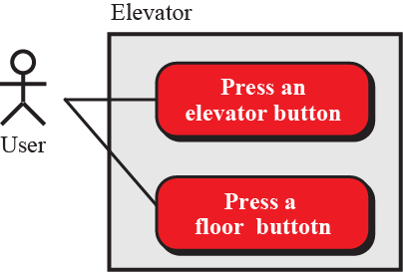
Use case diagrams
A use-case diagram gives the user’s view of a system: it shows how users communicate with the system. A use-case diagram uses four components: system, use cases, actors and relationships. A system, shown by a rectangle, performs a function.
Figure 10.6: An example of use case diagram

Slide 62
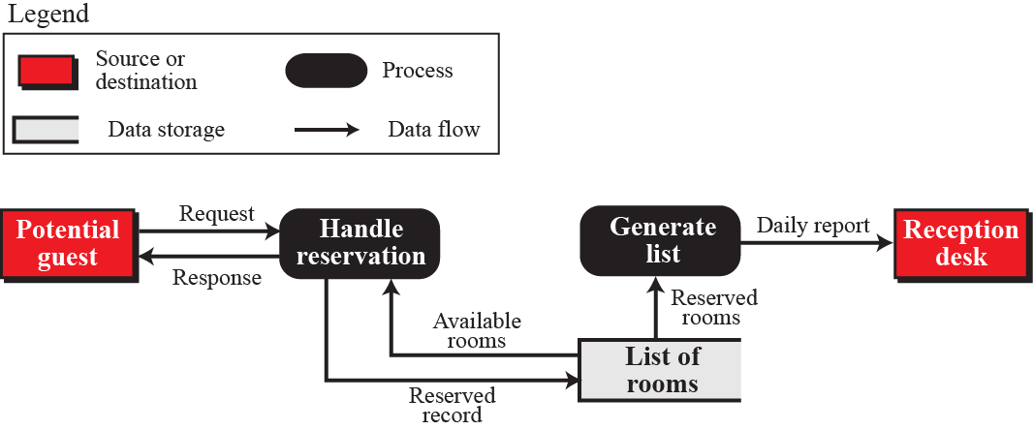
Data flow diagrams
Data flow diagrams show the movement of data in the system.
Figure 10.4: An example of a data flow diagram

Slide 63
innovation
Do you have any idea for any “innovation” of application scenario?
What is your thinking about this?

Slide 64
innovation
What is a good innovation?
What is the flow of innovation?
“executable” is important?

Slide 65
More applications?

Slide 67
多媒體網路概論 影片

Slide 68
Discussion
你可以找一個或設計一個物聯網的情境嗎？並說明這個情境，需要收集怎樣的資料？這些資料是透過何種通訊管道收集的？資料又可能會怎麼處理？以及處理完後會有那些回饋或反應？

Slide 69
穿戴科技
What to wear?
Sensor? Sensing what? (bio, health, motion…)
Vision? VR or AR or others
Audio? Music or others
Networking?
Multi-players?
Application domain?
Game, education, performance, exercise, health…

